Slide 1
Application: AI Portrait Repairer
2019/08/10

Slide 2
Chapter
Functions
Solution
Division
Test Set
Report

Slide 3
Functions

Slide 4
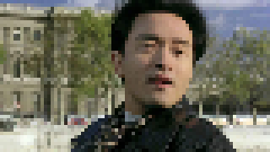

Repair the Portrait
Ultimate goal

Slide 5
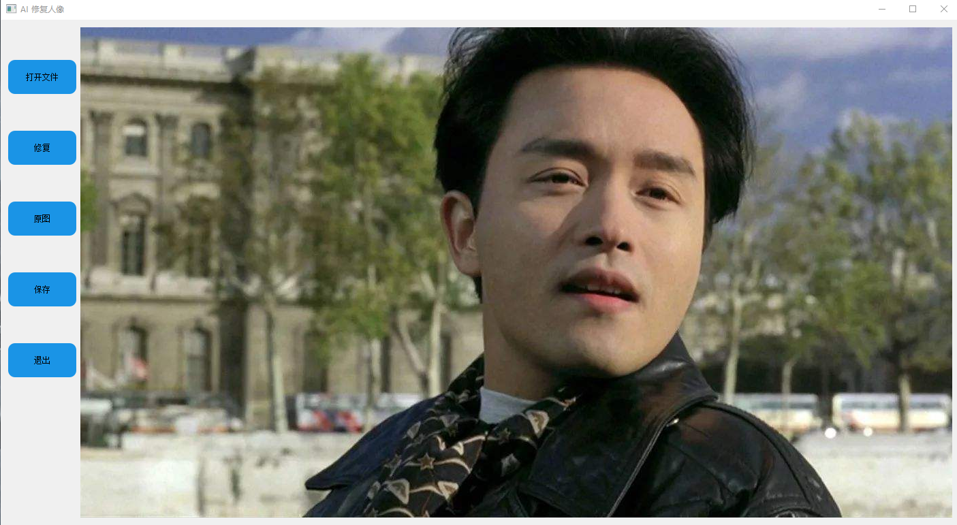
AI Repairer

Slide 6
Solution

Slide 7
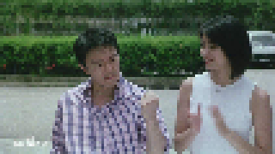


Processing Flow
x, y, h, w
Opencv? Dlib? MTCNN? …
Face Detection
[
,
]
[
,
]
Is it necessary to do edge smoothing?

Slide 8
Division

Slide 9
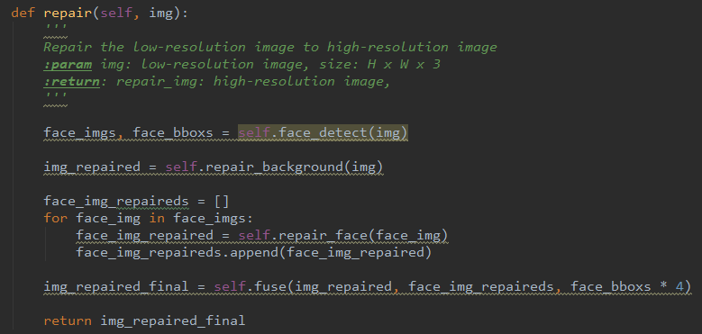
Code Completion
1
2
3
4

Slide 10
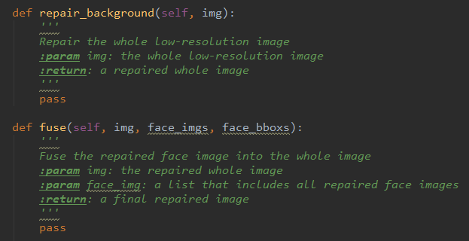
Girls

Slide 11
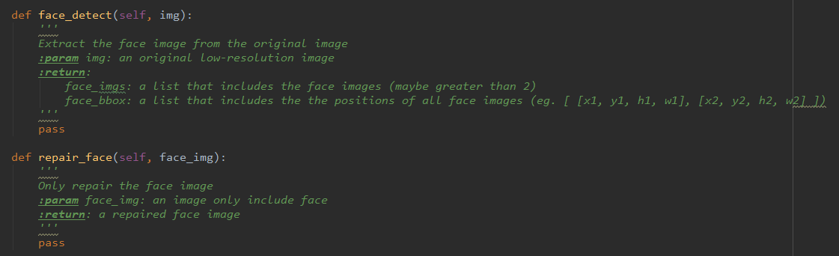
Boys

Slide 12
Test Set

Slide 13
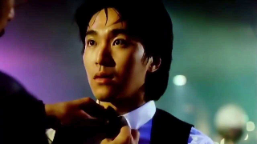

4 Images

Slide 14
Report

Slide 15
Content & Format
Wait to release

Slide 16
Thanks for Your Listening!
Application: AI Portrait Repairer
2019/08/10

