Slide 1



Garbage Classification

Slide 2

Understand Deep Learning for Image Classification Learn how CNNs can classify different types of waste using images.
Work with Real-World Datasets Gain hands-on experience in processing and using image datasets for training models.
Apply Transfer Learning Use pre-trained models like MobileNetV2 to improve accuracy and reduce training time.
Build an Interactive AI App Deploy the model using Streamlit to create a real-time waste prediction interface.
Improve Technical & Project Skills Strengthen coding, debugging, version control (Git), and documentation skills useful for real-world AI projects.
Learning Objectives
GOAL
Source :
www.freepik.com/

Slide 3
Tools and Technology used
Python 3.10 – Programming language for model development and scripting
TensorFlow – Deep learning framework for model training and prediction
Keras – High-level API used within TensorFlow for building CNN models
MobileNetV2 – Pre-trained CNN model used for transfer learning
OpenCV – Image processing library for reading and resizing images
NumPy – For numerical operations and data manipulation
Matplotlib – For visualizing accuracy/loss graphs
scikit-learn – For evaluation metrics like confusion matrix
Pillow (PIL) – For image file handling (optional)
Kaggle Dataset – Real-world image dataset of 6 trash categories
Git & GitHub – For version control and project management

Slide 4
Methodology
1. Data Collection
Used a dataset from Kaggle with 6 types of waste: plastic, metal, paper, cardboard, glass, and trash.
2. Data Preprocessing
All images were resized to 128×128.
Pixel values were scaled between 0 and 1.
Used data augmentation (like rotating and flipping) to improve model performance.
3. Model Building
Used MobileNetV2, a pre-trained model.
Changed the last layers to classify 6 types of waste.
4. Model Training
Split the data into training and validation sets.
Trained using the Adam optimizer and categorical crossentropy loss.
Used EarlyStopping to stop training if no improvement.
5. Model Testing
Checked how well the model worked using accuracy and loss graphs.
Also used a confusion matrix to see correct and wrong predictions.
6. Image Prediction
Wrote a Python script to:
Take an image input from the user
Predict the waste type
Show the result and confidence score

Slide 5
Problem Statement:
Waste management is a major challenge in modern cities, especially with the growing volume of plastic, metal, paper, and other waste materials. Improper segregation of waste leads to increased pollution, health risks, and inefficient recycling. Traditional methods of manual sorting are time-consuming, error-prone, and labor-intensive.
This project aims to develop an intelligent system that can automatically classify waste images into categories like plastic, metal, paper, cardboard, glass, and trash using deep learning. By enabling accurate waste identification through images, the system helps support better recycling and smarter waste disposal.

Slide 6
Solution:
To address the problem of improper waste segregation, we developed a Smart Waste Classifier using deep learning. The solution uses a Convolutional Neural Network (CNN) model based on MobileNetV2 to automatically classify waste images into six categories: plastic, metal, paper, cardboard, glass, and trash.
We trained the model using a labeled dataset from Kaggle, applied image preprocessing and data augmentation to improve generalization, and optimized the model using transfer learning techniques. The final model can predict the type of waste with high accuracy.
A simple Python-based prediction script allows users to input any waste image and instantly receive the predicted class along with confidence level. This system can help reduce manual labor, support proper recycling, and contribute to cleaner waste management practices.

Slide 7
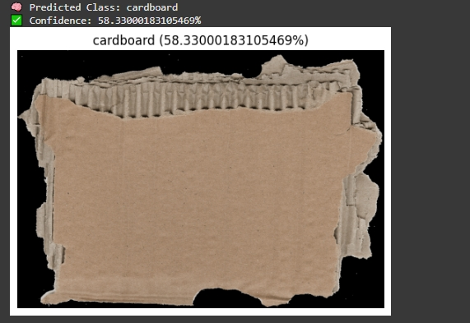
Screenshot of Output:

Slide 8
Conclusion:
The Smart Waste Classifier successfully demonstrates how deep learning can be applied to real-world environmental challenges. Using a pre-trained MobileNetV2 model and transfer learning, the system is able to classify waste images into categories such as plastic, metal, paper, cardboard, glass, and trash with reasonable accuracy.
Through data preprocessing, augmentation, and model optimization, the project achieves a working solution that can assist in automating waste segregation. This helps promote efficient recycling and reduce manual sorting efforts. Although the current implementation uses a Python script, it lays a strong foundation for future enhancements such as real-time mobile or web-based deployment.
Overall, the project helped improve understanding of machine learning workflows, model training, evaluation techniques, and the practical use of AI for sustainability-focused applications.

