Slide 1
FISH270
Lec12

Slide 2
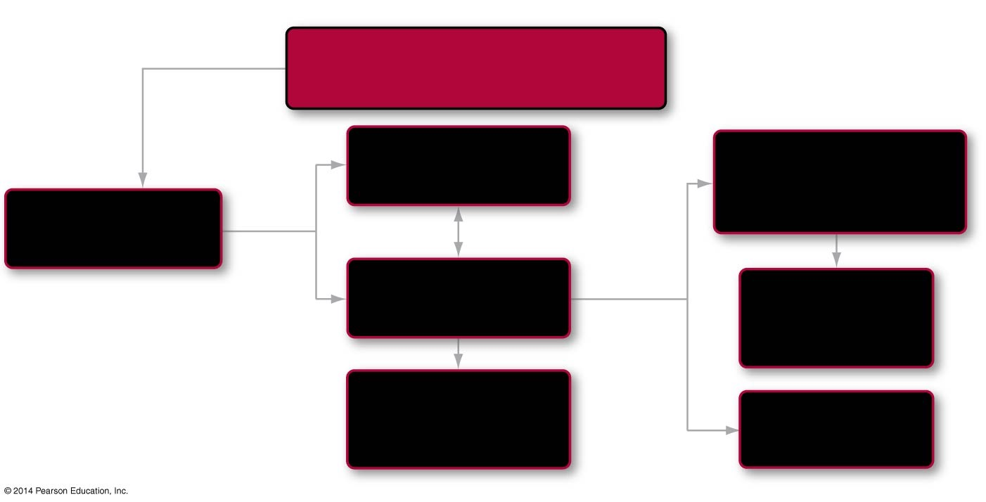
Roadmap 50
In this chapter you will learn that
Animals have an amazing diversity
of reproductive strategies
by first
comparing
Mechanisms of
asexual reproduction
Reproductive structures
and their functions
looking
into
50.3
Asexual and sexual
reproduction
(some can
switch modes)
50.1
modified by
Sexual reproduction
and gametogenesis
Sex hormones
in mammals
finally
exploring
50.4
leads to
Fertilization and
egg development
50.2
Notes:
Chapter 50 Opening Roadmap.

Slide 3
Introduction to Animal Reproduction
The reproductive systems of animals are highly variable
Some species switch between asexual and sexual reproduction
In sexual reproduction, fertilization may be external or internal
Egg development may take place inside or outside the mother’s body

Slide 4
Introduction to Animal Reproduction
In humans, the male reproductive system includes structures specialized for producing and storing sperm, synthesizing semen
The human female reproductive system includes structures specialized for producing eggs and receiving sperm, and caring for the developing embryo

Slide 5
Introduction to Animal Reproduction
In humans, hormones from the pituitary gland and female reproductive organs regulate the menstrual cycle
These hormones interact via positive or negative feedback
Pregnancy is maintained by hormonal signals from the embryo and the mother’s reproductive organs

Slide 6
Asexual and Sexual Reproduction
Asexual reproduction is based on mitosis and results in offspring that are genetically identical to one another and to their parent
This type of reproduction is equivalent to cloning
Sexual reproduction is based on meiosis and fusion of gametes
Due to genetic recombination during meiosis and the fusion of haploid gametes—usually from different parents—during fertilization, sexual reproduction results in offspring that are genetically different from each other and from their parents

Slide 7
Divergence on Hormones and more…

Slide 8
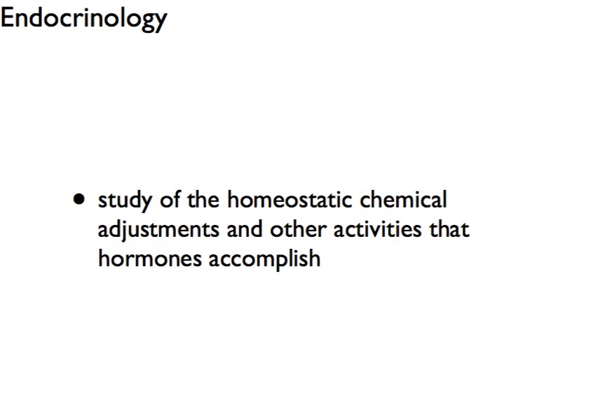

Slide 9
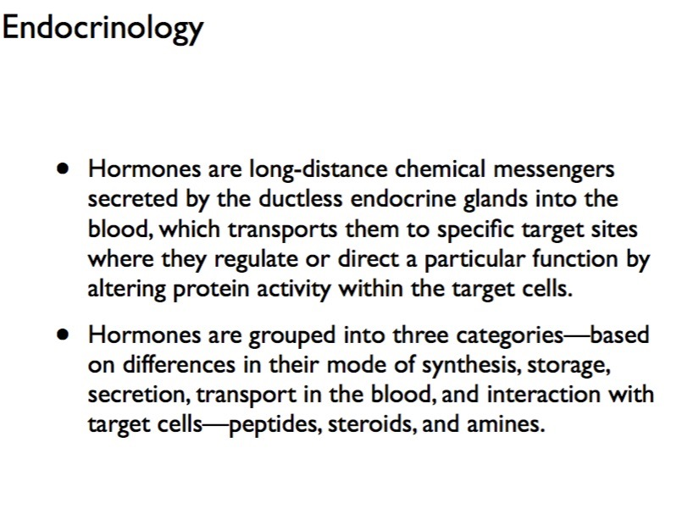

Slide 10
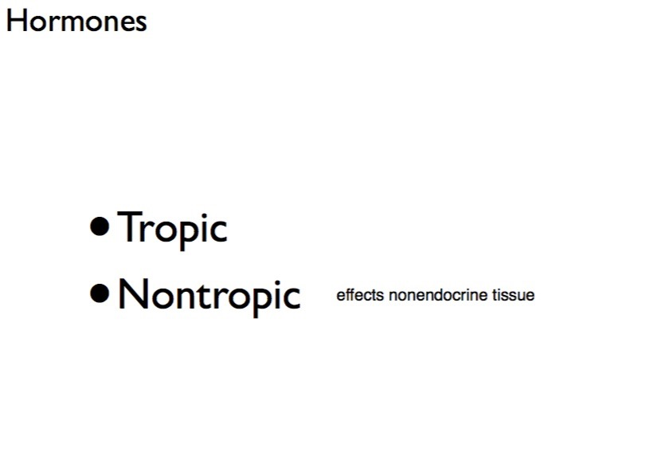

Slide 11
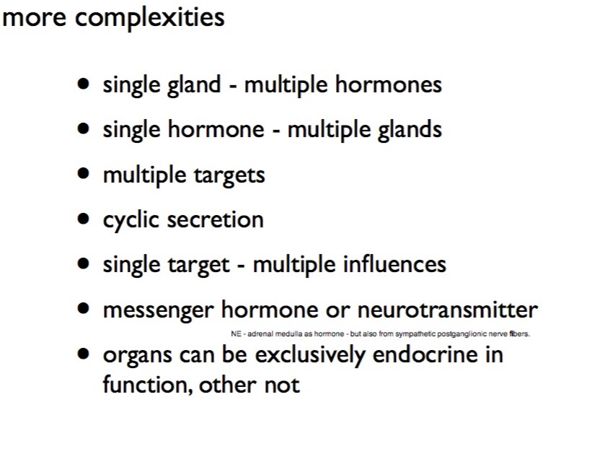

Slide 12
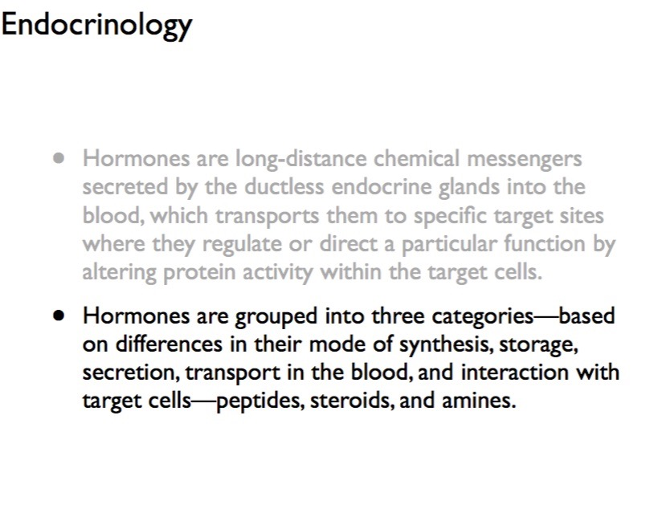

Slide 13
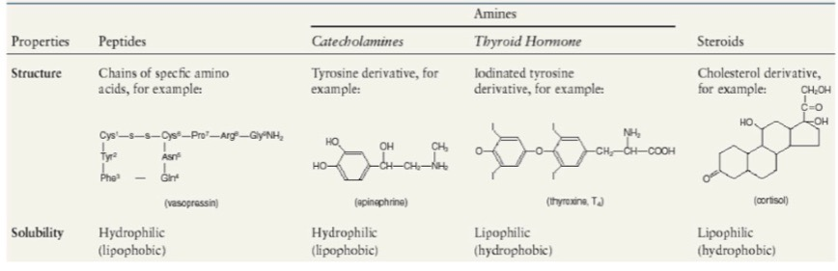

Slide 14
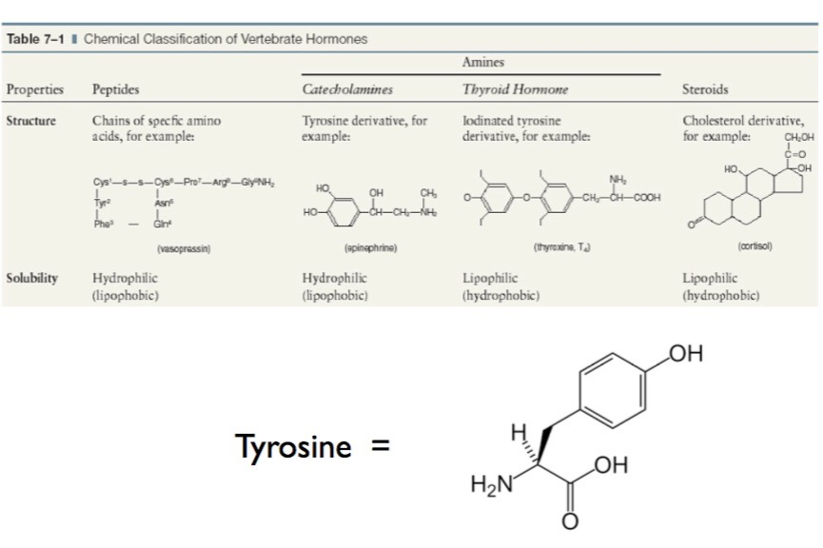

Slide 15
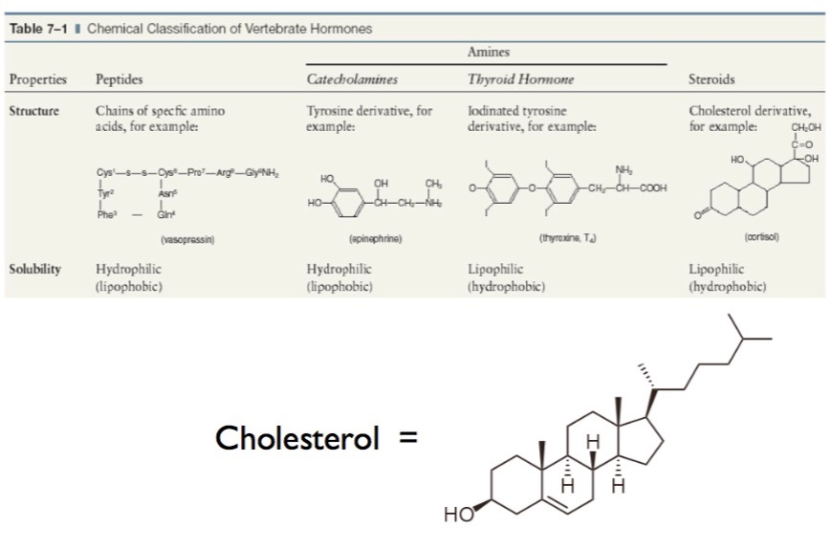

Slide 16
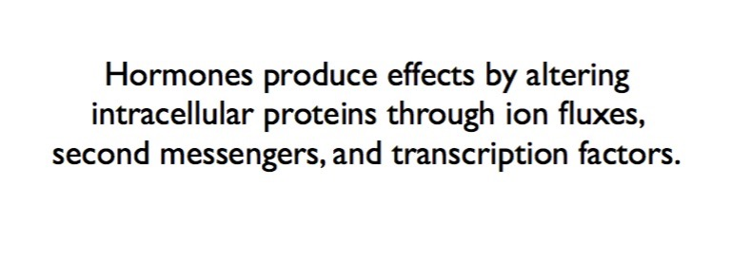

Slide 17
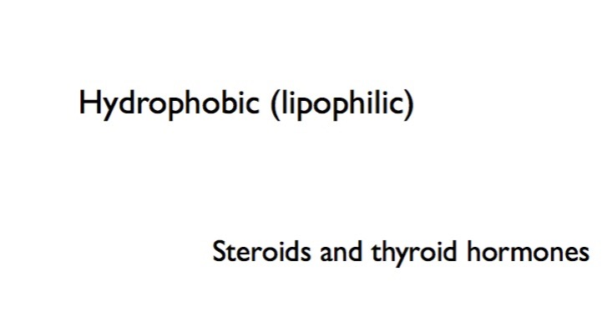

Slide 18
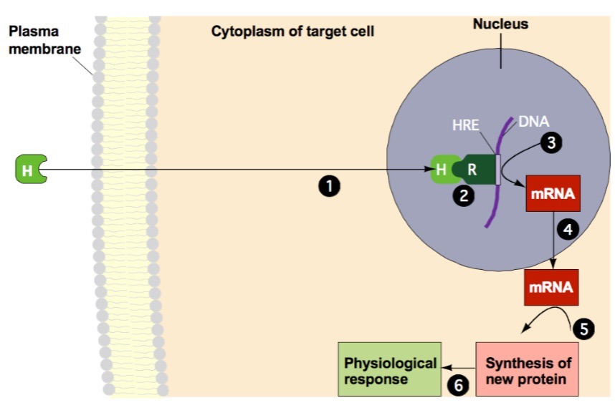

Slide 19
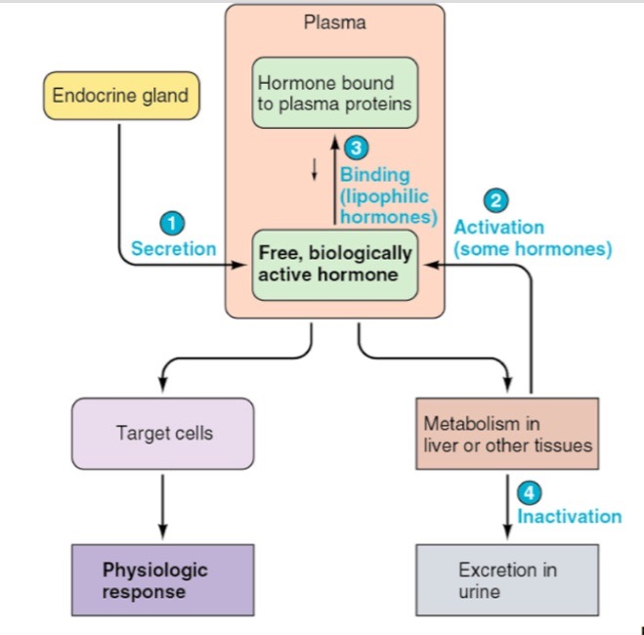

Slide 20
asexual

Slide 21
How Does Asexual Reproduction Occur?
There are three main mechanisms of asexual reproduction:
Budding—the offspring forms in or on the parent; when fully developed, the offspring breaks away
Fission—an individual splits into two organisms
Parthenogenesis—the female produces an offspring without fertilization from a male
The offspring are genetically identical to the mother
Eggs can be produced by mitosis or meiosis

Slide 22
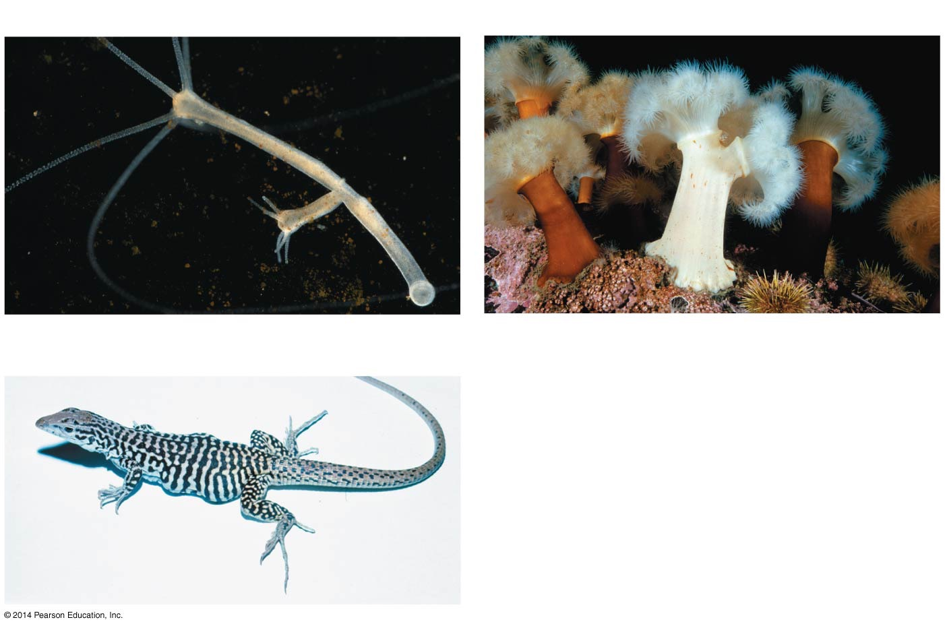
Figure 50.1
(a) Budding in hydra
(b) Fission in anemones
Bud
5 mm
5 cm
(c) Parthenogenesis in lizards
Unfertilized
eggs develop
into offspring
Notes:
Figure 50.1 Mechanisms of Asexual Reproduction in Animals Are Diverse.

Slide 23
switching

Slide 24
Switching Reproductive Modes: A Case History
Many animal species regularly switch between reproducing asexually and sexually
For example, Daphnia are crustaceans that reproduce both asexually and sexually in a typical year
Throughout the spring and summer, Daphnia produce only diploid female offspring by parthenogenesis
The eggs produced by parthenogenesis develop in a structure called a brood pouch and are released when the female molts her exoskeleton

Slide 25
Switching Reproductive Modes: A Case History
In late summer/early fall, however, many females begin producing male offspring
Haploid sperm produced by meiosis in the males fertilize haploid eggs that females produce by meiosis
In spring, the sexually produced offspring hatch and begin reproducing asexually

Slide 26
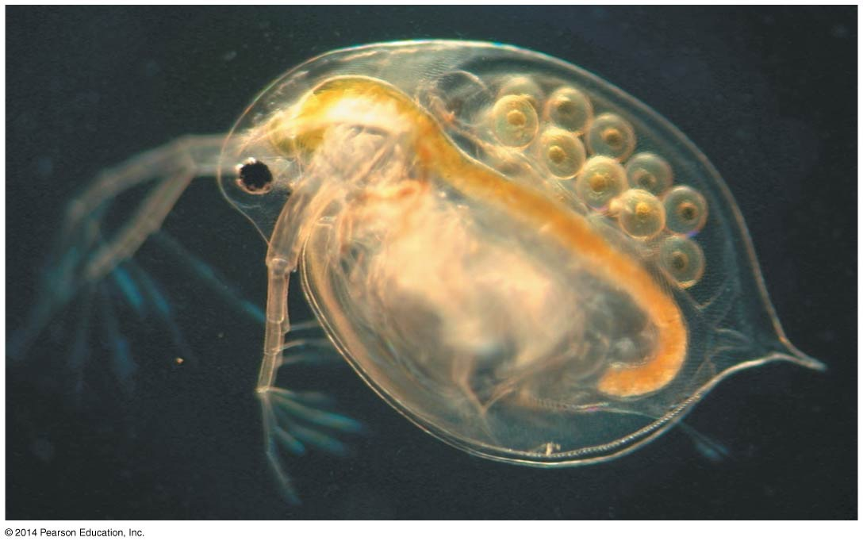
Figure 50.2
Brood pouch
with eggs
0.5 mm
Notes:
Figure 50.2 Female Daphnia Can Produce Eggs by Parthenogenesis.

Slide 27
Switching Reproductive Modes: A Case History
Biologists try to explain observations like this at two levels:
Ultimate causation addresses why a trait occurs, in terms of its effect on fitness—the focus is on the evolutionary history of traits
Proximate causation addresses how a trait is produced. When researchers identify the genetic, developmental, hormonal, or neural mechanisms responsible for a phenotype, they are working at the proximate level

Slide 28
What Environmental Cues Trigger the Switch?
Two environmental conditions were determined to affect the mode of reproduction in Daphnia:
Day length
Population density—particularly, water quality and food availability
More specifically, individuals switched to sexual reproduction only if they were exposed to poor-quality water, low food availability, and short day lengths

Slide 29
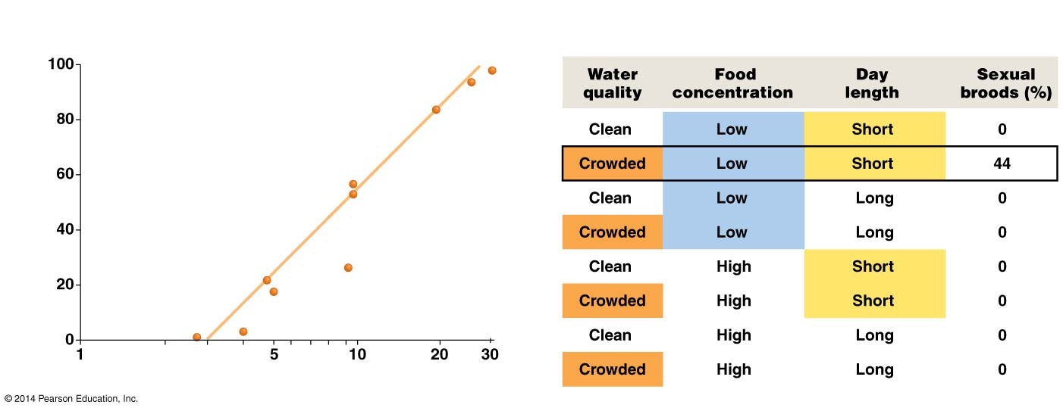
Figure 50.3
(a) Sexual reproduction is more common in crowded
populations of Daphnia pulex than in sparse populations.
(b) In Daphnia magna, which environmental cues trigger
the switch to sexual reproduction?
Percentage of Daphnia females
reproducing sexually
Daphnia density (number/50 mL)
Notes:
Figure 50.3 In Daphnia, Environmental Cues Signal the Switch from Asexual to Sexual Reproduction.

Slide 30
Why Do Daphnia Switch Modes of Reproduction?
Research indicates that Daphnia start reproducing sexually when environmental conditions worsen
Sexual reproduction leads to genetic variability, which makes for stronger offspring
Scientists hypothesize that genetically variable offspring have higher fitness in environments with rapidly evolving parasites, deteriorating physical conditions, or other types of rapid environmental change
Genetically variable offspring are more fit for a harsh environment than the offspring of asexual reproduction, which lack genetic variability

Slide 31
gametogenesis

Slide 32
Mechanisms of Sexual Reproduction: Gametogenesis
The mitotic cell divisions, meiotic cell divisions, and developmental events that result in the production of male and female gametes, or sperm and eggs, are collectively called gametogenesis
Spermatogenesis is the formation of sperm, and oogenesis is the formation of eggs
In the vast majority of animals, gametogenesis occurs in a sex organ, or gonad. Male gonads are called testes; female gonads are called ovaries

Slide 33
Spermatogenesis in Mammals
In the male gonad, diploid cells called spermatogonia divide by mitosis to generate the cells that undergo meiosis
This process occurs continuously throughout the male’s adult life
In human males, the spermatogonia divide by mitosis to produce primary spermatocytes, which undergo meiosis I and produce two secondary spermatocytes, which then undergo meiosis II
The result is four haploid cells called spermatids, each of which matures into a sperm

Slide 34
Oogenesis in Mammals
In the female gonad, diploid cells called oogonia divide by mitosis to form primary oocytes
The production of primary oocytes stops early in development in many mammals; in humans, it stops before birth
When these cells undergo meiosis, only one of the four haploid products, known as an ovum, matures into an egg
The other cells do not mature into eggs; these cells are called polar bodies

Slide 35
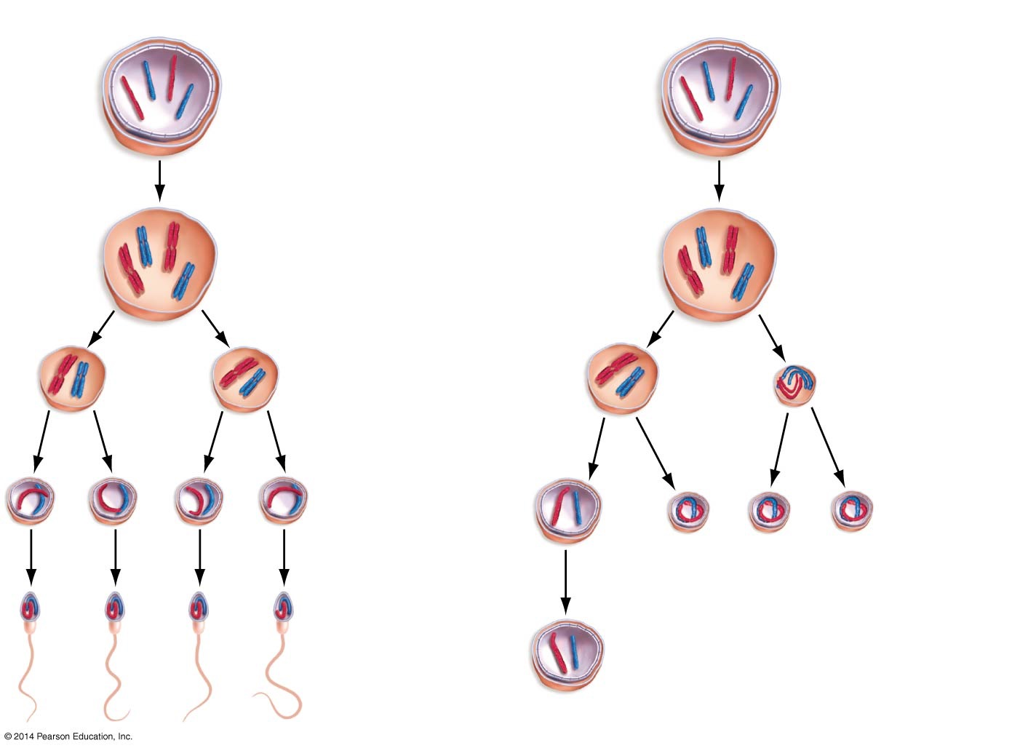
Figure 50.4
(a) Spermatogenesis
(b) Oogenesis
Spermatogonium (2n)
Oogonium (2n)
(May divide by mitosis to
form more spermatogonia)
Mitosis and
differentiation
Mitosis and
differentiation
Primary spermatocyte (2n)
Primary oocyte (2n)
Meiosis I
Meiosis I
Secondary
spermatocytes (n)
Secondary oocyte (n)
+ polar body (n)
Meiosis II
Meiosis II
Spermatids (n)
Ootid
(n)
Polar bodies (n)
Mature sperm
cells (n)
Mature egg cell (ovum) (n)
Notes:
Figure 50.4 Gametogenesis in Sexually Reproducing Animals Produces Sperm or Eggs via Meiosis.

Slide 36

Human Gametogenesis
Web Activity: Human Gametogenesis

Slide 37
fertilization

Slide 38
Fertilization and Egg Development
Fertilization is the joining of a sperm and an egg to form a diploid zygote
In many animal species, individuals release their gametes into their environment, and external fertilization occurs
In other animals, males deposit sperm into the reproductive tracts of females and internal fertilization occurs

Slide 39
The Structure of Mammalian Sperm
There are four components to the mammalian sperm:
The head contains the nucleus and an enzyme, acrosome, for penetrating the egg
The neck contains one centriole, which will combine with the centriole contributed by the egg
Centrioles form the spindle during mitosis
A midpiece contains mitochondria, which supply the ATP that powers the sperm to swim to the egg
A tail with a flagellum for swimming

Slide 40
The Structure of the Mammalian Egg
The egg not only carries genetic material from the female, but contains nutrients needed by the embryo during early growth
The contents of an egg cell:
Yolk, a nutrient source loaded with protein and fats
A vitelline envelope outside the cell membrane
In sea animals, the vitelline envelope may be surrounded by a jelly-like layer. Both protect the egg
In humans, this is called the zona pellucida

Slide 41
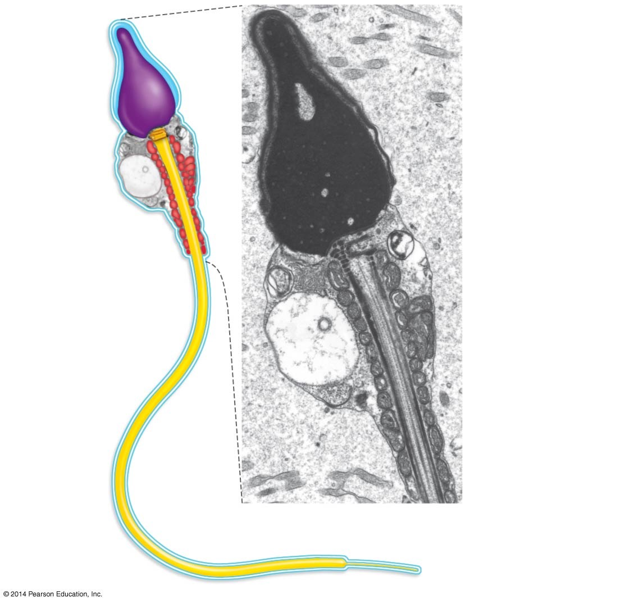
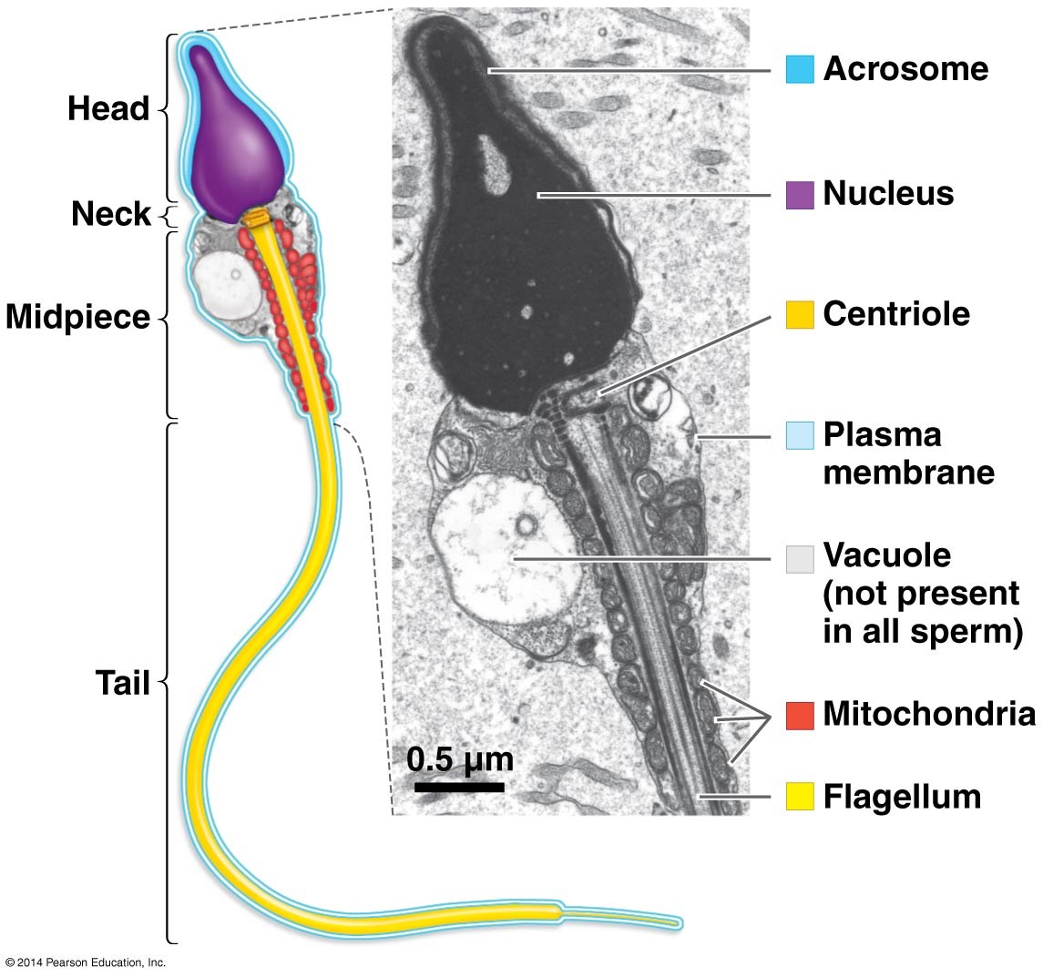
Figure 50.5
Acrosome
Head
Nucleus
Neck
Midpiece
Centriole
Plasma
membrane
Vacuole
(not present
in all sperm)
Tail
Mitochondria
0.5 μm
Flagellum
Notes:
Figure 50.5 Mammalian Sperm Are Specialized for Motility and Fusing with an Egg Cell.

Slide 42
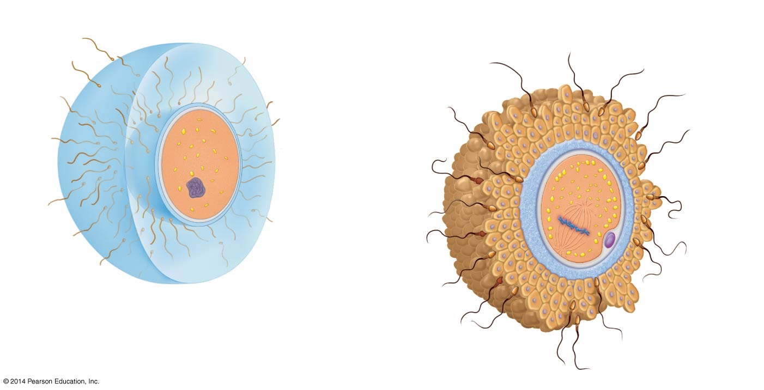
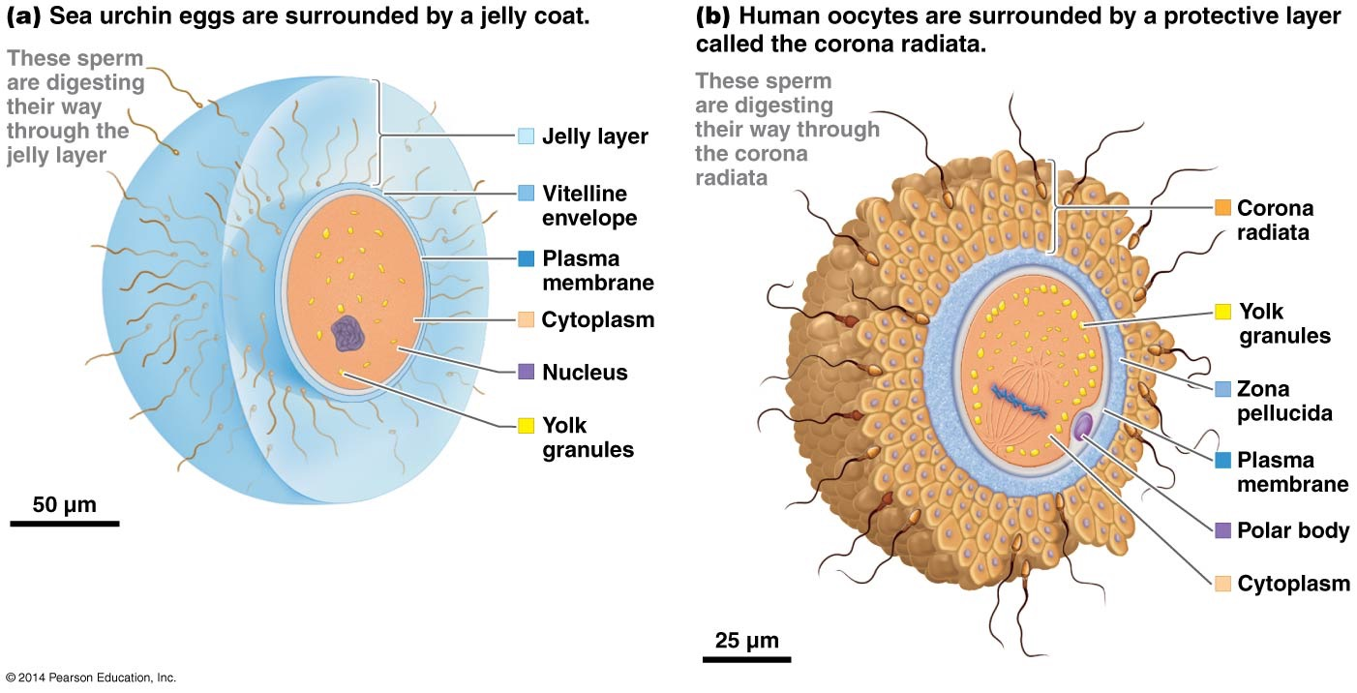
Figure 50.6
(a) Sea urchin eggs are surrounded by a jelly coat.
(b) Human oocytes are surrounded by a protective layer
called the corona radiata.
These sperm
are digesting
their way
through the
jelly layer
These sperm
are digesting
their way through
the corona
radiata
Jelly layer
Vitelline
envelope
Corona
radiata
Plasma
membrane
Cytoplasm
Yolk
granules
Nucleus
Zona
pellucida
Yolk
granules
Plasma
membrane
50 μm
Polar body
Cytoplasm
25 μm
Notes:
Figure 50.6 Eggs Are Surrounded by Protective Structures.

Slide 43
External Fertilization
Most animals that rely on external fertilization live in aquatic environments and tend to produce large numbers of gametes
Gametogenesis occurs in response to environmental cues such as lengthening days and warmer water temperatures, which indicate a favorable season for breeding
Gametes are released in response to specific cues from individuals of the same species
Research indicates that chemical messengers called pheromones might be involved in coordination of the release of the gametes

Slide 44
Internal Fertilization
Internal fertilization occurs in the vast majority of terrestrial animals and in a significant number of aquatic animals
Internal fertilization occurs in one of two ways:
Copulation—males deposit sperm directly into the female reproductive tract with the aid of a copulatory organ called the penis
Males may also package their sperm into a spermatophore, which is then placed into the female’s reproductive tract by the male or female

Slide 45
The Salamander—A Case Study
In salamanders, the male deposits the spermatophore on the ground
The female picks up the spermatophore with the cloaca
The cloaca is a chamber that opens to the outside
Both urinary and reproductive systems empty products into the cloaca
The result in the salamander case is that there is internal fertilization without contacting the male

Slide 46
What Is Sperm Competition?
Sperm competition is competition between sperm from different males to fertilize the eggs of the same female
In experiments on dung flies, Geoff Parker determined that when two males mated with a single female, whichever male was last to copulate fathered an average of 85% of the offspring produced
Follow-up research has confirmed that second-male advantage is widespread, although not universal, in insects and some other animal groups

Slide 47
Sperm Competition and Second-Male Advantage
Experiments consisting of a series of fruit fly matings between one female and two males indicated that the second male’s sperm physically dislodged and replaced the first male’s gametes from the female sperm storage area
The researchers also showed that the fluid that accompanies sperm during fertilization is able to displace stored sperm from competing males
These two mechanisms resulted in the second male’s sperm fertilizing most of the eggs laid

Slide 48
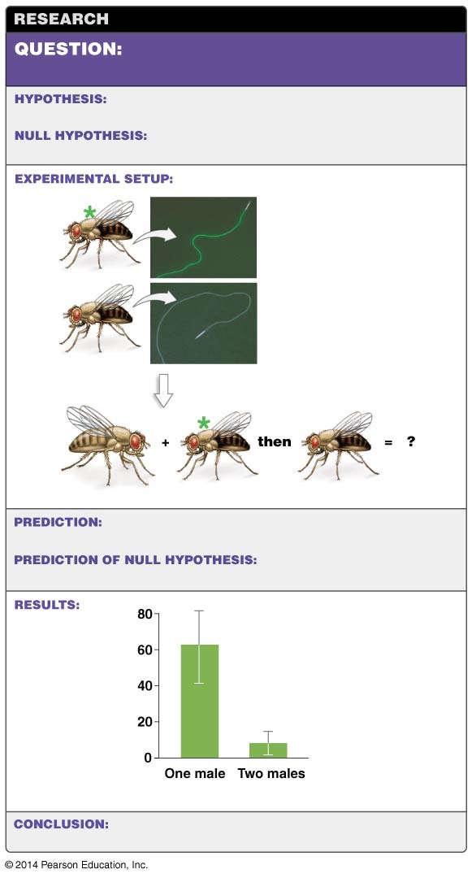
Figure 50.7
How does the “second-male advantage”
occur in sperm competition?
In sperm-storage areas, sperm from the second male
displaces sperm from the first male.
displacement from sperm-storage areas.
The mechanism does not involve sperm
1. Introduce gene into
male flies to make their
sperm green.
Green sperm
Normal-colored sperm
2. Allow flies to mate;
afterward observe sperm
in female.
Female
First male
Second male
remains in storage.
When females mate twice, little sperm from the first male
or all of the sperm deposited by the first male is still present.
When females mate twice, most
Mean first-male sperm
stored in female
The
difference
represents
displaced
sperm
First male
Number of males that mate with female
male she mated with disappears.
If a female mates a second time, most sperm from the first
Notes:
Figure 50.7 Experimental Evidence Supports Second-Male Advantage in Drosophila.

Slide 49
Why Is Testes Size Variable among Species?
In species in which females routinely mate with multiple males before laying eggs or giving birth, males have extraordinarily large testes for their size and produce proportionately larger numbers of sperm
In some species, females choose which male is the last to copulate; in other species, females physically eject sperm from undesirable males
This behavior is called cryptic female choice

Slide 50
Unusual Mating Strategies
Some forms of animal sexual reproduction are quite remarkable, including
Femmes fatales—some arthropod females cannibalize the male before the copulation is completed, elongating copulation time and increasing the number of fertilized eggs
Giant sperm—Drosophila bifurca produce sperm that are so large they preclude additional matings with other males
False penises—the red-billed buffalo weaver has a false penis that becomes erect during copulation, stimulating the female’s reproductive tract and triggering an orgasm-like state in males

Slide 51
Unusual Aspects of Mating
Infidelity—in monogamous bird species, up to 60% of nests include at least one offspring fathered by a male not mated to the resident female
Love darts—many snails and slugs are hermaphroditic: they contain both male and female gonads. Some species fire “love darts” into the mating partner; a substance in the mucus increases the chance that sperm will successfully fertilize eggs
Hypodermic insemination—some bedbugs have hypodermic penises that function like a hypodermic needle. Males force the organ through the female’s abdominal wall and deposit sperm

Slide 52
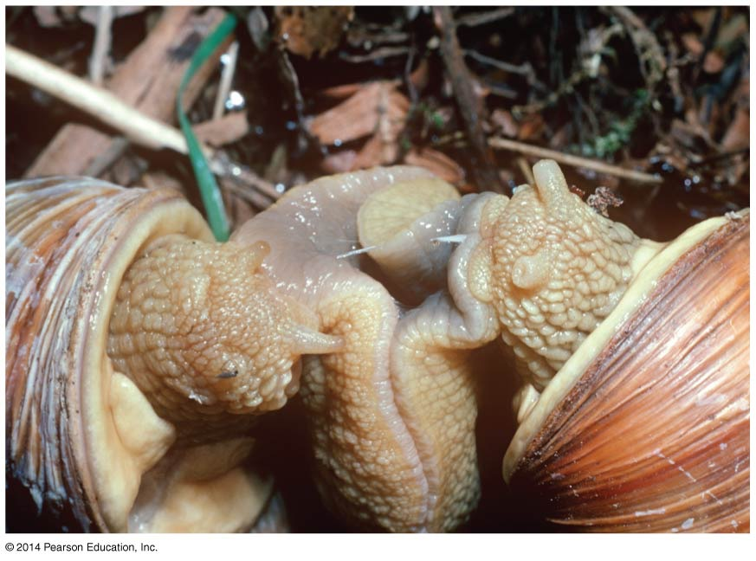
Figure 50.8
Lots of crazy stuff….
Love dart
Notes:
Figure 50.8 Snails Stab with Love Darts.

Slide 53
Females: Lay Eggs or Give Birth
Once fertilization has occurred, the embryo is either laid as an egg outside the mother’s body or retained inside her body
In oviparous animals, the egg is laid outside the mother’s body and the embryo develops in the external environment
The care of the young is variable among animals

Slide 54
Females: Lay Eggs or Give Birth
In viviparous species, the egg remains within the mother’s body
There, the embryo develops and receives nutrition directly from the mother
In ovoviviparious animals, offspring develop inside the mother’s body but are nourished by nutrient-rich yolk stored in the egg

Slide 55
Why the Difference between Oviparous and Ovoviviparous?
In the lizard genus Sceloporus, some populations are oviparous while others are ovoviviparous
Phylogenetic analysis based on molecular and morphological data of many Sceloporus species yielded two conclusions:
Because most Sceloporus populations are oviparous, egg laying probably represents the ancestral condition
Ovoviviparity evolved independently

Slide 56
Why the Difference between Oviparous and Ovoviviparous?
Researchers hypothesize that natural selection favoring ovoviviparity or viviparity should be especially strong in cold habitats, and many data support this hypothesis

Slide 57
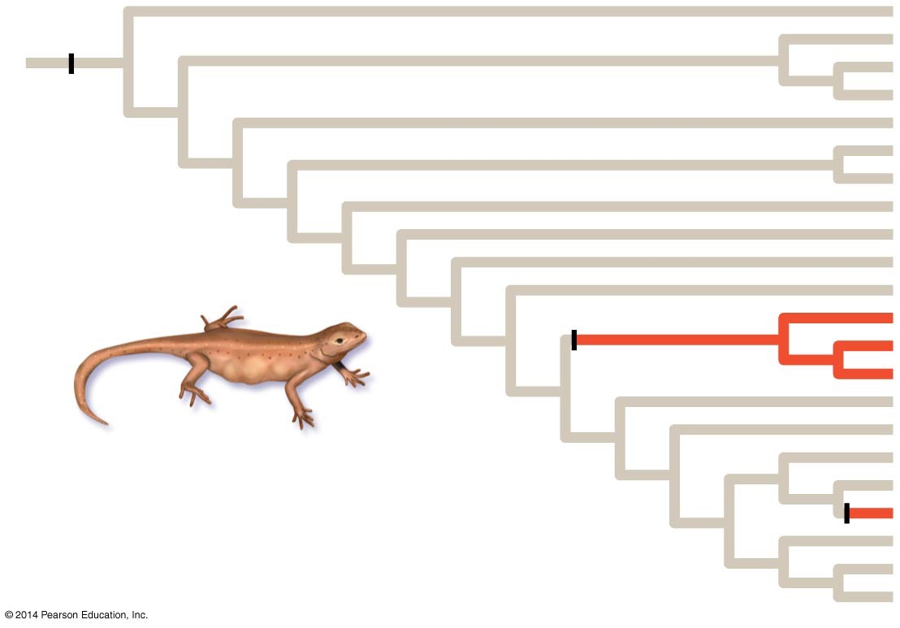
Figure 50.9
Oviparity
Oviparity
in ancestral
population
Ovoviviparity
evolved in
two groups
independently
Notes:
Figure 50.9 Ovoviviparity Has Evolved More than Once in Sceloporus Lizards.

Slide 58
Male Reproductive Systems
In humans, the male reproductive system consists of the saclike scrotum, which holds the testes, and the penis, which functions as the organ of copulation needed for internal fertilization
Some data suggest that, in insects and perhaps other animal species, variation in the size and shape of male genitalia (external reproductive organs) has a strong impact on male reproductive success
For example, in the seed beetle Callosobruchus maculatus, males with long genital spines father more offspring

Slide 59
Anatomy of Human Male Reproductive Organs
Spermatogenesis and sperm storage—sperm are produced in the testes and stored in the nearby epididymis
Production of additional fluids—accessory fluids are formed in the seminal vesicles, prostate gland, and bulbourethral gland
These accessory fluids are added to sperm before ejaculation, or expulsion from the body
Semen is the combination of sperm and accessory fluids

Slide 60
Anatomy of Human Male Reproductive Organs
Transport and delivery—the vas deferens are tubes that transport sperm from the epididymis to the ejaculatory duct. The semen then enters the urethra, a longer tube that passes through the penis and services both the reproductive and urinary systems in males
The semen is expelled during ejaculation
The composition of the accessory fluids varies widely among animals
Some species have a bone inside the penis called the baculum
Other species, including humans, lack this feature

Slide 61
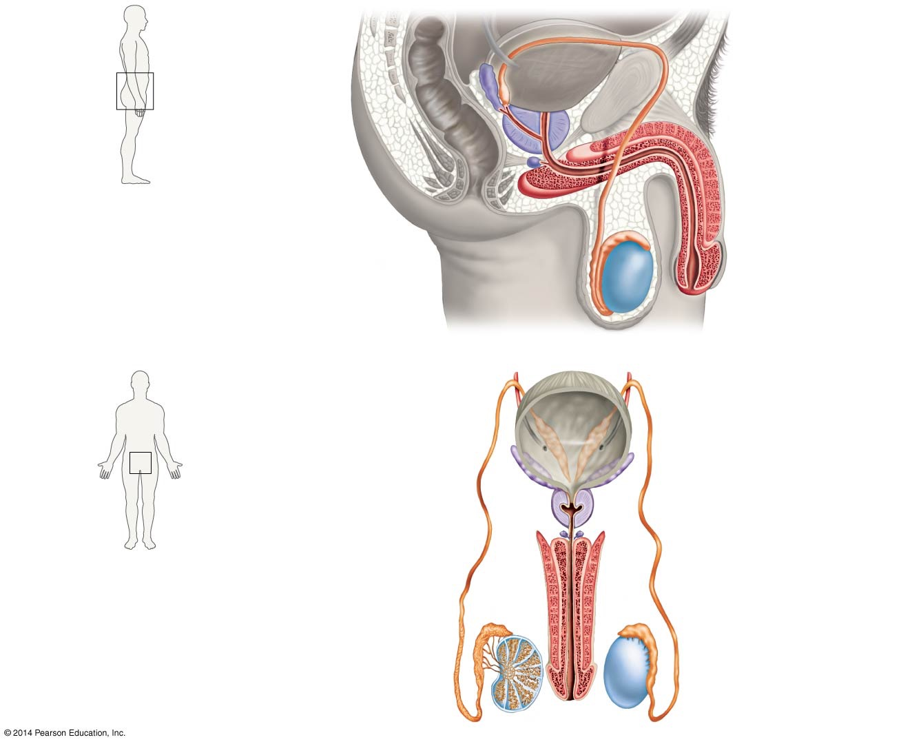
Figure 50.11
(a) Side view
Vas deferens
Urinary bladder
Seminal vesicle
Ejaculatory duct
Prostate gland
Bulbourethral gland
Urethra
Vas deferens
Erectile tissue
of penis
Epididymis
Testis
Prepuce (foreskin)
Scrotum
(b) Front view
Urinary bladder
Seminal vesicle
Prostate gland
Bulbourethral gland
Urethra
Erectile tissue of penis
Vas deferens
Epididymis
Testis
Notes:
Figure 50.11 The Reproductive Tract in a Human Male Produces, Stores, and Transports Sperm.

Slide 62
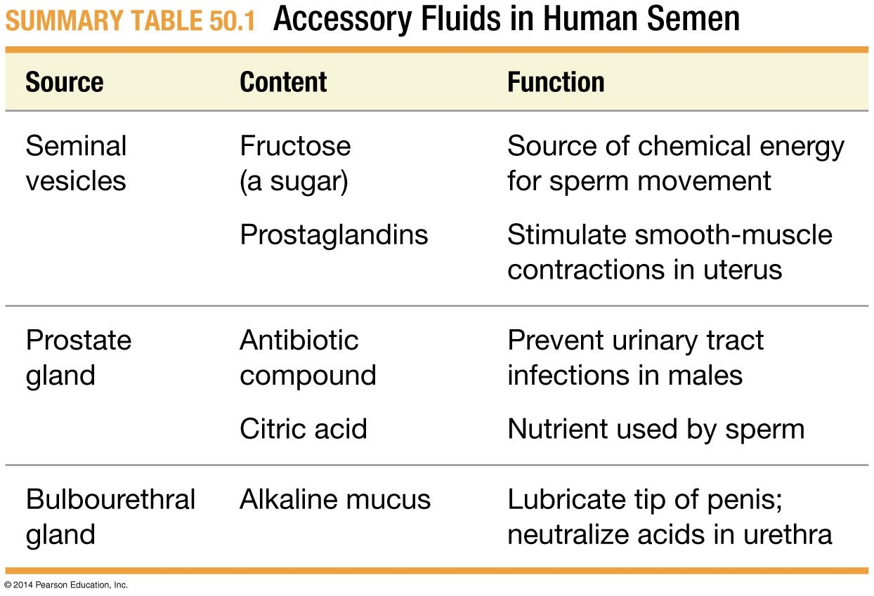
Summary Table 50.1
Notes:
Summary Table 50.1 Accessory Fluids in Human Semen

Slide 63
Female Reproductive Systems
The most important part of the reproductive system in female animals is the ovary, where meiosis occurs and egg cells, or ova, are produced
In the vast majority of species, the mature egg cell is a membrane-bound structure consisting of a haploid nucleus, a full complement of other organelles, and a large supply of nutrients in the form of yolk

Slide 64
The Reproductive Tract of Female Birds
Birds are oviparous vertebrates; they lay an amniotic egg protected by a hard shell
The structures that make up the female bird reproductive system include
A single ovary, from which ova are released
The oviduct, where fertilization occurs
The uterus, where the embryo develops and eggshell forms
The vagina, through which the mature egg passes
The cloaca, out of which the egg is laid

Slide 65
The Bird’s Egg
The result of hard-shelled eggs is that they are laid into the outside or environment and must be incubated
The egg will not dry out, because it is a rich amniotic hard-shelled egg
The adaptation is that the egg can be laid on land
Another adaptation in female birds is the single ovary, making female birds light in weight for flight

Slide 66
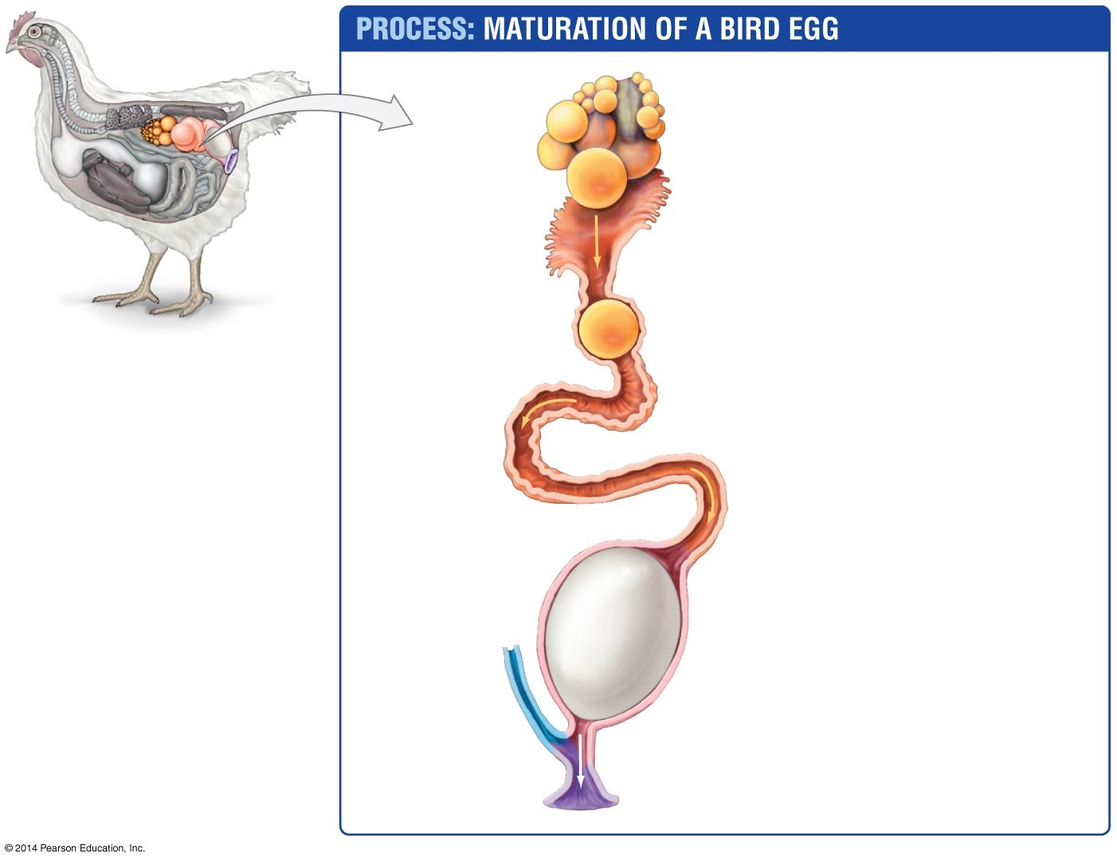
Figure 50.12
1. Meiosis and maturation
of follicles.
Ovary
2. Entry of the follicle
into oviduct.
Follicle
Left
oviduct
3. Addition of egg white.
4. Addition of outer
membranes.
Uterus
5. Formation of eggshell.
Intestine
Vagina
6. Egg is laid.
Cloaca
Notes:
Figure 50.12 All Birds Are Oviparous.

Slide 67
External and Internal Anatomy of Human Females
Humans are viviparous vertebrates; the female retains the embryo and provides the nourishment
The external anatomy of the human female reproductive system consists of
The labia minora and labia majora, folds of skin that cover the urethral and vaginal openings
The clitoris, a sensitive organ that develops from the same embryonic cells that give rise to the penis in males
The vagina, the chamber where semen is deposited during sexual intercourse and through which a baby is delivered during childbirth

Slide 68
External and Internal Anatomy of Human Females
The mammalian internal female reproductive system has two functions:
Production and transport of eggs
Eggs are produced in the paired ovaries
During ovulation, an egg is expelled from the ovary and enters the oviduct (fallopian tube), where fertilization may take place
Fertilized eggs are then transported to the uterus
Development of offspring
Embryonic development takes place in the uterus
The developed fetus passes through its opening, the cervix, and into the vagina during childbirth

Slide 69
An Adaptation of the Hyena
In the spotted hyena, birth occurs through the clitoris, which is much longer than in most animals
The birth canal is enclosed in the clitoris structure
Mating and birthing occur through this organ
Because of the unusually high levels of the male hormone testosterone, females tend to be larger and more dominant

Slide 70
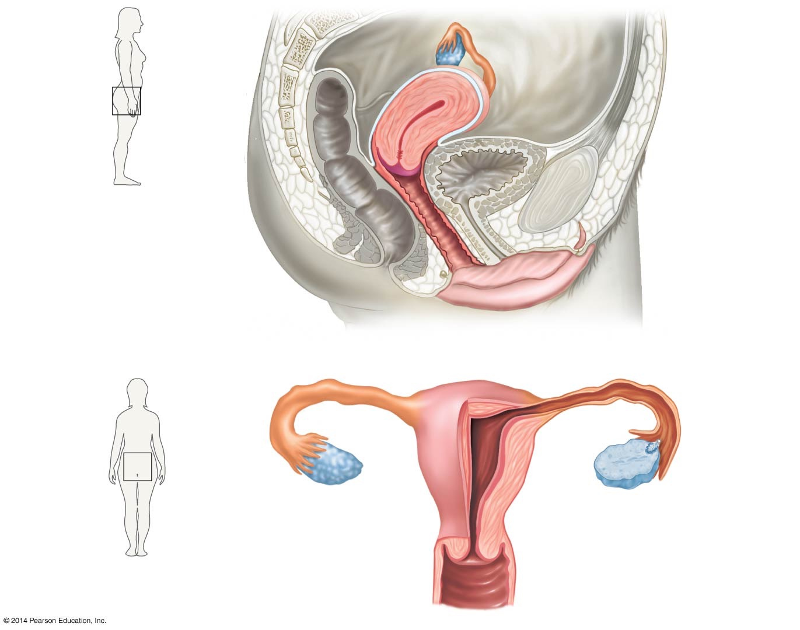
Figure 50.13
(a) Side view
Oviduct
Ovary
Uterus
Cervix
Urinary bladder
Vagina
Urethra
Clitoris
Labium minus
Labium majus
Opening
of vagina
Opening
of urethra
(b) Front view
Oviduct
Ovary
Uterus
Cervix
Vagina
Notes:
Figure 50.13 The Reproductive Tract in a Human Female Produces Eggs and Nurtures the Embryo and Fetus.

Slide 71
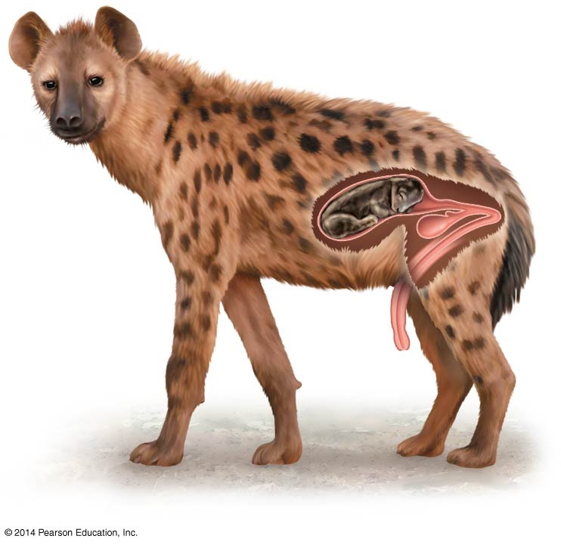
Figure 50.14
Notes:
Figure 50.14 Female Spotted Hyenas Have Enlarged Clitori.

Slide 72
The Role of Sex Hormones in Mammalian Reproduction
The male sex hormone is testosterone; the main female sex hormone is estradiol, which belongs to a class of hormones called estrogens
Testosterone is synthesized in specialized cells inside the testes
Estrogens are produced in the ovaries by cells that surround the developing egg, which form a structure called a follicle

Slide 73
The Role of Sex Hormones in Mammalian Reproduction
Human sex hormones play a key role in
Development of the reproductive tract in embryos
Maturation of the reproductive tract during the transition from childhood to adulthood
Regulation of spermatogenesis and oogenesis in adults

Slide 74
Control of Puberty in Humans and Other Animals
A number of changes take place in boys and girls during puberty, the process that leads to sexual maturation in humans
In humans, these changes are triggered by increased levels of testosterone in boys and estradiol in girls
In amphibians, the juvenile-to-adult transition is triggered by the hormone T₃ (triiodothyronine)
In insects, the transition to adulthood occurs in response to the hormone ecdysone

Slide 75
What Regulates the Gonadal Hormones?
Puberty is initiated when gonadotropin-releasing hormone (GnRH) is released from the hypothalamus
This triggers release of luteinizing hormone (LH) and follicle-stimulating hormone (FSH) from the pituitary gland
LH and FSH then trigger increases in testosterone and estradiol
In adolescents experiencing delays in the onset of puberty, GnRH treatment induced surges in LH and FSH, followed by puberty onset

Slide 76
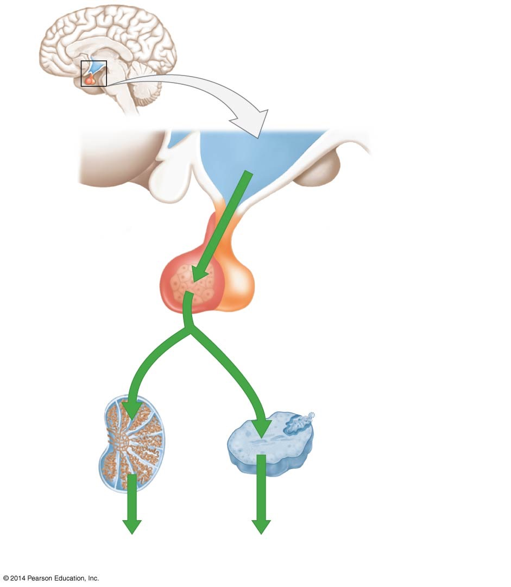
Figure 50.15
Adolescent brain
Hypothalamus
GnRH
(gonadotropin-
releasing hormone)
Anterior
pituitary gland
LH
LH (luteinizing hormone)
FSH
or
FSH (follicle-stimulating hormone)
Testis
(in males)
Ovary
(in females)
Testosterone
Estradiol
Larynx and other
target tissues
Breasts and other
target tissues
Notes:
Figure 50.15 In Humans, Puberty Is Triggered by Hormones from the Hypothalamus and Pituitary.

Slide 77
Regulation of the Hypothalamic and Pituitary Hormones
There is some evidence that nutritional state is involved in triggering GnRH increases at the appropriate age
Puberty onset in the United States has dropped from age 17 during the eighteenth and nineteenth centuries, when the general nutritional state of the population was poorer, to age 12 today
Among girls living today, individuals with large fat stores tend to enter puberty earlier than do girls who are thin
High fat stores are related to leptin, a hormone produced by fat cells, which in turn may trigger the GnRH and begin puberty

Slide 78
Hormones Control the Mammalian Menstrual Cycle
The menstrual cycle is a monthly reproductive cycle that occurs in the ovary and uterus. It averages 28 days in humans
In conjunction with changes in the ovary, the uterine lining undergoes a dramatic thickening and regression, and a part of the lining ultimately sloughs off
The onset of the combined ovarian and uterine cycles is the start of menstruation—the expulsion of the uterine lining through the vagina. This event is designated as day 0 in the cycle

Slide 79
Hormones Control the Mammalian Menstrual Cycle
Only humans and other great apes menstruate. Female mammals that do not menstruate have what is called an estrous cycle
The menstrual cycle has two phases:
In the follicular phase, which lasts an average of 14 days, the follicle matures and ovulation occurs
Primary oocytes undergo meiosis to produce a mature ovum. When the ovum matures, ovulation occurs
During the luteal phase, which also lasts an average of 14 days, a structure called a corpus luteum forms from the ruptured follicle and later degenerates

Slide 80
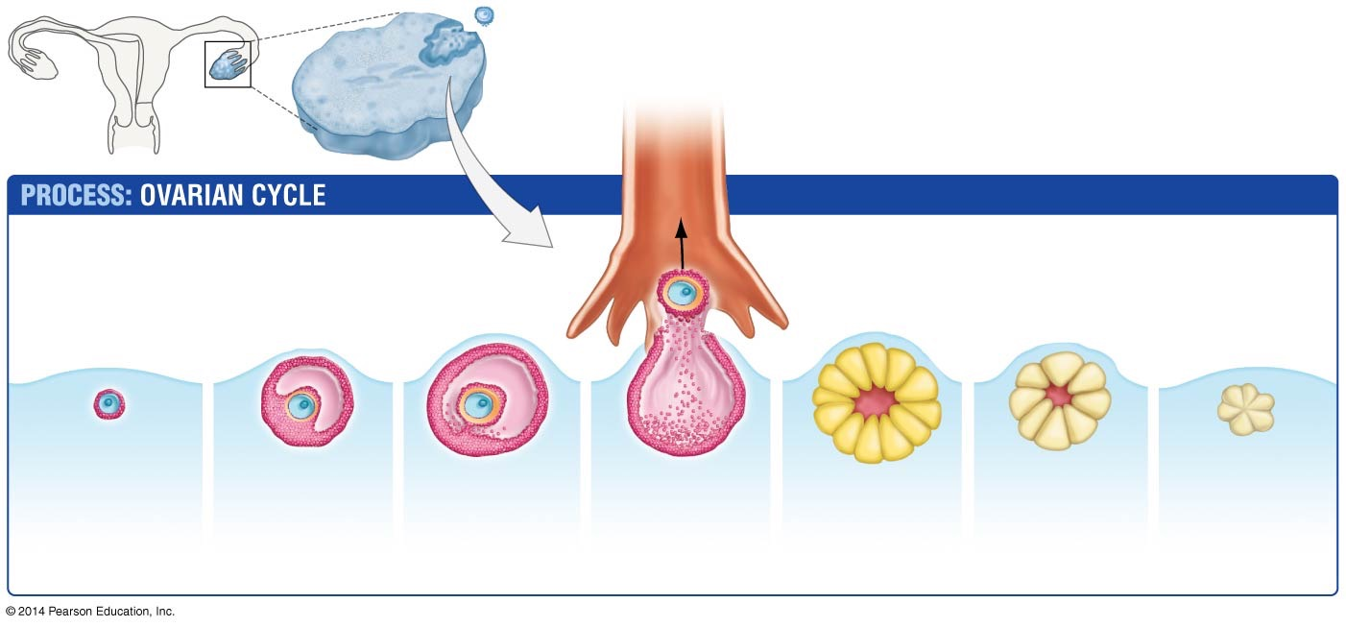
Figure 50.16
Ovary
Oviduct
FOLLICULAR PHASE
LUTEAL PHASE
Oocyte
Follicle cells
1. Formation of
primary oocytes
within follicles
2. Follicle
growth
3. Maturation
of follicle
4. Ovulation
of secondary
oocyte
5. Corpus
luteum
6. Degeneration
(if no
implantation)
7. Degeneration
Notes:
Figure 50.16 The Menstrual Cycle Consists of a Follicular Phase and a Luteal Phase.

Slide 81
Hormones Change during a Menstrual Cycle
During each cycle
LH and FSH are produced in the anterior pituitary gland in response to GnRH
The steroid hormone progesterone is produced along with estrogens, including estradiol, in the ovaries

Slide 82
Hormones Change during a Menstrual Cycle
At least four changes have been observed:
LH stays fairly constant except for a spike that begins just before ovulation, suggesting LH might be the trigger for this event
FSH levels are relatively high during the follicular phase and low during the luteal phase
Progesterone is present at very low levels during the follicular phase but at high levels during the luteal phase
Estradiol surges during the follicular phase, while progesterone surges during the luteal phase

Slide 83
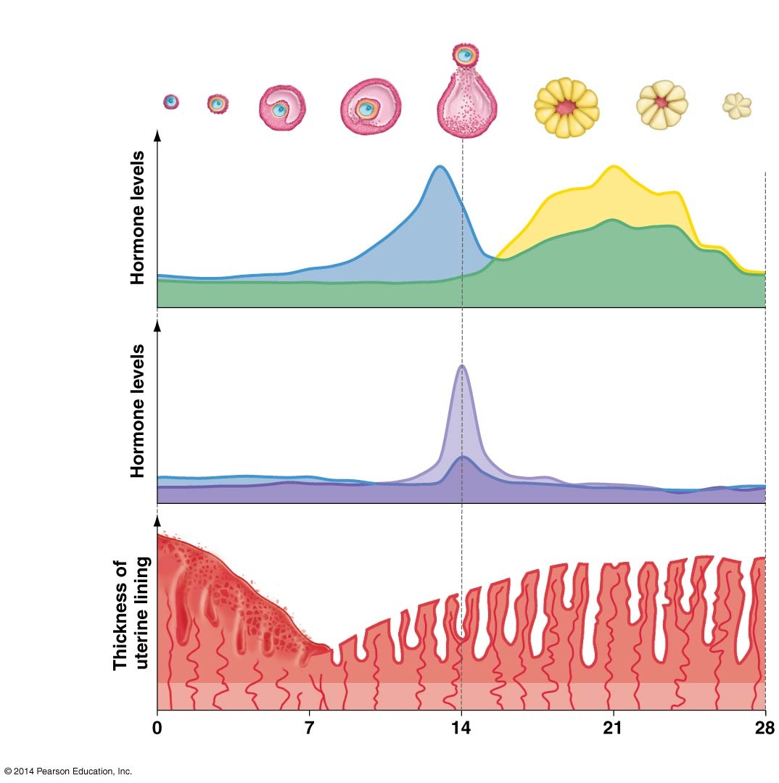
Figure 50.17
FOLLICULAR PHASE
Ovulation
LUTEAL PHASE
Follicle matures
Corpus luteum degenerates
Ovarian
cycle
Ovarian
hormone
cycle
Progesterone
Estradiol
LH
Pituitary
hormone
cycle
FSH
Menstruation
Menstrual
(uterine)
cycle
Day
Notes:
Figure 50.17 Hormones Regulate Events in the Human Menstrual Cycle.

Slide 84
Human Reproduction
Web Activity: Human Reproduction

Slide 85
How Do Pituitary and Ovarian Hormones Interact?
Changes in the concentration of estradiol and progesterone affect the release of the pituitary hormones LH and FSH
Estradiol exerts negative feedback on LH and FSH at low levels, but positive feedback at high levels
In other words, estradiol’s effect on the pituitary hormones is dosage dependent
Progesterone exerts only negative feedback on the two pituitary hormones, inhibiting their effect

Slide 86
Day 0–7 of the Menstrual Cycle
As the uterus is shedding much of its lining, a follicle is beginning to develop in one ovary under the influence of FSH
The follicle produces estradiol and a small amount of progesterone
While its levels are still relatively low, estradiol suppresses LH secretion through negative feedback inhibition

Slide 87
Day 8–14 of the Menstrual Cycle
As the follicle grows, its production of estradiol gradually increases
Estradiol stimulates mitosis and an increase in cell number in the uterine lining
The enlarged follicle produces large quantities of estradiol, which begin to exert positive feedback on LH secretion
Positive feedback results in a spike in LH levels, just after estradiol concentrations peak
The LH surge triggers ovulation and ends the follicular phase

Slide 88
Day 15–21 of the Menstrual Cycle
As the corpus luteum develops from the remains of the ruptured follicle, it secretes large amounts of progesterone and small quantities of estradiol, in response to LH
The rise in progesterone lowers production of LH and FSH and activates the thickened uterine lining, creating a spongy tissue with a well-developed blood supply
In this way, progesterone fosters an environment that supports embryonic development if fertilization occurs

Slide 89
Day 22–28 of the Menstrual Cycle
If fertilization does not occur, the corpus luteum degenerates
Progesterone levels fall as the corpus luteum shrinks
When progesterone declines, the thickened lining of the uterus degenerates
GnRH, LH, and FSH are released from the inhibitory control that progesterone exerts
LH and FSH levels rise, and a new menstrual cycle begins
The relationship between the ovarian and pituitary hormones is similar in other animals

Slide 90
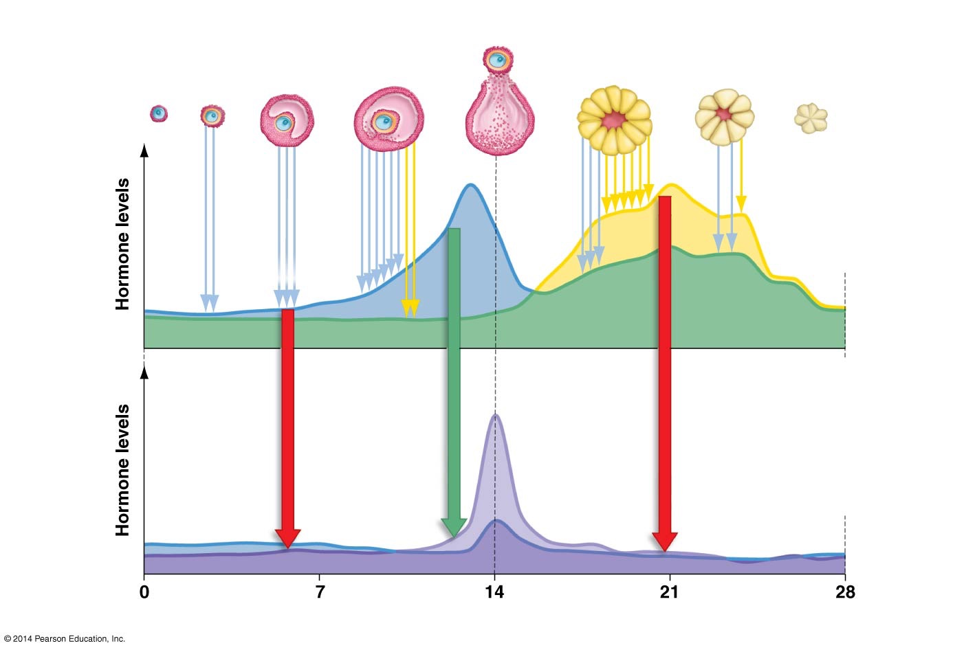
Figure 50.18
FOLLICULAR PHASE
Ovulation
LUTEAL PHASE
Follicle matures
Corpus luteum degenerates
Ovarian
cycle
Progesterone
Ovarian
hormone
cycle
Estradiol
Negative
feedback
on LH
Positive
feedback
on LH
LH
Negative
feedback
on LH,
FSH
Ovarian hormones and
pituitary hormones exert
feedback on each other
Pituitary
hormone
cycle
FSH
Day
Notes:
Figure 50.18 Complex Interactions among Hormones Regulate the Menstrual Cycle.

Slide 91
Manipulating Hormone Levels to Prevent Pregnancy
Manipulating levels of progesterone and estrogen can prevent ovulation and serve as a safe and effective method of preventing unwanted pregnancies
Hormone-based birth-control methods deliver synthetic versions of progesterone, or progesterone and estradiol
Because an LH spike does not occur during the follicular phase of the cycle, the follicle does not mature and ovulation does not occur
In addition to hormone-based methods, there are also barrier, behavioral, and preventing embryo implantation approaches to preventing pregnancy

Slide 92
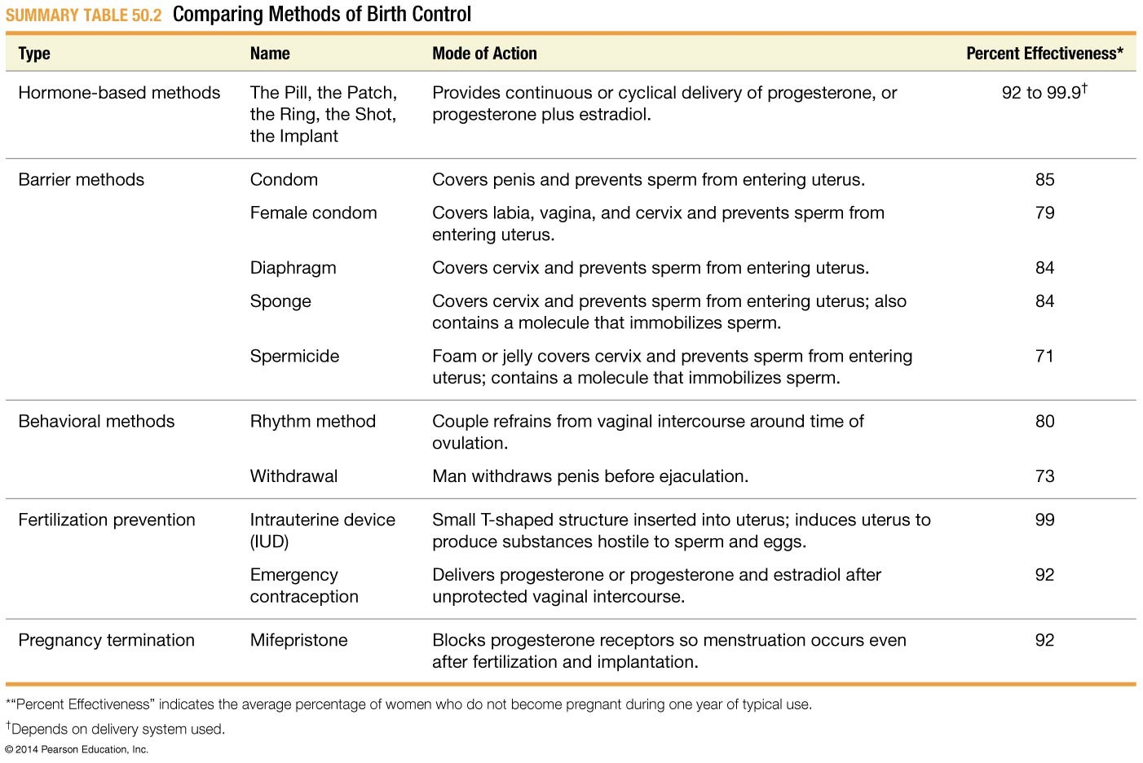
Summary Table 50.2
Notes:
Summary Table 50.2 Comparing Methods of Birth Control

Slide 93
Pregnancy and Birth in Mammals
Pregnancy and lactation, providing milk that nourishes offspring after birth, represent some of the most extreme forms of parental care known in animals
In some mammal species, parental care continues long after lactation ends
In humans, care of the offspring can last until puberty or longer
Other animals may care for their young for a period of time

Slide 94
Three Lineages and Modes of Reproduction
The three mammalian lineages are distinguished by their mode of reproduction:
Monotremes lay eggs and incubate them until hatching
Eutherian mothers carry offspring for relatively long periods of development during gestation and nourish them via a placenta
In marsupials, the corpus luteum is not maintained as it is in eutherians, and no placenta forms. The young are ejected from the mother’s body at the end of the estrous cycle. The young climbs into the mother’s pouch and clings to a nipple from which it gets its nourishment

Slide 95
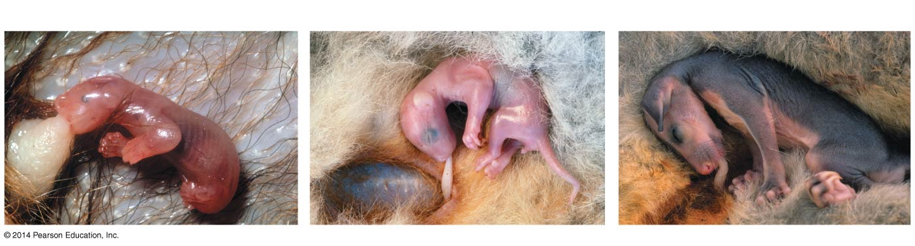
Figure 50.19
(a) Brushtail possum shortly after birth
(b) 1.5 months after birth
(c) 3.5 months after birth
5 mm
20 mm
20 mm
Notes:
Figure 50.19 Marsupials Trade a Long Gestation Period for a Long Lactation Period.

Slide 96
Major Events during Human Pregnancy
Humans are examples of eutherian reproduction
Many events occur before and during pregnancy
An egg released from the ovary is viable for less than 24 hours
Sperm remain capable of fertilizing an egg for up to 5 days

Slide 97
Major Events during Human Pregnancy
When the sperm and oocyte meet, enzymes released from the head of the sperm create a path through the material surrounding the oocyte membrane
Once the membranes of the oocyte and sperm have fused, the oocyte nucleus completes meiosis II
The two nuclei then unite to form a diploid zygote

Slide 98
Implantation
Smooth muscle contractions in the oviduct move the zygote toward the uterus
By the time the embryo reaches the uterus, it consists of a hollow ball of cells, which then undergoes implantation in the wall of the uterus
The embryo secretes a hormone called human chorionic gonadotropin (hCG) after implanting. When hCG is present, the corpus luteum does not disintegrate, the ovary continues to secrete progesterone, and the menstrual cycle is arrested

Slide 99
The First Trimester
In humans, gestation is divided into three 3-month stages called trimesters
Shortly after implantation, the three major embryonic tissues—ectoderm, endoderm, and mesoderm—form
By 8 weeks, these tissues have differentiated into the organs and systems of the body, and the heart has begun pumping blood through a circulatory system
The embryo at this stage is called a fetus

Slide 100
The First Trimester
The embryonic ectoderm contributes to several important membranes
One of these, the amnion, completely surrounds the embryo. The amnion eventually fills with amniotic fluid, which provides the embryo with a protective cushion
The placenta, the primary source of nutrition for the growing fetus, also forms during the first trimester
Arteries transport blood from the circulatory system of the fetus, through the umbilical cord, to an extensive capillary bed in the placenta

Slide 101
The First Trimester
The placenta thus provides a large surface area for the exchange of gases, nutrients, and wastes between maternal and fetal blood, even though maternal and fetal blood do not commingle
The placenta also secretes a variety of hormones, including estrogens and progesterone. These hormones suppress the release of GnRH, LH, and FSH through negative feedback, and thus prevent ovulation during pregnancy

Slide 102
The Second and Third Trimesters
After the organs and placenta form during the first trimester, development during the second and third trimesters focuses on growth
During the last weeks of pregnancy, the brain and lungs undergo particularly dramatic growth and development
If a baby is born prematurely, intervention may be required to keep the baby alive until the lungs can complete their development

Slide 103
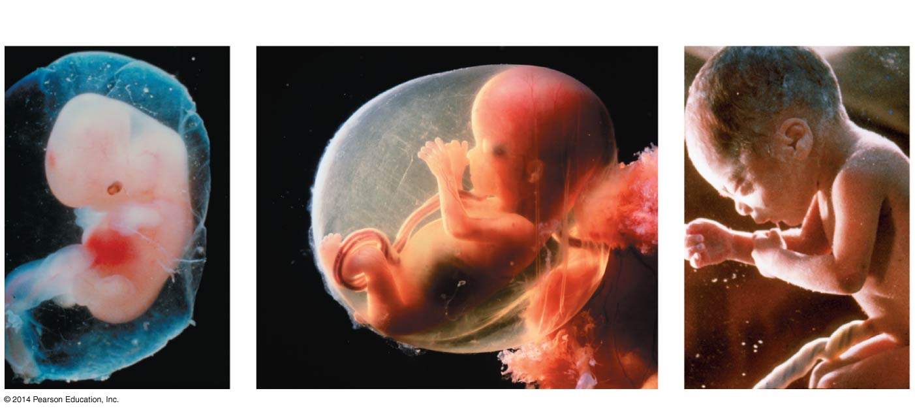
Figure 50.20
(a) 1st trimester
(b) 2nd trimester
(c) 3rd trimester
Notes:
Figure 50.20 Development of the Human Fetus Can Be Divided into Three Trimesters.

Slide 104
How Does the Mother Nourish the Fetus?
In oviparous and ovoviviparous species, mothers produce relatively large eggs that contain all of the nutrients and fluids that the embryo needs to develop until hatching
In viviparous species, on the other hand, eggs are small and contain almost no nutrients. Instead, the developing embryo is dependent on the mother for oxygen, chemical energy in the form of sugars, amino acids, and other raw materials for growth, and waste removal
Many adaptations exist that accommodate these needs

Slide 105
The Fetus Demands Oxygen and Nourishment
During pregnancy, the mother’s respiratory and circulatory change to meet the oxygen and nourishment demands of the fetus
A mother’s blood volume and heart-pumping capacity increase greatly, as do her breathing rate and volume
Blood vessels dilate to increase blood supply and lower blood pressure
In another adaptation, the fetus’s blood always has a higher affinity for oxygen than does the mother’s blood. The high oxygen affinity of fetal hemoglobin ensures that the fetus is always able to acquire oxygen from the mother

Slide 106
The Fetus Demands Oxygen and Nourishment
The mother’s breathing rate and volume increases, providing more oxygen to the fetus
The mother’s heart has enlarged and beats faster
The gas exchange efficiency is increased
Mothers and embryos exchange more than nutrients and wastes—they can also exchange dangerous molecules
This is due to the villi of the fetus’s blood vessels in the placenta providing a large surface area for exchange of gases and waste products

Slide 107
Toxic Chemicals Can Also Be Transferred
Compared to children of mothers who do not drink alcohol, children of mothers who imbibe ethanol are at high risk for hyperactivity, severe learning disabilities, and depression
Collectively, these symptoms are termed fetal alcohol syndrome (FAS)

Slide 108
Toxic Chemicals Can Also Be Transferred
Experiments with alcohol in newborn rats illustrate that alcohol consumption in early development can lead to degeneration of brain neurons
The messages of these data are as follows:
Ethanol destroys growing neurons
Even a single, “moderate” dose of alcohol can have a devastating effect

Slide 109
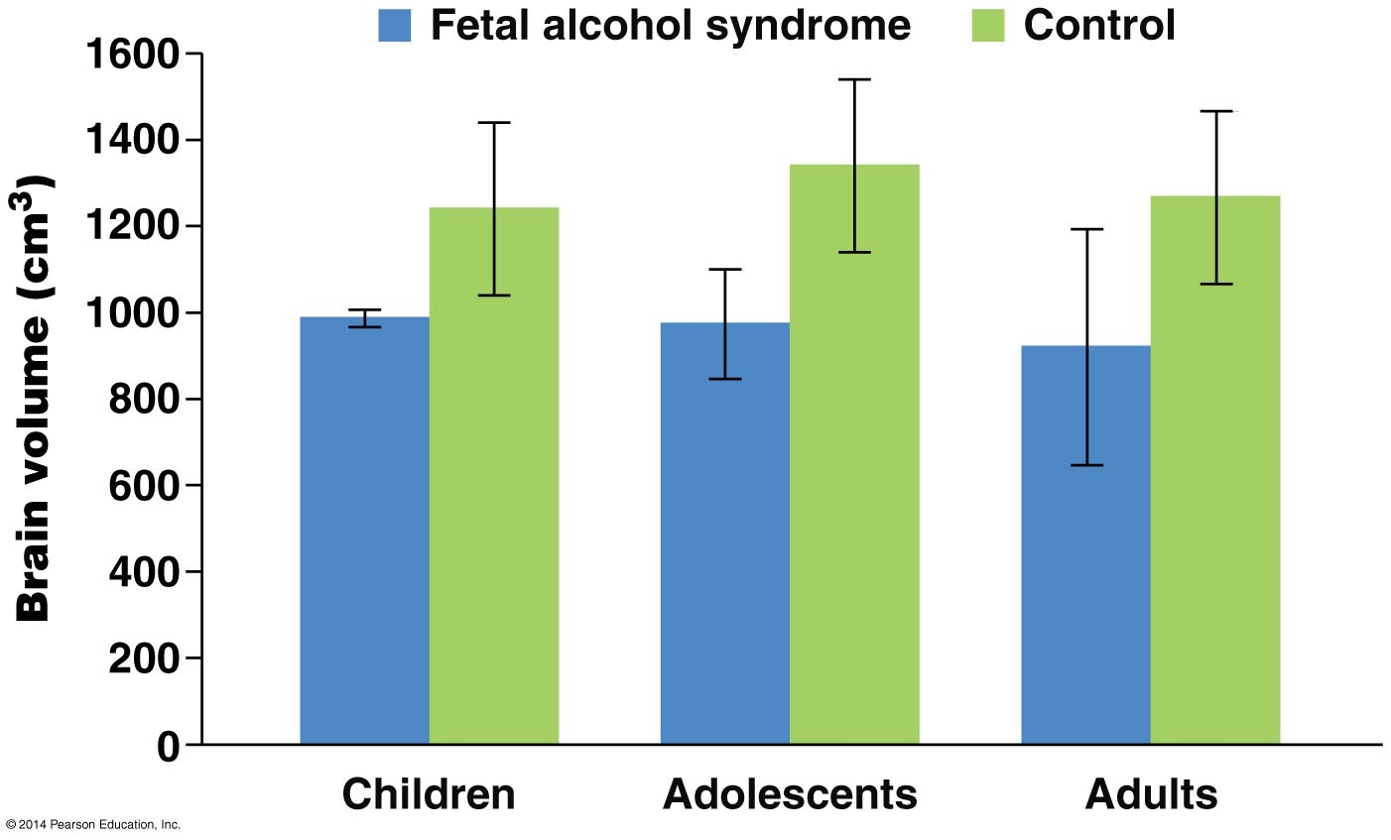
Figure 50.22
Notes:
Figure 50.22 Patients with Fetal Alcohol Syndrome Have Reduced Brain Size.
© 2000 AAAS http://www.sciencemag.org/content/287/5455/1056.abstract

Slide 110
Countercurrent Flow
Sheep exhibit an adaptation known as countercurrent flow
There is a countercurrent flow in the placenta between the mother’s blood and the blood of the fetus
This type of flow maintains a concentration gradient that promotes the exchange of gases, nutrients, and wastes

Slide 111
Human Birth
The pituitary hormone oxytocin is important in stimulating smooth-muscle cells in the uterine wall to begin labor—the contractions that expel the fetus from the mother’s body
Three steps that lead to birth:
Dilation of the cervix
Delivery of the infant
Delivery of the placenta

Slide 112
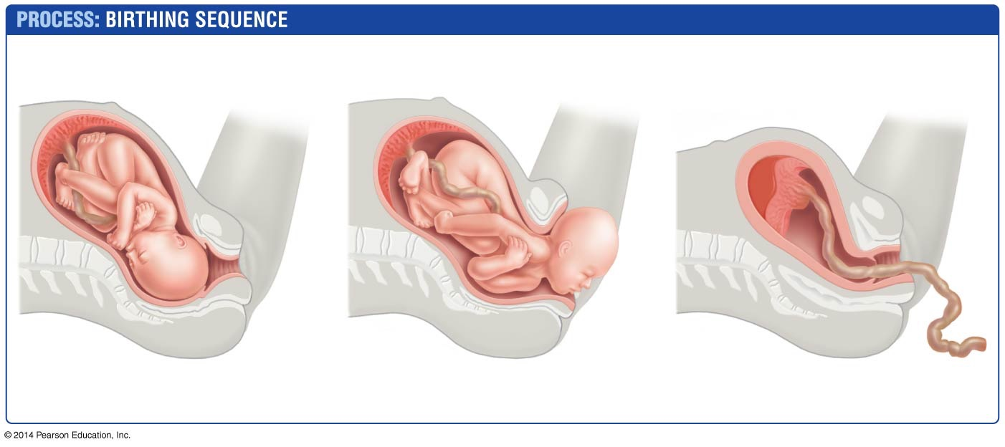
Figure 50.23
Umbilical cord
Placenta
(detaching
from uterus)
Placenta
Uterus
Cervix
Umbilical
cord
1. Dilation of cervix
2. Expulsion: delivery
of the infant
3. Delivery of placenta
Notes:
Figure 50.23 Human Birth Occurs in Three Stages.

Slide 113
Childbirth Can Involve Complications
Records of Swedish mothers who died in childbirth were kept between 1760 and 1980
In 1760, approximately 1.4 mothers died for every 100 infants successfully delivered, usually due to blood loss or infection following delivery
The steepest drop in mortality rate occurred with the introduction of hand-washing in the late 1870s
As a result of sterile techniques, antibiotics, and blood transfusion technology, Sweden’s mortality rate has now declined to less than 0.007%
As a result, the sterile techniques have been applied worldwide, or least where they are available

Slide 114
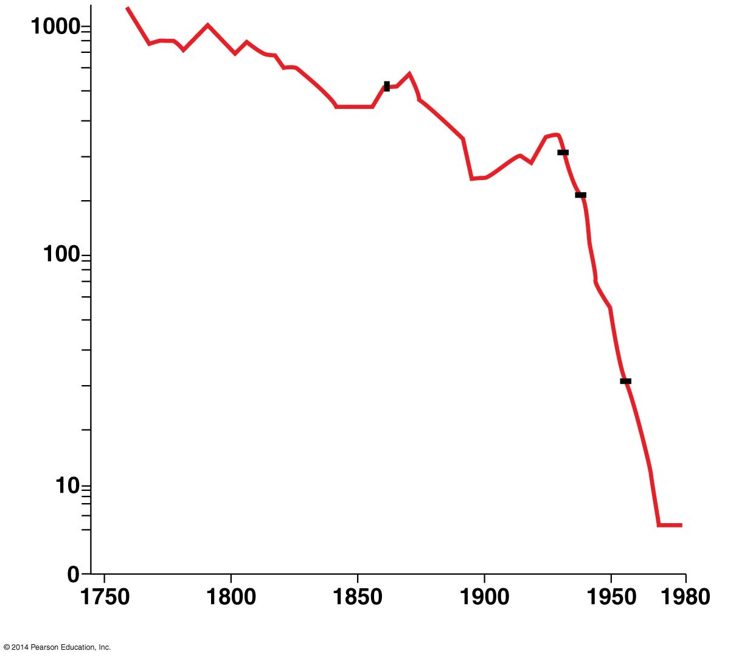
Figure 50.24
First data on efficacy of hand-
washing when assisting birth
First
antibiotics
(sulfa drugs)
Penicillin; first
blood transfusions
Maternal mortality per 100,000 live births
90% of mothers
receive prenatal
care
Year
Notes:
Figure 50.24 Maternal Mortality in Childbirth Has Decreased Dramatically.

