Slide 1
FISH270
Lecture 5

Slide 2
Reminders

Slide 3
Monday

Slide 4
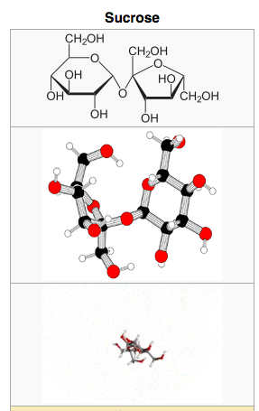
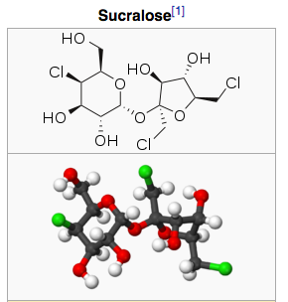
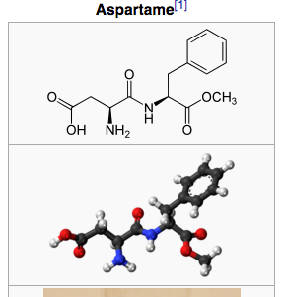
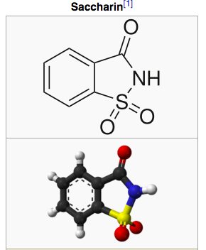

Slide 5
Metazoan centric

Slide 6
small things

Slide 7
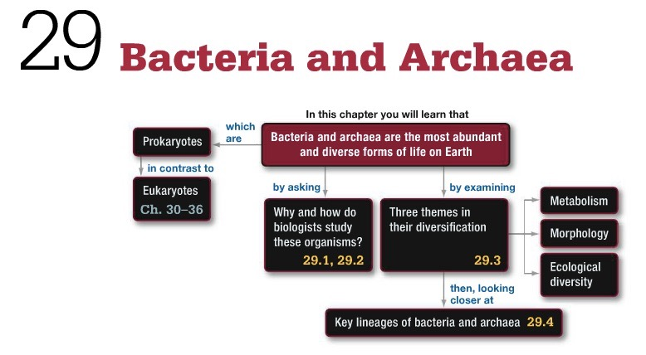

Slide 8
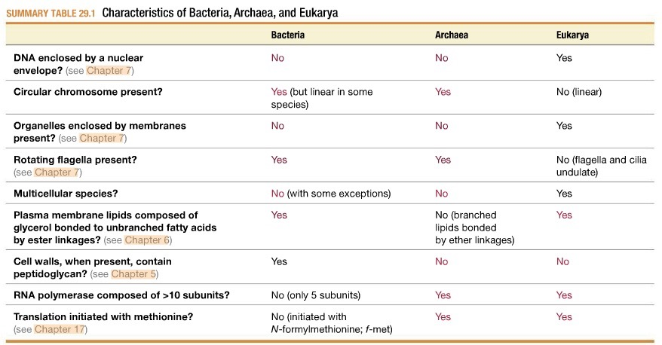

Slide 9
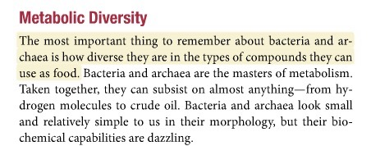
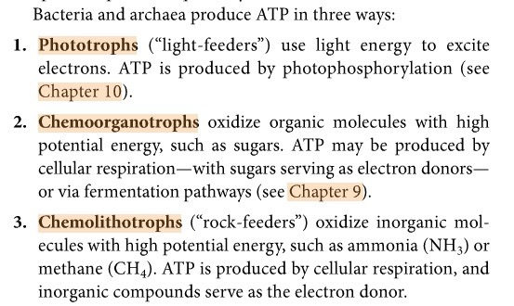

Slide 11
Nutrition

Slide 12
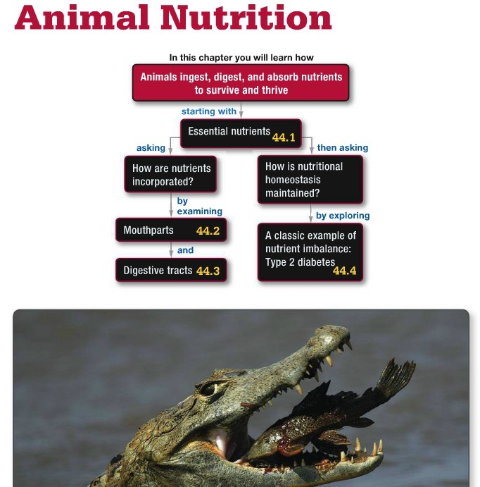

Slide 13
Introduction to Animal Nutrition
Animals have two basic requirements:
Chemical energy from ATP
Carbon-containing molecules
Animals are heterotrophs
They obtain the energy and nutrients they need from other organisms rather than making their own food as plants do
Four processes are needed to obtain energy from food:
Ingestion, digestion, absorption, and elimination

Slide 14
Requirements for Life
Chemical energy for synthesizing ATP
Carbon containing compounds for building complex macromolecules

Slide 15
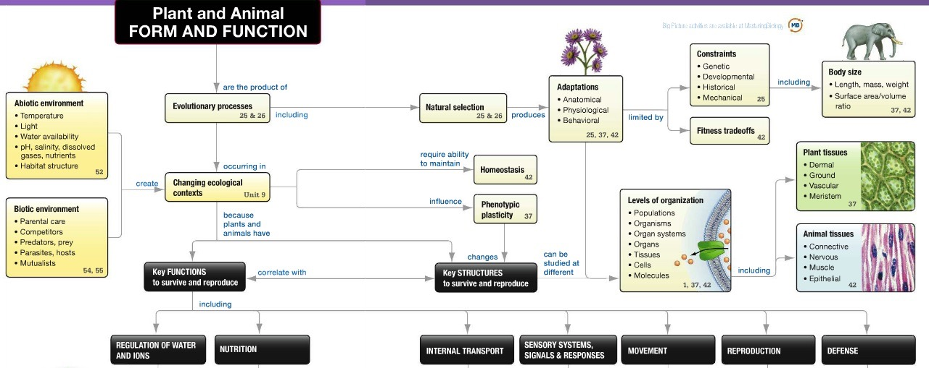
Big Picture

Slide 16

Big Picture

Slide 17
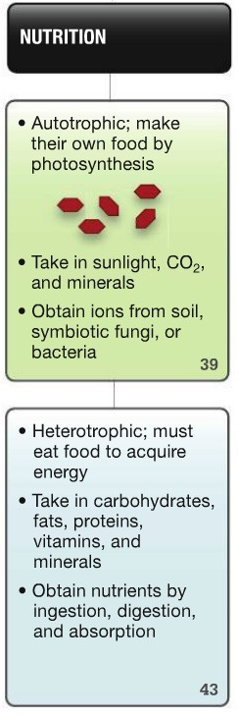
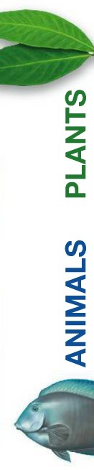
Big Picture

Slide 18
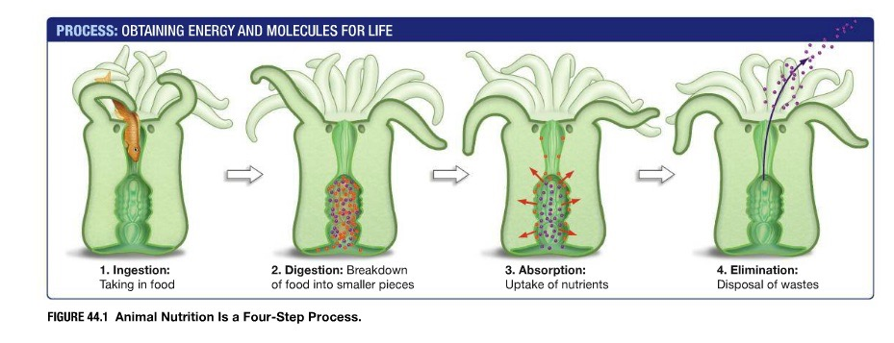

Slide 19
Nutritional Requirements
Animals get the chemical energy and carbon-containing building blocks they need from carbohydrates and fats
Food is any material that contains nutrients
Animals as well as humans require other nutrients
Nutrients are substances an organism needs to remain alive, such as
Amino acids, vitamins, minerals, and electrolytes

Slide 20
Essential Nutrients
Of the 20 amino acids, 12 can be made
The so-called essential amino acids cannot be synthesized by humans and must be obtained from food
Vitamins are organic compounds that are vital for health but are required only in minute amounts
Vitamins function as coenzymes

Slide 21
Essential Nutrients
Minerals are important components of cofactors or structural materials, such as Ca, Fe, and Mg
Electrolytes are inorganic ions that influence osmotic balance
Are required for normal membrane function
Although not considered by many as a nutrient, water is important

Slide 22
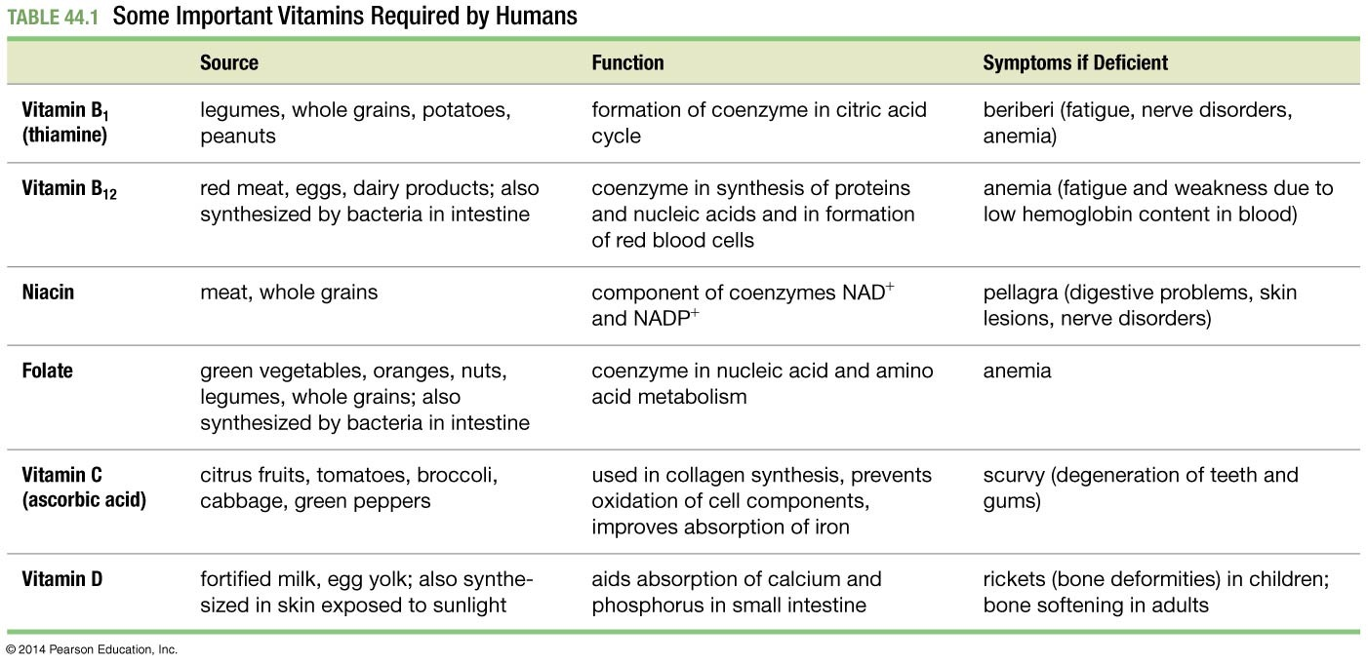
Table 44.1
Notes:
Table 44.1 Some Important Vitamins Required by Humans

Slide 23
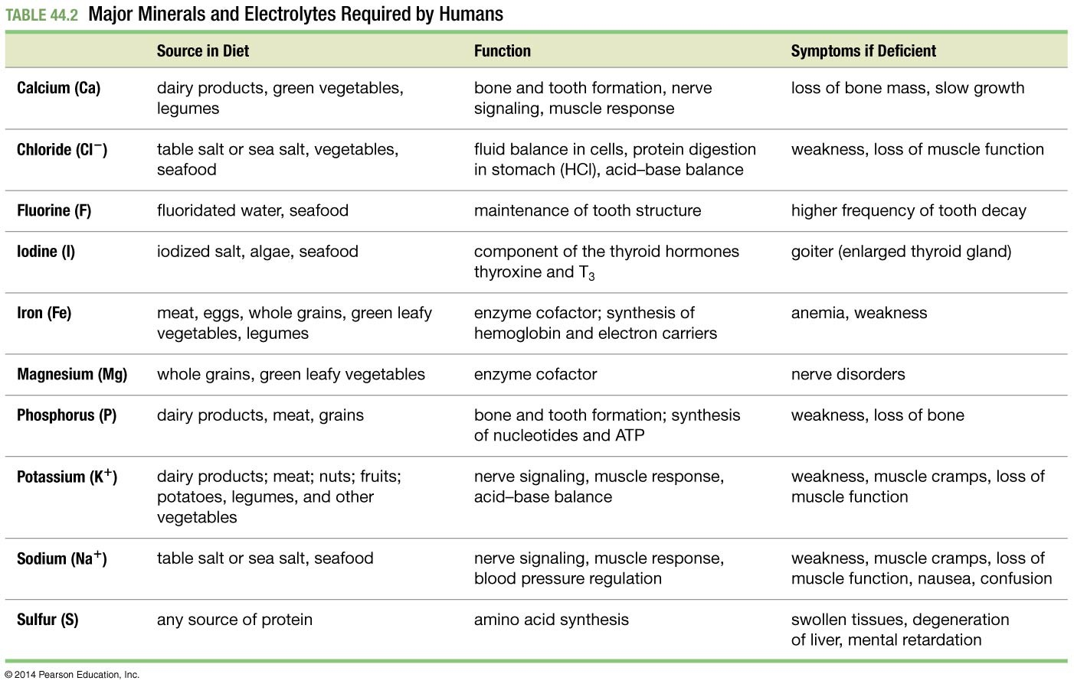
Table 44.2
Notes:
Table 44.2 Major Minerals and Electrolytes Required by Humans

Slide 24
Capturing Food: The Structure of Mouthparts
Biologists assign animal food-getting techniques to one of four strategies:
Suspension feeders filter small organisms or bits of organic debris from water, by means of cilia, mucus- lined “nets,” or other structures
Deposit feeders swallow organic-rich sediments and other types of deposited material
Fluid feeders suck or lap up fluids
Mass feeders seize and manipulate chunks of food by using jaws, teeth, beaks, or special toxin-injecting organs

Slide 25
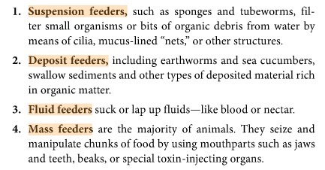
Capturing Food

Slide 26
Mouthparts as Adaptations
Natural selection has tightly matched the structure of animal mouthparts to their method of obtaining food
Evolution is not progressive—animal mouthparts do not get “better” over time in the sense of being more complex
Adaptation is not perfect—some structures are actually maladaptive

Slide 27
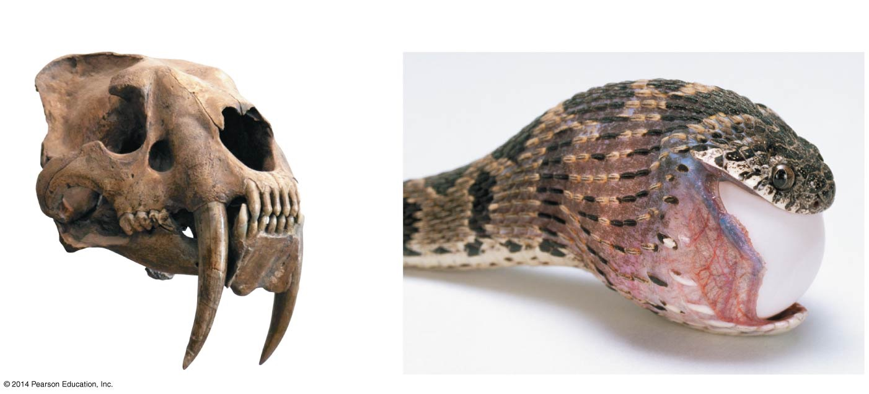
Figure 44.2
(a) The large canines of saber-toothed
cats stabbed and sliced prey.
(b) A highly mobile cranium and jaws allows snakes
to swallow large prey whole.
Notes:
Figure 44.2 Mouthpart Structure Correlates with Function.

Slide 28
Mouthparts and Adaptations
One example of natural selection is the mammal, which must chew its food
A variety of tooth shapes used to achieve this function
Other adaptations are the skull, jawbone, and related muscles

Slide 29
A Case Study: The Cichlid Jaw
The correlation between the mouthpart morphology and the size and shape of food can be seen in the structure and function of jaws and teeth in the cichlid fishes that inhabit the Rift Lakes of East Africa
These fish exemplify adaptive radiation
The diversification of a single ancestral lineage into many species, each of which lives in a different habitat or employs a distinct feeding method
For example, Lake Victoria is home to 300 endemic cichlids—meaning species that live nowhere else

Slide 30
A Case Study: The Cichlid Jaw
Most of these species feed on a specific item, but as a group they exploit almost every conceivable food source in the lake
Planktonic organisms, algae on rocks, algae with leaflike blades, eggs, fish scales, fish fins, whole fish, plants, insects, and snails

Slide 31
A Case Study: The Cichlid Jaw
The cichlids can exploit so many food sources because they have an extra set of pharyngeal jaws located behind the normal oral jaws
Non-cichlid fishes have jaws behind the mouth opening also (pharyngeal jaws)
But use the pharyngeal jaw only to move food down into the throat

Slide 32
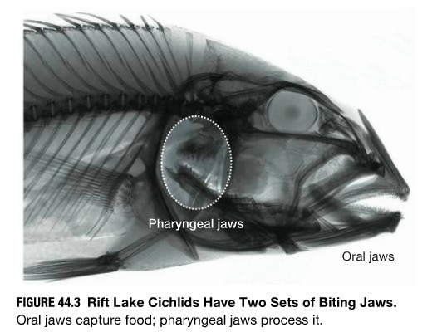
Cichlid Jaw
Adaptive Radiation

Slide 33
The Cichlid Pharyngeal Jaw
How can one closely related group of fish exploit different food sources?
The pharyngeal jaw is attached to the skull
Muscles of the lower jaw allow it to move up against the upper jaw
Have a set of specialized tooth structures that are adapted to the type of food

Slide 34
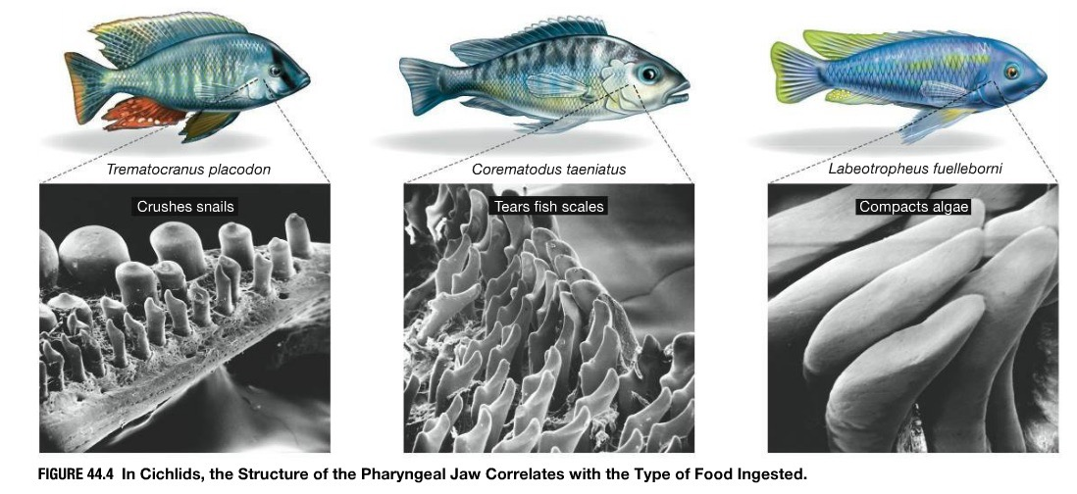
Cichlid Jaw
Adaptive Radiation

Slide 35
Digestion and Absorption

Slide 36
How Are Nutrients Digested and Absorbed?
Digestion is the breakdown of food into small enough pieces to allow for absorption—the uptake of nutrients
Digestion occurs in a tube like structure known as the gastrointestinal tract (GI tract)
Absorption takes place through the membranes of the cells of the GI tract
Along the GI tract are glands that secrete enzymes that break down the food into small enough molecules to be absorbed

Slide 37
An Introduction to the Digestive Tract
Digestion takes place in the digestive tract—also called the alimentary canal or gastrointestinal (GI) tract
Beginning at the mouth and ending at the anus

Slide 38
An Introduction to the Digestive Tract
Digestive tracts come in two general designs:
Incomplete digestive tracts
Have one opening for both ingestion of food and elimination of wastes
Digestion takes place in a gastrovascular cavity
Complete digestive tracts
Have two openings, the mouth for ingestion, and the anus, for elimination of wastes
In addition to the GI tract, several auxilary organs contribute to the digestion process

Slide 39
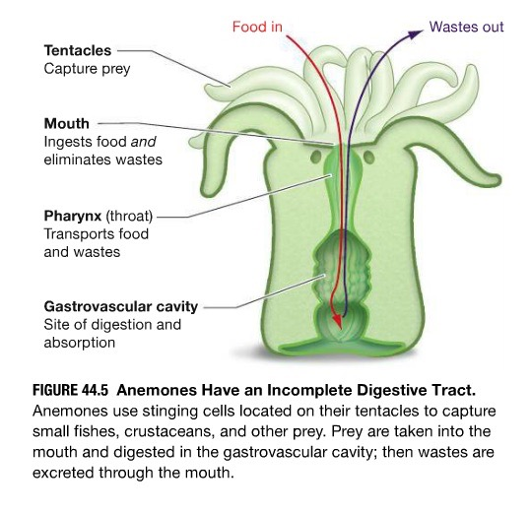
Digestion and Absorption

Slide 40
The Complete Digestive Tract
Complete digestive tracts
Have two openings—they start at the mouth and end at the anus
The interior of this tube communicates directly with the external environment via these openings

Slide 41
The Complete Digestive Tract
Complete digestive tracts have three advantages:
Animals can feed on large pieces of food
Chemical and physical processes can be separated within the canal, so that they occur independently of each other and in a prescribed sequence
Material can be ingested and digested continuously. The flow of the food is in one direction

Slide 42
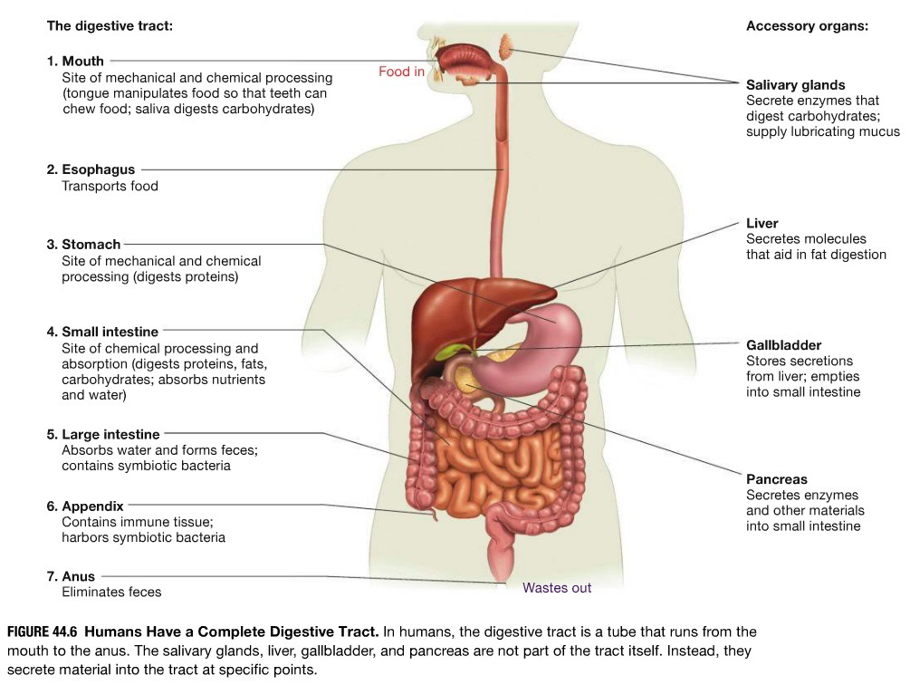
Digestion and Absorption

Slide 43
Overview of the Digestive Process
Digestion begins in the mouth, starting with the tearing and crushing activity of teeth during chewing
Protein digestion begins in the acid environment of the stomach
Each of the three major types of macromolecules—carbohydrates, lipids, and proteins—must be broken down during digestion
This chemical processing, started in the mouth, continues in the stomach and finishes in the small intestine

Slide 44
Overview of the Digestive Process
The small molecules that result from this digestion are absorbed in the small intestine, along with water, vitamins, and ions
More water is absorbed in the large intestine, producing feces that eventually exit the body at the anus

Slide 45
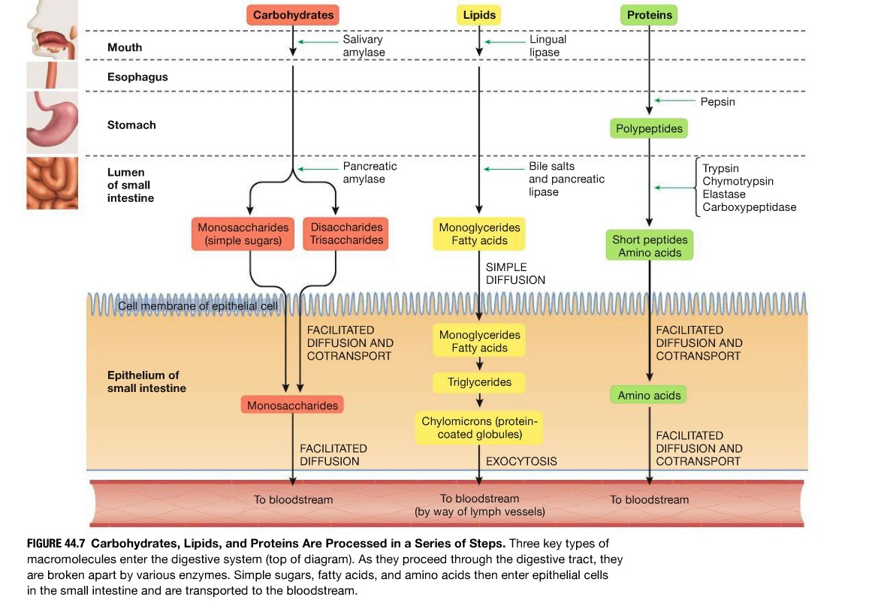

Slide 46
The Mouth and Esophagus
Digestion begins in the mouth
Salivary amylase begins the breakdown of carbohydrates
Starches break down to sugar
Salivary glands in the mouth release water and glycoproteins called mucins
When mucins contact water, they form the slimy substance called mucus
The mucus allows for food to be swallowed
Cells in the tongue also secrete lipase, which begins the breakdown of lipids

Slide 47
The Mouth and Esophagus
Food then enters the esophagus—a muscular tube connecting the mouth and stomach—and is propelled to the stomach by a wave of muscle contractions called peristalsis
The system is a reflex—an automatic reaction to a stimulus—that is stimulated by the act of swallowing

Slide 48
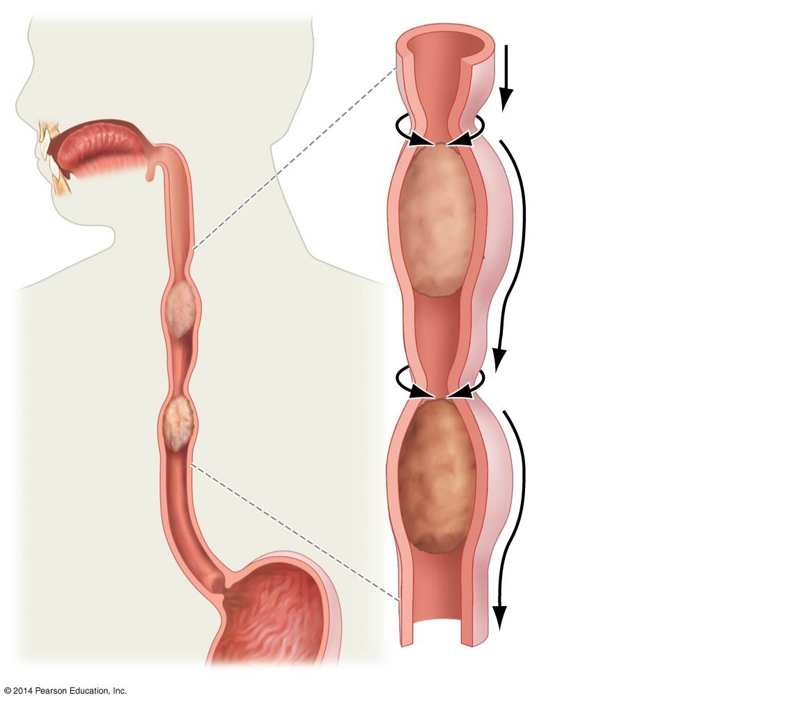
Figure 44.8
1. Muscle constricts
esophagus above
food
2. Muscle
contraction
moves like a
wave down the
esophagus,
pushing the food
below it into the
stomach
Notes:
Figure 44.8 In the Esophagus, Peristalsis Transports Food to the Stomach.

Slide 49
The Stomach
The stomach is
A tough, muscular pouch
Bracketed on both ends by valves called sphincters
When food enters the stomach, muscular contractions result in churning that mixes and breaks down the food mechanically

Slide 50
The Stomach
The lumen of the stomach is highly acidic; the predominant acid in the stomach is hydrochloric acid (HCl)
Protein digestion begins in the stomach
Much of the knowledge of digestion in the stomach came from Dr. Beaumont, who nursed a gunshot victim (whose wound left a hole into the stomach) back to health

Slide 51
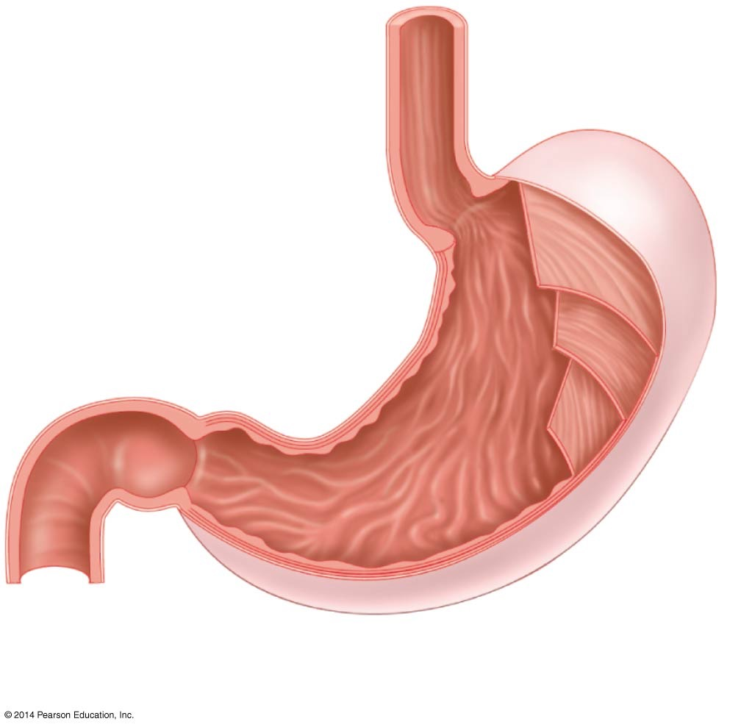
Figure 44.9
Bottom of esophagus
Sphincter seals off
stomach from esophagus
Sphincter seals off
stomach from small
intestine
Layers
of muscle
Beginning of
small intestine
Lumen
(interior)
Notes:
Figure 44.9 The Stomach Is a Muscular Pocket of the Digestive Tract.

Slide 52
The Stomach as a Site of Protein Digestion
Churning mixes the food with gastric juice, which contains hydrochloric acid (HCl) and the enzyme pepsin to begin the digestion of proteins
Specialized stomach cells called chief cells contain a pepsin precursor called pepsinogen that is converted to pepsin in the presence of the HCl
Secretion of a protein-digesting enzyme in inactive form is important
It prevents destruction of proteins in the cells where the enzyme is synthesized

Slide 53
Which Cells Produce Stomach Acid?
The stomach epithelium contains several types of secretory cells, each of which is specialized for a particular function
Parietal cells are the source of HCl in gastric juice
Gastric juice can have a pH as low as 1
This acid condition helps to denature the proteins aiding in their digestion
Mucous cells secrete mucus, which lines the gastric epithelium and protects the stomach from damage by HCl

Slide 54
Parietal Cells Secrete HCl
The enzyme carbonic anhydrase is found in high concentration in parietal cells
This enzyme catalyzes the formation of carbonic acid (H₂CO₃), which immediately dissociates into the bicarbonate ion (HCO₃–) and a proton:
CO₂ + H₂O ↔ H₂CO₃ ↔ H⁺ + HCO₃–

Slide 55
Parietal Cells Secrete HCl
The protons formed by the dissociation of carbonic acid are actively pumped into the lumen of the stomach
The proton (H+ ion) is combined with the Cl– from the blood which is transported into the lumen via Cl– channel

Slide 56
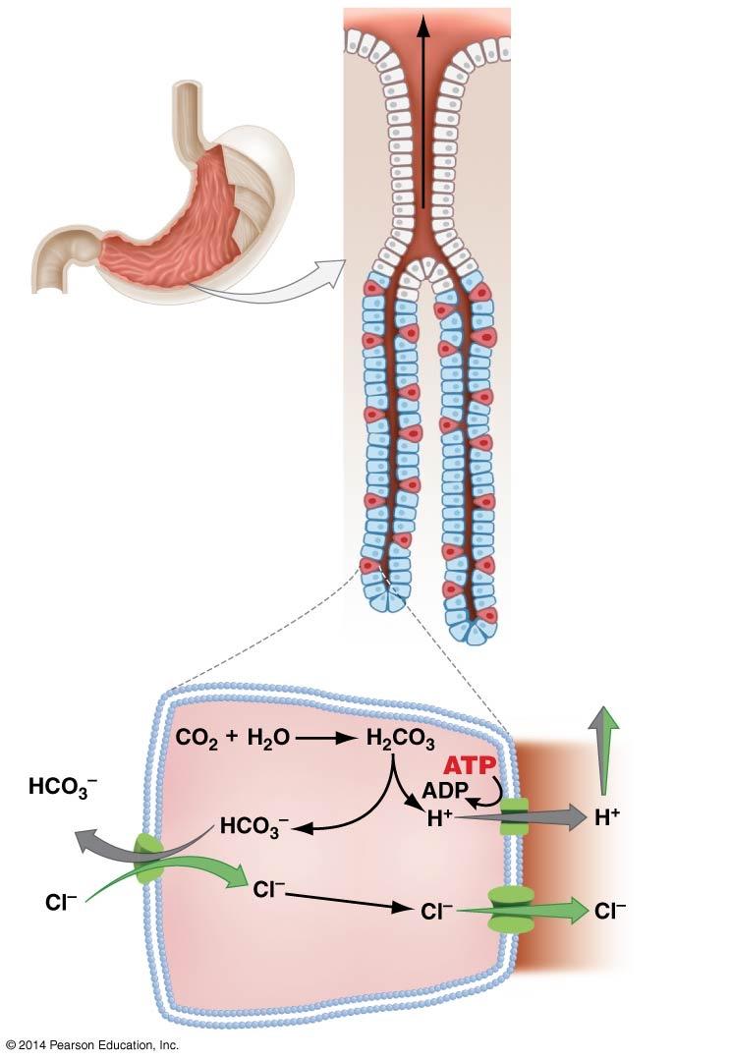
Figure 44.10
(a) Secretory cells in
the stomach lining
Canal empties into
lumen of stomach
Stomach
Mucous cells
Chief cells
(secrete
pepsinogen)
Parietal cells
(secrete HCI)
(b) Secretion of HCI
by parietal cells
HCI to lumen
of stomach
(to blood)
Proton pump
(from blood)
Chloride channel
Parietal cell
Notes:
Figure 44.10 Cells in the Stomach Lining Secrete Mucus, Pepsinogen, and Hydrochloric Acid.

Slide 57
The Small Intestine
Partially digested food passes from the stomach into the small intestine, a six-meter-long tube
The food mixes with secretions from the pancreas and liver and begins to move through the tube
At the end of the small intestine, digestion is complete and most nutrients—along with much water—have been absorbed
The small intestine has an enormous surface area for absorption of nutrients due to projections called villi
Villi have projections called microvilli

Slide 58
The Small Intestine
The enormous surface area of the small intestine increases the efficiency of nutrient absorption
Because each villus contains blood vessels and a lymphatic vessel called a lacteal, nutrients pass quickly from epithelial cells into the body’s transport systems

Slide 59
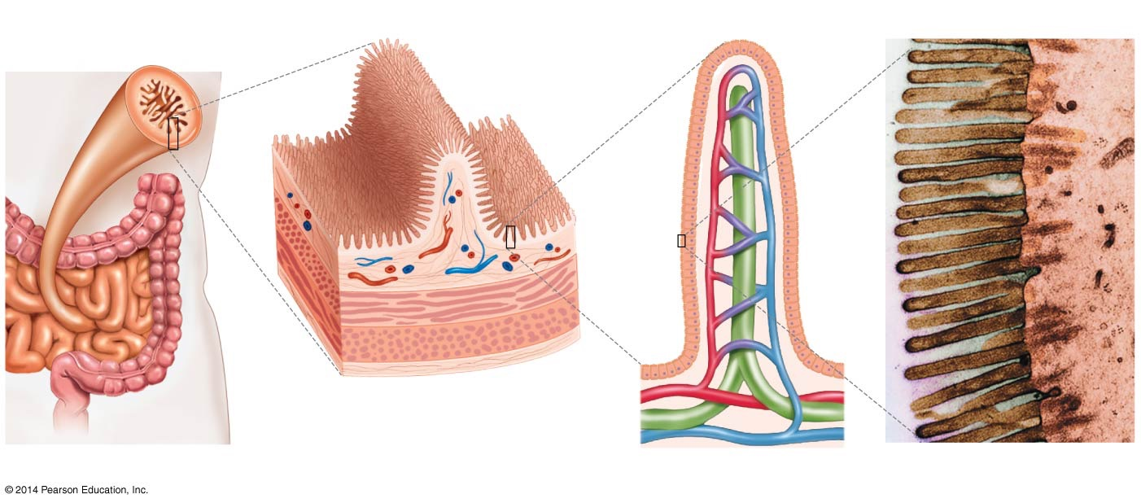
Figure 44.12
Cross section
of small
intestine
Fold
Villus
Microvilli
Epithelial
cell
Villi
Muscle
Epithelial
cells
Blood vessels
0.5 μm
Lacteal
(lymphatic
vessel)
Notes:
Figure 44.12 The Small Intestine Has an Extremely Large Surface Area.

Slide 60
The Digestion of Proteins
Due to the highly acidic nature of the stomach, the secondary and tertiary structure of proteins are broken down
The enzyme pepsin breaks down the peptide bonds between amino acids of proteins

Slide 61
The Digestion of Proteins
Enzymes (from the pancreas) in the small intestine called proteases digest polypeptides to monomers
There are many types of proteases, each specific for a different kind of polypeptide
Proteases are synthesized in inactive form by the pancreas, transferred through the pancreatic duct to the small intestine, and activated there
Pancreatic enzymes are activated by another enzyme known as enterokinase

Slide 62
Regulating the Pancreatic Enzymes
Enterokinase activates a pancreatic enzyme called trypsinogen by phosphorylating it, resulting in the active enzyme trypsin
Trypsin, in turn, activates other enzymes that are synthesized by the pancreas and secreted in an inactive form
Each enzyme begins cleaving specific peptide bonds
Eventually polypeptides are broken up into amino acid monomers

Slide 63
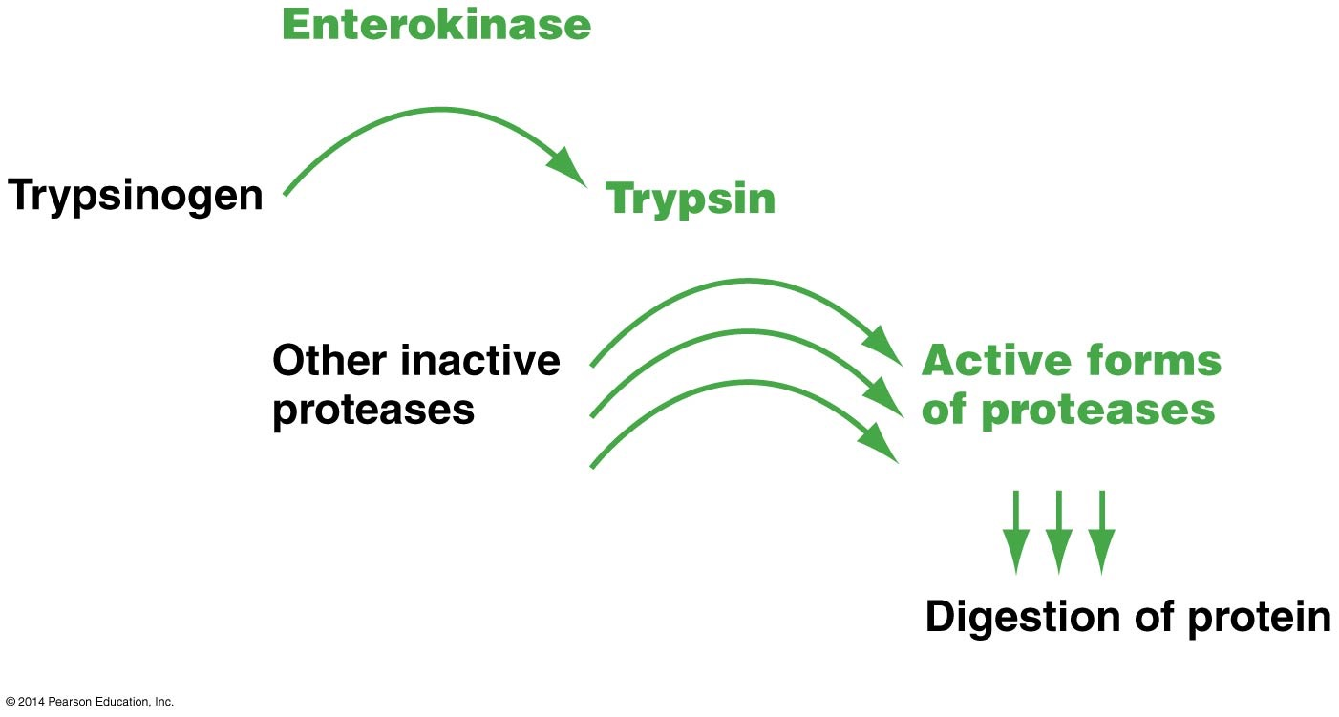
Figure 44.13
(in small intestine)
(from pancreas)
(in small intestine)
(from pancreas)
(in small intestine)
(in small intestine)
Notes:
Figure 44.13 Enterokinase Triggers an Enzyme-Activation Cascade in the Small Intestine.

Slide 64
What Regulates the Release of Pancreatic Enzymes?
The hormone secretin is produced in the small intestine in response to the arrival of food from the stomach
Secretin’s primary function is to induce a flow of bicarbonate ions from the pancreas to the small intestine
Bicarbonate neutralizes the acid arriving from the stomach

Slide 65
What Regulates the Release of Pancreatic Enzymes?
A second hormone, cholecystokinin, stimulates secretion from the liver and gall bladder
These enzymes aid in the digestion of lipids
Gastrin is a hormone found in the stomach; gastrin stimulates the secretion of the HCl

Slide 66
Carbohydrates: Digestion and Transport
The pancreas also produces enzymes for the digestion of DNA, RNA, and carbohydrates
Nucleases digest the RNA and DNA
Pancreatic amylase continues the digestion of carbohydrates
It is logical to predict two general principles about nutrient absorption:
It is highly selective; proteins in the plasma membranes of microvilli transport nutrients into cells
It is active transport

Slide 67
Carbohydrates: Digestion and Transport
Glucose is transported into the epithelial cells via a Na⁺-glucose cotransporter
Inspiring a three-step model for glucose absorption, the same mechanism used in the proximal tubule of the kidney
Na⁺/K⁺-ATPase in the basolateral membrane of epithelial cells generate an electrochemical gradient that favors Na⁺ entry
Glucose enters the cell along with sodium via the cotransporter
Glucose diffuses into nearby blood vessels through a glucose carrier in the basolateral membrane

Slide 68
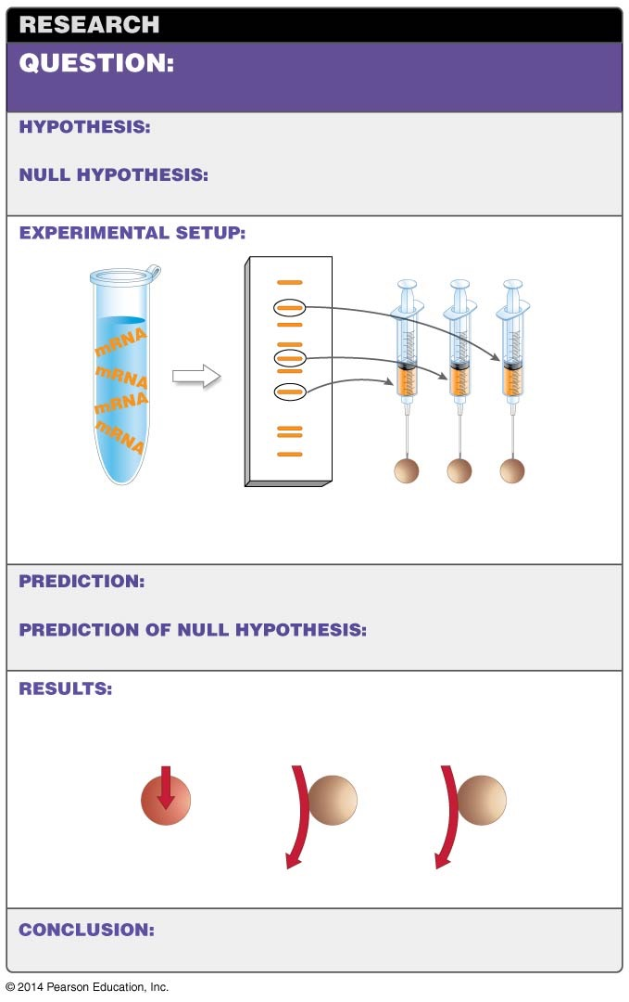
Figure 44.14
How is glucose transported into
epithelial cells of the small intestine?
Glucose enters epithelial cells along with sodium
ions via a Na⁺-glucose cotransporter protein.
Glucose transport does not depend on Na⁺
transport.
1. Purify mRNA.
2. Separate
mRNAs.
3. Inject individual
mRNAs into frog eggs.
An egg will be able to absorb Na⁺ and glucose, because
it received the mRNA that codes for the Na⁺-glucose cotransporter.
None of the eggs will be
able to absorb Na⁺ and glucose.
Na⁺,
glucose
in medium
Na⁺,
glucose
in medium
Na⁺,
glucose
in medium
Egg 1
Egg 2
Egg 3
ABSORBED
Not absorbed
Not absorbed
The egg that absorbs Na⁺ and glucose received the
mRNA from the Na⁺-glucose cotransporter gene.
Notes:
Figure 44.14 The Experimental Protocol for Locating the Na⁺-Glucose Cotransporter Gene.

Slide 69
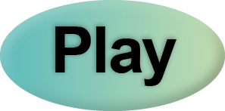
The Digestion and Absorption of Food
Web Activity: The Digestion and Absorption of Food

Slide 70
Digesting Lipids: Bile and Transport
The pancreatic secretions include digestive enzymes that act on fats as well as proteins and carbohydrates
Pancreatic lipase
Breaks certain bonds present in complex fats
Results in the release of fatty acids and other small lipids
Hydrophobic fats tend to enter the small intestine in large globules that must be broken up (emulsified) before digestion can begin

Slide 71
Digesting Lipids: Bile and Transport
Emulsification results from the action of small lipids, bile salts synthesized in the liver and secreted in a complex solution called bile
Bile is stored in the gallbladder
When bile enters the small intestine, it raises the pH and emulsifies the fat into small globules
Pancreatic lipase breaks bonds in the complex fats, resulting in the release of fatty acids and other small lipids

Slide 72
Digesting Lipids: Bile and Transport
After the monoglycerides and fatty acids are released by lipase activity, they enter the epithelial cells attached to a protein named fatty-acid binding protein
Once inside the cell, they are processed into protein-coated globules called chylomicrons
Which diffuse into lacteals by the process of exocytosis

Slide 73
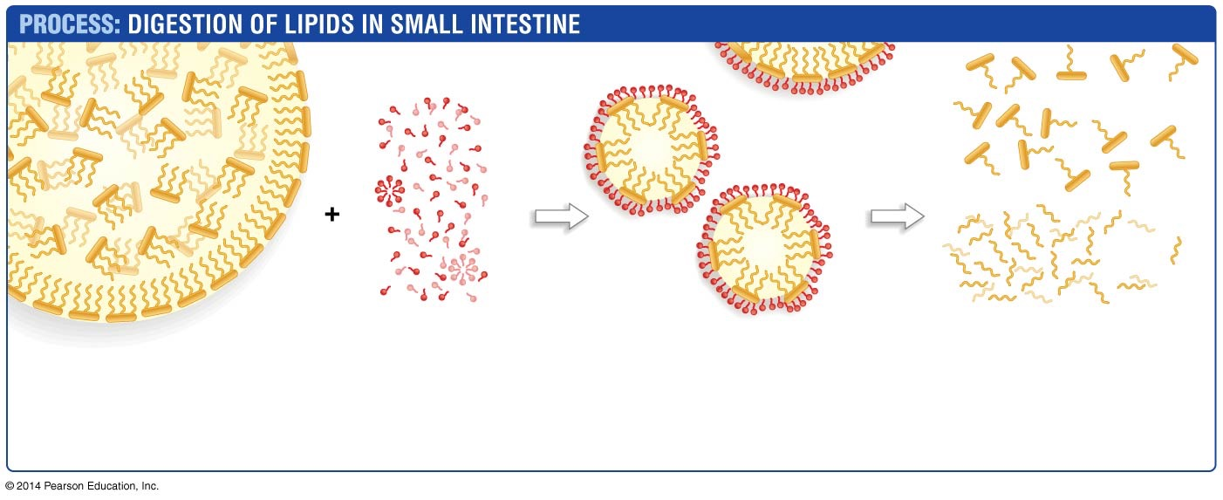
Figure 44.15
Monoglycerides
Lipase
Fatty
acids
1. Large fat globules
are not digested
efficiently by lipase.
2. Bile salts
(produced in liver)
act as emulsifying
agents.
3. Small fat
droplets result
from emulsification.
4. Lipase digests the
small fat droplets into
monoglycerides and
free fatty acids.
Notes:
Figure 44.15 Emulsifying Agents and Lipases Digest Lipids in the Small Intestine.

Slide 74
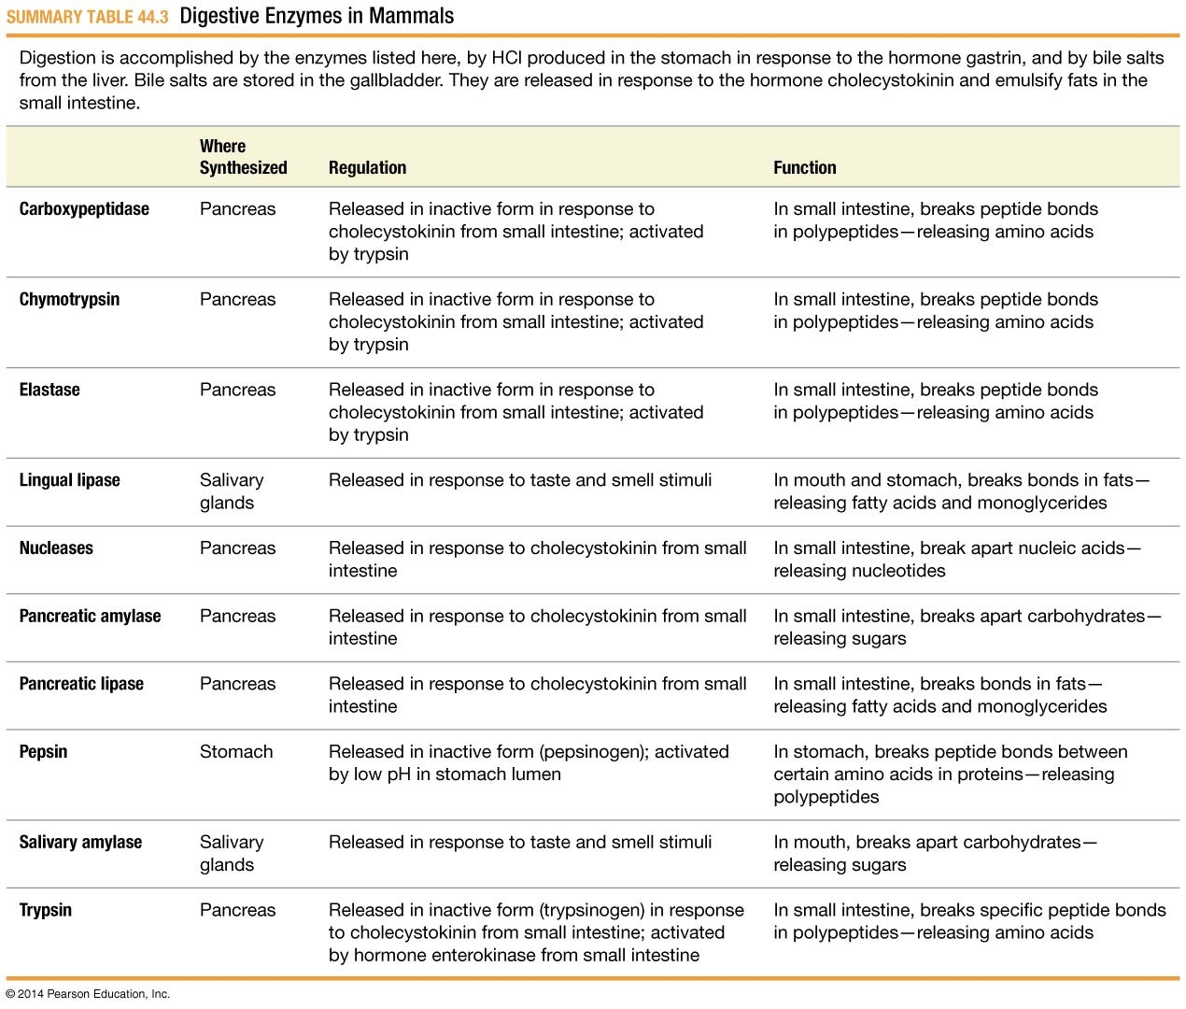
Table 44.3
Notes:
Table 44.3 Digestive Enzymes in Mammals

Slide 75
The Absorption of Water
When solutes from digested material are brought into the epithelium of the small intestine via active transport, water follows passively by osmosis
Some water is absorbed in order to form the feces
Water is absorbed in the large intestine through aquaporins

Slide 76
The Large Intestine: Cecum and Appendix
The cecum is
An outpocketing of the digestive tract
Located at the beginning of the large intestine
The fermentation chamber for processing cellulose

Slide 77
The Large Intestine: Cecum and Appendix
In humans, the cecum is dramatically reduced in size and functions in defense against invading bacteria and viruses
Because its size and function differ from those of a cecum, it is called the appendix
On an evolutionary note, the appendix is considered a vestigial organ, or it may store symbiotic organisms active in the colon

Slide 78
The Large Intestine
By the time digested material reaches the large intestine, a large amount of water and virtually all of the available nutrients have been absorbed
The primary function of the large intestine
Compact wastes that remain
Absorb enough water to form feces
These processes occur in the colon, the main section of the structure
Feces are held in the rectum, the final part of the large intestine, until they can be excreted

Slide 79
Aquaporins Play a Key Role in Water Reabsorption
The transmembrane water channels aquaporins play a major role in water movement in the large intestine
To date, the molecular mechanisms responsible for water absorption in the large intestine are not as well understood as are those in the collecting duct of nephrons

Slide 80
Variation in Structure and Function
It is not unusual for animal species to lack a colon and rectum entirely
In insects, the posteriormost portion of the gastrointestinal tract, called the hindgut, functions to reabsorb water and ions and form feces

Slide 81
Variation in Structure and Function
Among vertebrates, the various lineages of fish have no large intestine at all
Many plant-eating species have extremely large colons
In amphibians, reptiles, and birds, the urine that is produced by the kidneys, and the feces both empty into an enlarged portion of the large intestine called the cloaca

Slide 82
Nutritional Homeostasis―Glucose as a Case Study
When digestion is complete, amino acids, fatty acids, ions, and sugars enter the bloodstream and are delivered to the cells that need them
People with the disease diabetes mellitus experience abnormally high levels of glucose in their blood
The disease is caused by problems with a hormone called insulin

Slide 83
Insulin’s Role in Homeostasis
Insulin is produced in the pancreas when blood glucose levels are high
Cells increase their rate of glucose uptake and processing, decreasing blood glucose levels

Slide 84
Insulin’s Role in Homeostasis
If blood glucose levels fall too much, cells in the pancreas secrete a hormone called glucagon
In response to glucagon, cells in the liver catabolize glycogen and produce glucose via gluconeogenesis
The synthesis of glucose from non-carbohydrate compounds
As a result, glucose levels in the blood rise
Insulin and glucagon form a negative feedback system

Slide 85
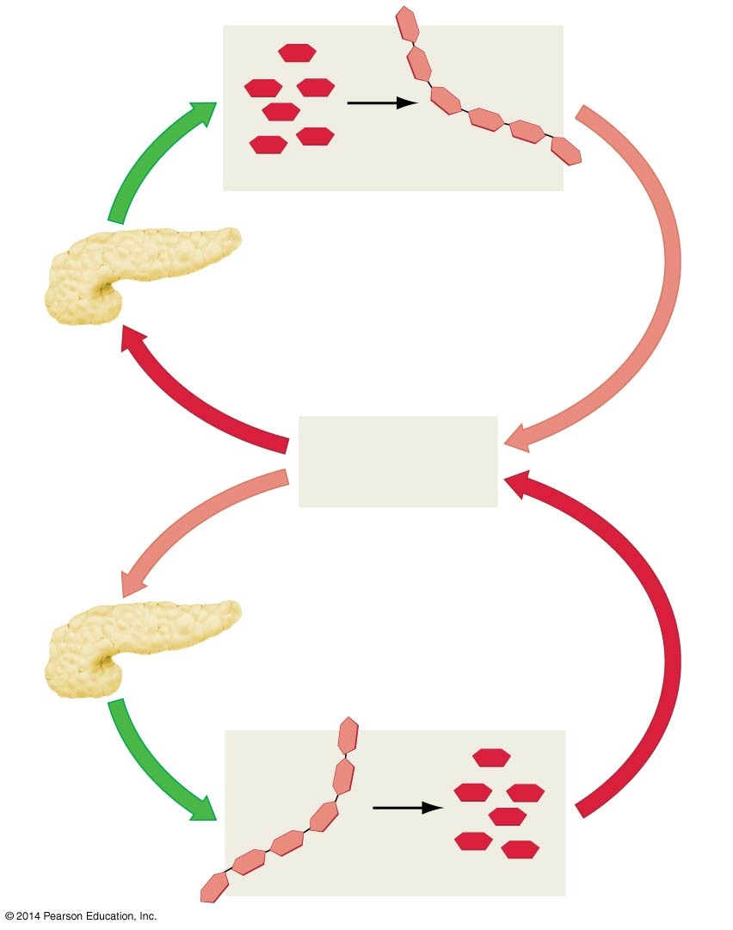
Figure 44.16
Glucose
Glycogen
Insulin stimulates cells in liver and
muscle to synthesize glycogen
Pancreas secretes
INSULIN
If glucose
level is too high
Glucose
level falls
Homeostasis
(normal glucose
levels in blood)
If glucose
level is too low
Glucose
level rises
Pancreas secretes
GLUCAGON
Glucagon stimulates cells in
liver to catabolize glycogen
Glycogen
Glucose
Notes:
Figure 44.16 Insulin and Glucagon Provide Negative Feedback in a Homeostatic System.

