Slide 1
FISH270 Aquatic Ecophysiology

Slide 2
Today
What is this class?
Why?
Logistics and Details
Biology

Slide 3
Instructors

Slide 4
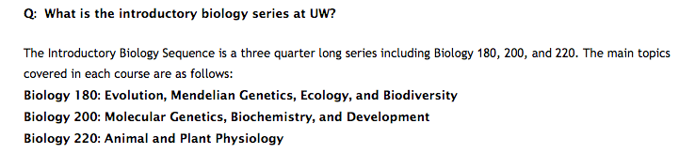

FISH270

Slide 5
Biology 180: Evolution, Mendelian Genetics, Ecology, and Biodiversity
Biology 200: Molecular Genetics, Biochemistry, and Development

Slide 6
What is different?
This course will teach fundamental aspects of biological form and function with an emphasis on highlighting the profound differences and similarities across taxa. The first half of the course will focus on primary physiological processes including energy metabolism, thermal biology, osmoregulation, and immune function. During the second half of the course we will apply the principles to specific case studies that are environment specific as we transition through terrestrial habitat, open ocean, coastal estuaries, polar and tropical ecosystems, and deep ocean.

Slide 7
It will be different

Slide 8
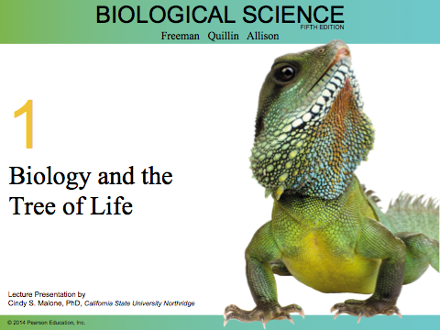
Some things will be similar.
Textbook

Slide 9
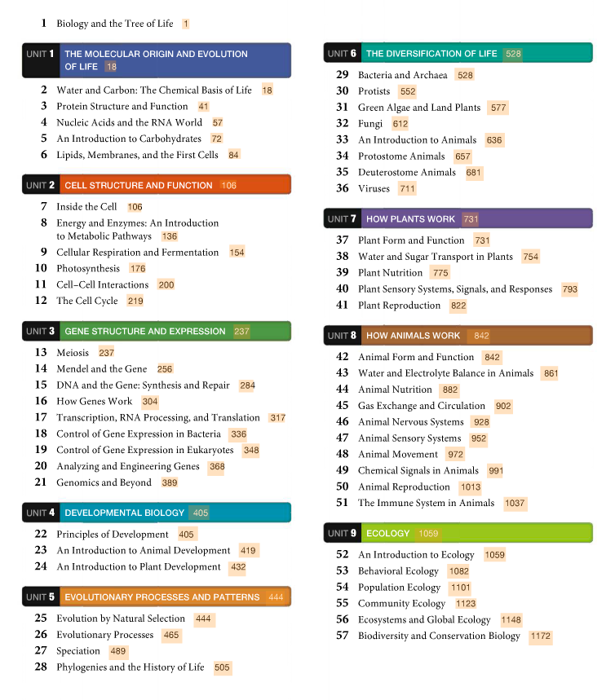

Slide 10
What works and and has not…

Slide 11
Canvas

Slide 12
Objectives This class aims to provide you with an understanding of basic physiological process and the ability to apply this knowledge to understand how diverse taxa, ranging from prokaryotes to mammals, live in diverse and changing environments.
Specific goals are:
• Describe how essential life processes (growth, reproduction) work and the common and unique challenges organisms face in different environments.
• Discriminate similarities and difference across taxa at the physiological level.
• Develop quantitative reasoning and skills in physiology and in biology in general
• Apply physiological principles to determine how a variety of organisms function in different aquatic environments.
• Synthesize scientific principles by effectively searching primary literature, collating information and presenting knowledge in a succinct fashion.
• Work collaboratively to reach solutions
• Assist the advancement of knowledge by evaluating peer contributions.
• Apply the use of microscopes and lab equipment in investigation in physiological experiments

Slide 13
Objectives This class aims to provide you with an understanding of basic physiological process and the ability to apply this knowledge to understand how diverse taxa, ranging from prokaryotes to mammals, live in diverse and changing environments.
Specific goals are:
• Describe how essential life processes (growth, reproduction) work and the common and unique challenges organisms face in different environments.
• Discriminate similarities and difference across taxa at the physiological level.
• Develop quantitative reasoning and skills in physiology and in biology in general
• Apply physiological principles to determine how a variety of organisms function in different aquatic environments.
• Synthesize scientific principles by effectively searching primary literature, collating information and presenting knowledge in a succinct fashion.
• Work collaboratively to reach solutions
• Assist the advancement of knowledge by evaluating peer contributions.
• Apply the use of microscopes and lab equipment in investigation in physiological experiments

Slide 14
Assessment
Exams (3) – 45%
Participation on Discussion Board 5%
Question Sets – 5%
Lab Worksheets - 20%
Special Project – 5%
Final Exam – 20%

Slide 15
Grading Scale

Slide 16
Late Policy: Assignments will not be accepted after due date.
Exams: Material on the exams will be from information presented in lecture, lab, and from the assigned readings. The three exams will consist of:
• Multiple choice
• Short answer
• Short essay
• Sketches / drawings
The final exam will be comprehensive
Participation on Discussion board should be at least 2 posts per week.

Slide 17
More Policies
Attendance - Students are individually responsible for all information presented in lectures, and readings. No make-up exams will be allowed.
Academic Conduct - Passing anyone else’s scholarly work (which can include written material, exam answers, graphics or other images, and even ideas) as your own, without proper attribution, is considered academic misconduct. Anyone engaging in academic misconduct will not receive credit for the course.

Slide 18
If you anticipate or experience barriers to your learning or full participation in this course based on a physical, learning, or mental health disability, please immediately contact the instructor to discuss possible accommodations. A more complete description of the disability policy of the College of the Environment website. If you have, or think you have, a temporary or permanent disability that impacts your participation in any course, please also contact Disability Resources for Students (DRS) at:
206–543–8924 V / 206–543–8925 TDD / uwdss@uw.edu / http://www.uw.edu/students/drs.

Slide 19


Slide 20
Let me know if issues arise…

Slide 21
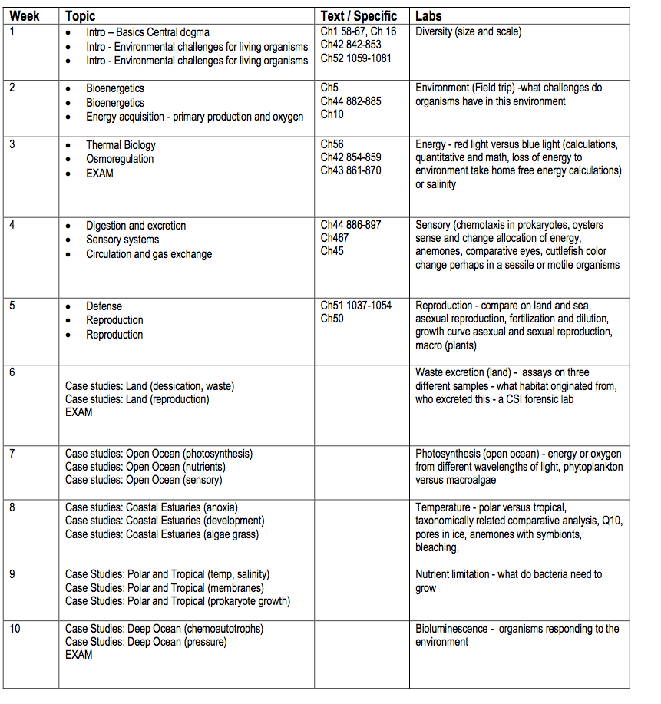
PLAN

Slide 22
Topics
Bioenergetics
Thermal Biology
• Osmoregulation
• Digestion and excretion
• Sensory systems
• Circulation and gas exchange
• Defense
• Reproduction

Slide 23
You need to read

Slide 24
You need to ask questions

Slide 25
You need to contribute
knowledge

Slide 26
Aquatic Environment

Slide 27
Topics
Bioenergetics
Thermal Biology
• Osmoregulation
• Digestion and excretion
• Sensory systems
• Circulation and gas exchange
• Defense
• Reproduction

Slide 28
Aquatic Environment
How does the vary

Slide 29
Organization

Slide 30
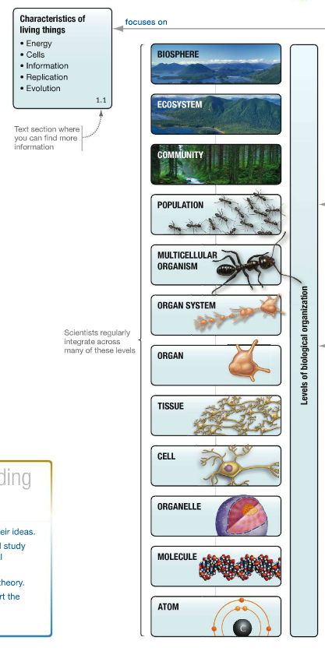
Big
Picture

Slide 31
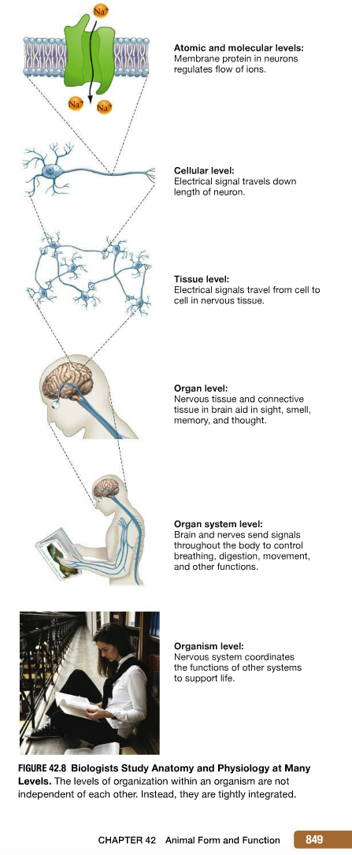
Big
Picture

Slide 32
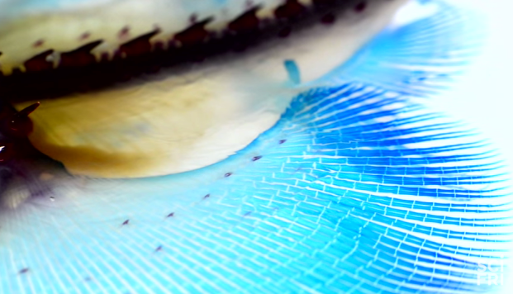
Form and Function
https://www.youtube.com/watch?v=haopSRCuPdo

Slide 33
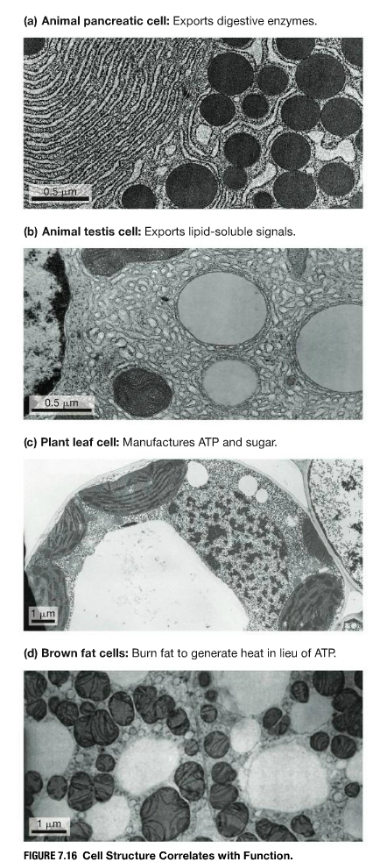

Slide 34
Biology Review

Slide 35
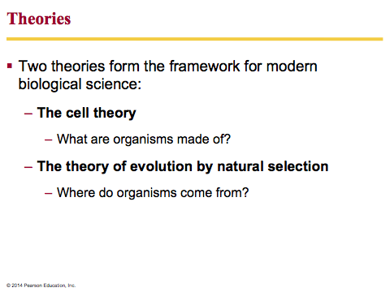

Slide 36
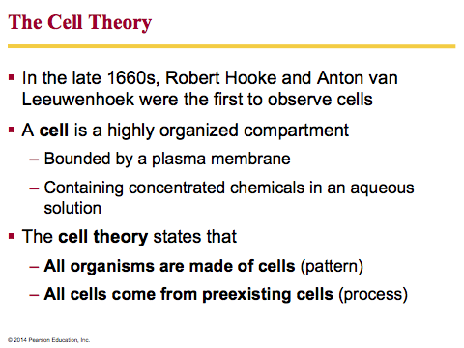

Slide 37
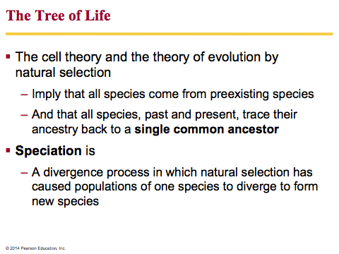

Slide 38
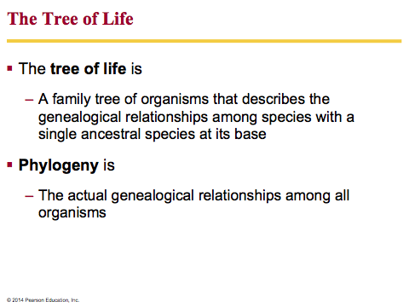

Slide 39
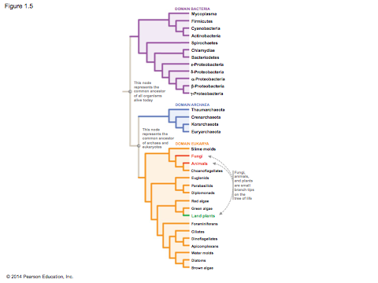

Slide 40
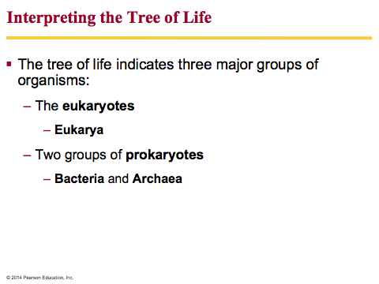

Slide 41
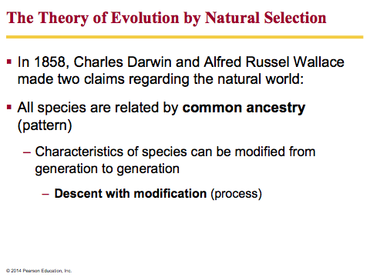

Slide 42
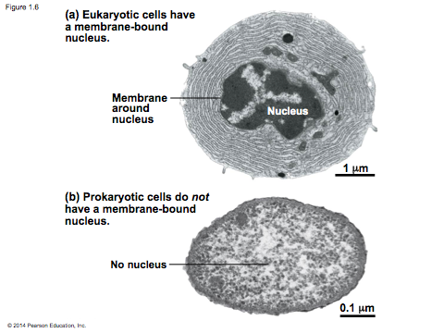

Slide 43
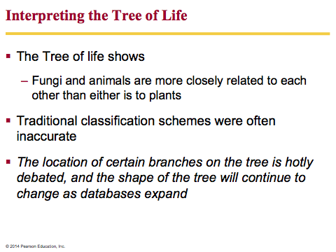

Slide 44
Central Dogma

