Slide 1
FISH270
Lecture 6

Slide 2
Stuff
Question set #2
Study Guide
Next week - Feeding Fishes; Osmoregulation; Exam
Question set a bit early…

Slide 3
Did you digest everything from Wednesday?

Slide 4
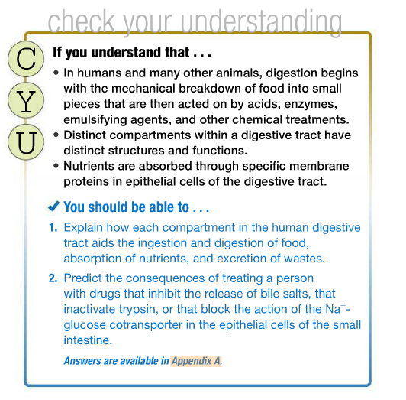
Lecture 5

Slide 5
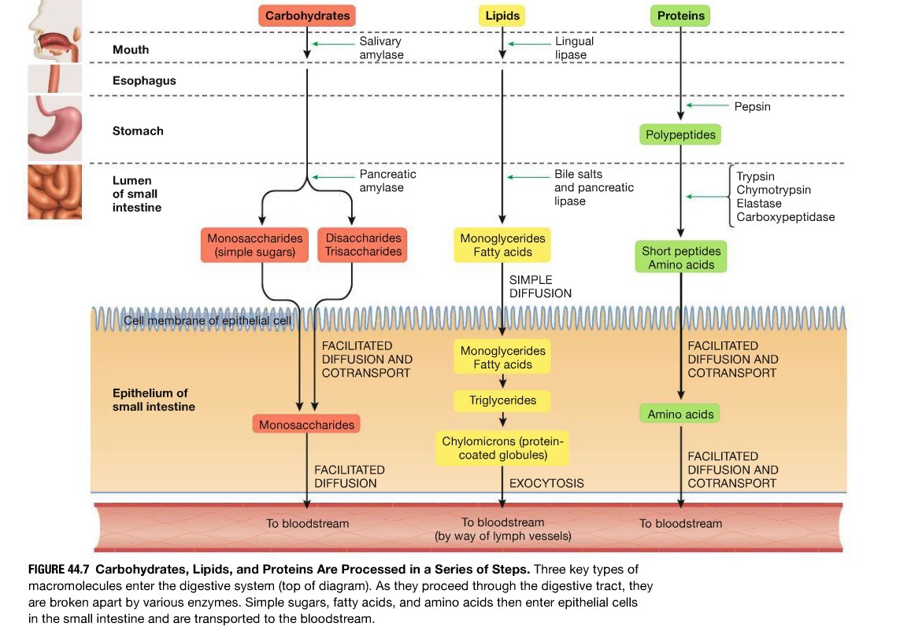

Slide 6
up to page 888

Slide 7
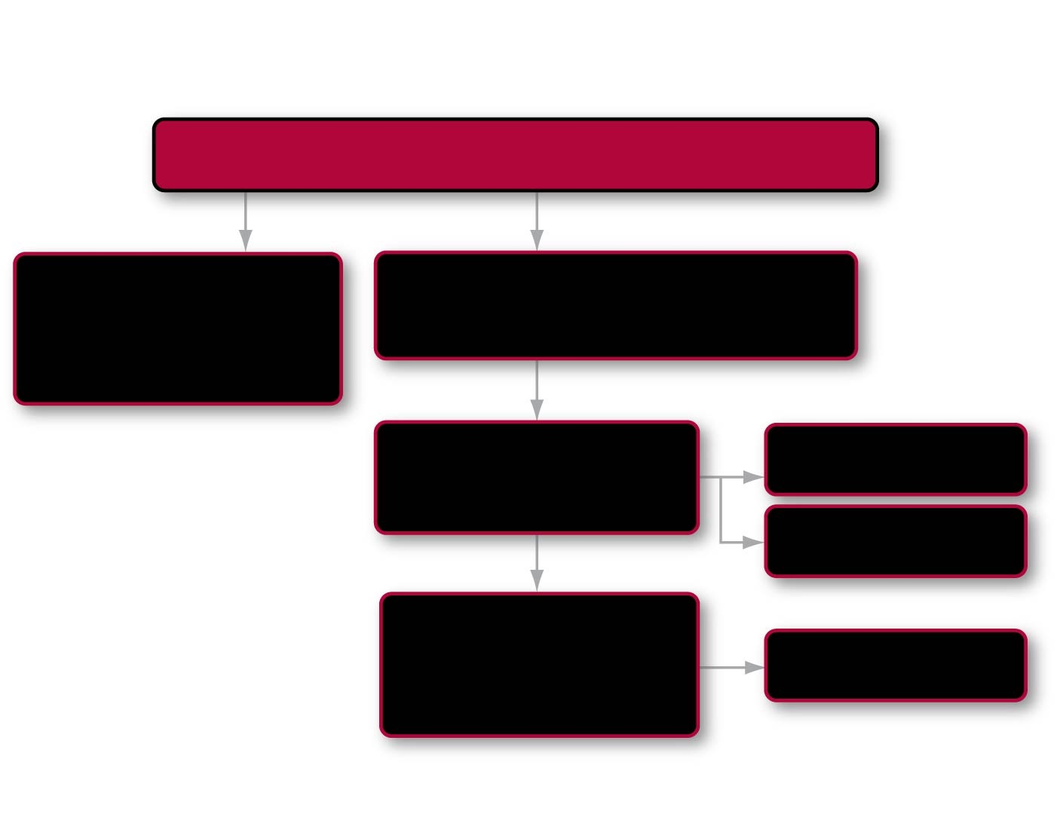
Roadmap 10
In this chapter you will learn how
Photosynthesis links life to the power of the Sun
by previewing
by examining
Conversion of light energy into chemical energy
How photosynthetic pigments capture light energy
10.2
10.1
then looking closer at
Energy flow and ATP production
Photosystem II
10.3
Photosystem I
and exploring
CO₂ fixation and reduction to form sugars
The Calvin cycle
10.4
Notes:
Chapter 10 Opening Roadmap.

Slide 8
You should be able to..
Explain energy flow and conversion of photosynthesis
Describe how ATP is produced during the light capturing reactions of photosynthesis
Understand the purpose of the Calvin cycle and how it related to photosynthesis

Slide 9
An Overview of Photosynthesis
Photosynthesis
Is the process of using sunlight to produce carbohydrate
Requires sunlight, carbon dioxide, and water
Produces oxygen as a by-product
The overall reaction when glucose is the carbohydrate:
6 CO₂ + 6 H₂O + light energy →→→ C₆H₁₂O₆ + 6 O₂

Slide 10
An Overview of Photosynthesis
Photosynthesis contrasts with cellular respiration
Photosynthesis is endergonic
Reduces CO₂ to sugar
Cellular respiration is exergonic
Oxidizes sugar to CO₂

Slide 11
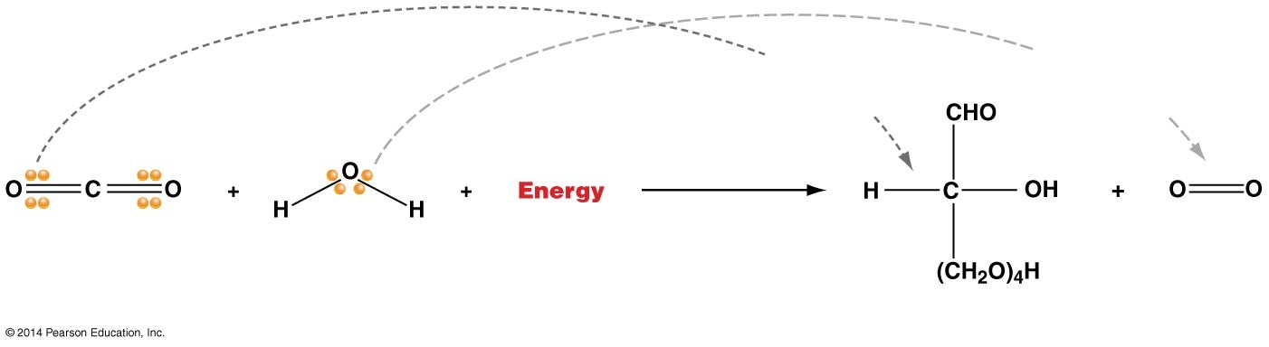
Figure 10.1
Electrons are pulled __________; C is _________
Electrons are pulled _______________; O is _________
Potential energy increases
6 CO₂ (carbon dioxide)
6 H₂O (water)
Input of energy
Glucose
6 O₂ (oxygen)
Notes:
Figure 10.1 Electron Transfer during the Reduction of Glucose.

Slide 12
Photosynthesis: Two Linked Sets of Reactions
Light-dependent reactions
Produce O₂ from H₂O
Calvin cycle reactions
Produce sugar from CO₂
The reactions are linked by electrons
Released in the light-dependent reactions
When water is split to form oxygen gas
Then transferred to the electron carrier NADP⁺, forming NADPH

Slide 13
Photosynthesis: Two Linked Sets of Reactions
The Calvin cycle then uses
These electrons
The potential energy in ATP
To reduce CO₂ to make sugars

Slide 14
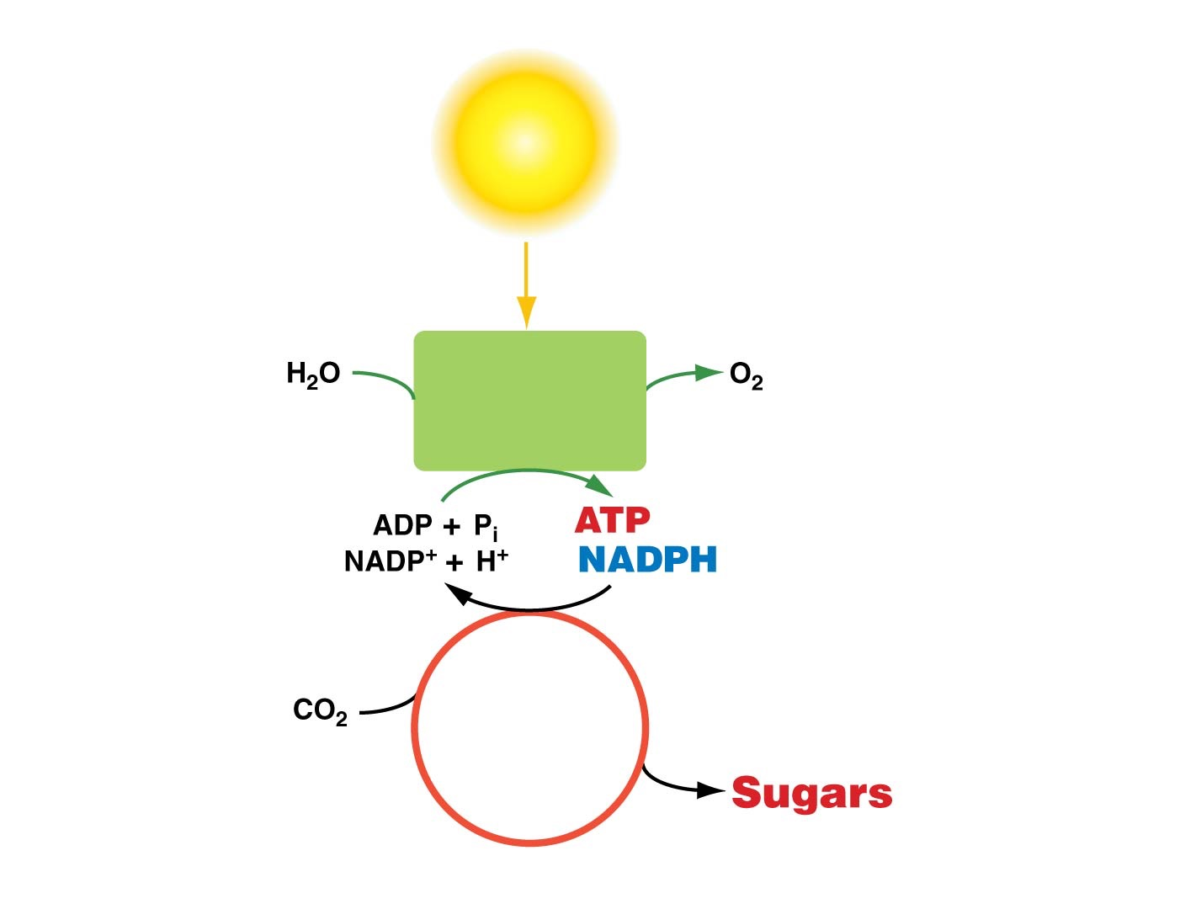
Figure 10.2
Sunlight
(Light energy)
Know this!
Light- capturing reactions
(Chemical energy)
Calvin cycle
(Chemical energy)
Notes:
Figure 10.2 Photosynthesis Has Two Linked Components.

Slide 15
Figure 10.2
Sunlight
(Light energy)
Know this!
Light- capturing reactions
(Chemical energy)
Calvin cycle
(Chemical energy)
then…
Notes:
Figure 10.2 Photosynthesis Has Two Linked Components.

Slide 17
The Structure of the Chloroplast
Photosynthesis occurs in the chloroplasts of green plants, algae, and other photosynthetic organisms
Chloroplasts are surrounded by two membranes
Thylakoids
Internal membranes of chloroplasts that form flattened, vesicle-like structures
Form stacks called grana
Thylakoid membranes contain large quantities of pigments
The most common pigment is chlorophyll

Slide 18
The Structure of the Chloroplast
Stroma
Fluid-filled space between the thylakoids and the inner membrane

Slide 19
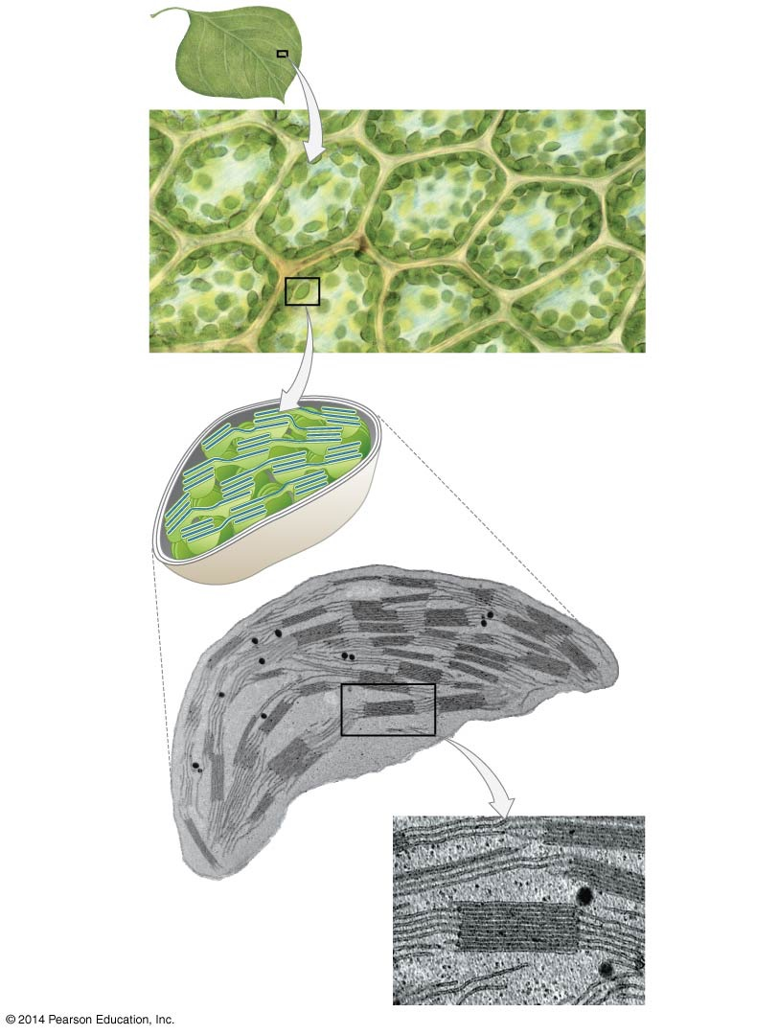
Figure 10.3
In plants, cells that photosynthesize typically have 40–50 chloroplasts
10 μm
Chloroplast
Outer membrane
Inner membrane
0.5 μm
Thylakoids (flattened sacs)
Granum (stack of thylakoids)
Stroma (liquid matrix)
Notes:
Figure 10.3 Photosynthesis Takes Place in Chloroplasts.

Slide 20
The Nature of Light Energy
Electromagnetic radiation is a form of energy
Light
Is a type of energy electromagnetic radiation
Acts both particle-like and wave-like
Photons
As a particle, light exists in discrete packets
As a wave, light can be characterized by its wavelength
The distance between two successive wave crests

Slide 21
The Electromagnetic Spectrum
The electromagnetic spectrum
The range of wavelengths of electromagnetic radiation
Visible light
Electromagnetic radiation that humans can see
Each photon and wavelength has a specific amount of energy
The energy of a photon of light is inversely proportional to its wavelength
Shorter wavelengths such as ultraviolet light
Have more energy than longer wavelengths
Such as infrared light

Slide 22
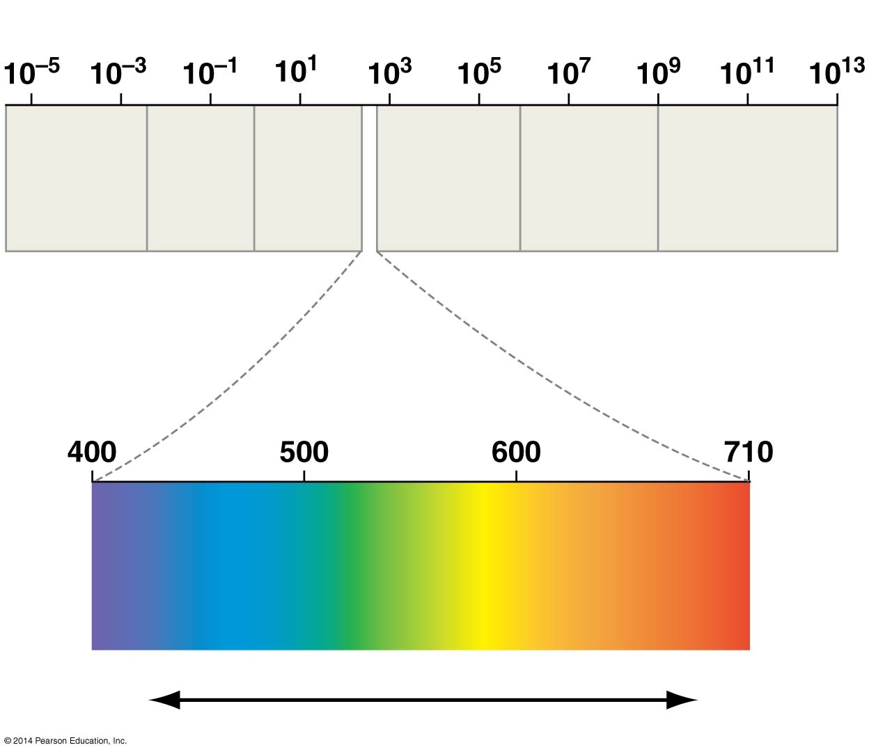
Figure 10.4
Wavelengths (nm)
Gamma rays
Ultra- violet
Micro- waves
Radio waves
X-rays
Infrared
Shorter wavelength
Longer wavelength
Visible light
nm
Higher energy
Lower energy
Notes:
Figure 10.4 The Electromagnetic Spectrum.

Slide 23
Photosynthetic Pigments Absorb Light
Photons may be absorbed, transmitted, or reflected when they strike an object
Pigments are
Molecules that absorb only certain wavelengths of light

Slide 24
Photosynthetic Pigments Absorb Light
There are two major classes of pigment in plant leaves:
1. The chlorophylls (chlorophyll a and chlorophyll b)
Absorb red and blue light
Reflect and transmit green light
2. The carotenoids
Absorb blue and green light
Reflect and transmit yellow, orange, and red light

Slide 25
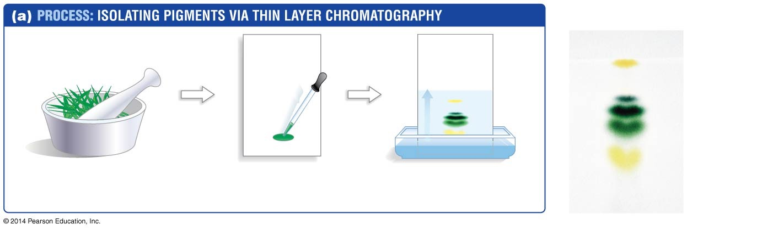
Figure 10.5
(b) A finished chromatograph
Migration of solvent
Carotene
Pheophytin
Chlorophyll a
Chlorophyll b
Xanthophyll
1. Grind leaves, add solvent. Pigment molecules move from leaves into solvent.
2. Spot pigments on a thin layer of porous material that coats a solid support.
3. Separate pigments in solvent.
Notes:
Figure 10.5 Chromatography Is a Technique for Separating Molecules.

Slide 26
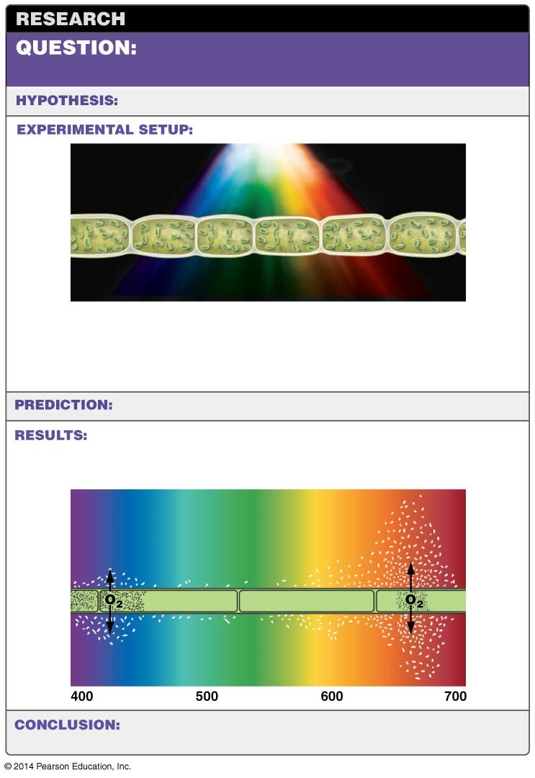
Figure 10.6
Which of the wavelengths found in white light are responsible for driving photosynthesis?
No specific hypothesis.
Alga (Cladophora sp.)
1. Expose algal cells to all the wavelengths of visible light in the presence of oxygen-seeking bacteria.
2. Record the number of bacteria swarming near algal cells exposed to different wavelengths.
No specific prediction.
Swarming bacteria, observed and sketched by Engelmann (1882)
Bacteria congregate in the wavelengths of light where the alga is producing the most oxygen
Alga
Oxygen-seeking bacteria
Pigments that absorb violet-to-blue and red wavelengths are most effective at triggering photosynthesis.
Notes:
Figure 10.6 Certain Wavelengths of Light Are Used to Drive Photosynthesis.

Slide 27
Each Pigment Has a Specific Absorption Spectrum
Absorption spectrum
Is a graph to study pigments
Plots the wavelength of light absorbed by pigment molecules
An action spectrum
Shows the rate of photosynthesis vs. wavelength
Pigments that absorb blue and red photons
Are the most effective at driving photosynthesis
Because the chlorophylls absorb these wavelengths
They are most likely the main photosynthetic pigments

Slide 28
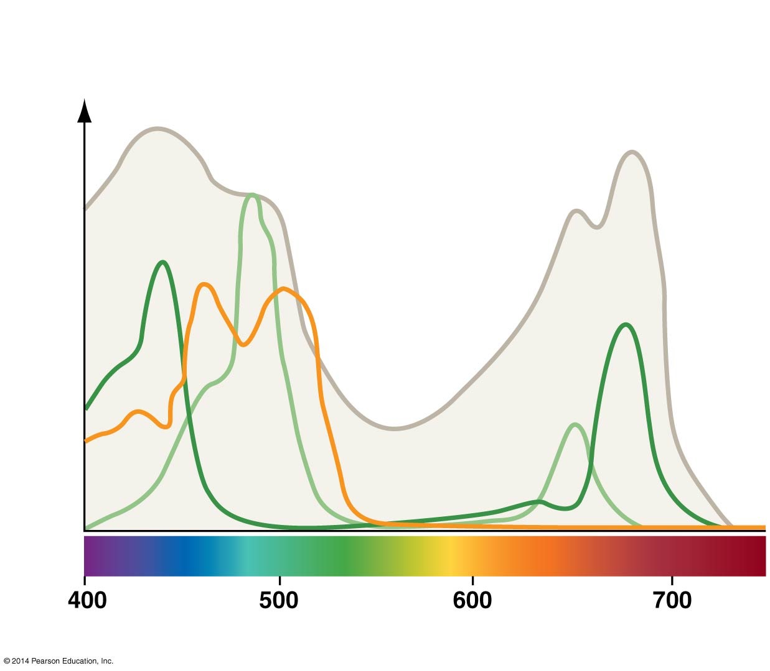
Figure 10.7
Chlorophylls
ABSORB: violet-to-blue and red light TRANSMIT: green light
Action spectrum of photosynthesis
a
b
Carotenoids
ABSORB: blue and green light TRANSMIT: yellow, orange, or red light
Oxygen produced
Light absorbed
Wavelength of light (nm)
Notes:
Figure 10.7 There Is a Strong Correlation between the Absorption Spectra of Pigments and the Action Spectrum for Photosynthesis.

Slide 29
The Structure of Chlorophyll
Chlorophyll a and b
Are similar in structure and absorption spectra
Chlorophylls have
A long “tail” made of isoprene subunits
Keeps the molecule embedded in the thylakoid membrane
A “head” consisting of a large ring structure with a magnesium atom in the middle
Light is absorbed in the head

Slide 30
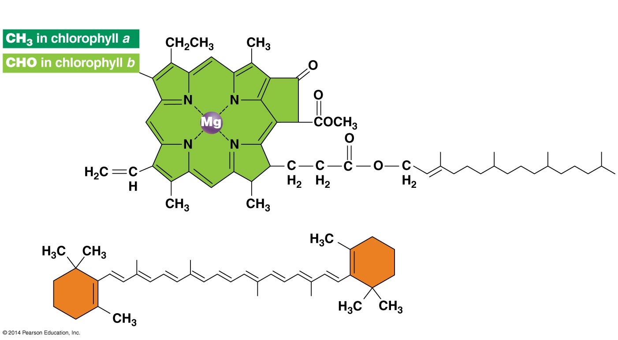
Figure 10.8
(a) Chlorophylls a and b
Head (ring structure that absorbs light)
Tail (anchors chlorophyll in thylakoid membrane)
(b) β-Carotene
Notes:
Figure 10.8 Photosynthetic Pigments Contain Ring Structures.

Slide 31
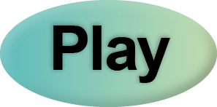
Chlorophyll
Cell Biology Video: Space-Filling Model of Chlorophyll

Slide 32
The Role of Carotenoids and Other Accessory Pigments
Carotenoids
Are accessory pigments that absorb light
Pass the energy on to chlorophyll
Classified into two groups:
Carotenes and xanthophylls
Absorb wavelengths of light
Not absorbed by chlorophyll
Extend the range of wavelengths that can drive photosynthesis

Slide 33
The Role of Carotenoids and Other Accessory Pigments
Also
Stabilize free radicals
Protect chlorophylls from damage

Slide 34
Electrons Become Excited When Light Is Absorbed
When a photon strikes chlorophyll
Its energy can be transferred to an electron in the chlorophyll head
The electron becomes excited—raised to a higher energy state
In chlorophyll:
Red and blue photons can be absorbed
Excite electrons to different states

Slide 35
Electrons Become Excited When Light Is Absorbed
Red photons raise electrons to state 1
Higher-energy blue photons raise electrons to state 2
Green photons are of an intermediate energy level
Are not easily absorbed by chlorophyll

Slide 36
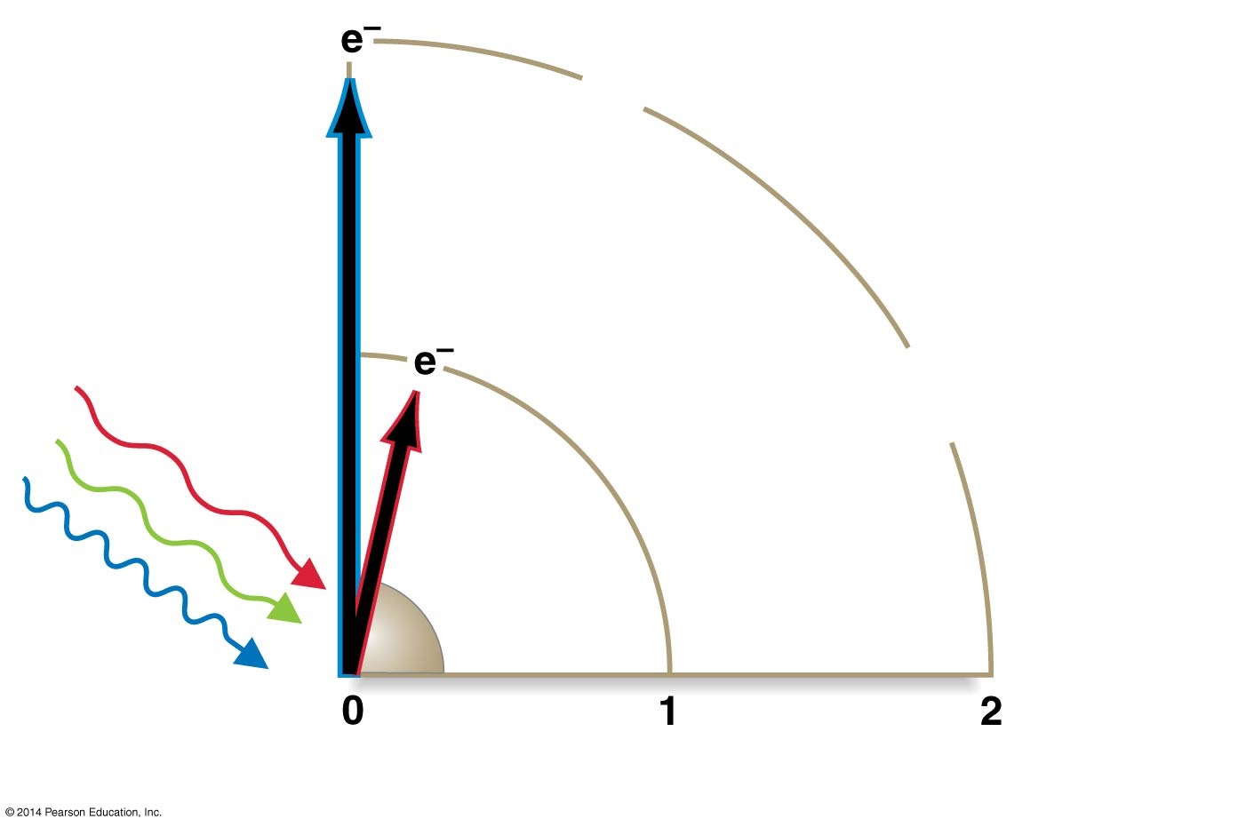
Figure 10.9
Blue photons excite electrons to an even higher energy state
Red photons excite electrons to a high-energy state
Photons
Energy state of electrons in chlorophyll
Notes:
Figure 10.9 Electrons Are Promoted to High-Energy States When Photons Strike Chlorophyll.

Slide 37
Fluorescence
Fluorescence occurs when
A pigment absorbs a photon and the electron gets excited
Then falls back to its ground state
Some of the absorbed energy is released as heat
The rest is released as electromagnetic radiation (light)
About 2% of red and blue photons produce fluorescence
98% drive photosynthesis

Slide 38
Photosystems
Chlorophyll molecules work together in groups
They form a complex called a photosystem
A photosystem consists of two major elements:
1. An antenna complex
2. A reaction center
as well as proteins that capture and process excited electrons

Slide 39
The Antenna Complex
The photosystem’s antenna complex is composed of
Accessory pigment molecules
When a red or blue photon strikes a pigment molecule
In the antenna complex
The energy is absorbed and an electron excited

Slide 40
The Antenna Complex
This energy is passed to another chlorophyll molecule
Exciting another electron
This phenomenon is called resonance
Energy is transferred inside the antenna complex
From one molecule to the next
Until it reaches the reaction center

Slide 41
The Reaction Center
At the reaction center
Excited electrons are transferred to a specialized chlorophyll molecule
Acts as an electron acceptor
When this electron acceptor becomes reduced
The electromagnetic energy is transformed to chemical energy

Slide 42
The Reaction Center
Excited electrons in chloroplasts may
Drop back down to a low energy state, causing fluorescence
Excite an electron in a nearby pigment, inducing resonance
Be transferred to an electron acceptor in a redox reaction

Slide 43
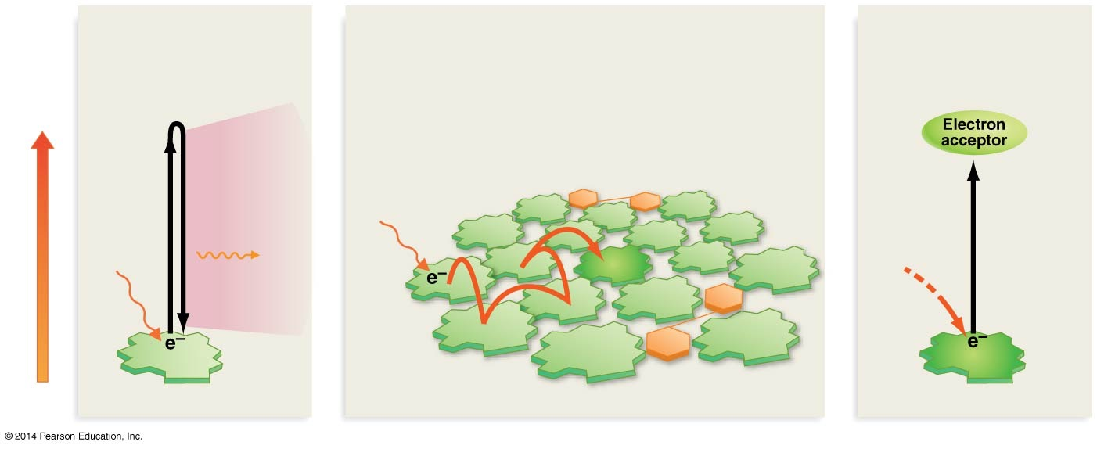
Figure 10.10
FLUORESCENCE or HEAT
or
RESONANCE-ENERGY TRANSFER
or
REDUCTION/OXIDATION
Electron drops back down to lower energy level and emits fluorescence and/or heat.
Energy in electron is transferred to nearby pigment.
Electron is transferred to a new compound.
Higher
Chlorophyll
β-Carotene
Fluorescence
Photon
and/or
Energy of electron
Photon
Heat
Reaction center
Lower
Chlorophyll molecule
Chlorophyll and β-Carotene molecules in antenna complex
Reaction center
Notes:
Figure 10.10 Four Fates for Excited Electrons in Photosynthetic Pigments.

Slide 44
Figure 10.2
Sunlight
(Light energy)
Know this!
Light- capturing reactions
(Chemical energy)
Calvin cycle
(Chemical energy)
Notes:
Figure 10.2 Photosynthesis Has Two Linked Components.

Slide 45
Summary of Photosystems I and II
Photosystem II produces
A proton gradient that drives the synthesis of ATP
Photosystem I yields
Reducing power in the form of NADPH
Several groups of bacteria have just one of the two photosystems
The cyanobacteria, algae, and plants have both

Slide 46
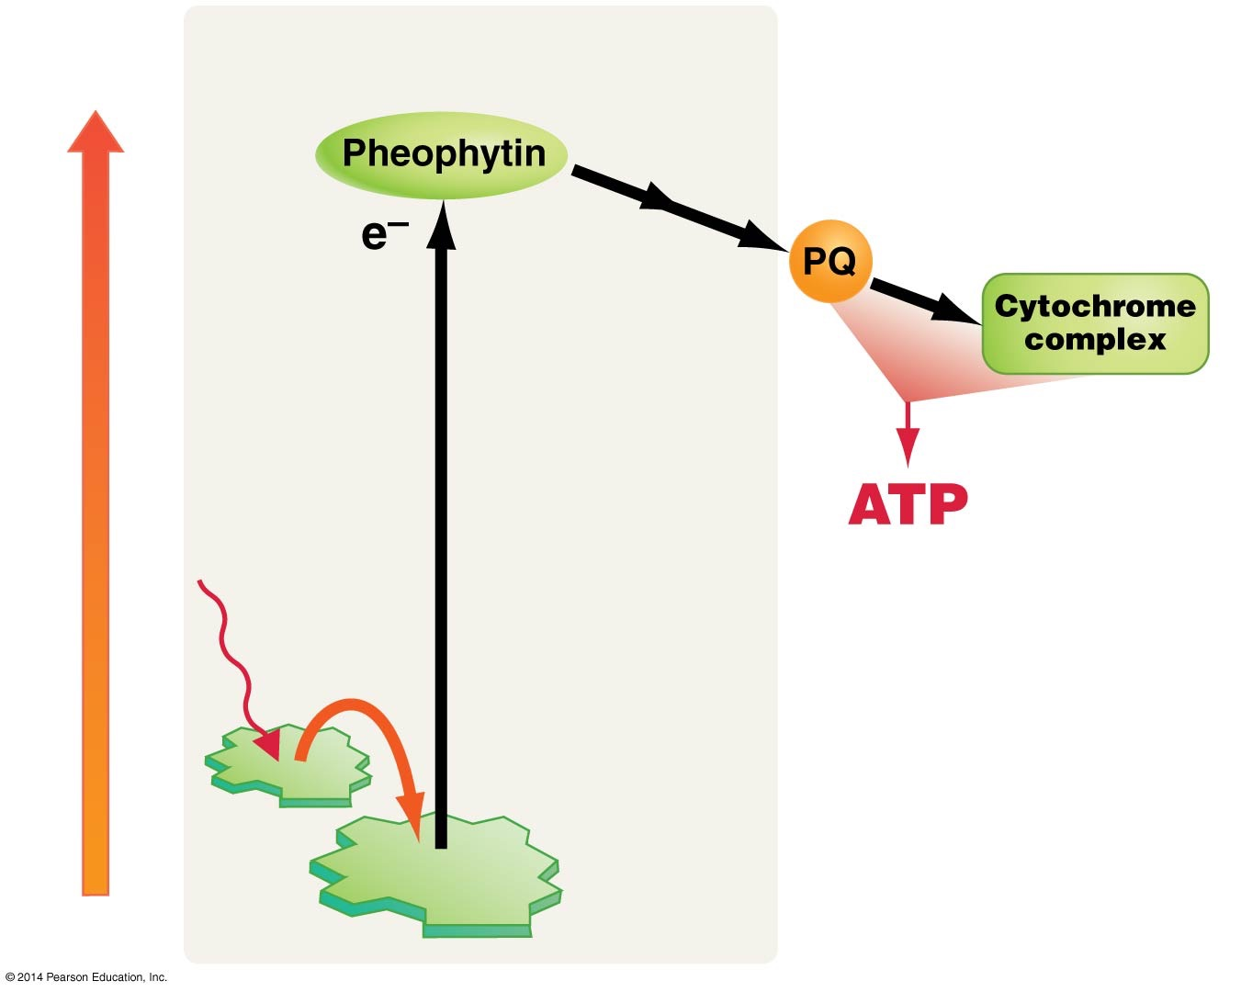
Figure 10.12
Photosystem II
Higher
Electron transport chain
Energy of electron
Photon
produced via proton-motive force
Reaction center
Lower
Notes:
Figure 10.12 Photosystem II Feeds High-Energy Electrons to an Electron Transport Chain.

Slide 47
Figure 10.12
Photosystem II
Higher
Electron transport chain
Energy of electron
Photon
produced via proton-motive force
Reaction center
Lower
Notes:
Figure 10.12 Photosystem II Feeds High-Energy Electrons to an Electron Transport Chain.

Slide 48
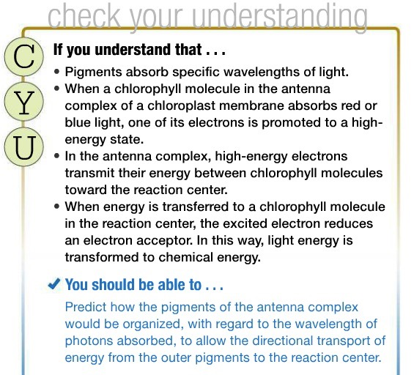

Slide 49
The Discovery of Photosystems I and II
There are two types of reaction centers:
1. Photosystem I
2. Photosystem II
These photosystems work together to produce an enhancement effect
Photosynthesis increases dramatically
When cells are exposed to both red and far-red light

Slide 50
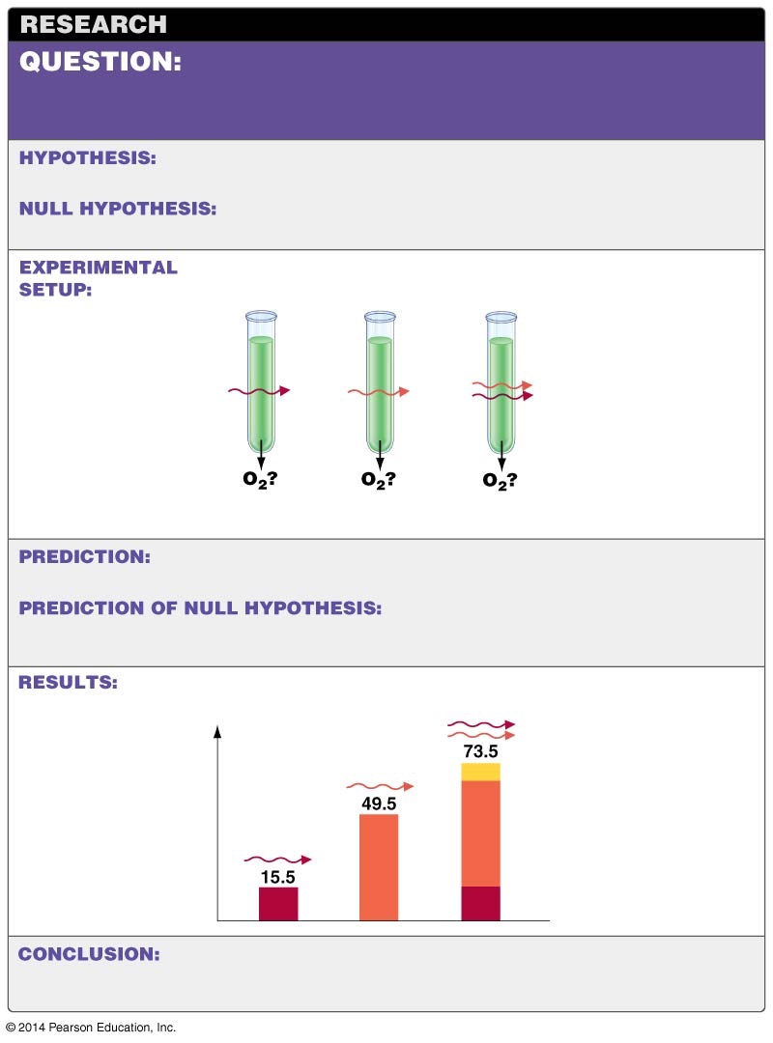
Figure 10.11
Red and far-red light each stimulate a moderate rate of photosynthesis. How does a combination of both wavelengths affect the rate of photosynthesis?
When red and far-red light are combined, the rate of photosynthesis will be the sum of the single wavelength rates.
When red and far-red light are combined, the rate of photosynthesis will be no more than the highest single wavelength rate.
Far-red light (713 nm)
Red light (653 nm)
Both wavelengths
Expose cells to light and record rate of photosynthesis.
When the two wavelengths are combined, the amount of oxygen produced will be the sum of the single wavelength tests.
When the two wavelengths are combined, the amount of oxygen produced will be no more than the single wavelength test that yielded the highest amount of oxygen.
Activity due to enhancement effect
Both wavelengths
Red light (680 nm)
Far-red light (700 nm)
Oxygen production
Neither hypothesis is correct. The combination of both wavelengths yielded more oxygen than the sum of the single tests. A new hypothesis is required to explain this enhancement effect.
Notes:
Figure 10.11 The “Enhancement Effect” of Two Different Wavelengths in Isolated Chloroplasts.

Slide 51
How Does Photosystem II Work?
When energy reaches the reaction center
The chlorophyll is oxidized when a high-energy electron is donated to the electron acceptor pheophytin
A pigment molecule structurally similar to chlorophyll
The electron is passed to an electron transport chain (ETC)
In the thylakoid membrane
Producing a proton gradient
Driving ATP production via ATP synthase

Slide 52
How Does Photosystem II Work?
Photosystem II triggers
Chemiosmosis and ATP synthesis in the chloroplast

Slide 53
Figure 10.12
Photosystem II
Higher
Electron transport chain
Energy of electron
Photon
produced via proton-motive force
Reaction center
Lower
Notes:
Figure 10.12 Photosystem II Feeds High-Energy Electrons to an Electron Transport Chain.

Slide 54
Electrons from Pheophytin Enter an ETC
Electrons are passed from the reduced pheophytin
To an electron transport chain in the thylakoid membrane
This ETC is similar in structure and function
To the ETC in mitochondria
The ETC includes plastoquinone (PQ)
Shuttles electrons from pheophytin
Across the thylakoid membrane
To a cytochrome complex

Slide 55
Electrons Participate in Redox Reactions
Electrons in the electron transport chain
Participate in redox reactions
Are gradually stepped down in potential energy
These redox reactions result in
Protons being pumped from one side of the membrane to the other
Proton concentration inside the thylakoid increases 1000-fold

Slide 56
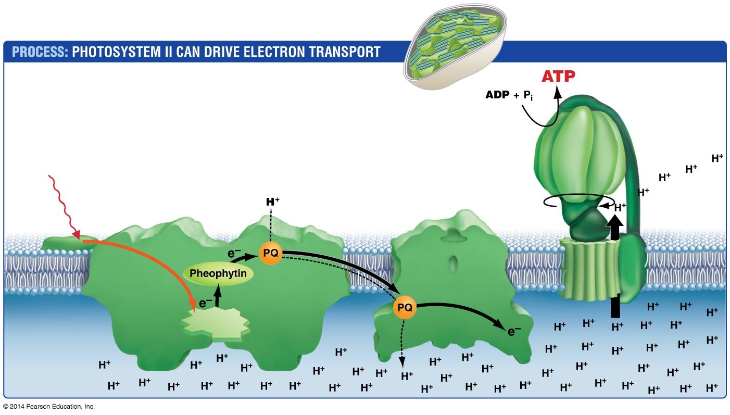
Figure 10.13
Photosystem II and the cytochrome complex are located in the thylakoid membranes
Chloroplast stroma
ATP synthase
Photophos- phorylation
Photon
Antenna complex
Photosystem II
Cytochrome complex
Proton- motive force
Thylakoid lumen (low pH)
Reaction center
Notes:
Figure 10.13 Electron Transport between Photosystem II and the Cytochrome Complex.

Slide 57
Chemiosmosis and Photophosphorylation
As in the mitochondria
Protons diffuse down their electrochemical gradient
Chemiosmosis
Results when the flow of protons through ATP synthase
Causes a change in its shape
Driving the phosphorylation of ADP
Photophosphorylation
Is the capture of light energy by photosystem II
To produce ATP

Slide 58
Chemiosmosis
Web Activity: Chemiosmosis

Slide 59
How Does Photosystem II Obtain Electrons?
Photosystem II
Oxidizes water
To replace electrons used during the light reactions
When excited electrons leave photosystem II and enter the ETC
The photosystem becomes electronegative
Enzymes can remove electrons from water
Leaving protons and oxygen

Slide 60
Oxygenic and Anoxygenic Photosynthesis
Photosystem II “splits” water
To replace its lost electrons
Produces oxygen
2 H₂O → 4 H⁺ + 4 e– + O₂
This process is called oxygenic photosynthesis
Photosystem II is the only protein complex able to oxidize water in this way

Slide 61
Oxygenic and Anoxygenic Photosynthesis
Purple photosynthetic bacteria and purple sulfur bacteria
Have a single photosystem
Cannot oxidize water
Perform anoxygenic photosynthesis

Slide 62
The Importance of Oxygenic Photosynthesis
The oxygen released from oxygenic photosynthesis was critical to the evolution of life as we know it
O₂ was almost nonexistent on Earth before enzymes evolved that could catalyze the oxidation of water

Slide 63
How Does Photosystem I Work?
Photosystem I
Pigments in the antenna complex absorb photons
Pass the energy to the reaction center
Excited electrons from the reaction center are
Passed down an ETC of iron- and sulfur-containing proteins
To ferredoxin

Slide 64
How Does Photosystem I Work?
The enzyme NADP⁺ reductase transfers
A proton and two electrons
From ferredoxin to NADP⁺, forming NADPH
The photosystem itself and NADP⁺ reductase are anchored in the thylakoid membrane

Slide 65
NADPH Is an Electron Carrier
Photosystem I produces NADPH
Similar in function to the NADH and FADH₂ produced by the citric acid cycle
NADPH
Is an electron carrier
Can donate electrons to other compounds
And reduce them

Slide 66
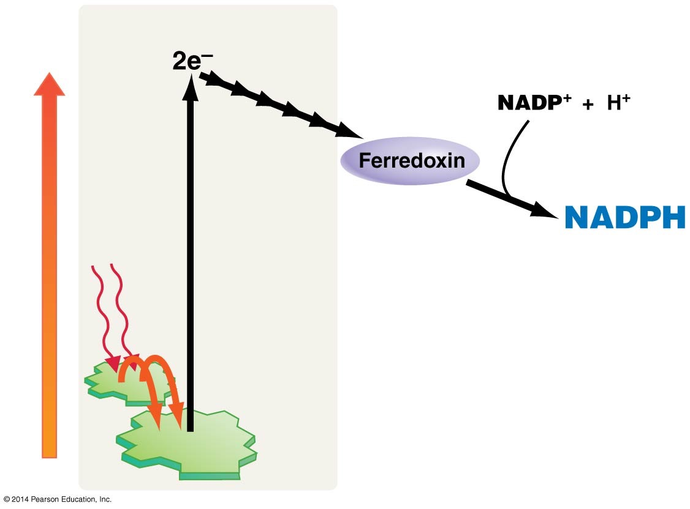
Figure 10.14
Photosystem I
Higher
(NADP⁺
reductase)
Energy of electron
2 Photons
Reaction center
Lower
Notes:
Figure 10.14 Photosystem I Produces NADPH.

Slide 67
Summary of Photosystems I and II
Photosystem II produces
A proton gradient that drives the synthesis of ATP
Photosystem I yields
Reducing power in the form of NADPH
Several groups of bacteria have just one of the two photosystems
The cyanobacteria, algae, and plants have both

Slide 68
The Z Scheme
The Z scheme is a model of how photosystems I and II interact
First, a photon excites an electron in the pigment molecules of photosystem II’s antenna complex
Resonance occurs until the energy reaches the reaction center
The electrons of photosystem II will be replaced by electrons stripped from water, producing oxygen gas as a by-product

Slide 69
The Z Scheme
A special pair of reaction-center chlorophyll molecules named P680
Passes the excited electron to pheophytin

Slide 70
The Z Scheme
From pheophytin, the potential energy of the electron is
Gradually stepped down through redox reactions in an ETC
Plastoquinone uses the released energy to
Transport protons across the thylakoid membrane
Build up a proton electrochemical gradient
ATP synthase uses this force to
Phosphorylate ADP, producing ATP

Slide 71
The Z Scheme
At the end of photosystem II’s ETC, the electron is passed to a protein called plastocyanin (PC)
Plastocyanin (PC)
Carries the electron back across the thylakoid membrane
Donates it to photosystem I
Physically linking the two photosystems

Slide 72
The Z Scheme
Electrons from PC
Replace electrons from the P700 pair of chlorophyll molecules
In the photosystem I reaction center
Enter an ETC
Are eventually passed to ferredoxin
Used to reduce NADP⁺ to NADPH

Slide 73
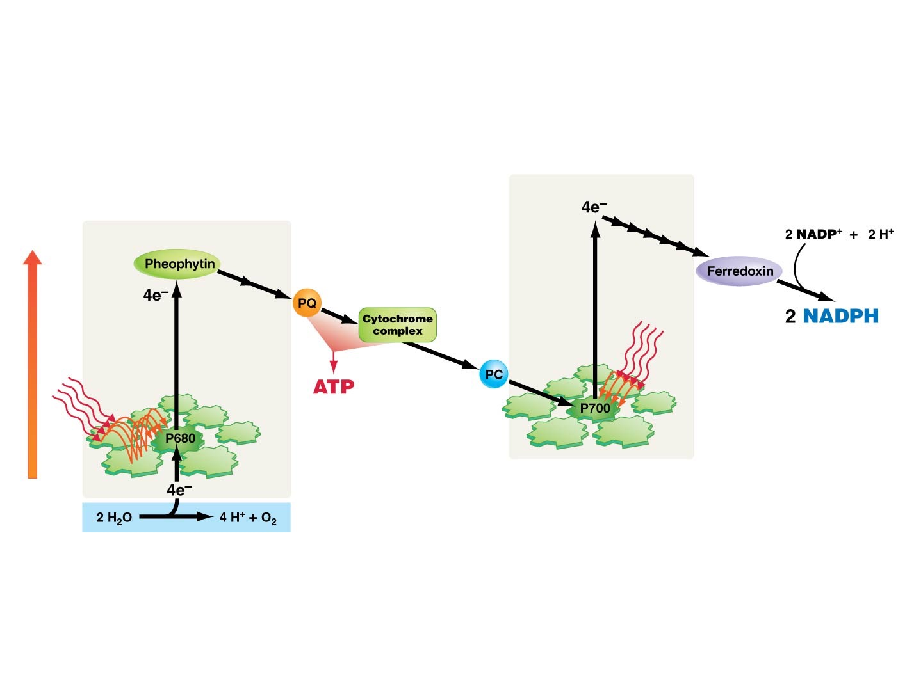
Figure 10.15
Photosystem I
Higher
Photosystem II
Electron transport chain
4 Photons
Energy of electron
4 Photons
produced via proton-motive force
Lower
Notes:
Figure 10.15 The Z-Scheme Model Links Photosystems II and I.

Slide 74
The Enhancement Effect
The Z scheme explains the enhancement effect
Photosynthesis is more efficient when
Both 680-nm and 700-nm wavelengths are available
Allowing both photosystems to run at maximum rates
Photosystem I occasionally transfers electrons to photosystem II’s electron transport chain to
Increase ATP production
Instead of using the electrons to reduce NADP⁺

Slide 75
The Enhancement Effect
This cyclic photophosphorylation
Coexists with the Z scheme
Produces additional ATP

Slide 76
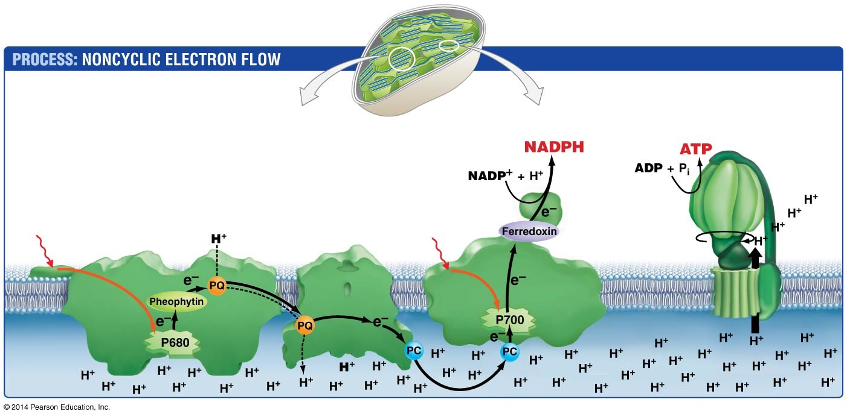
Figure 10.16
Most abundant in membranes of grana
Most abundant in membranes exterior to grana
Chloroplast stroma
ATP synthase
Antenna complex
Photosystem II
Cytochrome complex
Photosystem I
NADP⁺ reductase
Photon
Photon
Proton- motive force
Thylakoid lumen
Notes:
Figure 10.16 Electrons Are Passed from Water to NADP⁺ in a Linear Pathway.

Slide 77
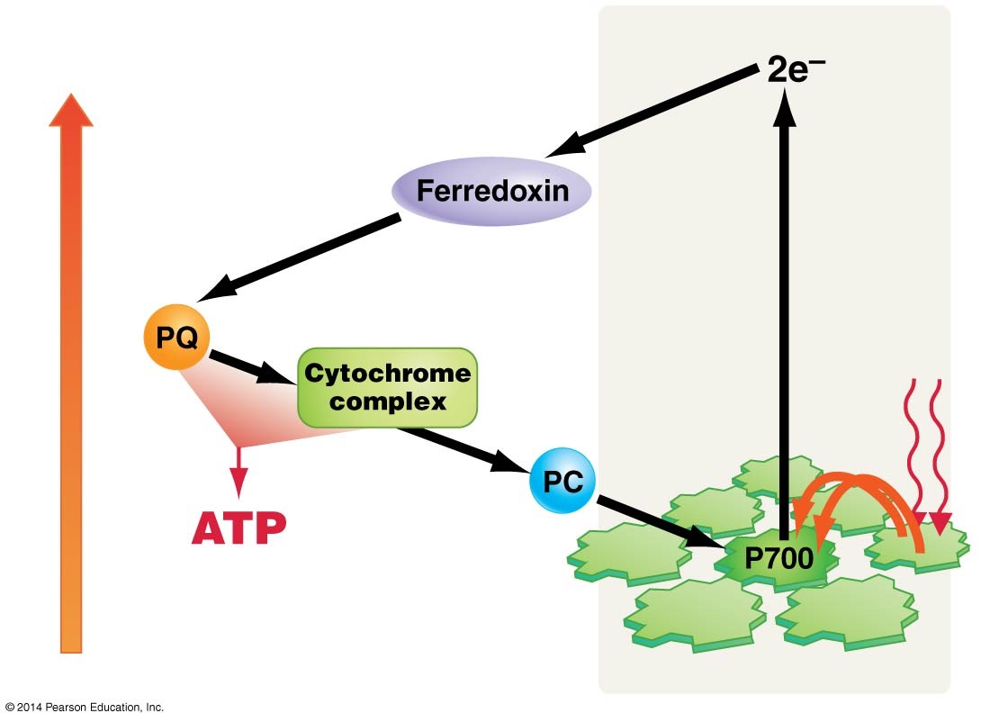
Figure 10.17
Photosystem I
Higher
Energy of electron
2 Photons
produced via proton-motive force
Lower
Notes:
Figure 10.17 Cyclic Electron Flow Leads to ATP Production.

Slide 78
The Location of Photosystem I and Photosystem II
Photosystem II is much more abundant in the interior, stacked membranes of grana
Photosystem I and ATP synthase are much more common in the exterior, unstacked membranes
The stroma
Is the site of ATP production
Where the proton gradient established by PS II drives protons

Slide 79
The Calvin Cycle and Carbon Fixation
Two separate but linked processes in photosynthesis:
The energy transformation of the light-dependent reactions
The carbon dioxide reduction of the Calvin cycle
In the presence of light
ATP and NADPH are produced by photosystems I and II
The reactions that produce sugar from carbon dioxide in the Calvin cycle are light-independent
Require the ATP and NADPH
Produced by the light-dependent reactions

Slide 80
Figure 10.2
Sunlight
(Light energy)
Know this!
Light- capturing reactions
(Chemical energy)
Calvin cycle
(Chemical energy)
Notes:
Figure 10.2 Photosynthesis Has Two Linked Components.

Slide 81
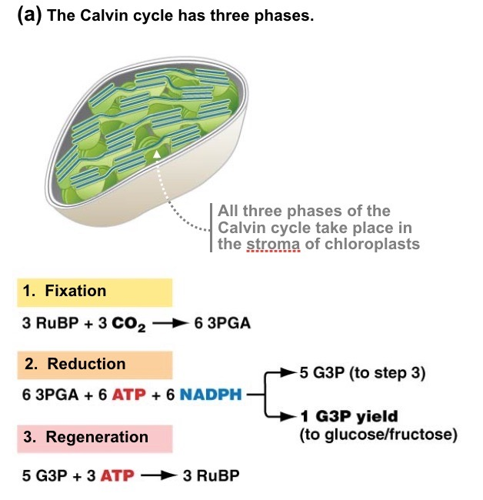

Slide 82
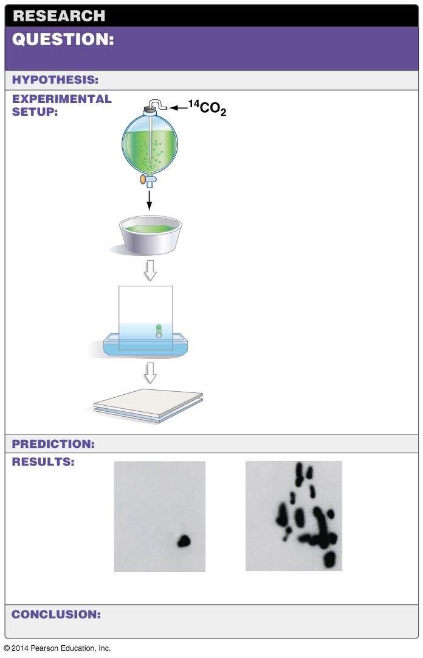
Figure 10.18
What intermediates are produced as carbon dioxide is reduced to sugar?
No specific hypothesis.
1. Feed algae pulse of labeled CO₂.
2. Homogenize cells.
3. Separate molecules.
4. Locate label.
No specific prediction.
3-Phosphoglycerate
Compounds produced after 5 seconds
Compounds produced after 60 seconds
3-Phosphoglycerate is the first intermediate product. Other intermediates appear later.
Notes:
Figure 10.18 Experiments Revealed the Reaction Pathway Leading to Reduction of CO₂.

Slide 83
The Calvin Cycle
The Calvin cycle has three phases:
Fixation: CO₂ reacts with ribulose bisphosphate (RuBP)
Produces two 3-phosphoglycerate molecules
Attachment of CO₂ to an organic compound is carbon fixation
Reduction: The 3-phosphoglycerate molecules are:
Phosphorylated by ATP
Reduced by NADPH
Producing glyceraldehyde 3-phosphate (G3P)
Regeneration: The remaining G3P is used in reactions that regenerate RuBP

Slide 84
The Calvin Cycle
This cycle of reactions occurs in the chloroplast’s stroma
One turn of the Calvin cycle fixes one molecule of CO₂
3 turns of the Calvin cycle are required
To produce 1 molecule of G3P
The discovery of the Calvin cycle clarified
How the ATP and NADPH produced by light-capturing reactions
Allow cells to reduce CO₂ to carbohydrate

Slide 85
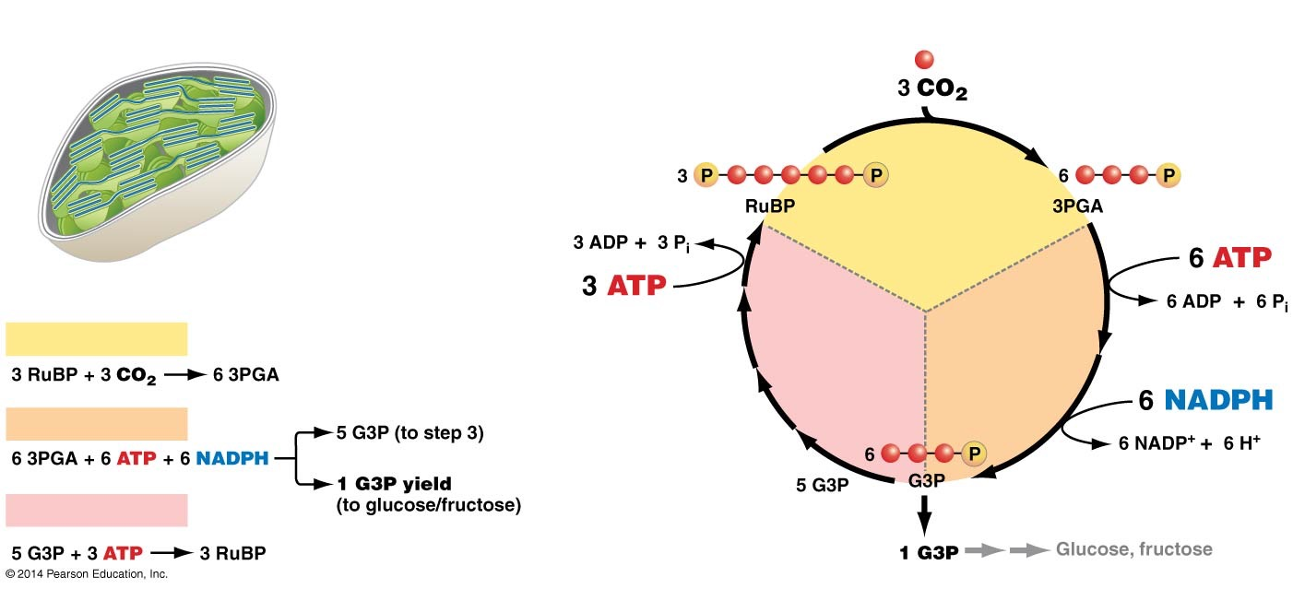
Figure 10.19
(a) The Calvin cycle has three phases.
(b) The reaction occurs in a cycle.
Carbons are symbolized as red balls (each CO₂ enters the cycle one at a time)
1. Fixation of carbon dioxide
All three phases of the Calvin cycle take place in the stroma of chloroplasts
3. Regeneration of RuBP from G3P
2. Reduction of 3PGA to G3P
1. Fixation
2. Reduction
3. Regeneration
Notes:
Figure 10.19 Carbon Dioxide Is Reduced in the Calvin Cycle.

Slide 86
Photosynthesis
Web Activity: Photosynthesis

Slide 87
The Importance of Rubisco
The CO₂-fixing enzyme is
Ribulose 1,5-bisphosphate carboxylase/oxygenase (rubisco)
Rubisco is
Found in all photosynthetic organisms
That use the Calvin cycle to fix carbon
Thought to be the most abundant enzyme on Earth

Slide 88
The Importance of Rubisco
Rubisco is
Inefficient because it catalyzes the addition of CO₂ to RuBP
It also catalyzes the addition of O₂ to RuBP

Slide 89
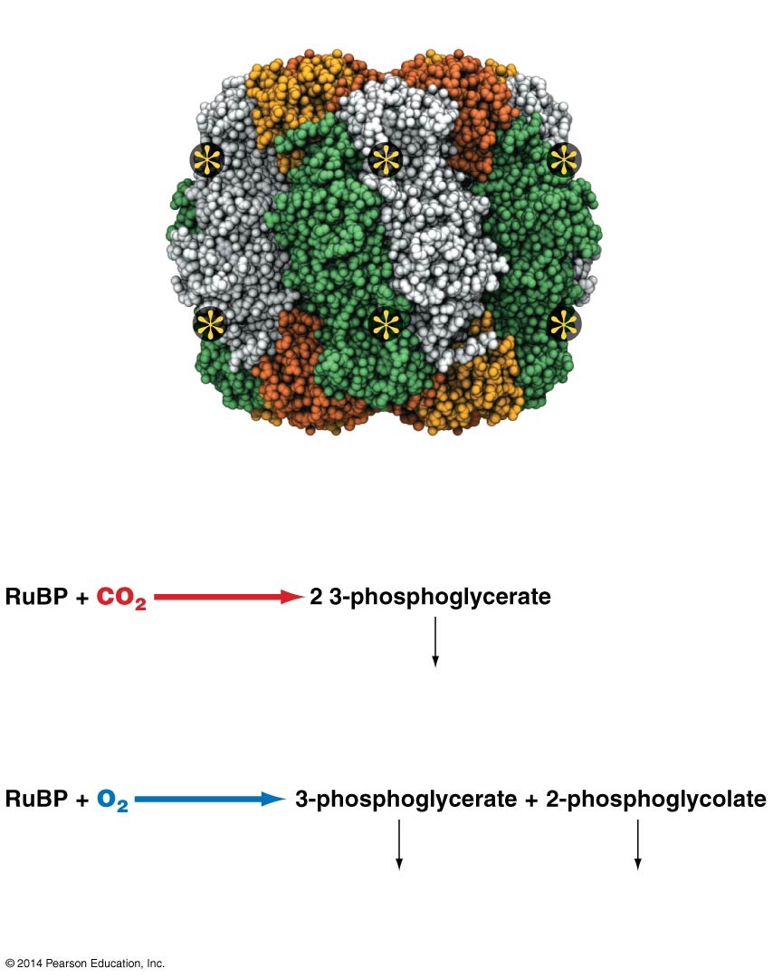
Figure 10.20
(a) Rubisco has 16 subunits and a total of 8 active sites.
Active site
(b) Rubisco’s active sites can interact with CO₂ or O₂.
Reaction with carbon dioxide during photosynthesis :
Rubisco
used in Calvin cycle
Reaction with oxygen during photorespiration :
Rubisco
used in Calvin cycle
when processed, CO₂ is released and ATP is used
Notes:
Figure 10.20 Rubisco Is a Large Enzyme Complex That Can React with CO₂ or O₂.

Slide 90
Photorespiration
O₂ and CO₂ compete at the rubisco’s active sites
Slows the rate of CO₂ reduction
When O₂ and RuBP react in rubisco’s active site
One of the products undergoes a process called photorespiration
Photorespiration “undoes” photosynthesis
It consumes energy and releases fixed CO₂

Slide 91
Photorespiration
When photorespiration occurs, the rate of photosynthesis declines drastically
Carbon fixation is favored over photorespiration when
CO₂ concentration is high
O₂ concentration is low

Slide 92
Carbon Dioxide Pass through Stomata
Stomata
Are leaf structures where gas exchange occurs
Consist of two guard cells that change shape to open or close
When a leaf’s CO₂ concentration is low during photosynthesis
Stomata open to allow atmospheric CO₂ to diffuse into the leaf and its cells’ chloroplasts
A strong concentration gradient favoring entry of CO₂ is maintained by the Calvin cycle
Which constantly uses up the CO₂ in chloroplasts

Slide 93
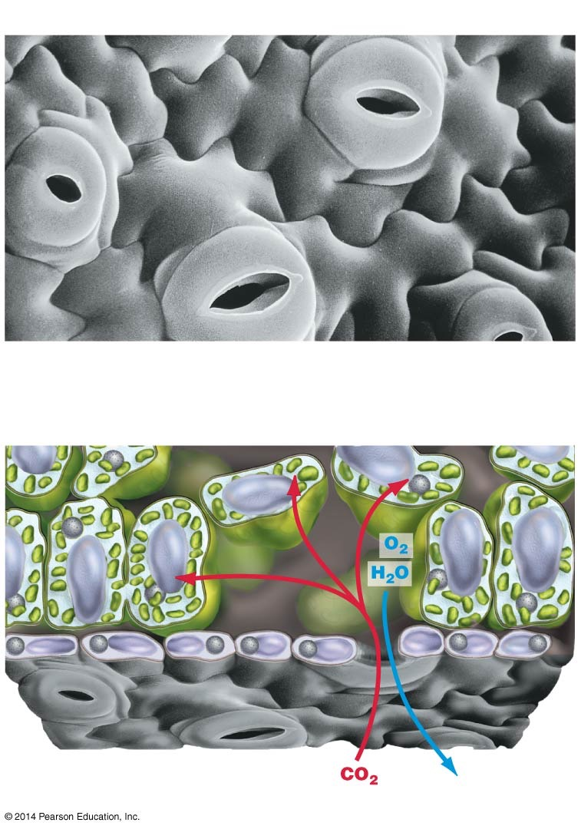
Figure 10.21
(a) Leaf surfaces contain stomata.
Leaf surface
20 μm
Guard cells + Pore = Stoma
(b) Carbon dioxide diffuses into leaves through stomata.
Interior of leaf
Leaf surface
Photosynthetic cells
Extracellular space
Stoma
Notes:
Figure 10.21 Leaf Cells Obtain Carbon Dioxide through Stomata.

Slide 94
Plants Must Balance Water Preservation and CO₂ Delivery
Stomata are normally
Open during the day
Closed at night
On hot, dry days, leaf cells
Lose a great deal of water to evaporation through their stomata
Close the openings and halt photosynthesis
Or risk death from dehydration

Slide 95
Plants Must Balance Water Preservation and CO₂ Delivery
Closing the stomata causes
CO₂ delivery, and thus photosynthesis, to stop
Oxygen levels increase as cellular respiration continues
Increases rates of photorespiration

Slide 96
Mechanisms for Increasing CO₂ Concentration
The C₄ pathway
Occurs mostly in plants from hot, dry habitats
Limits the damaging effects of photorespiration by spatially separating carbon fixation and the Calvin cycle
During carbon fixation, incorporate CO₂ into
4-carbon (C₄) organic acids
Instead of 3-phosphoglycerate (performed by C₃ plants)

Slide 97
Mechanisms for Increasing CO₂ Concentration
In crassulacean acid metabolism (CAM) plants
Carbon fixation and the Calvin cycle are separated in time
Also live in hot, dry habitats
Keep their stomata closed all day
Open them only at night

Slide 98
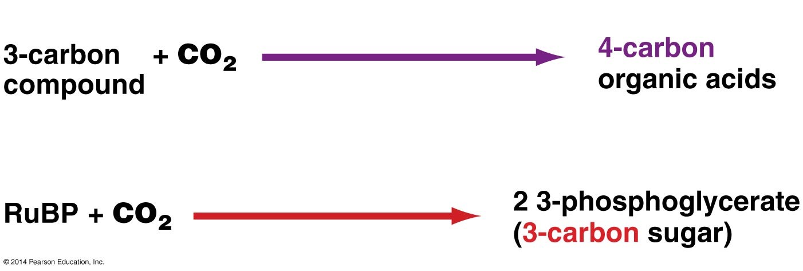
Figure 10.22
C₄ plants:
PEP carboxylase
C₃ plants:
Rubisco
Notes:
Figure 10.22 Initial Carbon Fixation in C4 Plants Is Different from That in C3 Plants.

Slide 99
C₄ Photosynthesis
In C₄ plants
Perform C₄ photosynthesis
Carbon fixation and the Calvin cycle occur in separate cells
The Calvin Cycle occurs in a three-step process
1. PEP carboxylase fixes CO₂
In mesophyll cells
2. 4-carbon organic acids produced travel
To bundle-sheath cells

Slide 100
C₄ Photosynthesis
3. The four-carbon organic acids release a CO₂ molecule
Rubisco uses to form 3-phosphoglycerate
Initiating the Calvin cycle

Slide 101
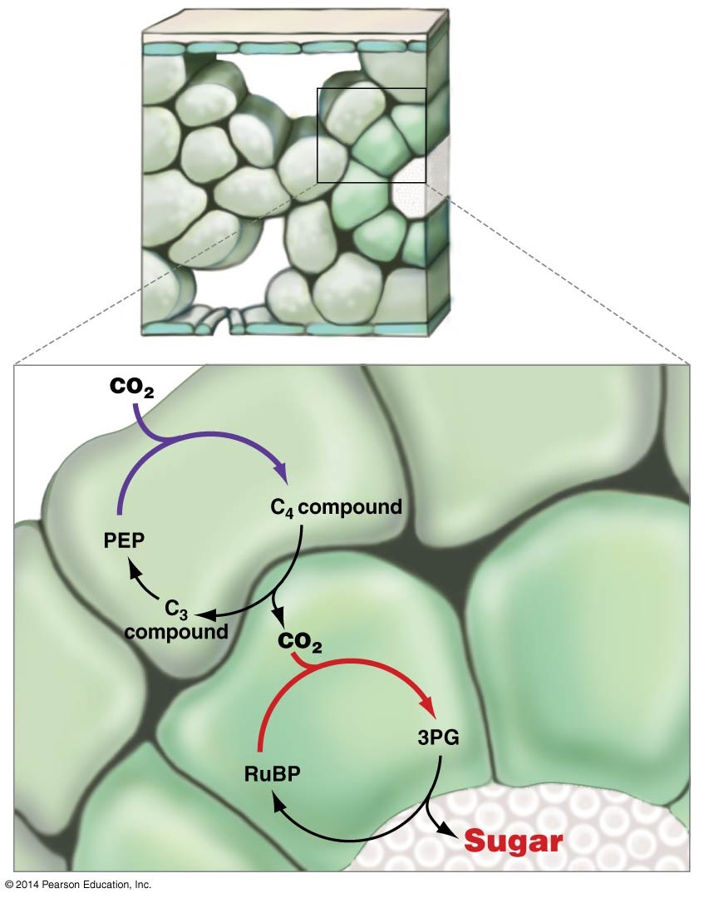
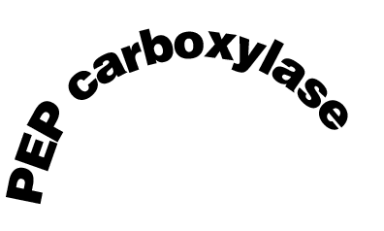

Figure 10.23
(a) C₄ plant
Leaf surface
Mesophyll cells contain PEP carboxylase
Bundle-sheath cells contain rubisco
Vascular tissue
(b)
1
Mesophyll cells
C₄ cycle
2
3
Bundle-sheath cells
Calvin cycle
Vascular tissue
Notes:
Figure 10.23 In C4 Plants, Carbon Fixation and the Calvin Cycle Occur in Different Cell Types.

Slide 102
CAM Plants
During the night, CAM plants take in CO₂
Temporarily fix it into organic acids
During the day, CO₂ is released from the stored organic acids
Used by the Calvin cycle
Minimizing the effects of photorespiration

Slide 103
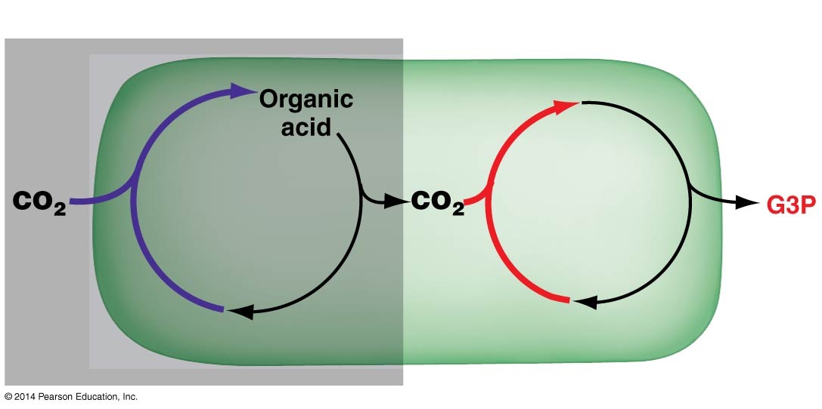
Figure 10.24
CO₂ is stored at night …
… and used during the day.
C₄ cycle
Calvin cycle
Notes:
Figure 10.24 In CAM Plants, Carbon Fixation Occurs at Night and the Calvin Cycle Occurs during the Day.

Slide 104
C₄ and CAM Photosynthesis
C₄ photosynthesis and CAM function as CO₂ pumps
They minimize photorespiration when
Stomata are closed
CO₂ cannot diffuse in directly from the atmosphere
In C₄ plants
The reactions catalyzed by PEP carboxylase and rubisco are separated in space
In CAM plants
The reactions are separated in time

Slide 105
Strategies for Carbon Fixation
Web Activity: Strategies for Carbon Fixation

Slide 106
The Regulation of Photosynthesis
The rate of photosynthesis is finely tuned
To reflect changes in environmental conditions
And use resources efficiently
For example
Light triggers synthesis of photosynthetic proteins
High sugar levels inhibit synthesis of photosynthetic proteins
High sugar levels stimulate production of proteins required for sugar processing and storage

Slide 107
The Fate of Sugar Produced by Photosynthesis
G3P molecules produced by the Calvin cycle are
Often used to make glucose and fructose
Which can be combined to form sucrose
In photosynthesizing cells where sucrose is abundant
Glucose is temporarily stored in the chloroplast as starch
Because starch is not water soluble
It is broken down at night
And used to make more sucrose for transport throughout the plant

Slide 108
Figure 10.24
CO₂ is stored at night …
… and used during the day.
C₄ cycle
Calvin cycle
Notes:
Figure 10.24 In CAM Plants, Carbon Fixation Occurs at Night and the Calvin Cycle Occurs during the Day.

