Slide 1
FISH270
Lecture 4

Slide 2
Reminders
Discussion Board
Question Sets

Slide 3
Building blocks

Slide 4
The week ahead
Carbohydrates
Animal Nutrition
Photosynthesis

Slide 5
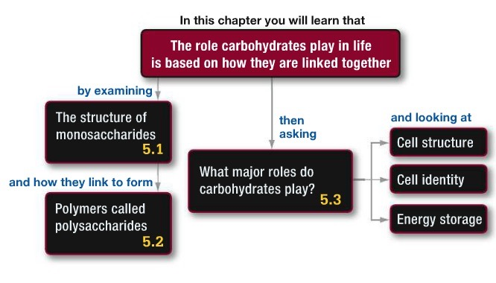
Carbohydrates

Slide 6
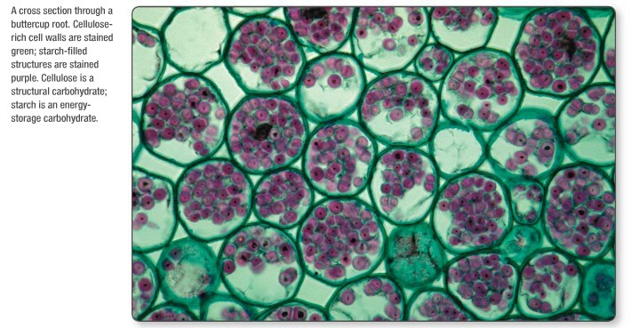

Slide 7
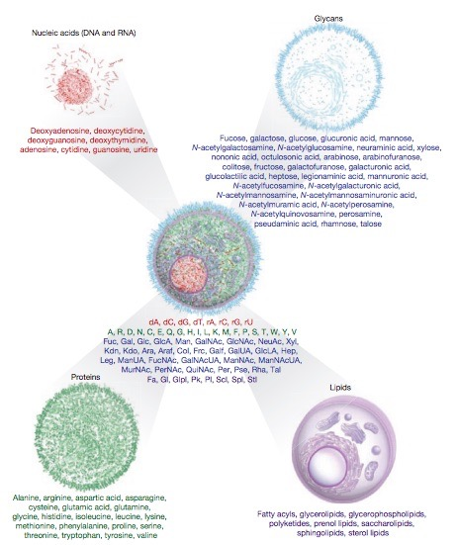

Slide 8
ENERGY!
info
replication
evolution

Slide 9
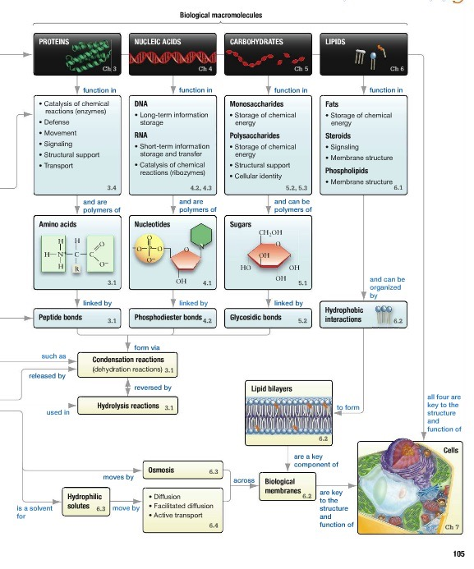
Big
Picture

Slide 10
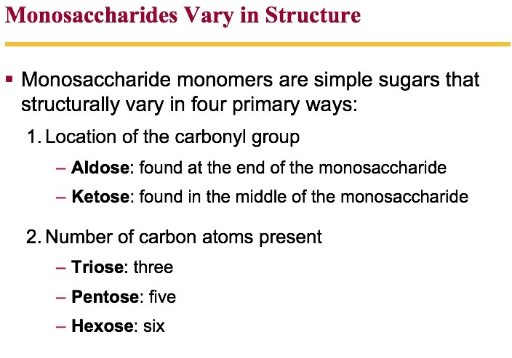

Slide 11
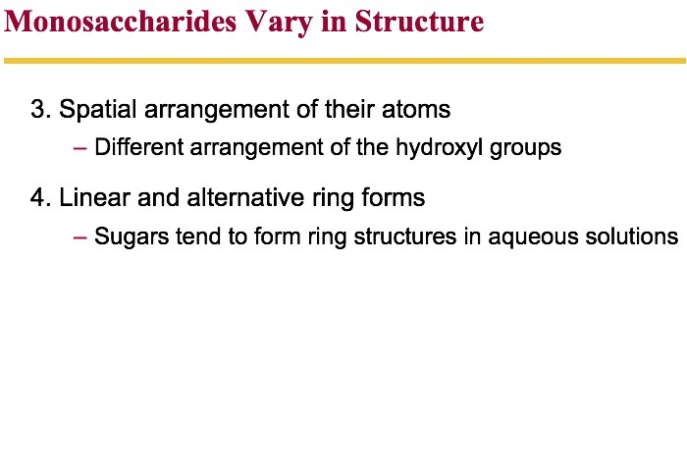

Slide 12
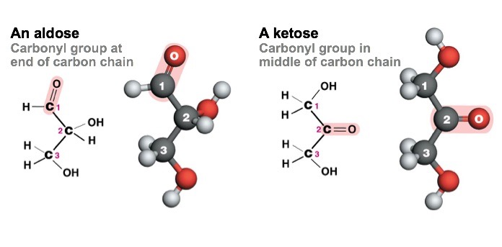

Slide 13
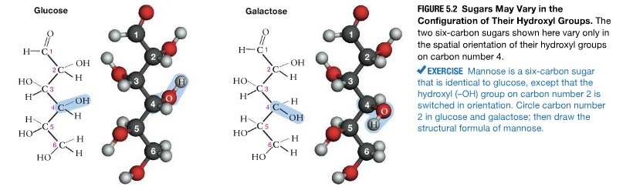


Slide 14
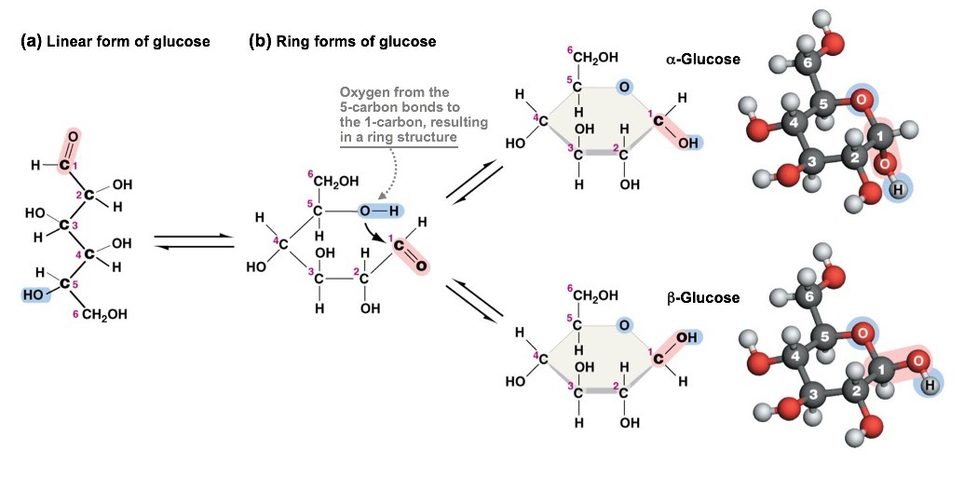

Slide 15
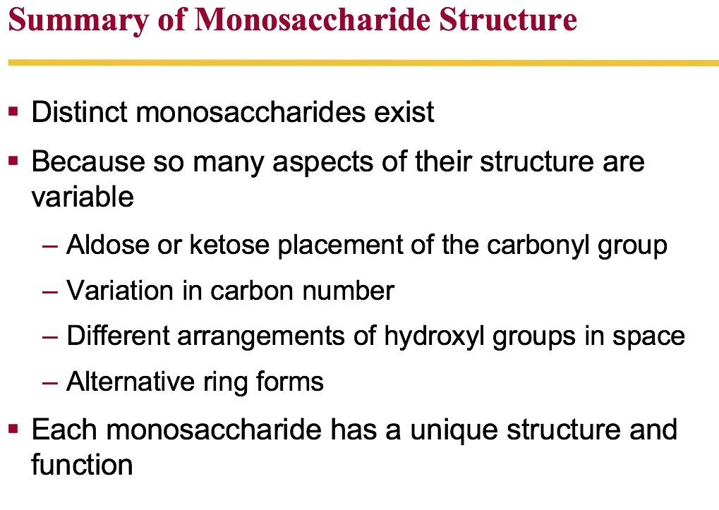

Slide 16
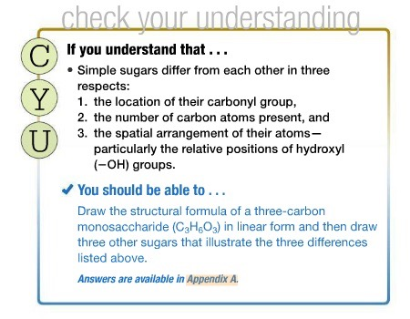

Slide 17
The Structure of Polysaccharides
Polysaccharides, or complex carbohydrates, are polymers of monosaccharide monomers
The simplest polysaccharides are disaccharides
Comprised of two monosaccharide monomers
The monomers can be identical or different
Simple sugars polymerize when
A condensation reaction occurs
Between two hydroxyl groups
Resulting in a covalent bond called a glycosidic linkage

Slide 18
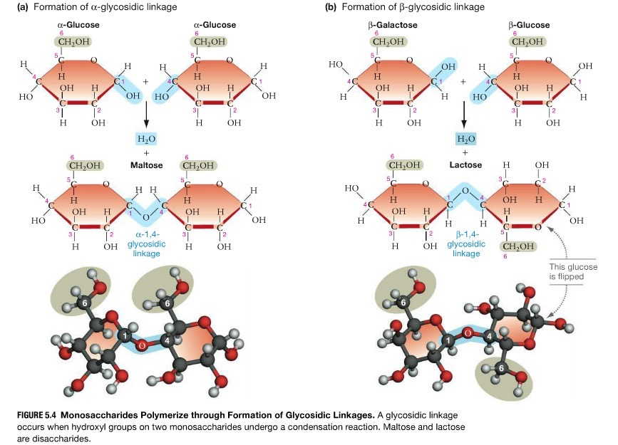
Polysaccarides

Slide 19
Types of Polysaccharides
Plants store sugar as starch
Mixture of branched (amylopectin) and unbranched (amylose) α-glucose polymer
Animals store sugar as glycogen
Highly branched α-glucose polymer
Cellulose: a structural polymer found in plant cell walls
Polymer of β-glucose monomers

Slide 20
Types of Polysaccharides
Chitin: a structural polymer found in fungi cell walls, some algae, and many animal exoskeletons
Comprised of N-acetylglucosamine (NAc) monomers
Peptidoglycan: structural support for bacterial cell walls
Backbones of alternating monosaccharides

Slide 21
Polysaccharides
Starch
Glycogen
Cellulose
Chitin
Peptidoglycan

Slide 22
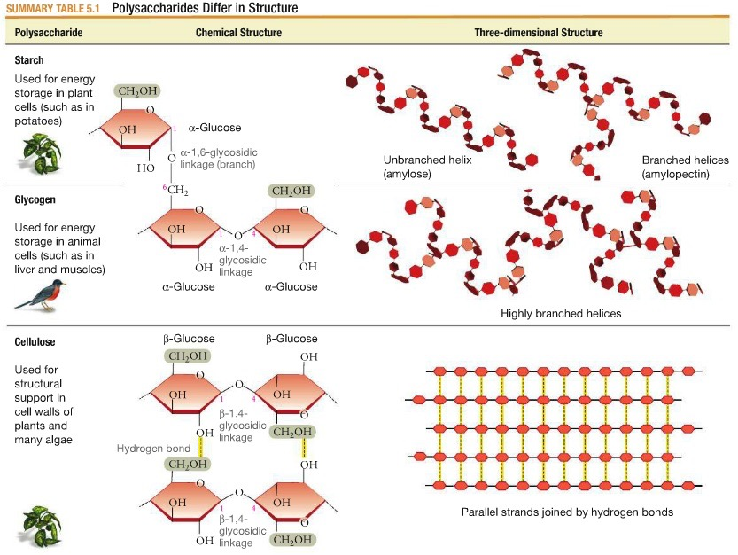

Slide 24
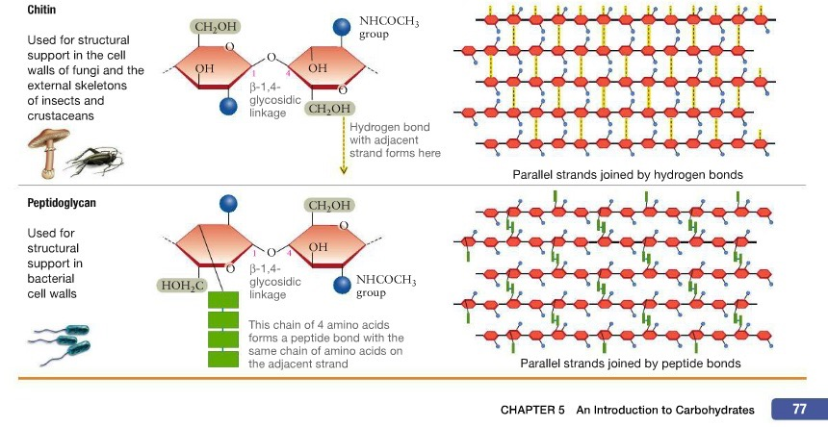

Slide 26
What Do Carbohydrates Do?

Slide 27
Precursors to larger molecules
Provide fibrous structural materials
Indicate cell identity
Store chemical energy

Slide 28
Carbohydrates Can Provide Structural Support
They provide fibrous structural materials
Water is excluded and the fibers tend to be insoluble
Due to the strong interactions between strands consisting of β-1,4-glycosidic linkages
The absence of water within these fibers makes their hydrolysis more difficult
As a result, the structural polysaccharides are resistant to degradation and decay

Slide 29
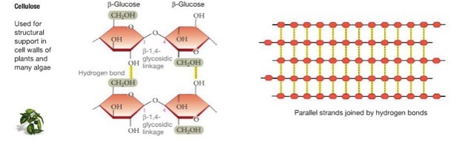
Structure

Slide 30
Carbohydrates: Cell Identity
Carbohydrates indicate cell identity
Display information on the outer surface of cells in the form of glycoproteins
Proteins joined to carbohydrates by covalent bonds
Glycoproteins are key molecules in
Cell–cell recognition
Each cell in your body has glycoproteins on its surface
Identify it as part of your body
Cell–cell signaling

Slide 31
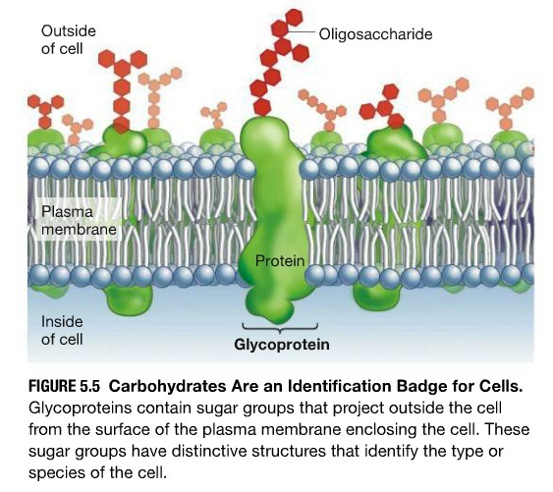
Cell Identity

Slide 32
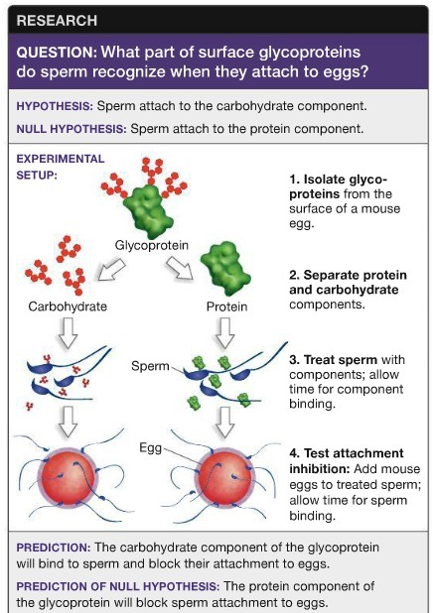

Slide 33
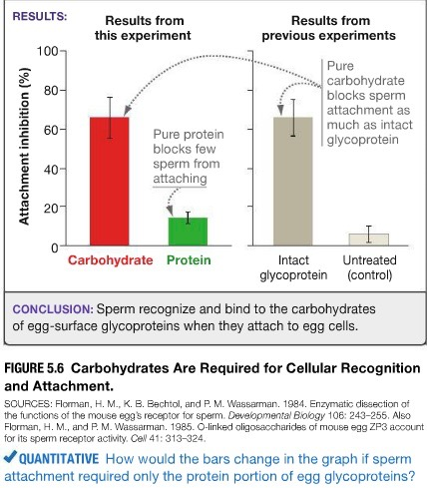

Slide 34
Energy Storage

Slide 35
Carbohydrates and Energy Storage
Carbohydrates store chemical energy
They also provide chemical energy in cells
In chemical evolution
Kinetic energy of sunlight and heat were converted into chemical energy stored in the bonds of H₂CO and HCN
Today, most sugars are produced via photosynthesis
A key process that transforms the energy of sunlight into the chemical energy of C–H bonds in carbohydrates

Slide 36
Carbohydrates and Energy Storage
Carbohydrates have more free energy than CO₂
Electrons in C–H bonds and C–C bonds are shared more equally
Held less tightly than they are in C–O bonds

Slide 37
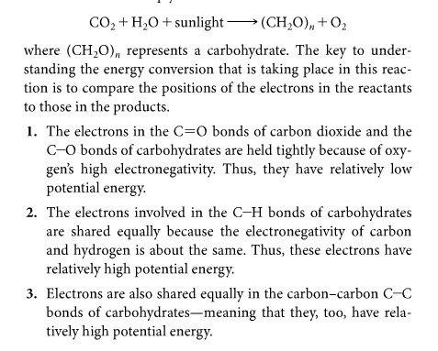
Energy Storage
Photosynthesis

Slide 38
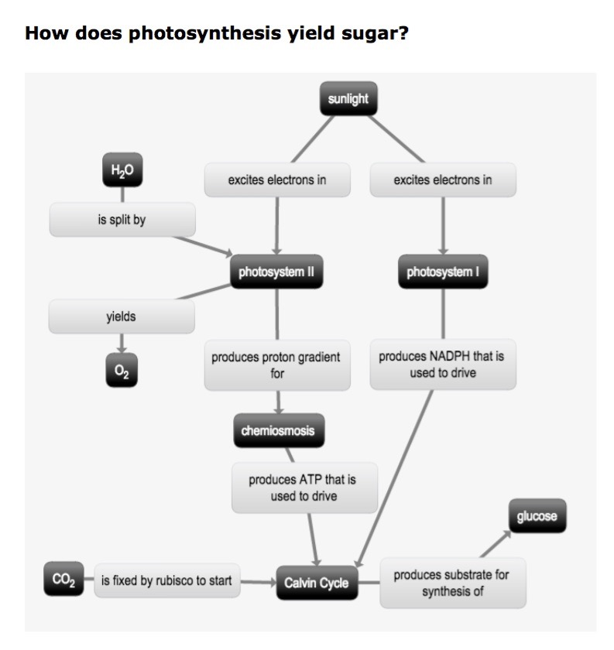

Slide 39
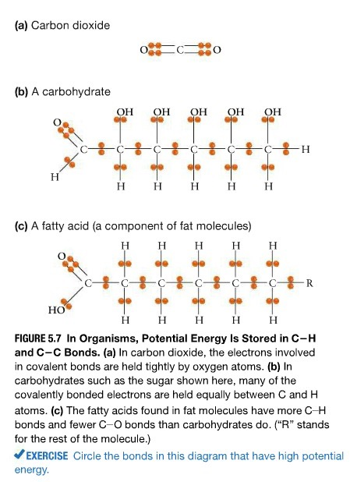


Slide 40
Starch and Glycogen Are Hydrolyzed to Release Glucose
The hydrolysis of α-glycosidic linkages in glycogen is catalyzed by the enzyme phosphorylase
Most animal cells contain phosphorylase
They can readily break down glycogen to provide glucose
The α-glycosidic linkages in starch are hydrolyzed by amylase enzymes
Amylases play a key role in carbohydrate digestion

Slide 41
Energy Stored in Glucose Is Transferred to ATP
When a cell needs energy, carbohydrates participate in
Exergonic reactions that synthesize adenosine triphosphate (ATP):
CH₂O + O₂ + ADP + P_{i} → CO₂ + H₂O + ATP
The free energy in ATP is used to drive endergonic reactions and perform cell work
Carbohydrates contain a large number of C–H bonds
These bonds have high free energy
Fatty acids have even more C–H bonds
They have more free energy than carbohydrates

Slide 42
How Do Carbohydrates Store Energy?
Starch and glycogen are efficient energy-storage molecules
The α-linkages are readily hydrolyzed
The β-linkages of structural carbohydrates resist enzymatic degradation
The enzyme amylase catalyzes hydrolysis of α-glycosidic linkages in glycogen

Slide 43
How Do Carbohydrates Store Energy?
The enzyme phosphorylase catalyzes hydrolysis of α-glycosidic linkages in starch
α-glycosidic linkages in glycogen and starch, respectively
The released glucose subunits can then be used in the production of ATP

Slide 44
Energy Stored in Glucose Is Used to Make ATP
When a cell needs energy
Reactions lead to the breakdown of the glucose
They also capture released energy through synthesis of the nucleotide adenosine triphosphate (ATP)
The chemical energy stored in the C–H and C–C bonds of carbohydrate is transferred to a new bond linking a third phosphate group to ADP to form ATP
Carbohydrates store chemical energy
ATP makes chemical energy useful to the cell

Slide 45
