Slide 1
FISH270
Lecture 3

Slide 2
4 processes that shift alleles - causing Evolution
Natural Selection
Genetic Drift
Mutation
Gene Flow

Slide 3
Environment

Slide 4
Ecology
Review

Slide 5
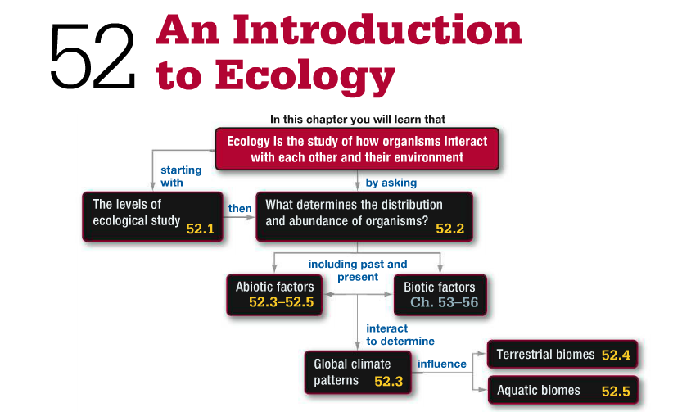

Slide 6
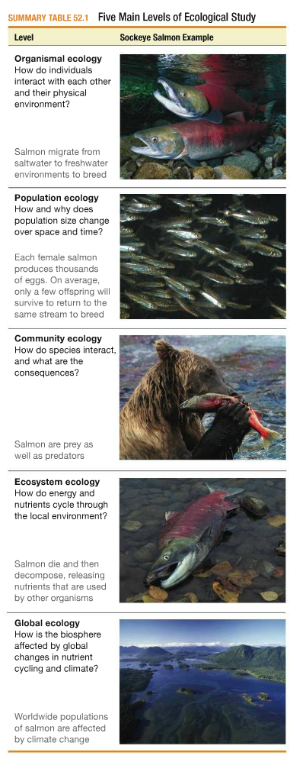

Slide 7
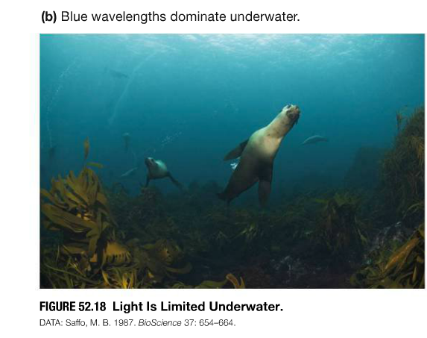
Aquatic Biomes

Slide 8
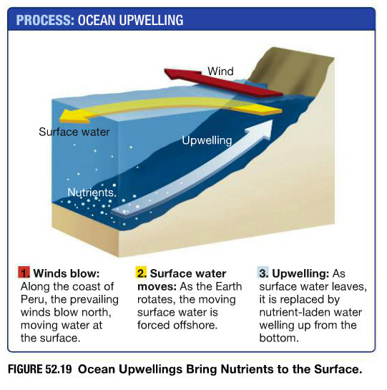
Aquatic Biomes

Slide 9
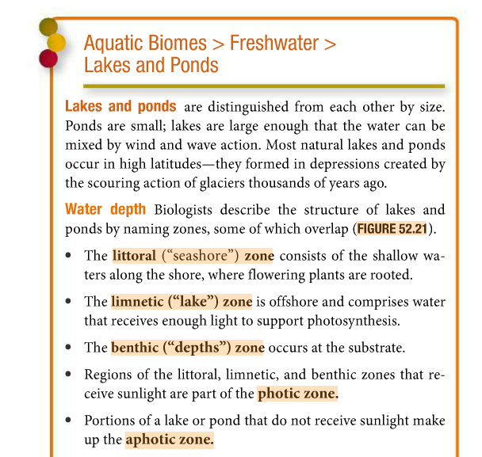
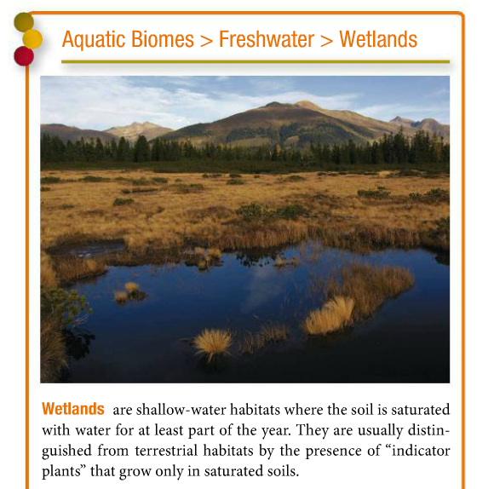
Aquatic Biomes

Slide 10
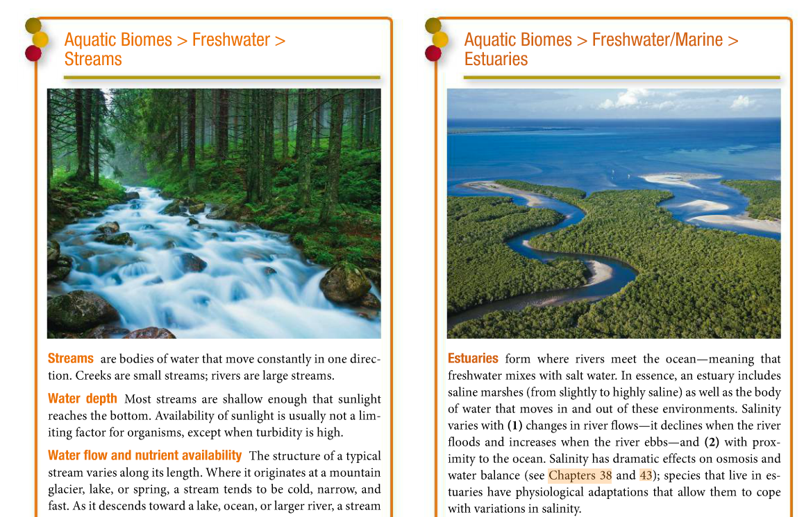
Aquatic Biomes

Slide 11
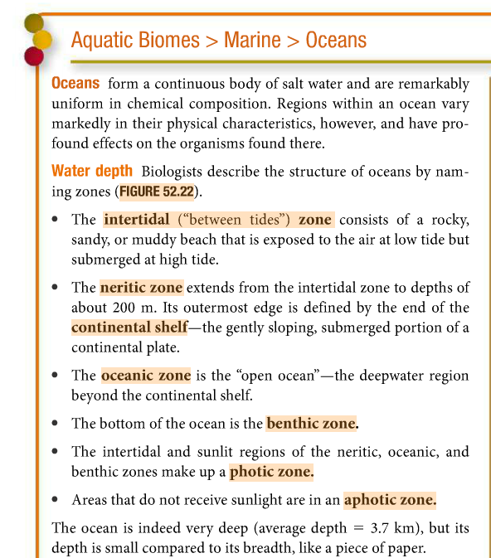
Aquatic Biomes

Slide 12
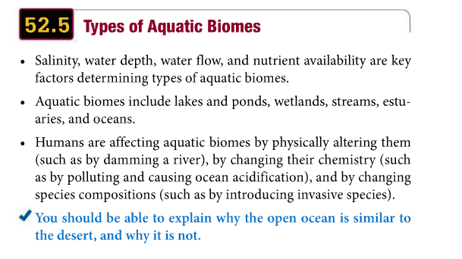

Slide 13
How organisms adapt and successes in different aquatic environments: Introduction to functional adaptations to the environment:
o Respiratory adaptations (aquatic vs. terrestrial, anoxia, etc.)
o Osmotic adaptations (osmotic/ionic regulation, differences in fresh sea water/terrestrial ecosystems, etc.)
o Light adaptations (photoreception, pigments, circadian rhythms, bioluminescence, etc)
o Thermal adaptation (endothermic vs. exothermic, polar vs. tropical)
o Electromagnetic and gravitational adaptations (electroreception, electrogenesis, adaptation to hydrostatic pressure, air bladder, etc)
o Reproductive adaptations (sexual vs. asexual, internal vs. external, r/k strategies, etc)
o Defensive adaptations (simple –swimming and hiding- and complex tactics –spines, chemicals-)
o Feeding adaptations
o Locomotion adaptations

