Slide 1
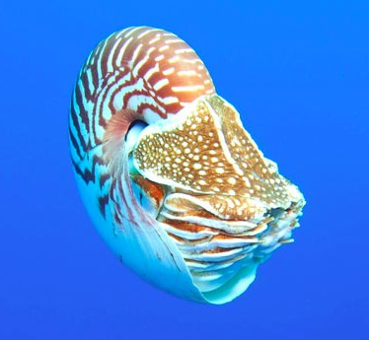
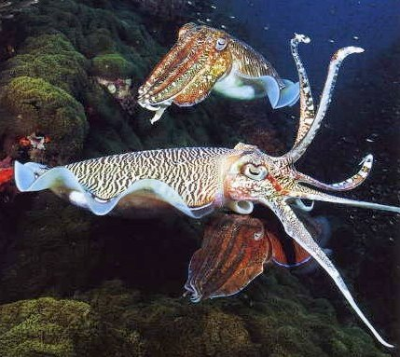
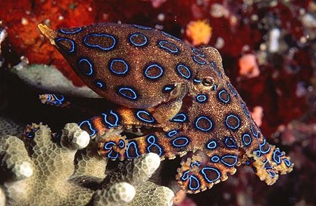
Mollusca: Class Cephalopoda
Lecture 11

Slide 2
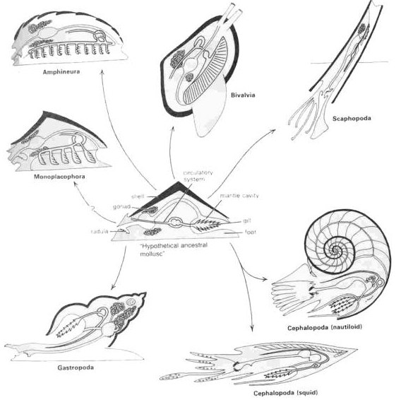
Cephalophod Characteristics
Characteristics of class
All marine
Most 6-70 cm up to 20m Architeuthis
Shell divided by septa, chambers connected by siphuncle
Closed circulatory system
Foot modification
Ganglia fused to form large brain in cartilaginous cranium
~700 species (~10K extinct) & 46 families

Slide 3
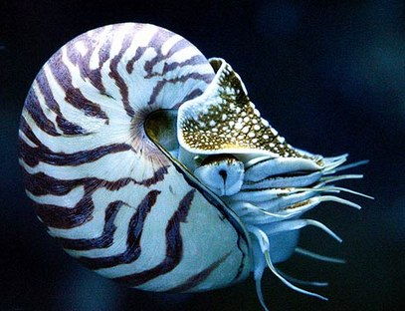
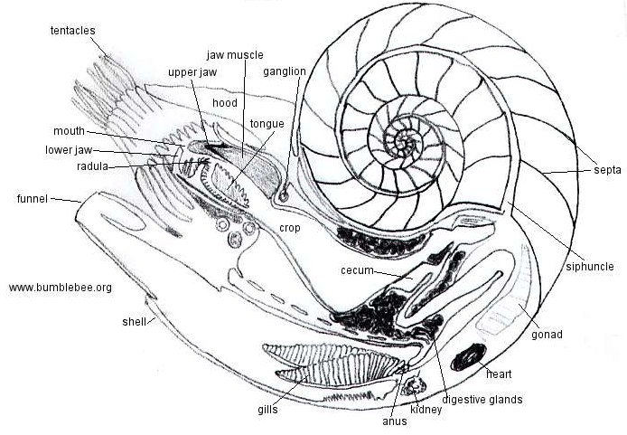
Cephalopod Morphology
Shell
Tentacles
Siphuncle
Septa
Radula
Funnel
Shell
Gills
Heart

Slide 4
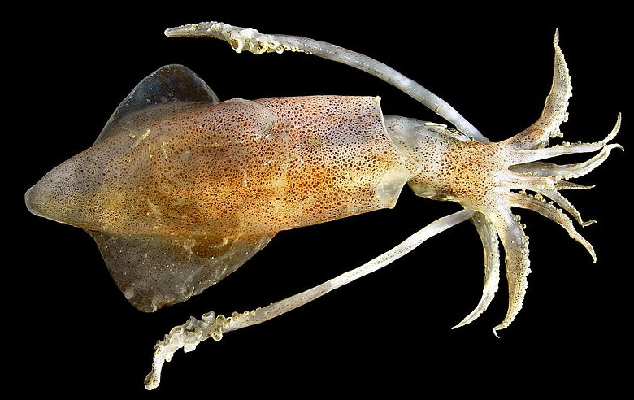
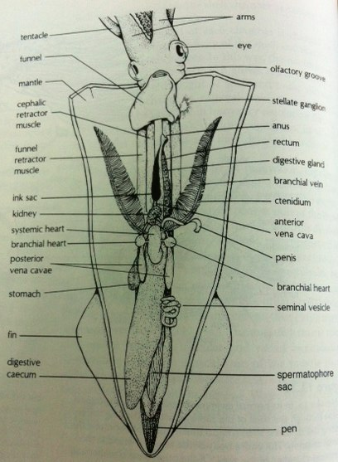
Cephalopod Morphology
Mantle
Arms
Fins
Extendable Tentacle

Slide 5
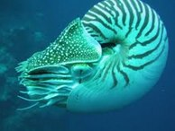
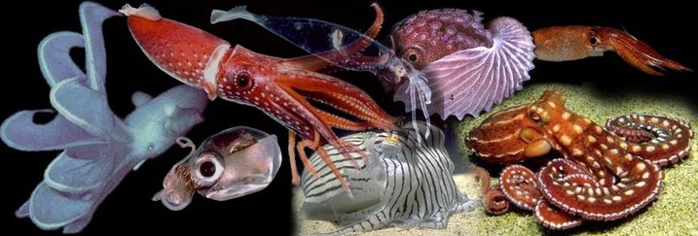
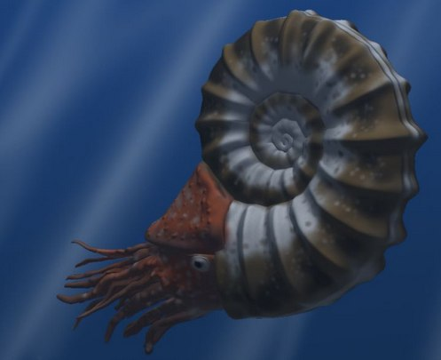
Taxonomy
Nautiloidea
Coleoidea
Ammonoidea

Slide 6
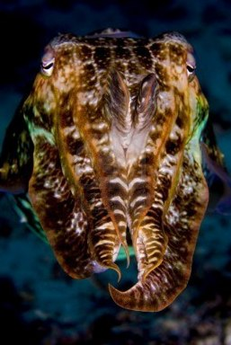
Cephalopod ecology
Strictly marine, none can tolerate freshwater
Occupy most depths of ocean- from abyssal plain to sea surface
All are predators and use tentacles to catch prey, beak to consume

Slide 7
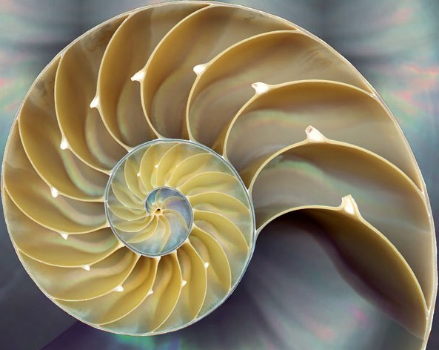
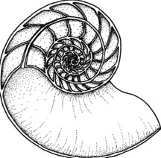
Cephalopod Shells
Nautilus possess a true external shell
Hypostracum, Ostracum, Periostracum
Shell spiral and divided by septa
Animal in largest outermost chamber
Septa penetrated by siphuncle
Calcified tube
Osmotic pump empty water from chambers, buoyancy
http://www.fhperry.com/pages/relationships.html

Slide 8
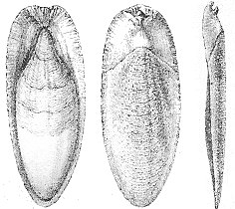
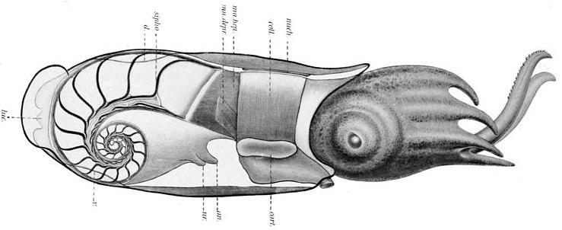
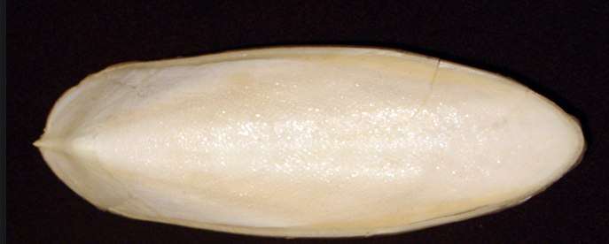
Shells and Buoyancy Regulation
Nautilus: chambered shell
Gas diffusion into gap between mantle and shell
Cuttlefish: internal chambered shell involved in buoyancy regulation
Squid: internalized shell=pen
Regulate water volume

Slide 9
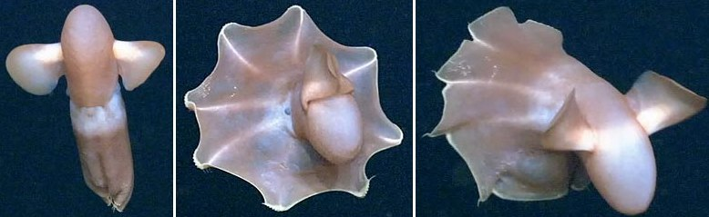
Movement
Jet propulsion
Nautilus: Expel water from mantle cavity through funnel
Other cephalopods: contract and expand mantle tissue
Escaping predators and capturing prey
Arms (Octopus) or muscular lateral fins (squid and cuttlefish)

Slide 10
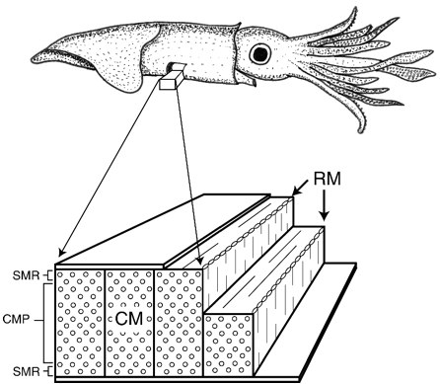
Jet Propulsion
Water enter cavity through one-way valves
Influx cause animal to draw forward
Muscles relax, large volume of water expelled
Enable cephalopod to move at high speed
Circular and radial muscles

Slide 11
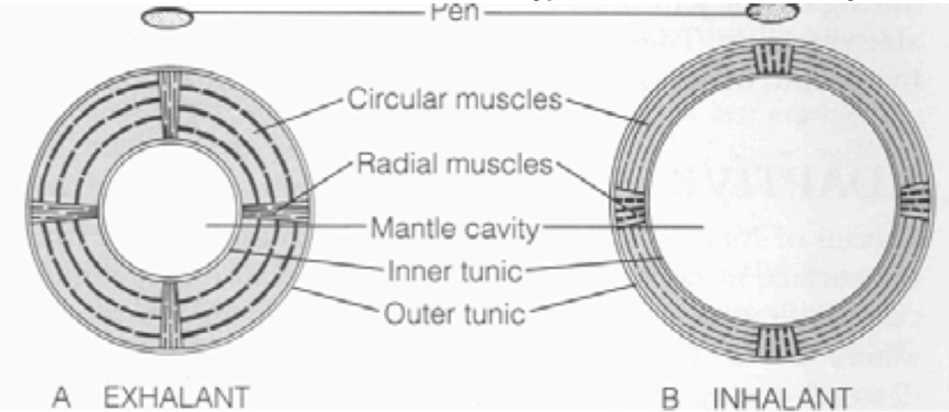
Jet Propulsion
Circular and radial muscles
Contraction of circular muscles expels water
Contractions of radial muscle hyperextends mantle cavity

Slide 12
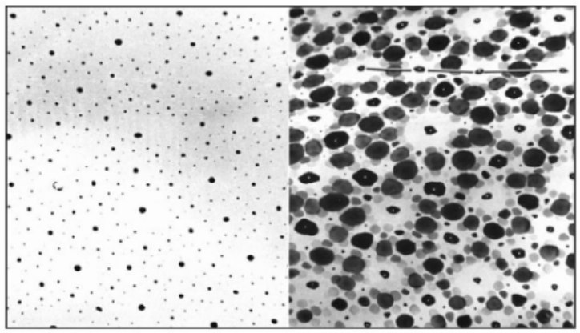
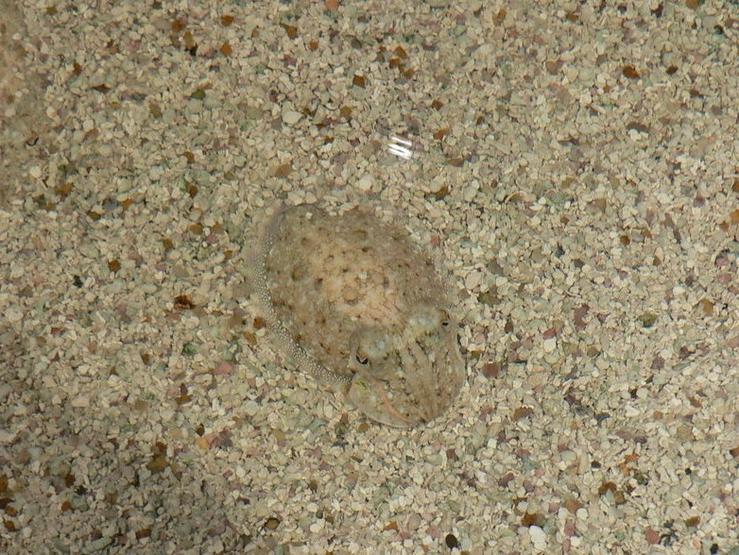
Cephalopod protection
Chromatophores
Tiny colored cells or pigment sacs that overlay reflective cells (iridocytes)
Muscle contraction=sac expansion
Defensive, camouflaging, and courtship behaviors
Red, yellow, black and brown

Slide 13
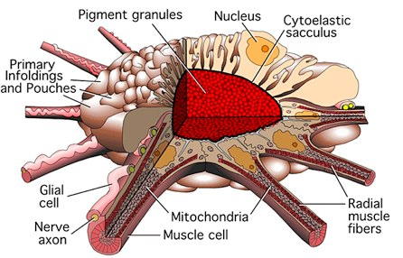
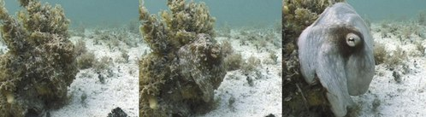
Cephalopod protection
Iridophores
Brain reads changing light passing through eye, trigger electrical instructions
Appear as shifting iridescent colors depending on the angle of light

Slide 14
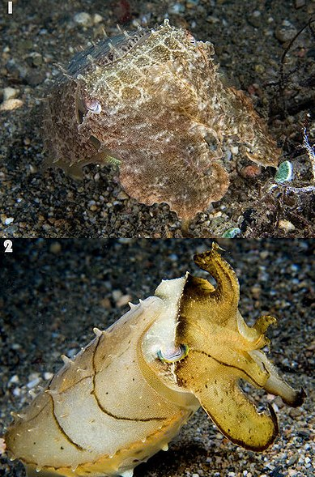
Cephalopod protection
Iridophores
Pigment cells that diffract light using plates of crystalline chemochromes
When illuminated, generate iridescent colors from reflecting light within stacked plates
Light hits plates, some reflected and some passes through
Can match wavelength of different colors of light by controlling size of gap between plates
Metallic greens and blues

Slide 15
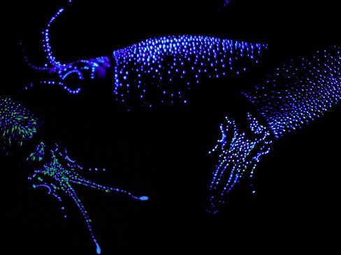
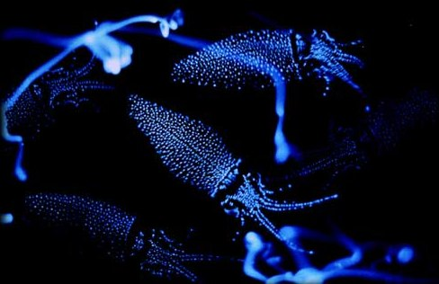
Cephalopod protection
Photophores- light production by biochemical reactions
Bioluminescence: biochemical production of light with minimal heat
Produced by symbiotic bacteria living within photophores
Attracting/recognizing mates, luring in prey, and protecting against predation

Slide 16
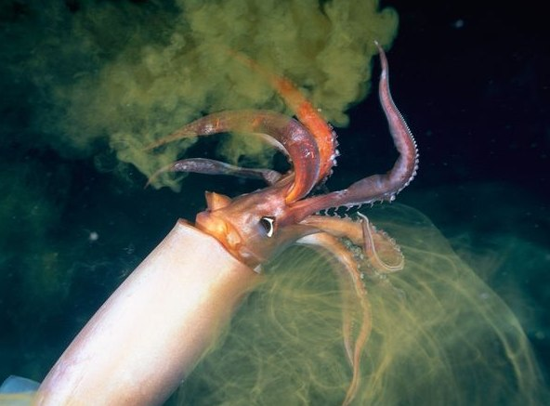
Cephalopod protection
Ink Sac
Most cephalopods other than Nautilus
Dark-pigmented fluid=melanin and mucous
Form a cloud that confuses potential predators
May act as mild narcotic

Slide 17
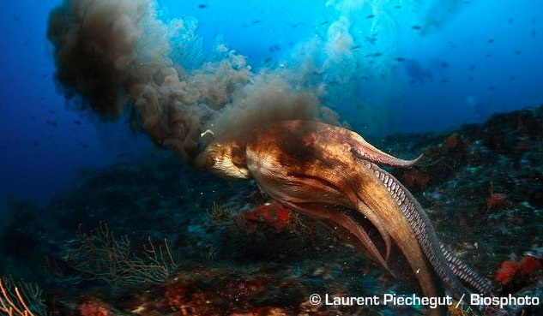
Cephalopod protection
Ink Sac
Pseuodomorph decoy
Greater mucus content
Resemblance to cephalopod that released it

Slide 18
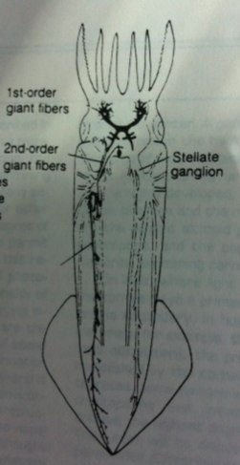
Nervous System
Highly developed- correlated with locomotor dexterity
Cephalization encased in cartilaginous cranium
Large complex highly differentiated brain
Nerves from visceral ganglia supply the mantle
Command center: pair of very large neurons, fired by impulses from sensory organs

Slide 19
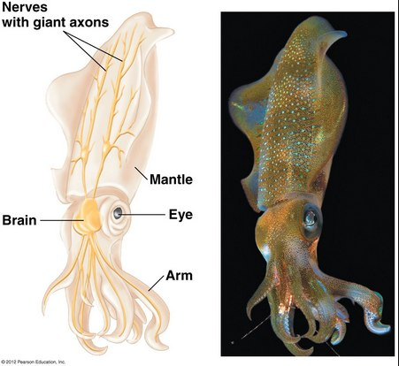
Squid giant axon: providing clues to nerve cell repair
Giant axon up to 1mm in diameter
Model for nerve cell repair
Inject membrane with fluorescent dyes visualize what occurs when nerve injured
Axon membrane diameter shrinks and vesicles travel to site of injury

Slide 20
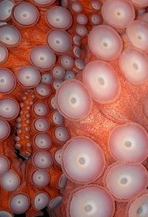
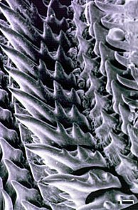
Feeding Mechanisms
Raptorial feeding and carnivorous diet
Tentacles with adhesive suckers
Rim is toothed and inner wall has hooks
Radula
Pair of powerful beak-like jaws
Two pairs of salivary glands
Anterior=mucous
Posterior=poison, proteolytic enzymes (Octopus)

Slide 21
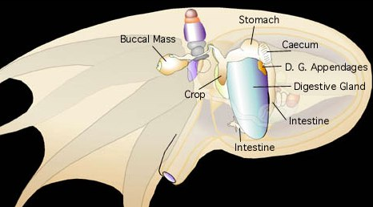
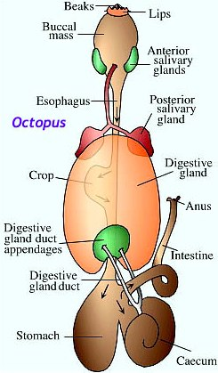
Digestive System
Complete digestive system with food transport via peristalsis
Digestive glands or digestive caeca
Digestion is extracellular
Absorption
Cecal walls=thin (Loligo)
Digestive gland=thick (Sepia and Octopus)
Waste through anus

Slide 22
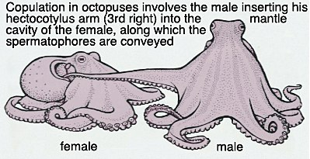
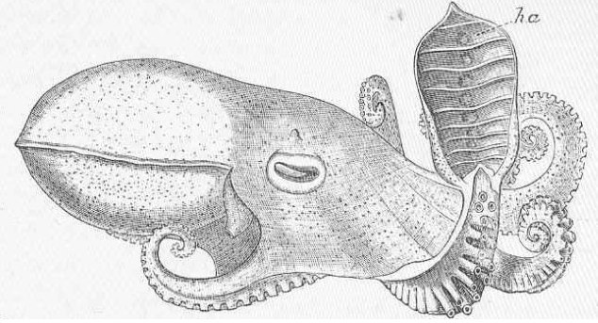
Cephalopod Reproduction
No known hermaphrodites
Usually dioecious: gonads in posterior of body
Internal fertilization
One arm of male modified as a copulatory organ to transfer sperm (hectocotylus)

Slide 23
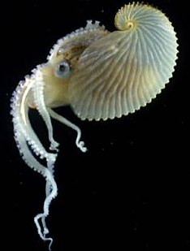
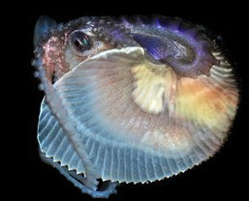
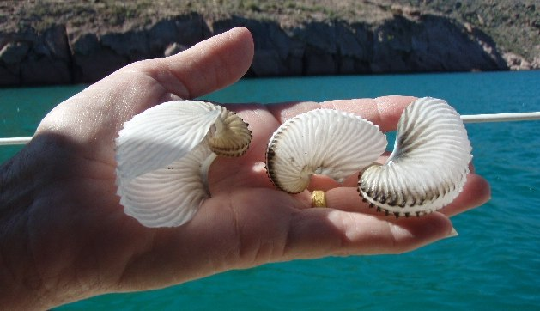
Paper Nautilus: Argonauta
Pelagic octopus
Adaptation for egg deposition
Eggcase secreted by tips of two expanded dorsal arms of female
Deposit eggs directly into case
Shell act as a brood chamber and a retreat for the female
Eggcase contains bubble of air used for buoyancy

Slide 24
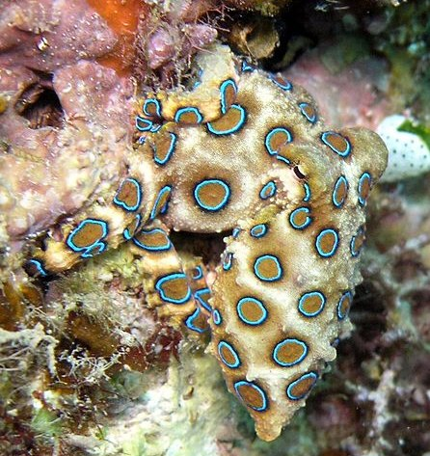
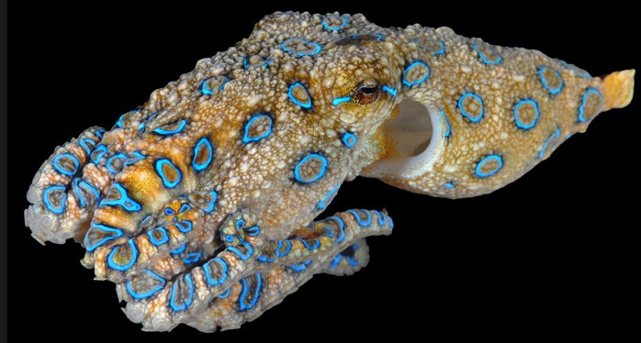
Blue-ringed octopus
Genus Hapalochlaena
Tide pools and coral reefs in Indian and Pacific Oceans
Use chromatophores to camouflage, changes color when provoked
One of the world’s most venomous animals, powerful enough to kill humans with no antivenom
Neurotoxin 100x more powerful than cyanide
Blocks sodium channels, causing motor paralysis and respiratory arrest
Produced by bacteria in salivary glands

Slide 25
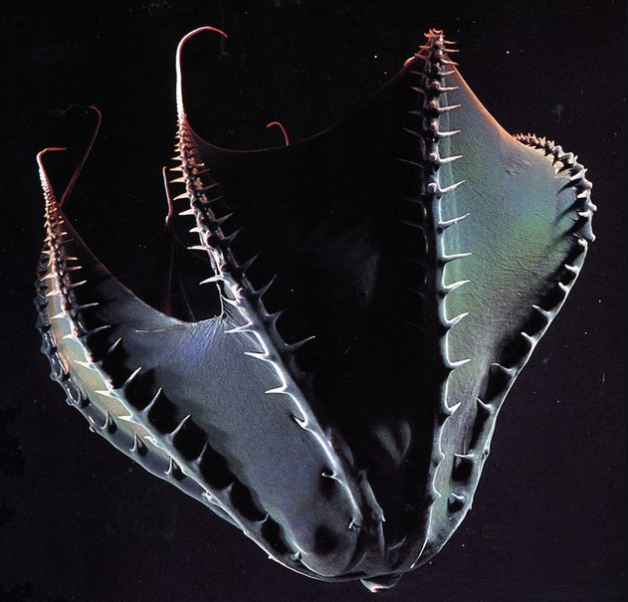
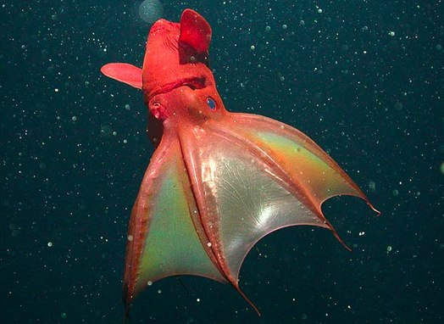
Vampire squid Vampyroteuthis infernalis
Deep sea in temperate and tropical areas
Radical adaptations to life in deep sea
Lowest mass-specific metabolic rate
Sophisticated statocysts
Ammonium-rich tissues
No ink sac,
Bioluminescent mucus as defense system
Turn inside-out

Slide 26
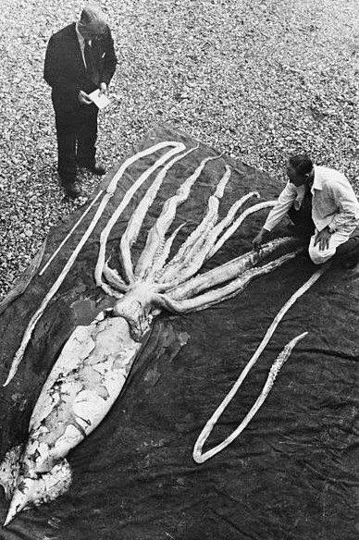
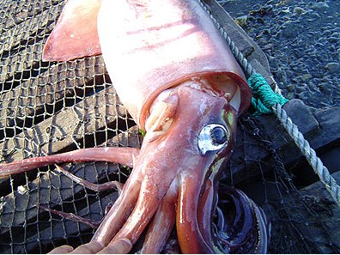
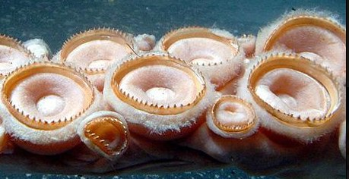
The Giant Squid: Architeuthis dux
Elusive creature
Eyes among the largest in the world- adaptation
Tentacles with suction cups with rings of chitin
Highly complex nervous system and highly developed brain

Slide 27
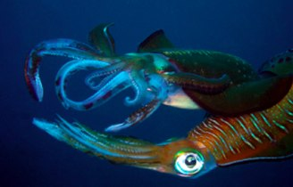
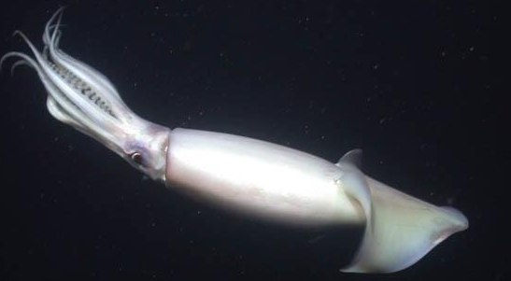
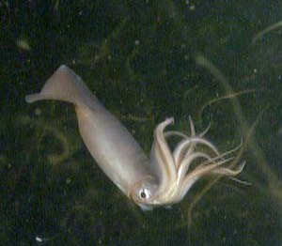
Humboldt squid migration
Squids moving north in response to overfishing and climate change
Ocean acidification changing their metabolism, driving them to shallower water

Slide 28
Awesome Videos!
Octopus camouflage: http://www.youtube.com/watch?v=PmDTtkZlMwM
Cuttlefish camouflage: http://www.youtube.com/watch?v=__XA6B41SQQ
Vampire squid: http://www.youtube.com/watch?v=IWAnliNc6wk

