Slide 1
Assessing environmental drivers of Olympia oyster population genetic diversity in Puget Sound, WA
OLYMPIA OYSTER · LOW-COVERAGE WHOLE-GENOME SEQUENCING
Zachary Bengtsson, Julieta Martinelli, Steven Roberts
International Conference on Shellfish Restoration
Notes:
~30 s. Introduce the team and the question: do environmental gradients across Puget Sound leave a genomic signature in Olympia oysters, beyond what geography and population history explain? This talk focuses on the population comparison using the new chromosome-level genome, then the redundancy analysis (RDA).

Slide 2
Restoration needs to know where seed should come from
BACKGROUND
A native species to restore
Sharp local gradients
The open question
Ostrea lurida is the West Coast's native oyster, and restoration in Puget Sound depends on moving broodstock and seed.
Inlets differ by more than 8 °C in summer temperature and many-fold in salinity swings and chlorophyll.
Is genetic variation shaped by today's environment, or mainly by geography and shared history?
If environment drives adaptation, seed should be matched by conditions; if history dominates, by genetic group.
Bengtsson, Martinelli & Roberts · Olympia oyster lc-WGS
2
Notes:
~50 s. Frame the management stakes: seed-transfer decisions. Two competing expectations: environment-matched sourcing vs. sourcing by genetic group. Our analyses are designed to tell those apart.

Slide 3
Where should restoration seed come from?
THE QUESTION
Match the environment
Match the genetic group
Source seed from beds with similar temperature, salinity and food, on the idea that oysters are tuned to local water.
Source seed from the same genetic “family” of populations, keeping natural groupings intact.
Works if water conditions shape oyster genetics.
Works if shared history shapes oyster genetics.
We asked which of these better explains the genetic differences we see among Puget Sound oyster beds.
Olympia oyster genetics · Bengtsson, Martinelli & Roberts
Notes:
~60 s. Olympia oysters are our only native oyster and restoration involves moving seed and broodstock among bays. Two common rules of thumb: match the environment, or keep within genetic groups. They lead to different sourcing decisions. Our study tests which one the oysters' genomes support.

Slide 4
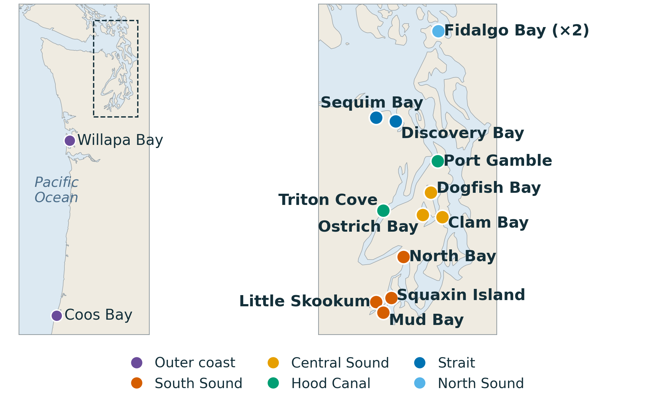
15 collections span the Salish Sea and outer coast
SAMPLING DESIGN
109
oysters analysed (one low-depth sample dropped)
15
collections: 13 in the Salish Sea plus Willapa Bay and Coos Bay
~7×
mean sequencing depth per oyster
Bengtsson, Martinelli & Roberts · Olympia oyster lc-WGS
Notes:
~50 s. Walk the map north to south: Fidalgo Bay, Strait sites (Sequim, Discovery Bay), Hood Canal (Port Gamble, Triton Cove), Central Sound (Dogfish, Ostrich Bay, Clam Bay area), South Sound (North Bay, Squaxin, Little Skookum, Mud Bay), then the two outer-coast sites as outgroups. Seven to eight oysters per site. Note Fidalgo Bay has two collections (2018 and another set), which becomes useful later.

Slide 5
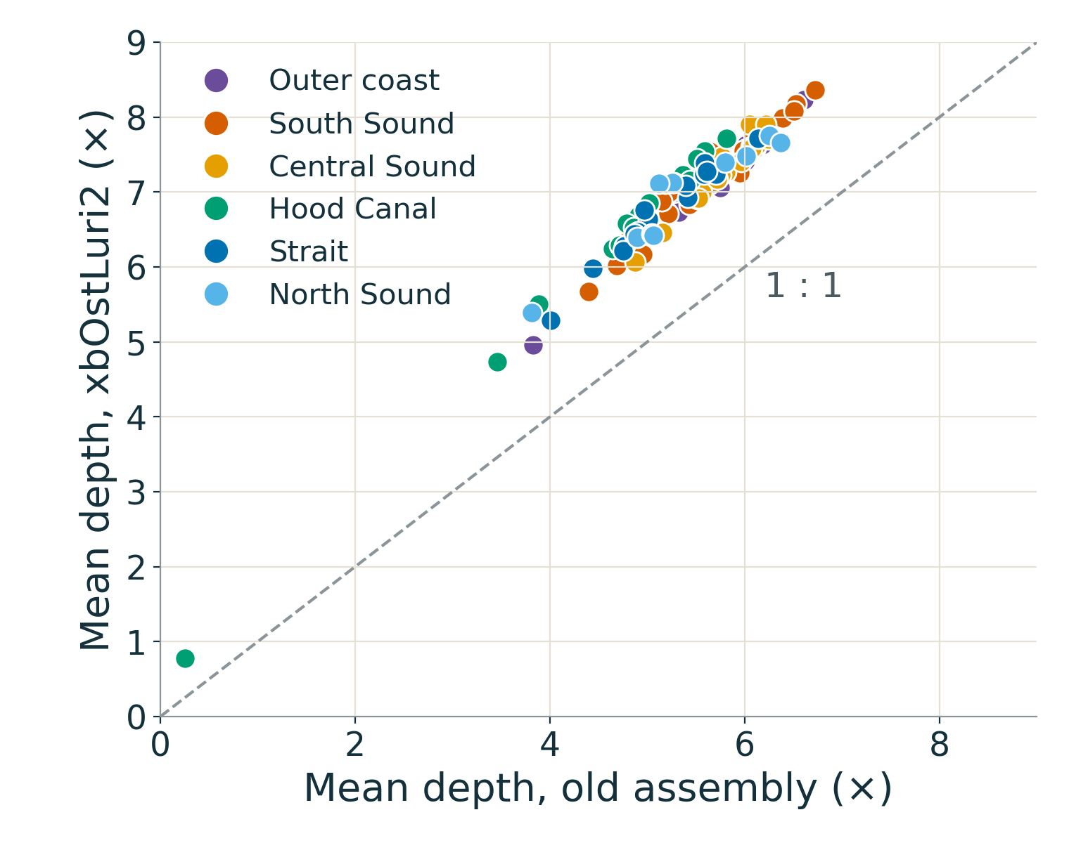
A chromosome-level genome raises depth and resolution
NEW REFERENCE GENOME
Metric | Olurida_v081 | xbOstLuri2
Assembly | contigs, N50 12.9 kb | 10 chromosomes, 995 Mb
Mean depth | 5.4× | 7.0×
Reads mapped | — | 98.6%
Every oyster gained depth (≈ 1.3× on average), and SNPs can now be placed by chromosome and position.
Reference: GCA_061535525.1 (USDA-ARS / PSRF)
Bengtsson, Martinelli & Roberts · Olympia oyster lc-WGS
Notes:
~50 s. All 112 libraries (including two blanks) were re-aligned to the chromosome-level assembly. The old reference was highly fragmented (contig N50 12.9 kb). Depth per oyster rose about 30%, mapping is ~98.6% everywhere, and every SNP now has a chromosome coordinate, which is what makes the genome-wide outlier scan later possible. The one low outlier (Triton Cove 10, <1×) was excluded.

Slide 6
Genotype likelihoods carry low-depth data to the RDA
APPROACH
1
2
3
4
5
Align
Likelihoods
Structure
Environment
RDA
bwa-mem to xbOstLuri2; duplicates marked; 109 oysters kept
ANGSD genotype likelihoods: 7.42 M SNPs, MAF ≥ 0.05, present in ≥ 87 oysters
PCAngsd PCA and admixture (K 2–6); folded SFS for θ, π and Tajima's D; pairwise Fst
WA Ecology CTD and ORCA moorings, 2015–2018: 0–5 m monthly climatologies
Site allele frequencies against environment, geography (dbMEM) and structure; permutation tests
At ~7× per oyster, hard genotype calls miss heterozygotes. Likelihoods keep that uncertainty all the way into population allele frequencies.
Bengtsson, Martinelli & Roberts · Olympia oyster lc-WGS
5
Notes:
~45 s. Pipeline in one breath. Key point for a low-coverage audience: everything downstream (PCA, admixture, SFS, Fst, and the RDA allele frequencies) comes from genotype likelihoods rather than called genotypes. The RDA is run on site-level allele frequencies so that sites, not oysters, are the units of replication.

Slide 7
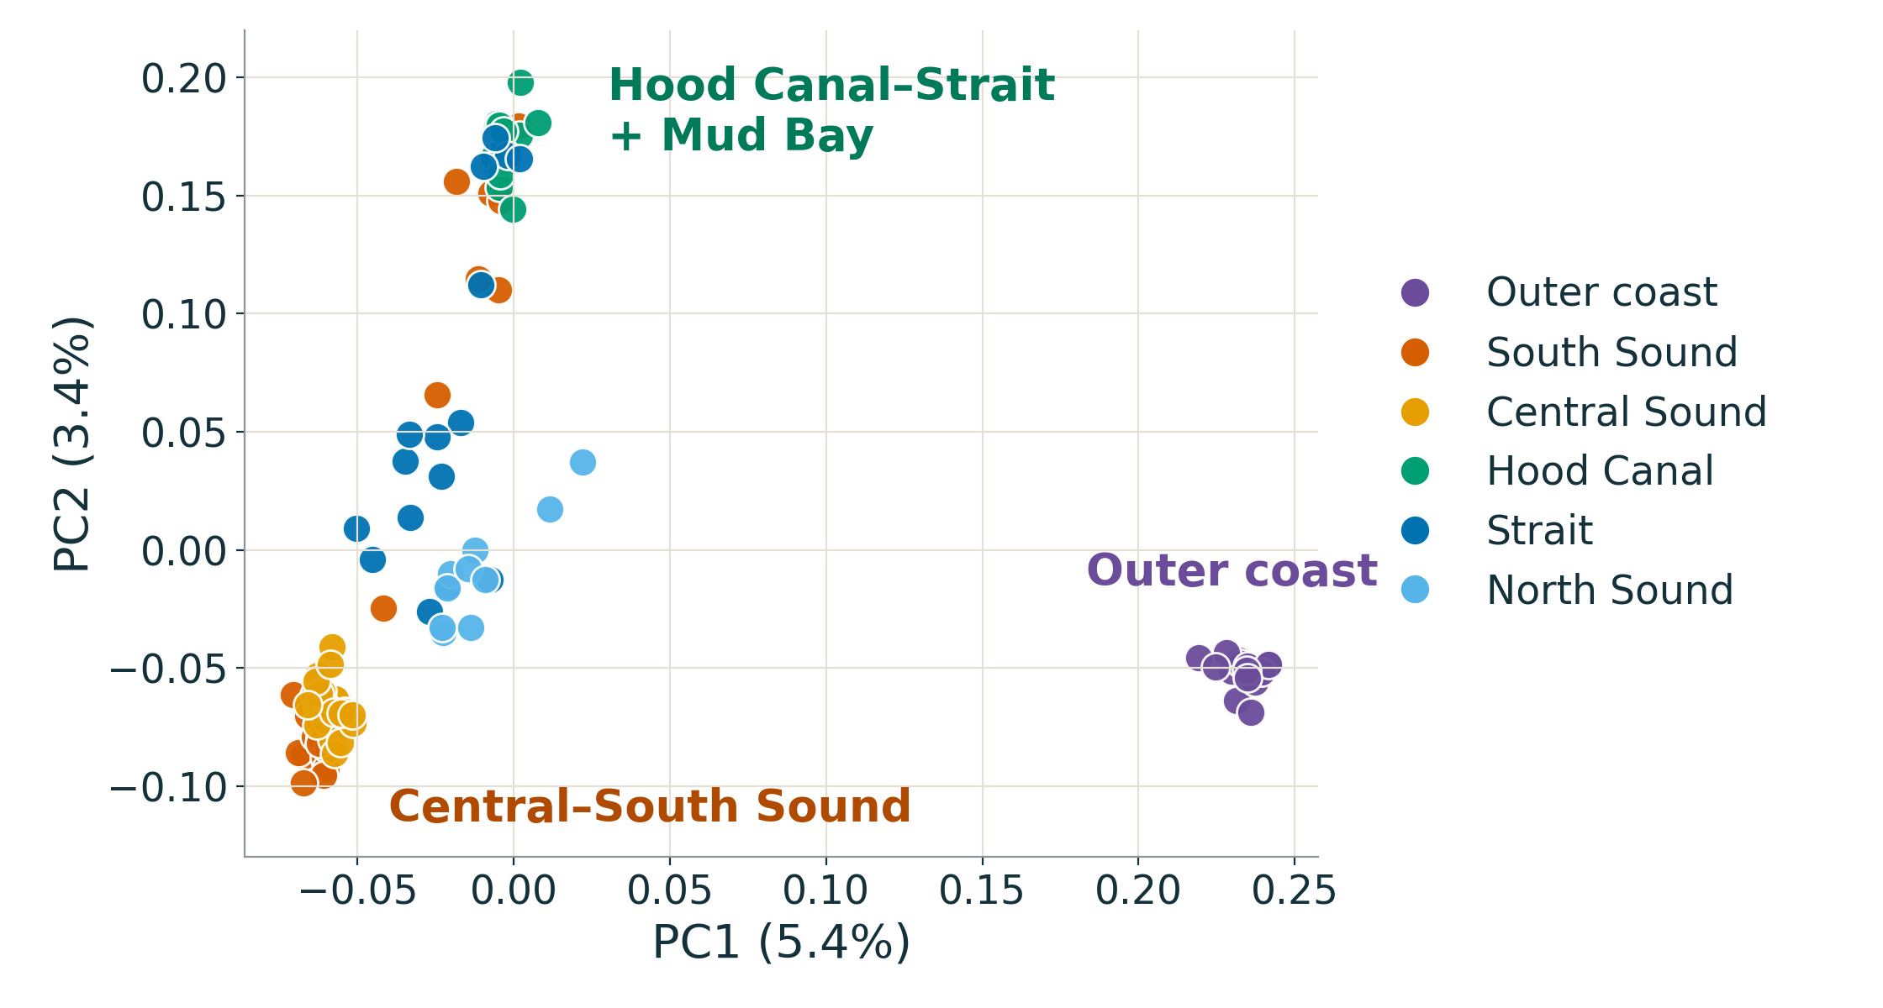
Genomes split the outer coast from the Salish Sea
POPULATION STRUCTURE
PC1 · 5.4%
Willapa Bay and Coos Bay separate from every Salish Sea site.
PC2 · 3.4%
Hood Canal, Sequim, Port Gamble and Mud Bay split from Central and South Sound.
In between
Fidalgo Bay and Discovery Bay are intermediate.
Bengtsson, Martinelli & Roberts · Olympia oyster lc-WGS
Notes:
~55 s. PC1 is the coast: Willapa and Coos Bay cluster tightly together, far from the Sound. Within the Salish Sea, PC2 runs from a Hood Canal / Strait group at the top to a tight Central and South Sound cluster at the bottom, with North Sound sites between. PC3 and PC4 pull out Fidalgo and the Central Sound sites, but each explains only about 1%.

Slide 8
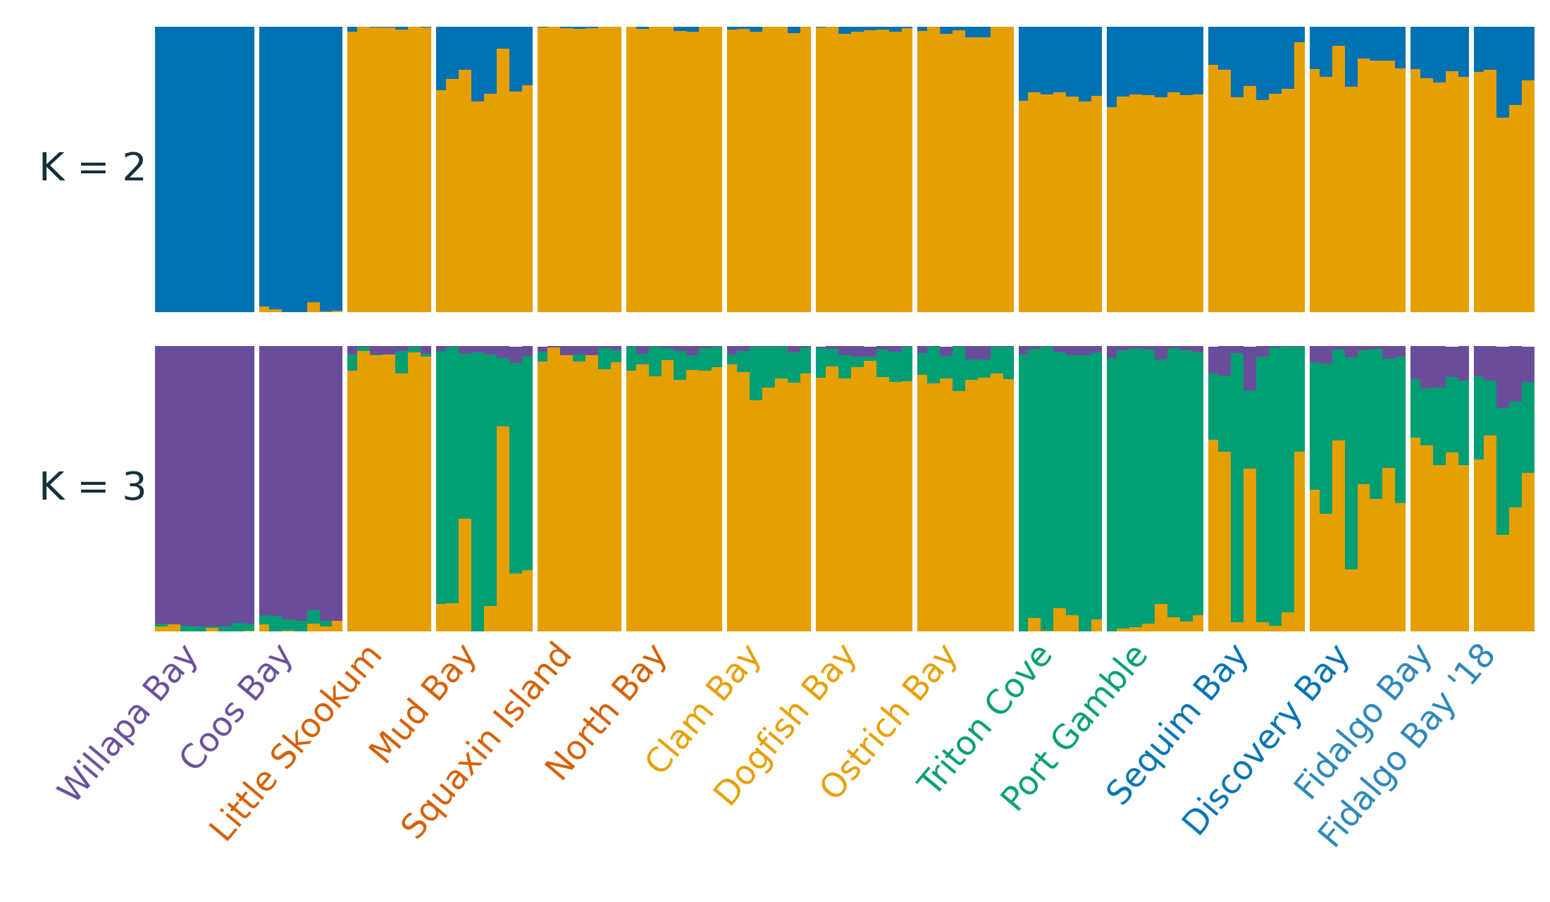
Admixture resolves three groups; Mud Bay joins Hood Canal
POPULATION STRUCTURE
K = 2
Outer coast versus the Salish Sea.
K = 3
Orange: Central–South Sound.
Green: Hood Canal, Sequim, Mud Bay.
Discovery and Fidalgo mix both.
A puzzle
Mud Bay lies in South Sound yet groups with Hood Canal. Is this a legacy of past transfers?
Bengtsson, Martinelli & Roberts · Olympia oyster lc-WGS
Notes:
~55 s. K = 2 is the coast split. K = 3 adds the Central–South versus Hood Canal–Strait split seen on PC2. Higher K mostly subdivides the Central–South group and shows Fidalgo and Discovery Bay as mixtures. Flag Mud Bay (Eld Inlet): geographically South Sound but genetically Hood Canal-like. We don't yet know why; a restoration or transfer history is one hypothesis to check.

Slide 9
Oysters fall into three genetic groups
FINDING 1
Outer coast
Central & South Sound
Hood Canal & Strait
Mixed
Willapa Bay
Clam Bay area
Triton Cove
Fidalgo Bay
Coos Bay (OR)
Dogfish Bay
Port Gamble Bay
Discovery Bay
Separate stock from Puget Sound
Ostrich Bay
Sequim Bay
Share ancestry with both Sound groups
North Bay
Mud Bay*
Squaxin Island
*Mud Bay sits in South Sound
Little Skookum
Tight, closely related group
Olympia oyster genetics · Bengtsson, Martinelli & Roberts
Notes:
~75 s. The biggest split is outer coast versus everything inside the Salish Sea. Inside the Sound, oysters form two groups: Central and South Sound, and a Hood Canal and Strait group. Fidalgo and Discovery Bay are mixtures of the two. One surprise: Mud Bay in Eld Inlet is geographically South Sound but genetically groups with Hood Canal. We don't know why yet; past seed transfers are one possibility worth checking in records.

Slide 10
The outer coast is a different stock
FINDING 2
3–4×
≈ same
2 groups
more different
Willapa Bay and Coos Bay
inside the Sound
Coast oysters differ from Puget Sound oysters 3–4 times more than Puget Sound beds differ from one another.
The two coastal sites, in different states, are as similar as neighbouring Puget Sound bays.
Differences within Puget Sound are real but modest, mostly between the two groups on the last slide.
Genetic differentiation (weighted Fst): coast vs. Puget Sound 0.11–0.14; among Puget Sound sites 0.034–0.088; Willapa vs. Coos Bay 0.037.
Olympia oyster genetics · Bengtsson, Martinelli & Roberts
Notes:
~60 s. In plain terms: moving coast oysters into Puget Sound, or the reverse, would mix genetically distinct stocks. Within the Sound the differences are smaller, but they are consistent and form the two groups. The footnote gives the actual Fst values for anyone who wants them.

Slide 11
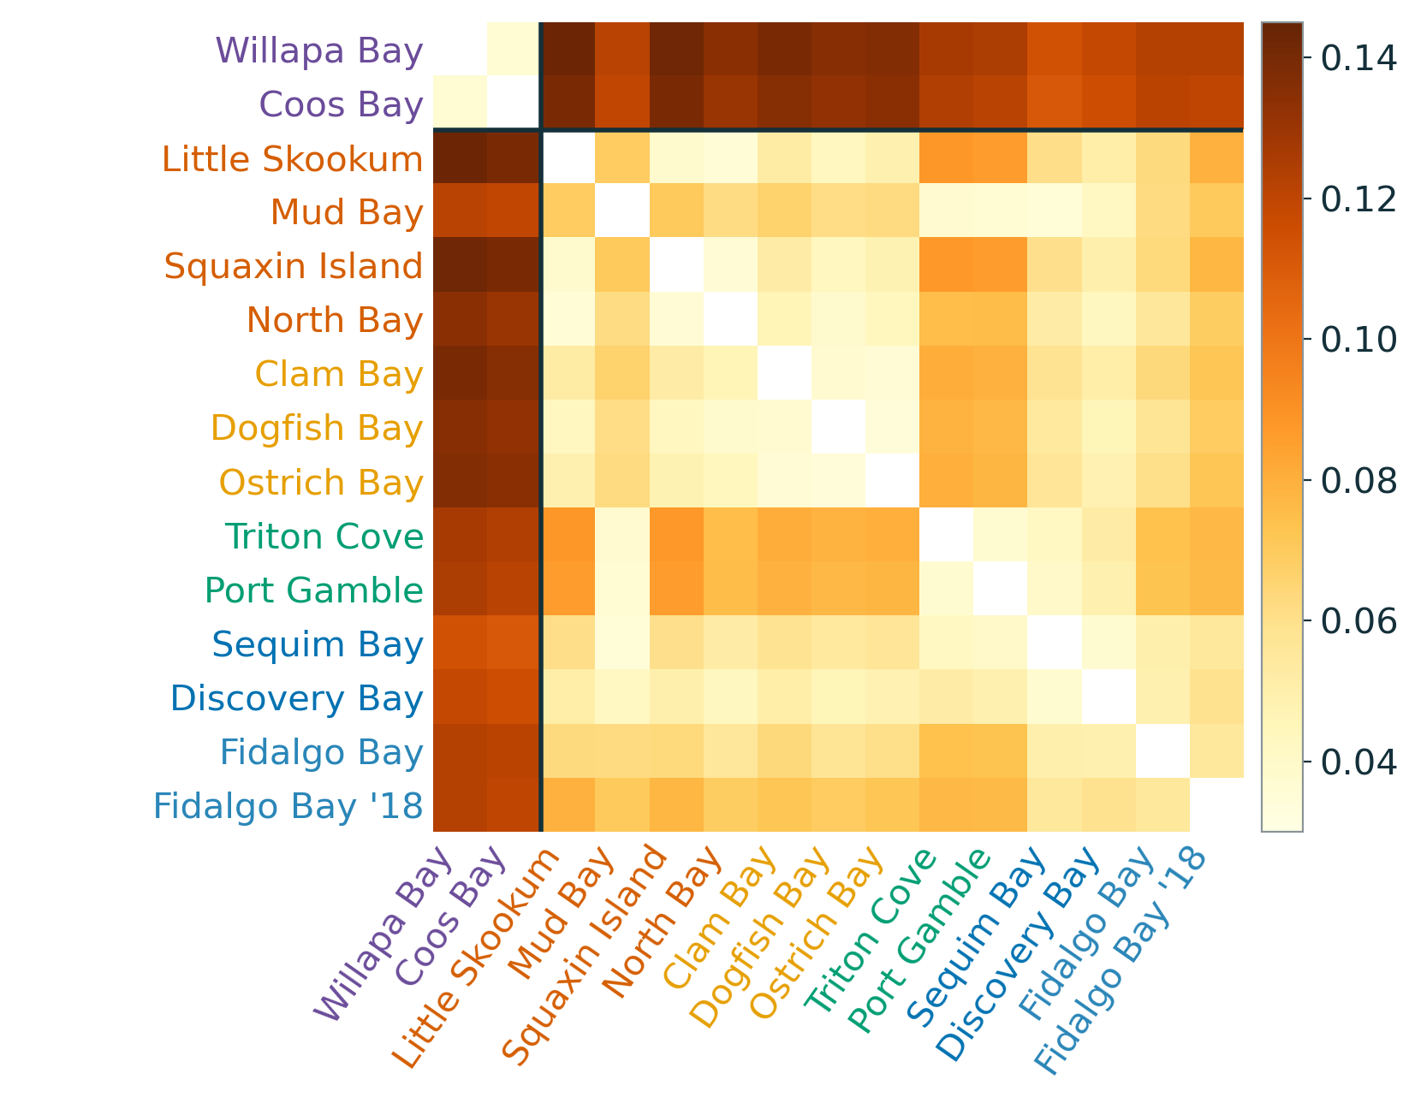
Fst is modest within the Sound and high to the coast
DIFFERENTIATION
0.11–0.14
Salish Sea vs. outer coast
0.034–0.088
among Salish Sea sites
0.037
Willapa Bay vs. Coos Bay: the two coast sites are close relatives
Weighted Fst from realSFS folded 2D SFS.
Bengtsson, Martinelli & Roberts · Olympia oyster lc-WGS
8
Notes:
~45 s. Weighted Fst confirms the picture. Coast versus Sound is three to four times higher than most within-Sound pairs. The lowest values are within the Central–South group (e.g., Dogfish–Ostrich 0.034); the highest within the Sound are Little Skookum vs Triton Cove (0.088), the two groups' extremes.

Slide 12
Diversity tracks collection set as much as geography
GENETIC DIVERSITY
2018 wild collections · 7 sites
2024 collections · 8 sites
Nucleotide diversity π
0.0036–0.0040
Nucleotide diversity π
0.0034–0.0037
Tajima's D
−0.37 to 0.09
Tajima's D
0.35 to 0.49
Duplicate reads
12.5–16.1%
Duplicate reads
19.9–21.6%
Same bay, two collections: Fidalgo 2018 vs. Fidalgo has weighted Fst 0.055, as large as many between-site pairs.
Collection year is now modelled in the RDA; diversity estimates still mix year and site.
Bengtsson, Martinelli & Roberts · Olympia oyster lc-WGS
Notes:
~55 s. Be candid here. The highest diversity is in Triton Cove, Hood Canal (π 0.0040), but the stronger pattern is that the seven 2018 collections have higher θ and near-zero or negative Tajima's D, while the eight 2024 collections have positive D around 0.4, and the two sets also differ in library duplication. Structure is still geographic (North Bay, a 2018 collection, clusters with South Sound), but diversity and D differences may partly be technical or cohort effects.

Slide 13
History and geography outweigh water conditions
FINDING 3
Share of the genetic differences between sites that each factor explains
Shared ancestry (genetic group)
14%
clear effect
Location and distance
6%
clear effect
Water conditions
3%
could be chance
Water conditions, once location is known
0%
no effect
Water conditions = summer temperature, salinity swings and summer food (chlorophyll), 2015–2018. Redundancy analysis on 14 sites. The result holds after accounting for collection year (2018 vs. 2024).
Olympia oyster genetics · Bengtsson, Martinelli & Roberts
Notes:
~75 s. This is the core result. Which group an oyster population belongs to explains about 14% of the genetic differences among sites; where the site is explains about 6%. Water conditions explain about 3%, and that is not distinguishable from chance. Once we account for location, water conditions add nothing. Warm, low-salinity bays tend to be in the same part of the Sound, so environment and geography are tangled together. We also checked collection year: oysters were sampled in 2018 at seven sites and 2024 at eight. Year explains under 1%, and the conclusion is the same with it in the model.

Slide 14
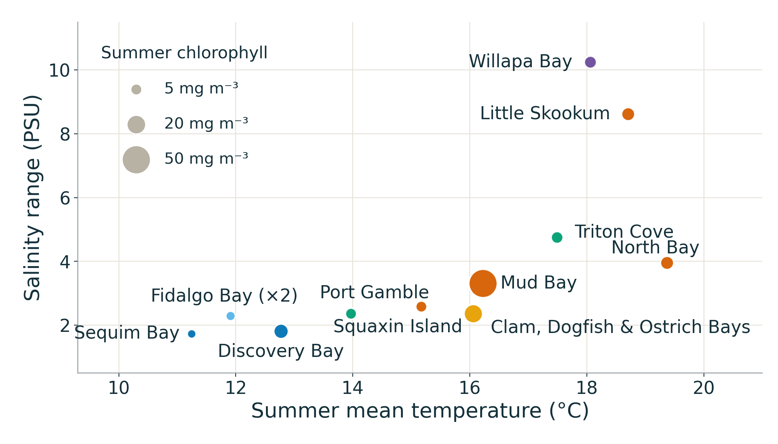
Sites span 8 °C of summer temperature
ENVIRONMENTAL PREDICTORS
Summer temperature
11.2–19.4 °C
Sequim → North Bay
Salinity range
1.7–10.2 PSU
Sequim → Willapa Bay
Summer chlorophyll
2.4–51 mg m⁻³
Sequim → Mud Bay
Kept from 6 candidates (VIF ≤ 2.2). 14 sites on 10 Ecology stations; Coos Bay (temperature only) is left out of the environment model.
Bengtsson, Martinelli & Roberts · Olympia oyster lc-WGS
10
Notes:
~55 s. Predictors are 2015–2018 surface (0–5 m) climatologies from WA Ecology CTD stations within ~3–20 km of each site, cross-checked against ORCA moorings. From six candidates, a collinearity screen kept summer mean temperature, salinity range and summer chlorophyll. Caveat: three Central Sound sites share one station and the two Fidalgo collections share another, so there are effectively 10 environmental points for 14 genetic units.

Slide 15
Structure and geography outweigh environment
REDUNDANCY ANALYSIS
Full model
15.1%
Structure (PC1 + PC2)
14.0%
p = 0.001
Geography (dbMEM)
6.3%
p = 0.003
Collection year (2018 vs 2024)
0.6%
p = 0.19, n.s.
Environment
3.0%
p = 0.16, n.s.
Environment | structure
0.6%
p = 0.36, n.s.
Environment | geography
−2.8%
p = 0.92, n.s.
Adjusted R² of RDA models on population allele frequencies · 14 site units · 7.26 M SNPs · “|” = after conditioning
Bengtsson, Martinelli & Roberts · Olympia oyster lc-WGS
11
Notes:
~60 s. This is the key result. Population structure (the first two genetic PCs) explains 14% of allele-frequency variation; geography (dbMEMs) 6%. The three environmental predictors together explain 3% and are not significant (p = 0.16). Collection year (2018 vs 2024) explains under 1% on its own. Once geography is accounted for, environment explains nothing (adjusted R² below zero), with or without year in the model. Environment and geography are largely confounded across these sites.

Slide 16
No clear “local adaptation” genes yet
FINDING 4
0
Weak
< 1%
standout markers
salinity hint
temperature hint
Of 7.3 million markers scanned, none stood out as tied to water conditions.
Sites with bigger salinity swings differ slightly, but this rests mostly on Willapa Bay.
Summer temperature explains under 1% once genetic group is accounted for.
Counting each oyster as independent made the environment look important; treating each bay as one sample removed most of that signal.
Olympia oyster genetics · Bengtsson, Martinelli & Roberts
Notes:
~60 s. We searched the whole genome for markers that track temperature, salinity or food. None stood out. There are faint hints for salinity swings and summer temperature, but they are small. The note at the bottom matters for anyone reading other studies: oysters from the same bay are not independent samples; analyses that treat them that way can overstate environmental effects.

Slide 17
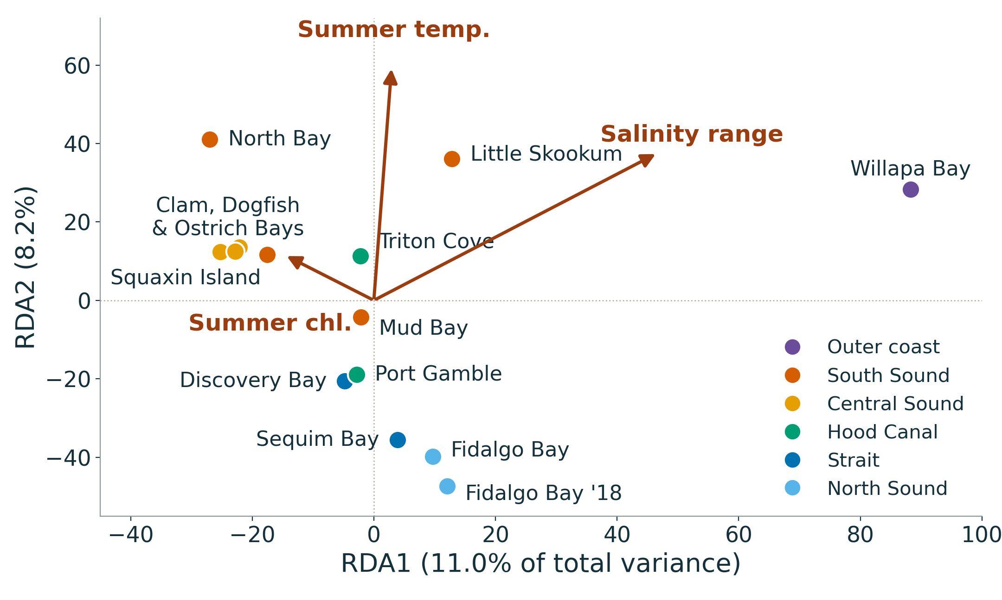
Salinity range carries the only environmental signal
REDUNDANCY ANALYSIS
p = 0.024
salinity range, marginal test
11.0%
RDA1, driven mostly by Willapa Bay
p = 0.16
global environment model, 14 sites
Bengtsson, Martinelli & Roberts · Olympia oyster lc-WGS
Notes:
~50 s. In the environment-only RDA, RDA1 is essentially Willapa Bay, the site with by far the largest salinity range, so the salinity signal leans heavily on one site. RDA2 runs from the cooler Strait and Fidalgo sites to the warm South Sound inlets (North Bay, Little Skookum) along summer temperature. Only salinity range is marginally significant; the global model is not.

Slide 18
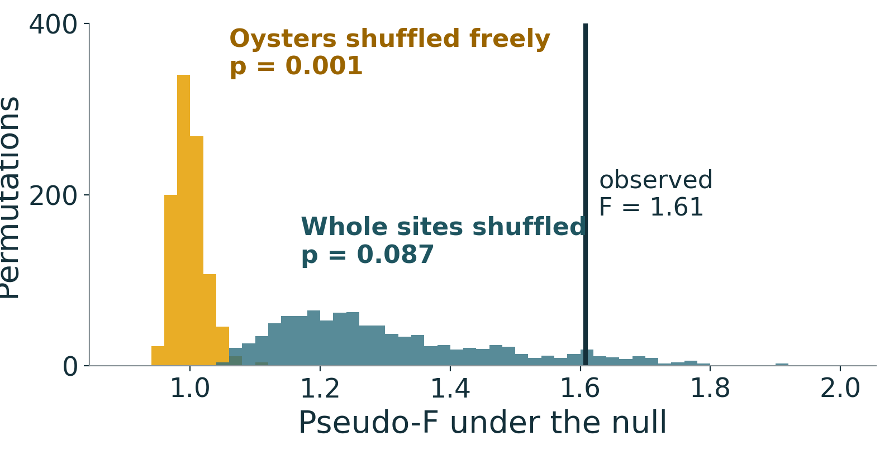
Individual and SNP-level tests agree: the signal is weak
ROBUSTNESS
No outlier loci
0 of 7.26 M
SNPs at q < 0.2 in the genome-wide RDA outlier scan (minimum q 0.98).
Temperature, after structure
adj. R² 0.009
p = 0.036 with all 15 sites; p = 0.41 without conditioning on PC1 + PC2.
Individual RDA, 102 oysters. Shuffling oysters freely treats bay-mates as independent and inflates significance.
Bengtsson, Martinelli & Roberts · Olympia oyster lc-WGS
13
Notes:
~60 s. Three checks. (1) Left: run on individuals, the environment model looks highly significant if oysters are permuted freely (p = 0.001), but that treats oysters from the same bay as independent; permuting whole sites gives p = 0.087. (2) The genome-wide outlier scan finds no SNP even at q < 0.2: no candidate loci for local adaptation at this sampling depth. (3) A hint: summer temperature becomes marginally significant once population structure is removed (p = 0.036), though it explains under 1%. Restricting permutations to within collection year gives the same picture (site-level p = 0.16).

Slide 19
What the results do and don't tell us
READING THE RESULTS
What they support
What they don't show
Genetic groups are real and consistent
Coast and Puget Sound stocks are distinct
Water conditions are not a strong guide to genetic makeup
That oysters are not adapted to local water. Effects may be small or need more sites
Which sites hold the most genetic diversity. Differences track collection year (2018 vs. 2024)
Why Mud Bay groups with Hood Canal
Olympia oyster genetics · Bengtsson, Martinelli & Roberts
Notes:
~60 s. Be clear on limits. Fourteen sites is a small number for detecting environmental effects, and several sites share the same monitoring station. Diversity estimates differ between the 2018 and 2024 collections, so we are not ranking sites by diversity yet. Collection year does not change the genetic-group or environment results: the same bay sampled in 2018 and 2024 (Fidalgo) differs less than most pairs of different sites.

Slide 20
Accounting for collection year leaves the result unchanged
COLLECTION YEAR
Year on its own
Environment, given year
Same bay, six years apart
0.6%
4.3%
0.055
of allele-frequency variation (adj. R²), p = 0.19. Not a strong batch signal.
p = 0.08 (0.12 with permutations kept within year). Given geography + year: −2.0%, p = 0.84.
Fidalgo 2018 vs 2024 Fst: lower than 61% of between-site pairs.
2024 sites only (7)
2018 sites only (7)
Environment adj. R² 11%, p = 0.10
Environment adj. R² −0.9%, p = 0.59
Sites labelled 18 were collected in 2018, the rest in 2024, so year is partly confounded with site. Year entered as a variance component, a conditioning term and a permutation stratum.
Bengtsson, Martinelli & Roberts · Olympia oyster lc-WGS
14
Notes:
~45 s. We recently confirmed collection dates: seven sites were sampled in 2018 and eight in 2024. Year by itself explains well under 1% of allele-frequency variation. Conditioning on year slightly raises the environment fraction (4.3%) but it is still not significant, and adding geography removes it again. The Fidalgo comparison is a useful check: the same bay sampled six years apart differs less than most pairs of different sites. Split by year, the 2024 set hints at an environment effect (11%, p = 0.10) but with only seven sites per year we have little power.

Slide 21
Considerations for seed and broodstock sourcing
CONSIDERATIONS
1
Keep outer-coast and Puget Sound stocks separate.
The clearest and largest genetic boundary in the data.
2
Source within the same genetic group where possible.
Central & South Sound and Hood Canal & Strait as a starting frame.
3
Don't choose sources on water conditions alone.
Current evidence doesn't show environment-matched genetics.
4
Check transfer history before treating Mud Bay as a South Sound source.
Its genetics match Hood Canal.
Olympia oyster genetics · Bengtsson, Martinelli & Roberts
9
Notes:
~75 s. These are considerations, not rules: they follow from the genetics and should be weighed with existing guidance, logistics and disease concerns. The coast–Sound split is the firmest. The two Puget Sound groups are a reasonable starting frame. Mixed sites like Fidalgo and Discovery Bay share ancestry with both groups.

Slide 22
Across Puget Sound, shared history, not today's water, explains most genomic differentiation.
THE TAKE-HOME
At the scale of 14 sites and 2015–2018 surface climatologies, with or without collection year in the model.
Notes:
~20 s. Pause on this. Population structure and geography explain allele-frequency differences; environment adds little once those are accounted for. The caveat is scale: few sites, shared stations, and climatologies rather than in-situ records.

Slide 23
What this means for restoration, and what comes next
CONCLUSIONS
For restoration
Next steps
Keep outer-coast and Salish Sea stocks distinct
Use Central–South and Hood Canal–Strait groups as a first frame for seed transfer
Any environmental adaptation is subtle; don't rely on it alone to match sources
Model collection batch (year, library duplication) explicitly
Add sites and in-situ loggers to break shared-station confounding
Trace the Mud Bay–Hood Canal link through transfer records
More oysters per site for polygenic GEA
Thank you · WDFW · Code and results: github.com/zbengt/oly-lc-WGS
Bengtsson, Martinelli & Roberts · Olympia oyster lc-WGS
Notes:
~60 s, then questions. Management: the coast vs Sound split is clear and large; within the Sound, two genetic groups are a defensible starting point for seed transfer guidance. Environmental adaptation may exist but is not detectable with this design. Next: account for collection batch, increase site number and in-situ environmental data, follow up Mud Bay, and scale up individuals for polygenic signals.

