Slide 1
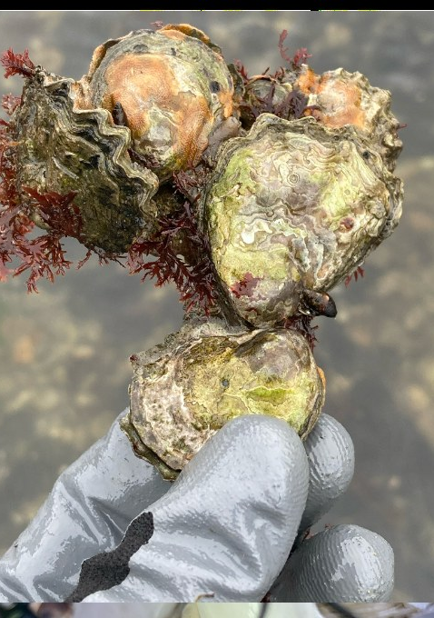
Conservation aquaculture maintains genetic composition in hatchery-produced Olympia oysters
PUGET SOUND RESTORATION FUND · UNIVERSITY OF WASHINGTON · NOAA NWFSC
Evelyn Abbott, Zachary Bengtsson, Ryan N. Crim, Crystal Simchick, Giles Goetz, Frederick W. Goetz, Steven Roberts, Mackenzie Gavery
International Conference on Shellfish Restoration
Notes:
About 30 seconds. Introduce the work as a collaboration between Puget Sound Restoration Fund, UW and NOAA. Frame the question in one sentence: when we use a hatchery to rebuild a native oyster, do we change its genetics? Preview the answer: under the current protocol, very little.

Slide 2
A native oyster reduced to remnants
BACKGROUND
~4%
Ostrea lurida is the only oyster native to the US west coast, once forming beds from Southeast Alaska to Baja California.
Overharvest, sedimentation and pollution drove a range-wide collapse by the early 1900s.
of historic dense core Olympia oyster populations remained in Puget Sound by the early 2000s
Since 2014, PSRF, NOAA and WDFW have produced restoration seed at the Kenneth K. Chew Center.
Olympia oyster hatchery genetics · Abbott et al., in prep
2
Notes:
About 50 seconds. Olympia oysters built biogenic beds that filtered water and provided habitat, and were a food source for thousands of years. Collapse came in the early 1900s. By the early 21st century only about 4 percent of dense core populations remained in Puget Sound. Restoration now combines habitat enhancement with outplanting hatchery seed, produced at the Chew Center since 2014. That hatchery step is where genetic risk enters.

Slide 3
Puget Sound oysters are not one population
WHY GENETICS MATTERS HERE
Microsatellites (Stick 2012)
Genome-wide SNPs (Silliman 2019)
75% of genetic variation partitioned among four sub-basins: North, Central, South Sound and Hood Canal
Strong neutral structure across the range, with putatively adaptive genes for development, metabolism and immunity
Ocean acidification (Spencer et al. 2020, 2023)
Transplants and expression (Heare et al. 2017, 2018)
Populations differ in transcriptional and phenotypic responses, with evidence of transgenerational plasticity
Basin-level differences in growth, survival, reproduction and stress response
Risk: hatchery seed could erode diversity or blur these distinct gene pools.
Olympia oyster hatchery genetics · Abbott et al., in prep
3
Notes:
About 60 seconds. Despite a planktonic larval stage, gene flow among Puget Sound basins is limited. Four lines of evidence: microsatellites partition most variation among sub-basins, genome-wide SNPs confirm structure, and experiments show populations respond differently to stress and acidification. Whether that structure reflects drift or local adaptation is still debated, but either way restoration should not disrupt it. The two hatchery risks are loss of diversity and domestication selection.

Slide 4
Seven practices designed to protect wild diversity
THE HATCHERY PROTOCOL
1
2
3
4
Large broodstock
Local source
Wild origin
Annual refresh
Minimum of 1,200 adults
Matched to the restoration site's genetic stock
No hatchery-born parents
New broodstock every year
5
6
7
Mass spawning
Long collection
Even culling
Volitional, no controlled crosses
Larvae collected for at least 4 weeks
Spread across the whole spawning period
Olympia oyster hatchery genetics · Abbott et al., in prep
Codified in WDFW protocols for Olympia oyster restoration seed (Blake et al., 2025) · 4
Notes:
About 60 seconds. These practices were refined over two decades with WDFW and are now mandated for restoration seed. Olympia oysters are brooding, alternating hermaphrodites that spawn asynchronously, so larvae come out over weeks. Collecting for at least four weeks captures diversity tied to spawn timing. Large, wild, local, annually refreshed broodstock and volitional spawning limit both inbreeding and unintentional selection. The question for this study: does it actually work at the genomic level?

Slide 5
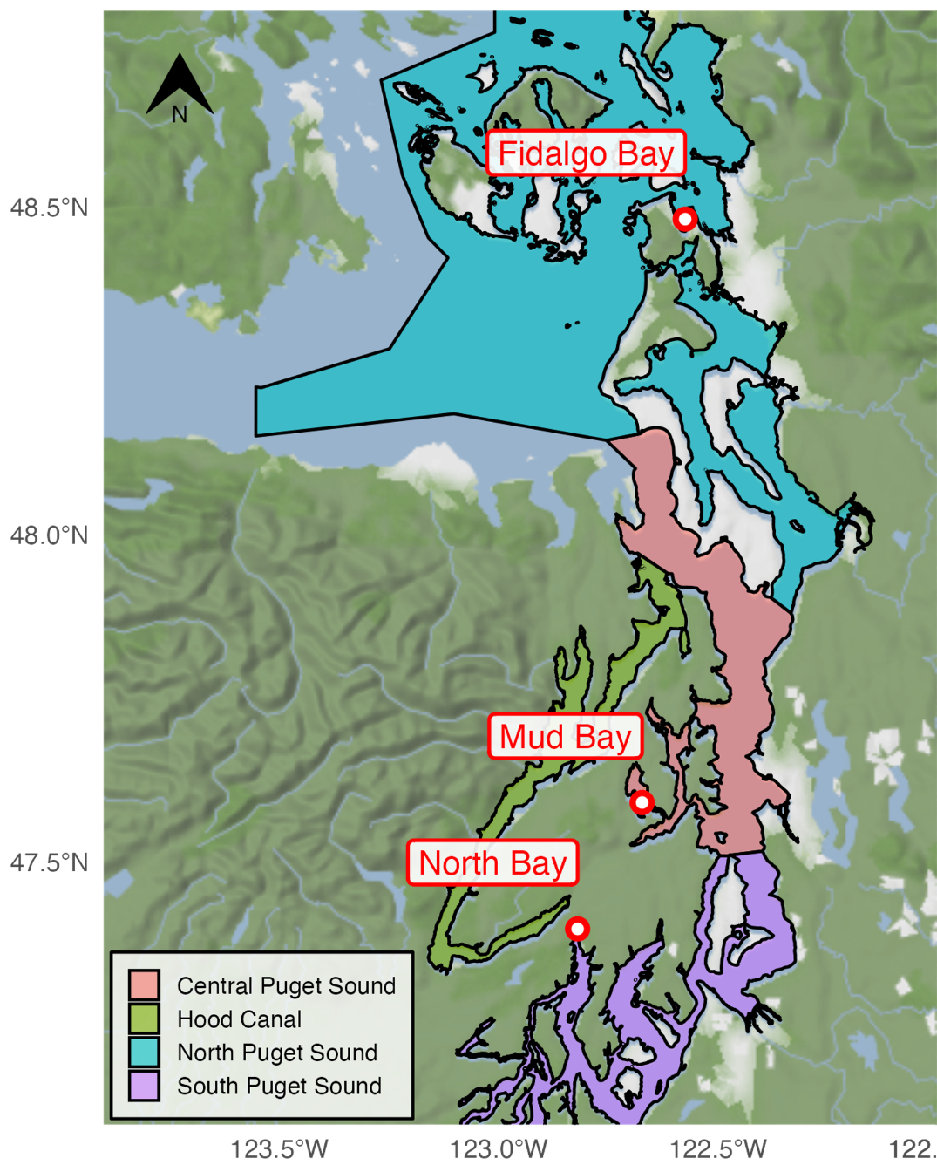
Three source populations, hatchery vs wild
STUDY DESIGN
Source | Wild adults | Hatchery seed
North · Fidalgo Bay | 2018 | 2017
Central · Mud Bay | 2017 | 2018
South · North Bay | 2018 | 2018
96 oysters per group (NW, NH, CW, CH, SW, SH); seed sampled at 5 to 10 mm before outplant. 23 batch-linked loci removed (NH library prepared separately during COVID-19).
561
2,342
RAD
oysters retained of 576
filtered SNPs
BestRAD, SbfI, NovaSeq 150 PE
Olympia oyster hatchery genetics · Abbott et al., in prep
5
Notes:
About 60 seconds. Wild adults and hatchery seed came from the three genetically distinct basins: North, Central and South Sound. Hatchery seed was produced from those same source populations using the protocol. RAD-seq yielded 2,342 filtered SNPs across 561 oysters. One wrinkle: the North hatchery library was prepped separately during the COVID lockdown. Loci showing linkage only in that group were flagged as batch artifacts and removed, so the North comparisons are conservative.

Slide 6
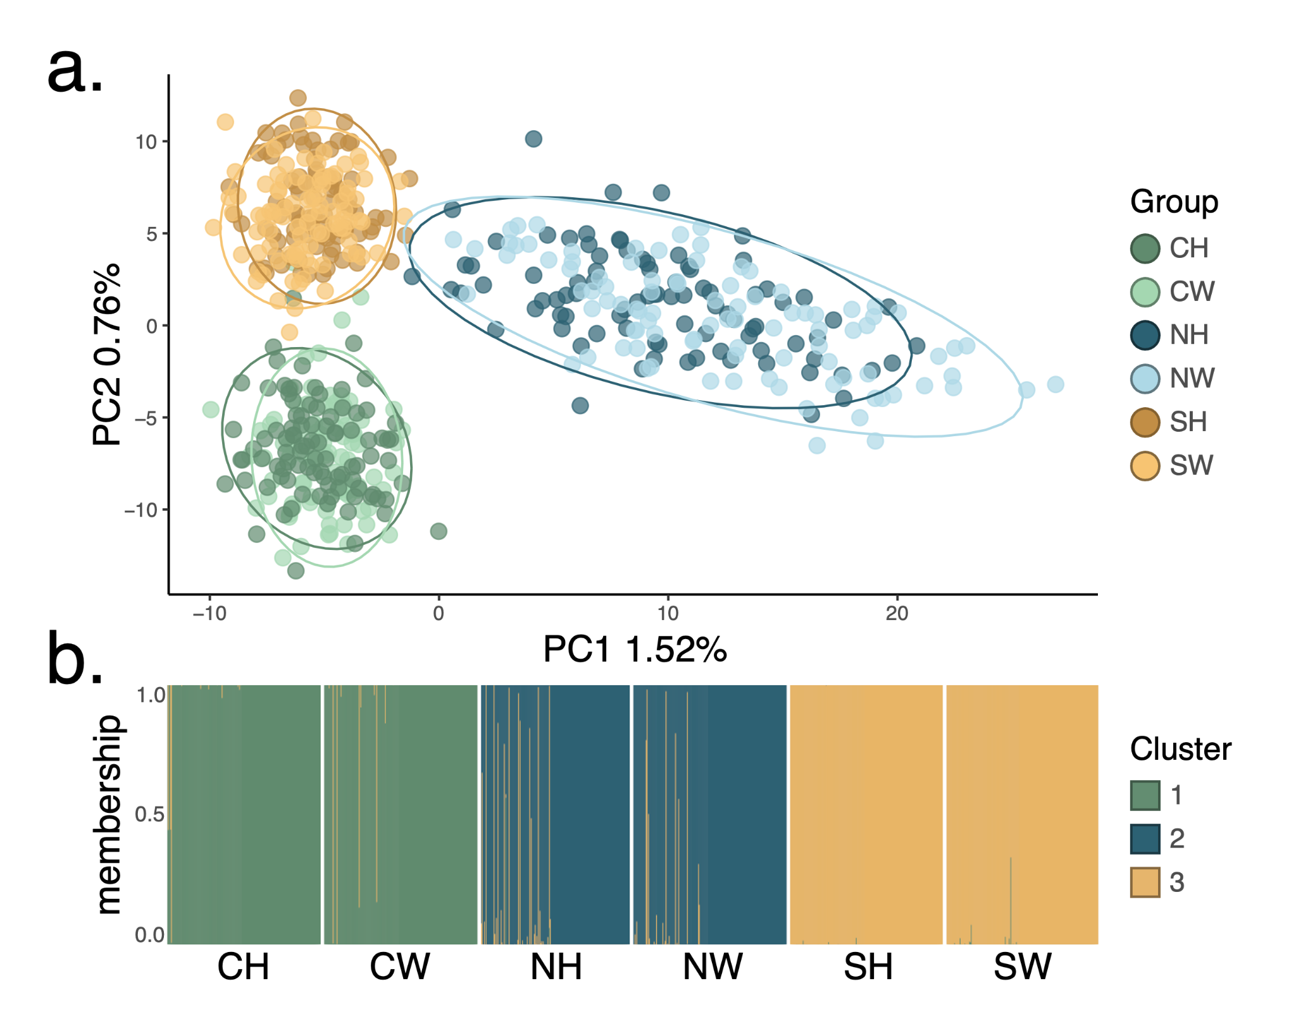
Oysters cluster by source, not by rearing
RESULT 1 · POPULATION STRUCTURE
Cluster 1: 185 of 190 Central
93 hatchery · 92 wild
Cluster 2: 168 of 184 North
79 hatchery · 89 wild
Cluster 3: all 187 South
Plus 21 North and Central individuals
No hatchery cluster: hatchery and wild intermix within every source.
Olympia oyster hatchery genetics · Abbott et al., in prep
PCA and DAPC, 561 individuals; BIC supported K = 3 · 6
Notes:
About 60 seconds. PCA and DAPC both recover three genetic clusters that line up with the three source basins. Hatchery and wild oysters from the same basin fall in the same cluster in nearly equal numbers. Only nine individuals had under 70 percent membership probability to any single cluster. The variance explained is small, as expected for neutral SNPs in a high gene flow invertebrate, but the pattern is clear.

Slide 7
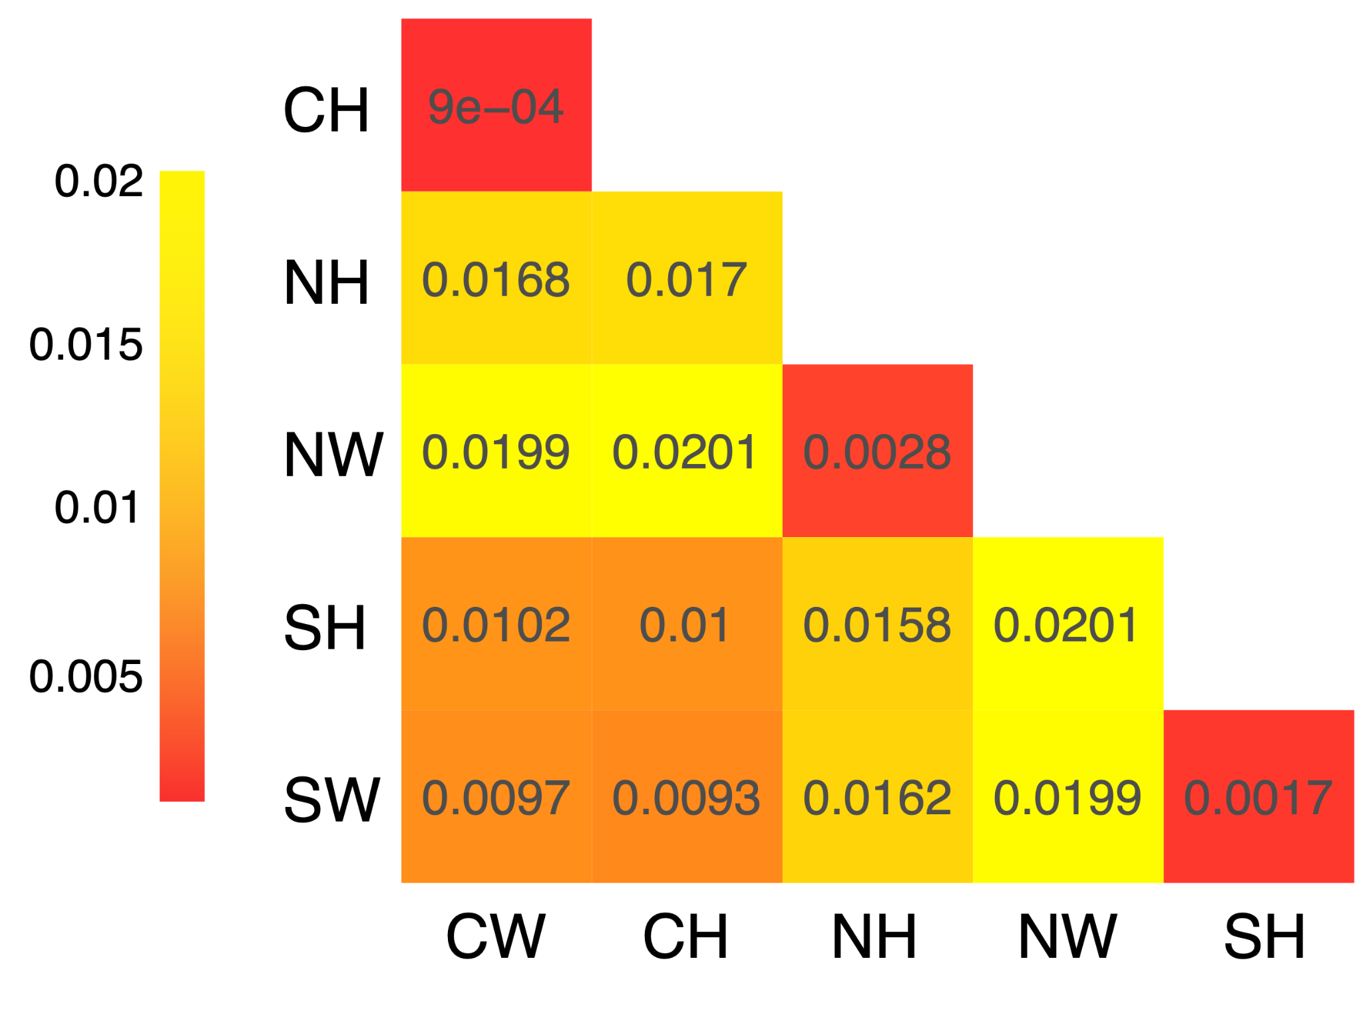
Each hatchery group is closest to its own wild source
RESULT 2 · DIFFERENTIATION
0.0009 to 0.0028
Each hatchery group vs its own wild source: the three lowest values
~0.01
Central vs South, regardless of rearing
0.0158 to 0.0201
North vs the other sources
Olympia oyster hatchery genetics · Abbott et al., in prep
StAMPP, 100 bootstraps; all p < 2e-16 · 7
Notes:
About 55 seconds. Fst is low overall, which is typical. The key result is the ordering: the smallest values in the whole matrix are each hatchery group paired with its own wild source. Central and South are relatively similar to each other, and North wild is the most distinct from everything else. So the hatchery step is a much smaller genetic signal than the natural structure among basins.

Slide 8
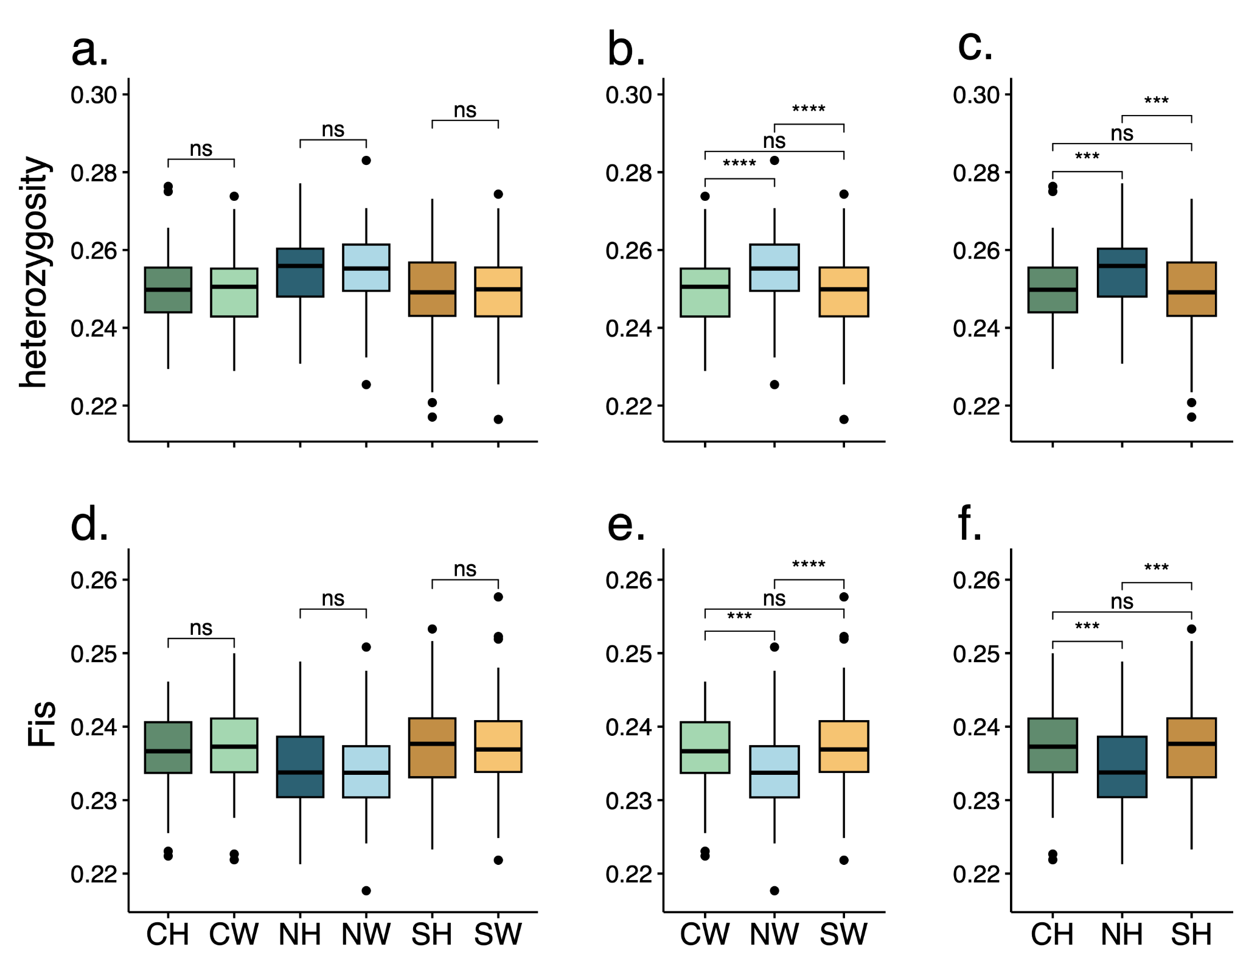
No loss of heterozygosity, no rise in inbreeding
RESULT 3 · GENETIC DIVERSITY
Heterozygosity (Ho)
Wild
Hatchery
0.2514
0.2509
Inbreeding (Fis)
Wild
Hatchery
0.2361
0.2365
Neither difference significant (panels a, d). North is highest in Ho and lowest in Fis in both wild and hatchery groups (b, c, e, f).
Olympia oyster hatchery genetics · Abbott et al., in prep
8
Notes:
About 55 seconds. Across individuals, hatchery and wild means are essentially identical for heterozygosity and inbreeding, and no within-source pair differed significantly. Just as important, the ranking among sites is preserved: North wild is the most diverse wild group and North hatchery is the most diverse hatchery group. South is lowest in both. The hatchery seed mirrors its source population, not a generic hatchery profile.

Slide 9
Hatchery Ne is lower, but well above a family sweep
RESULT 4 · EFFECTIVE POPULATION SIZE
NW
1,716 to 1,880
Wild Ne in the low to mid thousands resembles less impacted eastern oyster populations.
NH
331 to 374
CW
2,994 to 3,466
CH
485 to 531
Hatchery Ne of roughly 300 to 530 is comparable to natural and restored Chesapeake Bay reefs (~70 to 500).
SW
3,338 to 4,054
SH
298 to 333
LD Ne, NeEstimator v2.1 (Pcrit 0.05 to 0.01). Blue = wild, orange = hatchery.
Olympia oyster hatchery genetics · Abbott et al., in prep
9
Notes:
About 60 seconds. This is the one place hatchery and wild clearly differ, and it is expected: a hatchery has far fewer contributing parents. Hatchery Ne is still in the hundreds, below thresholds for long-term adaptive potential but enough to limit short-term inbreeding in a single outplanted cohort. For context, it is similar to or above estimates for natural and restored eastern oyster reefs in Chesapeake Bay. These are also the first Ne baselines reported for Puget Sound Olympia oysters.

Slide 10
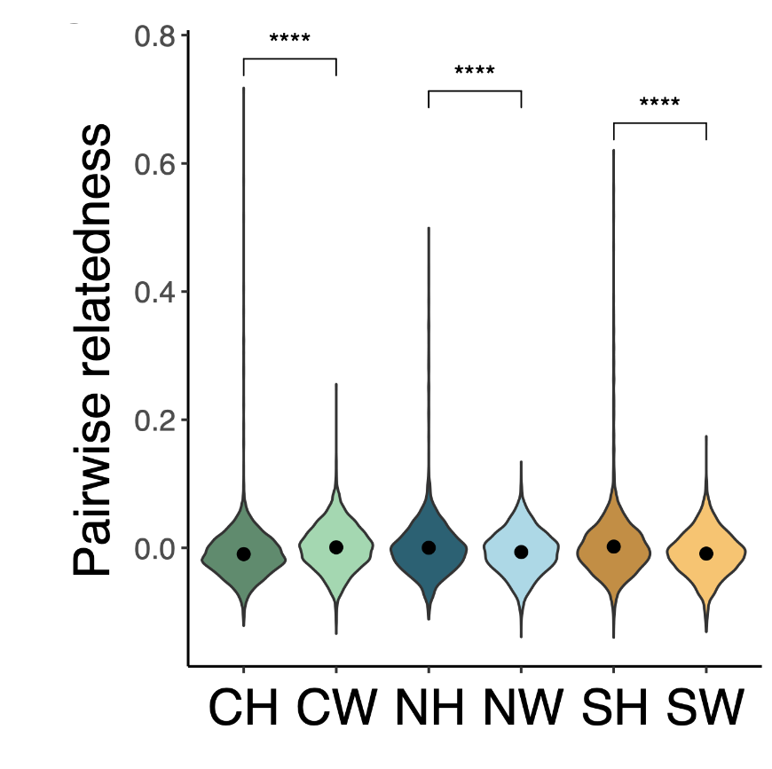
Siblings appear in hatchery seed, but rarely
RESULT 5 · RELATEDNESS
0.03%
1.07%
of wild pairs were siblings; no full siblings
of hatchery pairs were siblings
Hatchery group | Full sibs | Half sibs
SH | 0.16% | 1.42%
NH | 0.11% | 0.89%
CH | 0.11% | 0.51%
Far from sweepstakes reproduction.
Olympia oyster hatchery genetics · Abbott et al., in prep
Queller and Goodnight estimator; kNN assignment on simulated families · 10
Notes:
About 60 seconds. Relatedness was the other metric where groups diverged. Only hatchery groups had full siblings, and they had more half siblings. But siblings were still only about 1 percent of hatchery pairs. Other oyster hatcheries have seen family sweeps where a few parents dominate. That did not happen here. And the direction is not strictly hatchery versus wild: Central wild had higher mean relatedness than North and Central hatchery groups. The spread in group means was tiny, about 0.007.

Slide 11
What this study cannot tell us yet
LIMITATIONS AND NEXT STEPS
Adaptive variation
Field performance
Scalability
2,342 neutral SNPs resolve structure and kinship but not loci under selection. Whole-genome sequencing could test whether adaptive alleles are retained.
Genetic similarity is not fitness. In situ comparisons of hatchery and wild survival, growth and reproduction are the real test.
1,200+ broodstock is hard for most programs, and Ne tracks broodstock number in oysters (Hornick and Plough 2022).
Olympia oyster hatchery genetics · Abbott et al., in prep
11
Notes:
About 50 seconds. We cannot rule out domestication selection entirely, because RAD-seq at this density is not suited to scanning for selected loci. Whole-genome data would address that. Genetics is also a precursor to field experiments that measure relative fitness. Finally, the large broodstock requirement is probably a big reason Ne is as high as it is, and that may not be feasible elsewhere, so programs should think about how broodstock number scales.

Slide 12
A protocol that keeps wild genetics intact
TAKEAWAYS
1
Hatchery seed kept its source population's identity, and wild structure was preserved.
2
Diversity held steady; only Ne and sibling frequency shifted, and modestly.
3
Large wild broodstock, local sourcing and long larval collection are the levers.
Notes:
About 45 seconds. Three points to remember. Hatchery seed looks like its own wild source and Puget Sound structure is intact. Heterozygosity and inbreeding did not change; the shifts in Ne and kinship were expected and small. And the practices most likely responsible are very large wild broodstock, local sourcing and collecting larvae for at least four weeks. Developed collaboratively with managers, this is a model other conservation aquaculture programs can adapt to their species.

Slide 13
Thank you
ACKNOWLEDGMENTS
CODE AND DATA
Chew Center hatchery staff for collecting and storing samples. Jay Dimond, Jodie Toft and Louis Plough for early draft revisions.
github.com/evelynabbott/olympia_oyster_RAD
Puget Sound Restoration Fund · UW School of Aquatic and Fishery Sciences · NOAA Northwest Fisheries Science Center
Notes:
About 15 seconds. Thank the hatchery staff and reviewers, point to the GitHub repository, and open for questions.

