Slide 1
Future Shellf
Predictive Phenotyping for Oyster Performance
Steven Roberts · Ariana Huffmyer · Louis Plough · Mackenzie Gavery · Neil Thompson
University of Washington · USDA-ARS · NOAA NWFSC
PCSGA Annual Conference · 2026
SORMI.SCIENCE
Notes:
12-minute talk. Two things growers can use: predict phenotype before you grow it out, and read stress on the farm in real time.

Slide 2
Two questions
• Which seed should I buy — which family lines actually perform on my site?
• How stressed is my crop right now, before I start seeing mortality?
Today, answering either one means waiting.
Breeding trials take a season. Mortality events tell you after the fact.
We need a fast, cheap, non-lethal measure of how an oyster is doing — right now.
Notes:
Set up the grower problem before introducing the tool.

Slide 3
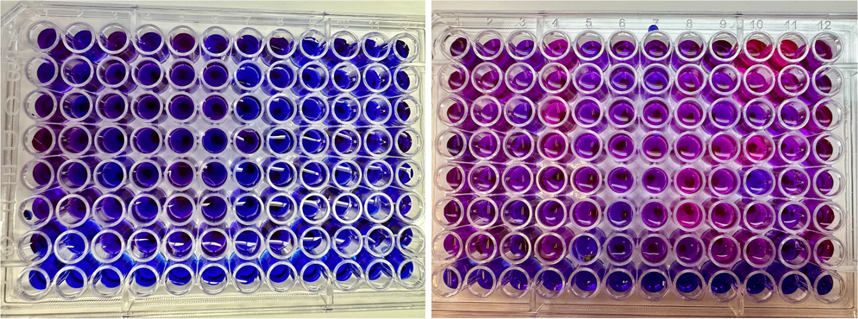
From blue to pink: the resazurin assay
A redox dye that reports whole-organism metabolism
Resazurin is blue and non-fluorescent.
Living cells reduce it to resorufin — pink and strongly fluorescent.
More metabolism = more pink = more signal.
The animal stays alive. Nothing is sacrificed.
Notes:
Left plate: early in the incubation. Right plate: 4-6 hours later. You can literally see metabolism.

Slide 4
How a run works
Roughly half a day, bench-top, ~$1 of dye per plate
• Photograph animals for shell length (size normalization), then load one oyster per well.
• Fill wells with resazurin working solution; empty wells serve as blanks.
• Read fluorescence on a plate reader (ex 530 / em 590 nm) — baseline, then hourly for 4–6 h.
• Hold at whatever condition you want to probe: ambient, heat, low salinity, freshwater.
• Correct to blanks, normalize to shell length → a metabolism curve for every individual.
96 individuals per plate, non-lethal, no respirometry hardware required.
Notes:
Emphasize throughput: this is the reason it is useful operationally.

Slide 5
This is published and validated
Huffmyer et al. 2026, PeerJ 14:e21542 — DOI 10.7717/peerj.21542
• Resazurin fluorescence correlates with oxygen consumption on the same individuals.
• Signal comes from live animals — live oysters far exceed empty shells and blanks (p < 0.001).
• Scales with body size, so we normalize to shell length (rho = 0.62, p < 0.001).
• Thermal performance curves behave as expected: metabolism peaks near 36 °C, then depresses.
• Works in both Pacific (C. gigas) and Eastern (C. virginica) oysters, seed through juveniles.
Peer-reviewed, open access, protocol included as an appendix — anyone can run it.
Notes:
Highlight that the method paper is out — this is not preliminary.

Slide 6
Use #1 — Predicting phenotype
Read metabolism today, forecast field performance later

Slide 7
Metabolism already tracks outcomes
Key findings from the PeerJ study
• Under acute heat stress, oysters that survived had ~52% lower cumulative metabolism than those that died.
• High metabolic output under stress = higher risk of mortality (p < 0.001).
• Families differ significantly in metabolic response — the trait is genetically variable.
• In 50 selectively bred C. virginica families, metabolism correlated with predicted survival in the environment they were selected for (r = 0.56, p = 0.004).
Metabolism is not just a health readout — it carries information about future performance.
Notes:
Objectives 3, 4, 5 of the paper, compressed.

Slide 8
Testing the idea head-on: survival trials
Nine USDA C. gigas families, run side by side
Trial | Stressor | Oysters | % died
Apr 27 | 33 °C | 128 | 49%
May 11 | 33 °C | 84 | 99%
Jun 04 | 36 °C | 39 | 95%
Jun 09 | 36 °C | 77 | 86%
Jul 06 | 35 °C | 378 | 97%
Jul 06 | 35 °C + low salinity | 204 | 84%
Jul 07 | Freshwater → 36 °C | 185 | 33%
Harshness varies enormously — raw survival can't be compared across trials.
Notes:
20 oysters per family per trial; time of death logged repeatedly.

Slide 9
A fair hardiness score
0–100, comparable across trials
• Within each trial, rank families on (1) fraction surviving and (2) how long they lasted.
• Convert each family's standing to a percentile against the other families in that same trial — this cancels out trial harshness.
• Average those percentiles across all seven trials.
Higher score = consistently tougher across many kinds of stress.
Notes:
Keep this brief — it's plumbing, not the point.

Slide 10
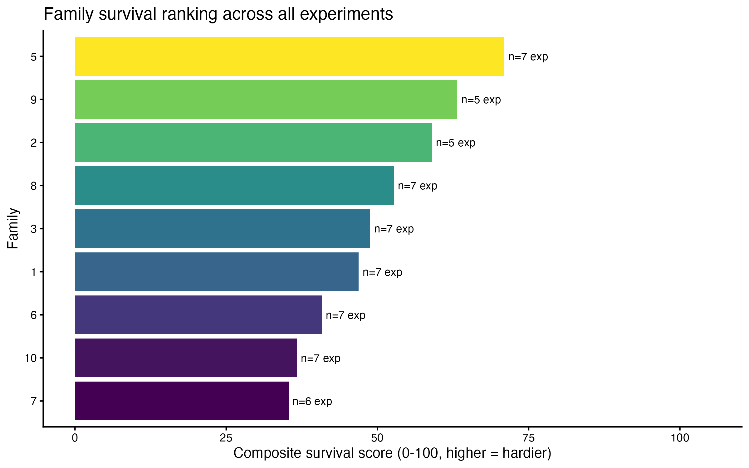
Families really do differ
Family 5 is the toughest; family 7 the most fragile — and the spread repeats across trials.
Notes:
This is the truth we want to predict.

Slide 11
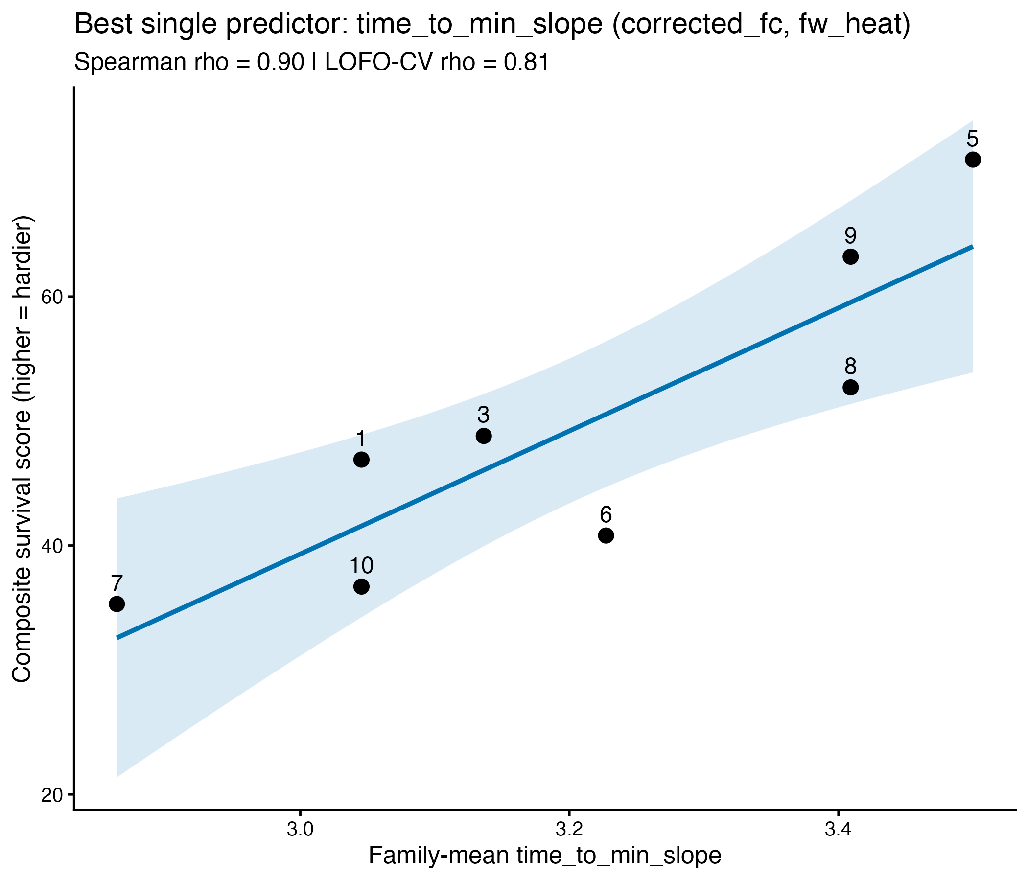
Tough families crash later
Single best metabolic predictor
• Each dot is a family.
• X: time to the steepest metabolic decline under freshwater + heat. Further right = crashes later.
• Y: survival score (higher = tougher).
• rho = 0.90; cross-validated rho = 0.81 when each family is predicted from the other eight.
Notes:
Leave-one-family-out CV is the honest number.

Slide 12
The counterintuitive part
Hardy oysters stay calm
• Families whose metabolism spikes hardest when heated survive the least.
• Hardy families keep metabolism restrained — they don't overreact.
• They decline slowly and late rather than crashing early.
• The signal is strongest when the assay is run during stress, not at rest.
Notes:
Metabolic depression as a resilience strategy — consistent with the PeerJ survival result.

Slide 13
The resazurin index
Four curve features, blended into one score per family
Feature | Plain meaning | Survivor-like value
Time to steepest drop | how long before metabolism crashes | later
Steadiness | how much metabolism bounces around | steadier
Early rise | how fast metabolism climbs at first | faster
Depth of collapse | how far it falls from its peak | smaller
Each feature is put on a common scale, flipped so higher = tougher, and the four are averaged.
Notes:
Measured under freshwater + heat. Blending averages out individual noise.

Slide 14
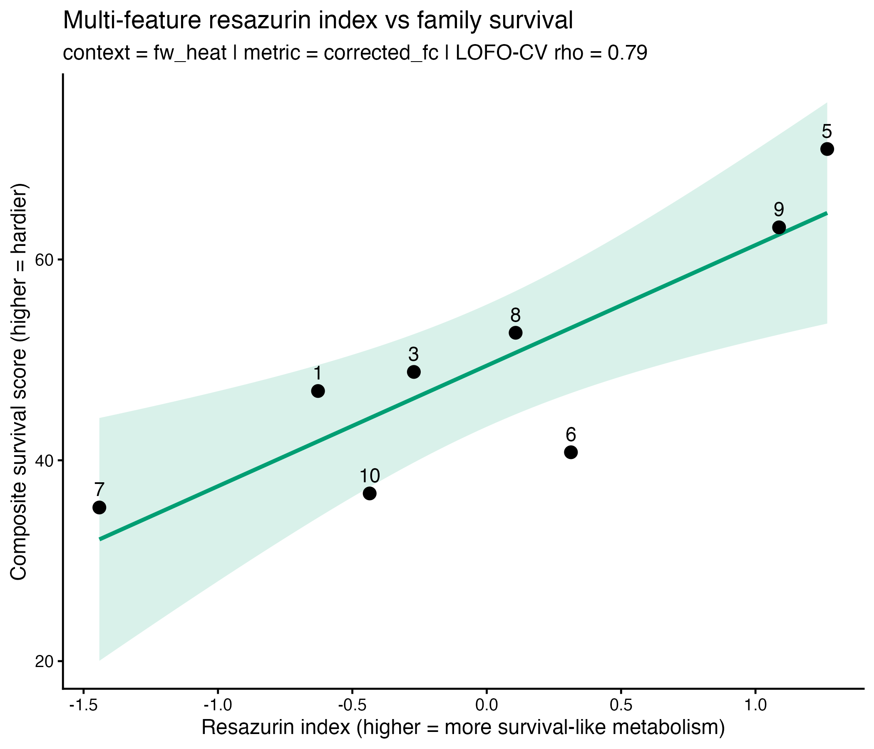
The index tracks real survival
• X: combined resazurin index (further right = more survivor-like metabolism).
• Y: survival score from the lethal trials.
• Leave-one-family-out rho = 0.79 — strong prediction for families the model never saw.
• Toughest (5) and most fragile (7) land at opposite ends.
Notes:
Half a day of dye work stands in for a season of grow-out.

Slide 15
Use #2 — Real-time stress on the farm
A thermometer for physiological condition

Slide 16
Reading stress while it's happening
Same assay, different question
• Pull a small sample of animals, run a plate, get an answer the same day.
• Elevated metabolism under a heat or salinity event flags a crop under load — before mortality shows up.
• Compare bags, tidal heights, gear types, or sites on the same afternoon.
• Track recovery after an event: does metabolism return to baseline, and how fast?
• Non-lethal and cheap enough to repeat weekly through a risky season.
Turns "the water got hot last week" into a number you can act on.
Notes:
This is the operational pitch: early warning + management comparison.

Slide 17
What's next
• Broaden the index with additional assays:
  – Glycogen (heat vs. control, 3 h)
  – Na+/K+ ATPase
  – Citrate synthase
• Validate predictions against field outplants across PNW sites.
• Package a grower-facing protocol and a simple scoring sheet.
Notes:
Short — leave time for questions.

Slide 18
Takeaways
• Resazurin turns metabolism into a color change — cheap, non-lethal, 96 animals at a time.
• Published and validated against oxygen consumption (PeerJ 2026).
• Predicts phenotype: metabolic curve shape forecasts family hardiness (cross-validated rho ≈ 0.8).
• Measures stress in real time: a same-day readout of how hard your crop is working.
FUNDING - USDA-WRAC - sormi.science
Notes:
Land on the two grower uses.

