Slide 1
Future Shellf
Predictive Phenotyping for Oyster Performance
Steven Roberts · Ariana Huffmyer · Louis Plough · Mackenzie Gavery · Neil Thompson
University of Washington · USDA-ARS · NOAA NWFSC
PCSGA Annual Conference · 2026
SORMI.SCIENCE
Notes:
12-minute talk. Two things growers can use: predict phenotype before you grow it out, and read stress on the farm in real time.

Slide 2
Two questions
• Which seed should I buy — which family lines actually perform on my site?
• How stressed is my crop right now, before I start seeing mortality?
Today, answering either one means waiting.
Breeding trials take a season. Mortality events tell you after the fact.
We need a fast, cheap, non-lethal measure of how an oyster is doing — right now.
Notes:
Set up the grower problem before introducing the tool.

Slide 3
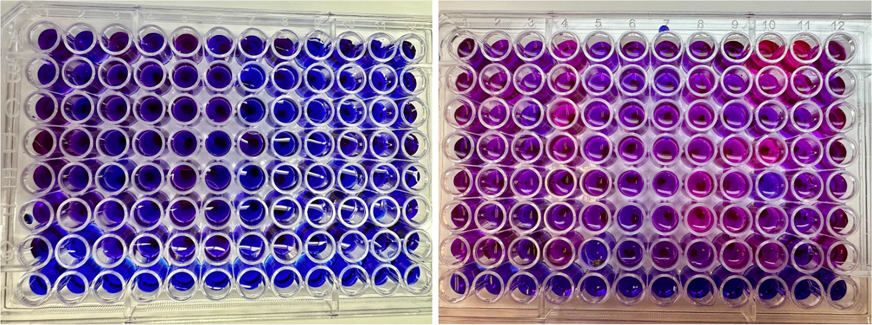
From blue to pink: the resazurin assay
A redox dye that reports whole-organism metabolism
Resazurin is blue and non-fluorescent.
Living cells reduce it to resorufin — pink and strongly fluorescent.
More metabolism = more pink = more signal.
The animal stays alive. Nothing is sacrificed.
Notes:
Left plate: early in the incubation. Right plate: 4-6 hours later. You can literally see metabolism.

Slide 4
How a run works
Roughly half a day, bench-top, ~$1 of dye per plate
• Photograph animals for shell length (size normalization), then load one oyster per well.
• Fill wells with resazurin working solution; empty wells serve as blanks.
• Read fluorescence on a plate reader (ex 530 / em 590 nm) — baseline, then hourly for 4–6 h.
• Hold at whatever condition you want to probe: ambient, heat, low salinity, freshwater.
• Correct to blanks, normalize to shell length → a metabolism curve for every individual.
96 individuals per plate, non-lethal, no respirometry hardware required.
Notes:
Emphasize throughput: this is the reason it is useful operationally.

Slide 5
From blue to pink: the resazurin assay
Huffmyer et al. 2026, PeerJ 14:e21542 — DOI 10.7717/peerj.21542
• Resazurin fluorescence correlates with oxygen consumption on the same individuals.
• Signal comes from live animals — live oysters far exceed empty shells and blanks.
• Scales with body size, so we normalize to shell length.
• Thermal performance curves behave as expected: metabolism peaks near 36 °C, then depresses.
• Works in both Pacific (C. gigas) and Eastern (C. virginica) oysters, seed through juveniles.
Peer-reviewed, open access, protocol included as an appendix — anyone can run it.
Notes:
Highlight that the method paper is out — this is not preliminary.

Slide 6
Use #1 — Predicting phenotype
Read metabolism today, forecast field performance later

Slide 7
Metabolism already tracks outcomes
Key findings from the PeerJ study
• Under acute heat stress, oysters that survived had ~52% lower cumulative metabolism than those that died.
• High metabolic output under stress = higher risk of mortality (p < 0.001).
• Families differ significantly in metabolic response — the trait is genetically variable.
• In 50 selectively bred C. virginica families, metabolism correlated with predicted survival in the environment they were selected for (r = 0.56, p = 0.004).
Metabolism is not just a health readout — it carries information about future performance.
Notes:
Objectives 3, 4, 5 of the paper, compressed.

Slide 8
Testing the idea head-on: survival trials
Nine USDA C. gigas families, run side by side
Trial | Stressor | Oysters | % died
Apr 27 | 33 °C | 128 | 49%
May 11 | 33 °C | 84 | 99%
Jun 04 | 36 °C | 39 | 95%
Jun 09 | 36 °C | 77 | 86%
Jul 06 | 35 °C | 378 | 97%
Jul 06 | 35 °C + low salinity | 204 | 84%
Jul 07 | Freshwater → 36 °C | 185 | 33%
Harshness varies enormously — raw survival can't be compared across trials.
Notes:
20 oysters per family per trial; time of death logged repeatedly.

Slide 9
A fair hardiness score
0–100, comparable across trials
• Within each trial, rank families on (1) fraction surviving and (2) how long they lasted.
• Convert each family's standing to a percentile against the other families in that same trial — this cancels out trial harshness.
• Average those percentiles across all seven trials.
Higher score = consistently tougher across many kinds of stress.
Notes:
Keep this brief — it's plumbing, not the point.

Slide 10
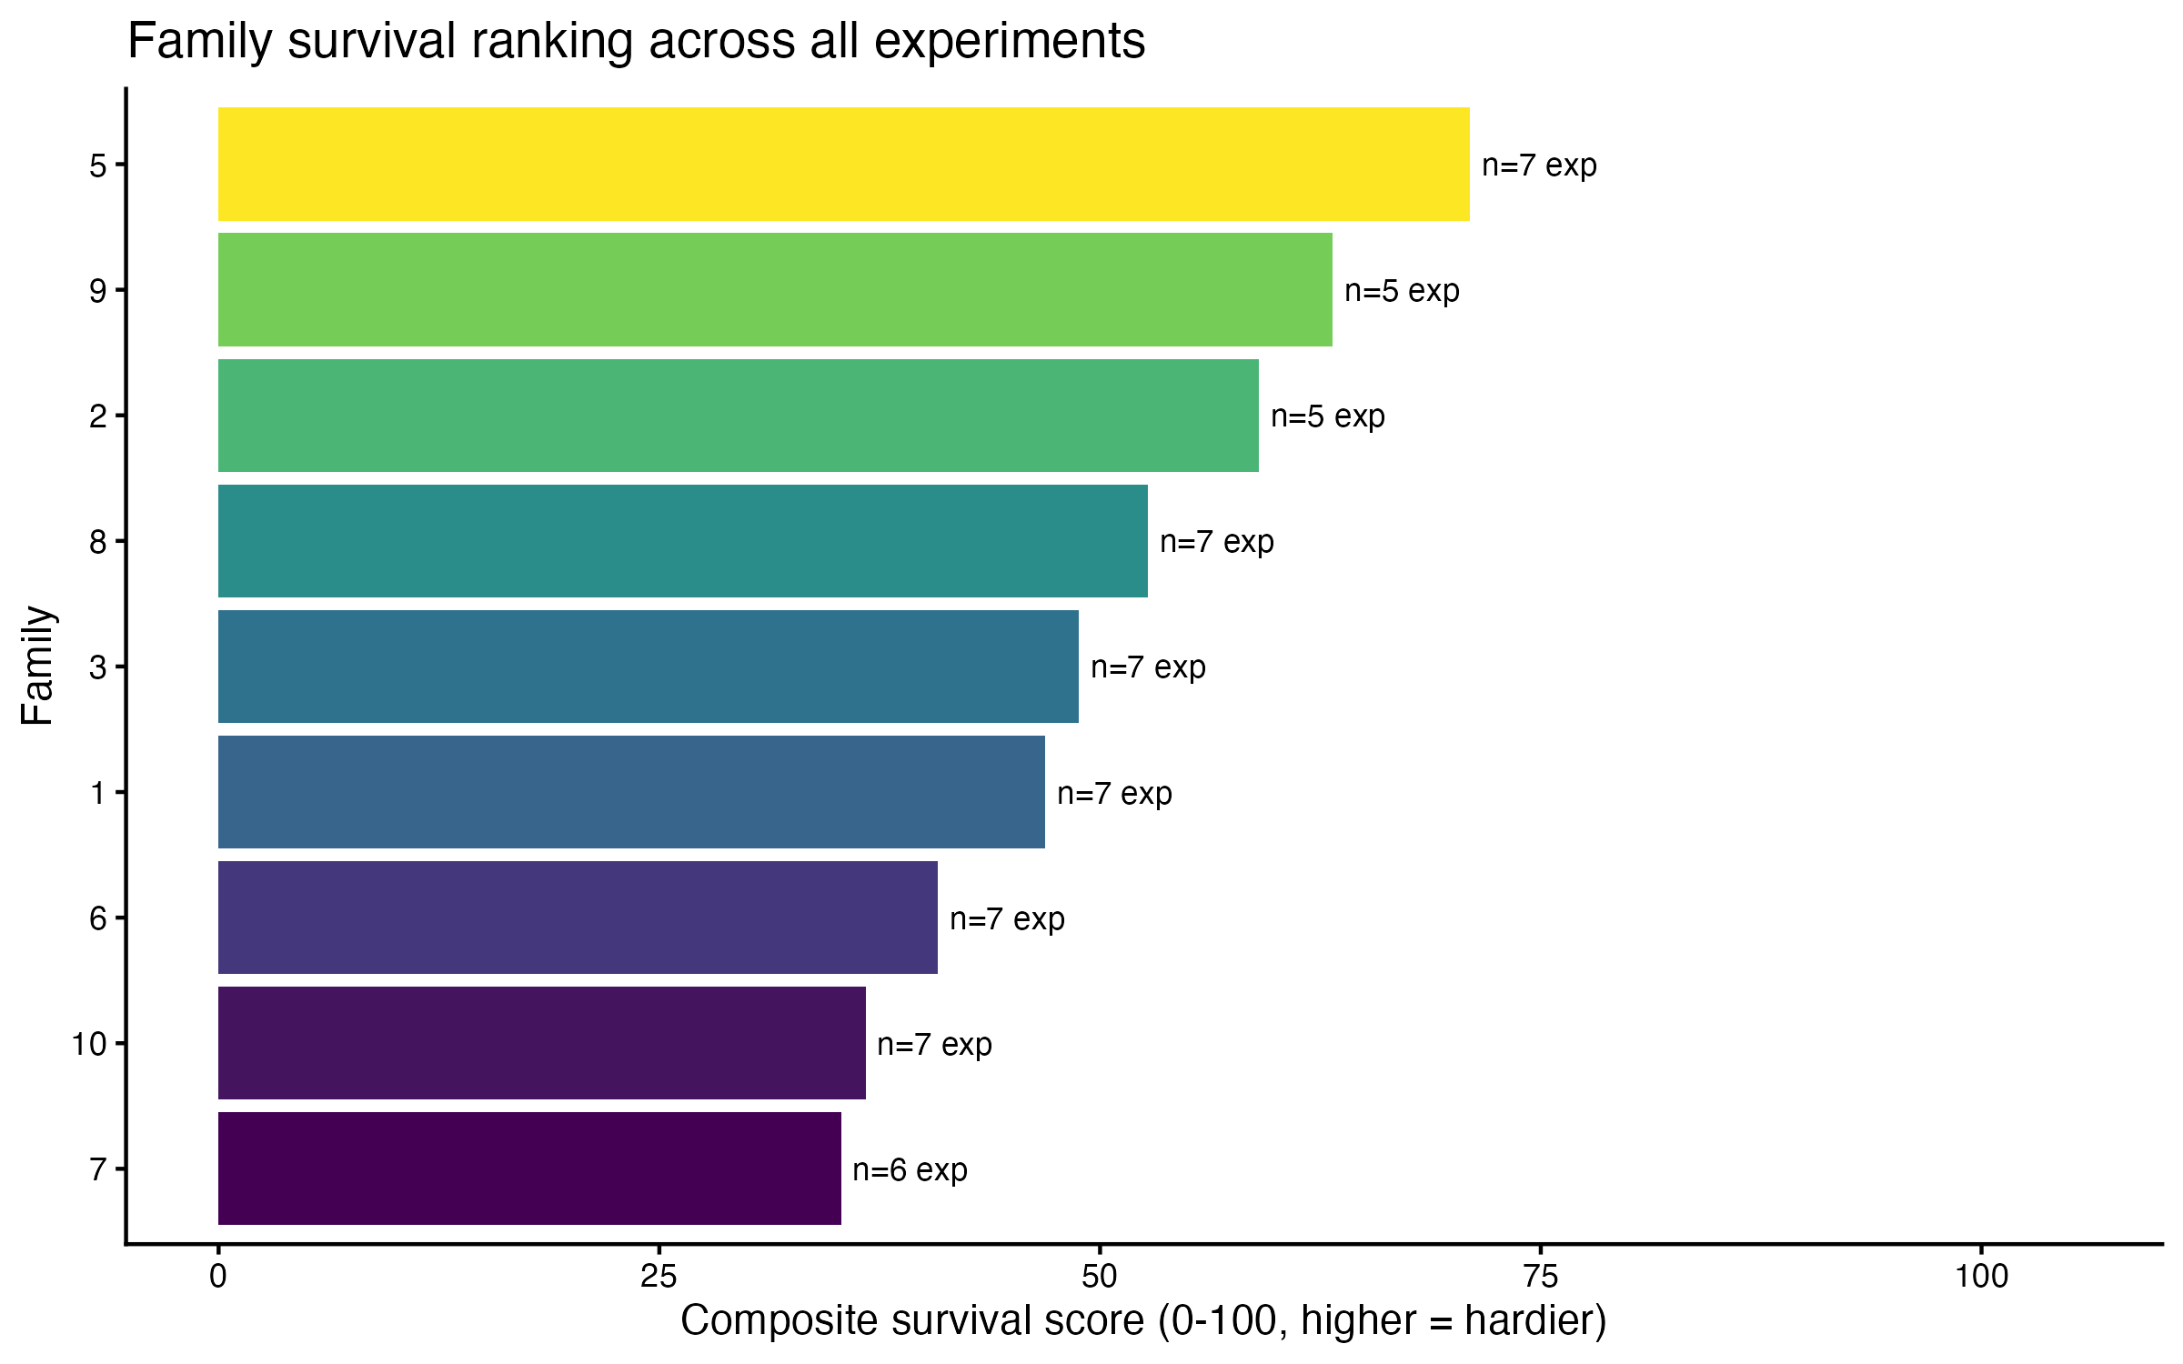
Families really do differ
Family 5 is the toughest; family 7 the most fragile — and the spread repeats across trials.
Notes:
This is the truth we want to predict.

Slide 11
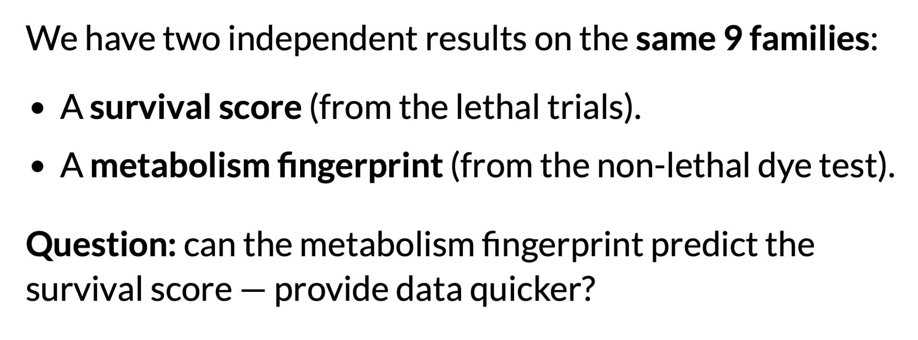
Predictive Phenotyping
Notes:
This is the truth we want to predict.

Slide 12
Reading the score: what the numbers mean
Both numbers ask the same thing, on a scale of -1 to +1
Does the test rank the families in their true survival order?
Spearman rho
A ranking agreement score. +1 = same order (the test's toughest really is the toughest), 0 = unrelated, -1 = reversed. We rank rather than use raw values so one odd family can't distort it.
LOFO-CV rho
The same score, measured honestly on families the model never saw: hide one family, predict it from the other eight, repeat for all nine, then compare.
Spearman rho = optimistic best case. LOFO-CV rho = the trustworthy one.
Notes:
A small gap between the two means the prediction isn't just memorizing our nine families. Spend ~45 s here — every rho on the next three slides depends on it.

Slide 13
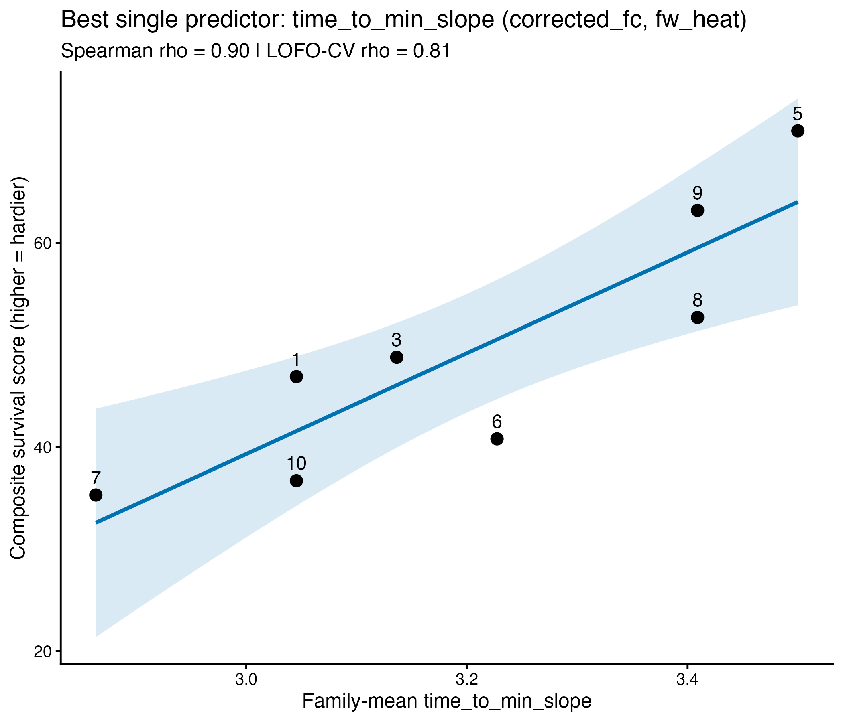
Tough families crash later
Single best metabolic predictor
• Each dot is a family.
• X: time to the steepest metabolic decline. Further right = crashes later.
• Y: survival score (higher = tougher).
• rho = 0.90; cross-validated rho = 0.81 when each family is predicted from the other eight.
Notes:
Leave-one-family-out CV is the honest number.

Slide 14
The counterintuitive part
Hardy oysters stay calm
• Families whose metabolism spikes hardest when heated survive the least.
• Hardy families keep metabolism restrained — they don't overreact.
• They decline slowly and late rather than crashing early.
• The signal is strongest when the assay is run during stress, not at rest.
Notes:
Metabolic depression as a resilience strategy — consistent with the PeerJ survival result.

Slide 15
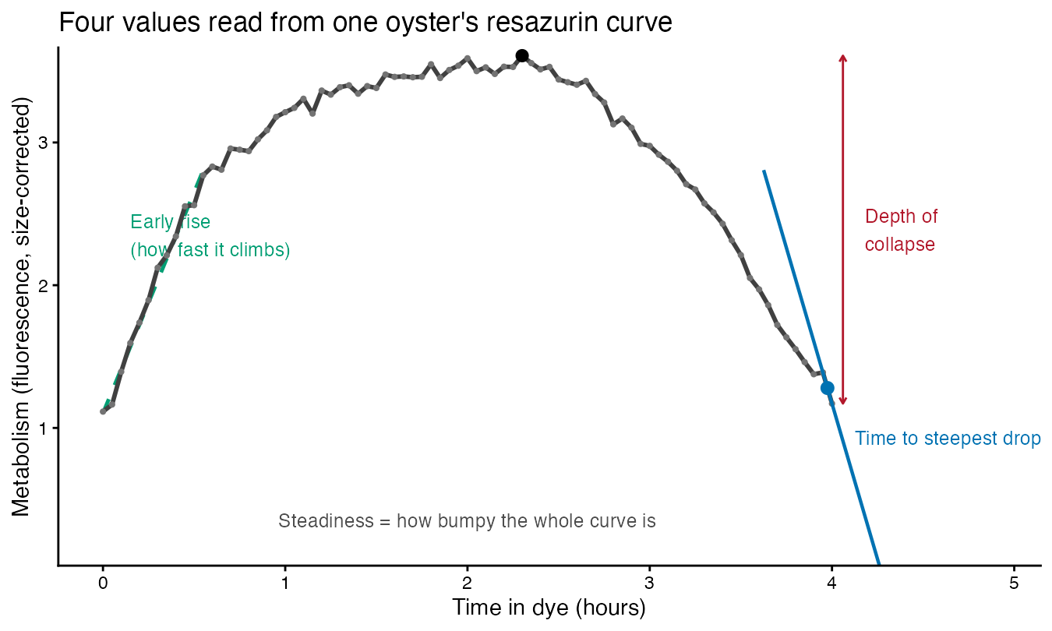
Four values read from one curve
Everything in the index comes from the shape of a single oyster's run
Notes:
Walk the curve once: climbs, peaks, then drops. Early rise, steadiness, time to steepest drop, depth of collapse. Then the next slide says which direction is good.

Slide 16
The resazurin index
Four curve features, blended into one score per family
Feature | Plain meaning | Survivor-like value
Time to steepest drop | how long before metabolism crashes | later
Steadiness | how much metabolism bounces around | steadier
Early rise | how fast metabolism climbs at first | faster
Depth of collapse | how far it falls from its peak | smaller
Each feature is put on a common scale, flipped so higher = tougher, and the four are averaged.
Notes:
Measured under freshwater + heat. Blending averages out individual noise.

Slide 17
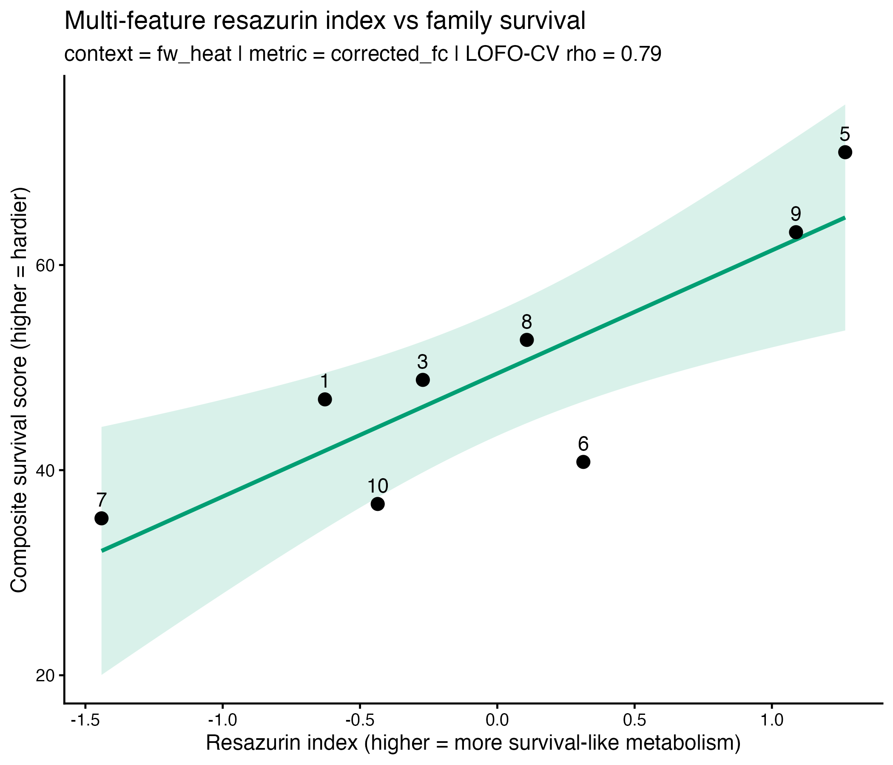
The index tracks real survival
• X: combined resazurin index (further right = more survivor-like metabolism).
• Y: survival score from the lethal trials.
• Leave-one-family-out rho = 0.79 — strong prediction for families the model never saw.
• Toughest (5) and most fragile (7) land at opposite ends.
Notes:
Half a day of dye work stands in for a season of grow-out.

Slide 18
Use #2 — Real-time stress on the farm
A thermometer for physiological condition - early development – conceptual

Slide 19
Reading stress while it's happening
Same assay, different question
• Pull a small sample of animals, run a plate, get an answer the same day.
• Elevated metabolism under a heat or salinity event flags a crop under load — before mortality shows up.
• Compare bags, tidal heights, gear types, or sites on the same afternoon.
• Track recovery after an event: does metabolism return to baseline, and how fast?
• Non-lethal and cheap enough to repeat weekly through a risky season.
Turns "the water got hot last week" into a number you can act on.
Notes:
This is the operational pitch: early warning + management comparison.

Slide 20
Takeaways
• Resazurin turns metabolism into a color change — cheap, non-lethal, 96 animals at a time.
• Predicts phenotype: metabolic curve shape forecasts family hardiness.
• Need additional field performance data and will add other assays to index.
• Could measure stress in real time: a same-day readout of how hard your crop is working.
USDA-WRAC (Hudson - PSI) More @ sormi.science
Notes:
Land on the two grower uses.

Slide 21
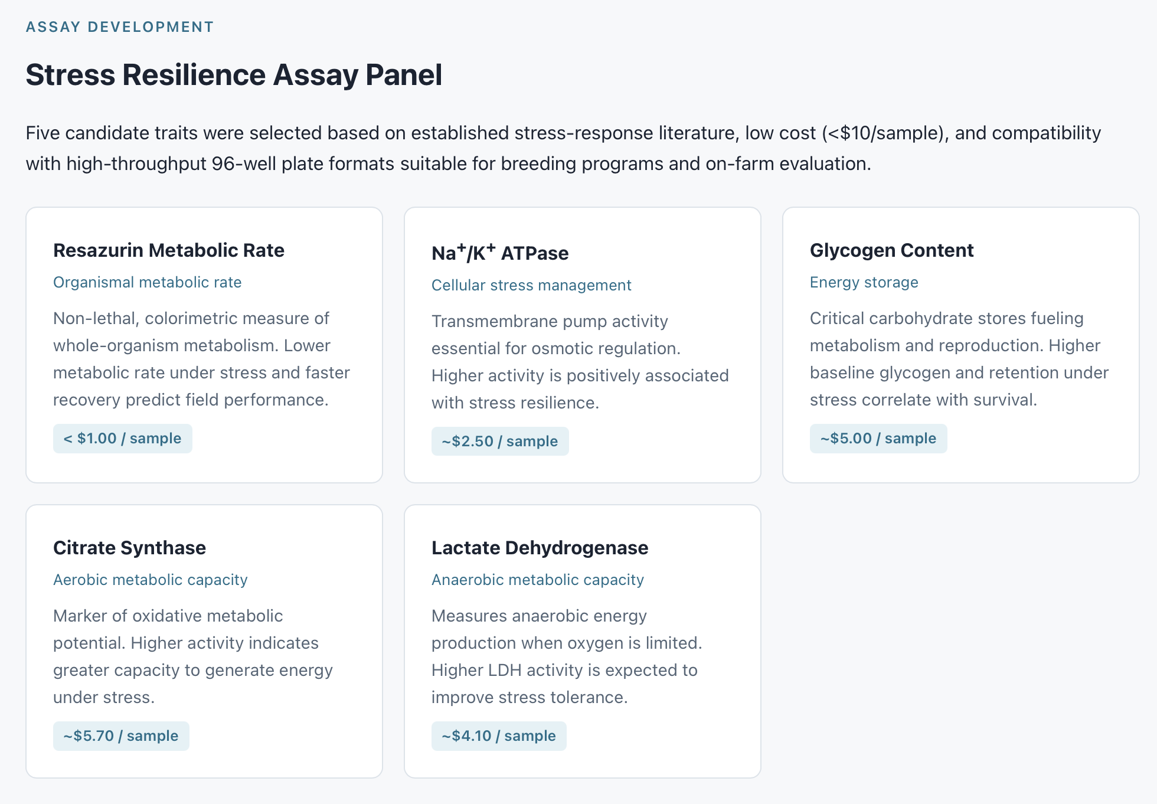
USDA-WRAC (Hudson - PSI) More @ sormi.science
Notes:
Land on the two grower uses.

Slide 22
Takeaways
• Resazurin turns metabolism into a color change — cheap, non-lethal, 96 animals at a time.
• Predicts phenotype: metabolic curve shape forecasts family hardiness.
• Need additional field performance data and will add other assays to index.
• Could measure stress in real time: a same-day readout of how hard your crop is working.
USDA-WRAC (Hudson - PSI) More @ sormi.science
Notes:
Land on the two grower uses.

