Slide 1
Mini Project – 1

Slide 2
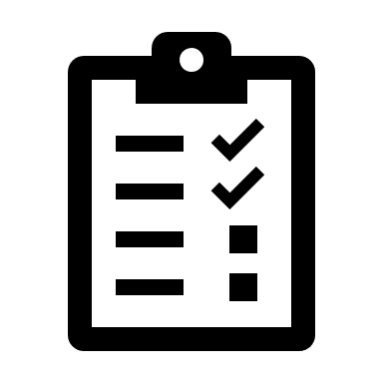
To-do list
A task manager you can trust

Slide 3
TEAM Our Team Members
M Nikhil Narasimha 737-025
M. Pavan Kalyan 737-027
R. Srujan Teja 737-046

Slide 4
Features of our Project
Adding Tasks
Checking tasks off
Recurring tasks
Notes
Priority bar
Reminder
Productivity Chart
Notifications (Not finalized)
Themes (Not finalized).

Slide 5
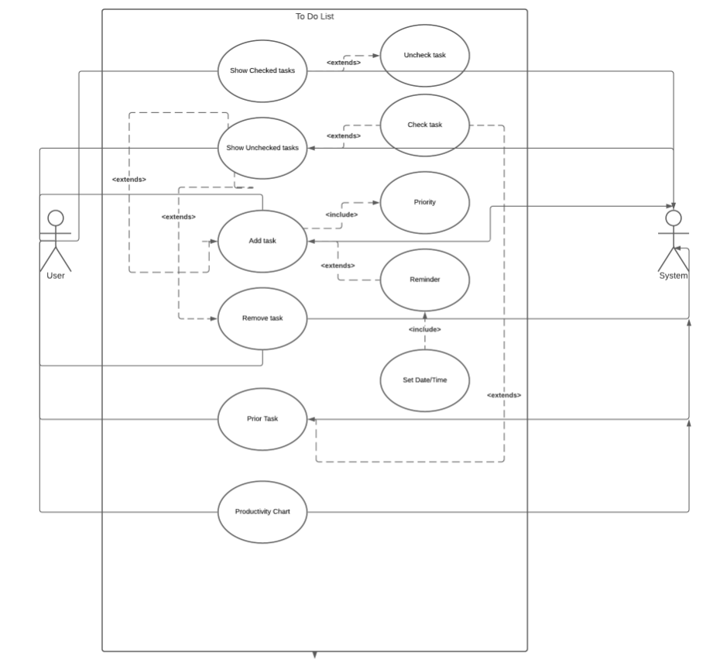
Use Case Diagram

Slide 6
Use Case Descriptions
Name : Add Task
Actors : User
Description : Allows to create a new task
Pre-Conditions : None
Post-Conditions : A Task is created
Main Flow
User | System
1.Clicks the Add Task Button
 | 2.Prompts a message to read priority
 | 3.Asks for Date
4.User Enters the respective info if needed

Slide 7
Name : Remove tasks
Actors : User
Description : Allows to remove/delete a task
Pre-Conditions : The task must be existing
Post-Conditions : The existing task will be deleted
Main Flow
User | System
1.Clicks the Remove task button
 | 2.The System deletes the task

Slide 8
Name : Show unchecked tasks
Actors : User
Description : Displays the Unchecked tasks
Pre-Conditions :Unchecked tasks existing
Post-Conditions : The Unchecked tasks will be displayed
Main Flow
User | System
1.Clicks the Show Unchecked tasks button
 | 2.The unchecked tasks are shown
3.User can check off the tasks Or add new tasks
 | 4.The respective operations are performed by system

Slide 9
Name : Show checked tasks
Actors : User
Description : Displays the checked tasks
Pre-Conditions :Checked tasks existing
Post-Conditions : The checked tasks will be known
Main Flow
User | System
1.Clicks the Show checked tasks button
 | 2.The checked tasks are shown
3.User can uncheck the tasks
-- | --

Slide 10
Name : Prior Task
Actors : User
Description : Displays the High Prior Task
Pre-Conditions : Tasks existing
Post-Conditions : The high prior task will be shown
Main Flow
User | System
1.Clicks the Prior Task button
 | 2.The Highest Priority task is shown
3.User can check the task
-- | 4.If so, the task is checked

Slide 11
Name : Productivity Chart
Actors : User
Description : Displays the Productivity chart i.e. analysis of checked vs unchecked tasks.
Pre-Conditions : None
Post-Conditions : The graph is displayed
Main Flow
User | System
1.Clicks the Productivity Chart button
-- | 2.The Graph is displayed

Slide 12
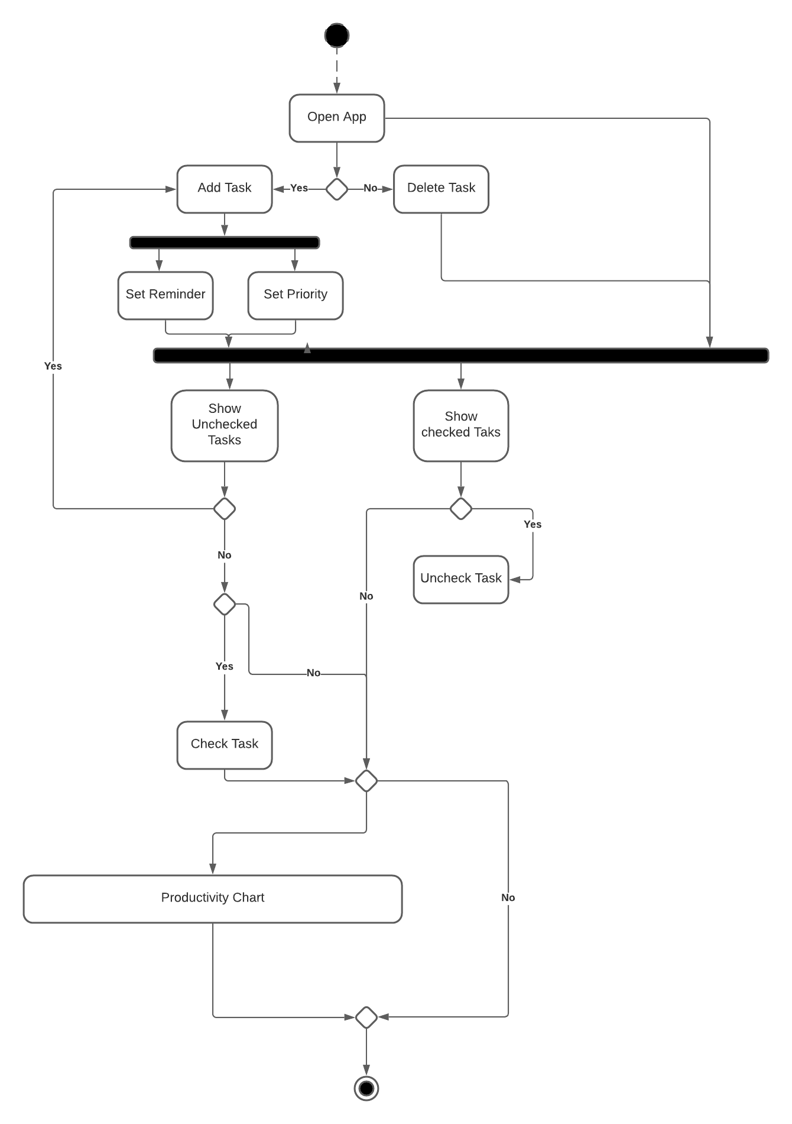
Activity Diagram

Slide 13

THANKS!

