Slide 1

MHRD GRANT SCHEME
Project developed and designed by,
SHUBHAM RATH
RAJASRSHI KHARE
SHRUTI SINGH
SAROJ SETHY

Slide 2
WORKING PROJECT
The Ministry of Human Resource Development (MHRD) plays a significant and remedial role in balancing the socio-economic fabric of the Country through education. It is responsible for development of school education and literacy and is engaged in bringing world class opportunities of higher education and research. Formulating the National Policy on Education, improving quality of the educational institutions and provide financial help in the form of scholarships, loan subsidy, etc. are its major functions.

Slide 3
PURPOSE AND MOTIVATION FOR THE PROJECT
Our project focuses on the research grants given to various institutions by MHRD. MHRD promotes education for all. It provides funds to various institutions for research so that our country progresses in the field of education. This project provides an interface to the Universities to apply for grants. Through this project, we aim to educate the less privileged by funds and ensuring a bright future for our country.

Slide 4
CLASSES, FUNCTIONS, TEMPLATES USED
Class registration: //To register a new college
registeration() //Constructor to input details
void csvinput(registeration r) //To write to csv file

Slide 5
CLASSES, FUNCTIONS, TEMPLATES USED
Class College_Details: //To edit details of existing college
College_Details(std::string collegename) //To enter details of college
void csveditinput(College_Details ob) //To write details to csv file
void csvedit(std::string collegename) //To clear screen and call the above functions

Slide 6
CLASSES, FUNCTIONS, TEMPLATES USED
Class grant: //For grant related operations
void get_grant() //To input new grant value
void rate_calc(std::string); //To calculate rate for grant
void grant_increase(std::string); //To increase grant on existing projects
void found(grant); //To calculate respective grants
void new_grantfunc(std::string); //To input & check for new project grant
Others:
void grant_edit(double g, std::string c, int f) //To write grant to csv file
Template T // To convert double to string

Slide 7
CLASSES, FUNCTIONS, TEMPLATES USED
Class credentials: //For login operations
void getusername() //To input user name
void getpassword() //To input password
friend int usercredential(credentials/registration) //Overloaded function to check for correct user & password
friend int adminkey(credentials) //To check for correct admin

Slide 8
CLASSES, FUNCTIONS, TEMPLATES USED
Others:
main()
int loginoption() //Main Login screen
void useroperationui(std::string collegename) //User operations menu
void userui() //User login screen
void adminui() //Admin login screen
void adminoperation() //Admin Operations menu
void edit_password() //Admin password editor
void list() //Lists the colleges in database

Slide 9
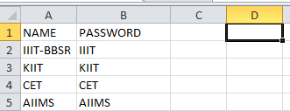
CSV FILES
Five csv files are used.
usercredential.csv

Slide 10
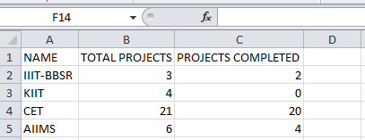
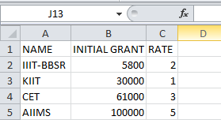
CSV FILES
2. project.csv:
3. grant.csv:

Slide 11
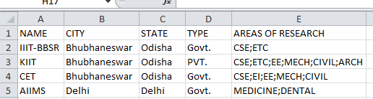

CSV FILES
4. college_details.csv:
5. admincredentials.csv

Slide 12
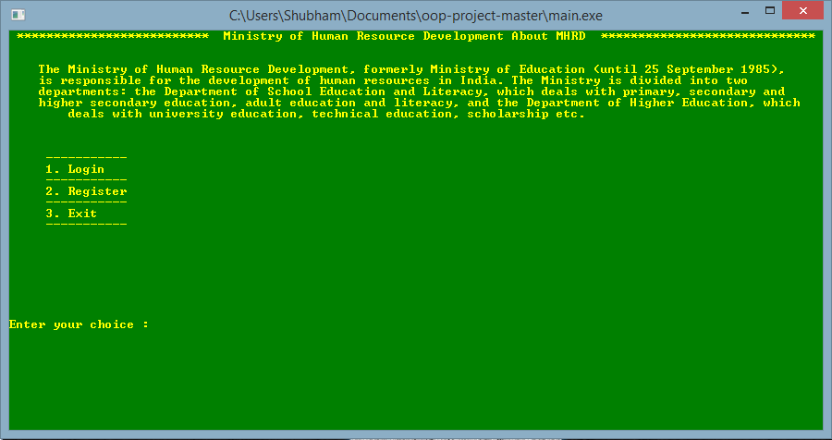
MAIN UI

Slide 13
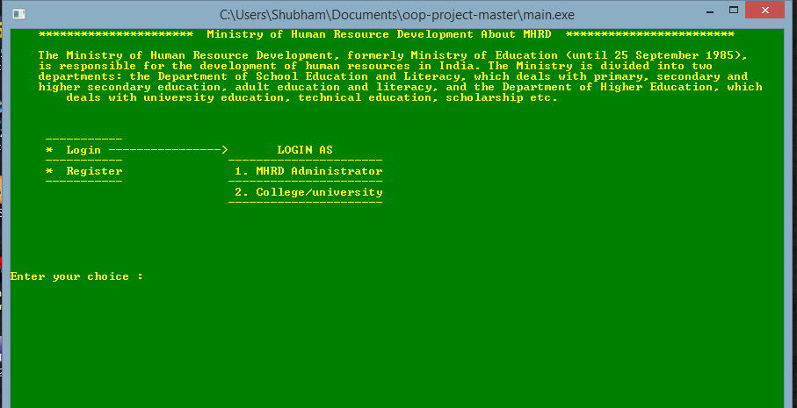
MAIN UI LOGIN

Slide 14
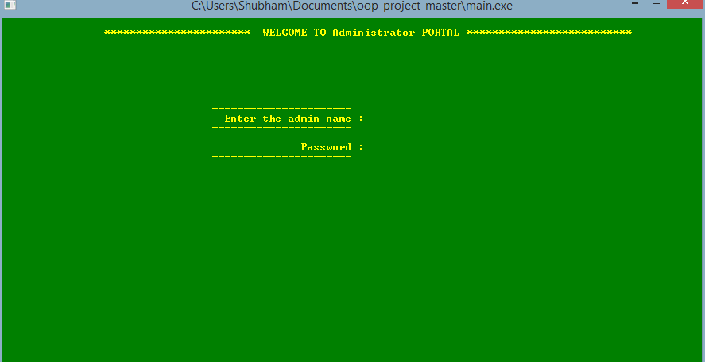
ADMIN LOGIN

Slide 15
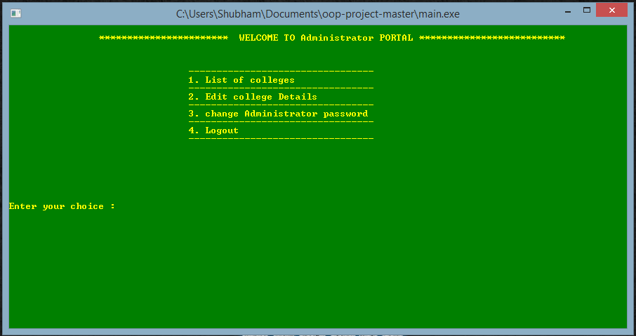
ADMIN OPERATIONS

Slide 16
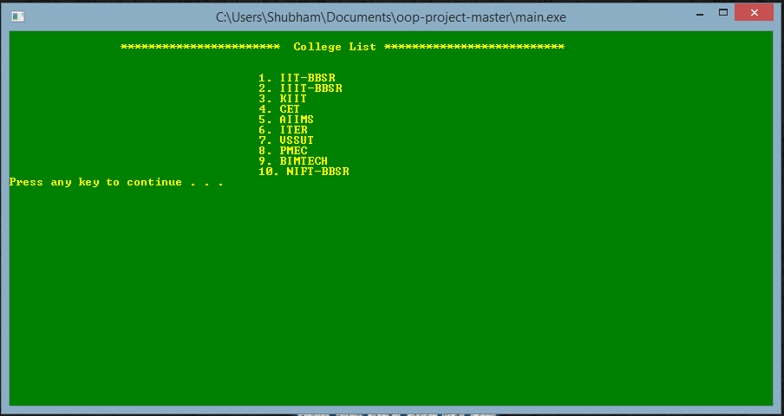
LISTING COLLEGES

Slide 17
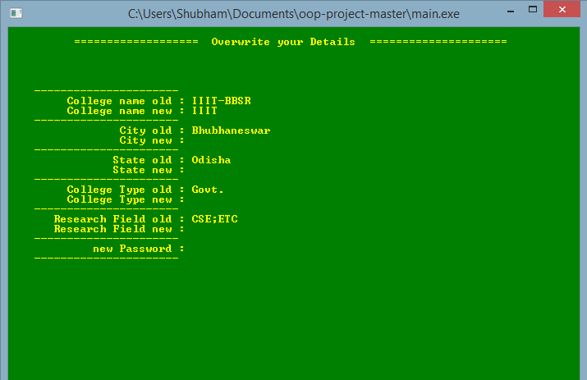
EDITING COLLEGE DETAILS

Slide 18
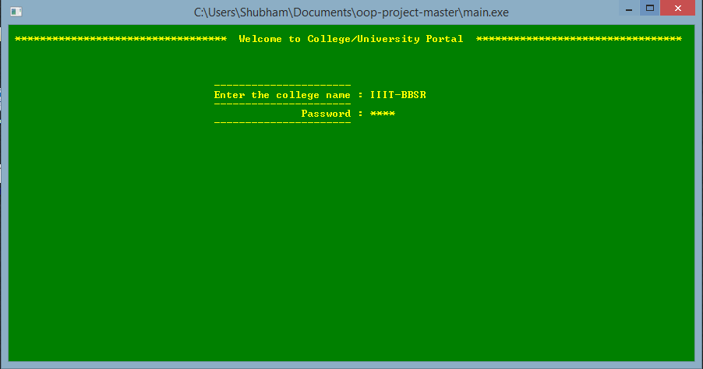
USER/COLLEGE LOGIN

Slide 19
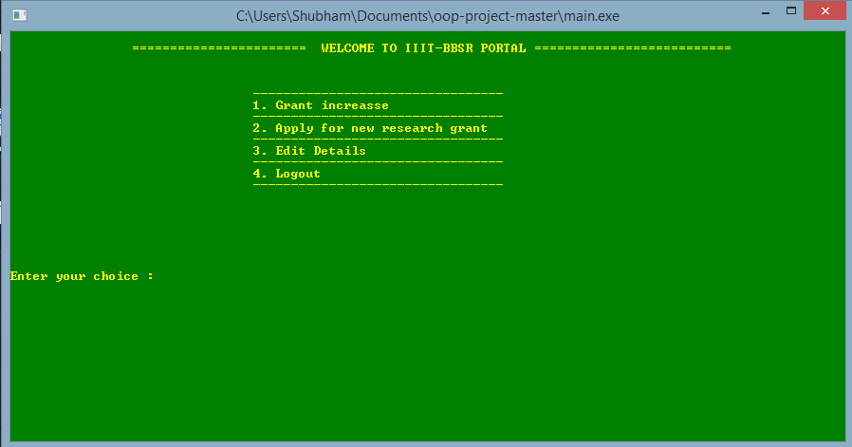
USER/COLLEGE OPERATIONS

Slide 20
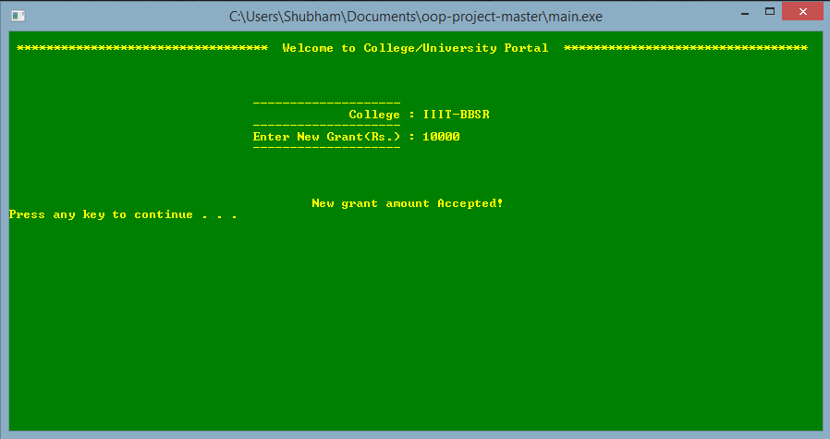
GRANT HIKE FOR PRESENT PROJECT

Slide 21
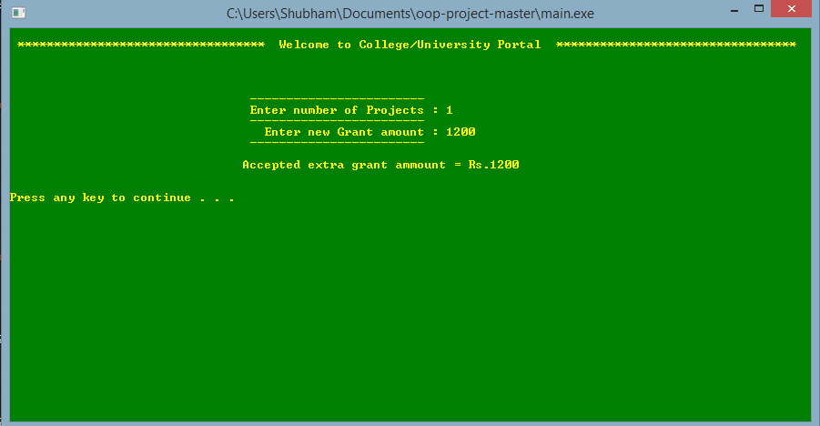
GRANT REQUEST FOR NEW PROJECT

Slide 22
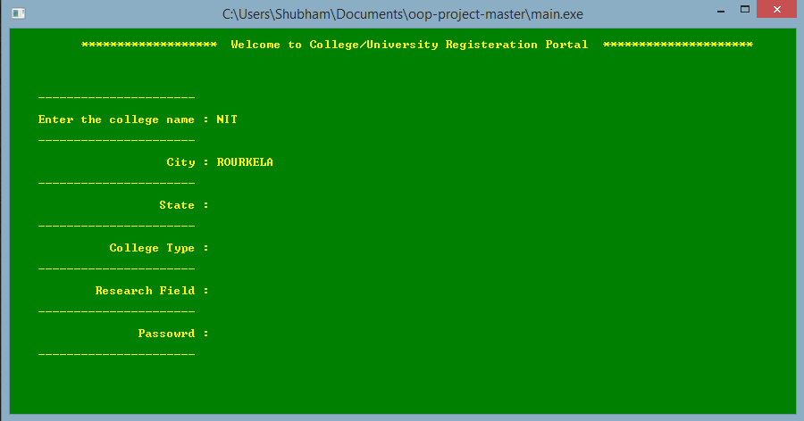
NEW USER/COLLEGE REGISTRATION

Slide 23
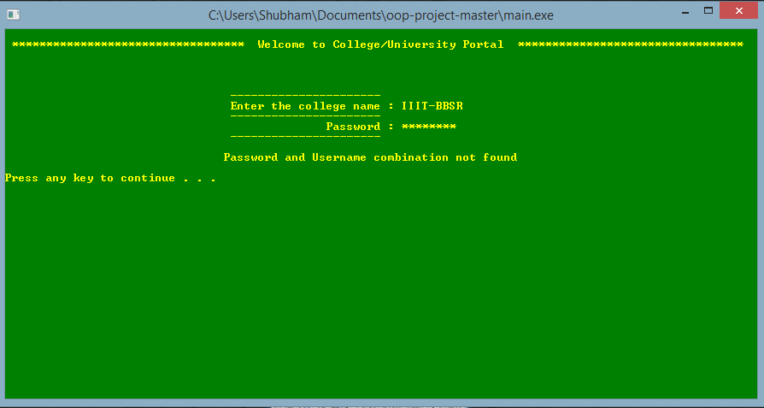
PASSWORD PROTECTION

Slide 24
THANK YOU

