Slide 1
Pace Website: Reeducated (Remastered)
By Sebastian Roman, Aaron Metsch ChatGPT

Slide 2
Why Rewrite Pace.edu?
The Pace website has major UX issues:
Bloated
Cluttered
Slow
Needs “www.” for some reason

Slide 3
Layout
We went with a hierarchical layout:
Different people with different needs will use this site
This makes it quicker to get to the pages you care about
Its more organized than the current random assortment of pages on the Pace website

Slide 4
Images
We Used few images to:
Keep the page less cluttered
Help the website load faster
Keep the focus on the important content

Slide 5
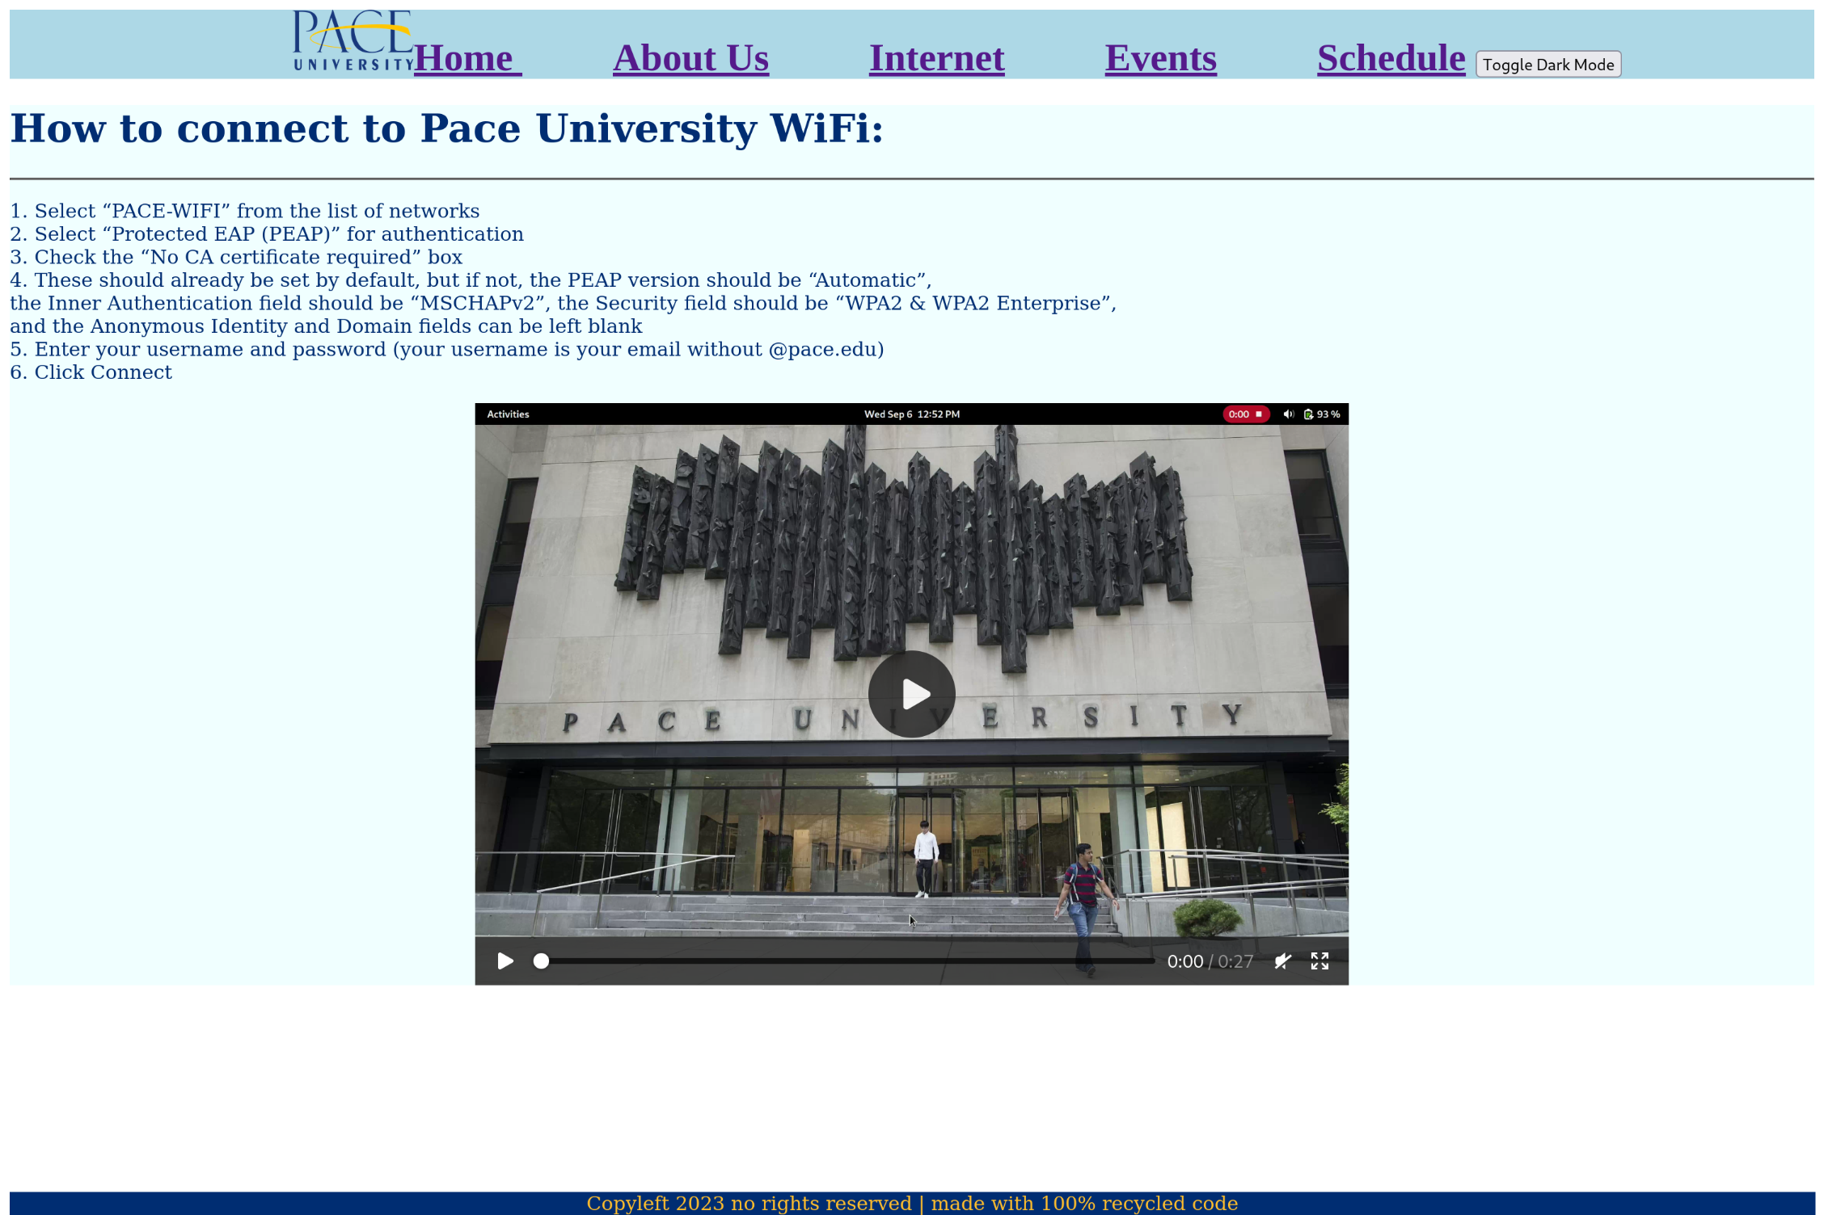
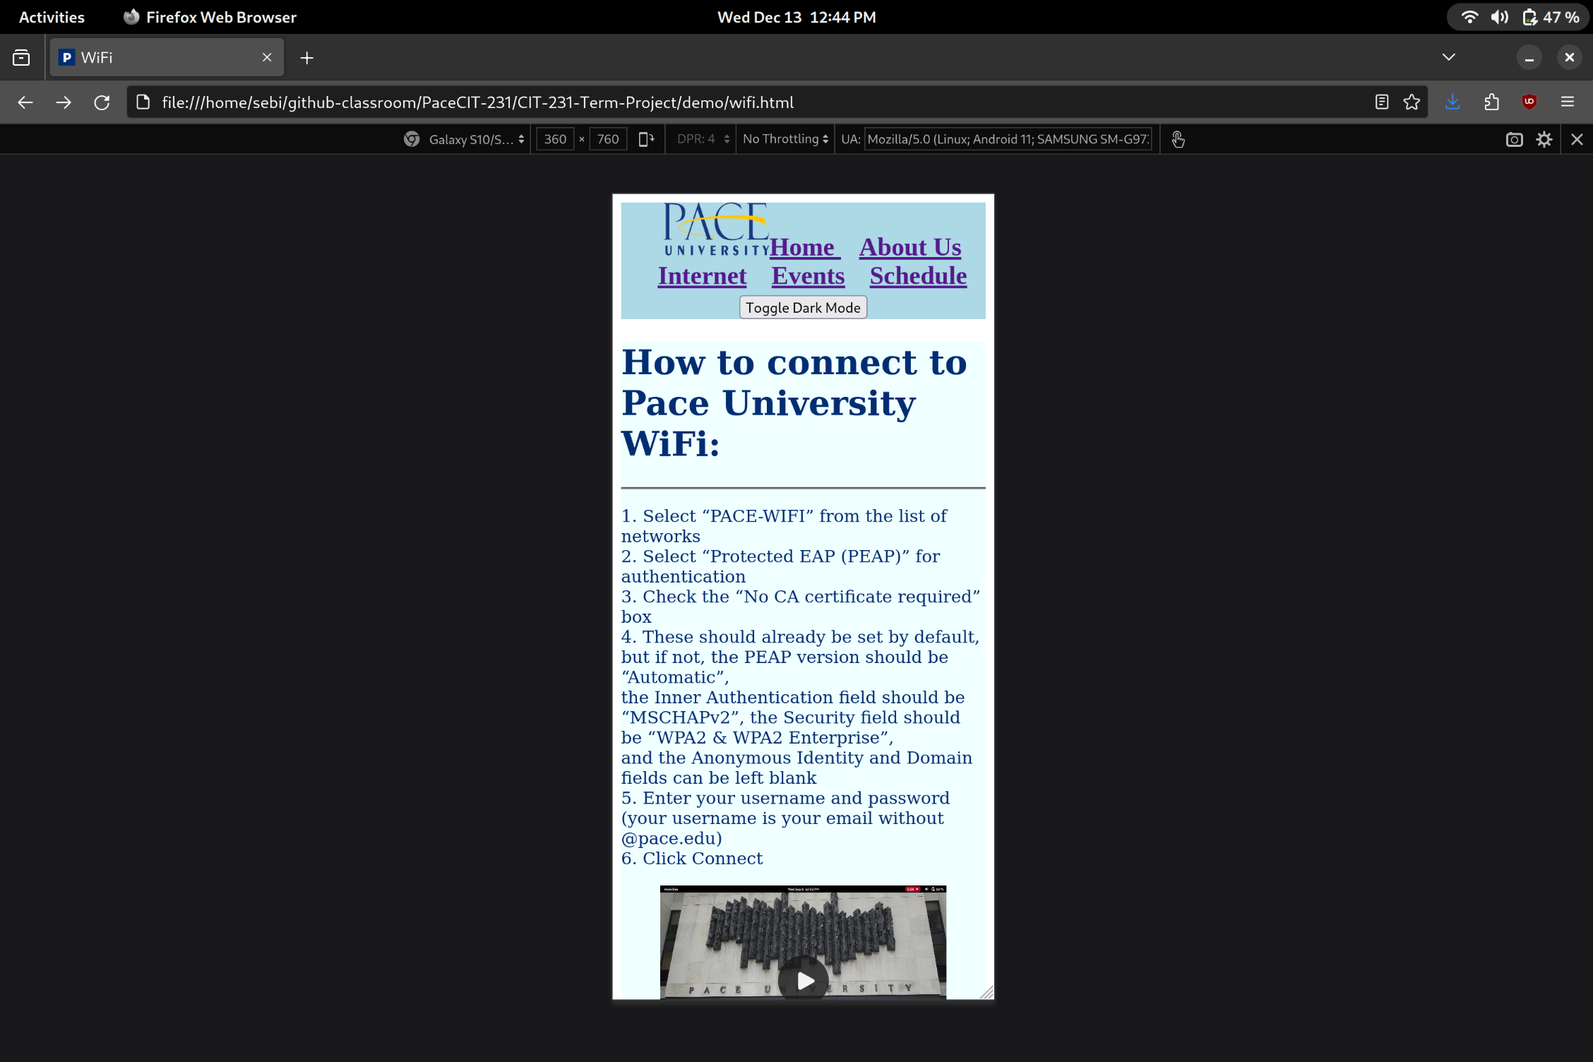
Responsiveness
Looks absolutely incredibly phenomenal on desktop & mobile

Slide 6
Demonstration

Slide 7
Preference
What are our favorite/least favorite parts of the website?

Slide 8
Questions?

