Slide 1
VERILOG: Synthesis - Combinational Logic
Combination logic function can be expressed as:
logic_output(t) = f(logic_inputs(t))
Combinational
Logic
logic_inputs(t)
logic_outputs(t)
Rules
  Avoid technology dependent modeling; i.e. implement functionality, not timing.
  The combinational logic must not have feedback.
  Specify the output of a combinational behavior for all possible cases of its inputs.
  Logic that is not combinational will be synthesized as sequential.

Slide 2
Styles for Synthesizable Combinational Logic
Synthesizable combinational can have following styles
  Netlist of gate instances and Verilog primitives (Fully structural)
  Combinational UDP (Some tools)
  Functions
  Continuous Assignments
  Behavioral statements
  Tasks without event or delay control
  Interconnected modules of the above

Slide 3
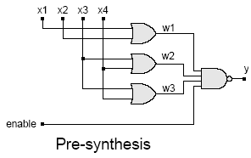
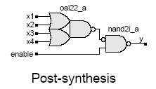
Synthesis of Combinational Logic – Gate Netlist
Synthesis tools further optimize a gate netlist specified in terms of Verilog primitives
Example:
module or_nand_1 (enable, x1, x2, x3, x4, y);
input enable, x1, x2, x3, x4;
output y;
wire w1, w2, w3;
or (w1, x1, x2);
or (w2, x3, x4);
or (w3, x3, x4); // redundant
nand (y, w1, w2, w3, enable);
endmodule

Slide 4
Synthesis of Combinational Logic – Gate Netlist (cont.)
General Steps:
  Logic gates are translated to Boolean equations.
  The Boolean equations are optimized.
  Optimized Boolean equations are covered by library gates.
  Complex behavior that is modeled by gates is not mapped to complex library cells (e.g. adder, multiplier)
  The user interface allows gate-level models to be preserved in synthesis.

Slide 5
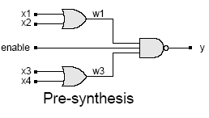
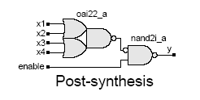
Synthesis of Combinational Logic – Continuous Assignments
Example:
  module or_nand_2 (enable, x1, x2, x3, x4, y);
  input enable, x1, x2, x3, x4;
  output y;
  assign y = !(enable & (x1 | x2) & (x3 | x4));
  endmodule

Slide 6
Synthesis of Combinational Logic – Behavioral Style
Example:
  module or_nand_3 (enable, x1, x2, x3, x4, y);
  input enable, x1, x2, x3, x4;
  output y;
  reg y;
  always @ (enable or x1 or x2 or x3 or x4)
  if (enable)
  y = !((x1 | x2) & (x3 | x4));
  else
  y = 1; // operand is a constant.
  endmodule
  Note: Inputs to the behavior must be included in the event control expression, otherwise a latch will be inferred.

Slide 7
Synthesis of Combinational Logic – Functions
Example:
  module or_nand_4 (enable, x1, x2, x3, x4, y);
  input enable, x1, x2, x3, x4;
  output y;
  assign y = or_nand(enable, x1, x2, x3, x4);
  function or_nand;
  input enable, x1, x2, x3, x4;
  begin
  or_nand = ~(enable & (x1 | x2) & (x3 | x4));
  end
  endfunction
  endmodule

Slide 8
Synthesis of Combinational Logic – Tasks
Example:
  module or_nand_5 (enable, x1, x2, x3, x4, y);
  input enable, x1, x2, x3, x4;
  output y;
  reg y;
  always @ (enable or x1 or x2 or x3 or x4)
  or_nand (enable, x1, x2, x3c, x4);
  task or_nand;
  input enable, x1, x2, x3, x4;
  output y;
  begin
  y = !(enable & (x1 | x2) & (x3 | x4));
  end
  endtask
  endmodule

Slide 9
Construct to Avoid for Combinational Synthesis
Edge-dependent event control
Multiple event controls within the same behavior
Named events
Feedback loops
Procedural-continuous assignment containing event or delay control
fork ... join blocks
wait statements
External disable statements
Procedural loops with timing
Data dependent loops
Tasks with timing controls
Sequential UDPs

Slide 10
Synthesis of Multiplexors
Conditional Operator
  module mux_4bits(y, a, b, c, d, sel);
  input [3:0] a, b, c, d;
  input [1:0] sel;
  output [3:0] y;
  assign y =
  (sel == 0) ? a :
  (sel == 1) ? b :
  (sel == 2) ? c :
  (sel == 3) ? d : 4'bx;
  endmodule
a[3:0]
b[3:0]
y[3:0]
c[3:0]
d[3:0]
sel[1:0]

Slide 11
Synthesis of Multiplexors (cont.)
CASE Statement
  module mux_4bits (y, a, b, c, d, sel);
  input [3:0] a, b, c, d;
  input [1:0] sel
  output [3:0] y;
  reg [3:0] y;
  always @ (a or b or c or d or sel)
  case (sel)
  0: y = a;
  1: y = b;
  2: y = c;
  3: y = d;
  default: y = 4'bx;
  endcase
  endmodule
a[3:0]
b[3:0]
y[3:0]
c[3:0]
d[3:0]
sel[1:0]

Slide 12
Synthesis of Multiplexors (cont.)
if .. else Statement
  module mux_4bits (y, a, b, c, d, sel);
  input [3:0] a, b, c, d;
  input [1:0] sel
  output [3:0] y;
  reg [3:0] y;
  always @ (a or b or c or d or sel)
  if (sel == 0) y = a; else
  if (sel == 1) y = b; else
  if (sel == 2) y = c; else
  if (sel == 3) y = d;
  else y = 4'bx;
  endmodule
a[3:0]
b[3:0]
y[3:0]
c[3:0]
d[3:0]
sel[1:0]
Note: CASE statement and if/else statements are more preferred and recommended styles for inferring MUX

Slide 13
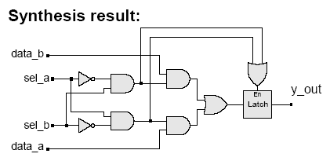
Unwanted Latches
Unintentional latches generally result from incomplete case statement or conditional branch
Example: case statement
  always @ (sel_a or sel_b or data_a or data_b)
  case ({sel_a, sel_b})
  2'b10: y_out = data_a;
  2'b01: y_out = data_b;
  endcase
The latch is enabled by the "event or" of the cases under which assignment is explicitly made. e.g. ({sel_a, sel_b} == 2'b10) or ({sel_a, sel_b} == 2'b01)

Slide 14
Unwanted Latches (cont.)
Example: if .. else statement
  always @ (sel_a or sel_b or data_a or data_b)
  if ({sel_a, sel_b} == 2’b10)
  y_out = data_a;
  else if ({sel_a, sel_b} == 2’b01)
  y_out = data_b;

Slide 15
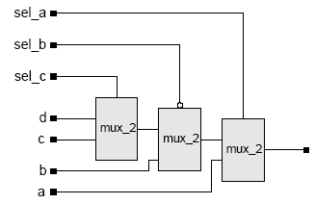
Priority Logic
When the branching of a conditional (if) is not mutually exclusive, or when the branches of a case statement are not mutually exclusive, the synthesis tool will create a priority structure.
Example:
  module mux_4pri (y, a, b, c, d, sel_a, sel_b, sel_c);
  input a, b, c, d, sel_a, sel_b, sel_c;
  output y;
  reg y;
  always @ (sel_a or sel_b or sel_c or a or b or c or d)
  begin
  if (sel_a == 1) y = a; else
  if (sel_b == 0) y = b; else
  if (sel_c == 1) y = c; else
  y = d;
  end
  endmodule

Slide 16
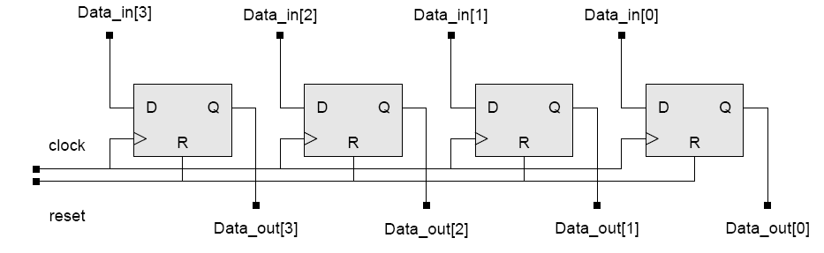
VERILOG: Synthesis - Sequential Logic
General Rule: A variable will be synthesized as a flip-flop when its value is assigned synchronously with an edge of a signal.
Example:
  module D_reg4a (Data_in, clock, reset, Data_out);
  input [3:0] Data_in;
  input clock, reset;
  output [3:0] Data_out;
  reg [3:0] Data_out;
  always @ (posedge reset or posedge clock)
  if (reset == 1'b1) Data_out <= 4'b0;
  else Data_out <= Data_in;
  endmodule

Slide 17
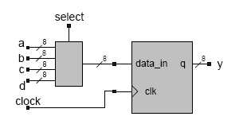
Registered Combinational Logic
Combinational logic that is included in a synchronous behavior will be synthesized with registered output.
Example:
module mux_reg (a, b, c, d, y, select, clock);
  input [7:0] a, b, c, d;
  output [7:0] y;
  input [1:0] select;
  reg [7:0] y;
  always @ (posedge clock)
  case (select)
  0: y <= a; // non-blocking
  1: y <= b; // same result with =
  2: y <= c;
  3: y <= d;
  default y <= 8'bx;
  endcase
  endmodule

Slide 18
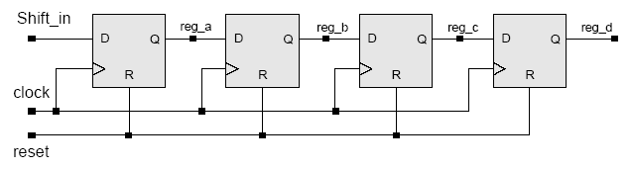
Verilog Shift Register
Shift register can be implemented knowing how the flip-flops are connected
  always @ (posedge clock) begin
  if (reset == 1'b1) begin
  reg_a <= 1'b0;
  reg_b <= 1'b0;
  reg_c <= 1'b0;
  reg_d <= 1'b0;
  end
  else begin
  reg_a <= Shift_in;
  reg_b <= reg_a;
  reg_c <= reg_b;
  reg_d <= reg_c;
  end
  end

Slide 19
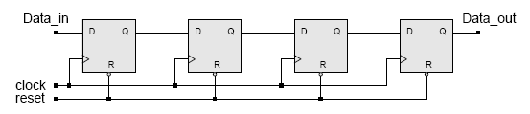
Verilog Shift Register
Shift register can be implemented using concatenation operation referencing the register outputs
  module Shift_reg4 (Data_out, Data_in, clock, reset);
  input Data_in, clock, reset;
  output Data_out;
  reg [3:0] Data_reg;
  assign Data_out = Data_reg[0];
  always @ (negedge reset or posedge clock) begin
  if (reset == 1'b0) Data_reg <= 4'b0;
  else Data_reg <= {Data_in, Data_reg[3:1]};
  end
  endmodule

Slide 20
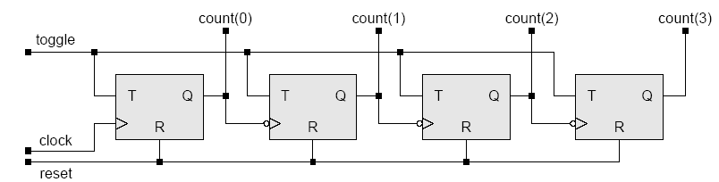
Verilog Ripple Counter
4-bit Ripple Counter

Slide 21
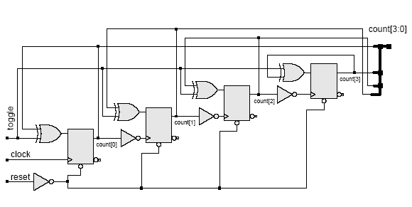
Verilog Ripple Counter
module ripple_counter (clock, toggle, reset, count);
input clock, toggle, reset;
output [3:0] count;
reg [3:0] count;
wire c0, c1, c2;
assign c0 = count[0], c1 = count[1], c2 = count[2];
always @ (posedge reset or posedge clock)
if (reset == 1'b1) count[0] <= 1'b0;
else if (toggle == 1'b1) count[0] <= ~count[0];
always @ (posedge reset or negedge c0)
if (reset == 1'b1) count[1] <= 1'b0;
else if (toggle == 1'b1) count[1] <= ~count[1];
always @ (posedge reset or negedge c1)
if (reset == 1'b1) count[2] <= 1'b0;
else if (toggle == 1'b1) count[2] <= ~count[2];
always @ (posedge reset or negedge c2)
if (reset == 1'b1) count[3] <= 1'b0;
else if (toggle == 1'b1) count[3] <= ~count[3];
endmodule
Synthesis Result

Slide 22
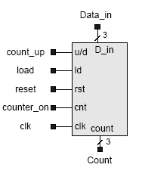
Verilog Up/Down Counter
Functional Specs.
Load counter with Data_in when load = 1
Counter counts when counter_on = 1
  counts-up when count_up = 1
  Counts-down when count_up = 0

Slide 23
Verilog Up/Down Counter (cont.)
module up_down_counter (clk, reset, load, count_up, counter_on, Data_in, Count);
input clk, reset, load, count_up, counter_on;
input [2:0] Data_in;
output [2:0] Count;
reg [2:0] Count;
always @ (posedge reset or posedge clk)
if (reset == 1'b1)
Count = 3'b0;
else if (load == 1'b1)
Count = Data_in;
else if (counter_on == 1'b1) begin
if (count_up == 1'b1)
Count = Count +1;
else Count = Count –1;
end
endmodule

