Slide 1
Introduction to
Systems Analysis and Design
Text Book: System Analysis and Design
By: Elias M. Awad

Slide 2
What is Systems Analysis and Design?
Systems are created to solve problems.
Think of the systems approach as an organized way of dealing with a problem.
System Analysis and Design, mainly deals with the software development activities.

Slide 3

Defining A System
This term is derived from a Greek word systema which means an organized relationship among functioning units and components.
A collection of components that work together to realize some objective forms a system.
Basically there are three major components in every system, namely input, processing and output.

Slide 4
Systems Analysis: understanding and specifying in detail what an information system should do
System Design: specifying in detail how the parts of an information system should be implemented

Slide 5
System analysis and design focus on three main things:
Systems: complete knowledge required for the makeup of the system which in turn requires knowledge about the functioning of an organization for which the system is being designed
Processes
Technology
Thus a system is a way of thinking bout an organization and their problems which involves techniques that helps in solving those problems.

Slide 6
Basic implications of a System
A system exists because it is designed to achieve one or more objectives.
As we know that the system consists of small sub systems where none of the sub systems is of much use as a single independent system
So there are three basic implications:
A system must be designed to achieve predetermined objectives.
Interrelationships and interdependencies must exist among the components.
The objectives of an organization must be given higher priority than the objectives of the sub system.

Slide 7
Characteristics of a system:
organization (order),
interaction,
interdependence,
integration
central objective

Slide 8
Characteristics of a system contd..
Organization
  structure and order
  Example: Hierarchical organization in a company.
  Computer system: organization of various components like input devices, output devices, CPU and storage devices
Interaction
  Between sub systems or the components
  Example: the main memory holds the data that has to be operated by the ALU.

Slide 9
Interdependence
  Component linkage
  Component dependence
Integration
  How subsystems are tied together to achieve the system objective
Central Objective
  Should be known in early phases of analysis

Slide 10
Elements of a System
A system is a set of components working together to achieve some goal.
The basic elements of the system may be listed as:
Resources-h/w, s/w and liveware (human)
  Example: Banking system- computers, trained staff
Procedures- set of rules to accomplish the goal of the system.
  Example: Banking systems have their predefined rules for providing interest at different rates for different types of accounts.
Data/Information -inputs/outputs

Slide 11
Intermediate Data- intermediate transformation of data before final output
  Output depends on it
Processes-operational elements to convert i/p into o/p
  Example: the processing of a cheque as a process.
  A cheque passes through several stages before it actually gets processed and converted
Environment
  System should adapt to the environment

Slide 12
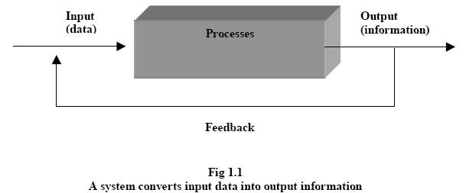
  Example: Y2K problem for computer systems. Those systems, which are not Y2K compliant, will not be able to work properly after year 2000. For computer systems to survive it is important these systems are made Y2K compliant or Y2K ready.
Feed Back
  Compares the output against a performance standard.
  Useful to improve the system to meet the user needs.

Slide 13
Boundaries and Interfaces
  Every system has defined boundaries within which it operates. Beyond these limits the system has to interact with the other systems.
  Interfaces are another important element through which the system interacts with the outside world
    Should be customized to the user needs. These should be as user friendly as possible.

Slide 14
Types of Systems
1.Physical or Abstract System
  Physical system: tangible entities
  static or dynamic in nature.
  Example : system-computer centre
    Desks and chairs are the static parts
    Programs, data, and applications can change according to the user's needs.
  Abstract systems are conceptual. These are not physical entities. They may be formulas, representation or model of a real system.

Slide 15
2.Open Closed System- Majority of systems are open systems
  open system has many interfaces with its environment
  can also adapt to changing environmental conditions
  can receive inputs from, and delivers output to the outside of system
  Closed systems: Systems that don't interact with their environment. Closed systems exist in concept only.

Slide 16
3.Man made Information System
  Information system is the basis for interaction between the user and the analyst.
  Main purpose-manage data for a particular organization.
  Further Categorized as:
    Formal Information Systems:
      Responsible for flow of information from top management to lower management
      But feedback can be given from lower authorities to top management.

Slide 17
    Informal Information Systems:
      Informal systems are employee based.
      These are made to solve the day to day work related problems.
    Computer-Based Information Systems:
      This class of systems depends on the use of computer for managing business applications

Slide 18
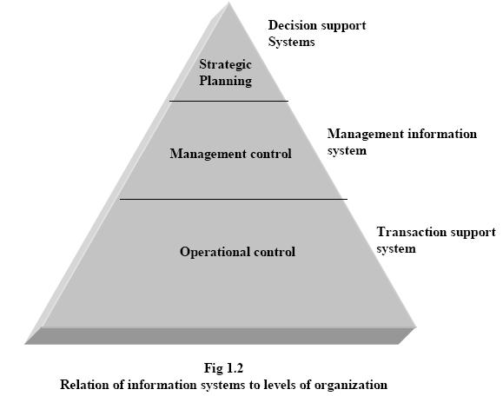
1. Formal Information system
Management and information levels in an organization:

Slide 19
Categories of information:
Information can be categorized as:
  strategic information
  managerial information
  operational information.

Slide 20
Strategic information
Strategic information is the information needed by top most management for decision making.
This information is not required by the lower levels in the organization.
The information systems that provide these kinds of information are known as Decision Support Systems (DSS).
For example the trends in revenues earned by the organization are required by the top management for setting the policies of the organization.

Slide 21
Managerial information
required by the middle management
used for making short term decisions and plans for the organization
Management information system (MIS) caters to such information needs of the organization.
Information like sales analysis for the past quarter or yearly production details etc. fall under this category.

Slide 22
Operational information
relating to the daily or short term information needs of the organization such as attendance records of the employees.
This kind of information is required at the operational level for carrying out the day-to-day operational activities.
The information system is known as Transaction Processing System (TPS) or Data Processing System (DPS).
Some examples of information provided by such systems are processing of orders, posting of entries in bank, evaluating overdue purchaser orders etc.

Slide 23
2. Informal Information system
“The system of relationships and lines of authority that develops spontaneously as employees meet; that is the human side of the organization.
  Basic Characteristics:
  Involves two or more people
  Informal relationships, groupings & interactions
  Involves the human need to socialize
  Includes both friendly and hostile relationships and interactions

Slide 24
3. Computer based information systems
a) Transaction Processing Systems or Data Processing Systems
TPS processes business transaction of the organization.
Transaction can be any activity of the organization.
Transactions differ from organization to organization.
For example, take a railway reservation system. Booking, canceling, etc are all transactions.
Any query made to it is a transaction.
Transaction processing systems provide speed and accuracy, and can be programmed to follow routines functions of the organization.

Slide 25
b)Management Information Systems
These systems assist lower management in problem solving and making decisions.
They use the results of transaction processing and some other information also.
An important element of MIS system is database.
And the information is accessed through DBMS.
But there are two drawbacks of database i.e. requirement of a specialized personnel and need to secure data from unauthorized access.

Slide 26
The three sub-components:
System emphasizing a fair degree of integration and a holistic view;
Information stressing on processed data in the context in which it is used by end users;
Management focusing on the ultimate use of such information systems for managerial decision making.

Slide 27
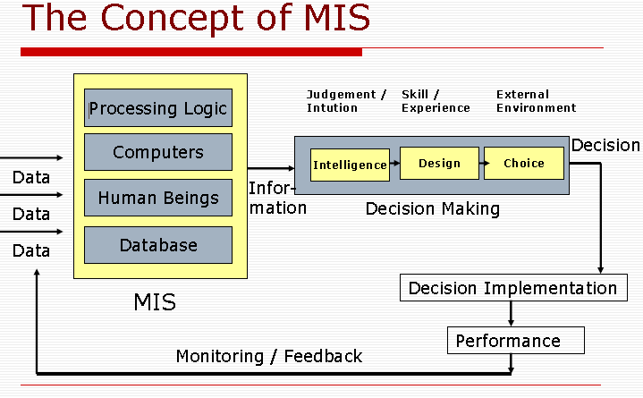

Slide 28
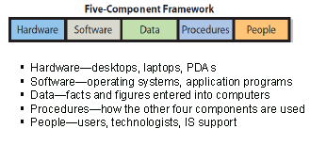
Components of MIS

Slide 29
c) Decision Support Systems
These systems assist higher management to make long term decisions.
These type of systems handle unstructured or semi structured decisions.
A decision is considered unstructured if
  there are no clear procedures for making the decision and
  if not all the factors to be considered in the decision can be readily identified in advance.
The user should be able to produce customized reports by giving particular data and format specific to particular situations.

Slide 30
Three fundamental components of a DSS architecture are:
the database (or knowledge base).
the model (i.e., the decision context and user criteria), and
the user interface.
The users themselves are also important components of the architecture.

Slide 31
Classification of DSS
Using the relationship with the user as the criterion:
A passive DSS is a system that aids the process of decision making, but that cannot bring out explicit decision suggestions or solutions.
An active DSS can bring out such decision suggestions or solutions.
A cooperative DSS allows the decision maker (or its advisor) to modify, complete, or refine the decision suggestions provided by the system, before sending them back to the system for validation.

Slide 32
Using the mode of assistance as the criterion :
A communication-driven DSS supports more than one person working on a shared task; examples include integrated tools like Microsoft's NetMeeting or Groove.
A data-driven DSS or data-oriented DSS emphasizes access to and manipulation of a time series of internal company data and, sometimes, external data.
A document-driven DSS manages, retrieves, and manipulates unstructured information in a variety of electronic formats.

Slide 33
A knowledge-driven DSS provides specialized problem-solving expertise stored as facts, rules, procedures, or in similar structures.
A model-driven DSS emphasizes access to and manipulation of a statistical, financial, optimization, or simulation model.
Model-driven DSS use data and parameters provided by users to assist decision makers in analyzing a situation; they are not necessarily data-intensive

Slide 34
Basic Principles of a successful system
System should be of use for the user.
Ready in time.
Visible benefits
Maintained effectively
Well documented.

Slide 35
Man Made and Automated systems
Man-made systems
Man-made systems include such things as:
1. Social systems: organizations of laws, doctrines, customs, and so on.
2. An organized, disciplined collection of ideas.
3. Transportation systems: networks of highways, canals, airlines and so on.
4. Communication systems: telephone, telex, and so on.
5. Manufacturing systems: factories, assembly lines, and so on.
6. Financial systems: accounting, inventory, general ledger and so on.
Most of these systems include computers today.

Slide 36
Automated systems:
Some information processing systems may not be automated because of these common reasons:
  Cost; Convenience; Security; Maintainability; Politics.
  Automated systems are the man-made systems that interact with or are controlled by one or more computers.
  We can distinguish many different kinds of automated systems, but they all tend to have common components:
  Computer hardware (CPUs, disks, terminals, and so on).
  Computer software: system programs such as operating systems, database systems, and so on.

Slide 37
  3. People: those who operate the system, those who provide its inputs and consume its outputs, and those who provide manual processing activities in a system.
  4. Data: the information that the system remembers over a period of time.
  5. Procedures: formal policies and instructions for operating the system.

Slide 38
Real-Life business sub system
Production sub system:
  Related to production of goods and services.
  Main problems involved are:
    Plant Location
    Plant layout
    Production policy(how much unit has to be produced)
    Purchase and inventory control.
    Production planning and control
    Quality and cost control.

Slide 39
Materials Management sub system
  Purchase of material(quality and cost)
  Storage and handling of material.
Financial Management sub system
  Proper utilization of funds
  Various issues involved like dividend policy etc.
Personnel Management sub system
  Deals with people at work
  Planning man-power
  Recruitment
  HR policies
Marketing Management sub system
  Marketing strategies
  Increasing the sales and thus the profit.

Slide 40
Real-Time system
Real-time systems have been defined as: "those systems in which the correctness of the system depends not only on the logical result of the computation, but also on the time at which the results are produced“
Real-time systems often are comprised of a
  Controlled system
  environment.
    Controlling system: acquires information about environment using sensors and controls the environment with actuators.

Slide 41
Con trolled System
Controlling
System
sensor
Environment
sensor
sensor
sensor
actuator
actuator
actuator
actuator

Slide 42
Hard versus soft real time system
Hard: failure to meet constraint is a fatal fault.
Validation system always meets timing constraints.
  Deterministic constraints
  Probabilistic constraints
  Constraints in terms of some usefulness function.
Soft: late completion is undesirable but generally not fatal.
No validation or only demonstration job meets some statistical constraint.
Occasional missed deadlines or aborted execution is usually considered tolerable.
Often specified in probabilistic terms

Slide 43
Distributed system
A distributed system is a collection of independent computers that appear to the users of the system as a single system.
Examples:
  Network of workstations
  Distributed manufacturing system (e.g., automated assembly line)
  Network of branch office computers

Slide 44
Advantages of Distributed Systems
Economics: cost effective way to increase computing power.
Speed: a distributed system may have more total computing power than a mainframe.
Ex. 10,000 CPU chips, each running at 50 MIPS. Not possible to build 500,000 MIPS single processor since it would require 0.002 nsec instruction cycle.
Reliability: If one machine crashes, the system as a whole can still survive. Higher availability and improved reliability.
Incremental growth: Computing power can be added in small increments. Modular expandability

Slide 45
  Data sharing: allow many users to access to a common data base
  Resource Sharing: expensive peripherals like color printers
  Communication: enhance human-to-human communication, e.g., email, chat
  Flexibility: spread the workload over the available machines

Slide 46
Disadvantages of Distributed Systems
  Software: difficult to develop software for distributed systems
  Network: saturation, lossy transmissions
  Security: easy access also applies to secrete data

