Slide 1
Chapter 3
Project Management

Slide 2
The 4 P’s
People — the most important element of a successful project
Product — the software to be built
Process — the set of framework activities and software engineering tasks to get the job done
Project — all work required to make the product a reality

Slide 3
Software Teams
The following factors must be considered when selecting a
software project team structure ...
the difficulty of the problem to be solved
the size of the resultant program(s) in lines of code or function points
the time that the team will stay together (team lifetime)
the degree to which the problem can be modularized
the required quality and reliability of the system to be built
the rigidity of the delivery date
the degree of sociability (communication) required for the project

Slide 4
Organizational Paradigms
closed paradigm—structures a team along a traditional hierarchy of authority
random paradigm—structures a team loosely and depends on individual initiative of the team members
open paradigm—attempts to structure a team in a manner that achieves some of the controls associated with the closed paradigm but also much of the innovation that occurs when using the random paradigm
synchronous paradigm—relies on the natural compartmentalization of a problem and organizes team members to work on pieces of the problem with little active communication among themselves

Slide 5
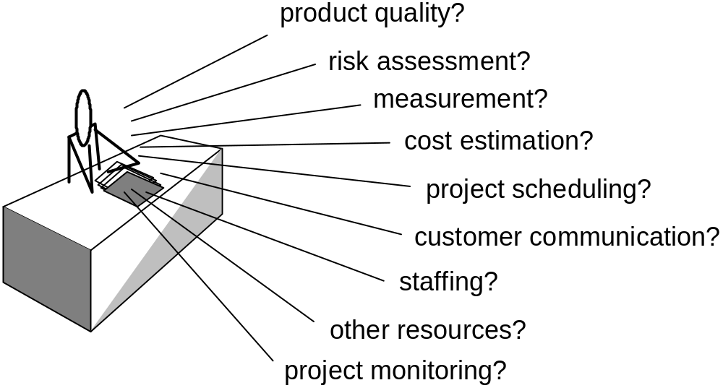
Project Management Concerns

Slide 6
Defining the Problem
establish scope—a narrative that bounds the problem
decomposition—establishes functional partitioning

Slide 7
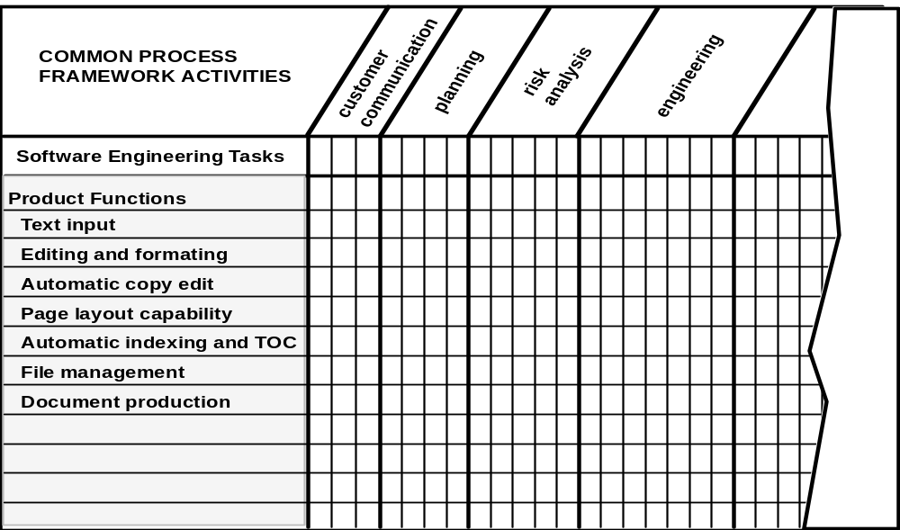
Melding Problem and Process

Slide 8
Software Projects
Factors that influence the end result ...
size
delivery deadline
budgets and costs
application domain
technology to be implemented
system constraints
user requirements
available resources

Slide 9
Why Projects Fail?
• changing customer requirements
• an unrealistic deadline is established
• an honest underestimate of effort
• predictable and/or unpredictable risks
• technical difficulties
• miscommunication among project staff
• failure in project management

Slide 10
To Get to the Essence of a Project
Why is the system being developed?
What will be done? By when?
Who is responsible for a function?
Where are they organizationally located?
How will the job be done technically and managerially?
How much of each resource (e.g., people, software, tools, database) will be needed?

Slide 11
Critical Practices
Formal risk analysis
Empirical cost and schedule estimation
Metric-based project management
Earned value tracking
Defect tracking against quality targets
People-aware project management

