Slide 1
Chapter 7
Project Scheduling and Tracking

Slide 2
Why Are Projects Late?
An unrealistic deadline established by someone outside the software development group.
Changing customer requirements that are not reflected in schedule changes.
An honest underestimate of the amount of effort and/or the number of resources that will be required to do the job.
Predictable and/or unpredictable risks that were not considered when the project commenced.

Slide 3
Why Projects are Late (Cont..)
Technical difficulties that could not have been foreseen in advance
Human difficulties that could not have been foreseen in advance
Miscommunication among project staff that results in delays
A failure by project management to recognize that the project is falling behind schedule and a lack of action to correct the problem

Slide 4
Scheduling Basic Principles
Compartmentalization—define distinct tasks
Interdependency—indicate task inter relationships effort validation—be sure resources are available
Defined responsibilities—people must be assigned
Defined outcomes—each task must have an output

Slide 5
Basic Principles
Time Allocation – Each task must be scheduled
Effort Validation – Allocate people in each task and in each phase and validate.
Defined milestones—review for quality

Slide 6
Defining Task Sets
Determine type of project
assess the degree of rigor required
  identify adaptation criteria
  compute task set selector (TSS) value
  interpret TSS to determine degree of rigor
select appropriate software engineering tasks

Slide 7
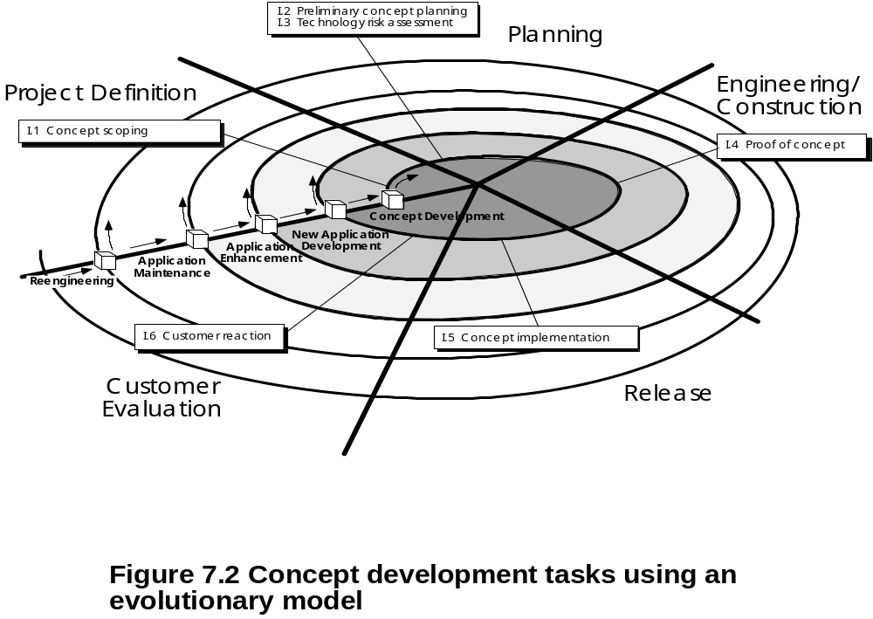
Example

Slide 8
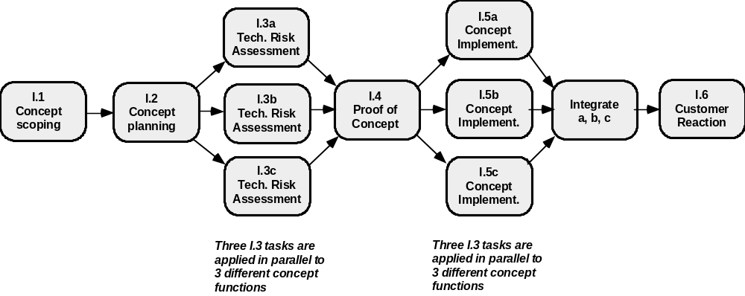
Define a Task Network

Slide 9
Effort Allocation
“front end” activities
  customer communication
  analysis
  design
  review and modification
construction activities
  coding or code generation
testing and installation
  unit, integration
  white-box, black box
  regression
40-50%
15-20%
30-40%

Slide 10
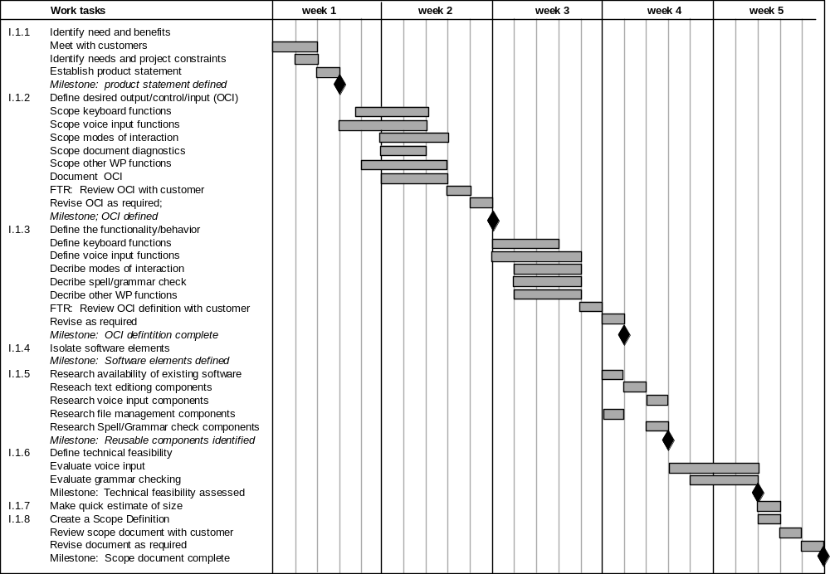
Use Automated Tools to
Derive a Timeline Chart

