Slide 1
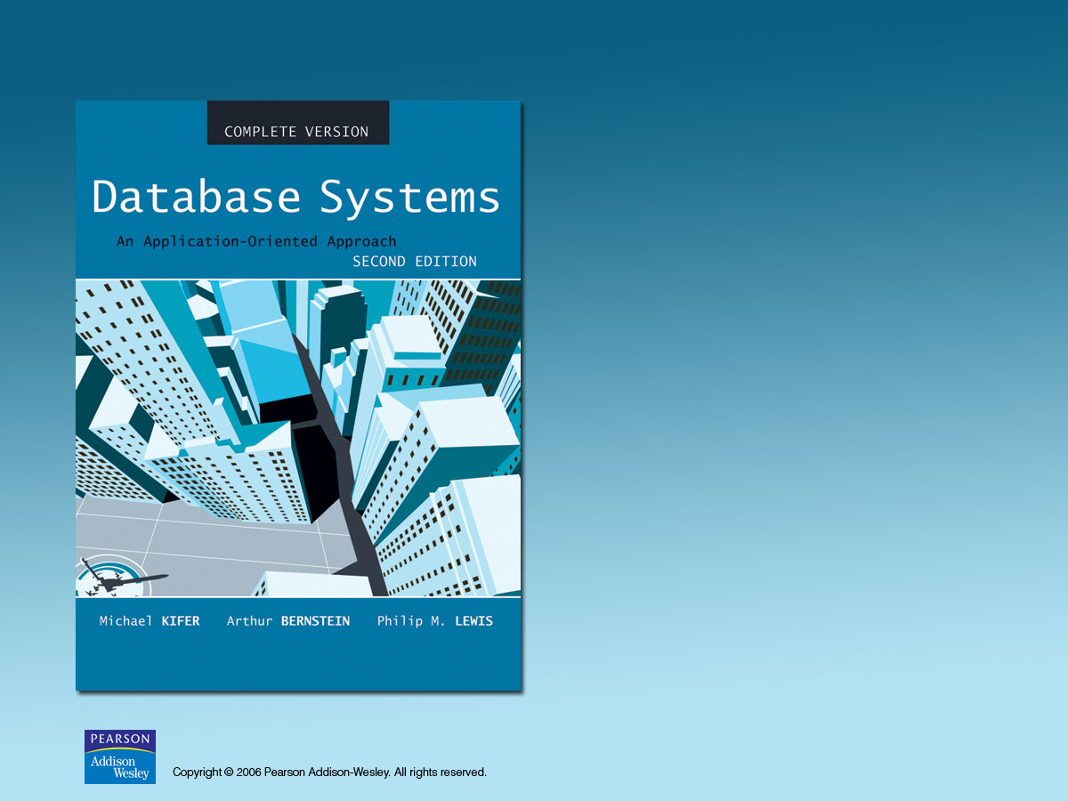
Chapter 5
Relational Algebra and SQL

Slide 2
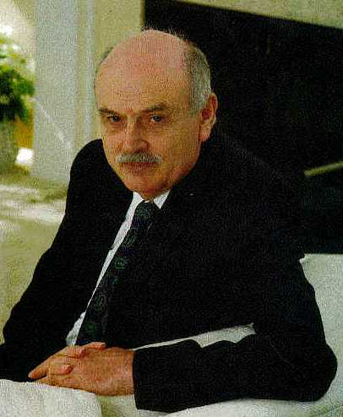
Father of Relational Model
Edgar F. Codd (1923-2003)
PhD from U. of Michigan, Ann Arbor
Received Turing Award in 1981.
More see http://en.wikipedia.org/wiki/Edgar_Codd

Slide 3
Relational Query Languages
Languages for describing queries on a relational database
Structured Query Language (SQL)
  Predominant application-level query language
  Declarative
Relational Algebra
  Intermediate language used within DBMS
  Procedural

Slide 4
What is an Algebra?
A language based on operators and a domain of values
Operators map values taken from the domain into other domain values
Hence, an expression involving operators and arguments produces a value in the domain
When the domain is a set of all relations (and the operators are as described later), we get the relational algebra
We refer to the expression as a query and the value produced as the query result

Slide 5
Relational Algebra
Domain: set of relations
Basic operators: select, project, union, set difference, Cartesian product
Derived operators: set intersection, division, join
Procedural: Relational expression specifies query by describing an algorithm (the sequence in which operators are applied) for determining the result of an expression

Slide 6
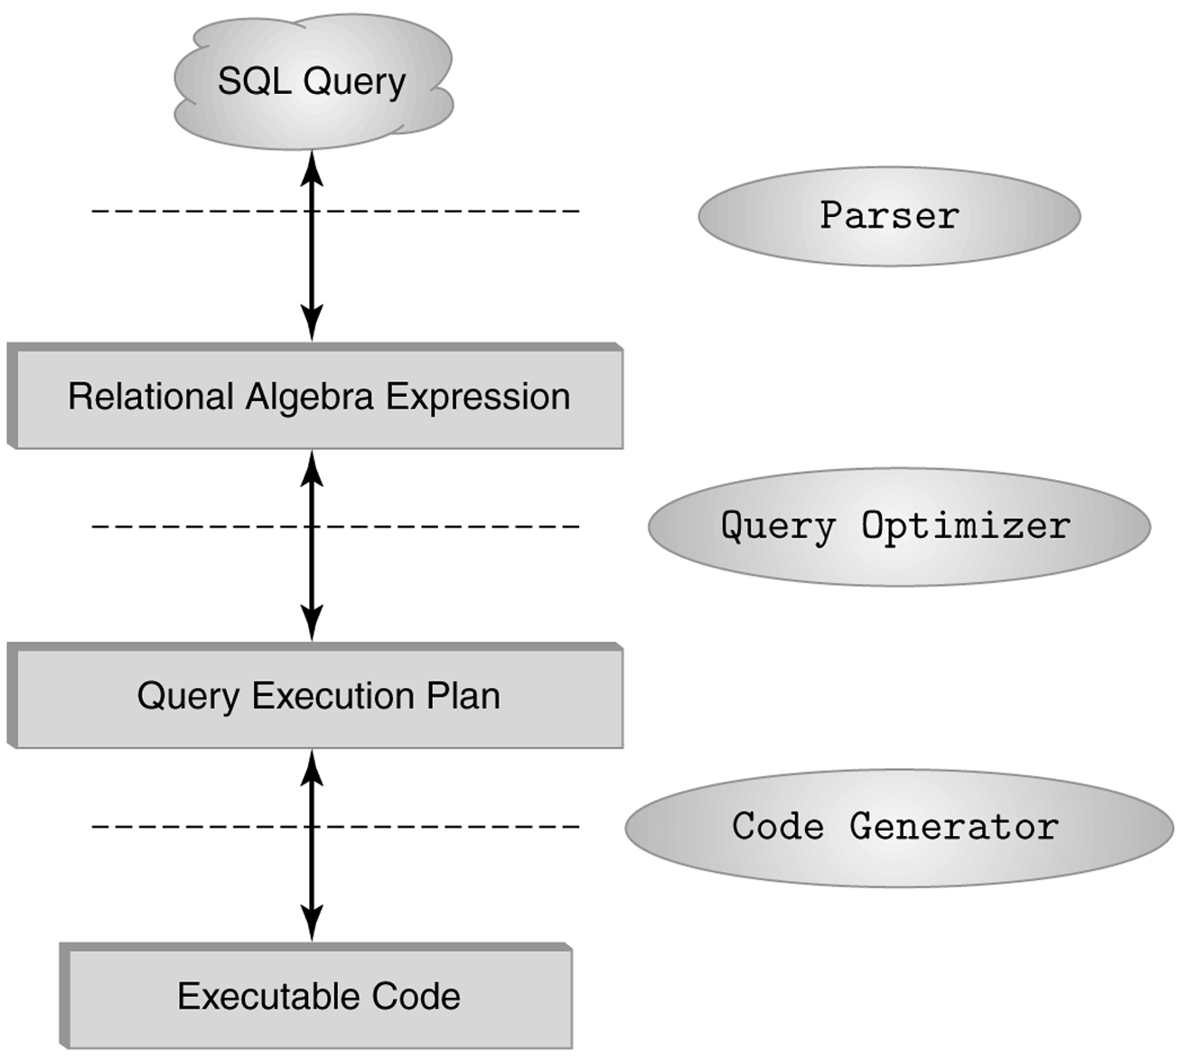
The Role of Relational Algebra in a DBMS

Slide 7
Select Operator
Produce table containing subset of rows of argument table satisfying condition
σ_{condition} (relation)
Example:
Person σ_{Hobby=‘stamps’}(Person)
Id Name Address Hobby
Id Name Address Hobby
1123 John 123 Main stamps
1123 John 123 Main coins
5556 Mary 7 Lake Dr hiking
9876 Bart 5 Pine St stamps
1123 John 123 Main stamps
9876 Bart 5 Pine St stamps

Slide 8
Selection Condition
Operators: <, ≤, ≥, >, =, ≠
Simple selection condition:
  <attribute> operator <constant>
  <attribute> operator <attribute>
<condition> AND <condition>
<condition> OR <condition>
NOT <condition>

Slide 9
Selection Condition - Examples
σ _{Id>3000 OR Hobby=‘hiking’} (Person)
σ _{Id>3000 AND Id <3999} (Person)
σ _{NOT(Hobby=‘hiking’)} (Person)
σ _{Hobby≠‘hiking’} (Person)

Slide 10
Project Operator
Produces table containing subset of columns of argument table
  π_{attribute list}(relation)
Example:
  Person π_{Name,Hobby}(Person)
Id Name Address Hobby Name Hobby
1123 John 123 Main stamps
1123 John 123 Main coins
5556 Mary 7 Lake Dr hiking
9876 Bart 5 Pine St stamps
John stamps
John coins
Mary hiking
Bart stamps

Slide 11
Project Operator
Example:
  Person π_{Name,Address}(Person)
Id Name Address Hobby
Name Address
1123 John 123 Main stamps
1123 John 123 Main coins
5556 Mary 7 Lake Dr hiking
9876 Bart 5 Pine St stamps
John 123 Main
Mary 7 Lake Dr
Bart 5 Pine St
Result is a table (no duplicates); can have fewer tuples
than the original

Slide 12
Expressions
π _{Id, Name} (σ Hobby=’stamps’ OR Hobby=’coins’ (Person) )
Id Name Address Hobby Id Name
1123 John 123 Main stamps
1123 John 123 Main coins
5556 Mary 7 Lake Dr hiking
9876 Bart 5 Pine St stamps
1123 John
9876 Bart
Result
Person

Slide 13
Set Operators
Relation is a set of tuples, so set operations should apply: ∩, ∪, − (set difference)
Result of combining two relations with a set operator is a relation => all its elements must be tuples having same structure
Hence, scope of set operations limited to union compatible relations

Slide 14
Union Compatible Relations
Two relations are union compatible if
  Both have same number of columns
  Names of attributes are the same in both
  Attributes with the same name in both relations have the same domain
Union compatible relations can be combined using union, intersection, and set difference

Slide 15
Example
Tables:
Person (SSN, Name, Address, Hobby)
Professor (Id, Name, Office, Phone)
are not union compatible.
But
π _{Name} (Person) and π _{Name} (Professor)
are union compatible so
π _{Name} (Person) - π _{Name} (Professor)
makes sense.

Slide 16
Cartesian Product
If R and S are two relations, R × S is the set of all concatenated tuples <x,y>, where x is a tuple in R and y is a tuple in S
  R and S need not be union compatible.
  But R and S must have distinct attribute names. Why?
R × S is expensive to compute. But why?
A B C D A B C D
x1 x2 y1 y2 x1 x2 y1 y2
x3 x4 y3 y4 x1 x2 y3 y4
x3 x4 y1 y2
R S x3 x4 y3 y4
R× S

Slide 17
Renaming
Result of expression evaluation is a relation
Attributes of relation must have distinct names. This is not guaranteed with Cartesian product
  e.g., suppose in previous example A and C have the same name
Renaming operator tidies this up. To assign the names A₁, A₂,… A_{n} to the attributes of the n column relation produced by expression expr use expr [A₁, A₂, … A_{n}]

Slide 18
Example
Transcript (StudId, CrsCode, Semester, Grade)
Teaching (ProfId, CrsCode, Semester)
π _{StudId, CrsCode} (Transcript)[StudId, CrsCode1]
× π _{ProfId, CrsCode}(Teaching) [ProfId, CrsCode2]
This is a relation with 4 attributes:
StudId, CrsCode1, ProfId, CrsCode2

Slide 19
Derived Operation: Join
A (general or theta) join of R and S is the expression
R _{c} S
where join-condition c is a conjunction of terms:
A_{i} oper B_{i}
in which A_{i} is an attribute of R; B_{i} is an attribute of S; and oper is one of =, <, >, ≥ ≠, ≤.
Q: Any difference between join condition and selection condition?
The meaning is:
σ _{c} (R × S)
Where join-condition c becomes a select condition c
except for possible renamings of attributes (next)

Slide 20
Join and Renaming
Problem: R and S might have attributes with the same name – in which case the Cartesian product is not defined
Solutions:
  Rename attributes prior to forming the product and use new names in join-condition´.
  Qualify common attribute names with relation names (thereby disambiguating the names). For instance: Transcript.CrsCode or Teaching.CrsCode
    This solution is nice, but doesn’t always work: consider
      R _{join_condition} R
      In R.A, how do we know which R is meant?

Slide 21
Theta Join – Example
Employee(Name,Id,MngrId,Salary)
Manager(Name,Id,Salary)
Output the names of all employees that earn
more than their managers.
π_{Employee.Name} (Employee MngrId=Id AND Employee.Salary> Manager.Salary Manager)
The join yields a table with attributes:
Employee.Name, Employee.Id, Employee.Salary, MngrId
Manager.Name, Manager.Id, Manager.Salary

Slide 22
Equijoin Join - Example
Equijoin: Join condition is a conjunction of equalities.
π_{Name,CrsCode}(Student
_{Id=StudId} σ_{Grade=‘A’} (Transcript))
Student
Transcript
Id Name Addr Status
111 John ….. …..
222 Mary ….. …..
333 Bill ….. …..
444 Joe ….. …..
StudId CrsCode Sem Grade
111 CSE305 S00 B
222 CSE306 S99 A
333 CSE304 F99 A
The equijoin is used very
frequently since it combines
related data in different relations.
Mary CSE306
Bill CSE304

Slide 23
Natural Join
Special case of equijoin:
  join condition equates all and only those attributes with the same name (condition doesn’t have to be explicitly stated)
  duplicate columns eliminated from the result
Transcript (StudId, CrsCode, Sem, Grade)
Teaching (ProfId, CrsCode, Sem)
Transcript
Teaching =
πStudId, Transcript.CrsCode, Transcript.Sem, Grade, ProfId
( Transcript
Transcipt.CrsCode=Teaching.CrsCode
AND Transcirpt.Sem=Teaching.Sem Teaching )
[StudId, CrsCode, Sem, Grade, ProfId ]
Q: but why natural join is a derived operator? Because…

Slide 24
Natural Join (cont’d)
More generally:
R
S = π_{attr-list} (σ_{join-cond} (R × S) )
where
attr-list = attributes (R) ∪ attributes (S)
(duplicates are eliminated) and join-cond has
the form:
R.A₁ = S.A₁ AND … AND R.A_{n} = S.A_{n}
where
{A₁ … A_{n}} = attributes(R) ∩ attributes(S)

Slide 25
Natural Join Example
List all Ids of students who took at least two different courses:
π_{StudId} ( σ_{CrsCode ≠ CrsCode2} (
Transcript
Transcript [StudId, CrsCode2, Sem2, Grade2] ))
We don’t want to join on CrsCode, Sem, and Grade attributes,
hence renaming!

Slide 26
Division
Goal: Produce the tuples in one relation, r, that match all tuples in another relation, s
  r (A₁, …A_{n}, B₁, …B_{m})
  s (B₁ …B_{m})
  r/s, with attributes A₁, …A_{n}, is the set of all tuples <a> such that for every tuple <b> in s, <a,b> is in r
Can be expressed in terms of projection, set difference, and cross-product

Slide 27
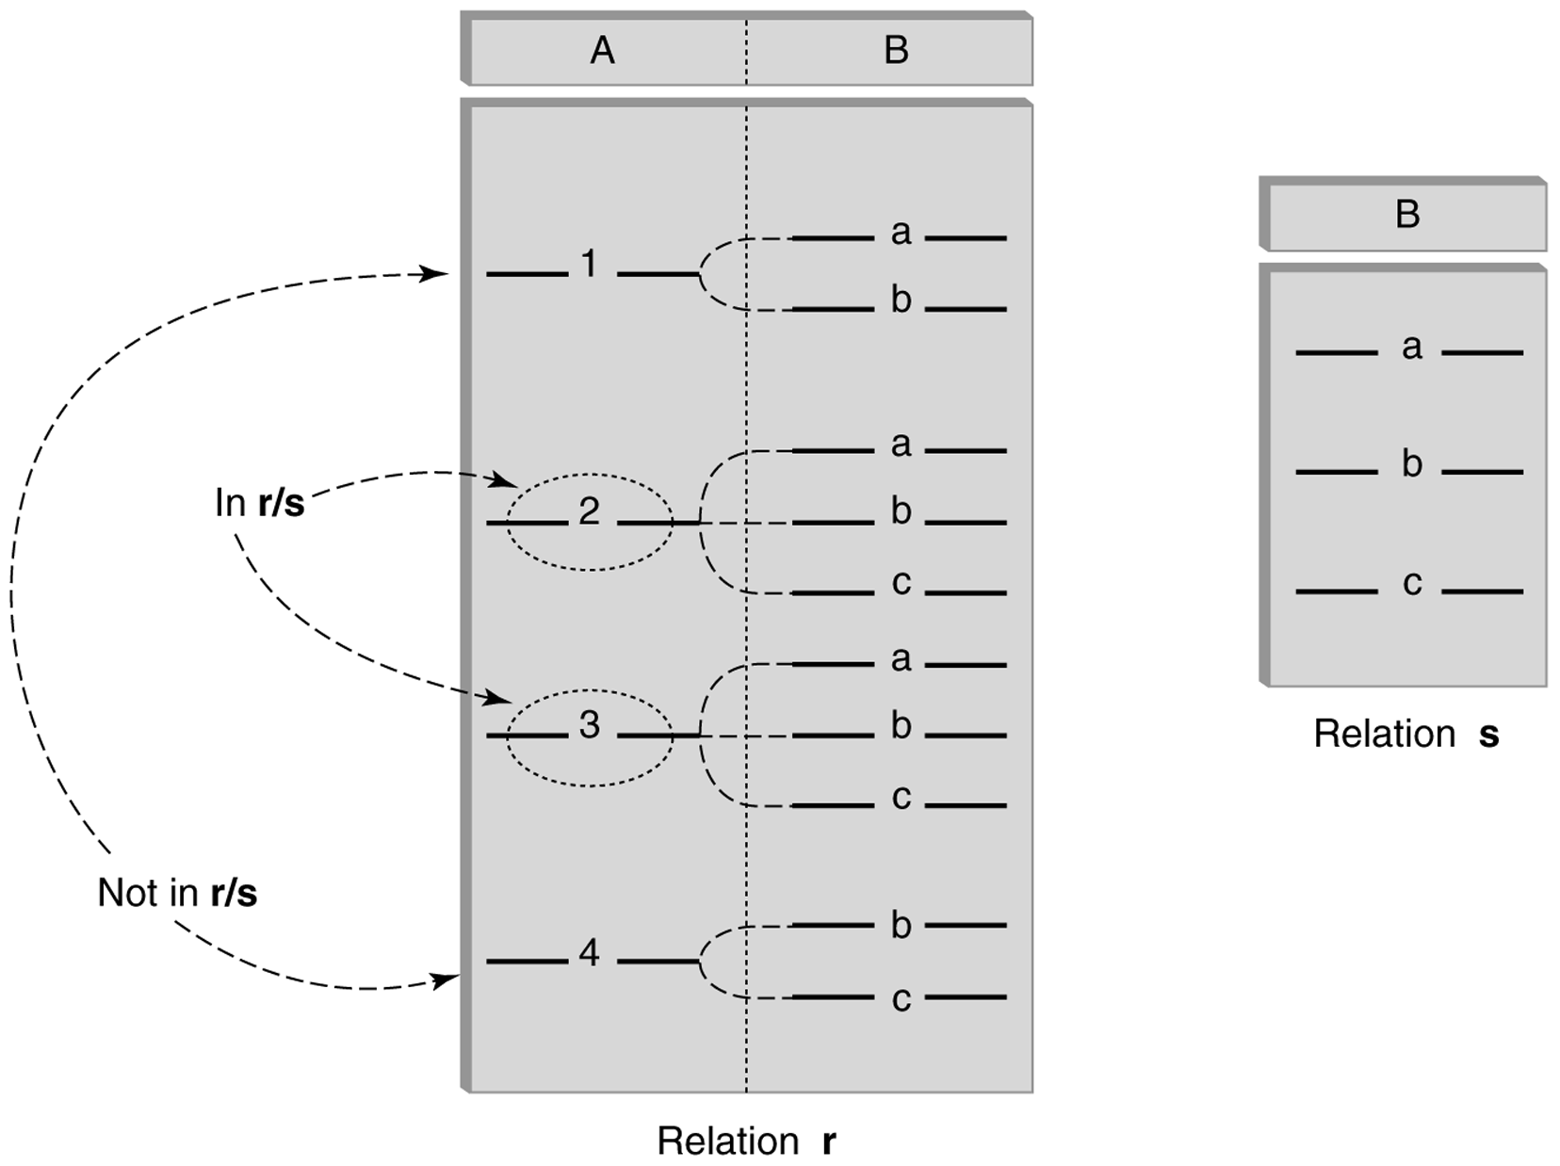
Division (cont’d)

Slide 28
Division - Example
List the Ids of students who have passed all courses that were taught in spring 2000
Numerator:
  StudId and CrsCode for every course passed by every student:
  π_{StudId, CrsCode} (σ_{Grade≠ ‘F’} (Transcript) )
Denominator:
  CrsCode of all courses taught in spring 2000
  π_{CrsCode} (σ_{Semester=‘S2000’} (Teaching) )
Result is numerator/denominator

Slide 29
Schema for Student Registration System
Student (Id, Name, Addr, Status)
Professor (Id, Name, DeptId)
Course (DeptId, CrsCode, CrsName, Descr)
Transcript (StudId, CrsCode, Semester, Grade)
Teaching (ProfId, CrsCode, Semester)
Department (DeptId, Name)

Slide 30
Query Sublanguage of SQL
SELECT C.CrsName
FROM Course C
WHERE C.DeptId = ‘CS’
Tuple variable C ranges over rows of Course.
Evaluation strategy:
  FROM clause produces Cartesian product of listed tables
  WHERE clause assigns rows to C in sequence and produces table containing only rows satisfying condition
  SELECT clause retains listed columns
Equivalent to: π_{CrsName}σ_{DeptId=‘CS’}(Course)

Slide 31
Join Queries
SELECT C.CrsName
FROM Course C, Teaching T
WHERE C.CrsCode=T.CrsCode AND T.Semester=‘S2000’
List CS courses taught in S2000
Tuple variables clarify meaning.
Join condition “C.CrsCode=T.CrsCode”
  relates facts to each other
Selection condition “ T.Semester=‘S2000’ ”
  eliminates irrelevant rows
Equivalent (using natural join) to:
π_{CrsName}(Course
σ_{Semester=‘S2000’} (Teaching) )
π_{CrsName} (σ_{Sem=‘S2000’} (Course Teaching) )

Slide 32
Correspondence Between SQL and Relational Algebra
SELECT C.CrsName
FROM Course C, Teaching T
WHERE C.CrsCode = T.CrsCode AND T.Semester = ‘S2000’
Also equivalent to:
π_{CrsName} σC_CrsCode=T_CrsCode AND Semester=‘S2000’
(Course [C_CrsCode, DeptId, CrsName, Desc]
× Teaching [ProfId, T_CrsCode, Semester])
This is the simplest evaluation algorithm for SELECT.
Relational algebra expressions are procedural.
  Which of the two equivalent expressions is more easily evaluated?

Slide 33
Self-join Queries
Find Ids of all professors who taught at least two courses in the same semester:
SELECT T1.ProfId
FROM Teaching T1, Teaching T2
WHERE T1.ProfId = T2.ProfId
AND T1.Semester = T2.Semester
AND T1.CrsCode <> T2.CrsCode
Tuple variables are essential in this query!
Equivalent to:
π_{ProfId} (σ_{T1.CrsCode≠T2.CrsCode}(Teaching[ProfId, T1.CrsCode, Semester]
Teaching[ProfId, T2.CrsCode, Semester]))

Slide 34
Duplicates
Duplicate rows not allowed in a relation
However, duplicate elimination from query result is costly and not done by default; must be explicitly requested:
SELECT DISTINCT …..
FROM …..

Slide 35
Use of Expressions
Equality and comparison operators apply to strings (based on lexical ordering)
WHERE S.Name < ‘P’
Concatenate operator applies to strings
WHERE S.Name || ‘--’ || S.Address = ….
Expressions can also be used in SELECT clause:
SELECT S.Name || ‘--’ || S.Address AS NmAdd
FROM Student S

Slide 36
Set Operators
SQL provides UNION, EXCEPT (set difference), and INTERSECT for union compatible tables
Example: Find all professors in the CS Department and all professors that have taught CS courses
(SELECT P.Name
FROM Professor P, Teaching T
WHERE P.Id=T.ProfId AND T.CrsCode LIKE ‘CS%’)
UNION
(SELECT P.Name
FROM Professor P
WHERE P.DeptId = ‘CS’)

Slide 37
Nested Queries
List all courses that were not taught in S2000
SELECT C.CrsName
FROM Course C
WHERE C.CrsCode NOT IN
(SELECT T.CrsCode --subquery
FROM Teaching T
WHERE T.Sem = ‘S2000’)
Evaluation strategy: subquery evaluated once to
produces set of courses taught in S2000. Each row
(as C) tested against this set.

Slide 38
Correlated Nested Queries
Output a row <prof, dept> if prof has taught a course
in dept.
SELECT P.Name, D.Name --outer query
FROM Professor P, Department D
WHERE P.Id IN
-- set of all ProfId’s who have taught a course in D.DeptId
(SELECT T.ProfId --subquery
FROM Teaching T, Course C
WHERE T.CrsCode=C.CrsCode AND
C.DeptId=D.DeptId --correlation
)

Slide 39
Correlated Nested Queries (con’t)
Tuple variables T and C are local to subquery
Tuple variables P and D are global to subquery
Correlation: subquery uses a global variable, D
The value of D.DeptId parameterizes an evaluation of the subquery
Subquery must (at least) be re-evaluated for each distinct value of D.DeptId
Correlated queries can be expensive to evaluate

Slide 40
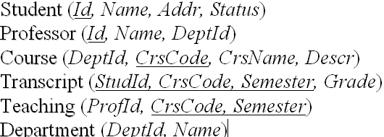
Division in SQL
Query type: Find the subset of items in one set that are related to all items in another set
Example: Find professors who taught courses in all departments
  Why does this involve division?
ProfId DeptId
DeptId
Contains row
<p,d> if professor
p taught a
course in
department d
All department Ids
π_{ProfId,DeptId}(Teaching Course) / π_{DeptId}(Department)

Slide 41
Division in SQL
Strategy for implementing division in SQL:
  Find set, A, of all departments in which a particular professor, p, has taught a course
  Find set, B, of all departments
  Output p if A ⊇ B, or, equivalently, if B–A is empty
But how to do this exactly in SQL?

Slide 42
Division Solution Sketch (1)
SELECT P.Id
FROM Professor P
WHERE P taught courses in all departments
SELECT P.Id
FROM Professor P
WHERE there does not exist any department that P has never taught a course
SELECT P.Id
FROM Professor P
WHERE NOT EXISTS(the departments that P has never taught a course)

Slide 43
Division Solution Sketch (1)
SELECT P.Id
FROM Professor P
WHERE NOT EXISTS(the departments that P has never taught a course)
SELECT P.Id
FROM Professor P
WHERE NOT EXISTS(
B: All departments
EXCEPT
A: the departments that P has ever taught a course)
But how do we formulate A and B?

Slide 44
Division – SQL Solution in details
SELECT P.Id
FROM Professor P
WHERE NOT EXISTS
(SELECT D.DeptId -- set B of all dept Ids
FROM Department D
EXCEPT
SELECT C.DeptId -- set A of dept Ids of depts in
-- which P taught a course
FROM Teaching T, Course C
WHERE T.ProfId=P.Id -- global variable
AND T.CrsCode=C.CrsCode)

Slide 45
Aggregates
Functions that operate on sets:
  COUNT, SUM, AVG, MAX, MIN
Produce numbers (not tables)
Aggregates over multiple rows into one row
Not part of relational algebra (but not hard to add)
SELECT COUNT(*)
FROM Professor P
SELECT MAX (Salary)
FROM Employee E

Slide 46
Aggregates (cont’d)
Count the number of courses taught in S2000
SELECT COUNT (T.CrsCode)
FROM Teaching T
WHERE T.Semester = ‘S2000’
But if multiple sections of same course
are taught, use:
SELECT COUNT (DISTINCT T.CrsCode)
FROM Teaching T
WHERE T.Semester = ‘S2000’

Slide 47
Grouping
But how do we compute the number of courses taught in S2000 per professor?
  Strategy 1: Fire off a separate query for each professor:
SELECT COUNT(T.CrsCode)
FROM Teaching T
WHERE T.Semester = ‘S2000’ AND T.ProfId = 123456789
    Cumbersome
    What if the number of professors changes? Add another query?
  Strategy 2: define a special grouping operator:
SELECT T.ProfId, COUNT(T.CrsCode)
FROM Teaching T
WHERE T.Semester = ‘S2000’
GROUP BY T.ProfId

Slide 48
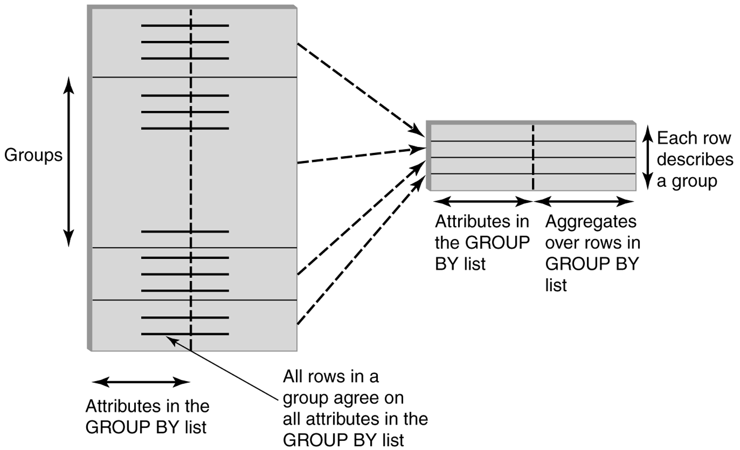
GROUP BY
Values are the same for all rows in same group
Values might be different for rows in the same group, need aggregation!

Slide 49
GROUP BY - Example
Transcript
Attributes:
–student’s Id
–avg grade
–number of courses
1234
1234
1234
1234
1234 3.3 4
SELECT T.StudId, AVG(T.Grade), COUNT (*)
FROM Transcript T
GROUP BY T.StudId
Finally, each group of rows is aggregated into one row

Slide 50
HAVING Clause
Eliminates unwanted groups (analogous to WHERE clause, but works on groups instead of individual tuples)
HAVING condition is constructed from attributes of GROUP BY list and aggregates on attributes not in that list
SELECT T.StudId,
AVG(T.Grade) AS CumGpa,
COUNT (*) AS NumCrs
FROM Transcript T
WHERE T.CrsCode LIKE ‘CS%’
GROUP BY T.StudId
HAVING AVG (T.Grade) > 3.5
Apply to each group not to the whole table

Slide 51
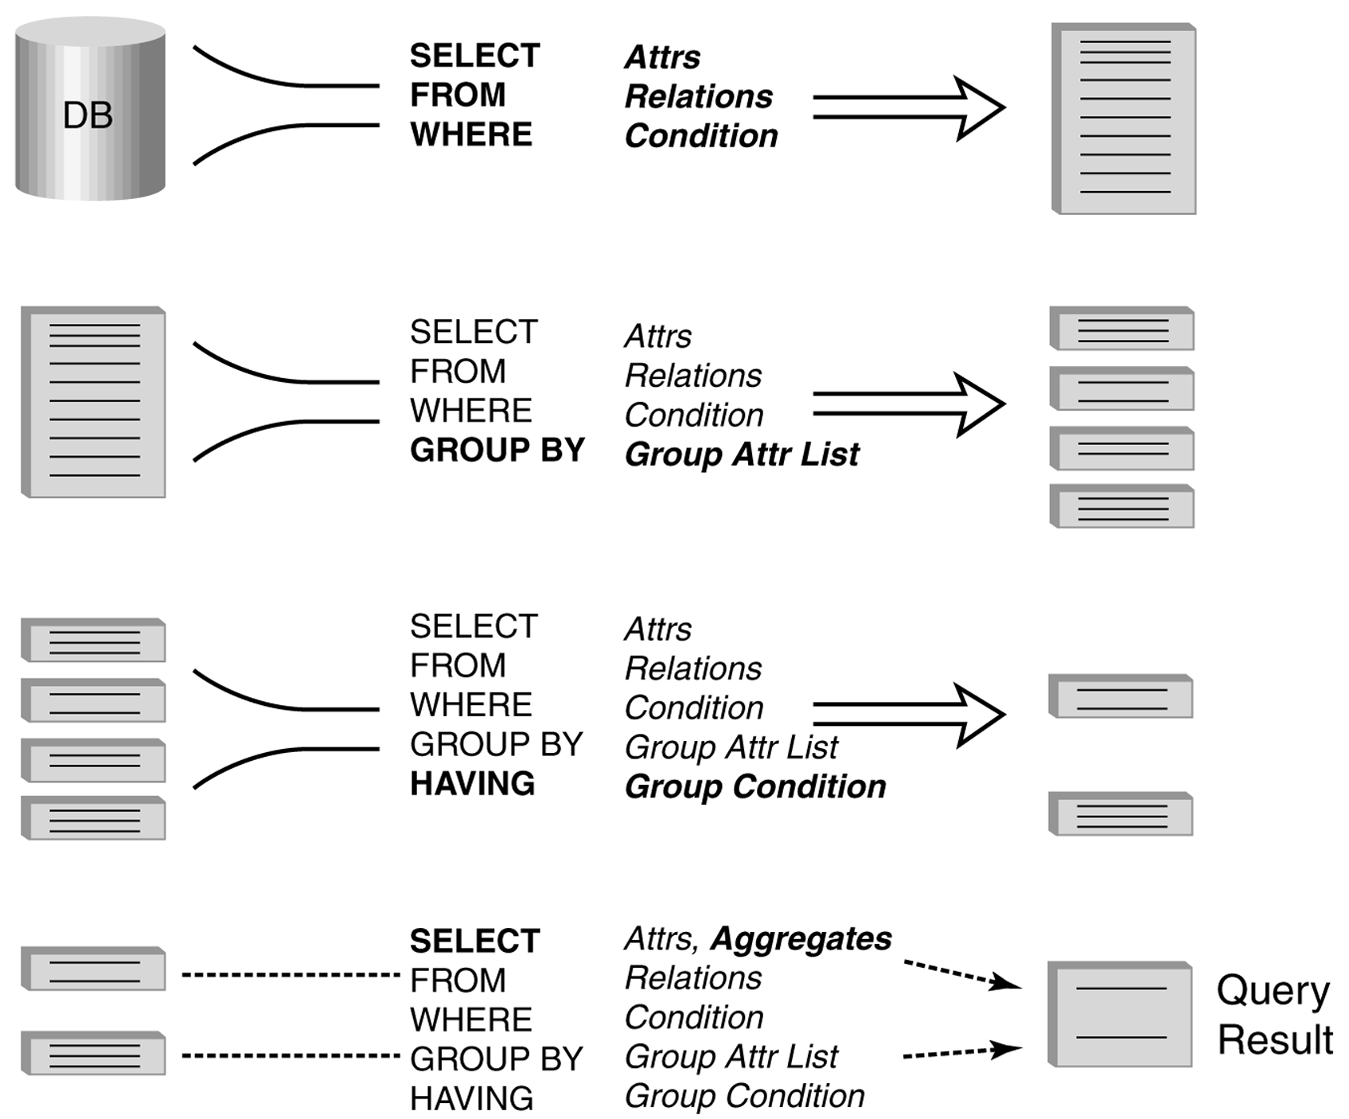
Evaluation of GroupBy with Having

Slide 52
Example
Output the name and address of all seniors on the Dean’s List
SELECT S.Id, S.Name
FROM Student S, Transcript T
WHERE S.Id = T.StudId AND S.Status = ‘senior’
GROUP BY
HAVING AVG (T.Grade) > 3.5 AND SUM (T.Credit) > 90
S.Id -- wrong
S.Id, S.Name -- right
Every attribute that occurs in SELECT clause must also occur in GROUP BY or it must be an aggregate. S.Name does not.
> The DB has not used the information that “S.Id → S.Name”.

Slide 53
Aggregates: Proper and Improper Usage
SELECT COUNT (T.CrsCode), T. ProfId
– makes no sense (in the absence of
GROUP BY clause)
SELECT COUNT (*), AVG (T.Grade)
– but this is OK
WHERE T.Grade > COUNT (SELECT ….)
– aggregate cannot be applied to result
of SELECT statement

Slide 54
ORDER BY Clause
Causes rows to be output in a specified order
SELECT T.StudId, COUNT (*) AS NumCrs,
AVG(T.Grade) AS CumGpa
FROM Transcript T
WHERE T.CrsCode LIKE ‘CS%’
GROUP BY T.StudId
HAVING AVG (T.Grade) > 3.5
ORDER BY DESC CumGpa, ASC StudId
Descending
Ascending

Slide 55
Query Evaluation with GROUP BY, HAVING, ORDER BY
Evaluate FROM: produces Cartesian product, A, of tables in FROM list
Evaluate WHERE: produces table, B, consisting of rows of A that satisfy WHERE condition
Evaluate GROUP BY: partitions B into groups that agree on attribute values in GROUP BY list
Evaluate HAVING: eliminates groups in B that do not satisfy HAVING condition
Evaluate SELECT: produces table C containing a row for each group. Attributes in SELECT list limited to those in GROUP BY list and aggregates over group
Evaluate ORDER BY: orders rows of C
A s b e f o r e

Slide 56
Views
Used as a relation, but rows are not physically stored.
  The contents of a view is computed when it is used within an SQL statement
  Each time it is used (thus computed), the content might different as underlying base tables might have changed
View is the result of a SELECT statement over other views and base relations
When used in an SQL statement, the view definition is substituted for the view name in the statement
  As SELECT statement nested in FROM clause

Slide 57
View - Example
CREATE VIEW CumGpa (StudId, Cum) AS
SELECT T.StudId, AVG (T.Grade)
FROM Transcript T
GROUP BY T.StudId
SELECT S.Name, C.Cum
FROM CumGpa C, Student S
WHERE C.StudId = S.StudId AND C.Cum > 3.5

Slide 58
View - Substitution
When used in an SQL statement, the view definition is substituted for the view name in the statement. As SELECT statement nested in FROM clause
SELECT S.Name, C.Cum
FROM (SELECT T.StudId, AVG (T.Grade)
FROM Transcript T
GROUP BY T.StudId) C, Student S
WHERE C.StudId = S.StudId AND C.Cum > 3.5

Slide 59
View Benefits
Access Control: Users not granted access to base tables. Instead they are granted access to the view of the database appropriate to their needs.
  External schema is composed of views.
  View allows owner to provide SELECT access to a subset of columns (analogous to providing UPDATE and INSERT access to a subset of columns)

Slide 60
Views – Limiting Visibility
Grade projected out
CREATE VIEW PartOfTranscript (StudId, CrsCode, Semester) AS
SELECT T. StudId, T.CrsCode, T.Semester -- limit columns
FROM Transcript T
WHERE T.Semester = ‘S2000’ -- limit rows
Give permissions to access data through view:
GRANT SELECT ON PartOfTranscript TO joe
This would have been analogous to:
GRANT SELECT (StudId,CrsCode,Semester)
ON Transcript TO joe
on regular tables, if SQL allowed attribute lists in GRANT SELECT

Slide 61
View Benefits (cont’d)
Customization: Users need not see full complexity of database. View creates the illusion of a simpler database customized to the needs of a particular category of users
A view is similar in many ways to a subroutine in standard programming
  Can be reused in multiple queries

Slide 62
Nulls
Conditions: x op y (where op is <, >, <>, =, etc.) has value unknown (U) when either x or y is null
  WHERE T.cost > T.price
Arithmetic expression: x op y (where op is +, –, *, etc.) has value NULL if x or y is NULL
  WHERE (T. price/T.cost) > 2
Aggregates: COUNT counts NULLs like any other value; other aggregates ignore NULLs
SELECT COUNT (T.CrsCode), AVG (T.Grade)
FROM Transcript T
WHERE T.StudId = ‘1234’

Slide 63
Nulls (cont’d)
WHERE clause uses a three-valued logic – T, F, U(ndefined) – to filter rows. Portion of truth table:
Rows are discarded if WHERE condition is F(alse) or U(nknown)
Ex: WHERE T.CrsCode = ‘CS305’ AND T.Grade > 2.5
Q: Why not simply replace each “U” to “F”?
C1 C2 C1 AND C2 C1 OR C2
T U U T
F U F U
U U U U

Slide 64
Modifying Tables – Insert
Inserting a single row into a table
  Attribute list can be omitted if it is the same as in CREATE TABLE (but do not omit it)
  NULL and DEFAULT values can be specified
INSERT INTO Transcript(StudId, CrsCode, Semester, Grade)
VALUES (12345, ‘CSE305’, ‘S2000’, NULL)

Slide 65
Bulk Insertion
Insert the rows output by a SELECT
CREATE TABLE DeansList (
StudId INTEGER,
Credits INTEGER,
CumGpa FLOAT,
PRIMARY KEY StudId )
INSERT INTO DeansList (StudId, Credits, CumGpa)
SELECT T.StudId, 3 * COUNT (*), AVG(T.Grade)
FROM Transcript T
GROUP BY T.StudId
HAVING AVG (T.Grade) > 3.5 AND COUNT(*) > 30

Slide 66
Modifying Tables – Delete
Similar to SELECT except:
  No project list in DELETE clause
  No Cartesian product in FROM clause (only 1 table name)
  Rows satisfying WHERE clause (general form, including subqueries, allowed) are deleted instead of output
DELETE FROM Transcript T
WHERE T.Grade IS NULL AND T.Semester <> ‘S2000’

Slide 67
Modifying Data - Update
UPDATE Employee E
SET E.Salary = E.Salary * 1.05
WHERE E.Department = ‘R&D’
Updates rows in a single table
All rows satisfying WHERE clause (general form, including subqueries, allowed) are updated

Slide 68
Updating Views
Question: Since views look like tables to users, can they be updated?
Answer: Yes – a view update changes the underlying base table to produce the requested change to the view
CREATE VIEW CsReg (StudId, CrsCode, Semester) AS
SELECT T.StudId, T. CrsCode, T.Semester
FROM Transcript T
WHERE T.CrsCode LIKE ‘CS%’ AND T.Semester=‘S2000’

Slide 69
Updating Views - Problem 1
INSERT INTO CsReg (StudId, CrsCode, Semester)
VALUES (1111, ‘CSE305’, ‘S2000’)
Tuple is in the VIEW
Question: What value should be placed in attributes of underlying table that have been projected out (e.g., Grade)?
Answer: NULL (assuming null allowed in the missing attribute) or DEFAULT

Slide 70
Updating Views - Problem 2
INSERT INTO CsReg (StudId, CrsCode, Semester)
VALUES (1111, ‘ECO105’, ‘S2000’)
Problem: New tuple not in view
Solution: Allow insertion (assuming the WITH CHECK OPTION clause has not been appended to the CREATE VIEW statement)

Slide 71
Updating Views - Problem 3
Update to a view might not uniquely specify the change to the base table(s) that results in the desired modification of the view (ambiguity)
CREATE VIEW ProfDept (PrName, DeName) AS
SELECT P.Name, D.Name
FROM Professor P, Department D
WHERE P.DeptId = D.DeptId

Slide 72
Updating Views - Problem 3 (cont’d)
Tuple <Smith, CS> can be deleted from ProfDept by:
  Deleting row for Smith from Professor (but this is inappropriate if he is still at the University)
  Deleting row for CS from Department (not what is intended)
  Updating row for Smith in Professor by setting DeptId to null (seems like a good idea, but how would the computer know?)

Slide 73
Updating Views – Restrictions
Updatable views are restricted to those in which
  No Cartesian product in FROM clause, single table
  no aggregates, GROUP BY, HAVING
  …
For example, if we allowed:
CREATE VIEW AvgSalary (DeptId, Avg_Sal ) AS
SELECT E.DeptId, AVG(E.Salary)
FROM Employee E
GROUP BY E.DeptId
then how do we handle:
UPDATE AvgSalary
SET Avg_Sal = 1.1 * Avg_Sal

Slide 74
Relational Algebra and SQL Exercises
Professor(ssn, profname, status)
Course(crscode, crsname, credits)
Taught(crscode, semester, ssn)

Slide 75
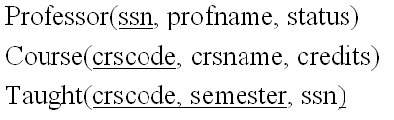
Query 1
Return those professors who have taught ‘csc6710’ but never ‘csc7710’.

Slide 76
Relational Algebra Solution
π_{ssn}(σ_{crscode=‘csc6710’}(Taught))-π_{ssn}(σ_{crscode=‘csc7710’}(Taught))

Slide 77
SQL Solution
(SELECT ssn
From Taught
Where crscode = ‘CSC6710’)
EXCEPT
(SELECT ssn
From Taught
Where crscode = ‘CSC7710’))

Slide 78
Query 2
Return those professors who have taught both ‘csc6710’ and ‘csc7710’.

Slide 79
Relational Algebra Solution
π_{ssn}(σcrscode=‘csc6710’ ∧ crscode=‘csc7710’ (Taught), wrong!
π_{ssn}(σ_{crscode=‘csc6710’}(Taught)) ∩ π_{ssn}(σ_{crscode=‘csc7710’}(Taught)), correct!

Slide 80
SQL Solution
SELECT T1.ssn
From Taught T1, Taught T2,
Where T1.crscode = ‘CSC6710’ AND T2.crscode=‘CSC7710’ AND T1.ssn=T2.ssn

Slide 81
Query 3
Return those professors who have never taught ‘csc7710’.

Slide 82
Relational Algebra Solution
π_{ssn}(σ_{crscode<>‘csc7710’}(Taught)), wrong answer!
π_{ssn}(Professor)-π_{ssn}(σ_{crscode=‘csc7710’}(Taught)), correct answer!

Slide 83
SQL Solution
(SELECT ssn
From Professor)
EXCEPT
(SELECT ssn
From Taught T
Where T.crscode = ‘CSC7710’)

Slide 84
Query 4
Return those professors who taught ‘CSC6710’ and ‘CSC7710” in the same semester

Slide 85
Relational Algebra Solution
Relational Algebra Solution
π_{ssn}(σ_{crscode1=‘csc6710’}(Taught[crscode1, ssn, semester]) σ_{crscode2=‘csc7710’}(Taught[crscode2, ssn, semester]))

Slide 86
SQL Solution
SELECT T1.ssn
From Taught T1, Taught T2,
Where T1.crscode = ‘CSC6710’ AND T2.crscode=‘CSC7710’ AND T1.ssn=T2.ssn AND T1.semester=T2.semester

Slide 87
Query 5
Return those professors who taught ‘CSC6710’ or ‘CSC7710” but not both.

Slide 88
Relational Algebra Solution
π_{ssn}(σcrscode<>‘csc7710’ ∨ crscode=‘csc7710’(Taught))-(π_{ssn}(σ_{crscode=‘csc6710’}(Taught)) ∩ π_{ssn}(σ_{crscode=‘csc7710’}(Taught)))

Slide 89
SQL Solution
(SELECT ssn
FROM Taught T
WHERE T.crscode=‘CSC6710’ OR T.crscode=‘CSC7710’)
Except
(SELECT T1.ssn
From Taught T1, Taught T2,
Where T1.crscode = ‘CSC6710’) AND T2.crscode=‘CSC7710’ AND T1.ssn=T2.ssn)

Slide 90
Query 6
Return those courses that have never been taught.

Slide 91
Relational Algebra Solution
π_{crscode}(Course)-π_{crscode}(Taught)

Slide 92
SQL Solution
(SELECT crscode
FROM Course)
EXCEPT
(SELECT crscode
FROM TAUGHT
)

Slide 93
Query 7
Return those courses that have been taught at least in two semesters.

Slide 94
Relational Algebra Solution
π_{crscode}(σ _{semester1 <> semester2}(
Taught[crscode, ssn1, semester1] Taught[crscode, ssn2, semester2]))

Slide 95
SQL Solution
SELECT T1.crscode
FROM Taught T1, Taught T2
WHERE T1.crscode=T2.crscode AND T1.semester <> T2.semester

Slide 96
Query 8
Return those courses that have been taught at least in 10 semesters.

Slide 97
SQL Solution
SELECT crscode
FROM Taught
GROUP BY crscode
HAVING COUNT(*) >= 10

Slide 98
Query 9
Return those courses that have been taught by at least 5 different professors.

Slide 99
SQL Solution
SELECT crscode
FROM (SELECT DISTINCT crscode, ssn FROM TAUGHT)
GROUP BY crscode
HAVING COUNT(*) >= 5

Slide 100
Query 10
Return the names of professors who ever taught ‘CSC6710’.

Slide 101
Relational Algebra Solution
π_{profname}(σ_{crscode=‘csc6710’}(Taught) Professor)

Slide 102
SQL Solution
SELECT P.profname
FROM Professor P, Taught T
WHERE P.ssn = T.ssn AND T.crscode = ‘CSC6710’

Slide 103
Query 11
Return the names of full professors who ever taught ‘CSC6710’.

Slide 104
Relational Algebra Solution
π_{profname}(σ_{crscode=‘csc6710’}(Taught) σ_{status=‘full’}(Professor))

Slide 105
SQL Solution
SELECT P.profname
FROM Professor P, Taught T
WHERE P.status = ‘full’ AND P.ssn = T.ssn AND T.crscode = ‘CSC6710’

Slide 106
Query 12
Return the names of full professors who ever taught more than two courses in one semester.

Slide 107
SQL Solution
SELECT P.profname
FROM Professor P
WHERE ssn IN(
SELECT ssn
FROM Taught
GROUP BY ssn, semester
HAVING COUNT(*) > 2
)

Slide 108
Query 13
Delete those professors who never taught a course.

Slide 109
SQL Solution
DELETE FROM Professor
WHERE ssn NOT IN
(SELECT ssn
FROM Taught
)

Slide 110
Query 14
Change all the credits to 4 for those courses that are taught in f2006 semester.

Slide 111
SQL Solution
UPDATE Course
SET credits = 4
WHERE crscode IN
(
SELECT crscode
FROM Taught
WHERE semester = ‘f2006’
)

Slide 112
Query 15
Return the names of the professors who have taught more than 30 credits of courses.

Slide 113
SQL Solution
SELECT profname
FROM Professor
WHERE ssn IN
(
SELECT T.ssn
FROM Taught T, Course C
WHERE T.crscode = C.crscode
GROUP BY T.ssn
HAVING SUM(C.credits) > 30
)

Slide 114
Query 16
Return the name(s) of the professor(s) who taught the most number of courses in S2006.

Slide 115
SQL Solution
SELECT profname
FROM Professor
WHERE ssn IN(
SELECT ssn FROM Taught
WHERE semester = ‘S2006’
GROUP BY ssn
HAVING COUNT(*) =
(SELECT MAX(Num)
FROM
(SELECT ssn, COUNT(*) as Num
FROM Taught
WHERE semester = ‘S2006’
GROUP BY ssn)
)
)

Slide 116
Query 17
List all the course names that professor ‘Smith” taught in Fall of 2007.

Slide 117
Relational Algebra Solution
π_{crsname}(σ_{profname=‘Smith’}(Professor) σ_{semester=‘f2007’}(Taught)
Course)

Slide 118
SQL Solution
SELECT crsname
FROM Professor P, Taught T, Course C
WHERE P.profname = ‘Smith’ AND P.ssn = T.ssn AND T.semester = ‘F2007’ AND T.crscode = C.crscode

Slide 119
Query 18
In chronological order, list the number of courses that the professor with ssn ssn = 123456789 taught in each semester.

Slide 120
SQL Solution
SELECT semester, COUNT(*)
FROM Taught
WHERE ssn = ‘123456789’
GROUP BY semester
ORDER BY semester ASC

Slide 121
Query 19
In alphabetical order of the names of professors, list the name of each professor and the total number of courses she/he has taught.

Slide 122
SQL Solution
SELECT P.profname, COUNT(*)
FROM Professor P, Taught T
WHERE P.ssn = T.ssn
GROUP BY P.ssn, P.profname
ORDER BY P.profname ASC

Slide 123
Query 20
Delete those professors who taught less than 10 courses.

Slide 124
SQL Solution
DELETE FROM Professor
WHERE ssn IN(
SELECT ssn
FROM Taught
GROUP BY ssn
HAVING COUNT(*) < 10
)

Slide 125
Query 21
Delete those professors who taught less than 40 credits.

Slide 126
SQL Solution
DELETE FROM Professor
WHERE ssn IN(
SELECT T.ssn
FROM Taught T, Course C
WHERE T.crscode = C.crscode
GROUP BY ssn
HAVING SUM(C.credits) < 40
)

Slide 127
Query 22
List those professors who have not taught any course in the past three semesters (F2006, W2007, F2007).

Slide 128
SQL Solution
SELECT *
FROM Professor P
WHERE NOT EXISTS(
SELECT *
FROM Taught
WHERE P.ssn = T.ssn AND (T.semester = ‘F2006’ OR
T.semester = ‘W2007’ OR T.semester=‘F2007’))
)

Slide 129
Query 23
List the names of those courses that professor Smith have never taught.

Slide 130
Relational Algebra Solution
π_{crsname}(Course)-π_{crsname}(σ_{profname=‘Smith’}(Professor) (Taught)
Course)

Slide 131
SQL Solution
SELECT crsname
FROM Course C
WHERE NOT EXISTS
SELECT *
FROM Professor P, Taught T
WHERE P.profname=‘Smith’ AND P.ssn = T.ssn AND T.crscode = C.crscode
)

Slide 132
Query 24
Return those courses that have been taught by all professors.

Slide 133
Relational Algebra Solution
π_{crscode, ssn}(Taught)/ π_{ssn}(Professor)

Slide 134
SQL Solution
SELECT crscode
FROM Taught T1
WHERE NOT EXISTS(
(SELECT ssn
FROM Professor)
EXCEPT
(SELECT ssn
FROM Taught T2
WHERE T2.crscode = T1.crscode)
)

Slide 135
Query 25
Return those courses that have been taught in all semesters.

Slide 136
Relational Algebra Solution
π_{crscode, semester}(Taught)/ π_{semester}(Taught)

Slide 137
SQL Solution
SELECT crscode
FROM Taught T1
WHERE NOT EXISTS(
(SELECT semester
FROM Taught)
EXCEPT
(SELECT semester
FROM Taught T2
WHERE T2.crscode = T1.crscode)
)

Slide 138
Query 25
Return those courses that have been taught ONLY by junior professors.

Slide 139
Relational Algebra Solution
π_{crscode}(Course) - π_{crscode} (σ_{status≠‘Junior’}(Professor) Taught)

Slide 140
SQL Solution
SELECT crscode
FROM Course C
WHERE c.crscode NOT IN(
(SELECT crscode
FROM Taught T, Professor P
WHERE T.ssn = P.ssn AND P.status=‘Junior’
)

