Slide 1
Module 10: Physical Storage Systems

Slide 2
Module 10: Physical Storage Systems
Overview of Physical Storage Media
Storage Interfaces
Magnetic Disks
Flash Storage
RAID
Disk-Block Access

Slide 3
Classification of Physical Storage Media
Speed with which data can be accessed
Cost per unit of data
Reliability
  Data loss on power failure or system crash
  Physical failure of the storage device
Can differentiate storage into:
  volatile storage: loses contents when power is switched off
  non-volatile storage:
    Contents persist even when power is switched off.
    Includes secondary and tertiary storage, as well as batter- backed up main-memory.

Slide 4
Volatile Storage Media
Cache – fastest and most costly form of storage; volatile; managed by the computer system hardware.
Main memory:
  Fast access (10s to 100s of nanoseconds; 1 nanosecond = 10^{–9} seconds)
  Generally too small (or too expensive) to store the entire database
    Capacities of up to a few Gigabytes widely used currently
    Capacities have gone up and per-byte costs have decreased steadily and rapidly (roughly factor of 2 every 2 to 3 years)
Contents of cache and main memory are usually lost if a power failure or system crash occurs.

Slide 5
Flash Memory
Data survives power failure
Data can be written at a location only once
  But location can be erased and written to again
    Can support only a limited number (10K – 1M) of write/erase cycles.
  Erasing of memory has to be done to an entire bank of memory
Reads are roughly as fast as main memory
But writes are slow (few microseconds), erase is slower
Widely used in embedded devices such as digital cameras, phones, and USB keys

Slide 6
Magnetic Disk Storage (HDD)
Data is stored on spinning disk, and read/written magnetically
Primary medium for the long-term storage of data; typically stores entire database.
Data must be moved from disk to main memory for access, and written back for storage
  Much slower access than main memory (more on this later)
direct-access – possible to read data on disk in any order, unlike magnetic tape
Capacities range up to roughly 14 TB as of 2018
  Much larger capacity and cost/byte than main memory/flash memory
  Growing constantly and rapidly with technology improvements (factor of 2 to 3 every 2 years)
Survives power failures and system crashes
  disk failure can destroy data, but is rare

Slide 7
Optical Storage
Non-volatile, data is read optically from a spinning disk using a laser light source.
DVD (4.7 to 17 GB) most popular forms
Blu-ray disks: 27 GB to 128 GB
Write-one, read-many (WORM) optical disks used for archival storage (CD-R, DVD-R, DVD+R)
Multiple write versions also available (CD-RW, DVD-RW, DVD+RW, and DVD-RAM)
Reads and writes are slower than with magnetic disk
Juke-box systems, with large numbers of removable disks, a few drives, and a mechanism for automatic loading/unloading of disks available for storing large volumes of data

Slide 8
Tape Storage
Non-volatile, storage used primarily for backup (to recover from disk failure), and for archival data
Sequential-access – much slower than disk
Very high capacity -- 1 to 12 terabytes (1 terabyte = 10¹² bytes)
Tape can be removed from drive ⇒ storage costs much cheaper than disk, but drives are expensive
Tape jukeboxes available for storing massive amounts of data
  Many of petabytes (1 petabyte = 10¹⁵ bytes)

Slide 9
Storage Hierarchy
Primary storage: Fastest media but volatile (cache, main memory).
Secondary storage: next level in hierarchy, non-volatile, moderately fast access time
  Also called on-line storage
  Examples: flash memory, magnetic disks
Tertiary storage: lowest level in hierarchy, non-volatile, slow access time
  Also called off-line storage
  Examples: magnetic tape, optical storage

Slide 10
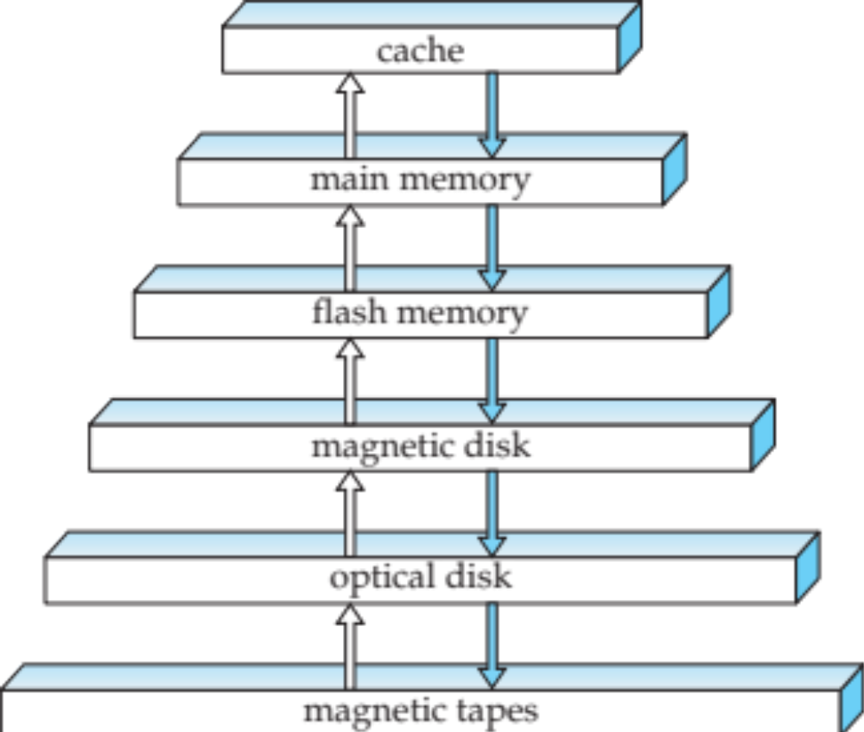
Storage Hierarchy

Slide 11
Storage Interfaces
Magnetic disks and flash-based solid-state disks are connected to a computer system through a high-speed interconnection.
Disks typically support either the Serial ATA (SATA) interface, or the Serial Attached SCSI (SA) interface.
Storage area network (SAN) architecture, allows a large numbers of disks to be appear as a single large disk and these are connected by a high-speed network to a number of server computers.
Network attached storage (NAS) is similar to SAN except that provides a file system interface using networked file system protocols (e.g., CIFS)
Cloud storage allows data to be is stored in the cloud and accessed via an API.

Slide 12
Magnetic Disks
Magnetic disks provide the bulk of secondary storage for modern computer systems.
A disk consists of a number of disk platters
  Each disk platter has a flat, circular shape. Its two surfaces are covered with a magnetic material, and information is recorded on the surfaces.
  Platters are made from rigid metal or glass.
When the disk is in use, a drive motor spins it at a constant high speed, typically 5,400 to 10,000 revolutions per minute (RPM).
Notes:
Mention: checksums, bad sector remapping

Slide 13
Magnetic Disks (Cont.)
Surface of platter divided into circular tracks
  Over 50K-100K tracks per platter on typical hard disks
Each track is divided into sectors.
  A sector is the smallest unit of data that can be read or written.
  Sector size typically 512 bytes
  Current generation disks have between 2 billion and 24 billion sectors.
  The inner tracks (closer to the spindle) are of smaller length than the outer tracks, and the outer tracks contain more sectors than the inner tracks.
Read-write head
  Positioned very close to the platter surface (almost touching it)
  Reads or writes magnetically encoded information.
Notes:
Mention: checksums, bad sector remapping

Slide 14
Magnetic Disks (Cont.)
To read/write a sector
  Disk arm swings to position head on right track
  Platter spins continually; data is read/written as sector passes under head
Head-disk assemblies
  Multiple disk platters on a single spindle (1 to 5 usually)
  One head per platter, mounted on a common arm.
Cylinder i consists of i^{th} track of all the platters
Notes:
Mention: checksums, bad sector remapping

Slide 15
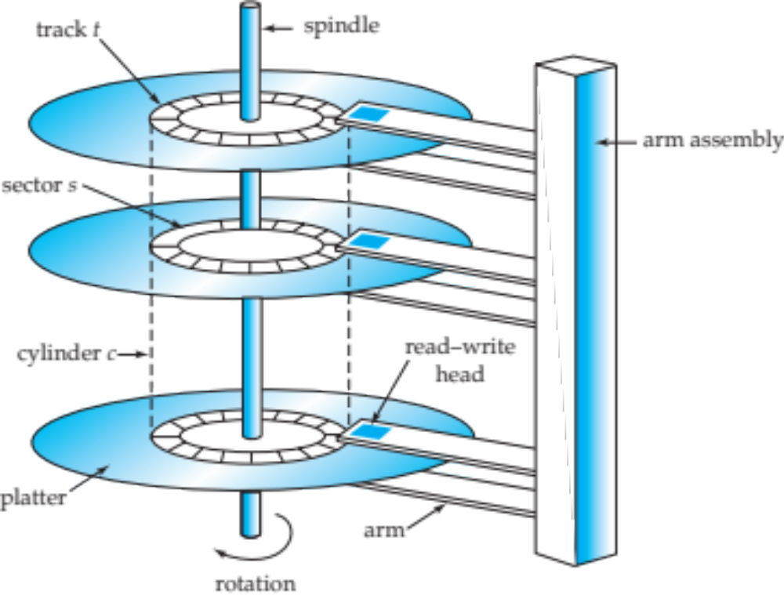
Magnetic Hard Disk Mechanism
NOTE: Diagram is schematic, and simplifies the structure of actual disk drives

Slide 16
Disk controller
Interfaces between the computer system and the disk drive hardware.
  Accepts high-level commands to read or write a sector
  Initiates actions such as moving the disk arm to the right track and actually reading or writing the data
  Computes and attaches checksums to each sector to verify that data is read back correctly
    If data is corrupted, with very high probability stored checksum won’t match recomputed checksum
  Ensures successful writing by reading back sector after writing it
  Performs remapping of bad sectors

Slide 17
Performance Measures of Disks
Access time – the time it takes from when a read or write request is issued to when data transfer begins.
Data-transfer rate – the rate at which data can be retrieved from or stored to the disk
Mean time to failure (MTTF) – the average time the disk is expected to run continuously without any failure

Slide 18
Access Time
Seek time – time it takes to reposition the arm over the correct track.
  Average seek time is 1/2 the worst case seek time.
    Would be 1/3 if all tracks had the same number of sectors, and we ignore the time to start and stop arm movement
  4 to 10 milliseconds on typical disks
Rotational latency – time it takes for the sector to be accessed to appear under the head.
  Average latency is 1/2 of the worst case latency.
  4 to 11 milliseconds on typical disks (5,400 to 15,000 RPM.)

Slide 19
Data-transfer rate
25 to 100 MB per second max rate, lower for inner tracks
Multiple disks may share a controller, so rate that controller can handle is also important
  For Example:
    SATA: 150 MB/sec, SATA-II 3Gb (300 MB/sec)
    Ultra 320 SCSI: 320 MB/s, SAS (3 to 6 Gb/sec)
    Fiber Channel (FC2Gb or 4Gb): 256 to 512 MB/s

Slide 20
Mean time to failure (MTTF)
Typically 3 to 5 years
Probability of failure of new disks is quite low, corresponding to a “theoretical MTTF” of 500,000 to 1,200,000 hours for a new disk
  An MTTF of 1,200,000 hours for a new disk means that given 1000 relatively new disks, on an average one will fail every 1200 hours
MTTF decreases as disk ages

Slide 21
Flash Memory
There are two types of flash memory -- NOR flash and NAND flash.
NAND flash is the variant that is predominantly used for data storage, since it is much cheaper than NOR flash
Requires page-at-a-time read (page: 512 bytes to 4 KB)
Transfer rate around 20 MB/sec
Erase is very slow (1 to 2 millisecs)
  Erase block contains multiple pages
  Remapping of logical page addresses to physical page addresses avoids waiting for erase
    Translation table tracks mapping
      also stored in a label field of flash page
    remapping carried out by flash translation layer
  After 100,000 to 1,000,000 erases, erase block becomes unreliable and cannot be use

Slide 22
Solid-state disks
Solid-state disks SSDs are built using NAND flash and provide the same block-oriented interface as disk storage.
Compared to magnetic disks, SSDs can provide much faster random access:
  Transfer rate of 100 to 200 MB/sec
  The latency to retrieve a page of data ranges from 20 to 100 microseconds for SSDs,
    A random access on disk would take 5 to 10 milliseconds.
The data transfer rate of SSDs is higher than that of magnetic disks and is usually limited by the interconnect technology;
  Transfer rates range from around 500 megabytes per second up to 3 gigabytes per second.
The power consumption of SSDs is also significantly lower than that of magnetic disks.

Slide 23
RAID

Slide 24
Redundant Arrays of Independent Disks (RAID)
Disk organization techniques that manage a large numbers of disks, providing a view of a single disk of
  High capacity and high speed by using multiple disks in parallel,
  High reliability by storing data redundantly, so that data can be recovered even if a disk fails
Originally a cost-effective alternative to large, expensive disks
  I in RAID originally stood for “inexpensive”
  Today RAIDs are used for their higher reliability and bandwidth and the “I” is interpreted as “independent”

Slide 25
RAID (Cont.)
The chance that some disk out of a set of N disks will fail is much higher than the chance that a specific single disk will fail.
  For example, a system with 100 disks, each with MTTF of 100,000 hours (approx. 11 years), will have a system MTTF of 1000 hours (approx. 41 days)
  Techniques for using redundancy to avoid data loss are critical with large numbers of disks
Redundancy – store extra information that can be used to rebuild information lost in a disk failure

Slide 26
Improvement Redundancy
Mirroring
  Duplicate every disk. Logical disk consists of two physical disks.
  Every write is carried out on both disks
    Reads can take place from either disk
  If one disk in a pair fails, data still available in the other
    Data loss would occur only if a disk fails, and its mirror disk also fails before the system is repaired
Mean time to data loss
  Depends on mean time to failure, and mean time to repair
  E.g. MTTF of 100,000 hours, mean time to repair of 10 hours gives mean time to data loss of 500*10⁶ hours (or 57,000 years) for a mirrored pair of disks (ignoring dependent failure modes)

Slide 27
Improvement in Performance via Parallelism
Two main goals of parallelism in a disk system:
  1. Load balance multiple small accesses to increase throughput
  2. Parallelize large accesses to reduce response time.
Improve transfer rate by striping data across multiple disks.
Bit-level striping – split the bits of each byte across multiple disks
  In an array of eight disks, write bit i of each byte to disk i.
  Each access can read data at eight times the rate of a single disk.
  But seek/access time worse than for a single disk
    Bit level striping is not used much any more
Block-level striping – with n disks, block i of a file goes to disk (i mod n) + 1
  Requests for different blocks can run in parallel if the blocks reside on different disks
  A request for a long sequence of blocks can utilize all disks in parallel

Slide 28
RAID Levels
Schemes to provide redundancy at lower cost by using disk striping combined with parity bits
  Different RAID organizations, or RAID levels, have differing cost, performance and reliability characteristics
There are There are 7 different RAID levels, numbered 0 to 6;
  Levels 2, 3, and 4 are not used in practice anymore and are not covered in the text.
We concentrate on:
  Level 0: Block striping; non-redundant
  Level 1: Mirrored disks with block striping
  Level 5: Block-Interleaved Distributed Parity
  Level 6: The P + Q redundancy scheme

Slide 29
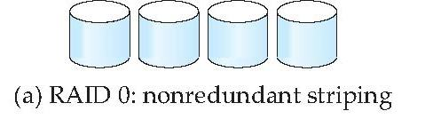
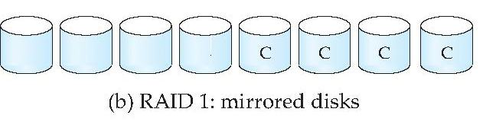
RAID Levels
RAID Level 0: Block striping; non-redundant.
  Used in high-performance applications where data loss is not critical
RAID Level 1: Mirrored disks with block striping
  Offers best write performance.
  Popular for applications such as storing log files in a database system.

Slide 30
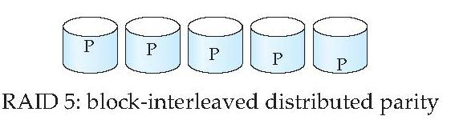
RAID Level 5
RAID Level 5: Block-Interleaved Distributed Parity.
  The data and parity are partitioned among all N + 1 disks, rather than storing data in N disks and parity in 1 disk.
Example: with 5 disks, parity block for nth set of blocks is stored on disk (n mod 5) + 1, with the data blocks stored on the other 4 disks.
Setup

Slide 31
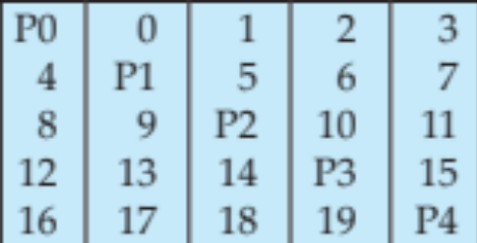
RAID Level 5 (Cont.)
Example. with an array of five disks
  The parity block, labeled Pk, for logical blocks 4k, 4k+1, 4k+2, 4k+3 is stored in disk k mod 5
  The corresponding blocks of the other four disks store the four data blocks 4k to 4k+3.
  The following table
  indicates how the first 20 blocks, numbered 0 to 19, and their parity blocks are laid out. The pattern shown gets repeated on further blocks.

Slide 32
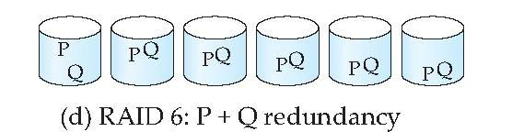
RAID Level 6
RAID Level 6: P+Q Redundancy scheme;
  similar to Level 5, but stores extra redundant information to guard against multiple disk failures.
Better reliability than Level 5 at a higher cost
  Becoming more important as storage sizes increase
Setup

Slide 33
Choice of RAID Level
Level 1 provides much better write performance than level 5
  Level 5 requires at least 2 block reads and 2 block writes to write a single block, whereas Level 1 only requires 2 block writes
  Level 1 preferred for high update environments such as log disks
Level 1 had higher storage cost than level 5
  Disk drive capacities increasing rapidly (50% per year) whereas disk access times have decreased much less (x 3 in 10 years)
  I/O requirements have increased greatly, e.g. for Web servers
  When enough disks have been bought to satisfy required rate of I/O, they often have spare storage capacity
    so there is often no extra monetary cost for Level 1!
Level 5 is preferred for applications with low update rate,
and large amounts of data
Level 1 is preferred for all other applications

Slide 34
Hardware Issues
Software RAID: RAID implementations done entirely in software, with no special hardware support
Hardware RAID: RAID implementations with special hardware
  Use non-volatile RAM to record writes that are being executed
Power failure during write can result in corrupted disk
  Example, failure after writing one block but before writing the second in a mirrored system
  Such corrupted data must be detected when power is restored
  Recovery from corruption is similar to recovery from failed disk
  NV-RAM helps to efficiently detected potentially corrupted blocks
    Otherwise all blocks of disk must be read and compared with mirror/parity block

Slide 35
Hardware Issues (Cont.)
Latent failures: data successfully written earlier gets damaged
  can result in data loss even if only one disk fails
Data scrubbing:
  continually scan for latent failures, and recover from copy/parity
Hot swapping: replacement of disk while system is running, without power down
  Supported by some hardware RAID systems,
  reduces time to recovery, and improves availability greatly

Slide 36
Hardware Issues (Cont.)
Many systems maintain spare disks which are kept online, and used as replacements for failed disks immediately on detection of failure
  Reduces time to recovery greatly
Many hardware RAID systems ensure that a single point of failure will not stop the functioning of the system by using
  Redundant power supplies with battery backup
  Multiple controllers and multiple interconnections to guard against controller/interconnection failures

Slide 37
DISK-BLOCK ACCESS

Slide 38
Storage Access
Requests for disk I/O are generated by the database system, with the query processing sub-system responsible for most of the disk I/O .
A database file is partitioned into fixed-length storage units called blocks. Blocks are units of both storage allocation and data transfer.
Database system seeks to minimize the number of block transfers between the disk and memory. We can reduce the number of disk accesses by keeping as many blocks as possible in main memory.
Buffer – portion of main memory available to store copies of disk blocks.
Buffer manager – subsystem responsible for allocating buffer space in main memory.

Slide 39
Storage Access (Cont.)
Buffering. Blocks that are read from disk are stored temporarily in an in-memory buffer.
Read-ahead. When a disk block is accessed, consecutive blocks from the same track are read into an in-memory buffer even if there is no pending request for the blocks.
Disk-arm-scheduling . Order pending accesses to disk tracks so that disk arm movement is minimized
  elevator algorithm

Slide 40
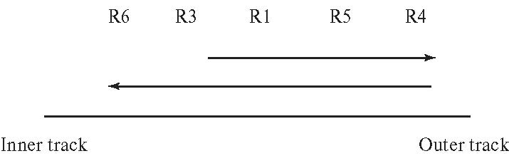
Optimization of Disk-Block Access
Block – a contiguous sequence of sectors from a single track
  data is transferred between disk and main memory in blocks
  sizes range from 512 bytes to several kilobytes
    Smaller blocks: more transfers from disk
    Larger blocks: more space wasted due to partially filled blocks
    Typical block sizes today range from 4 to 16 kilobytes
Disk-arm-scheduling algorithms order pending accesses to tracks so that disk arm movement is minimized
  Elevator algorithm:

Slide 41
File Organization
To reduce block-access time, we can organize blocks on disk in a way that corresponds closely to the way we expect data to be accessed.
Optimize block access time by organizing the blocks to correspond to how data will be accessed
  For example, store related information on the same or nearby cylinders.
Files may get fragmented over time
  Ff data is inserted to/deleted from the file, or
  Free blocks on disk are scattered, and newly created file has its blocks scattered over the disk
  Sequential access to a fragmented file results in increased disk arm movement
Some systems have utilities to defragment the file system, in order to speed up file access

Slide 42
Non-volatile Write buffers
To ensure that the contents of main memory are not lost in a power failure, information about database updates has to be recorded on disk to survive possible system crashes.
We can use nonvolatile random-access memory (NVRAM) to speed up disk writes. The contents of NVRAM are not lost in power failure.
When the database system requests that a block be written to disk, the disk controller writes the block to a NVRAM buffer and immediately notifies the system that the write completed successfully.
The controller can subsequently write the data to their destination on disk in a way that minimizes disk arm movement,

Slide 43
End of Module 10

