Slide 1
Module 12a: Dynamic Hashing

Slide 2
Dynamic Hashing
Allows the hash function to be modified dynamically
Extendable hashing – one form of dynamic hashing
  Hash function generates values over a large range — typically b-bit integers, with b = 32.
  At any time only a prefix of the hash function is uded to index into a table of bucket addresses.
  Let the length of the prefix be i bits, 0 ≤ i ≤ 31.
    Bucket address table size = 2^{i.} Initially i = 0
    Value of i grows and shrinks as the size of the database grows and shrinks.
  Multiple entries in the bucket address table may point to the same bucket.
  Thus, actual number of buckets is < 2^{i}
    The number of buckets also changes dynamically due to coalescing and splitting of buckets.

Slide 3
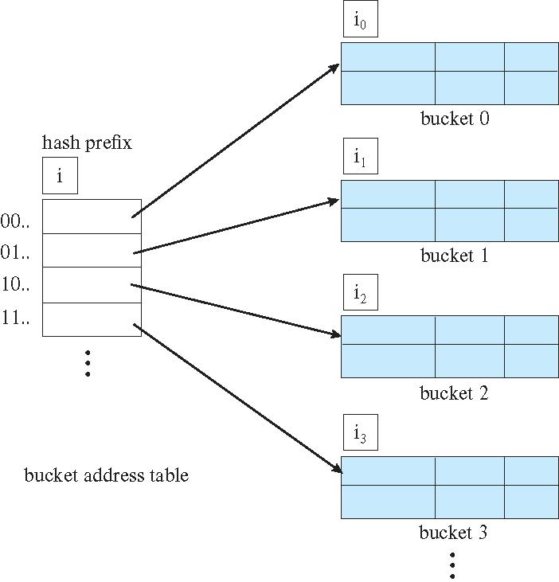
General Extendable Hash Structure
In this structure each bucket hold 2 entries.
i₂ = i₃ = i
i₁ = i – 1
For entry 0 in ther bucket address table, number of pointers is i₁ = i

Slide 4
Use of Extendable Hash Structure
Each bucket j is associated with a value i_{j}
  All the entries in the bucket address table that point to the same bucket have the same values on the first i_{j} bits.
To locate the bucket containing search-key K:
  1. Compute h(K) = X
  2. Use the first i high order bits of X as a displacement into bucket address table, and follow the pointer to appropriate bucket
To insert a record with search-key value K
  Follow same procedure as look-up and locate the bucket, say j.
  If there is room in the bucket j insert record in the bucket.
  Else, the bucket must be split and insertion re-attempted (see next slide.)
    Overflow buckets used in some cases (will see shortly)

Slide 5
Use of Extendable Hash Structure
Each bucket j is associated with a value i_{j}
  All the entries in the bucket address table that point to the same bucket have the same values on the first i_{j} bits.
To locate the bucket containing search-key K_{j}:
  1. Compute h(K_{j}) = X
  2. Use the first i high order bits of X as a displacement into bucket address table, and follow the pointer to appropriate bucket
To insert a record with search-key value K_{j}
  Follow same procedure as look-up and locate the bucket, say j.
  If there is room in the bucket j insert record in the bucket.
  Else the bucket must be split and insertion re-attempted (see next slide.)
    Overflow buckets used in some cases (will see shortly)

Slide 6
Insertion in Extendable Hash Structure
Splitting a bucket j when inserting record with search-key value K:
If i > i_{j} (more than one pointer to bucket j)
  Allocate a new bucket z, and set i_{j} = i_{z} = (i_{j} + 1)
  Update the second half of the bucket address table entries originally pointing to j, to point to z
  Remove each record in bucket j and reinsert (in j or z)
  Recompute new bucket for K and insert record in the bucket (further splitting is required if the bucket is still full)
If i = i_{j} (only one pointer to bucket j)
  If i reaches some limit b, or too many splits have happened in this insertion, create an overflow bucket
  Else
    Increment i and double the size of the bucket address table.
    Replace each entry in the table by two entries that point to the same bucket.
    Recompute new bucket address table entry for K
    Now i > i_{j} so use the first case above.

Slide 7
Deletion in Extendable Hash Structure
To delete a key value,
  Locate it in its bucket and remove it.
  The bucket itself can be removed if it becomes empty (with appropriate updates to the bucket address table).
  Coalescing of buckets can be done (can coalesce only with a “buddy” bucket having same value of i_{j} and same i_{j} –1 prefix, if it is present)
  Decreasing bucket address table size is also possible
    Note: decreasing bucket address table size is an expensive operation and should be done only if number of buckets becomes much smaller than the size of the table

Slide 8
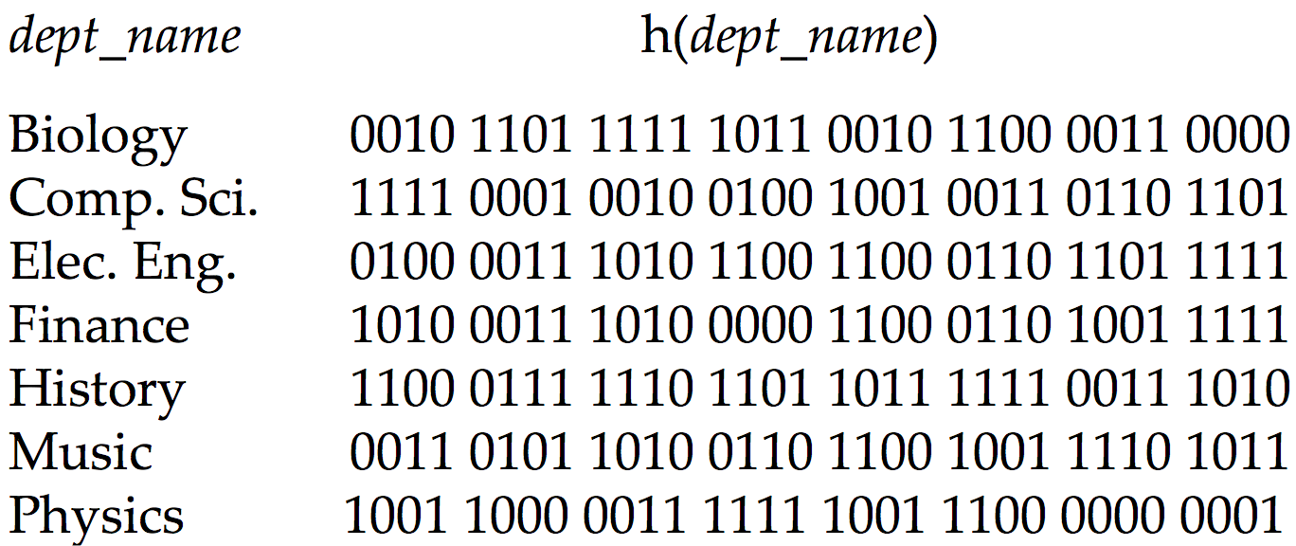
Use of Extendable Hash Structure: Example

Slide 9
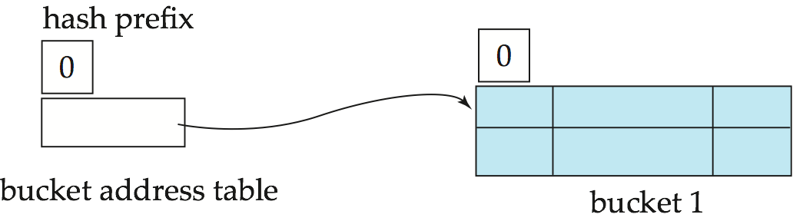
Example (Cont.)
Initial hash structure; bucket size = 2

Slide 10
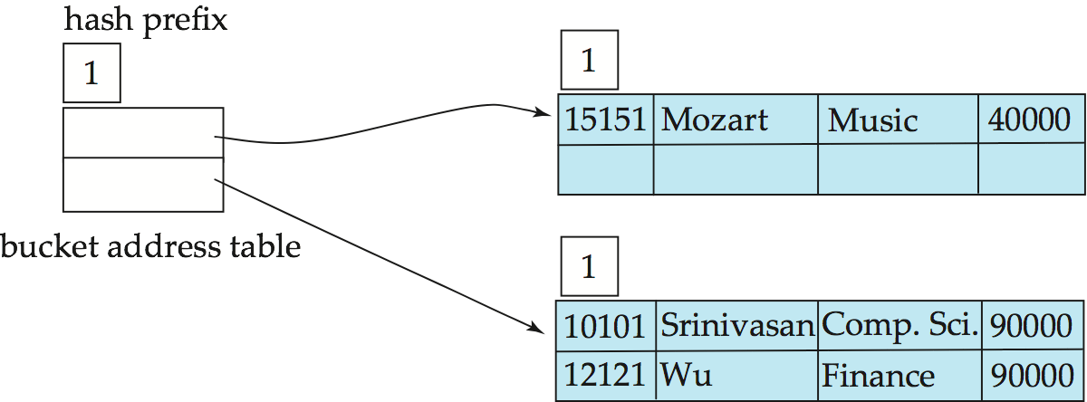
Example (Cont.)
Hash structure after insertion of the records “Mozart”, “Srinivasan”,
and “Wu”

Slide 11
Use of Extendable Hash Structure: Example

Slide 12
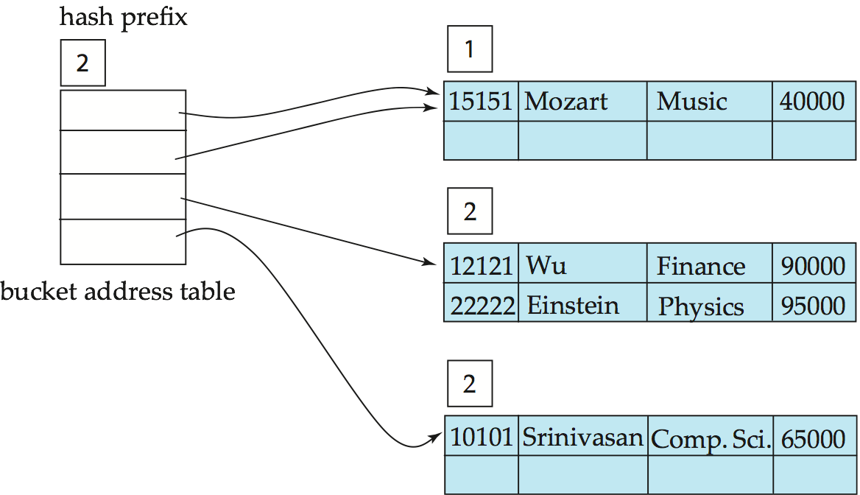
Example (Cont.)
Hash structure after insertion of Einstein record

Slide 13
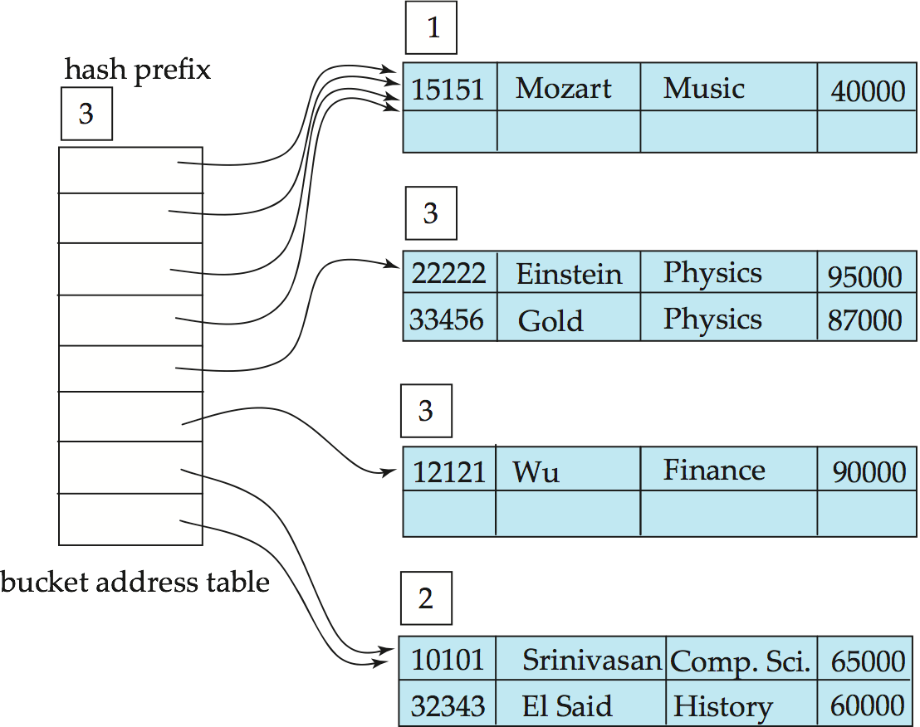
Example (Cont.)
Hash structure after insertion of Gold and El Said records

Slide 14
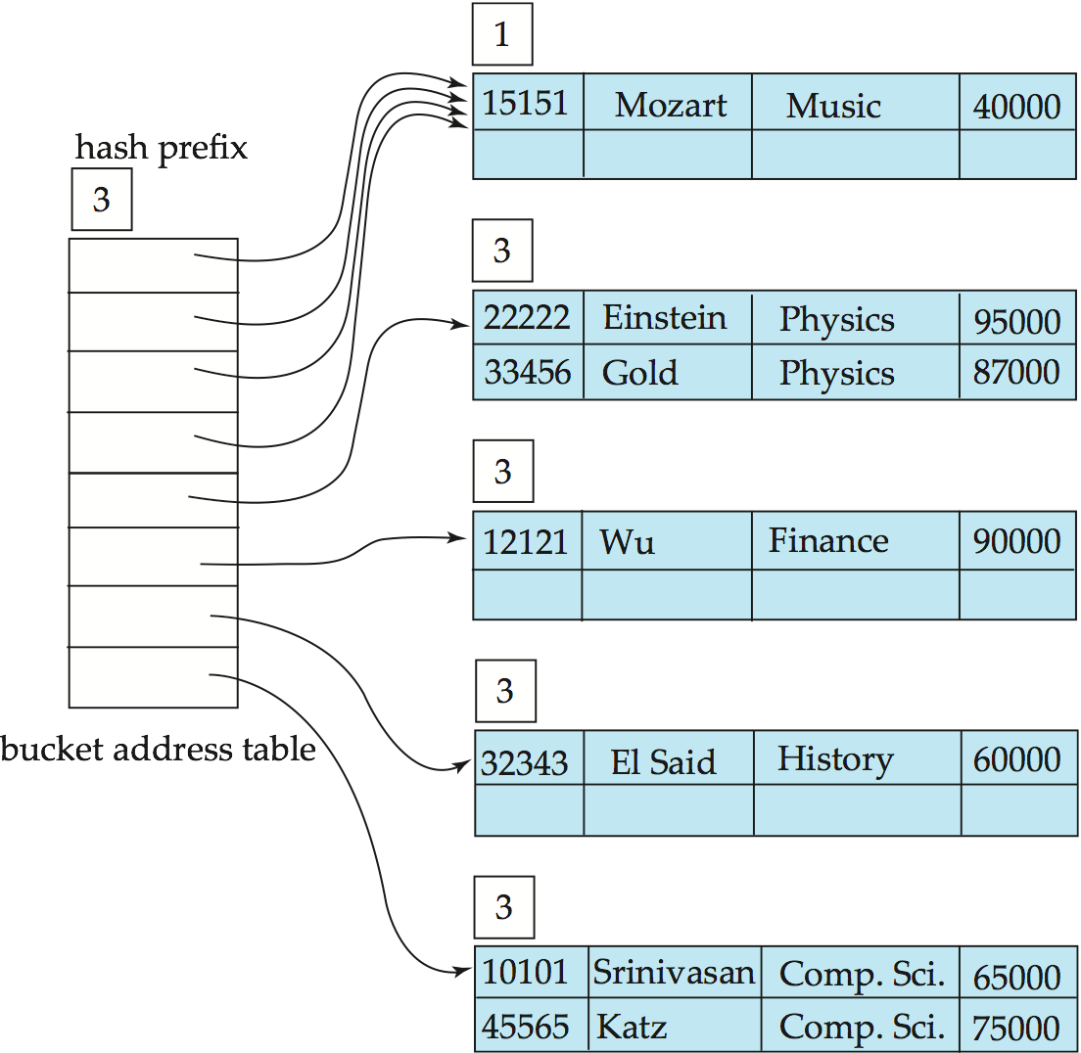
Example (Cont.)
Hash structure after insertion of Katz record

Slide 15
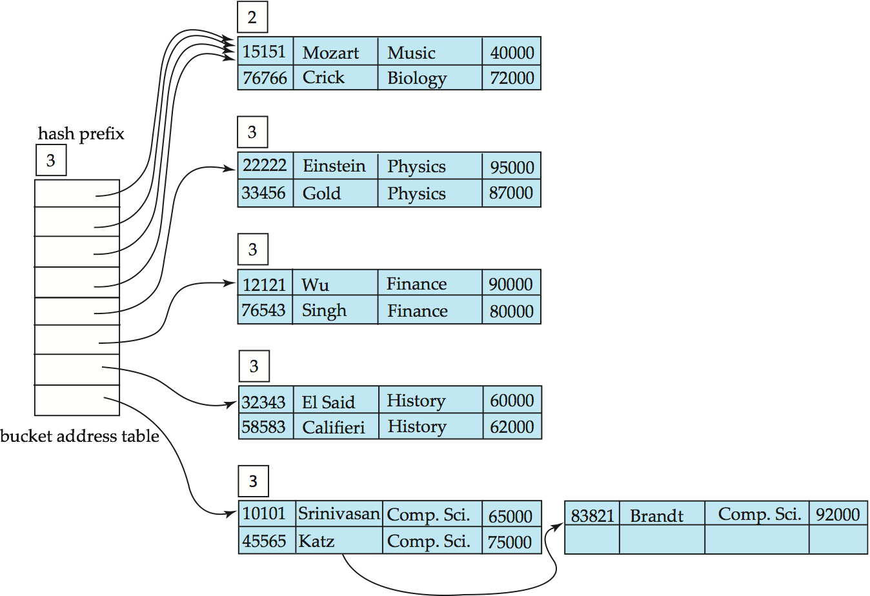
Example (Cont.)
And after insertion of
eleven records

Slide 16
Use of Extendable Hash Structure: Example

Slide 17
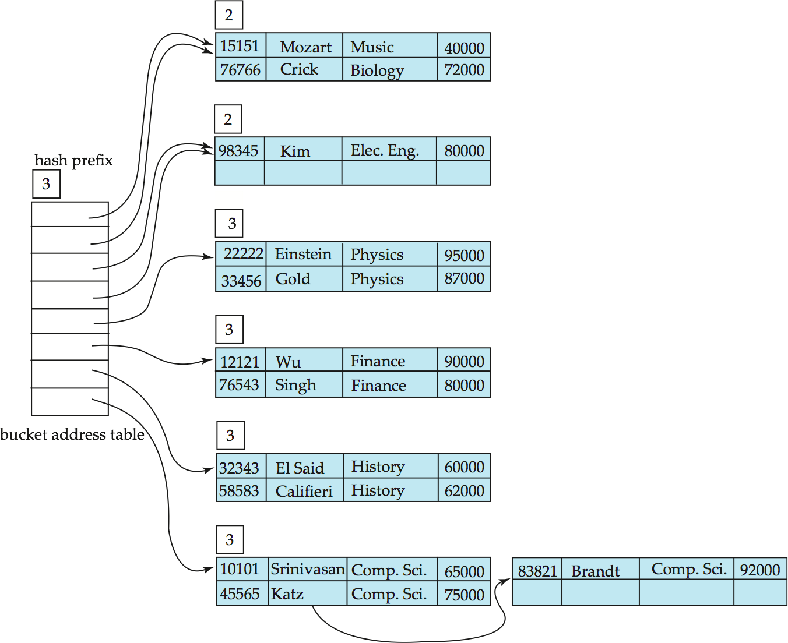
Example (Cont.)
And after insertion of
Kim record in previous
hash structure

Slide 18
Extendable Hashing vs. Other Schemes
Benefits of extendable hashing:
  Hash performance does not degrade with growth of file
  Minimal space overhead
Disadvantages of extendable hashing
  Extra level of indirection to find desired record
  Bucket address table may itself become very big (larger than memory)
    Cannot allocate very large contiguous areas on disk either
    Solution: B⁺-tree structure to locate desired record in bucket address table
  Changing size of bucket address table is an expensive operation
Linear hashing is an alternative mechanism
  Allows incremental growth of its directory (equivalent to bucket address table)
  At the cost of more bucket overflows

Slide 19
End of Module 12a

