Slide 1
Module 15: Transactions

Slide 2
Outline
Transaction Concept
Transaction State
Concurrent Executions
Serializability
Recoverability
Implementation of Isolation
Transaction Definition in SQL
Testing for Serializability.

Slide 3
Transaction Concept
A transaction is a unit of program execution that accesses and possibly updates various data items.
E.g. transaction to transfer $50 from account A to account B:
  1. read(A)
  2. A := A – 50
  3. write(A)
  4. read(B)
  5. B := B + 50
  6. write(B)
Two main issues to deal with:
  Failures of various kinds, such as hardware failures and system crashes
  Concurrent execution of multiple transactions

Slide 4
Example of Fund Transfer
Transaction to transfer $50 from account A to account B:
  1. read(A)
  2. A := A – 50
  3. write(A)
  4. read(B)
  5. B := B + 50
  6. write(B)
Atomicity requirement
  If the transaction fails after step 3 and before step 6, money will be “lost” leading to an inconsistent database state
    Failure could be due to software or hardware
  The system should ensure that updates of a partially executed transaction are not reflected in the database
Durability requirement — once the user has been notified that the transaction has completed (i.e., the transfer of the $50 has taken place), the updates to the database by the transaction must persist even if there are software or hardware failures.

Slide 5
Example of Fund Transfer (Cont.)
Consistency requirement in above example:
  The sum of A and B is unchanged by the execution of the transaction
In general, consistency requirements include
  Explicitly specified integrity constraints such as primary keys and foreign keys
  Implicit integrity constraints
    e.g., sum of balances of all accounts, minus sum of loan amounts must equal value of cash-in-hand
  A transaction must see a consistent database.
  During transaction execution the database may be temporarily inconsistent.
  When the transaction completes successfully the database must be consistent
    Erroneous transaction logic can lead to inconsistency

Slide 6
Example of Fund Transfer (Cont.)
Isolation requirement — if between steps 3 and 6, another transaction T2 is allowed to access the partially updated database, it will see an inconsistent database (the sum A + B will be less than it should be).
T1 T2
  1. read(A)
  2. A := A – 50
  3. write(A)
  read(A), read(B), print(A+B)
  4. read(B)
  5. B := B + 50
  6. write(B
Isolation can be ensured trivially by running transactions serially
  That is, one after the other.
However, executing multiple transactions concurrently has significant benefits, as we will see later.

Slide 7
ACID Properties
A transaction is a unit of program execution that accesses and possibly updates various data items.To preserve the integrity of data the database system must ensure:
Atomicity. Either all operations of the transaction are properly reflected in the database or none are.
Consistency. Execution of a transaction in isolation preserves the consistency of the database.
Isolation. Although multiple transactions may execute concurrently, each transaction must be unaware of other concurrently executing transactions. Intermediate transaction results must be hidden from other concurrently executed transactions.
  That is, for every pair of transactions T_{i} and T_{j}, it appears to T_{i} that either T_{j}, finished execution before T_{i} started, or T_{j} started execution after T_{i} finished.
Durability. After a transaction completes successfully, the changes it has made to the database persist, even if there are system failures.

Slide 8
Transaction State
Active – the initial state; the transaction stays in this state while it is executing
Partially committed – after the final statement has been executed.
Failed -- after the discovery that normal execution can no longer proceed.
Aborted – after the transaction has been rolled back and the database restored to its state prior to the start of the transaction. Two options after it has been aborted:
  restart the transaction
    can be done only if no internal logical error
  kill the transaction
Committed – after successful completion.

Slide 9
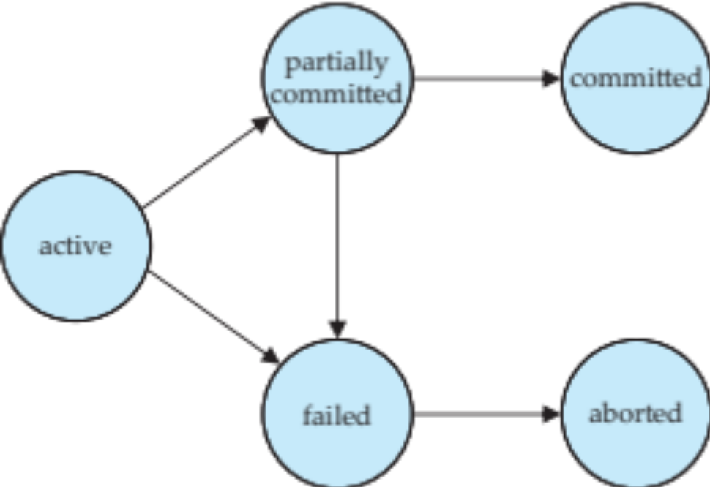
Transaction State (Cont.)

Slide 10
Concurrent Executions
Multiple transactions are allowed to run concurrently in the system. Advantages are:
  Increased processor and disk utilization, leading to better transaction throughput
    e.g., one transaction can be using the CPU while another is reading from or writing to the disk
  Reduced average response time for transactions: short transactions need not wait behind long ones.
Concurrency control schemes – mechanisms to achieve isolation
  That is, to control the interaction among the concurrent transactions in order to prevent them from destroying the consistency of the database
    Will study in Chapter 15, after studying notion of correctness of concurrent executions.

Slide 11
Schedules
Schedule – a sequences of instructions that specify the chronological order in which instructions of concurrent transactions are executed
  A schedule for a set of transactions must consist of all instructions of those transactions
  Must preserve the order in which the instructions appear in each individual transaction.
A transaction that successfully completes its execution will have a commit instructions as the last statement
  By default transaction assumed to execute commit instruction as its last step
A transaction that fails to successfully complete its execution will have an abort instruction as the last statement

Slide 12
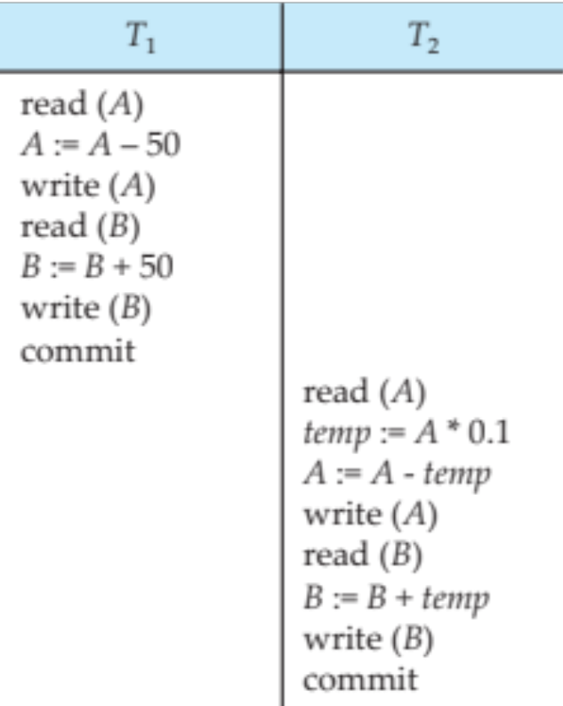
Schedule 1
Let T₁ transfer $50 from A to B, and T₂ transfer 10% of the balance from A to B.
A serial schedule in which T₁ is followed by T₂ :

Slide 13
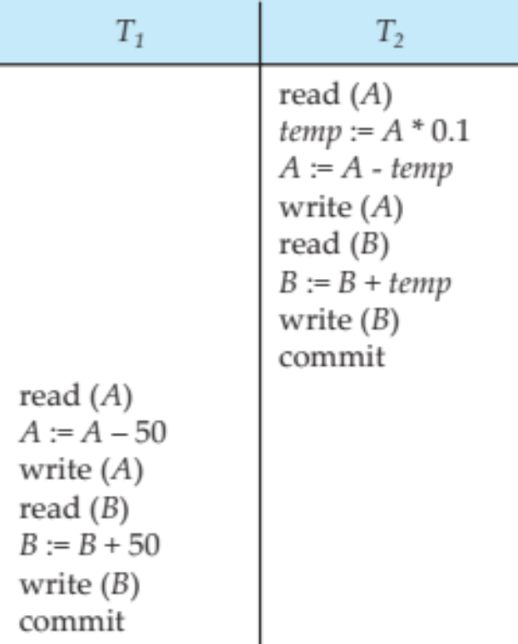
Schedule 2
A serial schedule where T₂ is followed by T₁

Slide 14
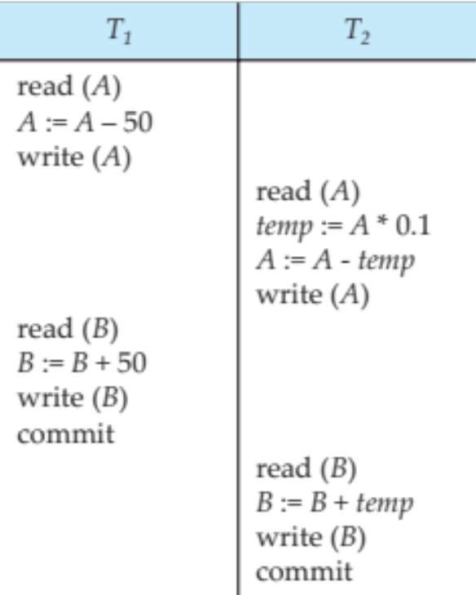
Schedule 3
Let T₁ and T₂ be the transactions defined previously. The following schedule is not a serial schedule, but it is equivalent to Schedule 1.
In Schedules 1, 2 and 3, the sum A + B is preserved.

Slide 15
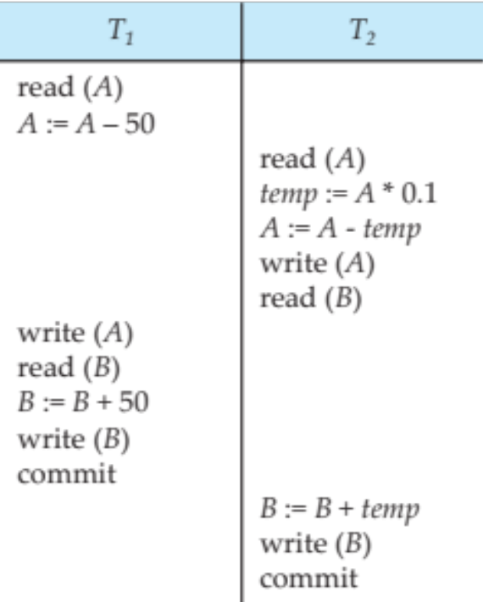
Schedule 4
The following concurrent schedule does not preserve the value of (A + B ).

Slide 16
Serializability
Basic Assumption – Each transaction preserves database consistency.
Thus, serial execution of a set of transactions preserves database consistency.
A (possibly concurrent) schedule is serializable if it is equivalent to a serial schedule. Different forms of schedule equivalence give rise to the notions of:
  1. conflict serializability
  2. view serializability

Slide 17
Simplified view of transactions
We ignore operations other than read and write instructions
We assume that transactions may perform arbitrary computations on data in local buffers in between reads and writes.
Our simplified schedules consist of only read and write instructions.

Slide 18
Conflicting Instructions
Instructions l_{i} and l_{j} of transactions T_{i} and T_{j} respectively, conflict if and only if there exists some item Q accessed by both l_{i} and l_{j}, and at least one of these instructions wrote Q.
1. l_{i} = read(Q), l_{j} = read(Q). l_{i} and l_{j} don’t conflict.
2. l_{i} = read(Q), l_{j} = write(Q). They conflict.
3. l_{i} = write(Q), l_{j} = read(Q). They conflict
4. l_{i} = write(Q), l_{j} = write(Q). They conflict
Intuitively, a conflict between l_{i} and l_{j} forces a (logical) temporal order between them.
  If l_{i} and l_{j} are consecutive in a schedule and they do not conflict, their results would remain the same even if they had been interchanged in the schedule.

Slide 19
Conflict Serializability
If a schedule S can be transformed into a schedule S´ by a series of swaps of non-conflicting instructions, we say that S and S´ are conflict equivalent.
We say that a schedule S is conflict serializable if it is conflict equivalent to a serial schedule

Slide 20
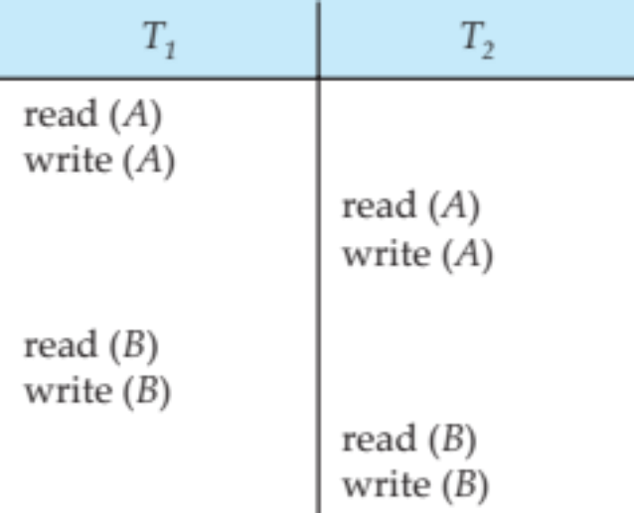
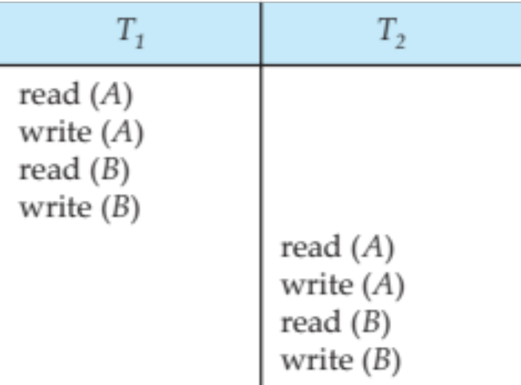
Conflict Serializability (Cont.)
Schedule 3 can be transformed into Schedule 6, a serial schedule where T₂ follows T₁, by series of swaps of non-conflicting instructions. Therefore Schedule 3 is conflict serializable.
Schedule 3
Schedule 6

Slide 21
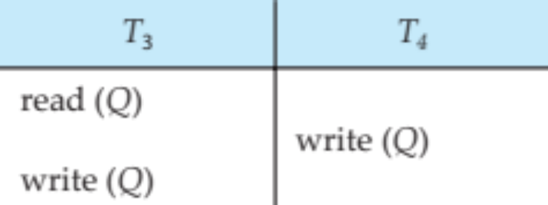
Conflict Serializability (Cont.)
Example of a schedule that is not conflict serializable:
We are unable to swap instructions in the above schedule to obtain either the serial schedule < T₃, T₄ >, or the serial schedule < T₄, T₃ >.

Slide 22
View Serializability
Let S and S´ be two schedules with the same set of transactions. S and S´ are view equivalent if the following three conditions are met, for each data item Q,
  If in schedule S, transaction T_{i} reads the initial value of Q, then in schedule S’ also transaction T_{i} must read the initial value of Q.
  If in schedule S transaction T_{i} executes read(Q), and that value was produced by transaction T_{j} (if any), then in schedule S’ also transaction T_{i} must read the value of Q that was produced by the same write(Q) operation of transaction T_{j} .
  The transaction (if any) that performs the final write(Q) operation in schedule S must also perform the final write(Q) operation in schedule S’.
As can be seen, view equivalence is also based purely on reads and writes alone.

Slide 23
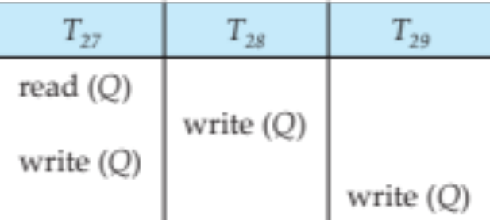
View Serializability (Cont.)
A schedule S is view serializable if it is view equivalent to a serial schedule.
Every conflict serializable schedule is also view serializable.
Below is a schedule which is view-serializable but not conflict serializable.
What serial schedule is above equivalent to?
Every view serializable schedule that is not conflict serializable has blind writes.

Slide 24
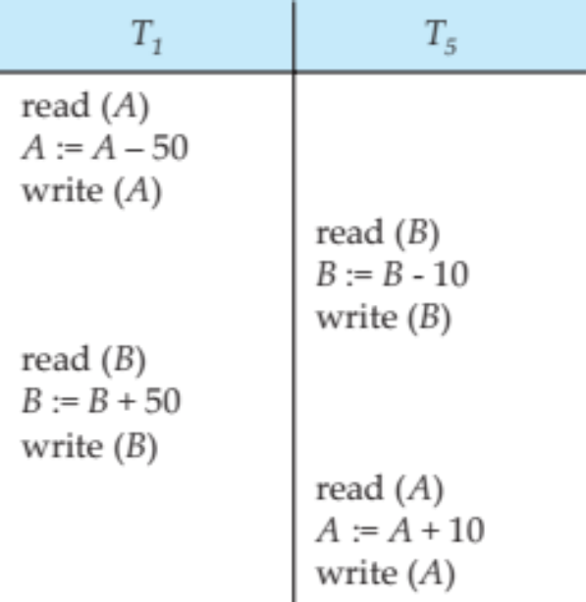
Other Notions of Serializability
The schedule below produces same outcome as the serial schedule < T₁, T₅ >, yet is not conflict equivalent or view equivalent to it.
Determining such equivalence requires analysis of operations other than read and write.

Slide 25
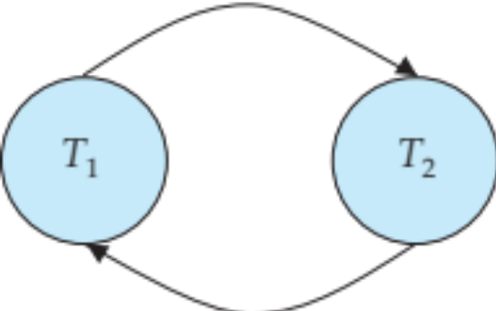
Testing for Serializability
Consider some schedule of a set of transactions T₁, T₂, ..., T_{n}
Precedence graph — a direct graph where the vertices are the transactions (names).
We draw an arc from T_{i} to T_{j} if the two transaction conflict, and T_{i} accessed the data item on which the conflict arose earlier.
We may label the arc by the item that was accessed.
Example 1

Slide 26
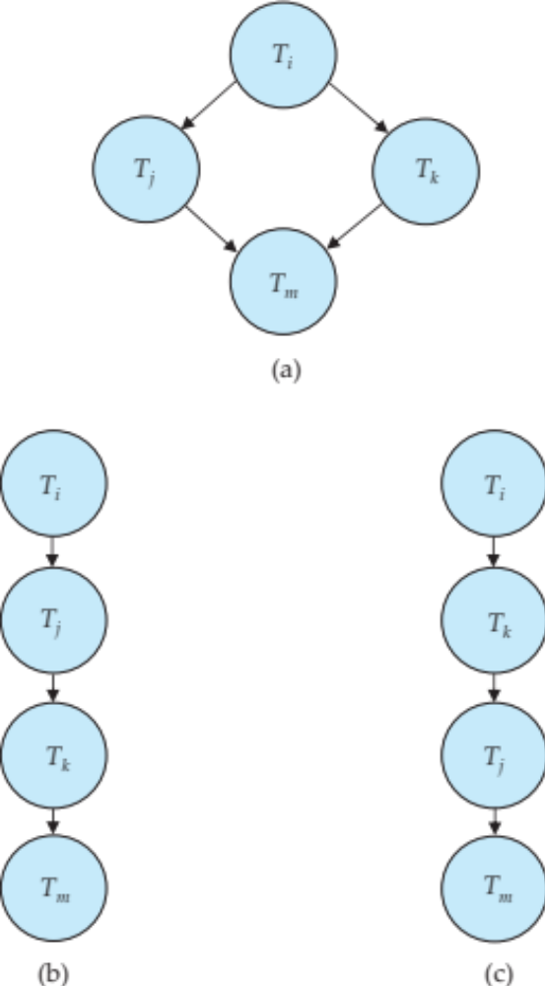
Test for Conflict Serializability
A schedule is conflict serializable if and only if its precedence graph is acyclic.
Cycle-detection algorithms exist which take order n² time, where n is the number of vertices in the graph.
  (Better algorithms take order n + e where e is the number of edges.)
If precedence graph is acyclic, the serializability order can be obtained by a topological sorting of the graph.
  This is a linear order consistent with the partial order of the graph.
  For example, a serializability order for Schedule A would be
  T₅ → T₁ → T₃ → T₂ → T₄
    Are there others?

Slide 27
Test for View Serializability
The precedence graph test for conflict serializability cannot be used directly to test for view serializability.
  Extension to test for view serializability has cost exponential in the size of the precedence graph.
The problem of checking if a schedule is view serializable falls in the class of NP-complete problems.
  Thus. existence of an efficient algorithm is extremely unlikely.
However practical algorithms that just check some sufficient conditions for view serializability can still be used.

Slide 28
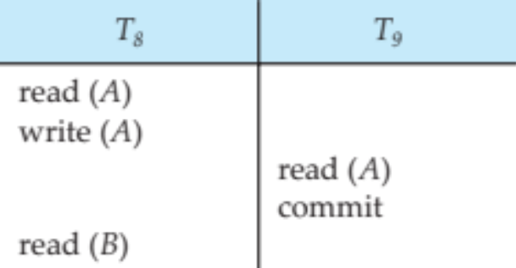
Recoverable Schedules
Need to address the effect of transaction failures on concurrently
running transactions.
Recoverable schedule — if a transaction T_{j} reads a data item previously written by a transaction T_{i} , then the commit operation of T_{i} appears before the commit operation of T_{j}.
The following schedule (Schedule 11) is not recoverable
If T₈ should abort, T₉ would have read (and possibly shown to the user) an inconsistent database state. Hence, database must ensure that schedules are recoverable.

Slide 29
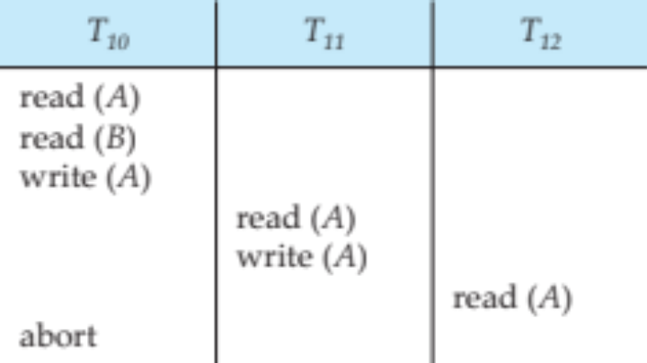
Cascading Rollbacks
Cascading rollback – a single transaction failure leads to a series of transaction rollbacks. Consider the following schedule where none of the transactions has yet committed (so the schedule is recoverable)
If T₁₀ fails, T₁₁ and T₁₂ must also be rolled back.
Can lead to the undoing of a significant amount of work

Slide 30
Cascadeless Schedules
Cascadeless schedules — cascading rollbacks cannot occur;
  For each pair of transactions T_{i} and T_{j} such that T_{j} reads a data item previously written by T_{i}, the commit operation of T_{i} appears before the read operation of T_{j}.
Every cascadeless schedule is also recoverable
It is desirable to restrict the schedules to those that are cascadeless

Slide 31
Concurrency Control
A database must provide a mechanism that will ensure that all possible schedules are
  either conflict or view serializable, and
  are recoverable and preferably cascadeless
A policy in which only one transaction can execute at a time generates serial schedules, but provides a poor degree of concurrency
  Are serial schedules recoverable/cascadeless?
Testing a schedule for serializability after it has executed is a little too late!
Goal – to develop concurrency control protocols that will assure serializability.

Slide 32
Concurrency Control (Cont.)
Schedules must be conflict or view serializable, and recoverable, for the sake of database consistency, and preferably cascadeless.
A policy in which only one transaction can execute at a time generates serial schedules, but provides a poor degree of concurrency.
Concurrency-control schemes tradeoff between the amount of concurrency they allow and the amount of overhead that they incur.
Some schemes allow only conflict-serializable schedules to be generated, while others allow view-serializable schedules that are not conflict-serializable.

Slide 33
Concurrency Control vs. Serializability Tests
Concurrency-control protocols allow concurrent schedules, but ensure that the schedules are conflict/view serializable, and are recoverable and cascadeless .
Concurrency control protocols (generally) do not examine the precedence graph as it is being created
  Instead a protocol imposes a discipline that avoids non-serializable schedules.
  We study such protocols in Chapter 16.
Different concurrency control protocols provide different tradeoffs between the amount of concurrency they allow and the amount of overhead that they incur.
Tests for serializability help us understand why a concurrency control protocol is correct.

Slide 34
Weak Levels of Consistency
Some applications are willing to live with weak levels of consistency, allowing schedules that are not serializable
  E.g., a read-only transaction that wants to get an approximate total balance of all accounts
  E.g., database statistics computed for query optimization can be approximate (why?)
  Such transactions need not be serializable with respect to other transactions
Tradeoff accuracy for performance

Slide 35
Levels of Consistency in SQL-92
Serializable — default
Repeatable read — only committed records to be read.
  Repeated reads of same record must return same value.
  However, a transaction may not be serializable – it may find some records inserted by a transaction but not find others.
Read committed — only committed records can be read.
  Successive reads of record may return different (but committed) values.
Read uncommitted — even uncommitted records may be read.

Slide 36
Levels of Consistency
Lower degrees of consistency useful for gathering approximate
information about the database
Warning: some database systems do not ensure serializable schedules by default
  E.g., Oracle (and PostgreSQL prior to version 9) by default support a level of consistency called snapshot isolation (not part of the SQL standard)

Slide 37
Transaction Definition in SQL
Data manipulation language must include a construct for specifying the set of actions that comprise a transaction.
In SQL, a transaction begins implicitly.
A transaction in SQL ends by:
  Commit work commits current transaction and begins a new one.
  Rollback work causes current transaction to abort.
In almost all database systems, by default, every SQL statement also commits implicitly if it executes successfully
  Implicit commit can be turned off by a database directive
    E.g., in JDBC -- connection.setAutoCommit(false);

Slide 38
End of Module 15

