Slide 1
Basic Structure of Computer
Computer Architecture
Lecture – 2

Slide 2
Functional Unit(I/O)
I/O Unit :
  Input Unit:
    Information handled by a computer must be encoded in a suitable format
    Any information is encoded as a string of binary digits, called bits, each having one of two possible values, 0 or 1
    The Input Unit accepts coded information.
    The information received is either stored in the computer’s memory for later use or immediately used to perform the desired operations.
Faruk Hossen, Lecturer, CSE, BSMRSTU

Slide 3
Functional Unit(I/O)
    A computer handles two types of information :
    Instruction :
      An instruction controls the transfer of information between a computer and its I/O devices and also within the computer.
      A list of instructions that performs a task is called a program, which is stored in the memory.
      To execute a program, computer fetches the instructions one by one and specifies the arithmetic and logical operations to be performed which are needed for the desired program.
      A computer is completely controlled by the stored programs except any external interrupts comes from any I/O device.
Faruk Hossen, Lecturer, CSE, BSMRSTU

Slide 4
Functional Unit(I/O)
    Data :
      Data is a kind of information which is used as an operand for a program.
      So, data can be any number or character.
      Even, a list of instructions, means an entire program can be data if it is processed by another high-level program.
      In such case, that data is called source program.
    The most well-known input device is the keyboard, beside this, there are many other kinds of input devices are available, i.e., mouses, joysticks etc.
Faruk Hossen, Lecturer, CSE, BSMRSTU

Slide 5
Functional Unit(I/O)
  Output Unit:
    The output unit is the counter part of the Input Unit.
    After processing the coded data and finishing the task, it outputs the information to the outside world.
    The most common and well-known output devices are monitor screen, printer etc.
Faruk Hossen, Lecturer, CSE, BSMRSTU

Slide 6
Functional Unit(Memory)
Memory Unit
  Memory unit is the storage for programs(set of instructions) and data.
    Programs must reside in the memory, while they are being executed and
    Data are processed within the computer in units of words, multiple of words, or part of words.
    But when a memory is accessed, only one word of data is read or written.
Faruk Hossen, Lecturer, CSE, BSMRSTU

Slide 7
Functional Unit(Memory)
  The memory consists of a large number of semiconductor storage cells, each of which are capable of storing one bit of information.
  But normally, these cells are not accessed individually, in fact, they are accessed and processed in groups of fixed size called words.
  The memory is organized in such a way that one word fixed n bits is read(retrieved) and written(stored) in one operation.
Faruk Hossen, Lecturer, CSE, BSMRSTU

Slide 8
Functional Unit(Memory)
  Each word location in the memory has a distinct address.
  So, in the memory a given word is accessed by specifying its address and issuing a command for respective operation.
  The number of bits in each word is called word length of the computer.
  Word lengths ranges from 16 to 64 bits which also indicates the capacity of the memory, which is an important characteristics of a computer.
Faruk Hossen, Lecturer, CSE, BSMRSTU

Slide 9
Functional Unit(Memory)
  The time needed to access any location of the memory is another important characteristics of a computer.
  There are two types of storage/memory :
  Primary Storage :
    Primary memory is fast memory.
    It can be reached in a short and fixed amount of time after specifying its address, this memory is called Random Access Memory(RAM).
Faruk Hossen, Lecturer, CSE, BSMRSTu

Slide 10
Functional Unit(Memory)
    Time required to access one word is called the memory access time, which is fixed and independent of the location of the word.
    This memory of a computer is organized as memory hierarchy of multiple levels of semiconductor RAM units with different size and speed.
    The smallest and fastest RAM units are called Caches.
    And the largest and slowest RAM units are called Main Memory.
    Primary storage is essential, but expensive.
Faruk Hossen, Lecturer, CSE, BSMRSTU

Slide 11
Functional Unit(Memory)
  Secondary Storage :
    Secondary Storage is used when large amounts of data and many programs have to be stored.
    Secondary storage is larger and cheaper than Primary Storage.
    It normally used to store the information which are not frequently used.
    Well-known secondary storage devices are magnetic disks, magnetic tapes, optical disks etc.
Faruk Hossen, Lecturer, CSE, BSMRSTU

Slide 12
Functional Unit(Processor)
Processor Unit
  Arithmetic and Logic Unit(ALU)
    Most of the operations are executed in the arithmetic and logic unit(ALU) of the processor.
    For any operation, if any operand is required, then at first the required operands are brought into the processor from stored memory or by input unit.
    Then the actual operation is performed by the ALU into the processor.
    Necessary control commands are provided from CU

Slide 13
Functional Unit(Processor)
    To keep the operands into processor, there is a high speed storage element attached to the processor
    This storage is called register, each of which can hold one word of data.
    Since registers are attached to the processor, time needed to access a register is less than even the time needed to access the fastest cache memory.

Slide 14
Functional Unit(Processor)
  Control Unit
    This unit performs the coordination task while an operation is being executed.
    It sends control signals to the other units and also keeps the knowledge about their current status.
    For any I/O operation the timing signal is also generated by the Control unit.
    Timing signals determine when a given action is to take place.

Slide 15
Functional Unit(Processor)
    Data transfer between the memory and processor and execution any instruction is also controlled by Control Unit through timing signal.
    So, overall, the Control Unit performs the task of making the components of the function unit of a computer interactive.

Slide 16
Overall operation of a computer
The total operation of the computer is executed as
  Computer accepts programs and data through input unit.
  Information is also fetched in the processor from memory.
  Then information is processed and the operation is executed.

Slide 17
Overall operation of a computer
  Processed information is passed from output unit .
  All these activities described above are sequentially done under the control signal from the control unit.

Slide 18
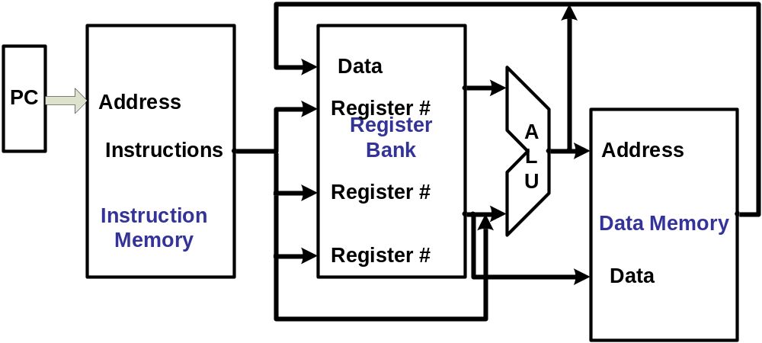
Overall operation of a computer

Slide 19
References
Zaky(Chapter 1 : 1.2)
Class Lecture
Faruk Hossen, Lecturer, CSE, BSMRSTU

