Slide 1

Computer Architecture
Lecture – 5

Slide 2

In the program-controlled I/O, the program repeatedly tests(entering into a loop) the device status that whether it is ready or not.
During this period, processor remains idle, but other useful tasks can be performed within this period.
For this, the device has to alert the processor at the point of being ready, then the processor need not to wait.
Faruk Hossen, Lecturer, CSE, BSMRSTU

Slide 3
The I/O device can alert the processor that it is ready by sending a hardware signal, called interrupt.
Normally, a line among the lines within the control bus is dedicated for this purpose, which is called interrupt-request line.
Now, since the processor need not to wait for the external devices being ready, useful computation can be perform in that time.
Faruk Hossen, Lecturer, CSE, BSMRSTU

Slide 4

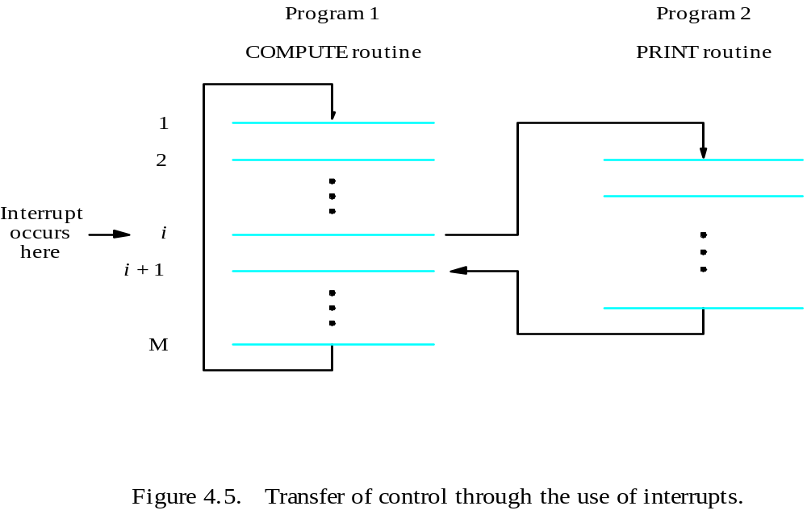
Example 4.2
Faruk Hossen, Lecturer, CSE, BSMRSTU

Slide 5
  In this example, COMPUTE produces a set of n lines of output and then print them by executing PRINT routing.
  This task can be done by executing the COMPUTE routine first repeatedly for n times and then execute PRINT routine in the similar way.
  The disadvantage of this simple approach is, here, COMPUTE and PRINT executes in a totally separate time.
Faruk Hossen, Lecturer, CSE, BSMRSTU

Slide 6
  COMPUTE does its whole task and send all the outputs to printer.
  But, since printer accepts only one line of text at a time, processor has to wait a considerable amount of time for the printer to become ready.
  If, COMPUTE and PRINT can be executed in overlapping time, this problem can be solved.
  This is done by interrupt, whenever printer is ready, it send an interrupt signal, for which processor switches from COMPUTE to PRINT.
Faruk Hossen, Lecturer, CSE, BSMRSTU

Slide 7

The routine that is executed in response of an interrupt is called interrupt-service routine (ISR), in the previous example, PRINT is that routine.
Before executing ISR from a program, processor must save its status of the program so that it can resume the program after returning from ISR.
Faruk Hossen, Lecturer, CSE, BSMRSTU

Slide 8
There is another part of handling interrupts :
  That is, when the interrupt issued by the device is recognized, it should remove its interrupt-request signal.
  This can done by a special control signal on the bus, that is, interrupt-acknowledgement signal.
  Another alternative to this process is if, any instruction of the ISR access the data/status register in that I/O device interface, then it is implicitly informed that its request is recognized.
Faruk Hossen, Lecturer, CSE, BSMRSTU

Slide 9
Similarities and Dissimilarities between ISR and a subroutine(function) :
  Till now, we have found no differences between a function call and execution process of an ISR.
  But one main difference between them is : When we call a function from another function/program, then we do it because there is a relation between the program & the function from where it is called.
Faruk Hossen, Lecturer, CSE, BSMRSTU

Slide 10
  But when a program is interrupted and the corresponding ISR is executed, the two routines are completely different from each other, and they have no relation between themselves.
  Even , most of the time the program currently executing and the ISR belongs to two different user.
  Because of it, before going to execute an ISR, every storage must be saved which has a change to be changed during the execution of the ISR.
Faruk Hossen, Lecturer, CSE, BSMRSTU

Slide 11
This task of saving the program status and again restoring can done either by the processor automatically, or by the separate program instructions.
This done to maintain the integrity of the program execution.
Most of the processor saves minimum amount of information because, a time delay occurs to save and restore this information.
Faruk Hossen, Lecturer, CSE, BSMRSTU

Slide 12
This time delay is important because, this process of saving and restoring information involves memory transfer.
This increases the total execution time, and hence this time delay is also referred to as execution overhead.
Saving this information also increases the time between the interrupt is recognized and the execution of the ISR.
This delay is called Interrupt Latency.
Faruk Hossen, Lecturer, CSE, BSMRSTU

Slide 13

We know that, there is only one line in the control bus, which is dedicated for sending interrupt request by any I/O device.
Most of the computers have multiple I/O devices, so there is a single interrupt request line for serving n I/O devices.
All the devices are connected to the line via switch to ground.
To request interrupt, device closes its switch.
Faruk Hossen, Lecturer, CSE, BSMRSTU

Slide 14
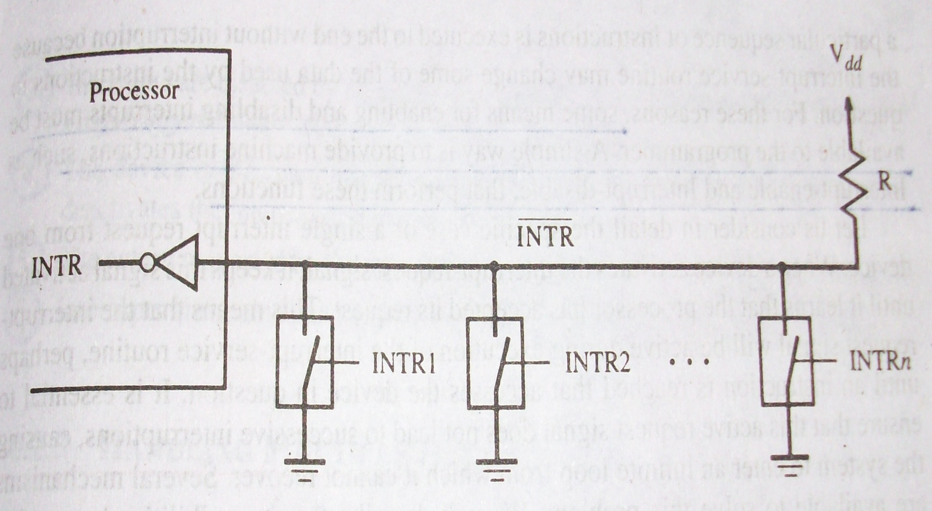
Faruk Hossen, Lecturer, CSE, BSMRSTU

Slide 15
When no device is sending request, that is all switches are open, voltage on the interrupt request line is V_{dd}(equivalent to 1) via a resistor R.
This is called pull-up resistor, because it pulls the line voltage up to the high voltage state when the switches are open.
Closing of one or more switches will cause the line voltage drop to 0.
Faruk Hossen, Lecturer, CSE, BSMRSTU

Slide 16
Then the value of the INTR = logical or of the requests of individual devices.
So, INTR = INTR1+INTR2+….+INTRn
It is must to use the complementary form of the individual device’s requests.
Since, the low voltage makes the common line active.
As switch, open collector bi polar circuit or open drain MOS circuits can be used.
Faruk Hossen, Lecturer, CSE, BSMRSTU

Slide 17

The interruption of program execution should be carefully controlled.
For this, in all computers, there is a facility to enable and disable interrupts.
Why this facility is important??
  A scenario can occur where an I/O device has issued an interrupt request on the interrupt-request control signal line.
Faruk Hossen, Lecturer, CSE, BSMRSTU

Slide 18
  Now this signal will remain active until the processor recognizes it, that is until any instruction of ISR accesses the I/O interface circuit.
  If successive interruption comes in such a way that before ending of the interrupt latency of one interrupt another interrupt comes, then an infinite loop can occur.
  For this provision of enabling and disabling the interrupt is necessary.
Faruk Hossen, Lecturer, CSE, BSMRSTU

Slide 19
There are many ways to provide this facility :
  A simple way is to provide corresponding machine instruction for this, such as, Interrupt-enable and Interrupt-disable.
  The processor hardware ignores interrupt request line until the first instruction of the ISR of previous interrupt has been completed. And, interrupt enable will be the last instruction in any ISR.
Faruk Hossen, Lecturer, CSE, BSMRSTU

Slide 20
  The processor automatically disables interrupts before starting the execution of the ISR and similarly automatically enables. Processor Status(PS) register is used for this.
  The processor has a special interrupt-request line for which the interrupt-handling circuit responds only to the leading edge of the signal, such a line is called edge-triggered.
Assuming any of this method, interrupts are handled by following 6 steps.(see Book)
Faruk Hossen, Lecturer, CSE, BSMRSTU

Slide 21

When several devices interrupts at the same time, multiple question rises :
  How can the processor recognize the devices?
  How can the processor obtain different starting address of the ISR for different interrupts?
  When one ISR is processed, should we allow any other device to interrupt?
  How two or more simultaneous requests are handled?
Faruk Hossen, Lecturer, CSE, BSMRSTU

Slide 22
When a request comes over the interrupt-request line, additional information is required to identify that which device has activated that line.
If two devices activate that line at the same time, then there must be a tie breaker and one is selected first and serviced. Then another one is taken into account.
Faruk Hossen, Lecturer, CSE, BSMRSTU

Slide 23
The information that is required to identify a device is some bits in its status register.
There are some IRQ bits in the status register of an I/O device(for example, KIRQ for keyboard and DIRQ for display).
When this bit is set(1), means this device has raises the interrupt, otherwise it is zero(0).
One way to detect the device is to poll the connected devices by the ISR.
Faruk Hossen, Lecturer, CSE, BSMRSTU

Slide 24
The first device found with IRQ bit set is serviced first.
An appropriate subroutine is then called to provide the requested service from the polling ISR.
Implementation of these polling scheme is easy.
But the disadvantage is the time spent to poll the devices IRQ bit and select that device.
Faruk Hossen, Lecturer, CSE, BSMRSTU

Slide 25
Other alternatives to this polling mechanism is :
  Vector Interrupts :
    A device requesting an interrupt may identify itself directly to the processor.
    Then, the processor can immediately start executing the corresponding ISR.
    Vector interrupts refers to all the interrupt-handling schemes based on this approach.
Faruk Hossen, Lecturer, CSE, BSMRSTU

Slide 26
    The device which request interrupts, sends a special code to the processor over the bus.
    This enables the processor to identify individual devices even if they are connected to a single interrupt-request line.
    The code given by the device can be the starting address of its ISR.
    The processor reads this address, called the interrupt vector and loads it into the PC.
    Normally, I/O devices send the interrupt-vector code(which is an address) over the data bus. Reason(see Book)
Faruk Hossen, Lecturer, CSE, BSMRSTU

Slide 27
Interrupt Nesting
  We know that interrupts should be disabled during the execution of an ISR to ensure that a request from one device will not cause more than one interruption.
  Same arrangement can done for multiple devices.
  That when the ISR for one device is executing, it continues to completion before accepting an interrupt request from another device.
Faruk Hossen, Lecturer, CSE, BSMRSTU

Slide 28
  ISR’s are normally short and the delay causes are acceptable for most of the I/O devices.
  And, for some operations, long delay can create problem.
  Example : The clock in the computer.
    Proper operation requires that the delay in responding to an interrupt request from the real time clock be small in comparison with the interval between two successive requests.
Faruk Hossen, Lecturer, CSE, BSMRSTU

Slide 29
    To ensure the proper operation of clock in presence of other interrupting devices, sometimes it is necessary to accept an interrupt request from clock during the execution of the ISR of any other device.
  So, from this example, we can tell that I/O devices should be organized in a priority structure.
  An interrupt from the high priority device is to be accepted while the processor is servicing a low-priority device.
Faruk Hossen, Lecturer, CSE, BSMRSTU

Slide 30
  To implement this scheme, the processor is assigned a priority that can be changed under program control.
  When an interrupt request comes, the priority of the processor is changed to the priority of that interrupt requesting device.
  In this way, all the lower and same priority devices are ignored.
  But high priority device’s interrupt request is continued to be accepted.
Faruk Hossen, Lecturer, CSE, BSMRSTU

Slide 31
  A multiple priority level interrupt scheme can easily be implemented using separate interrupt-request and interrupt-acknowledgment lines for each devices.
  Each of the interrupt-request lines are assigned a priority level.
  Interrupt requests received over these lines are sent to a priority arbitration circuit in the processor.
  A request is accepted only if it has a higher priority level than currently assigned ISR to the processor.
Faruk Hossen, Lecturer, CSE, BSMRSTU

Slide 32
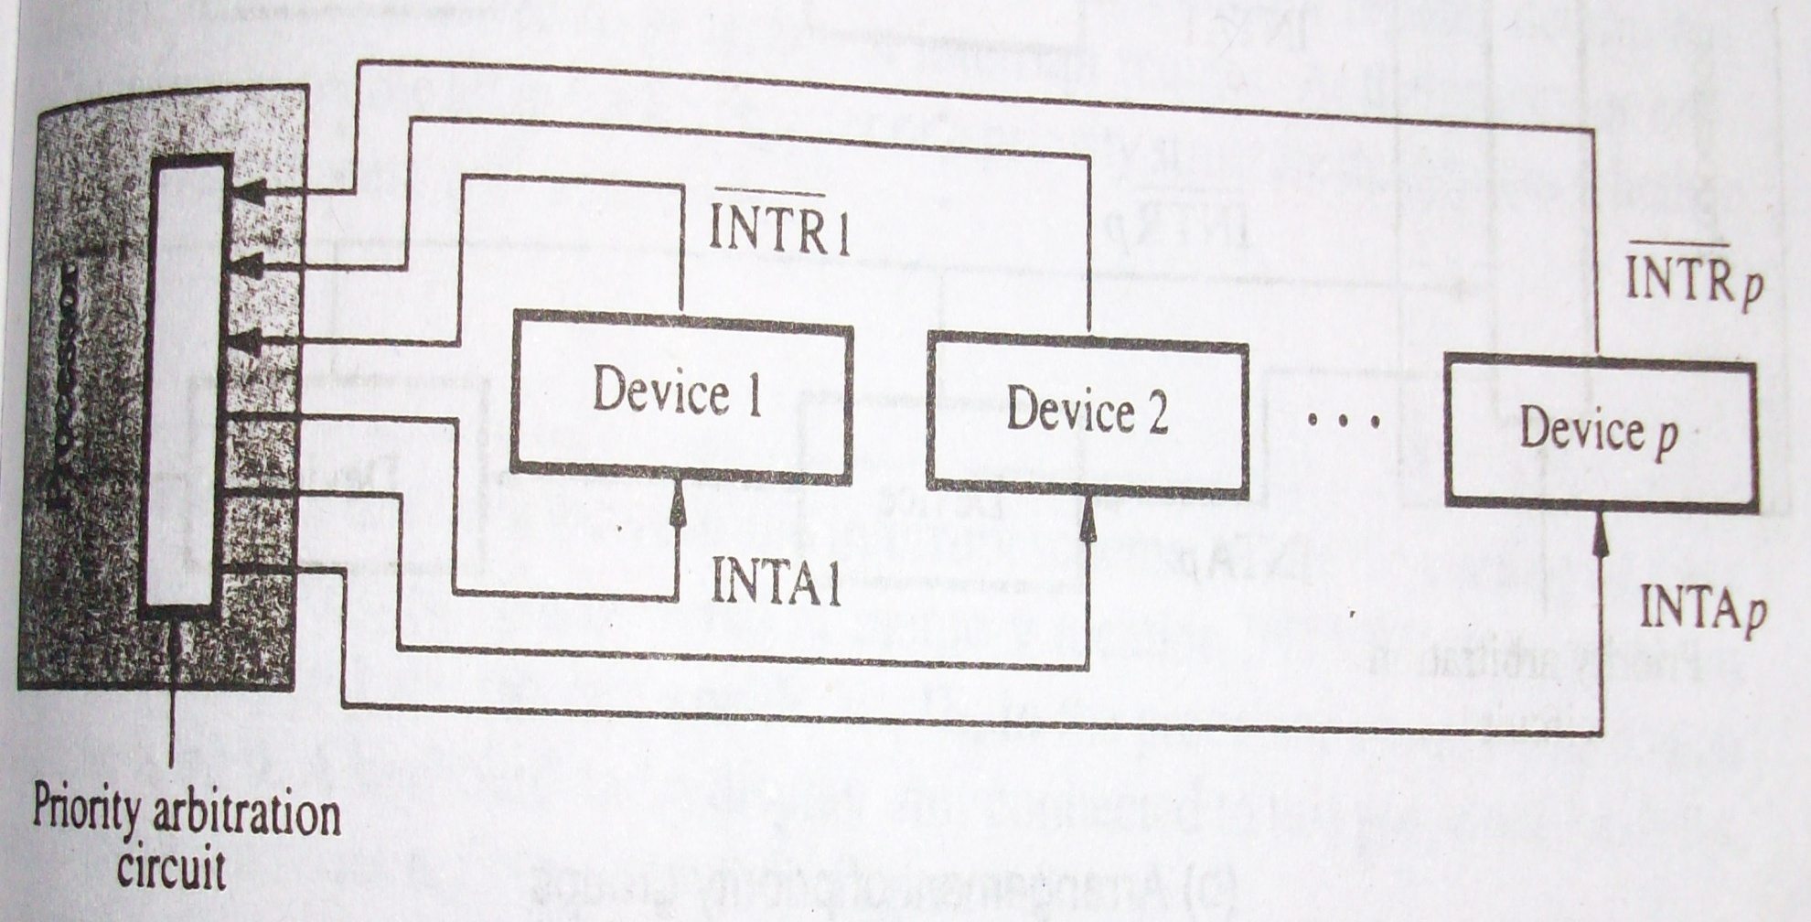
Faruk Hossen, Lecturer, CSE, BSMRSTU

Slide 33
Simultaneous Requests
  When simultaneous requests come to the processor, there should be some way to the processor for deciding which request to serve first.
  The straight forward solution is the way given in the “Interrupt Nesting” with priority scheme.
  Polling the status register of the I/O devices are another simple mechanism
    Here, priority is given by the order in which the devices are polled.
Faruk Hossen, Lecturer, CSE, BSMRSTU

Slide 34
  Another widely used mechanism is to form a daisy chain with the devices.
    Here, the interrupt-request line is common to all the devices
    And, the interrupt acknowledgement line is connected among the devices in a daisy chain fashion, that is, INTA signal propagates serially through the devices.
    When several devices send interrupt-request and make this line activated, , processor responds to this by setting INTA line to 1.
Faruk Hossen, Lecturer, CSE, BSMRSTU

Slide 35
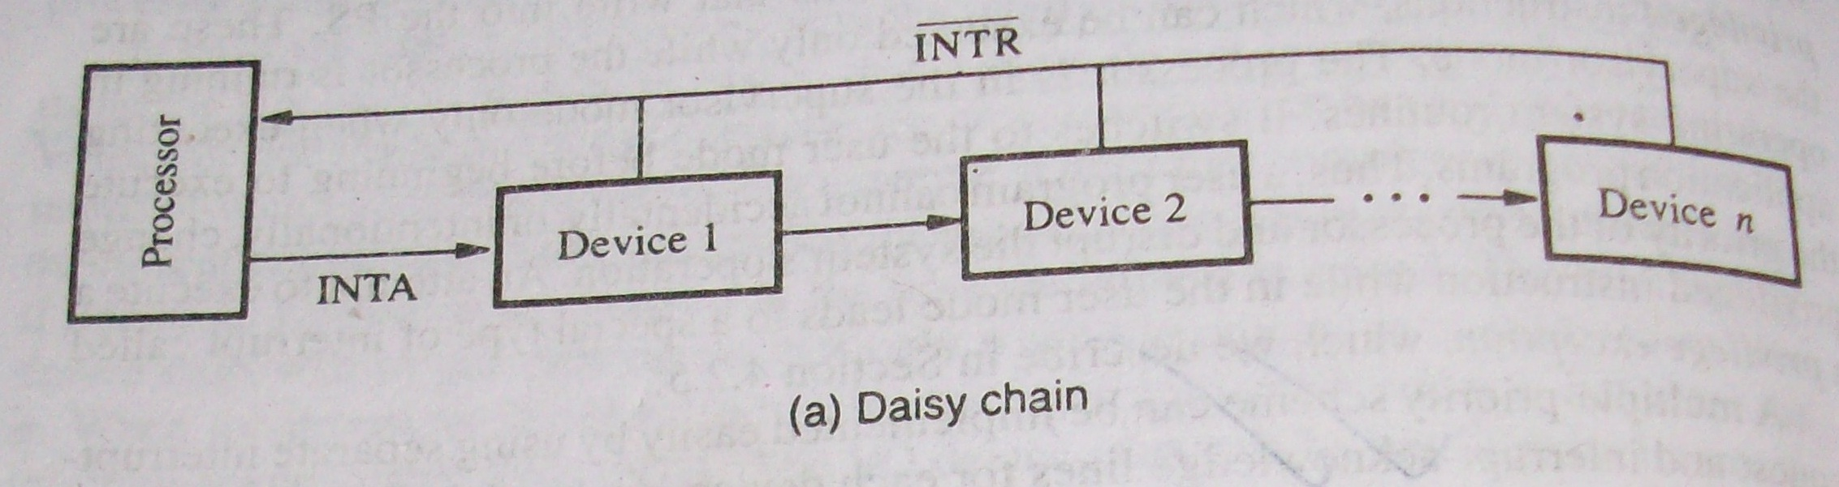
Faruk Hossen, Lecturer, CSE, BSMRSTU

Slide 36
    This signal is first received by the Device 1.
    If Device 1 requests interrupt, then it blocks the INTA signal and put its identifying code(interrupted vector) into data bus. Otherwise it just passes the signal to 2nd device.
    So, in this daisy-chain method, the closest device to the processor has the highest priority and second closest has second highest priority and so on.
Faruk Hossen, Lecturer, CSE, BSMRSTU

Slide 37
  Another method with multiple chain :
    Here, fewer wires are required than the individual connections.
    Here, a group of devices is given same priority and they are connected in a daisy-chain fashion.
    In this way, there are multiple chains with a group devices having a specific priority is connected to the processor.
    The main advantage is processor can accept request from some devices, but not from others, depending on their priorities.
Faruk Hossen, Lecturer, CSE, BSMRSTU

Slide 38
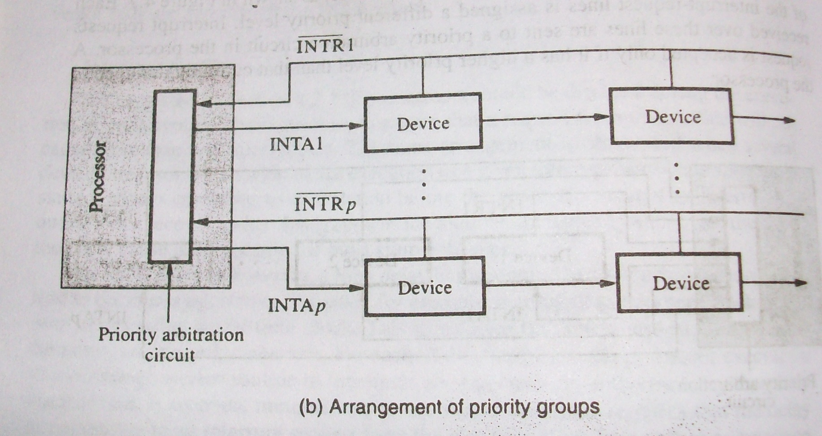
    This organization is used in many computer system.
Faruk Hossen, Lecturer, CSE, BSMRSTU

Slide 39

Zaky(Chapter 4 : 4.2(4.2.1, 4.2.2, 4.2.3))
Class Lecture
Faruk Hossen, Lecturer, CSE, BSMRSTU

