Slide 1
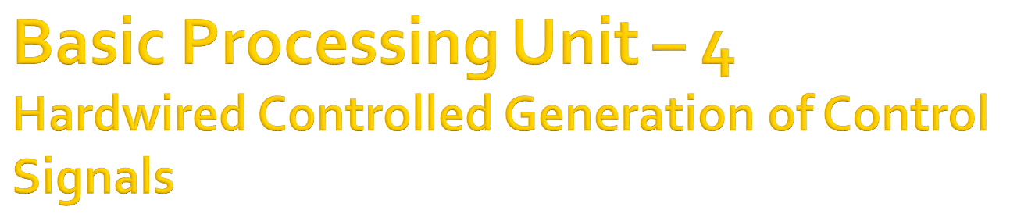
Computer Architecture
Lecture – 9

Slide 2

To execute an instruction properly, a sequence of control signals must be generated by the processor.
This signals must be generated in proper sequence to execute the instruction correctly.
The are two approaches for doing this :
  Hardwired Controlled
  Microprogrammed Controlled
Faruk Hossen, Lecturer, CSE, BSMRSTU

Slide 3

Execution of an instruction can be viewed as generating sequence of control signals in separate steps.
Each step in this sequence is completed in one clock period.
A counter is kept to maintain the track of the control steps.
So, each state/count of this counter corresponds to one control step.
Faruk Hossen, Lecturer, CSE, BSMRSTU

Slide 4
The required control signals for an instruction are determined by :
  Contents of the control step counter
  Contents of the instruction register
  Contents of the condition code flags
  External input signals, i.e. MFC and Interrupt Requests
Faruk Hossen, Lecturer, CSE, BSMRSTU

Slide 5

Hardware involved in the Control Unit :
  Control Step Counter :
    Counts the total control steps involved in an instruction with the help of clock signal.
  Step Decoder :
    Provides a separate signal line for each step or, time slot in the control sequence.
  Instruction Decoder :
    For each machine instruction, the instruction decoder consists of a separate line.
Faruk Hossen, Lecturer, CSE, BSMRSTU

Slide 6
Clock
CLK
Control step
counter
External
inputs
Decoder/
IR
encoder
Condition
codes
Control signals
Faruk Hossen, Lecturer, CSE, BSMRSTU

Slide 7
CLK
Reset
Clock
Control step
counter
Step decoder
T
1
T
2
T
n
INS
1
INS
External
2
inputs
IR
Instruction
Encoder
decoder
Condition
codes
INS
m
Run
End
Control signals
Figure 7.11.
Faruk Hossen, Lecturer, CSE, BSMRSTU

Slide 8
  Instruction register :
    Before execution of a program, each instruction is loaded into IR.
    Corresponding to every instruction, one of the output lines INS₁ through INS_{m} is set to 1 and all other lines are set to 0.
  Encoder :
    Encoder takes its input from instruction decoder, step decoder, external inputs and condition codes.
    Combining the inputs, the encoder block generates the individual control signals, i.e. Pc_{in}, Add, Read etc.
Faruk Hossen, Lecturer, CSE, BSMRSTU

Slide 9

Generation of control signal, Z_{in}, for the single bus structure of the processor :
  The logic function for Z_{in} which is to be implemented by the circuit :
  Z_{in} = T₁ + T₆.Add + T₄.BR + …
    T₁ : for all instruction(to fetch instruction)
    T₆ : for add instruction
    T₄ : for branch instruction
Faruk Hossen, Lecturer, CSE, BSMRSTU

Slide 10
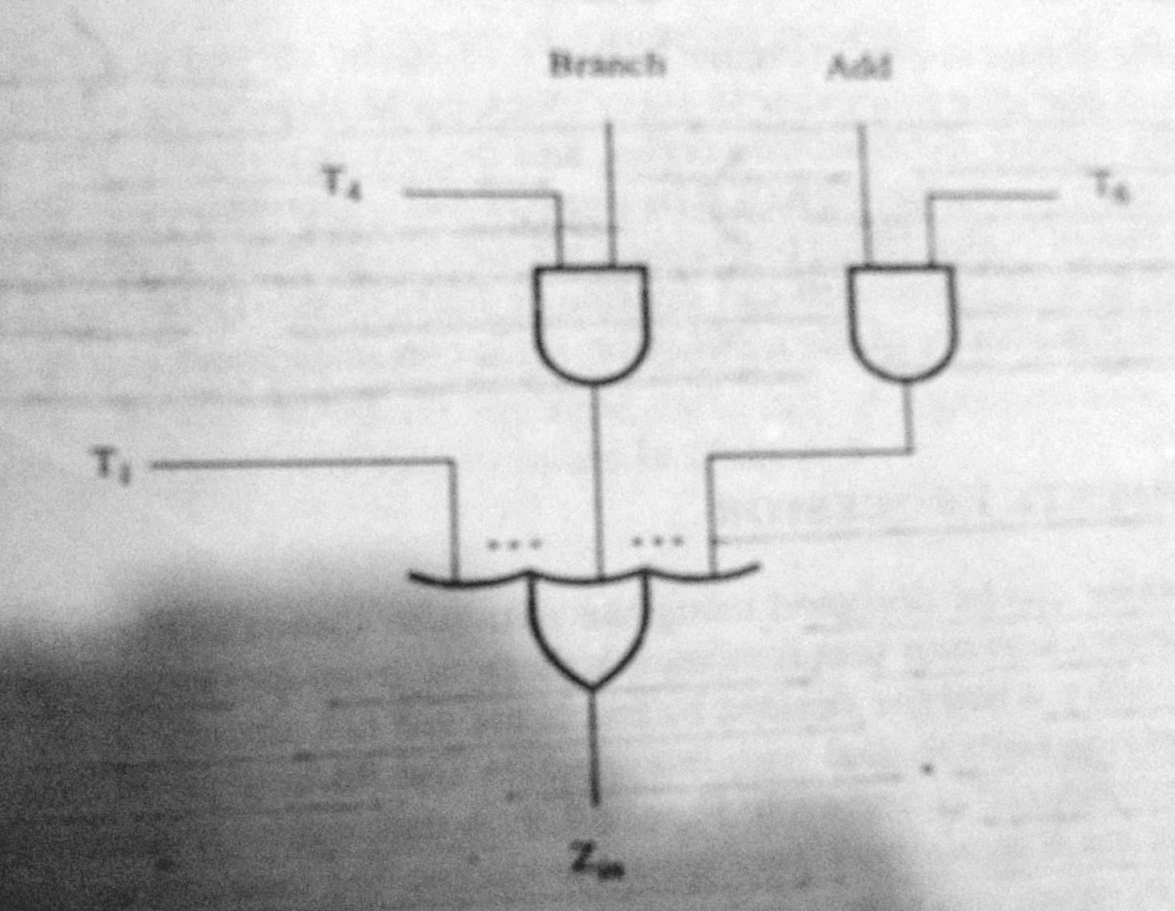
Faruk Hossen, Lecturer, CSE, BSMRSTU

Slide 11
Generation of control signal, End, for the single bus structure of the processor :
  The logic function for End which is to be implemented by the circuit :
  End = T₇.Add+ T₅.BR + (T₅.N + T4.N).BRN +…
    T₇ : for add instruction
    T₅ : for unconditional branch instruction
    T₅ .N: for conditional branch(true) instruction
    T₄ .N: for conditional branch(false) instruction
Faruk Hossen, Lecturer, CSE, BSMRSTU

Slide 12
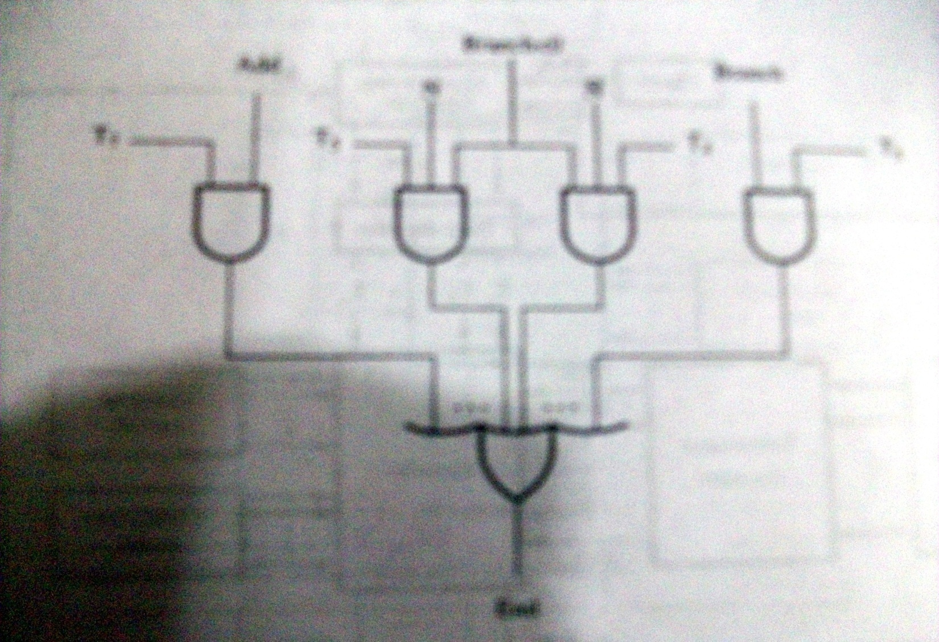
Faruk Hossen, Lecturer, CSE, BSMRSTU

Slide 13
The END Signal :
  Starts a new instruction fetch cycle by resetting the control step counter to its staring value.
The RUN Signal :
  When it is set to 1, the counter is incremented by one at the end of every clock cycle.
  When it is set to 0, the counter stops counting.
  This is needed when the WMFC external input signal is issued to cause the processor to wait for the reply from the memory.
Faruk Hossen, Lecturer, CSE, BSMRSTU

Slide 14

As a whole the hardware of the control unit can be viewed as a State Machine, which changes its state one to another in every clock cycle, depending on the content of IR, condition codes and external inputs.
The sequence of operations carried out by this machine is determined by the wiring of the logic circuit elements, so named Hardwired Controlled Control Unit.
Faruk Hossen, Lecturer, CSE, BSMRSTU

Slide 15
Advantage of hardwired controlled control unit :
  The control Unit that uses this approach can operate in a very high speed.
Disadvantage of hardwired controlled control unit :
  Allows a very little flexibility of changing.
  Only the instruction set with limited complexity can be implemented.
Faruk Hossen, Lecturer, CSE, BSMRSTU

Slide 16

A complete processor consists of the following parts :
  Instruction Unit :
    This unit fetches the desired instruction from an instruction cache or from the main memory when the instruction is not present in the instruction cache.
  Instruction cache :
    Instruction cache is a part of processor which contains a certain amount of most recently used instructions.
Faruk Hossen, Lecturer, CSE, BSMRSTU

Slide 17
  Integer Unit & Floating-point Unit:
    Integer Unit is a separate processing unit to deal with integer data.
    Floating Point unit is another separate unit to handle floating-point data.
    These two units provides required data for the instructions to be executed.
    These two units fetches data from the data cache.
    Some processor has more than one of these two units to support concurrent operations
Faruk Hossen, Lecturer, CSE, BSMRSTU

Slide 18
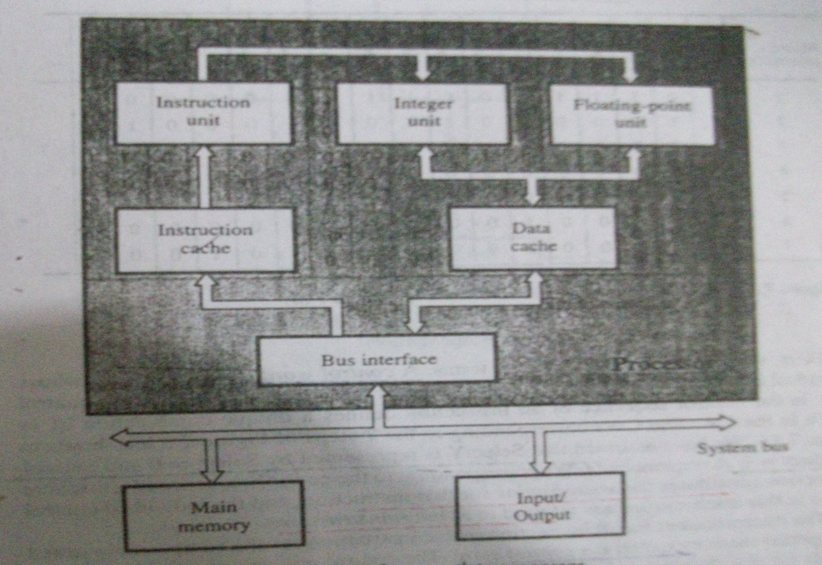
Faruk Hossen, Lecturer, CSE, BSMRSTU

Slide 19
  Data Cache :
    Data cache is a type of memory that is attached to processor and holds most recently used data.
    This data cache remains within the two data processing units and the main memory.
    Recently, two different cache memory is used in the processor.
    But previously, a single cache was used for both recently used instructions and data.
Faruk Hossen, Lecturer, CSE, BSMRSTU

Slide 20
  Bus Interface :
    The processor is connected to the rest of the computer (system bus) through bus interface.
    Bus interface is connected to system bus which is connected to the rest of the computer.
Main Memory and Input / Output :
  This two units are not part of processor , but connected to processor via system bus. Main memory is the main container of data and instruction to be stored and Input / Output provides external input and output.
Faruk Hossen, Lecturer, CSE, BSMRSTU

Slide 21

Zaky(Chapter 7 : 7.4)
Class Lecture
Faruk Hossen, Lecturer, CSE, BSMRSTU

