Slide 1
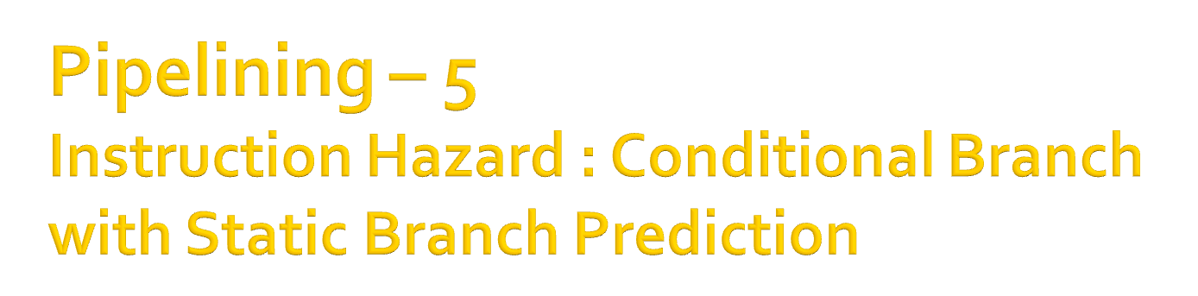
Computer Architecture
Lecture – 14

Slide 2

In the conditional branch instruction, whether the branching will occur or not is dependent on the status of the condition.
So, a conditional branch instruction introduces hazards when the condition is dependent on the result of any preceding instruction.
In this case, branching decision can not be made until that instruction has been executed.

Slide 3

Branch instruction constitutes 20% of the total number of instruction executions, taking into account that some program instructions are executed many times because of loops(Dynamic Count).
Due to the Branch Penalty occurred for branch instruction, the gain in performance will be reduced than that is expected from pipelining.

Slide 4
There are several ways by which the negative impact of branch instruction can be reduced on the rate of the execution of instructions.
The techniques we will learn :
  Delaying Branch
  Branch Prediction
    Static Branch Prediction
    Dynamic Branch Prediction

Slide 5

T
ime
Clock c
cycle
1
2
3
4
5
6
In the above figure, processor fetches instruction I3 before it is determined that I2 is a branch instruction.
Instruction
I
1
F
1
E
1
I
2
(Branch)
F
2
E
2
Ex
ecution unit idle
I
F
X
Delay Slot
3
3
I
k
F
k
E
k
I
k
+1
F
k+
1
E
k+
1

Slide 6
When the execution of I2 is completed and it is determined that a branch is to be made, the processor has to discard I3 and fetch the branch target instruction.
The location/instruction addresses following a branch instruction is called Branch Delay Slot.
There can be one or more branch delay slots depending on the time to execute the branch instruction.

Slide 7
For example, the previous figure has one delay slot and the following contains two delay slots.
T
ime
Clock cyle
1
2
3
4
5
6
7
8
I
F
1
D
1
E
1
W
1
1
I
2
(Branch)
F
2
D
2
E
2
I
F
3
D
3
X
3
Delay Slot
I
F
4
X
4
I
k
F
k
D
k
E
k
W
k
I
k+
1
F
k+
1
D
k+
1
E
k+
1

Slide 8
The instructions in the Branch Delay Slot are always fetched and partially executed.
And when the branch decision is made and branch address is calculated, processor switches to the branch target instruction discarding these instructions in the Branch Delay Slot.

Slide 9
Delayed Branching is a technique to minimize the penalty caused due to conditional branch instruction(Why this naming??[see lecture/book]).
The idea is :
  Since the instruction in the delay slots are always fetched, so execute them fully independent of the branch decision.
  Main objective is to use those slots by placing useful instructions there.
  If no such instruction found, NOP is used.

Slide 10
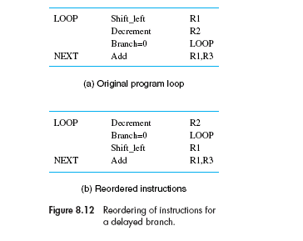
Example : (Explanation => class lecture)

Slide 11

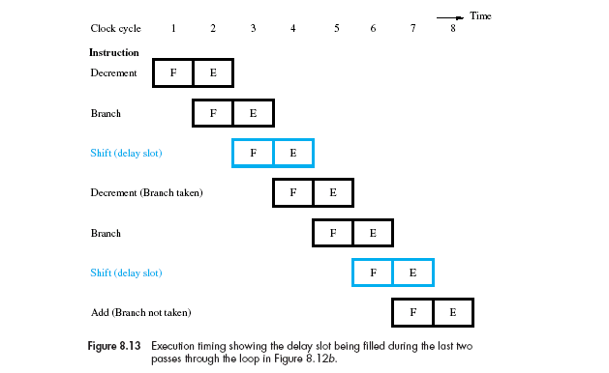


Slide 12
Problem of Delaying Branch Technique :
  Effectiveness of this approach is dependent on whether the instructions could be reordered or not.
  Most of the time, when there is one instruction in the delay slot, then it is possible to found one useful instruction preceding the branch instruction.
  Then that one instruction can be placed in the delay slot as useful instruction.

Slide 13
  But when there are more than one delay slots, then reordering two/three instruction from previous, and place it after branch instruction without causing any logical error is difficult.
  Because more than one such instruction to place after branch instruction is not found most of the time.
  So, when the number of pipelining stages increases, possibility of increase in the number of delay slot also increases.
  This sometimes reduces the potential gain in performance by delayed branch technique.

Slide 14

Brach Prediction is another technique for reducing the branch penalty associated with conditional branch.
The idea is :
  To predict that whether a branch will be taken place or not.
  Assume that branch will not take place.
  Continue to fetch instructions from sequential address order.

Slide 15

  Until the branch condition is evaluated, instructions are executed along the predicted path before the processor is sure that the instructions are in the correct execution sequence(Speculative Execution).
  So, care must be taken that no processor registers and memory locations are updated until it is confirmed that those predicted instructions should actually be executed.

Slide 16
  If branch decision indicates otherwise(that is branch will happen), the instructions and their associated data in the execution units must be purged and the correct instructions are fetched and executed.
  An example of incorrect branch prediction : (Explanation : [Lecture note/see book])

Slide 17
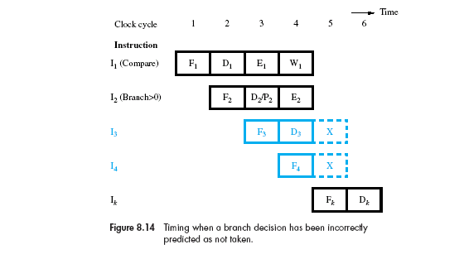

Slide 18
If we assume that branch outcomes are random then half of the branch will be taken.
Then the approach of assuming that branches will be not be taken will save 50% of the time of the total time lost due to conditional branches.
Better performance can be achieved, if we assume that some branch instructions to be predicted as taken and others as not taken depending on the expected program behavior.

Slide 19
For example :
  Branch instruction at the end of the loop
    It causes a branch to the start of the loop for every pass through the loop except the last one.
    So, it is normal/advantageous to assume that this branch will be taken .
    So, instruction fetch unit are arranged to start to fetch instructions at the branch target address.
  Branch instruction at the start of the loop
    it is normal/advantageous to assume that this branch will not be taken.

Slide 20
The way to predict the result of the branch may also be made in the hardware
  By observing whether the target address of the branch is lower that or higher that the address of the branch instruction.
Another way is to use the compiler to decide whether a branch instruction is predicted to be taken or not taken.

Slide 21
  Some processor, i.e. SPARC, includes a branch prediction bit for taking decision for branch instruction, which is set to 0 or 1 by the compiler indicating the prediction.
  The instruction fetch unit checks this bit to predict whether the branch will be taken or not taken.
In both the ways, the branch prediction decision is always the same every time a given instruction is executed.

Slide 22
Any approach having the above characteristic is called Static Branch Prediction.
And the approach in which, the prediction decision is made depending on execution history is called Dynamic Branch Prediction.

Slide 23

Zaky
  Chapter 8 : 8.3(8.3.2 before dynamic branch prediction)
Class Lecture

