Slide 1
The Network Layer

Slide 2
Network Layer
The network Layer controls the operation of the subnet. The main aim of this layer is to deliver packets from source to destination across multiple links (networks).
If two computers (system) are connected on the same link, then there is no need for a network layer. It routes the signal through different channels to the other end and acts as a network controller.
It also divides the outgoing messages into packets and to assemble incoming packets into messages for higher levels.
In broadcast networks, the routing problem is simple, so the network layer is often thin or even non-existent.

Slide 3
Functions of Network Layer
It translates logical network address into physical address. Concerned with circuit, message or packet switching.
Routers and gateways operate in the network layer. Mechanism is provided by Network Layer for routing the packets to final destination.
Connection services are provided including network layer flow control, network layer error control and packet sequence control.
Breaks larger packets into small packets.

Slide 4
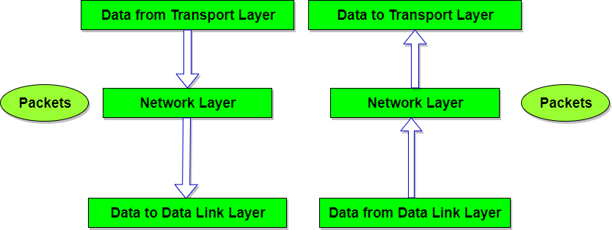
Network Layer

Slide 5
Network Layer Design Issues
Store-and-forward packet switching
Services provided to transport layer
Implementation of connectionless service
Implementation of connection-oriented service
Comparison of virtual-circuit and datagram networks

Slide 6
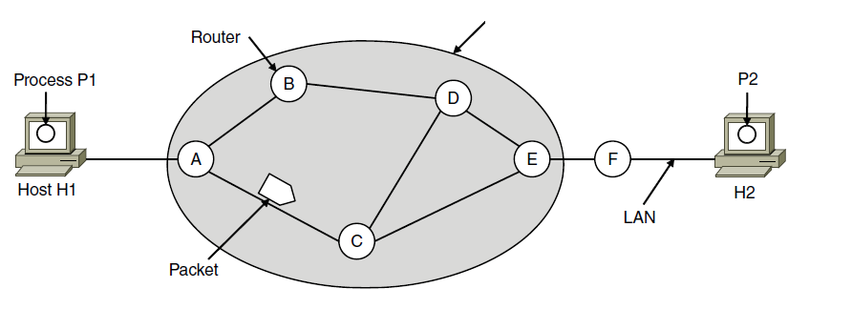
Store-and-Forward Packet Switching
ISP’s equipment
The environment of the network layer protocols.

Slide 7
Services Provided to the Transport Layer
Services independent of router technology.
Transport layer shielded from number, type, topology of routers.
Network addresses available to transport layer use uniform numbering plan
  even across LANs and WANs

Slide 8
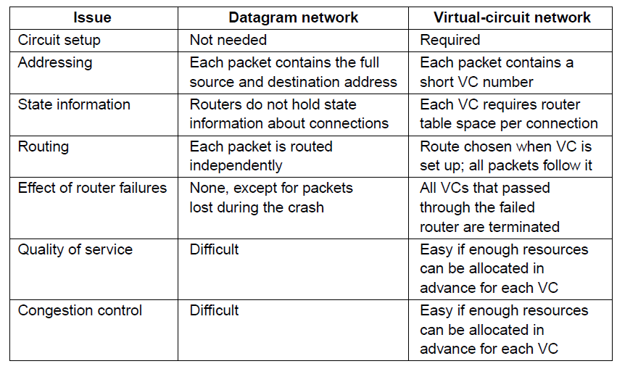
Comparison of Virtual-Circuit and Datagram Networks
Comparison of datagram and virtual-circuit networks

Slide 9
Routing
The process of selecting a path for traffic in a network or between or across multiple networks.
It is performed in many types of networks, including circuit-switched networks, such as the public switched telephone network (PSTN), and computer networks, such as the Internet.
In packet switching networks, routing is the higher-level decision making that directs network packets from their source toward their destination through intermediate network nodes by specific packet forwarding mechanisms.

Slide 10
Cont…
Intermediate nodes are typically network hardware devices such as routers, gateways, firewalls, or switches.
The routing process usually directs forwarding on the basis of routing tables.
Routing tables maintain a record of the routes to various network destinations.
Routing tables may be specified by an administrator, learned by observing network traffic or built with the assistance of routing protocols.

Slide 11
Static Routing
Static routing does not involve any change in routing table unless the network administrator changes or modify them manually.
Static routing algorithms function well where the network traffic is predictable.
This is simple to design and easy to implement. There is no requirement of complex routing protocols.
Static routing is also known as non-adaptive routing which enables a pre-computed route to be fed into the routers offline.

Slide 12
Dynamic Routing
Dynamic routing is a superior routing technique which alters the routing information according to the altering network circumstances by examining the arriving routing update messages.
The technique uses routing protocols to disseminate knowledge such as RIP, OSPF, BGP, etc.
Dynamic routing or otherwise called as adaptive routing. The routing decisions are altered in these algorithms to mirror the changes in the topology or traffic.

Slide 13
Static vs. Dynamic Routing
Basis for comparison | Static Routing | Dynamic Routing
Configuration | Manual | Automatic
Routing table building | Routing locations are hand-typed | Locations are dynamically filled in the table.
Routes | User defined | Routes are updated according to change in topology.
Routing algorithms | Doesn't employ complex routing algorithms. | Uses complex routing algorithms to perform routing operations.
Implemented in | Small networks | Large networks
Link failure | Link failure obstructs the rerouting. | Link failure doesn't affect the rerouting.

Slide 14
Security | Provides high security. | Less secure due to sending broadcasts and multicasts.
Routing protocols | No routing protocols are indulged in the process. | Routing protocols such as RIP, EIGRP, etc are involved in the routing process.
Additional resources | Not required | Needs additional resources to store the information.

Slide 15
Routing Algorithm
A routing algorithm is a set of step-by-step operations used to direct Internet traffic efficiently. When a packet of data leaves its source, there are many different paths it can take to its destination.
The routing algorithm is used to determine mathematically the best path to take.
Different routing algorithms use different methods to determine the best path.

Slide 16
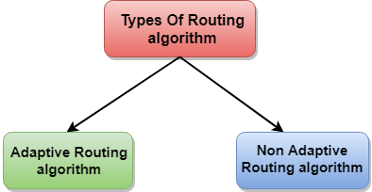
Routing Algorithm
Routing algorithms can be grouped into two major classes:
  Nonadaptive algorithms
  --Used for static routing
  Adaptive algorithms
  --Used for dynamic routing

Slide 17
Routing Algorithms
Optimality principle
Shortest path algorithm
Flooding
Distance vector routing
Link state routing
Routing in ad hoc networks

Slide 18
Cont…
Broadcast routing
Multicast routing
Anycast routing
Routing for mobile hosts
Routing in ad hoc networks

Slide 19
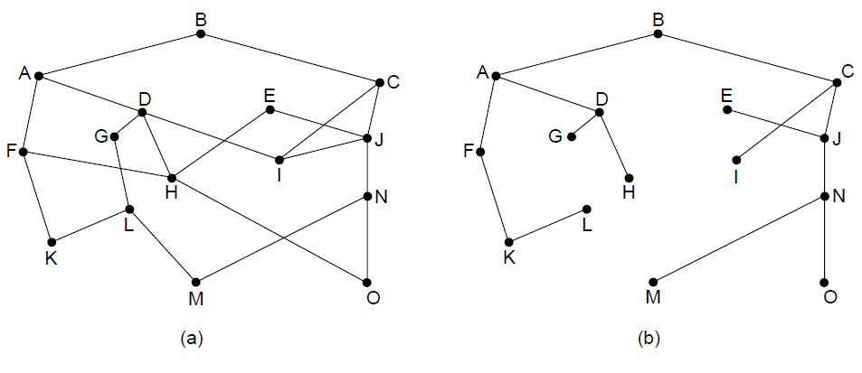
The Optimality Principle
(a) A network. (b) A sink tree for router B.

Slide 20
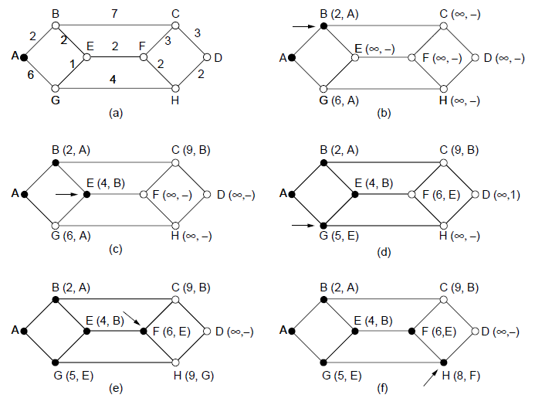
Shortest Path Algorithm (1)
The first five steps used in computing the shortest path from A to D. The arrows indicate the working node
Notes:
Shortest Path Algorithm
https://www.youtube.com/watch?v=YJfApSMbwaE&t=56s

Slide 21
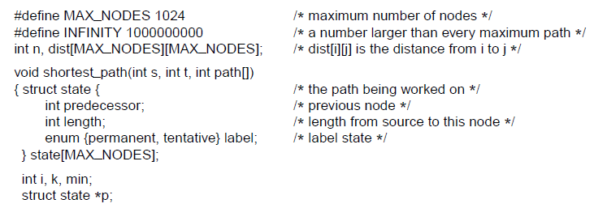
Shortest Path Algorithm (2)
. . .
Dijkstra’s algorithm to compute the shortest path through a graph.

Slide 22
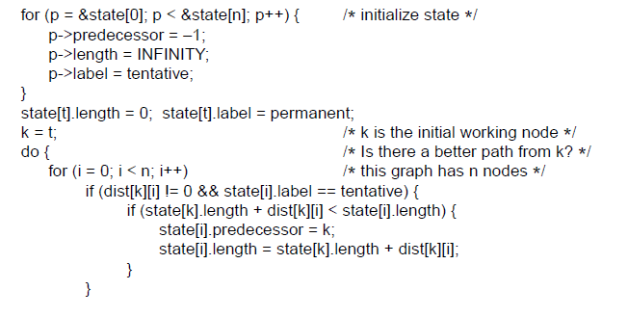
Shortest Path Algorithm (3)
. . .
. . .
Dijkstra’s algorithm to compute the shortest path through a graph.

Slide 23
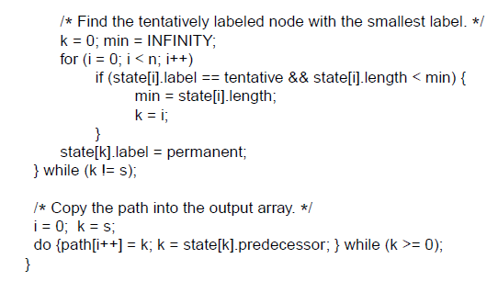
Shortest Path Algorithm (4)
. . .
Dijkstra’s algorithm to compute the shortest path through a graph.

Slide 24
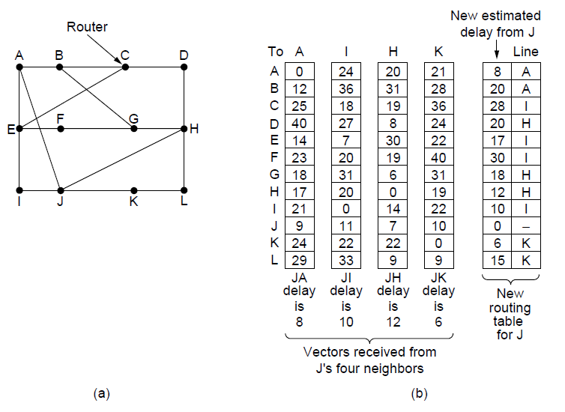
Distance Vector Routing
(a) A network.
(b) Input from A, I, H, K, and the new routing table for J.

Slide 25
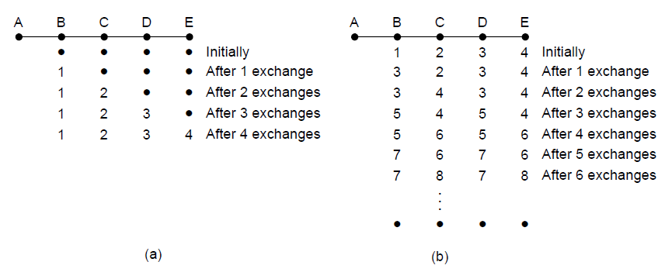
The Count-to-Infinity Problem
The count-to-infinity problem

Slide 26
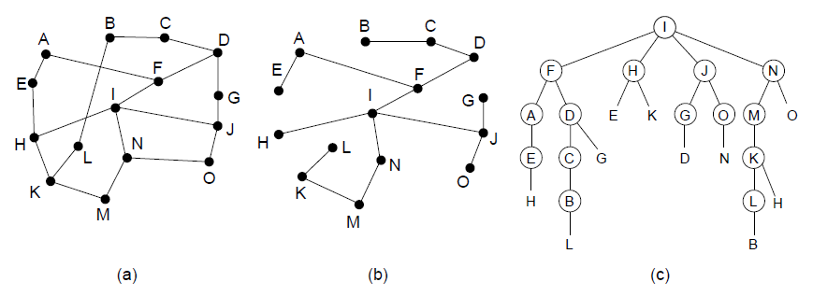
Broadcast Routing
Reverse path forwarding. (a) A network. (b) A sink tree.
(c) The tree built by reverse path forwarding.

Slide 27
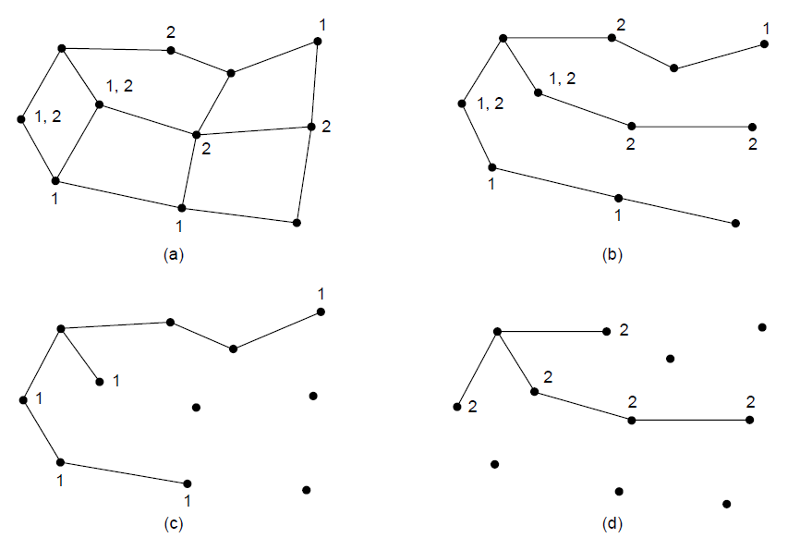
Multicast Routing (1)
(a) A network. (b) A spanning tree for the leftmost router. (c) A
multicast tree for group 1. (d) A multicast tree for group 2.

Slide 28
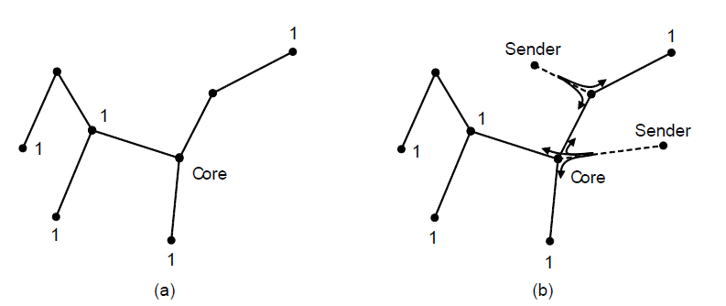
Multicast Routing (2)
Core-based tree for group 1.
Sending to group 1.

Slide 29
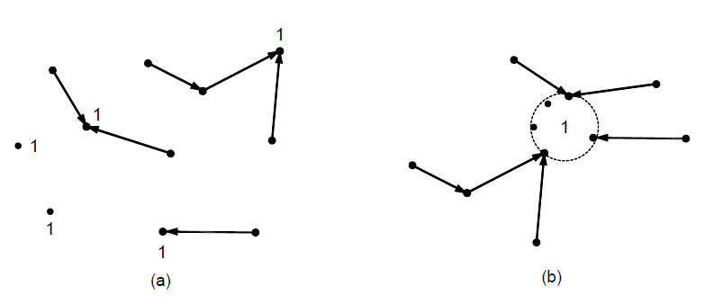
Anycast Routing
Anycast routes to group 1.
Topology seen by the routing protocol.

Slide 30
Network congestion
Congestion, in the context of networks, refers to a network state where a node or link carries so much data that it may deteriorate network service quality, resulting in queuing delay, frame or data packet loss and the blocking of new connections. In a congested network, response time slows with reduced network throughput.
In data networking and queueing theory, it is the reduced quality of service that occurs when a network node or link is carrying more data than it can handle.
Congestion occurs when bandwidth is insufficient and network data traffic exceeds capacity.

Slide 31
Congestion Control
  It is a network layer issue
  It is concerned with what happens when there is more data in the network than can be sent with reasonable packet delays, no lost packets
  Many design parameters at the data link, network and transport layers effect congestion.

Slide 32
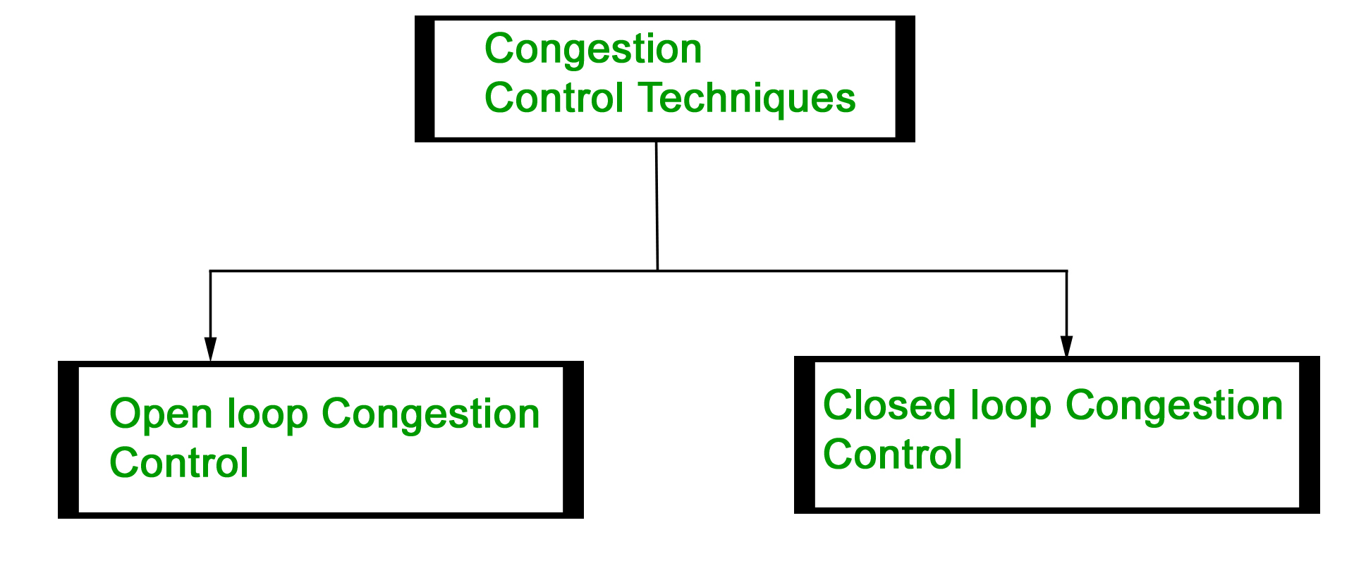
Congestion Control techniques in Computer Networks
Congestion control refers to the techniques used to control or prevent congestion.

Slide 33
Open Loop Congestion Control
Open loop congestion control policies are applied to prevent congestion before it happens.
The congestion control is handled either by the source or the destination.
Policies adopted by open loop congestion control
  Retransmission Policy
  Window Policy
  Discarding Policy
  Acknowledgment Policy
  Admission Policy

Slide 34
Closed Loop Congestion Control
Closed loop congestion control technique is used to treat or alleviate congestion after it happens.
Several techniques are used by different protocols; some of them are:
  Backpressure
  Choke Packet Technique
  Implicit Signaling
  Explicit Signaling

Slide 35
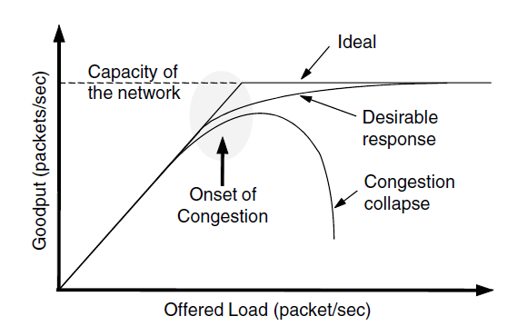
Congestion Control Algorithms (2)
When too much traffic is offered, congestion sets in and performance degrades sharply.

Slide 36
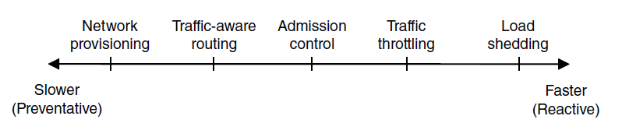
Approaches to Congestion Control
Timescales of approaches to congestion control

Slide 37
Quality of Service
Application requirements
Traffic shaping
Packet scheduling
Admission control
Integrated services
Differentiated services

Slide 38
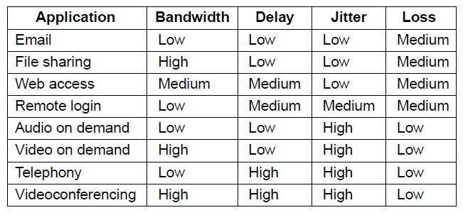
Application Requirements (1)
How stringent the quality-of-service requirements are.

Slide 39
Categories of QoS and Examples
Constant bit rate
  Telephony
Real-time variable bit rate
  Compressed videoconferencing
Non-real-time variable bit rate
  Watching a movie on demand
Available bit rate
  File transfer

Slide 40
Packet Scheduling
Kinds of resources can potentially be reserved for different flows:
Bandwidth.
Buffer space.
CPU cycles.

Slide 41
Internetworking
How networks differ
How networks can be connected
Tunneling
Internetwork routing
Packet fragmentation

Slide 42
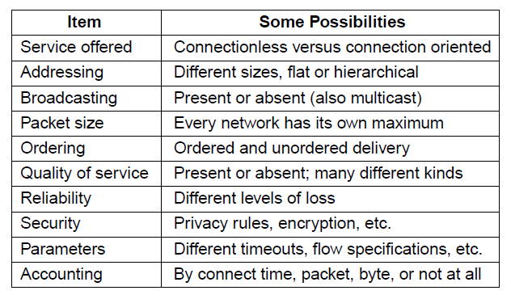
How Networks Differ
Some of the many ways networks can differ

Slide 43
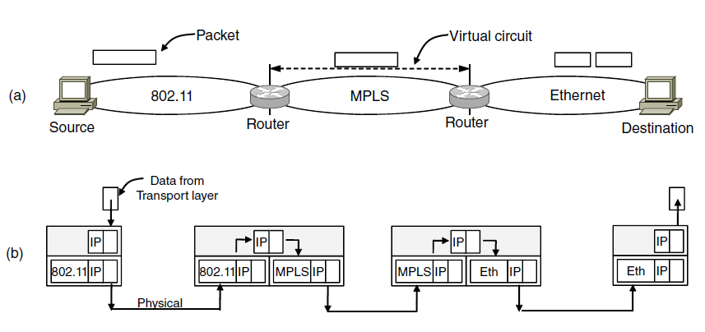
How Networks Can Be Connected
A packet crossing different networks.
Network and link layer protocol processing.

Slide 44
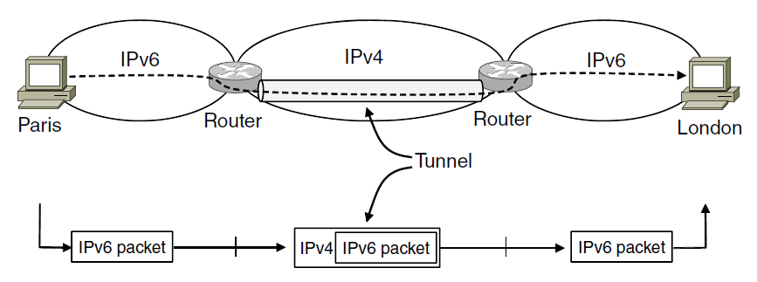
Tunneling (1)
Tunneling a packet from Paris to London.

Slide 45
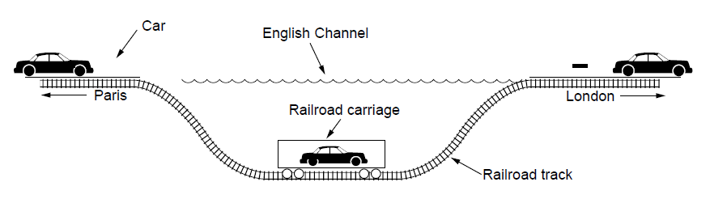
Tunneling (2)
Tunneling a car from France to England

Slide 46
Packet Fragmentation (1)
Packet size issues:
Hardware
Operating system
Protocols
Compliance with (inter)national standard.
Reduce error-induced retransmissions
Prevent packet occupying channel too long.

Slide 47
The Network Layer Principles (1)
Make sure it works
Keep it simple
Make clear choices
Exploit modularity
Expect heterogeneity
. . .

Slide 48
The Network Layer Principles (2)
. . .
Avoid static options and parameters
Look for good design (not perfect)
Strict sending, tolerant receiving
Think about scalability
Consider performance and cost

Slide 49
Network Address Translation (NAT)
NAT is a router function where IP addresses (and possibly port numbers) of IP datagrams are replaced at the boundary of a private network
NAT is a method that enables hosts on private networks to communicate with hosts on the Internet
NAT is run on routers that connect private networks to the public Internet, to replace the IP address-port pair of an IP packet with another IP address-port pair.

Slide 50
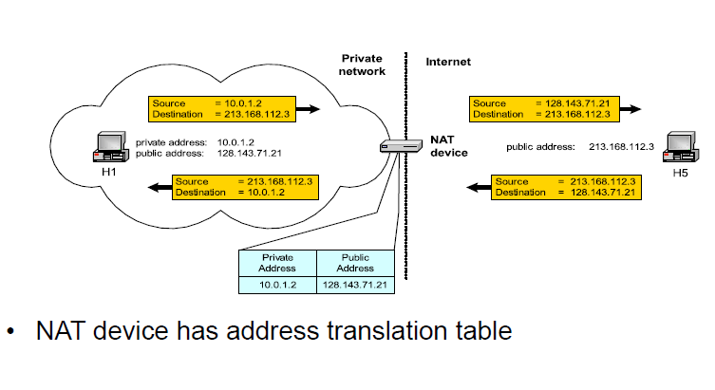

Slide 51
Internet Control Protocols (1)
Internet Protocol (IP) is the principal set (or communications protocol) of digital message formats and rules.
Used for exchanging messages between computers across a single network or a series of interconnected networks, using the Internet Protocol Suite (often referred to as TCP/IP).

Slide 52
ICMP(1)
ICMP is a supporting protocol in the Internet protocol suite.
It is used by network devices, including routers, to send error messages and operational information indicating success or failure when communicating with another IP address
It differs from transport protocols such as TCP and UDP in that it is not typically used to exchange data between systems, nor is it regularly employed by end-user network applications.

Slide 53
ICMP(2)
Since IP does not have a inbuilt mechanism for sending error and control messages. It depends on Internet Control Message Protocol(ICMP) to provide an error control. It is used for reporting errors and management queries.
It is a supporting protocol and used by networks devices like routers for sending the error messages and operations information.

Slide 54
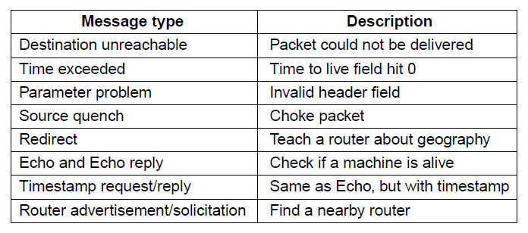
ICMP(3)
The principal ICMP message types.

Slide 55
IGMP
The Internet Group Management Protocol (IGMP) is a communications protocol used by hosts and adjacent routers on IPv4 networks to establish multicast group memberships. IGMP is an integral part of IP multicast.
IGMP can be used for one-to-many networking applications such as online streaming video and gaming, and allows more efficient use of resources when supporting these types of applications.
IGMP is used on IPv4 networks. Multicast management on IPv6 networks is handled by Multicast Listener Discovery (MLD) which is a part of ICMPv6 in contrast to IGMP's bare IP encapsulation.

Slide 56
ARP(1)
The Address Resolution Protocol (ARP) is a communication protocol used for discovering the link layer address, such as a MAC address, associated with a given internet layer address, typically an IPv4 address.
ARP was defined in 1982 by RFC 826, which is Internet Standard STD 37.
It has been implemented with many combinations of network and data link layer technologies.IPv4 over IEEE 802.3 and IEEE 802.11 is the most common usage.
In IPv6 networks, the functionality of ARP is provided by the Neighbor Discovery Protocol (NDP).
Notes:
It has been implemented with many combinations of network and data link layer technologies., such as IPv4, Chaosnet, DECnet and Xerox PARC Universal Packet (PUP) using IEEE 802 standards, FDDI, X.25, Frame Relay and Asynchronous Transfer Mode (ATM). IPv4 over IEEE 802.3 and IEEE 802.11 is the most common usage.

Slide 57
BGP
BGP may be used for routing within an autonomous system. In this application it is referred to as Interior Border Gateway Protocol, Internal BGP, or iBGP.
In contrast, the Internet application of the protocol may be referred to as Exterior Border Gateway Protocol, External BGP, or eBGP.

Slide 58
BGP
Border Gateway Protocol (BGP) is a standardized exterior gateway protocol designed to exchange routing and reachability information among autonomous systems (AS) on the Internet. The protocol is classified as a path vector protocol.
The Border Gateway Protocol makes routing decisions based on paths, network policies, or rule-sets configured by a network administrator and is involved in making core routing decisions.

Slide 59
Mobile IP
Goals
Mobile host use home IP address anywhere.
No software changes to fixed hosts
No changes to router software, tables
Packets for mobile hosts – restrict detours
No overhead for mobile host at home.

Slide 60
End
Chapter 5

