Slide 1
Internet Protocol

Slide 2
What is IP?
The Internet Protocol is the principal communications protocol in the Internet protocol suite for relaying datagrams across network boundaries.
Its routing function enables internetworking, and essentially establishes the Internet.
IP is the primary protocol in the Internet Layer of the Internet Protocol Suite, which is a set of communications protocols consisting of four abstraction layers: link layer (lowest), Internet layer, transport layer and application layer (highest).

Slide 3
IP
The main purpose and task of IP is the delivery of datagrams from the source host (source computer) to the destination host (receiving computer) based on their addresses.
IP includes methods and structures for putting tags (address information, which is part of metadata) within datagrams.
The process of putting these tags on datagrams is called encapsulation.

Slide 4
Datagram
A datagram is a unit of transfer associated with networking.
Data is transmitted from source to destination without guarantee of delivery
Data is frequently divided into smaller pieces and transmitted without a defined route or guaranteed order of delivery

Slide 5
What is IP address
An Internet Protocol address is a numerical label or numbering scheme assigned to each device connected to a computer network that uses the Internet Protocol for communication.
An IP address serves two main functions: host or network interface identification and location addressing.
A way to identify machines on a network
A unique identifier because an IP address is an address used to uniquely identify a device on an IP network.
  Global and Standardised

Slide 6
IP Addresses
The address is made up of 32 binary bits for IPv4 which can be divisible into a network portion and host portion with the help of a subnet mask.
32 binary bits are broken into four octets ( 1 octet = 8 bits)
Dotted decimal format (for example, 172.16.81.100)
The IP is responsible for addressing, delivering and routing online requests precisely.
Largest network of computers
American Registry of Internetwork Numbers (ARIN) provides services related to the technical coordination and management of Internet number resources.

Slide 7
How does an IP address work?
One of those networking protocols on your computer, It attaches an "electronic return address" to all your online requests and activity for you.

Slide 8
IP provides three major things
Specification of the exact format of all data.
It performs routing function and chooses path for sending the data.
It involves a collection of rules that support the idea of unreliable packet delivery.

Slide 9
What is the purpose of IP address?
An IP address serves two principal functions: host or network interface identification and location addressing.
IP usage
Used to connect to another computer
Allows transfers of files and e-mail

Slide 10
IPv4 and IPv6
IPv4 and IPv6 are the versions of internet protocol where IPv6 is the enhanced version of IPv4. There are various differences between IPv4 and IPv6 protocol including their features, but the crucial one is the number of addresses (Address space) it generates.
IP version 4 (IPv4) generates 4.29 x 10⁹ unique network addresses which is insufficient in quantity and as a result Internet is running out of space. Whereas IP version 6 (IPv6) produces 3.4 x 10³⁸ addresses and is a scalable and flexible solution to the current problem.

Slide 11
Definition of IPv4
An IPv4 address is a 32- bit binary value, which can be displayed as four decimal digits.
IP version 4 (IPv4) uses Broadcasting for transferring packets from one computer to all computers; this probably generates problems sometimes.
Dotted-Decimal Notation of IPv4
128.11.3.31

Slide 12
Packet Format
An IPv4 datagram is a variable-length packet comprised of a header (20 bytes) and data (up to 65,536 along with header).
The header contains information essential to routing and delivery.

Slide 13
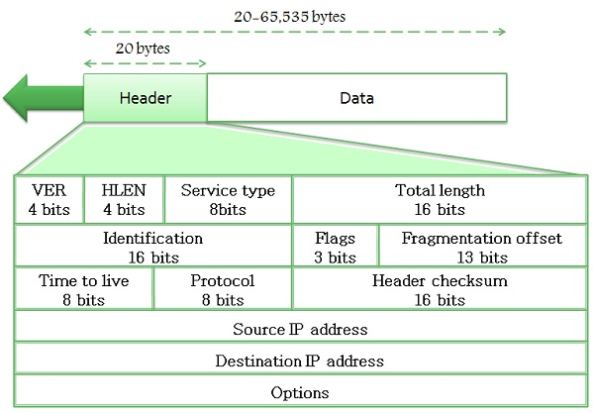
IPv4 Datagram

Slide 14
Base Header
Version: It defines the version number of IP, i.e., in this case, it is 4 with a binary value of 0100.
Header length (HLEN): It represents the length of the header in multiple of four bytes.
Service type: It determines how datagram should be handled and includes individual bits such as level of throughput, reliability, and delay.
Total length: It signifies the entire length of the IP datagram.

Slide 15
Identification: This field is used in fragmentation. A datagram is divided when it passes through different networks to match the network frame size. At that time each fragment is determined with a sequence number in this field.
Flags: The bits in the flags field handles fragmentation and identifies the first, middle or last fragment, etc.
Fragmentation offset: It’s a pointer that represents the offset of the data in the original datagram.
Time to live: It defines the number of hops a datagram can travel before it is rejected. In simple words, it specifies the duration for which a datagram remains on the internet.

Slide 16
Protocol: The protocol field specifies which upper layer protocol data are encapsulated in the datagram (TCP, UDP, ICMP, etc.).
Header checksum: This is a 16-bit field confirm the integrity of the header values, not the rest of the packet.
Source address: It’s a four-byte internet address which identifies the source of the datagram.
Destination address: This is a 4-byte field which identifies the final destination.
Options: This provides more functionality to the IP datagram. Furthermore can carry fields like control routing, timing, management, and alignment.
IPv4 is a two-level address structure (net id and host id) classified into five categories (A, B, C, D, and E).

Slide 17
Definition of IPv6
An IPv6 address is a 128-bit binary value, which can be displayed as 32 hexadecimal digits. Colons isolate entries in a sequence of 16-bit Hexadecimal fields.
As IPv4 uses two-level address structure where the use of address space is insufficient. That was the reason for proposing the IPv6, to overcome the deficiencies IPv4.
The format and the length of the IP addresses were changed along with the packet format and protocols were also modified.
Hexadecimal Colon Notation of IPv6
FDEC:BA98:7654:3210:ADBF:BBFF:2922:FFFF

Slide 18
IPv6 Packet format
Each packet is consist of a mandatory base header succeeded by the payload. The payload includes two parts namely optional extension headers and data from an upper layer.
The base header consumes 40 bytes, inversely the extension headers and data from the top layer usually hold up to 65,535 bytes of information.

Slide 19
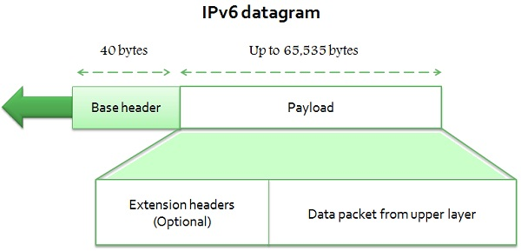

Slide 20
Base Header
Version: This four-bit field specifies the version of the IP, i.e., 6 in this case.
Priority: It defines the priority of the packet concerning traffic congestion.
Flow label: The reason for designing this protocol is to facilitate with special controlling for a certain flow of data.
Payload length: It defines the total length of the IP datagram excepting the base header.

Slide 21
Next header: It’s an eight-bit field describe the header that trails the base header in the datagram. The next header is one of the optional extension headers which IP uses or the header for an upper layer protocol such as UDP or TCP.
Hop limit: This eight-bit hop limit field assist with the same functions at the TTL field in IPv4.
Source address: It is a 16 bytes internet address identifies the source of the datagram.
Destination address: This is 16-byte internet address that generally describes the final destination of the datagram.

Slide 22
Key Differences Between IPv4 and IPv6
IPv4 has 32-bit address length whereas IPv6 has 128-bit address length.
IPv4 addresses represent the binary numbers in decimals. On the other hand, IPv6 addresses express binary numbers in hexadecimal.
IPv6 uses end-to-end fragmentation while IPv4 requires an intermediate router to fragment any datagram that is too large.
Header length of IPv4 is 20 bytes. In contrast, header length of IPv6 is 40 bytes.
The option fields in IPv4 are employed as extension headers in IPv6.

Slide 23
Key Differences Between IPv4 and IPv6
IPv4 uses checksum field in the header format for handling error checking. On the contrary, IPv6 removes the header checksum field.
In IPv4, the base header does not contain a field for header length, and 16-bit payload length field replaces it in the IPv6 header.
The Time to live field in IPv4 refers to as Hop limit in IPv6.
The header length field which is present in IPv4 is eliminated in IPv6 because the length of the header is fixed in this version.
IPv6 provides authentication and encryption, but IPv4 doesn’t provide it.

Slide 24
IPv4

Slide 25
IP structure
IP addresses consist of four sections
Each section is 8 bits long
Each section can range from 0 to 255
Written, for example, 128.35.0.72
Notes:
An IP address consists of four sections separated by dots.
Commonly written in decimal
Each section contains a number ranging from 0 to 255.
Example = 128.35.0.72

Slide 26
IP structure
These four sections represent the machine itself and the network it is on
The network portion is assigned.
The host section is determined by the network administrator
Notes:
These four sections represent both the machine itself, or host, and the network that the host is on.
The network portion of the IP address is allocated under authority of the Internet Assigned Numbers Authority (IANA). American Registry of Internetwork Numbers (ARIN)
Network administrators then assign the host portion of the IP address to the machines on the networks that they operate

Slide 27
IPv4 address space
The address space of IPv4 is
2³²
or
4,294,967,296.

Slide 28
Binary Notation
01110101 10010101 00011101 11101010

Slide 29
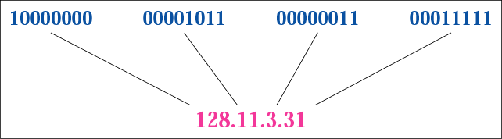
Figure 4-1
Dotted-decimal notation

Slide 30
Hexadecimal Notation
0111 0101 1001 0101 0001 1101 1110 1010
75 95 1D EA
0x75951DEA

Slide 31
Example 1
Change the following IP address from binary notation to dotted-decimal notation.
10000001 00001011 00001011 11101111
Solution
129.11.11.239

Slide 32
Example 2
Change the following IP address from dotted-decimal notation to binary notation:
111.56.45.78
Solution
01101111 00111000 00101101 01001110

Slide 33
Example 3
Find the error in the following IP Address
111.56.045.78
Solution
There are no leading zeroes in
Dotted-decimal notation (045)

Slide 34
Example 3 (continued)
Find the error in the following IP Address
75.45.301.14
Solution
In decimal notation each number <= 255
301 is out of the range

Slide 35
Example 4
Change the following binary IP address
Hexadecimal notation
10000001 00001011 00001011 11101111
Solution
0X810B0BEF or 810B0BEF16

