Slide 1
CSE 312
Computer Networks
Introduction
1-<number>

Slide 2
Course Objectives
To help you gain a general understanding of the principles of computer networks.
To give concepts governing the operations of computer networks.
To give the definition of the two often-used terms in the discussion of the Internet: protocol and standard.
To provide you with the opportunity to become skillful in the implementation and use of communication protocols.
To help you grasp the basic research methodologies in the field of computer networks.

Slide 3
Textbook
Required:
  ``Computer Networks,'' by Andrew S. Tanenbaum
Recommended:
  “Computer Networks: A Systems Approach’’ by Larry L. Peterson and Bruce S. Davie.
  ‘’TCP/IP Protocol Suite’’ by Behrouz A. Forouzan.
  Data Communication and Networking: by Behrouz A. Forouzan
  “Data and Computer Communication” by Willam Stallings

Slide 4
Class Expectations
Class participation – Your input is needed for good discussion
Keep up with reading material
Complete assignments and projects on time
Submit clean, organized, and concise reports.

Slide 5
Lecture Etiquette
Be on time (Don’t late to enter the class)
Your ringer is not that great! (cell phones off or muted)
Interrupt for questions – there is no dumb question

Slide 6

Key to Success
Attendance
  Pay attention to lectures and keep extra notes
  Ask necessary questions
Effort
  Do homework on your own. It’s ok to ask others, but make your own effort
  Read extra material on your own. Wealth of information available (library books, reference books, online articles, research papers)
Consistency
  Keep up with the class pace

Slide 7
Chapter 1
Introduction
Notes:
Page <number>

Slide 8
Tentative topics
Data Communication
Computer Networks
Applications
Network Hardware
Network Software
Connectionless and connection oriented services
OSI and TCP/IP Network models
Data link protocols
Local area networks
Network routing

Slide 9
Data Communication
The transmission of digital data between two or more computers.
Data communication aims at the transfer of data and maintenance of the data during the process.
These technologies include telecommunications, computer networking and radio/satellite communication.
Usually requires existence of a transportation or communication medium between the nodes wanting to communicate with each other, such as copper wire, fiber optic cables or wireless signals.
Notes:
Data communications refers to the transmission of digital data between two or more computers.

Slide 10
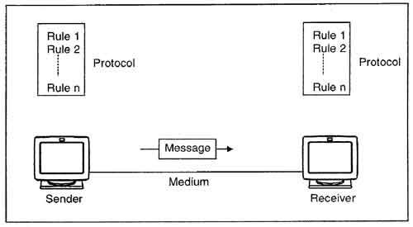
Data Communication System

Slide 11
Components of data communication system
1. Message: It is the information or data to be communicated. It can consist of text, numbers, pictures, sound or video or any combination of these.
2. Sender: It is the device/computer that generates and sends that message.
3. Receiver: It is the device or computer that receives the message. The location of receiver computer is generally different from the sender computer.
4. Medium: It is the channel or physical path through which the message is carried from sender to the receiver.
5. Protocol: It is a set of rules that govern the communication between the devices. Both sender and receiver follow same protocols to communicate with each other.
Notes:
The medium can be wired like twisted pair wire, coaxial cable, fiber-optic cable or wireless like laser, radio waves, and microwaves.

Slide 12
Computer Networks
A group of computer systems and other computing hardware devices that are linked together through communication channels to facilitate communication and resource-sharing among a wide range of users.
The most common resource shared today is connection to the Internet. Other shared resources can include a printer or a file server.
The Internet itself can be considered a computer network.

Slide 13
Cont..
An internet is two or more networks that can communicate with each other. The most notable internet is called the internet, composed of hundreds of thousands of interconnected networks.
Private individuals as well as various organizations such as government agencies, schools, research facilities, corporations, and libraries in more than 100 countries use the Internet.

Slide 14
Characteristics of a Computer Network
Share resources from one computer to another.
Create files and store them in one computer, access those files from the other computer(s) connected over the network.
Connect a printer, scanner, or a fax machine to one computer within the network and let other computers of the network use the machines available over the network.

Slide 15


Applications of Networks
Introduction to Computer Networks
Resource Sharing
  Hardware (computing resources, disks, printers)
  Software (application software)
Information Sharing
  Easy accessibility from anywhere (files, databases)
  Search Capability (WWW)
Communication
  Email
  Message broadcast
Remote computing
Distributed processing (GRID Computing)

Slide 16
Uses of Computer Networks
Business Applications
Home Applications
Mobile Users
Social Issues

Slide 17
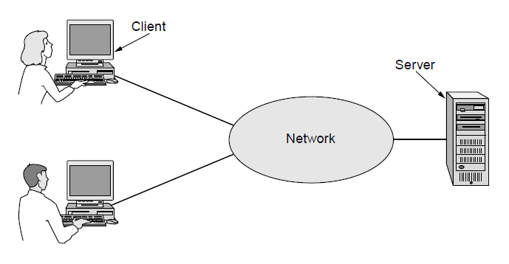
Business Applications (1)
A network with two clients and one server

Slide 18
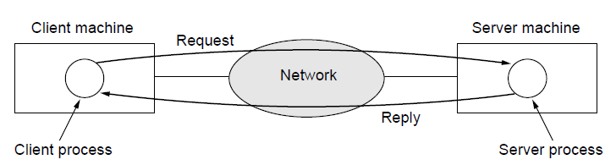
Business Applications (2)
The client-server model involves requests and replies

Slide 19
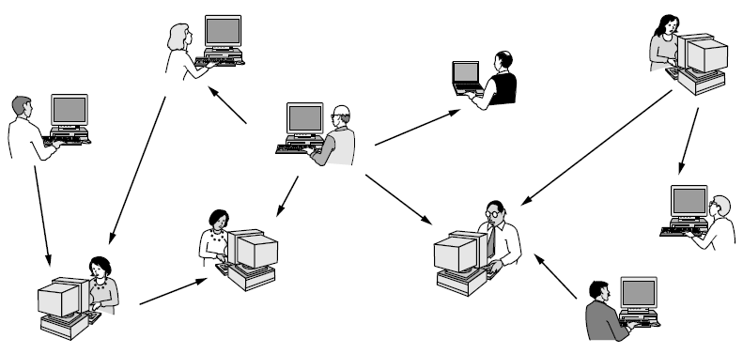
Home Applications (1)
In a peer-to-peer system there are no fixed clients and servers.

Slide 20
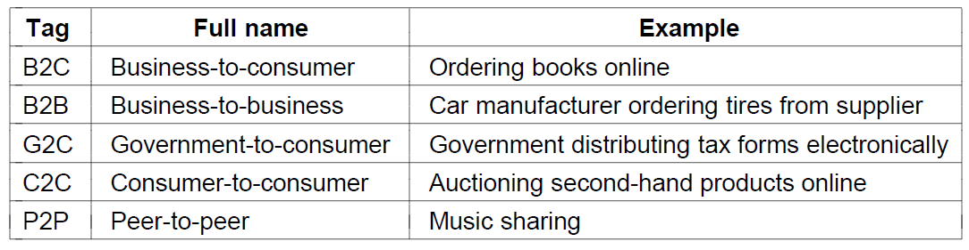
Home Applications (2)
Some forms of e-commerce

Slide 21
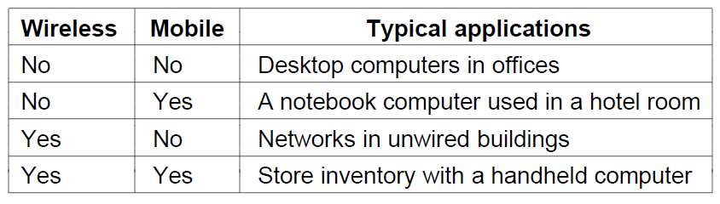
Mobile Users
Combinations of wireless networks and mobile computing

Slide 22
Social Issues
Network neutrality
Digital Millennium Copyright Act
Profiling users
Phishing

Slide 23
Network Hardware (1)
Personal area networks
Local area networks
Metropolitan area networks
Wide are networks
The internet
Computer Networks, Fifth Edition by Andrew Tanenbaum and David Wetherall, © Pearson Education-Prentice Hall, 2011

Slide 24
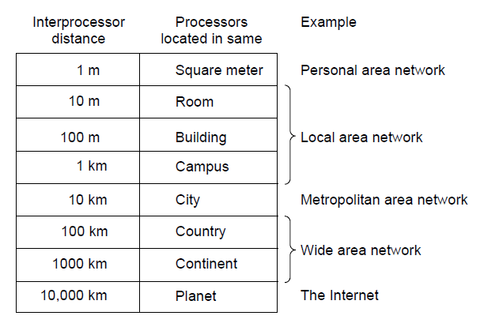
Network Hardware (2)
Classification of interconnected processors by scale.

Slide 25
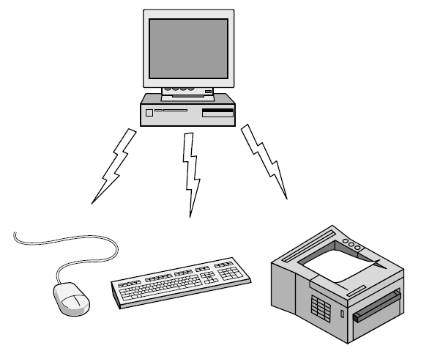
Personal Area Network
Bluetooth PAN configuration

Slide 26
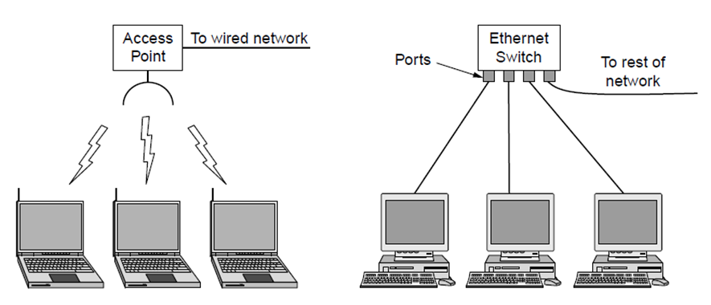
Local Area Networks
Wireless and wired LANs. (a) 802.11. (b) Switched Ethernet.

Slide 27
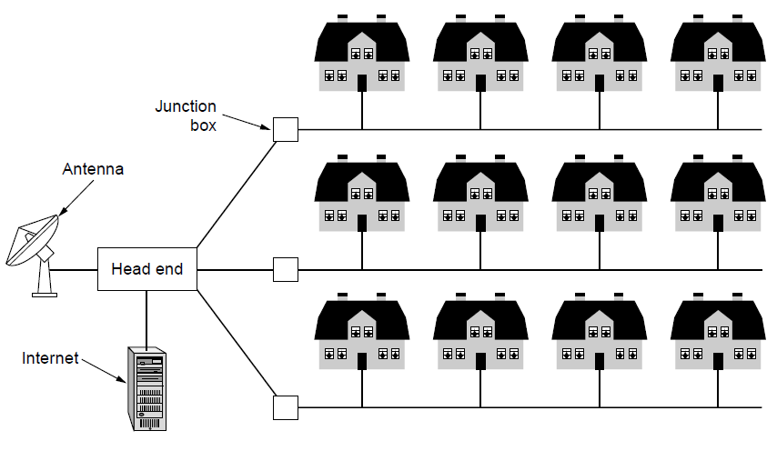
Metropolitan Area Networks
A metropolitan area network based on cable TV.

Slide 28
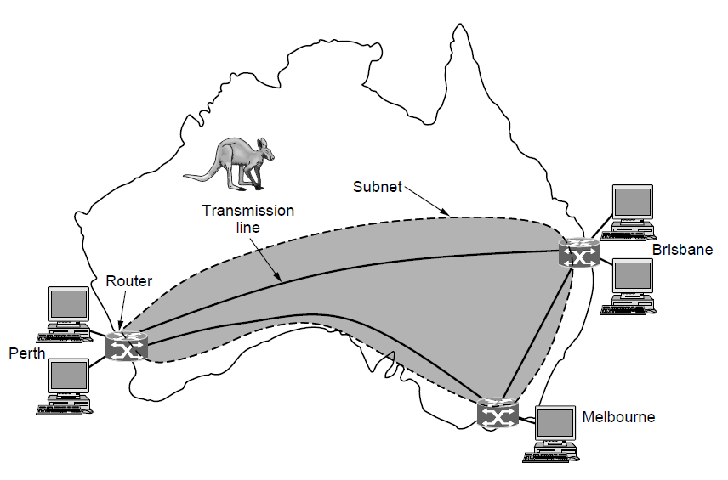
Wide Area Networks (1)
WAN that connects three branch offices in Australia

Slide 29
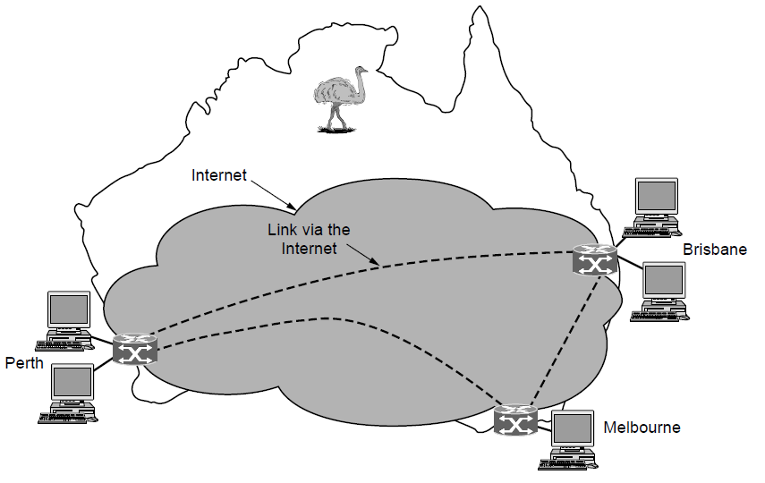
Wide Area Networks (2)
WAN using a virtual private network.

Slide 30
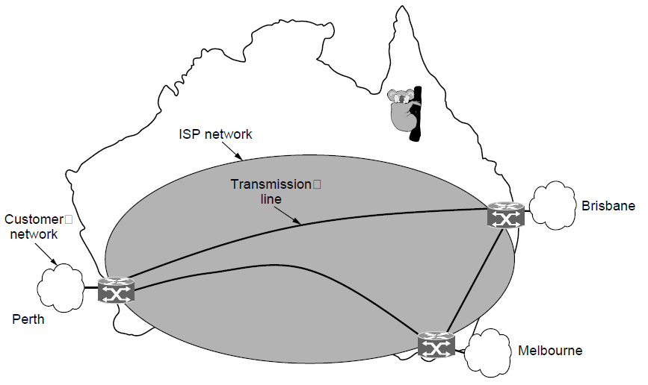
Wide Area Networks (3)
WAN using an ISP network.

Slide 31
Network Software
Protocol hierarchies
Design issues for the layers
Connection-oriented versus connectionless service
Service primitives
Relationship of services to protocols
Computer Networks, Fifth Edition by Andrew Tanenbaum and David Wetherall, © Pearson Education-Prentice Hall, 2011

Slide 32
Protocols
A protocol is an agreement between the communicating peers on how communication is to proceed.
Network protocols are sets of established rules that dictate how to format, transmit and receive data so computer network devices -- from servers and routers to endpoints -- can communicate regardless of the differences in their underlying infrastructures, designs or standards.

Slide 33
How network protocols work
Network protocols break larger processes into discrete, narrowly defined functions and tasks across every level of the network.
In the standard model, known as the Open Systems Interconnection (OSI) model, one or more network protocols govern activities at each layer in the telecommunication exchange.
Introduction
1-<number>

Slide 34
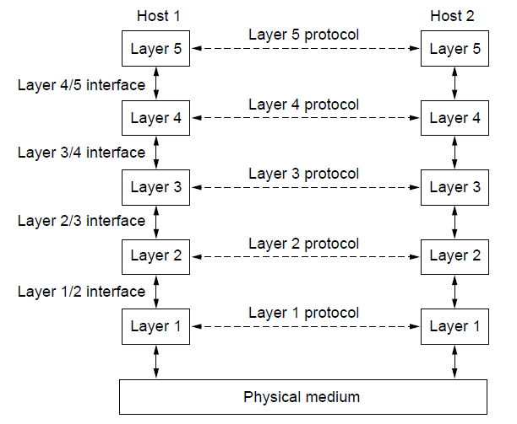
Protocol Hierarchies (1)
Layers, protocols, and interfaces.

Slide 35
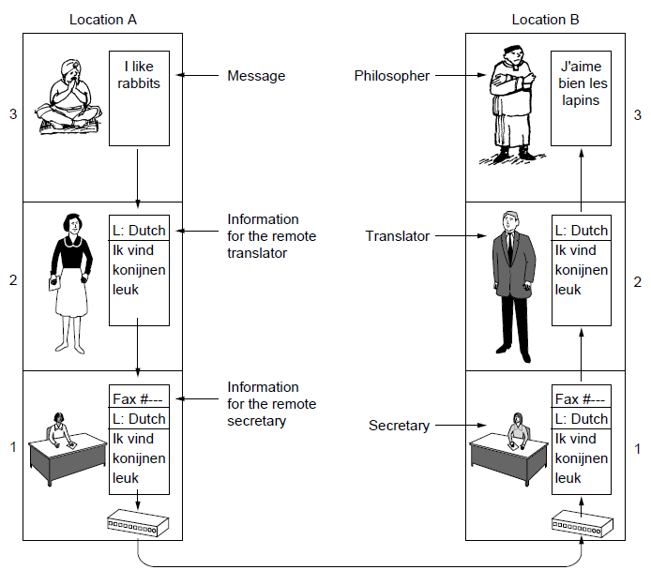
Protocol Hierarchies (2)
The philosopher-translator-secretary architecture

Slide 36
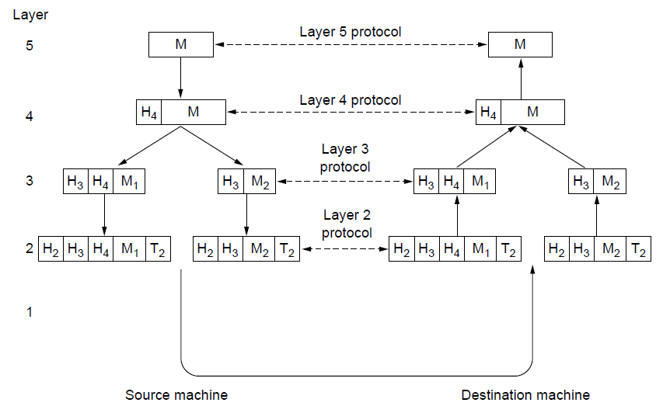
Protocol Hierarchies (3)
Example information flow supporting virtual
communication in layer 5.

Slide 37
Design issues for the layers
A number of design issues exist for the layer to layer approach of computer networks. Some of the main design issues are as follows:
Reliability
Network channels and components may be unreliable, resulting in loss of bits while data transfer. So, an important design issue is to make sure that the information transferred is not distorted.
Scalability
Networks are continuously evolving. The sizes are continually increasing leading to congestion. Also, when new technologies are applied to the added components, it may lead to incompatibility issues. Hence, the design should be done so that the networks are scalable and can accommodate such additions and alterations.
Addressing
At a particular time, innumerable messages are being transferred between large numbers of computers. So, a naming or addressing system should exist so that each layer can identify the sender and receivers of each message.
Introduction
1-<number>

Slide 38
Cont..
Error Control
Unreliable channels introduce a number of errors in the data streams that are communicated. So, the layers need to agree upon common error detection and error correction methods so as to protect data packets while they are transferred.
Flow Control
If the rate at which data is produced by the sender is higher than the rate at which data is received by the receiver, there are chances of overflowing the receiver. So, a proper flow control mechanism needs to be implemented.
Resource Allocation
Computer networks provide services in the form of network resources to the end users. The allocation/deallocation should occur so that minimal interference among the hosts occurs and there is optimal usage of the resources.
Introduction
1-<number>

Slide 39
Cont..
Statistical Multiplexing
It is not feasible to allocate a dedicated path for each message while it is being transferred from the source to the destination. So, the data channel needs to be multiplexed, so as to allocate a fraction of the bandwidth or time to each host.
Routing
There may be multiple paths from the source to the destination. Routing involves choosing an optimal path among all possible paths, in terms of cost and time. There are several routing algorithms that are used in network systems.
Security
A major factor of data communication is to defend it against threats like eavesdropping and surreptitious alteration of messages. So, there should be adequate mechanisms to prevent unauthorized access to data through authentication and cryptography.
Introduction
1-<number>

Slide 40
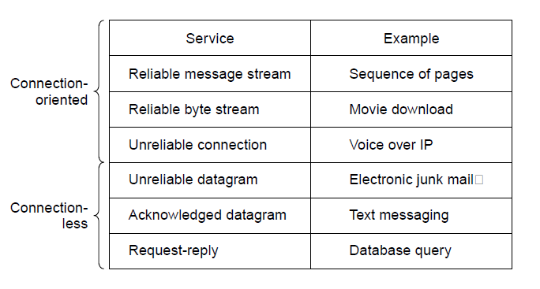
Connection-Oriented Versus
Connectionless Service
Six different type of services.

Slide 41
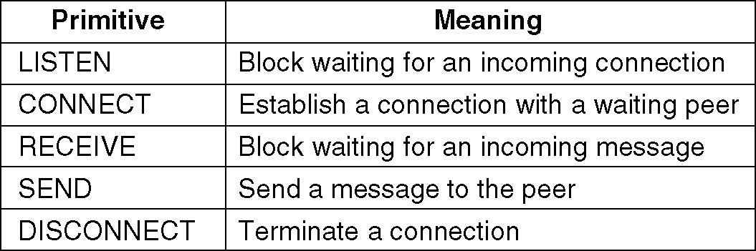
Service Primitives
A service is formally specified by a set of primitives (basic operations) available to a user or other entity to access the service.
Example: five service primitives for implementing a simple connection-oriented service.
Notes:
Page <number>
Another example with html

Slide 42
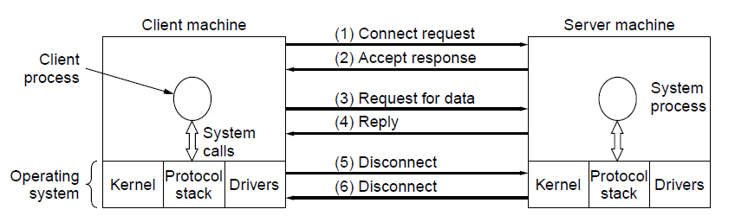
Service Primitives (2)
A simple client-server interaction using
acknowledged datagrams.
Computer Networks, Fifth Edition by Andrew Tanenbaum and David Wetherall, © Pearson Education-Prentice Hall, 2011
Notes:
A datagram is a basic transfer unit associated with a packet-switched network. Datagrams are typically structured in header and payload sections. Datagrams provide a connectionless communication service across a packet-switched network.

Slide 43
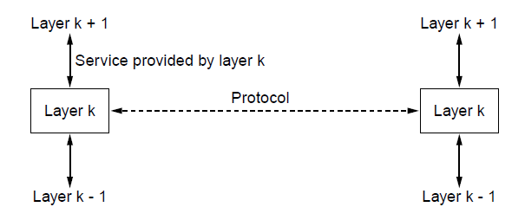
The Relationship of Services to Protocols
The relationship between a service and a protocol.
Computer Networks, Fifth Edition by Andrew Tanenbaum and David Wetherall, © Pearson Education-Prentice Hall, 2011

Slide 44
Reference Models
OSI reference model
TCP/IP reference model
Comparison of OSI and TCP/IP
Critique of OSI model and protocols
Critique of TCP/IP model
Computer Networks, Fifth Edition by Andrew Tanenbaum and David Wetherall, © Pearson Education-Prentice Hall, 2011

Slide 45
The OSI Reference Model
Principles for the seven layers
Layers created for different abstractions
Each layer performs well-defined function
Function of layer chosen with definition of international standard protocols in mind
Minimize information flow across interfaces between boundaries
Number of layers optimum
Computer Networks, Fifth Edition by Andrew Tanenbaum and David Wetherall, © Pearson Education-Prentice Hall, 2011

Slide 46
OSI Reference Model Layers
Physical layer
Data link layer
Network layer
Transport layer
Session layer
Presentation layer
Application layer
Computer Networks, Fifth Edition by Andrew Tanenbaum and David Wetherall, © Pearson Education-Prentice Hall, 2011

Slide 47
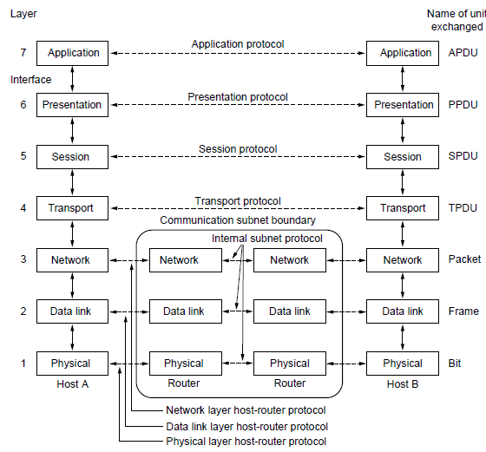
The OSI Reference Model
The OSI reference model
Computer Networks, Fifth Edition by Andrew Tanenbaum and David Wetherall, © Pearson Education-Prentice Hall, 2011

Slide 48
The TCP/IP Reference Model Layers
Link layer
Internet layer
Transport layer
Application layer
Computer Networks, Fifth Edition by Andrew Tanenbaum and David Wetherall, © Pearson Education-Prentice Hall, 2011

Slide 49
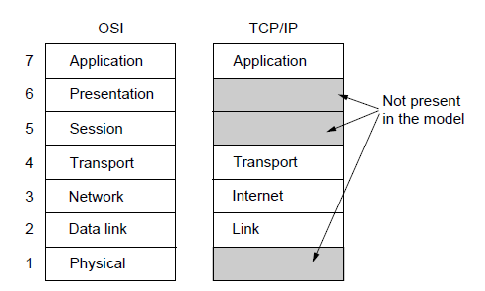
The TCP/IP Reference Model (1)
The TCP/IP reference model
Computer Networks, Fifth Edition by Andrew Tanenbaum and David Wetherall, © Pearson Education-Prentice Hall, 2011

Slide 50
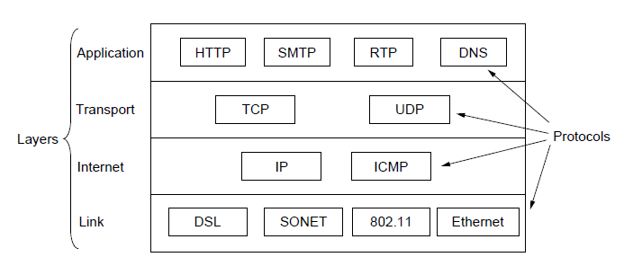
The TCP/IP Reference Model (2)
The TCP/IP reference model with some protocols we will study
Computer Networks, Fifth Edition by Andrew Tanenbaum and David Wetherall, © Pearson Education-Prentice Hall, 2011

Slide 51
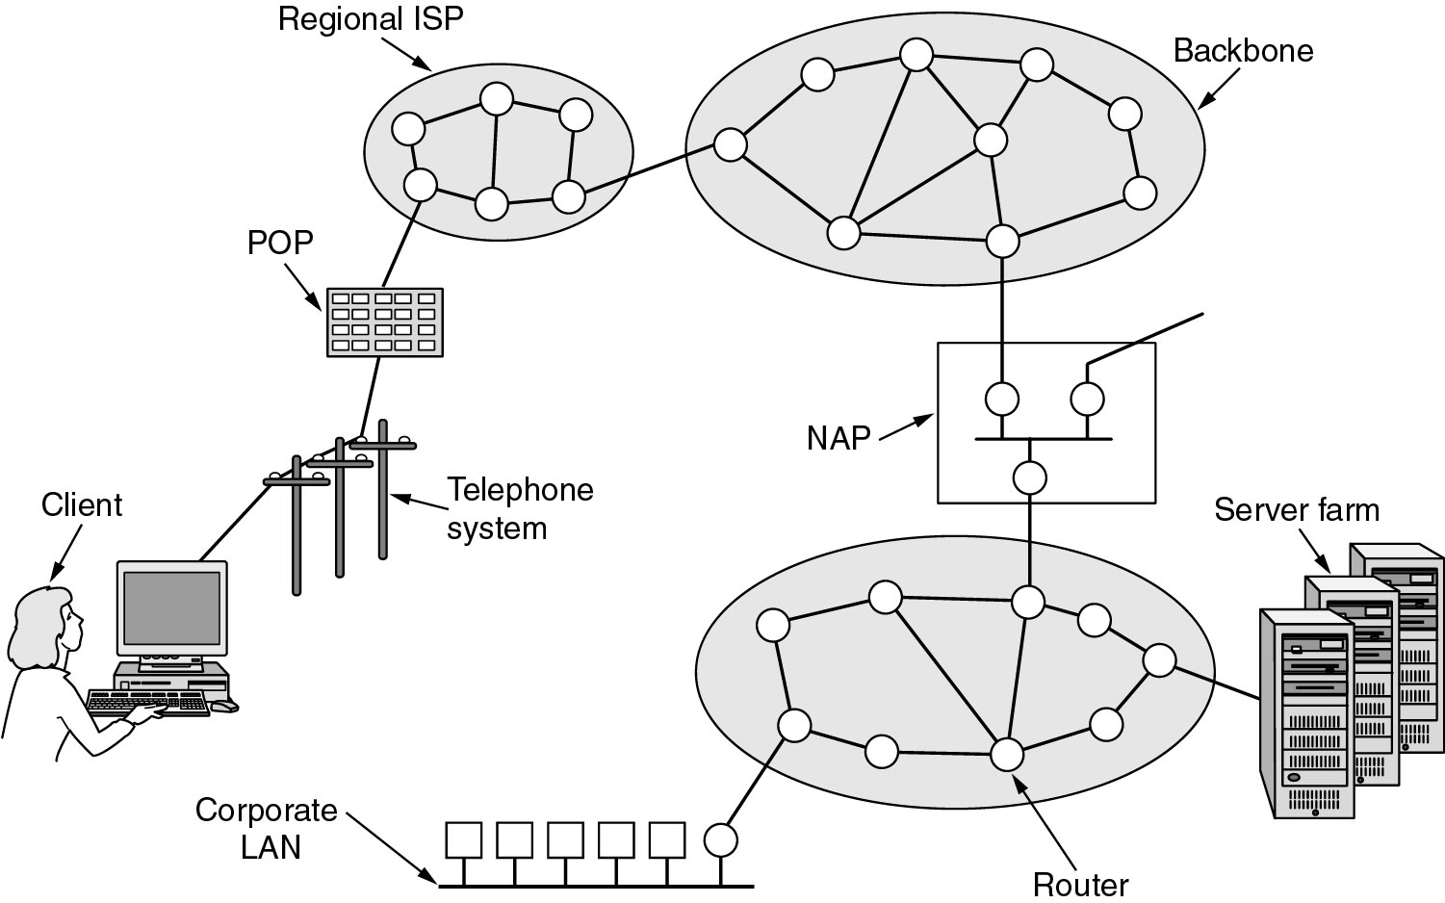
The TCP/IP Reference Model (3)
Overview of the Internet.
Notes:
Page <number>
Add a logical view

Slide 52
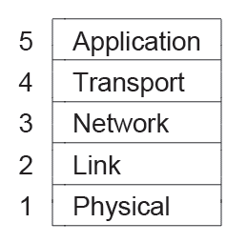
The Model Used in this Book
The reference model used in this book.
Computer Networks, Fifth Edition by Andrew Tanenbaum and David Wetherall, © Pearson Education-Prentice Hall, 2011

Slide 53
Comparison of the OSI and
TCP/IP Reference Models
Concepts central to OSI model
Services
Interfaces
Protocols
Computer Networks, Fifth Edition by Andrew Tanenbaum and David Wetherall, © Pearson Education-Prentice Hall, 2011

Slide 54
Critique of the OSI Model and Protocols
Bad timing.
Bad technology.
Bad implementations.
Bad politics.
Computer Networks, Fifth Edition by Andrew Tanenbaum and David Wetherall, © Pearson Education-Prentice Hall, 2011

Slide 55
Example Networks
Internet
ARPANET
NSFNET
Third-generation mobile phone networks
Wireless LANs: 802.11
RFID and sensor networks
Computer Networks, Fifth Edition by Andrew Tanenbaum and David Wetherall, © Pearson Education-Prentice Hall, 2011

Slide 56
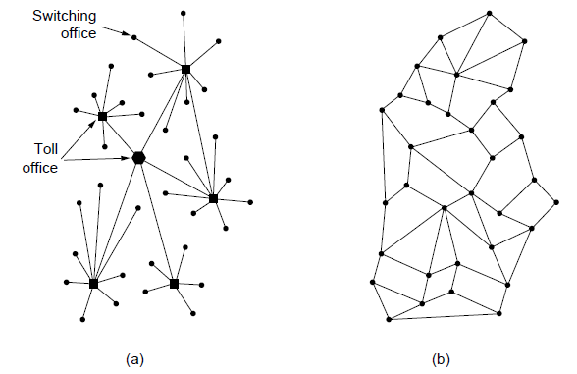
The ARPANET (1)
Structure of the telephone system.
Baran’s proposed distributed switching system.
Computer Networks, Fifth Edition by Andrew Tanenbaum and David Wetherall, © Pearson Education-Prentice Hall, 2011

Slide 57
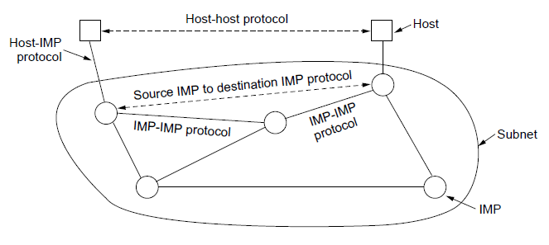
The ARPANET (2)
The original ARPANET design
Computer Networks, Fifth Edition by Andrew Tanenbaum and David Wetherall, © Pearson Education-Prentice Hall, 2011

Slide 58
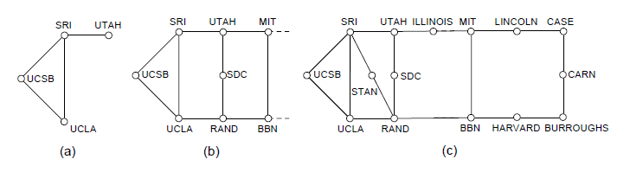
The ARPANET (3)
Growth of the ARPANET.
December 1969.
July 1970.
March 1971.
Computer Networks, Fifth Edition by Andrew Tanenbaum and David Wetherall, © Pearson Education-Prentice Hall, 2011

Slide 59
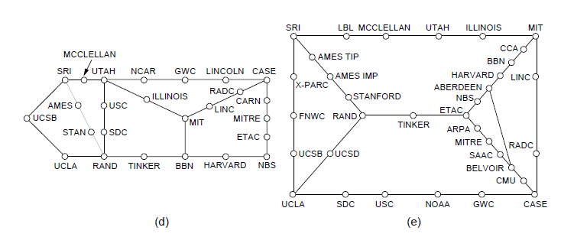
The ARPANET (4)
Growth of the ARPANET.
April 1972.
September 1972.
Computer Networks, Fifth Edition by Andrew Tanenbaum and David Wetherall, © Pearson Education-Prentice Hall, 2011

Slide 60
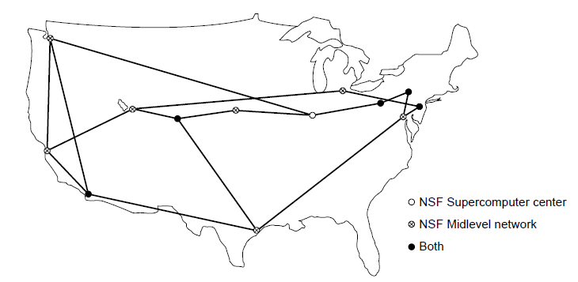
NSFNET
The NSFNET backbone in 1988.
Computer Networks, Fifth Edition by Andrew Tanenbaum and David Wetherall, © Pearson Education-Prentice Hall, 2011

Slide 61
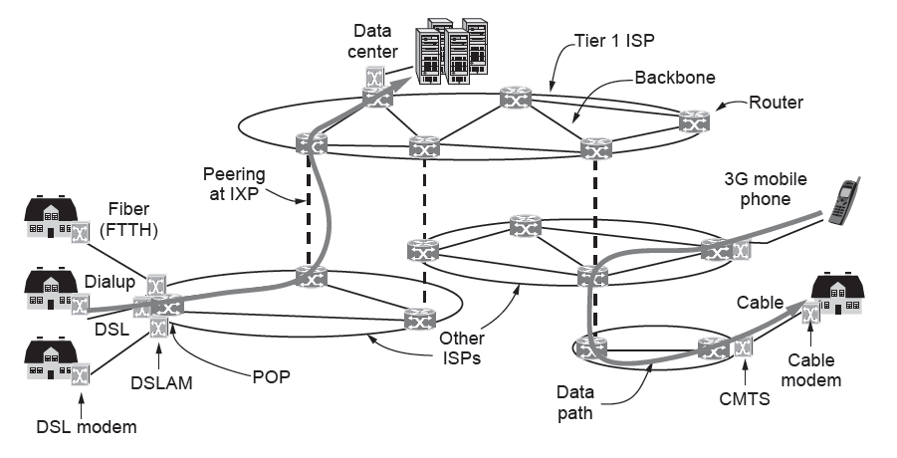
Architecture of the Internet
Overview of the Internet architecture
Computer Networks, Fifth Edition by Andrew Tanenbaum and David Wetherall, © Pearson Education-Prentice Hall, 2011

Slide 62
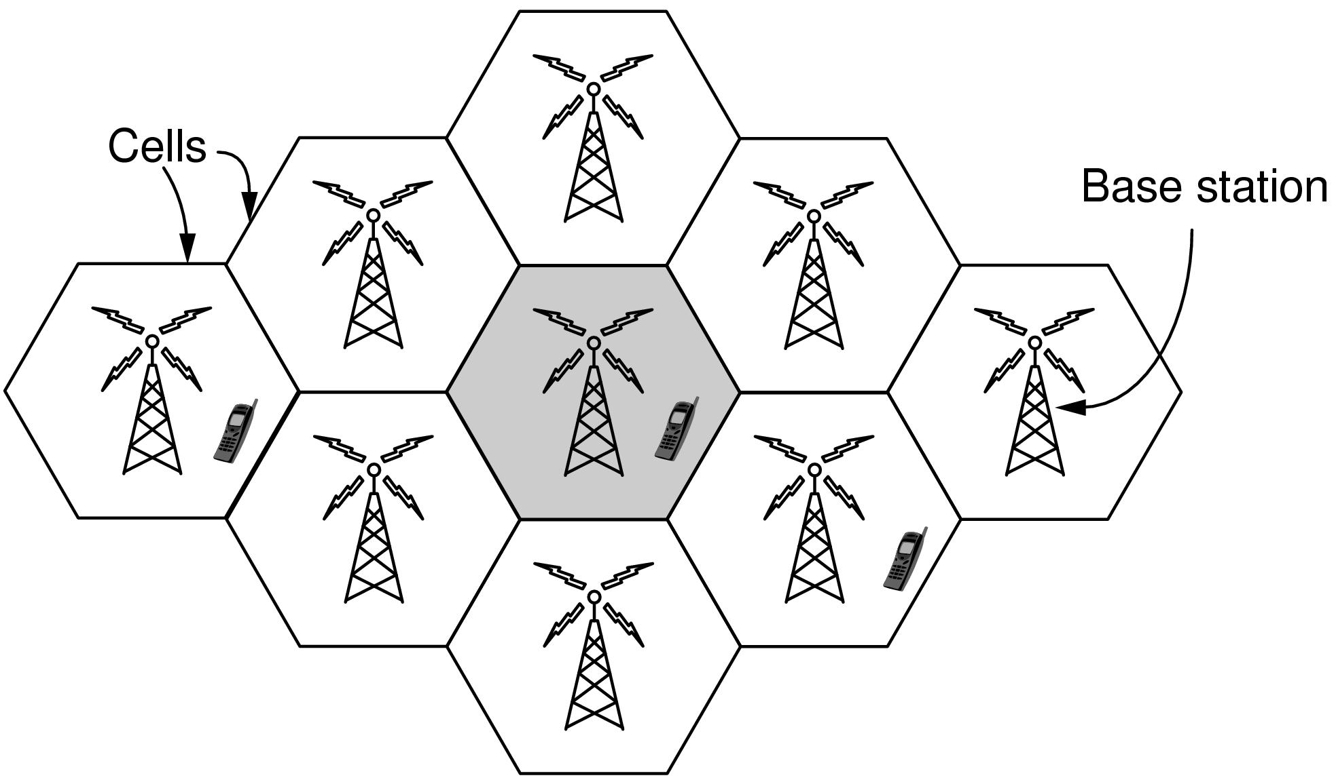
Third-Generation Mobile
Phone Networks (1)
Cellular design of mobile phone networks
Computer Networks, Fifth Edition by Andrew Tanenbaum and David Wetherall, © Pearson Education-Prentice Hall, 2011

Slide 63
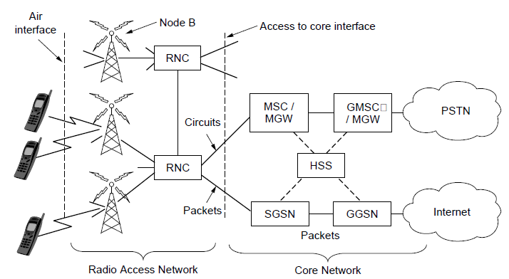
Third-Generation Mobile
Phone Networks (2)
Architecture of the UMTS 3G mobile phone network.
Computer Networks, Fifth Edition by Andrew Tanenbaum and David Wetherall, © Pearson Education-Prentice Hall, 2011

Slide 64
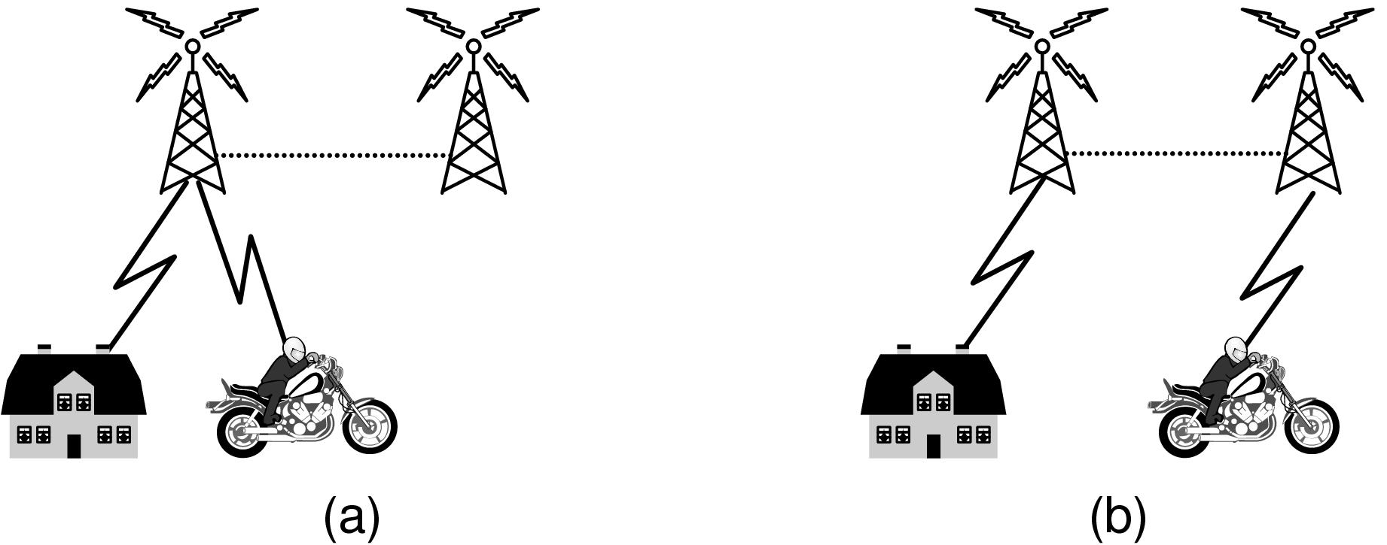
Third-Generation Mobile
Phone Networks (3)
Mobile phone handover (a) before, (b) after.
Computer Networks, Fifth Edition by Andrew Tanenbaum and David Wetherall, © Pearson Education-Prentice Hall, 2011

Slide 65
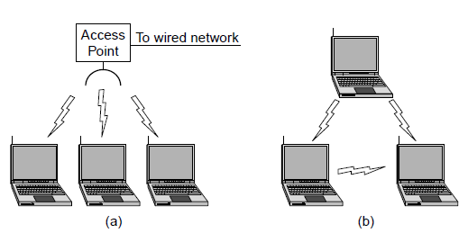
Wireless LANs: 802.11 (1)
Wireless network with an access point.
Ad hoc network.
Computer Networks, Fifth Edition by Andrew Tanenbaum and David Wetherall, © Pearson Education-Prentice Hall, 2011

Slide 66
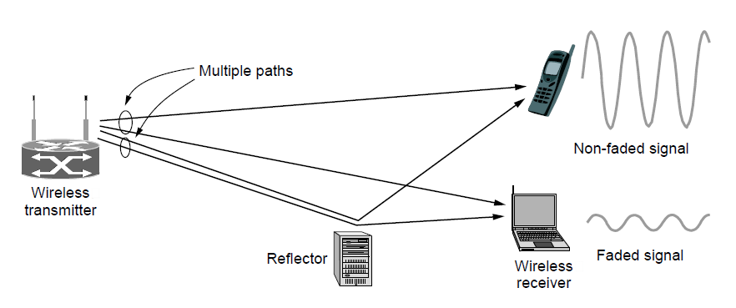
Wireless LANs: 802.11 (2)
Multipath fading
Computer Networks, Fifth Edition by Andrew Tanenbaum and David Wetherall, © Pearson Education-Prentice Hall, 2011

Slide 67
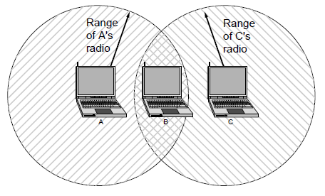
Wireless LANs: 802.11 (3)
The range of a single radio may not cover the entire system.
Computer Networks, Fifth Edition by Andrew Tanenbaum and David Wetherall, © Pearson Education-Prentice Hall, 2011

Slide 68
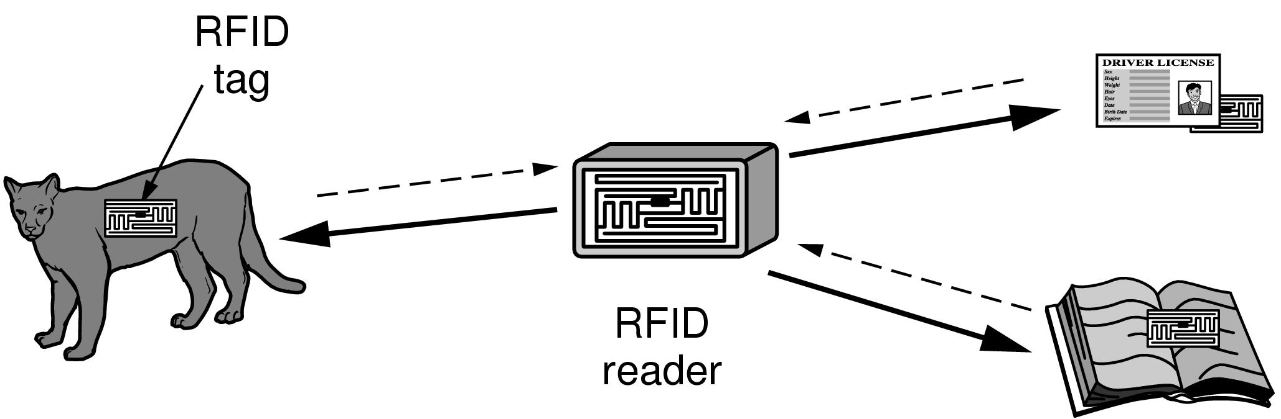
RFID and Sensor Networks (1)
RFID used to network everyday objects.
Computer Networks, Fifth Edition by Andrew Tanenbaum and David Wetherall, © Pearson Education-Prentice Hall, 2011

Slide 69
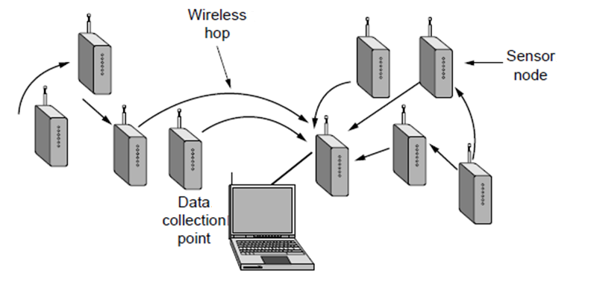
RFID and Sensor Networks (2)
Multihop topology of a sensor network
Computer Networks, Fifth Edition by Andrew Tanenbaum and David Wetherall, © Pearson Education-Prentice Hall, 2011

Slide 70
Network Standardization
Who’s Who in telecommunications
Who’s Who in international standards
Who’s Who in internet standards
Computer Networks, Fifth Edition by Andrew Tanenbaum and David Wetherall, © Pearson Education-Prentice Hall, 2011
Notes:
Who's Who (or "Who is Who") is the title of a number of reference publications, generally containing concise biographical information on the prominent people of a country. The title has been adopted as an expression meaning a group of notable persons.^{[1]}
The oldest and best-known is the annual publication Who's Who, a reference work on contemporary prominent people in Britain published annually since 1849.
The title "Who's Who" is in the public domain, and thousands of Who's Who compilations of varying scope and quality (and similar publications without the words "Who's Who") have been published by various authors and publishers.

Slide 71
Who’s Who
Who's Who (or "Who is Who") is the title of a number of reference publications, generally containing concise biographical information on the prominent people of a country.
The title has been adopted as an expression meaning a group of notable persons.
A listing or grouping of notable person or things.
Introduction
1-<number>

Slide 72
Cont…
The oldest and best-known is the annual publication Who's Who, a reference work on contemporary prominent people in Britain published annually since 1849.
The title "Who's Who" is in the public domain, and thousands of Who's Who compilations of varying scope and quality (and similar publications without the words "Who's Who") have been published by various authors and publishers.
Introduction
1-<number>

Slide 73
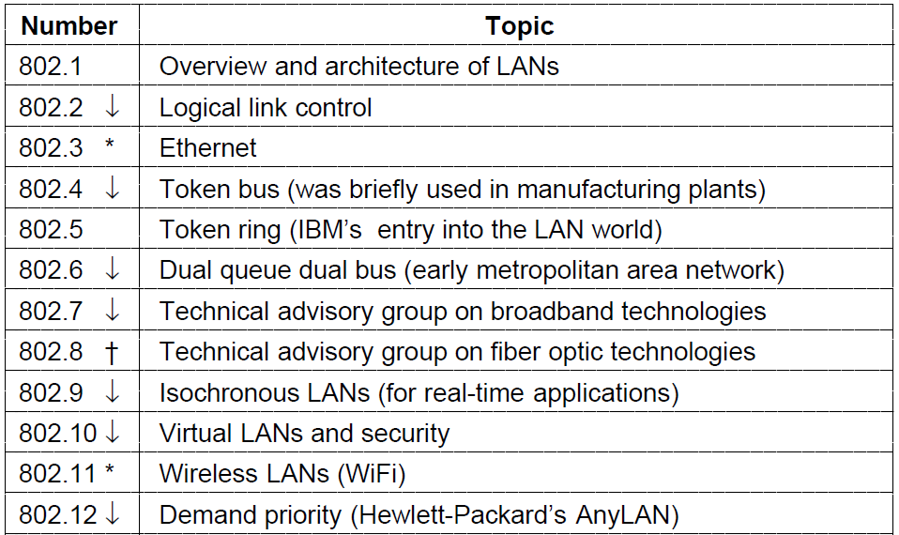
Who’s Who in International Standards (1)
The 802 working groups. The important ones are marked with *.
The ones marked with ↓ are hibernating. The one marked with † gave up and disbanded itself.

Slide 74
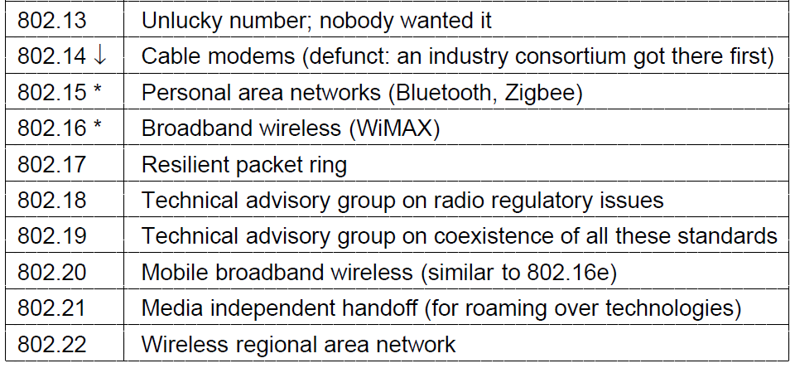
Who’s Who in International Standards (2)
The 802 working groups. The important ones are marked with *. The ones marked with ↓ are hibernating. The one marked with † gave up and disbanded itself.

Slide 75
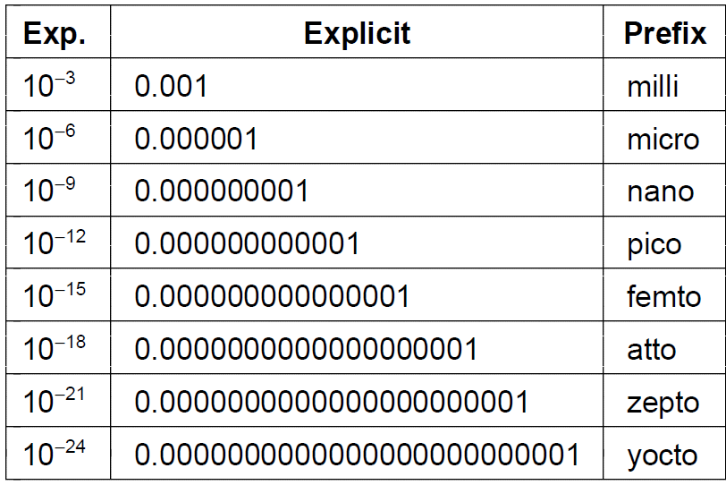
Metric Units (1)
The principal metric prefixes

Slide 76
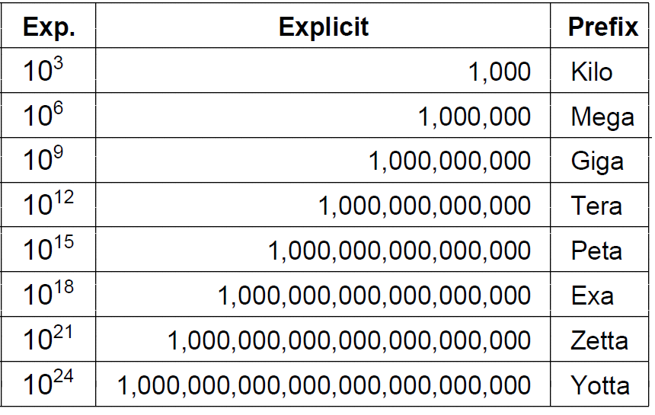
Metric Units (2)
The principal metric prefixes

