Slide 1
CLASSFUL
ADDRESSING

Slide 2
IP Address Classes
Class A
  N.H.H.H
  1-126
  0 can not be used as Net ID
  127 is reserved for loop back functions
  126 Different Networks
  16,777,214 Hosts per Network

Slide 3
IP Address Classes
Class B
  N.N.H.H
  128-191
  The first IP Address is the NET ID
  The last IP Address is the Broadcast Address
  16,384 Different Networks
  65543 Hosts per Network

Slide 4
IP Address Classes
Class C
  N.N.N.H
  192-223
  The first IP Address is the NET ID
  The last IP Address is the Broadcast Address
  2,097,152 Different Networks
  254 Hosts per Network

Slide 5
IP Address Classes
  CLASS D – Used for multicast broadcasts
  CLASS E – Experimental addresses not available to the public

Slide 6
IP structure
5 Classes of IP address A B C D and E
Class A reserved for governments
Class B reserved for medium companies
Class C reserved for small companies
Class D are reserved for multicasting
Class E are reserved for future use
Notes:
Which sections of the IP address represent the network and which sections represent the machine will depend on what "class" of IP address is assigned to a network.
There are 5 classes of IP addresses: Class A, Class B, Class C, Class D, and Class E.
Class A - supports 16 million hosts on each of 127 networks
Class B - supports 65,000 hosts on each of 16,000 networks
Class C - supports 254 hosts on each of 2 million networks

Slide 7
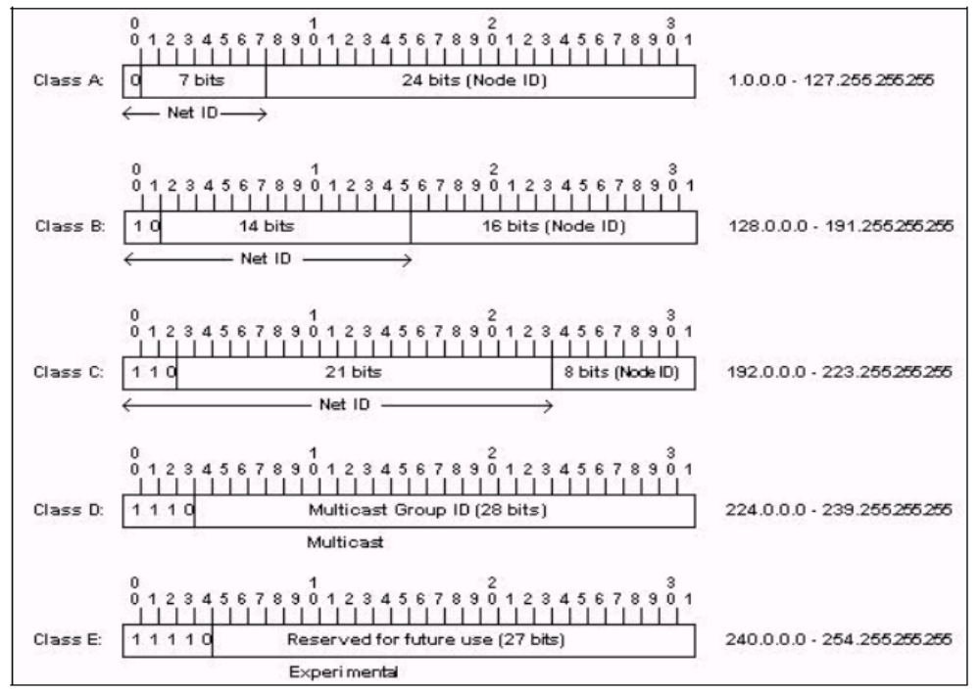
IP Address Classes

Slide 8
IP Address Classes
Class A: The first octet is the network portion. Octets 2, 3, and 4 are for subnets/hosts
Class B: The first two octets are the network portion. Octets 3 and 4 are for subnets/hosts
Class C: The first three octets are the network portion. Octet 4 is for subnets/hosts

Slide 9
In classful addressing the address space is
divided into 5 classes:
A, B, C, D, and E.

Slide 10
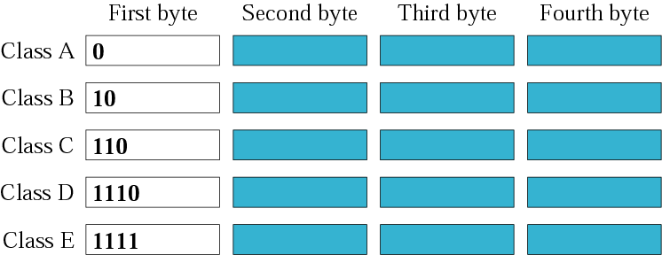
Figure 4-3
Finding the class in binary notation

Slide 11
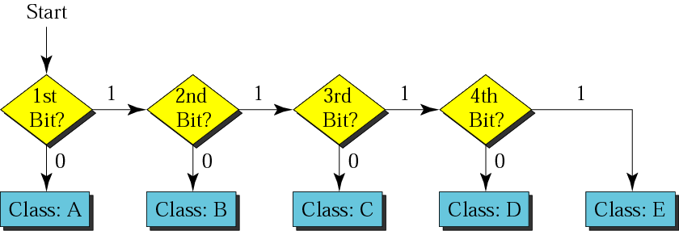
Figure 4-4
Finding the address class

Slide 12
Example 5
Show that Class A has
2³¹ = 2,147,483,648 addresses

Slide 13
Example 6
Find the class of the following IP addresses
00000001 00001011 00001011 11101111
11000001 00001011 00001011 11101111
Solution
00000001 00001011 00001011 11101111
1st is 0, hence it is Class A
11000001 00001011 00001011 11101111
1st and 2nd bits are 1, and 3rd bit is 0 hence, Class C

Slide 14

Figure 4-5
Finding the class in decimal notation

Slide 15
Example 7
Find the class of the following addresses
158.223.1.108
227.13.14.88
Solution
158.223.1.108
1st byte = 158 (128<158<191) class B
227.13.14.88
1st byte = 227 (224<227<239) class D

Slide 16
IP address with appending port number
158.128.1.108: 25
the four octet before colon is the IP address
The number of colon (25) is the port number

Slide 17
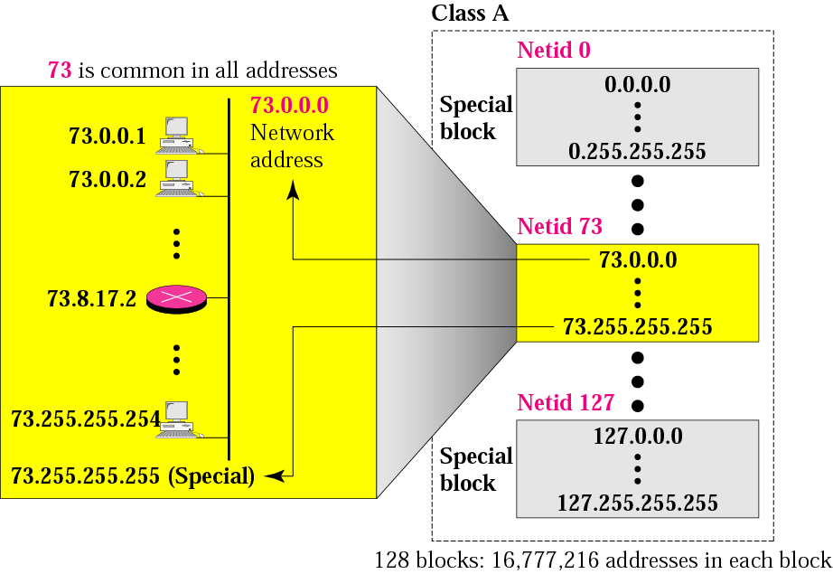
Figure 4-7
Blocks in class A

Slide 18

Millions of class A addresses
are wasted.

Slide 19
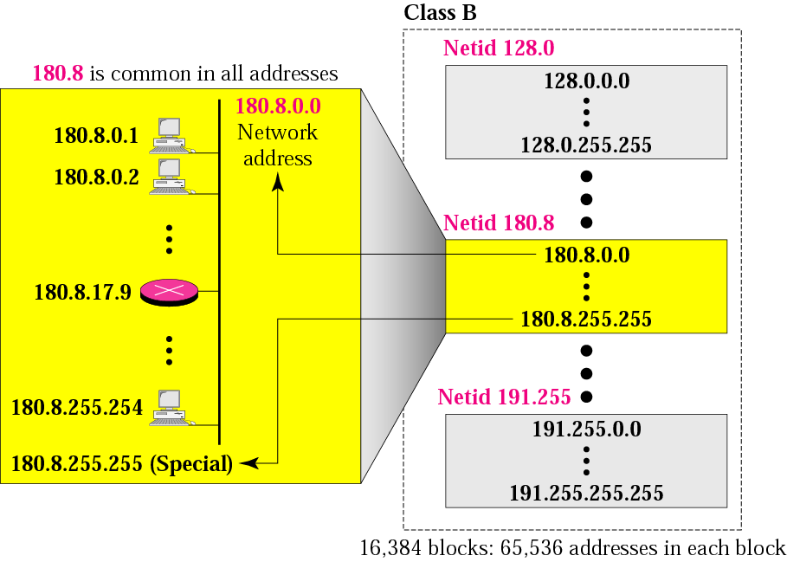
Figure 4-8
Blocks in class B

Slide 20
Many class B addresses
are wasted.

Slide 21
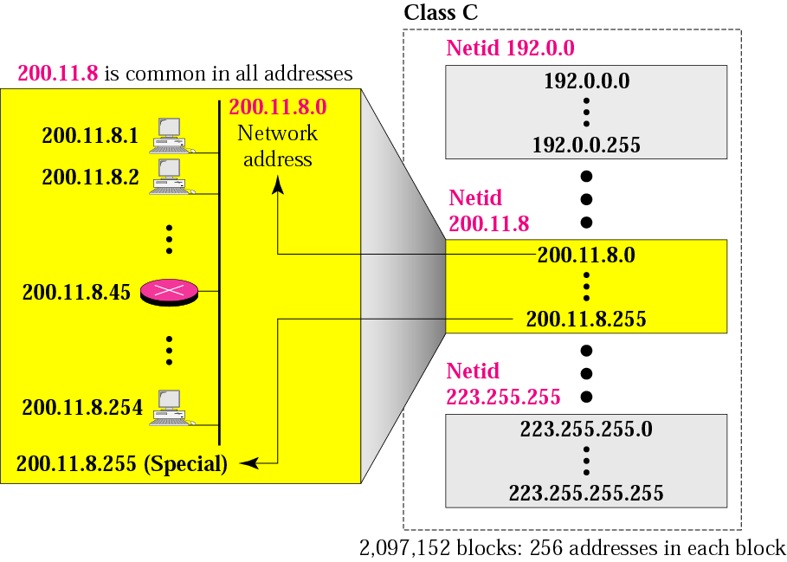
Figure 4-9
Blocks in class C

Slide 22
The number of addresses in
a class C block
is smaller than
the needs of most organizations.

Slide 23
Class D addresses
are used for multicasting;
there is only
one block in this class.

Slide 24
Class E addresses are reserved
for special purposes;
most of the block is wasted.

Slide 25
Network Addresses
The network address is the first address.
The network address defines the network to the rest of the Internet.
Given the network address, we can find the class of the address, the block, and the range of the addresses in the block

Slide 26
In classful addressing,
the network address
(the first address in the block)
is the one that is assigned
to the organization.

Slide 27
Example 8
Given the network address 132.21.0.0, find the
class, the block, and the range of the addresses
Solution
The 1st byte is between 128 and 191.
Hence, Class B
The block has a netid of 132.21.
The addresses range from
132.21.0.0 to 132.21.255.255.

Slide 28
Network Masks
Distinguishes which portion of the address identifies the network and which portion of the address identifies the node.
Default masks:
  Class A: 255.0.0.0
  Class B: 255.255.0.0
  Class C: 255.255.255.0

Slide 29
Mask
A mask is a 32-bit binary number.
The mask is ANDeD with IP address to get
  The bloc address (Network address)
  Mask And IP address = Block Address

Slide 30
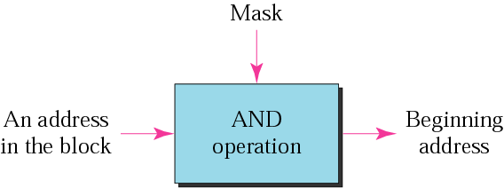
Figure 4-10
Masking concept

Slide 31
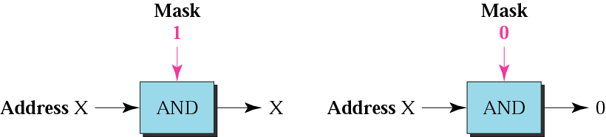
Figure 4-11
AND operation

Slide 32
The network address is the
beginning address of each block.
It can be found by applying
the default mask to
any of the addresses in the block
(including itself).
It retains the netid of the block
and sets the hostid to zero.

Slide 33
Default Mak
Class A default mask is 255.0.0.0
Class B default mask is 255.255.0.0
Class C Default mask 255.255.255.0

