Slide 1
Introduction & A Simple Robotic System
Md. Fazle Rabbi
ID:16CSE057

Slide 2
Contents
What is robot?
What Is Robotics...?
Law of Robotics
Essential Characteristics of robots
Types of Robots
A Simple Robotic System
Uses and Advantages of Robots
Disadvantages Of Robots

Slide 3
What is robot?
A robot is an autonomous machine capable of sensing its environment, carrying out computations to make decisions, and performing actions in the real world.
It is programmable, self control device consisting of electronic, electro-mechanical units
A robot is mechanical apparatus designed to do the work of man
Its components are electro-mechanical guided by computer.

Slide 4
What Is Robotics...?
Robotics is science of designing or building an application of robots. Simply ,Robotics may be defines as “The Study of Robots”.
The aim of robotics is to design an efficient robot.
Why Is Robotics Needed...?
Robotics is needed because:
•Speed
• Can work in hazardous/dangerous temperature
• Can do repetitive tasks
• Can do work with accuracy

Slide 5
laws of Robotics
Sir Isaac Asimov dealing on the subject of robotics framed three basic laws which the robotocists still obey with respect. The laws are philosophical in nature. They are as follows:
First Law: A robot must not harm a human being or, through inaction, allow one to come to harm.
Second Law: A robot must always obey human beings unless it is in conflict with the first law.
Third Law: A robot must protect itself from harm unless that is in conflict with the first and/or the second laws.

Slide 6
Essential Characteristics of robots
Sensing: The robot should be able to sense its surroundings and that is only possible with the help of sensors.
Types of sensors:
light sensors (eye) , touch sensors(hands) , hearing sensors(ears) or chemical, sensors(nose)
Movement: A robot needs to be able to move around its environment whether by rolling on wheels , walking , snaking or skating.
Energy: A robot needs to be able to power itself which depends upon its power resources e.g. batteries , power generators or fuel.
Intelligence: A robot needs to be intelligent and smart which is only possible by the programmer person.

Slide 7
Types of Robots
1) Mobile robots.
2) Industrial robots
3) Autonomous robots
4) Remote-controlled robots.
5) Virtual robots.

Slide 8
Autonomous Robots ▪ Autonomous robots are self supporting. ▪ They run a program that gives them the opportunity to decide on the action to perform depending on their surroundings
Mobile robots : Mobile robots are able to move, usually they perform tasks such as searching.
Industrial Robots or stationary robots
▪ Most of these robots perform repeating tasks without ever moving.
▪ Most robots are working in industries. Especially dull and repeating tasks are suitable for robots.

Slide 9
Remote-controlled Robots :Complicated tasks are still best performed by human beings with real brainpower. A person can guide a robot by remote control. A person can perform difficult and usually dangerous tasks without being at the spot where the tasks are performed.
Virtual Robots:
Virtual robots don’t exits in real life. Virtual robots are just programs, building blocks of software inside a computer.

Slide 10
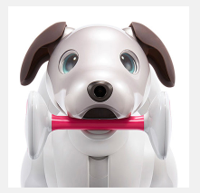
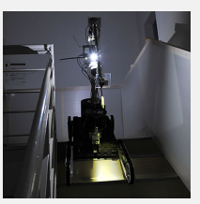
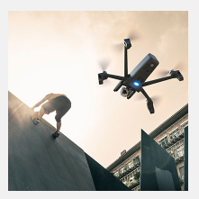
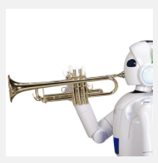
Consumer
Disaster Response
Drones
Entertainment:

Slide 11
A Simple Robotic System
A system is an integrated whole of parts or subsystems.
A system has a specified goal or output for a given set of inputs; a system may have many goals as well.
A robot is a system as it combines many subsystems that interact among themselves as well as with the environment in which the robot works.

Slide 12
A robot has many components which include:
1) A base-fixed or mobile.
2) A manipulator arm with several degrees of freedom (DOF).
3) An end-effector or gripper holding a part or a tool.
4) Drives or actuators causing the manipulator arm or end-effector to move in a space.
5) Controller with hardware and software support for giving commands to the drives.
6) Sensors to feed back the information for subsequent actions of the arm or gripper as well as to interact with the environment in which the robot is working.
7) Interfaces connecting the robotic subsystems to the external world.

Slide 13
Uses and Advantages of Robots
Used in vehicles and car factories
Mounting circuits on electronic devise e.g. mobile phones
Working where there might be danger e.g. nuclear leaks and bomb disposal
Surgeons are performing robotic surgeries to avoid jiggles and movement in microscopically aided surgery or brain surgery
Mail delivery to various mail stations throughout the building in large corporations
Toy robots are a good source of entertaining for the kids e.g. dancing and talking robots
Robots do not get bored or tired and they can work 24/7 without salary and food

Slide 14
Disadvantages Of Robots
It needs a high supply of power
People can lose jobs in factories
It needs maintenance to keep it running
It cost a lot of money to make or buy a robot as they are very expensive
A robot can not respond in time of danger as human can.

Slide 15
THE END

