Slide 1
Robot End-Effectors
Md. Fazle Rabbi
16CSE057

Slide 2
Robot End-Effectors
Robot end-effectors are the gripper or end-of-arm tooling mounted on the wrist of the robot manipulator arm.
The wide range of gripping methods include
Mechanical clamping
Magnetic gripping
Vacuum (suction) gripping
Mechanical type of grippers may simply use mechanical clamping with vice-type mechanism; it may use hooking or lifting mechanisms and mechanisms for scooping or ladling powders, molten metal or plastics. Mechanical type of grippers find wide applications in forging and metal working industry.
Magnetic grippers may be employed for transfer of steel sheets or chips.
Vacuum cups may be used for transfer of sheets of glass, plastic or thin sheets of papers.

Slide 3
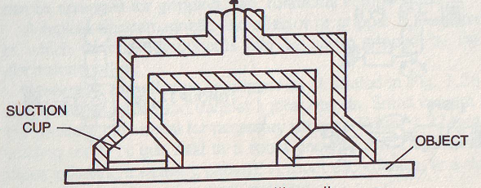
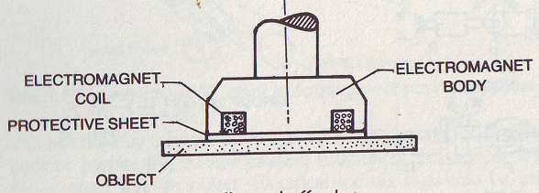
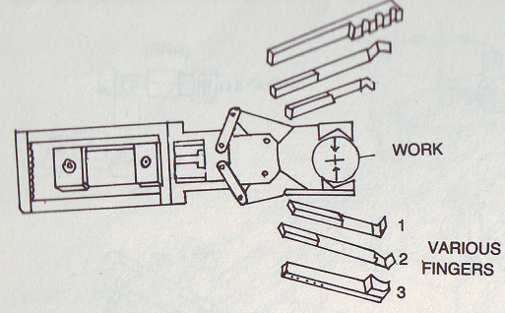
Robot End-Effectors

Slide 4
Classification of End Effectors
Impactive – jaws or claws which physically grasp by direct impact upon the object.
Ingressive – pins, needles or hackles which physically penetrate the surface of the object (used in textile, carbon and glass fiber handling).
Astrictive – suction forces (includes magnetic) applied to the objects surface.
Contigutive – requiring direct contact for adhesion to take place (such as glue, surface tension or freezing).
Grippers – to grasp and manipulate objects (e.g., parts) during work cycle
Tools – to perform a process, e.g., spot welding, spray painting

Slide 5
Tools as end effectors
In robot applications, the most commonly used three tools as end effectors are listed below:
1. Spot welding tools
2. Spray painting nozzle
3. Arc welding torch
Grippers as end effectors:
Grippers are the end effectors used for holding the parts or objects.
Grippers are devices which can be used for holding or gripping an object.

Slide 6
Robot Actuators
The robot arm can be put to a desired motion with its payload if actuator modules are fitted in to provide power drives to the systems.
There are three different types of power drives in common use. They are
Pneumatic
Hydraulic
Electric

Slide 7
Hydraulic actuators
The hydraulic actuators are used in robots handling heavy loads.
These actuators can produce very high force if we compared them with other actuators.
These actuators are deployed where higher speed, accuracy, and stability are required.

Slide 8
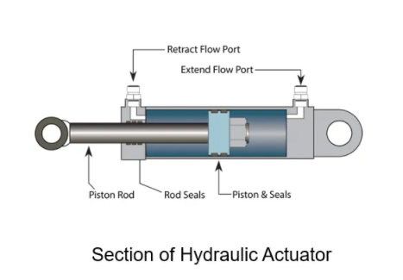
These actuators have a cylinder and piston arrangement which is shown in the following figure. The chamber is filled with hydraulic fluid.
The pressure applied to the fluid will push the piston, and that will move the actuator output shaft. The hydraulic actuators can convert the piston movement into linear and rotary movements.

Slide 9
Pneumatic actuators
As you have seen in hydraulic actuators, they use a hydraulic fluid in the cylinder in order to move the piston. The pressure applied to the fluid will move the piston. But in pneumatic actuators, instead of hydraulic fluid, compressed air is moving the piston.
Similar to hydraulic actuators, it can produce linear and rotary movements.

Slide 10
Electric actuators
The commonly used actuators in robotics are electric actuators. This actuator converts electric energy into linear or rotary motion.
The electric actuator can be AC/DC actuators. Mostly, robots are using DC actuators
Here are the advantages and disadvantage of electric actuators

Slide 11
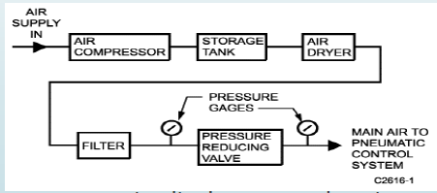
Pneumatic Drive System
A pneumatic control system uses compressed air as a method of control for HVAC systems. Compressed air is carried via copper and plastic tubes from a controller to a control device, usually a damper or valve actuator.
This control method relies on sensors and thermostats that bleed or retain the line pressure from the sensor to the control device and the actuator. Each senor responds to changes in temperature, humidity, and static pressure

Slide 12
Contitnue-----
The actuators contain diaphragms and spring to function in sequence with the control signal. This system uses the compressed air as the communication method. Each thermostat in a building with a pneumatic control system has one or more air lines connected to it from the main source of compressed air and to some type of final device such as a valve.

Slide 13
Hydraulic Drive System
Hydraulic systems apply pressure to fluid in order to generate power. A pump moves mechanical energy into the system by transporting fluid. Usually a hydraulic oil or synthetic lubricant, into a reservoir, where the fluid is stored and residual material including air and other moisture particles are removed.
Then, pressure is exerted against one side of the reservoir, forcing the liquid through valves using electrical, manual, hydraulic, pneumatic, or mechanical methods. The fluid is forced against an actuator, such as a hydraulic motor, cylinder, or piston on the opposite side of the reservoir. Energy is transferred to the actuator and turned from hydraulic energy into mechanical energy, forcing the actuator to move.

Slide 14
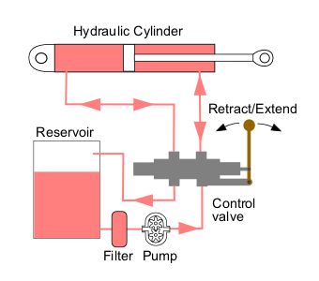
Contitnue-----
Due to the pressure exerted through the fluid, the actuator is not able to move in the opposite direction unless the pressure is released by a system operator. If the actuator is a piston being used, for example, to raise a forklift’s prongs, the prongs will remain elevated until the hydraulic pressure is released.

Slide 15
THE END

