Slide 1
Need For Sensing System
Human operators are continuously uses sensing concepts in their all activities
So for human like activities robots must be equipped with sensory feedback
The first reason is to provide positional and velocity information concerning the joint, arm and end-effector status, position, velocity and acceleration. These are manipulated by internal sensors
Other reasons are to prevent damage itself, its surroundings and human operator and to provide identification and real time information indicating the presence of different types of components and concerning the nature of tasks performed.

Slide 2
Sensors: Sensory Devices
A sensor is a transducer used to make a measurement of a physical variable. Five important characteristics of any sensing device are:
Range: This refers to the minimum and maximum change in input signal to which the sensor can respond. The sensor should possess a wide operating range.
Response: The sensor should be capable of responding to changes in the sensed variable in minimum time. Ideally, the response should be instantaneous.
Accuracy: The accuracy of the measurement should be as high as possible. The output of the sensing device should properly reflect the input quantity being measured or sensed.
Sensitivity: It refers to the change in the output exhibited by the sensor for a unit change in input. The sensitivity should be as high as possible.
Linearity The sensory device should exhibit the same sensitivity over its entire operating range.

Slide 3
Sensors: Sensory Devices
The following are the other considerations.
1. The device should not disturb or have any effect upon the quantity it senses or measures.
2. The device should be suitable for the environment in which it is to be employed.
3. Ideally, the device should include isolation from receiving excess signals or electrical noise that could give rise to the possibility of misoperation or damage of the sensor, circuit or system.
4. Also important are the physical size, cost and ease of operation.

Slide 4
Types of Sensors
Sensors in robotics may be broadly classified as contact and non-contact sensors.
As the name implies, the former class of sensors respond to physical contact, such as touch, slip, force and torque.
Non-contact sensors on the other hand rely on the response of a detector to variations in acoustic or electromagnetic radiation. The most prominent examples of non-contact sensors are range, proximity, and vision sensors.

Slide 5
Contact Sensors
Contact sensors are devices used in robotics to obtain information associated with the physical contact between a manipulator hand and objects in workspace.
Contact sensors can be subdivided into two principal categories: binary or touch sensor and analog or force sensors.
Binary sensors, also called touch sensors, are basically switches that respond to the presence or absence of an object. These sensors provide a binary output signal which indicates whether or not contact has been made with the object.
Analog sensors, also called force sensors, on the other hand provide an output signal proportional to a local force. They indicate not only that contact has been made with the object, but also the magnitude of the contact force between them

Slide 6
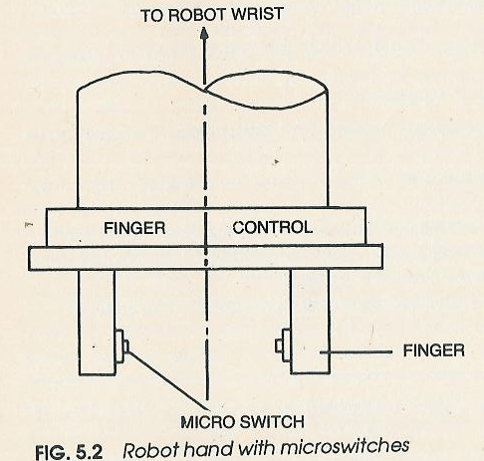
Touch Sensors

Slide 7
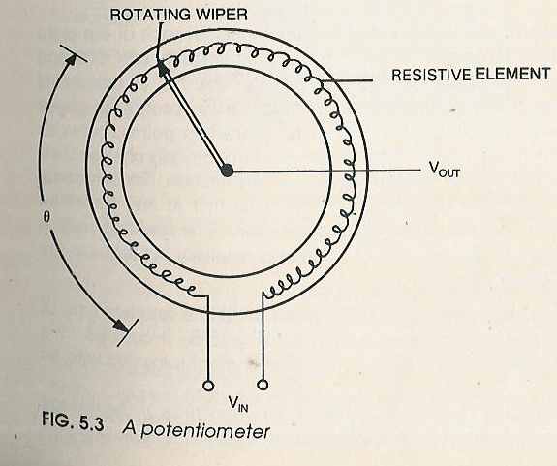
Position and Displacement Sensors
There are two main types of position sensors: absolute and incremental, the latter being also called displacement sensors.
Vo=K.θ
K= Constant in volt/rad. or volt/mm
Θ=position in rad.

Slide 8
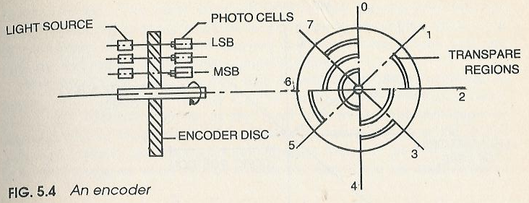
Position and Displacement Sensors
Encoders: Encoders which are non-contact type position sensors are classified into two basic types: incremental and absolute. Unlike potentiometers which give analog signals, encoders give digital signals directly.

Slide 9
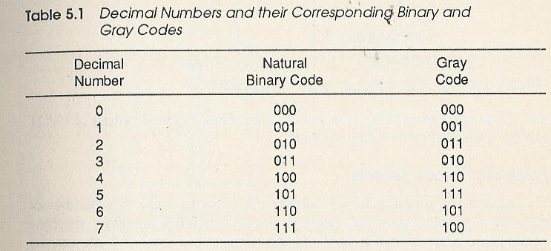
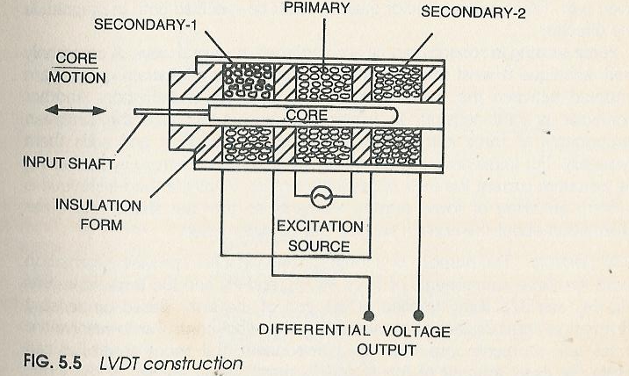
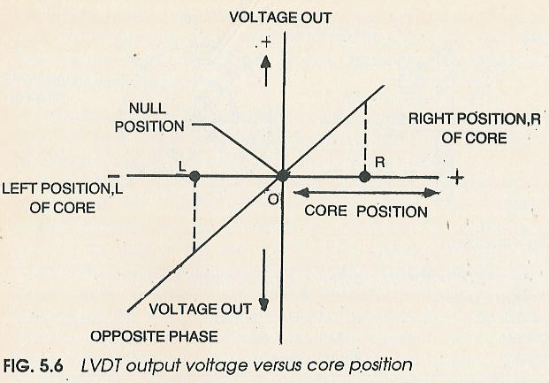
Position and Displacement Sensors
The Linear Variable Differential Transformer (LVDT)

Slide 10
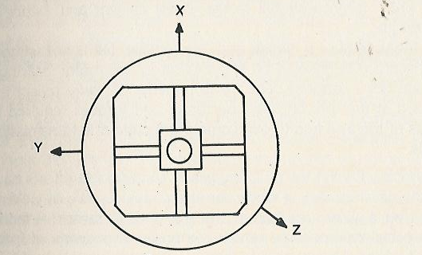
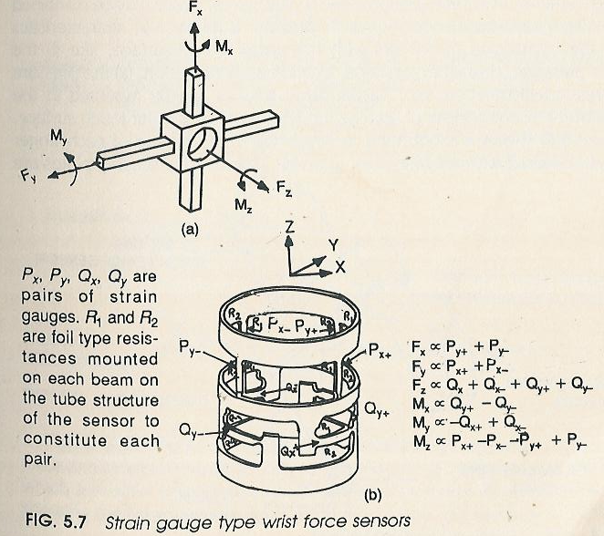
Force and Torque Sensors

Slide 11
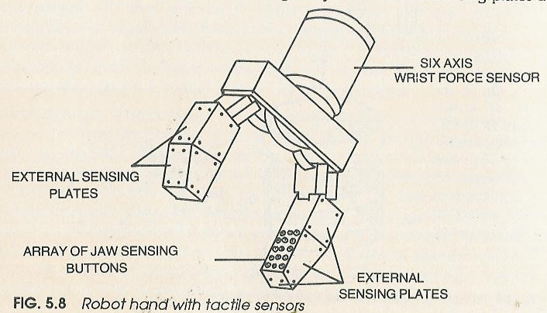
Tactile Array Sensors

Slide 12
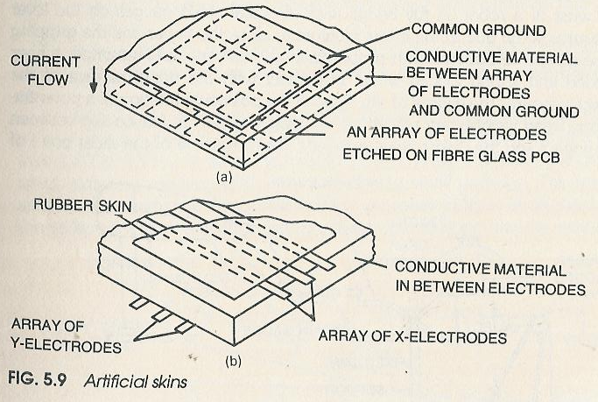
Artificial Skin

