Slide 1
Work Envelops & Robot Wrists
Md. Fazle Rabbi
ID:16CSE057

Slide 2
Robotics : Work Envelops
A robot's work envelope is its range of movement. It is the shape created when a manipulator reaches forward, backward, up and down. These distances are determined by the length of a robot's arm and the design of its axes. Each axis contributes its own range of motion.
Depending on the configuration and size of the links and wrist joints, robots can reach a collection of points called a Workspace.

Slide 3
what are the different types of robot?
Here's an overview of four types of industrial robots that every manufacturer should know.
Cartesian Coordinate Robot
Cylindrical Coordinate Robot
Spherical Coordinate Robot
Revolute Coordinate Robot

Slide 4
Cartesian Coordinate robots
Cartesian robots are a specific type of industrial robot that move on three orthogonal (perpendicular) axes — X, Y, and Z. These three axes are at right angles to one another and perform coordinated motions through a single motion controller.
Cartesian robots operate on cartesian coordinates, which are rectilinear two- or three-dimensional coordinates. While these axes all limit the robot to straight line motion in several directions, it is common for the third axis to be a rotary axis

Slide 5
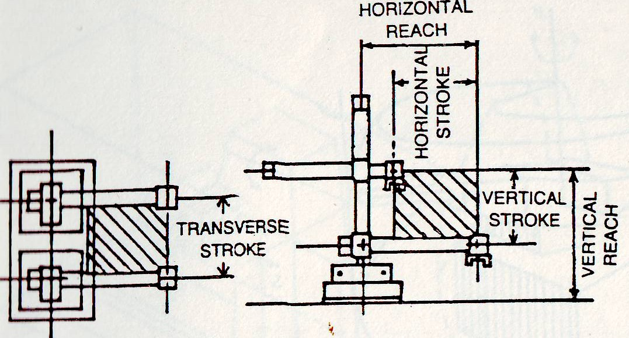
Cartesian Coordinate robots

Slide 6
Cylindrical Coordinate Robot
The cylindrical robot has a rotary joint for rotation and a prismatic joint for angular motion around the joint axis. The rotary joint moves in a rotational movement around the common axis. In contrast, the prismatic joint will move in a linear motion.
The main arm of cylindrical robots goes up and down. A cylinder built into the robotic arm produces this motion by stretching and retracting itself. Gears and a motor drive the movement of many of these cylindrical robotic versions, while a pneumatic cylinder drives the vertical motion. Assembly processes, management of machine tools and die-cast equipment, and spot welding are all done with cylindrical robots.

Slide 7
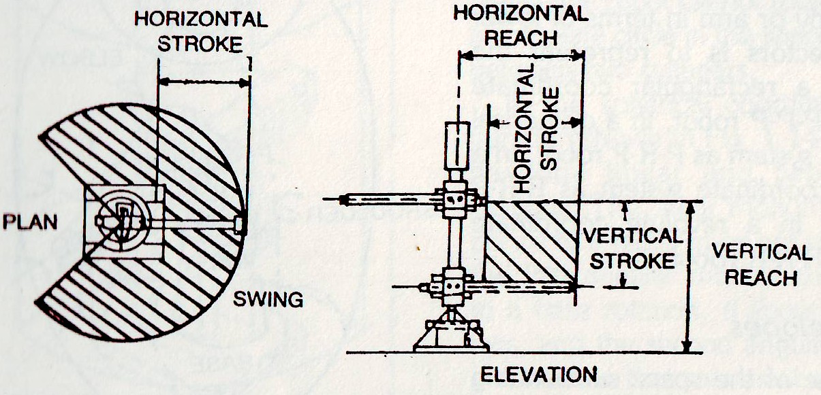
Cylindrical Coordinate Robot

Slide 8
Spherical Coordinate Robot
Spherical robots, sometimes regarded as polar robots, are stationary robot arms with spherical or near-spherical work envelopes that can be positioned in a polar coordinate system. Sounds pretty smart – you are free to use this if you want to impress someone with your wit.
So, these robots are more sophisticated than Cartesian and cylindrical robots, while control solutions are less complicated than those of articulated robot arms. This may be the reason why sometimes they are used as a base for robot kinematics exercises

Slide 9
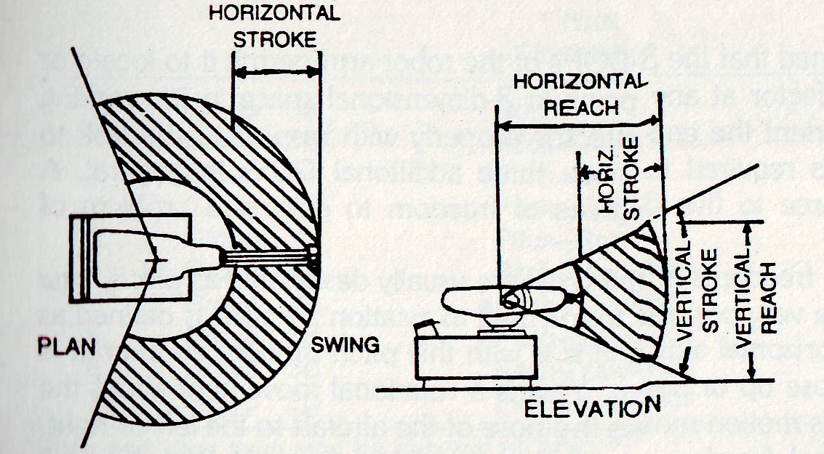
Spherical Coordinate Robot

Slide 10
Revolute Coordinate Robot
The revolute configuration, or jointed-arm, is the most common. These robots are often referred to as anthropomorphic because their movements closely resemble those of the human body. Rigid segments resemble the human forearm and upper arm. Various joints mimic the action of the wrist, elbow, and shoulder. A joint called the sweep represents the waist.
A revolute coordinate robot performs in an irregularly shaped work envelope. There are two basic revolute configurations: vertically articu- lated and horizontally articulated.

Slide 11
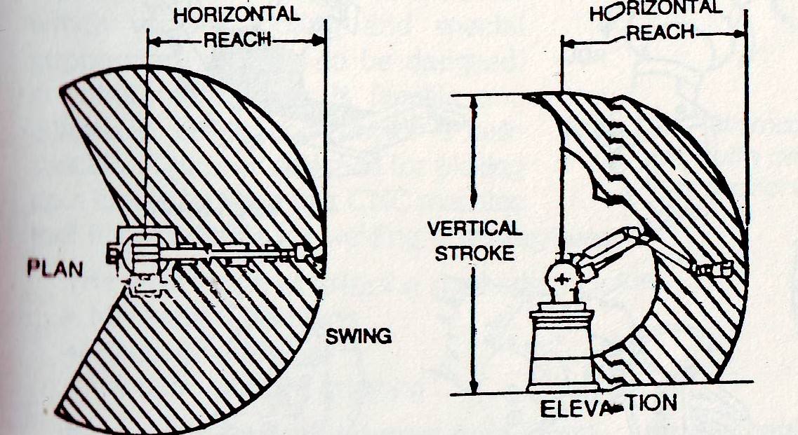
Revolute Coordinate Robot

Slide 12
Robotics : Robot Wrists
To orient the end-effectors properly with respect to the task to be performed, it is required to have three additional DOFs in general.
A wrist may have three to five degrees of freedom to solve the problem of orientation.
Three rotational freedoms of the wrist are usually designated as pitch, yaw and roll as they are very popular terms uses in aviation.

Slide 13
Continue
A pitch is defined as rotation about a horizontal axis and it is with this pitch motion, an aircraft is able to move its nose up or down.
Yaw is a rotational movement about the vertical axis and this motion moves the nose of the aircraft to the left or right.
A roll is a rotational freedom about the aircraft's own axis. With the roll motion, a craft can turn about its own axis. This concept has been extended to the design of the robot end-effectors attached to the wrist.

Slide 14
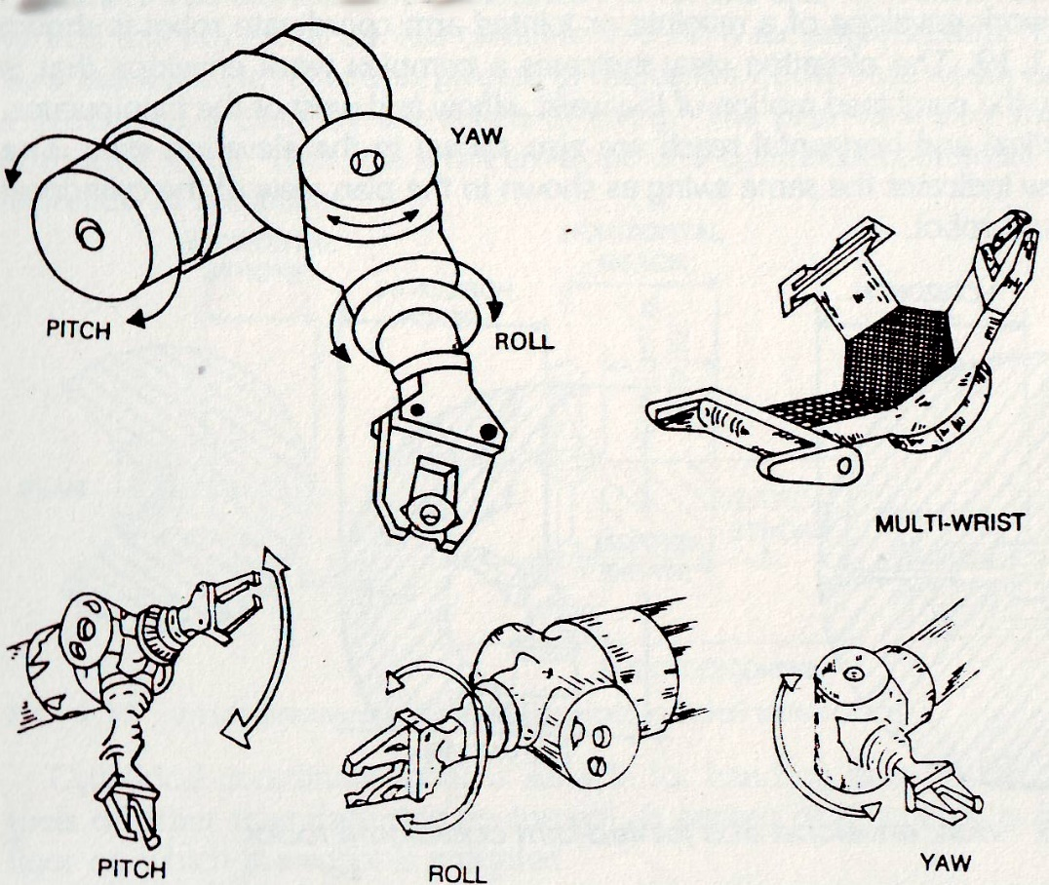
Continue

Slide 15
THE END

