Slide 1
Stepper Motors
Md. Fazle Rabbi
16CSE057

Slide 2
stepper motor
A stepper motor is an electromechanical device it converts electrical power into mechanical power. Also, it is a brushless, synchronous electric motor that can divide a full rotation into an expansive number of steps.
A stepper motor is a special electrical machine which rotates in discrete angular steps in response to a programmed sequence of input electrical pulses.
The motor’s position can be controlled accurately without any feedback mechanism, as long as the motor is carefully sized to the application.

Slide 3
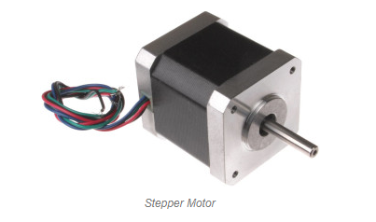
Construction stepper motor
The construction of a stepper motor is fairly related to a DC motor. It includes a permanent magnet like Rotor which is in the middle & it will turn once force acts on it.
This rotor is enclosed through a no. of the stator which is wound through a magnetic coil all over it. The stator is arranged near to rotor so that magnetic fields within the stators can control the movement of the rotor.

Slide 4
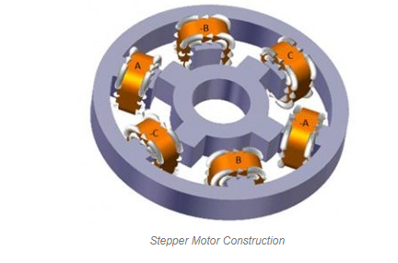
The stepper motor can be controlled by energizing every stator one by one. So the stator will magnetize & works like an electromagnetic pole which uses repulsive energy on the rotor to move forward.
The stator’s alternative magnetizing as well as demagnetizing will shift the rotor gradually &allows it to turn through great control.

Slide 5
stepper motor working principle
The stepper motor working principle is Electro-Magnetism.
It includes a rotor which is made with a permanent magnet whereas a stator is with electromagnets.
Once the supply is provided to the winding of the stator then the magnetic field will be developed within the stator.
Now rotor in the motor will start to move with the rotating magnetic field of the stator.

Slide 6
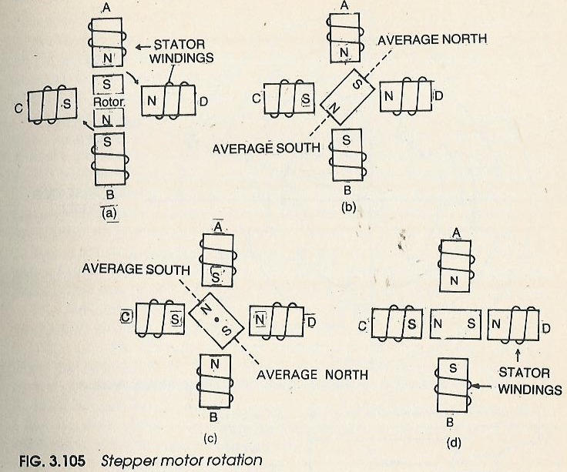
stepper motor working principle

Slide 7
Stepper Motor Circuit & Its Operation
Stepper motors operate differently from DC brush motors, which rotate when voltage is applied to their terminals.
Stepper motors, on the other hand, effectively have multiple toothed electromagnets arranged around a central gear-shaped piece of iron.
The electromagnets are energized by an external control circuit, for example, a microcontroller.

Slide 8
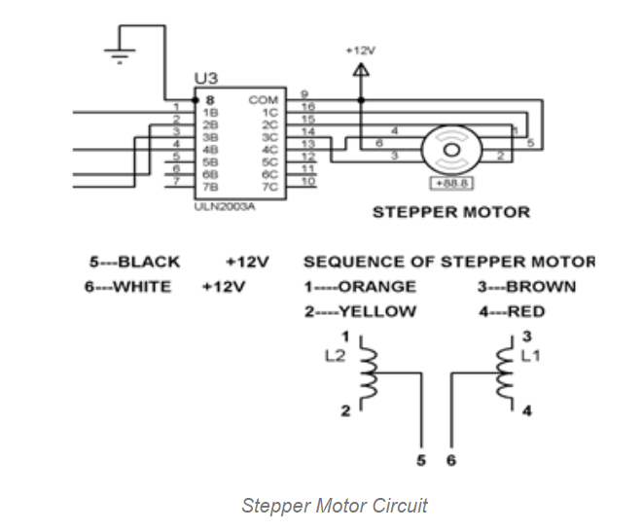
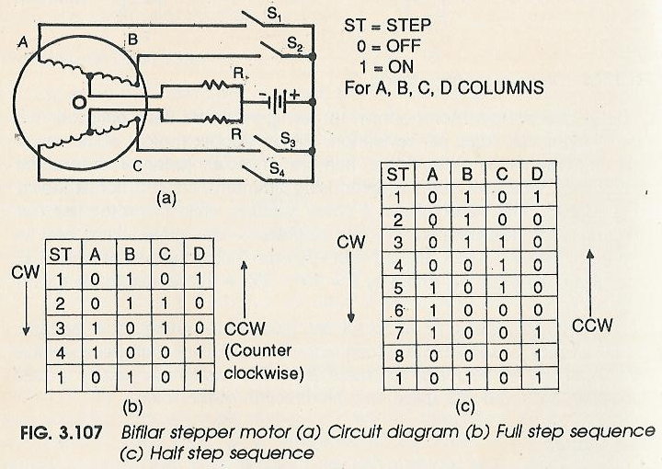
Stepper Motor Circuit design

Slide 9
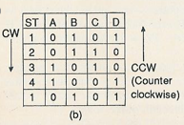
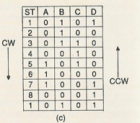
Stepper Motor Circuit design

Slide 10
To make the motor shaft turn, first one electromagnet is given power, which makes the gear’s teeth magnetically attracted to the electromagnet’s teeth.
At the point when the gear’s teeth are thus aligned to the first electromagnet, they are slightly offset from the next electromagnet.
So when the next electromagnet is turned ON and the first is turned OFF, the gear rotates slightly to align with the next one and from there the process is repeated. Each of those slight rotations is called a step, with an integer number of steps making a full rotation.
The working of this motor is shown by operating the switch. The coils are activated in series in 1-sec intervals. The shaft rotates 90º each time the next coil is activated. Its low-speed torque will vary directly with current.

Slide 11
The advantages of stepper motor include the following
Simple construction
Can work in an open-loop control system
Maintenance is low
It works in any situation
Reliability is high
The rotation angle of the motor is proportional to the input pulse.
The motor has full torque at standstill.
Precise positioning and repeatability of movement since good stepper motors have an accuracy of 3 – 5% of a step and this error is noncumulative from one step to the next.
Excellent response to starting, stopping, and reversing.
Very reliable since there are no contact brushes in the motor. Therefore the life of the motor is simply dependant on the life of the bearing.

Slide 12
The disadvantages of stepper motor include the following.
Efficiency is low
The Torque of a motor will declines fast with speed
Accuracy is low
Feedback is not used for specifying potential missed steps
Small Torque toward Inertia Ratio
Extremely Noisy
If the motor is not controlled properly then resonances can occur
Operation of this motor is not easy at very high speeds.
The dedicated control circuit is necessary
As compared with DC motors, it uses more current

Slide 13
The applications of stepper motor include the following.
Industrial Machines – Stepper motors are used in automotive gauges and machine tooling automated production equipment.
Security – new surveillance products for the security industry.
Medical – Stepper motors are used inside medical scanners, samplers, and also found inside digital dental photography, fluid pumps, respirators, and blood analysis machinery.
Consumer Electronics – Stepper motors in cameras for automatic digital camera focus and zoom functions.

Slide 14
THE END

