Slide 1
Message Authentication and Hash Functions

Slide 2
Message Authentication
Message authentication is concerned with:
  Protecting the integrity of a message
  Validating identity of originator
  Non-repudiation of origin (dispute resolution)
Will consider the security requirements
Three alternative functions used:
  Message encryption
  Message Authentication Code (MAC)
  Hash functions
Notes:
One of the most fascinating and complex areas of cryptography is that of message authentication and the related area of digital signatures. We now consider how to protect message integrity (ie protection from modification), as well as confirming the identity of the sender. Generically this is the problem of message authentication, and in eCommerce applications is arguably more important than secrecy. Message Authentication is concerned with: protecting the integrity of a message, validating identity of originator, & non-repudiation of origin (dispute resolution). There are three types of functions that may be used to produce an authenticator: a hash function, message encryption, message authentication code (MAC). Hash functions, and how they may serve for message authentication, are discussed in Chapter 11. The remainder of this section briefly examines the remaining two topics. The remainder of the chapter elaborates on the topic of MACs.
non-repudiation of origin (dispute resolution).

Slide 3
Message Authentication Requirements
In communications across a network, the following attacks could be identified:
Disclosure: Release of message contents
Traffic analysis: Discovery of the pattern of traffic between parties
Masquerade: Insertion of messages into the network from a fraudulent source
Content modification: Modification of the contents of a message

Slide 4
Message Authentication Requirements
Sequence modification: Modification to a sequence of messages between parties
Timing modification: Delay or replay of messages
Source repudiation: Denial of transmission of message by source
Destination repudiation: Denial of receipt of message by destination

Slide 5
Authentication Function
Message Encryption
Message Authentication Code (MAC)
Hash Function
Notes:
With public-key techniques, can get a digital signature which can only have been created by key owner. But at cost of two public-key operations at each end on message.

Slide 6
Message Encryption
Message encryption by itself also provides a measure of authentication
The analysis differs for symmetric and public key encryption schemes.
Notes:
Message encryption by itself can provide a measure of authentication. Here, the ciphertext of the entire message serves as its authenticator, on the basis that only those who know the appropriate keys could have validly encrypted the message. This is provided you can recognize a valid message (ie if the message has suitable structure such as redundancy or a checksum to detect any changes).

Slide 7
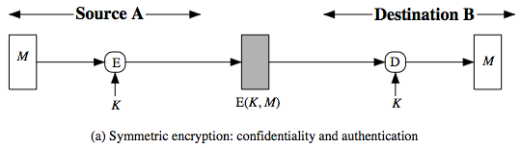
Symmetric Message Encryption
Encryption can also provides authentication
If symmetric encryption is used then:
  Receiver know sender must have created it
  Since only sender and receiver use key
  If message has suitable structure, redundancy or a checksum to detect any changes
Notes:
Message encryption by itself can provide a measure of authentication. The analysis differs for symmetric and public-key encryption schemes.
If use symmetric encryption, If no other party knows the key, then confidentiality is provided. As well, symmetric encryption provides authentication as well as confidentiality, since only the other party can have encrypted a properly constructed message (Stallings Figure 12.1a). Here, the ciphertext of the entire message serves as its authenticator, on the basis that only those who know the appropriate keys could have validly encrypted the message. This is provided you can recognize a valid message (ie if the message has suitable structure such as redundancy or a checksum to detect any changes).

Slide 8
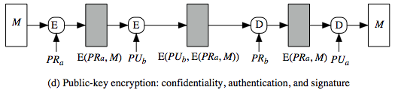
Public-key Message Encryption
If public-key encryption is used:
    Anyone potentially knows public-key
  However if
    Sender signs message using their private-key
    Then encrypts with recipients public key
    Have both secrecy and authentication
  Again need to recognize corrupted messages
  But at cost of two public-key uses on message
Notes:
With public-key techniques, can use a digital signature which can only have been created by key owner to validate the integrity of the message contents. To provide both confidentiality and authentication, A can encrypt M first using its private key, which provides the digital signature, and then using B's public key, which provides confidentiality (Stallings Figure 12.1d). The disadvantage of this approach is that the public-key algorithm, which is complex, must be exercised four times rather than two in each communication.

Slide 9
Message Authentication Codes
(MAC)
Why use a MAC?
  sometimes only authentication is needed
  sometimes need authentication to persist longer than the encryption (eg. archival use)
provides authentication
Can combine use of MAC with encryption for secrecy
  generally use separate keys for each
  can compute MAC either before or after encryption
  is generally regarded as better done before
MAC is not a digital signature
Notes:
Can combine use of MAC with encryption in various ways to provide both authentication & secrecy.
Use MAC in circumstances where just authentication is needed (or needs to be kept), see text for examples.
A MAC is NOT a digital signature since both sender & receiver share key and could create it.

Slide 10
Message Authentication Code (MAC)
Generated by an algorithm that creates a small fixed-sized block
  depends on both message and some key
  like encryption though need not be reversible
Appended to message as a signature
Receiver performs same computation on message and checks it matches the MAC
Provides assurance that message is unaltered and comes from sender
Notes:
An alternative authentication technique involves the use of a secret key to generate a small fixed-size block of data, known as a cryptographic checksum or MAC that is appended to the message. This technique assumes that two communicating parties, say A and B, share a common secret key K. A MAC function is similar to encryption, except that the MAC algorithm need not be reversible, as it must for decryption.

Slide 11
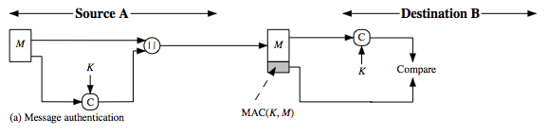
Message Authentication Code
A small fixed-sized block of data
  Generated from message + secret key
  MAC = C(K,M)
  Appended to message when sent
Notes:
An alternative authentication technique involves the use of a secret key to generate a small fixed- size block of data, known as a cryptographic checksum or MAC that is appended to the message. This technique assumes that two communicating parties, say A and B, share a common secret key K. When A has a message to send to B, it calculates the MAC as a function of the message and the key: MAC = C(K, M). The message plus MAC are transmitted to the intended recipient. The recipient performs the same calculation on the received message, using the same secret key, to generate a new MAC. The received MAC is compared to the calculated MAC (Stallings Figure 12.4a). If we assume that only the receiver and the sender know the identity of the secret key, and if the received MAC matches the calculated MAC, then the receiver is assured that the message has not been altered, is from the alleged sender, and if the message includes a sequence number then the receiver can be assured of the proper sequence because an attacker cannot successfully alter the sequence number. A MAC function is similar to encryption. One difference is that the MAC algorithm need not be reversible, as it must for decryption. In general, the MAC function is a many-to-one function.

Slide 12
MAC Properties
A MAC is a cryptographic checksum
  MAC = C(K,M)
  condenses a variable-length message M
  using a secret key K
  to a fixed-sized authenticator
Is a many-to-one function
  potentially many messages have same MAC
  but finding these needs to be very difficult
Notes:
A MAC (also known as a cryptographic checksum, fixed-length authenticator, or tag) is generated by a function C. The MAC is appended to the message at the source at a time when the message is assumed or known to be correct. The receiver authenticates that message by re-computing the MAC.
The MAC function is a many-to-one function, since potentially many arbitrarily long messages can be condensed to the same summary value, but don’t want finding them to be easy (see text for discussion)!

Slide 13
Requirements for MACs
Taking into account the types of attacks
Need the MAC to satisfy the following:
  knowing a message and MAC, is infeasible to find another message with same MAC
  MACs should be uniformly distributed
  MAC should depend equally on all bits of the message
Notes:
In assessing the security of a MAC function, we need to consider the types of attacks that may be mounted against it. Hence it needs to satisfy the listed requirements.
The first requirement deals with message replacement attacks, in which an opponent is able to construct a new message to match a given MAC, even though the opponent does not know and does not learn the key.
The second requirement deals with the need to thwart a brute-force attack based on chosen plaintext.
The final requirement dictates that the authentication algorithm should not be weaker with respect to certain parts or bits of the message than others.

Slide 14
Using Symmetric Ciphers for MACs
Can use any block cipher chaining mode and use final block as a MAC
Data Authentication Algorithm (DAA) is a widely used MAC based on DES-CBC
  using IV=0 and zero-pad of final block
  encrypt message using DES in CBC mode
  and send just the final block as the MAC
    or the leftmost M bits (16≤M≤64) of final block
But final MAC is now too small for security
Notes:
Can also use block cipher chaining modes to create a separate authenticator, by just sending the last block. This was done with the Data Authentication Algorithm (DAA), a widely used MAC based on DES-CBC (next slide). However this suffers from being too small for acceptable use today.

Slide 15
Hash Functions
Want a cryptographic hash function
  Computationally infeasible to find data mapping to specific hash (one-way property)
  Computationally infeasible to find two data to same hash (collision-free property)

Slide 16
Hash Functions
Condenses arbitrary message to fixed size
  h = H(M)
Usually assume that the hash function is public and not keyed
  cf. MAC which is keyed
Hash used to detect changes to message
Can use in various ways with message
Most often to create a digital signature
Notes:
A variation on the message authentication code is the one-way hash function. As with the message authentication code, a hash function accepts a variable-size message M as input and produces a fixed-size output, referred to as a hash code H(M). Unlike a MAC, a hash code does not use a key but is a function only of the input message. The hash code is also referred to as a message digest or hash value.
Condenses পরিস্থিতি

Slide 17
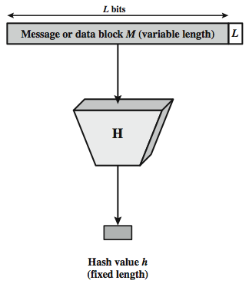
Cryptographic Hash Function
Figure depicts the general operation of a cryptographic hash function.
The input is padded out to an integer multiple of some fixed length (e.g., 1024 bits) and the padding includes the value of the length of the original message in bits.
The length field is a security measure to increase the difficulty for an attacker to produce an alternative message with the same hash value.

Slide 18
Hash Functions & Message Authentication
Message authentication is a mechanism or service used to verify the integrity of a message, by assuring that the data received are exactly as sent.
Figure A, B, C and D illustrates a variety of ways in which a hash code can be used to provide message authentication, as follows:

Slide 19
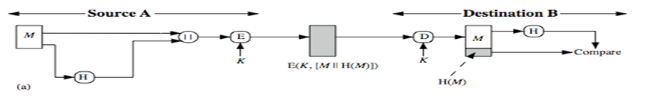
A
The message plus concatenated hash code is encrypted using symmetric encryption. Since only A and B share the secret key, the message must have come from A and has not been altered.
The hash code provides the structure or redundancy required to achieve authentication.

Slide 20
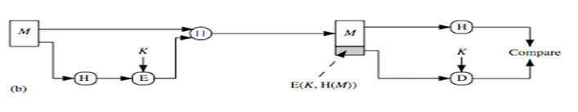
B
Only the hash code is encrypted, using symmetric encryption. This reduces the processing burden for those applications not requiring confidentiality.

Slide 21
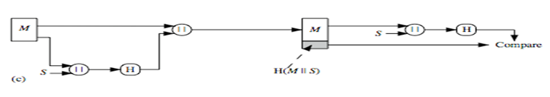
C
Shows the use of a hash function but no encryption for message authentication.
The technique assumes that the two communicating parties share a common secret value S.
A computes the hash value over the concatenation of M and S and appends the resulting hash value to M.
Because B possesses S, it can re-compute the hash value to verify.
Because the secret value itself is not sent, an opponent cannot modify an intercepted message and cannot generate a false message.

Slide 22
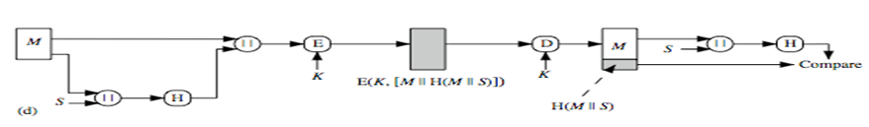
D
Confidentiality can be added to the approach of (c) by encrypting the entire message plus the hash code.

Slide 23
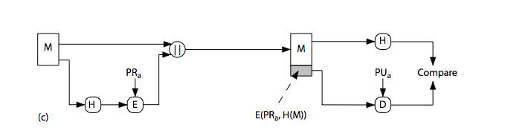
Hash Functions & Digital Signatures
Notes:
Stallings Figure 11.5c “Basic Uses of Hash Functions” shows the hash being “signed” with the senders private key, thus forming a digital signature.

Slide 24
Requirements for Hash Functions
Can be applied to any sized message M
Produces fixed-length output h
Is easy to compute h=H(M) for any message M
Given h is infeasible to find x
H(x)=h
  one-way property
Given x is infeasible to find y
H(y)=H(x)
  weak collision resistance
Is infeasible to find any x,y
H(y)=H(x)
  strong collision resistance
Notes:
The purpose of a hash function is to produce a “fingerprint”of a file, message, or other block of data.
These are the specifications for good hash functions. Essentially it must be extremely difficult to find 2 messages with the same hash, and the hash should not be related to the message in any obvious way (ie it should be a complex non-linear function of the message). There are quite a few similarities in the evolution of hash functions & block ciphers, and in the evolution of the design requirements on both.

Slide 25
Simple Hash Functions
Are several proposals for simple functions
Based on XOR of message blocks
Not secure since can manipulate any Message and either not change hash or change hash also
Need a stronger cryptographic function (next chapter)
Notes:
All hash functions operate using the following general principles. The input (message, file,etc.) is viewed as a sequence of n-bit blocks, processed one block at a time in an iterative fashion to produce an n-bit hash function. Can construct a range of possible simple hash functions by just XOR’ing blocks with rotates etc. None of these are secure, since can predict how changes to message affect the resulting hash.

Slide 26
Birthday Attacks
Might think a 64-bit hash is secure
But by Birthday Paradox is not
Birthday attack works thus:
  opponent generates 2^{m/2} variations of a valid message all with essentially the same meaning
  opponent also generates 2^{m/2} variations of a desired fraudulent message
  two sets of messages are compared to find pair with same hash (probability > 0.5 by birthday paradox)
  have user sign the valid message, then substitute the forgery which will have a valid signature
Conclusion is that need to use larger MAC/hash
Notes:
The Birthday Attack exploits the birthday paradox – the chance that in a group of people two will share the same birthday – only 23 people are needed for a Pr>0.5 of this. Can generalize the problem to one wanting a matching pair from any two sets, and show need 2^{m/2} in each to get a matching m-bit hash.
Note that creating many message variants is relatively easy, either by rewording or just varying the amount of white-space in the message. All of which indicates that larger MACs/Hashes are needed.

Slide 27
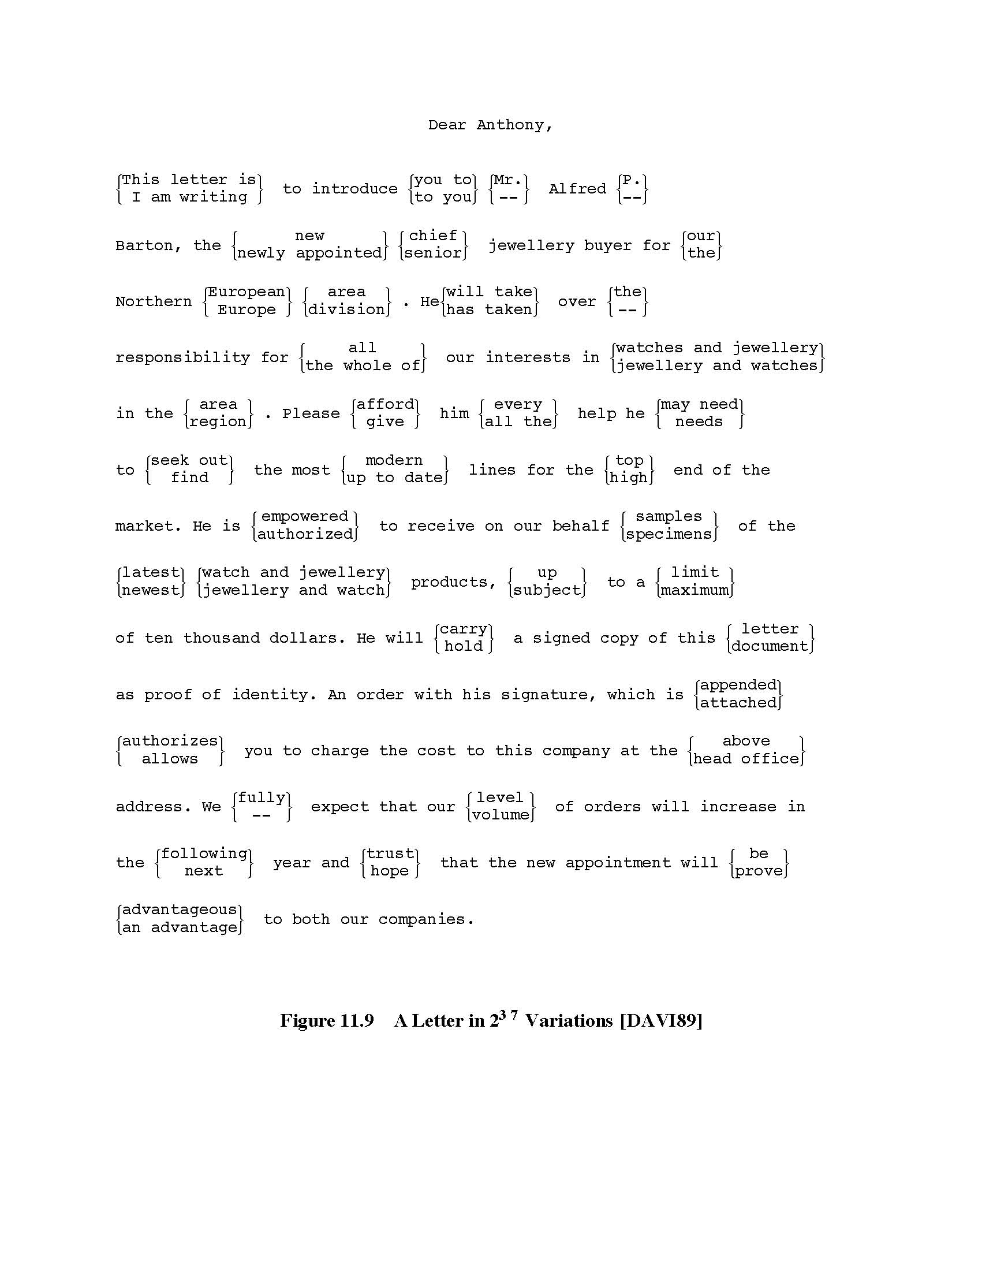

Slide 28
Block Ciphers as Hash Functions
Can use block ciphers as hash functions
  using H₀=0 and zero-pad of final block
  compute: H_{i} = E_{Mi} [H_{i-1}]
  and use final block as the hash value
  similar to CBC but without a key
Resulting hash is too small (64-bit)
  both due to direct birthday attack
  and to “meet-in-the-middle” attack
Other variants also susceptible to attack
Notes:
A number of proposals have been made for hash functions based on using a cipher block chaining technique, but without the secret key (instead using the message blocks as keys). Unfortunately these are subject to both the birthday attack, and to a “meet-in-the-middle” attack. Thus, attention has been directed at finding other approaches to hashing.

Slide 29
Hash Functions & MAC Security
Bike block ciphers have:
Brute-force attacks exploiting
  strong collision resistance hash have cost 2^{m/2}
    have proposal for h/w MD5 cracker
    128-bit hash looks vulnerable, 160-bits better
  MACs with known message-MAC pairs
    can either attack keyspace (cf key search) or MAC
    at least 128-bit MAC is needed for security
Notes:
Just as with symmetric and public-key encryption, we can group attacks on hash functions and MACs into two categories: brute-force attacks and cryptanalysis.
The strength of a hash function against brute-force attacks depends solely on the length of the hash code produced by the algorithm, with cost O(2^m/2). See proposal in text for a h/w MD5 cracker.
A brute-force attack on a MAC is a more difficult undertaking because it requires known message-MAC pairs. However analysis shows cost is related to min(2^k, 2^n), similar to symmetric encryption algorithms.

Slide 30
Hash Functions & MAC Security
Cryptanalytic attacks exploit structure
  like block ciphers want brute-force attacks to be the best alternative
Have a number of analytic attacks on iterated hash functions
  CV_{i} = f[CV_{i-1}, M_{i}]; H(M)=CV_{N}
  typically focus on collisions in function f
  like block ciphers is often composed of rounds
  attacks exploit properties of round functions
Notes:
As with encryption algorithms, cryptanalytic attacks on hash functions and MAC algorithms seek to exploit some property of the algorithm to perform some attack other than an exhaustive search. The way to measure the resistance of a hash or MAC algorithm to cryptanalysis is to compare its strength to the effort required for a brute-force attack. That is, an ideal hash or MAC algorithm will require a cryptanalytic effort greater than or equal to the brute-force effort.
Cryptanalysis of hash functions focuses on the internal structure of the compression function f and is based on attempts to find efficient techniques for producing collisions for a single execution of f. Keep in mind that for any hash function there must exist collisions, but want it to be computationally infeasible to find these collisions.

