Slide 1
Block Cipher and Stream Cipher Operation

Slide 2
Double-DES?
Could use 2 DES encrypts/decrypts on each block
  C = E_{K2}(E_{K1}(P))
  P = D_{K1}(D_{K2}(C))
Issue of reduction to single stage
    It would be possible to find a key K3 such that
    E_{K2}(E_{K1}(P))= E_{K3}(P)
Notes:
The simplest form of multiple encryption has two encryption stages and two keys - Double-DES.
Have concern that there might be a single key that is equivalent to using 2 keys as above, not likely but only finally proved in 1992.
More seriously have the “meet-in-the-middle” attack, first described by Diffie in 1977. It is a known plaintext attack (ie have know pair (P,C), and attempts to find by trial-and-error a value X in the “middle” of the double-DES encryption of this pair, and chances of this are much better at O(2^56) than exhaustive search at O(2^112).

Slide 3
Double-DES?
And have “meet-in-the-middle” attack
  works whenever use a cipher twice
  It is based on the observation that, if we have
  C = E_{K2}(E_{K1}(P))
  Then X = E_{K1}(P) = D_{K2}(C)
  attack by encrypting P with all keys and store
  then decrypt C with keys and match X value
  can show takes O(2⁵⁶) steps

Slide 4
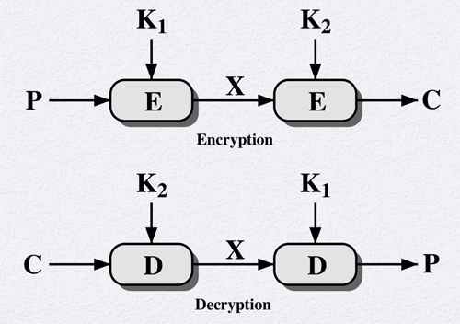
Double DES

Slide 5
Meet-in-the-Middle Attack
Given a known plaintext-ciphertext pair, proceed as follows:
  Encrypt P for all possible values of K1
  Store results in table and sort by value of X
  Decrypt C for all possible values of K2
    During each decryption, check table for match. If find one, test two keys against another known plaintext-ciphertext pair

Slide 6
Meet-in-the-Middle Attack
Analysis:
  For any given plaintext P, there are 2⁶⁴ possible ciphertexts produced by Double DES.
  But Double DES effectively has 112 bit key, so there are 2¹¹² possible keys.
  On average then, for a given plaintext, the number of different 112 bit keys that will produce a given ciphertext is 2¹¹²/2⁶⁴=2⁴⁸
  Thus, first (P,C) pair will produce about 2⁴⁸ false alarms
  Second (P,C) pair, however, reduces false alarm rate to 2⁴⁸⁻⁶⁴ = 2⁻¹⁶. So for two (P,C) pairs, the probability that correct key is determined is 1–2⁻¹⁶.
Bottom line: a known plaintext attack will succeed against Double DES with an effort on order of 2⁵⁶, not much more than the 2⁵⁵ required to crack single DES

Slide 7
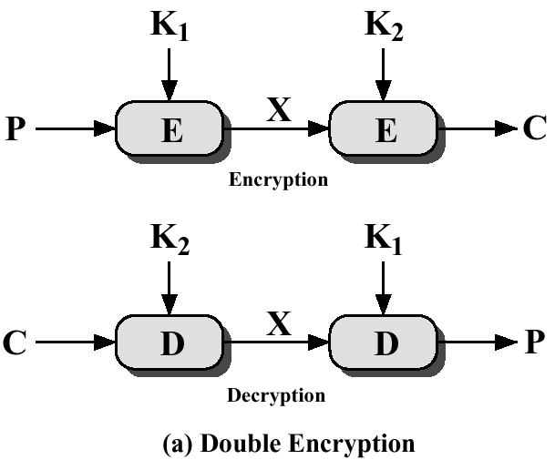
Why Not Double DES?
That is, why not just use C=E_{K1}[E_{K2}[P]]?
  Proven that it’s NOT same as C=E_{K3}[P]
Susceptible to Meet-in-the-Middle Attack
  Described by Diffie & Hellman in 1977
  Based on observation that if C= E_{K2}[E_{K1}[P]], then X=E_{K1}[P]=D_{K2}[C]
CS 395: Computer Security

Slide 8
Why Triple-DES?
Why not Double-DES?
  NOT same as some other single-DES use, but have
Meet-in-the-middle attack
  works whenever use a cipher twice
  since X = E_{K1}[P] = D_{K2}[C]
  attack by encrypting P with all keys and store
  then decrypt C with keys and match X value
  can show takes O(2⁵⁶) steps

Slide 9
Triple DES
A replacement for DES was needed
  theoretical attacks that can break it
  demonstrated exhaustive key search attacks
AES is a new cipher alternative
Before AES alternative
  use multiple encryptions with DES
Triple-DES is the chosen form

Slide 10
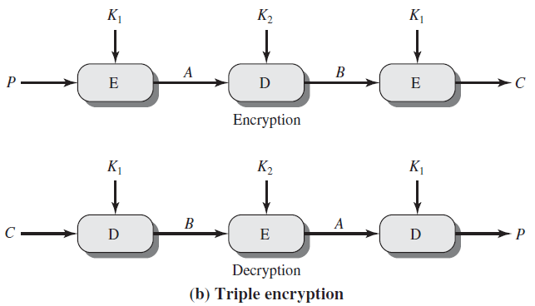
Triple DES

Slide 11
Triple-DES with Two-Keys
Hence must use 3 encryptions
  would seem to need 3 distinct keys
  Key of 56 X 3 = 168 bits seems too long
But can use 2 keys with E-D-E sequence
  C = E_{K1}[D_{K2}[E_{K1}[P]]]
  No cryptographic significance to the use of D in the second step
Standardized in ANSI X9.17 & ISO8732
No current known practical attacks
  some are now adopting Triple-DES with three keys for greater security
Notes:
Triple-DES with two keys is a popular alternative to single-DES, but suffers from being 3 times slower to run.
Although there are no practical attacks, have some indications of attack approaches.
Hence some are now adopting Triple-DES with three keys for greater security.

Slide 12
Triple-DES with Three-Keys
Although are no practical attacks on two-key Triple-DES have some indications
Can use Triple-DES with Three-Keys to avoid even these
  C = E_{K3}[D_{K2}[E_{K1}[P]]]
Has been adopted by some Internet applications

Slide 13
Blowfish
A symmetric block cipher designed by Bruce Schneier in 1993/94
Characteristics
  fast implementation on 32-bit CPUs, 18 clock cycles per byte
  compact in use of memory, less than 5KB
  simple structure for analysis/implementation
  variable security by varying key size
    Allows tuning for speed/security tradeoff

Slide 14
Blowfish Key Schedule
uses a 32 to 448 bit key
used to generate
  18 32-bit subkeys stored in P-array: P1 to P18
  S-boxes stored in S_{i,j,}
    i=1..4
    j=0..255

Slide 15
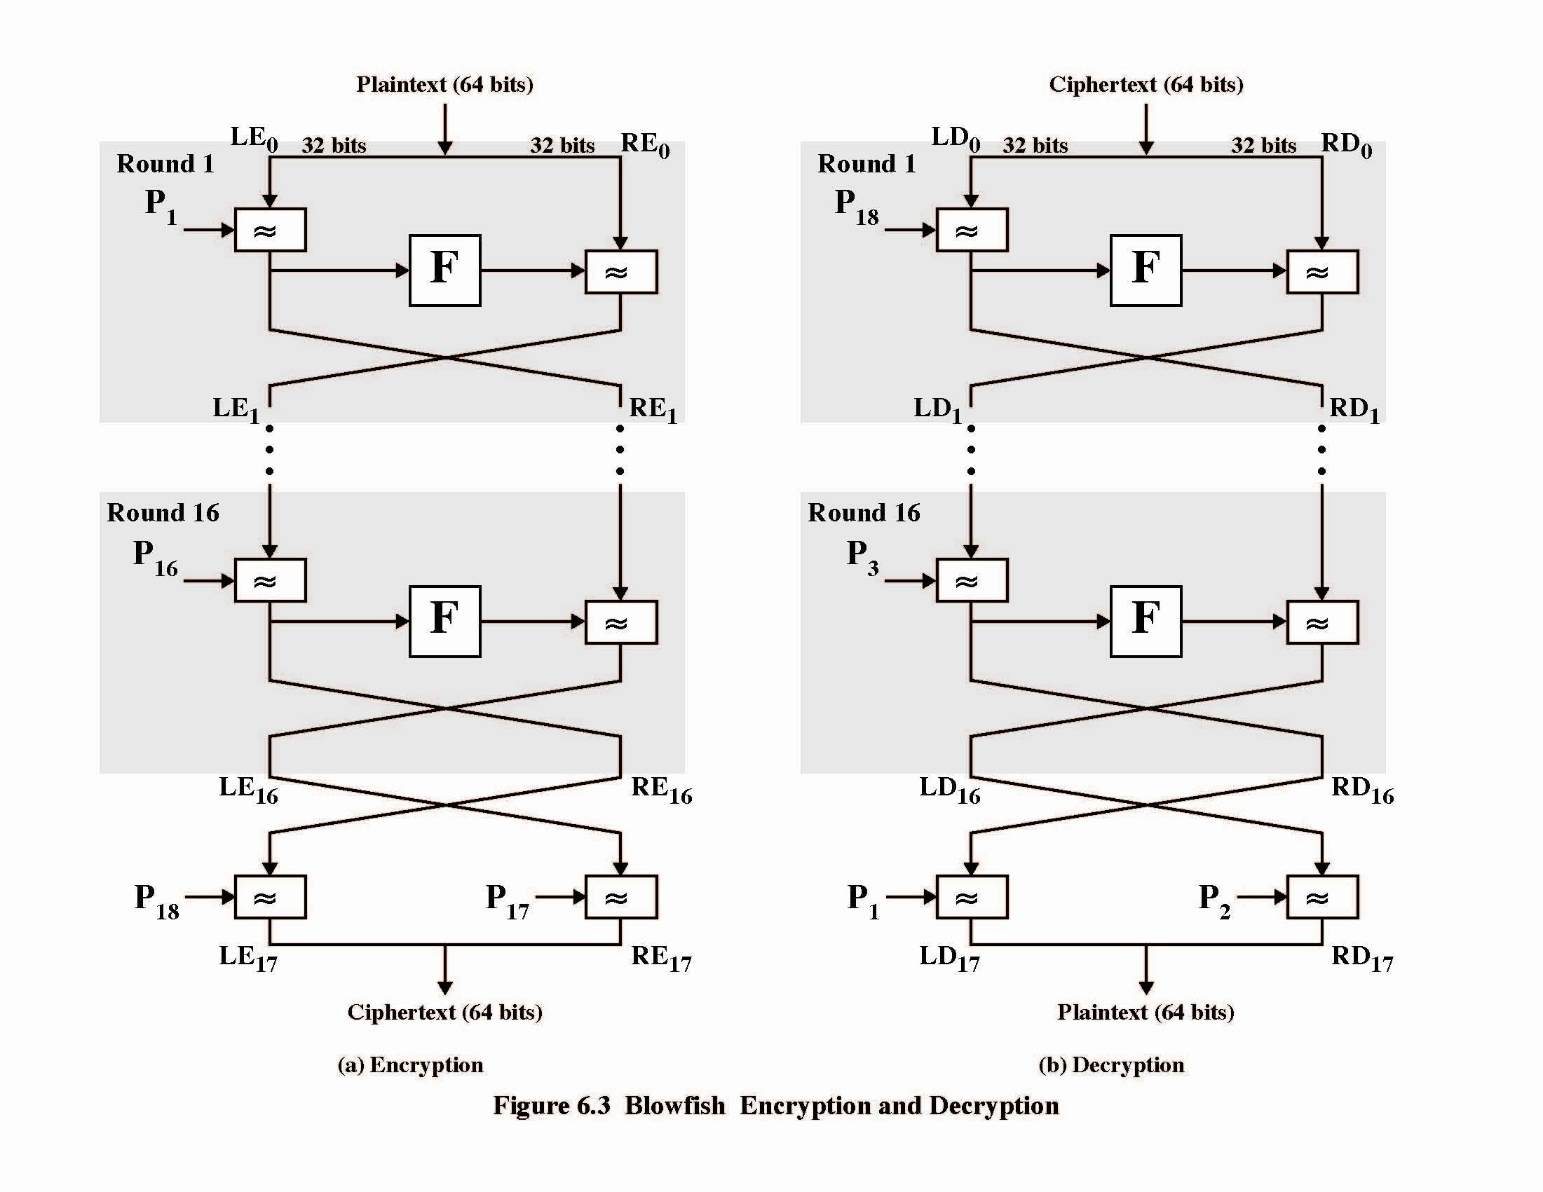

Slide 16
Blowfish Encryption
Uses two primitives: addition & XOR
Data is divided into two 32-bit halves L₀ & R₀
  for i = 1 to 16 do
    R_{i} = L_{i-1} XOR P_{i};
    L_{i} = F[R_{i}] XOR R_{i-1};
  L₁₇ = R₁₆ XOR P₁₈;
  R₁₇ = L₁₆ XOR i₁₇;
Where
  F[a,b,c,d] = ((S_{1,a} + S_{2,b}) XOR S_{3,c}) + S_{4,a}
  Break 32-bit R_{i} into (a,b,c,d)

Slide 17
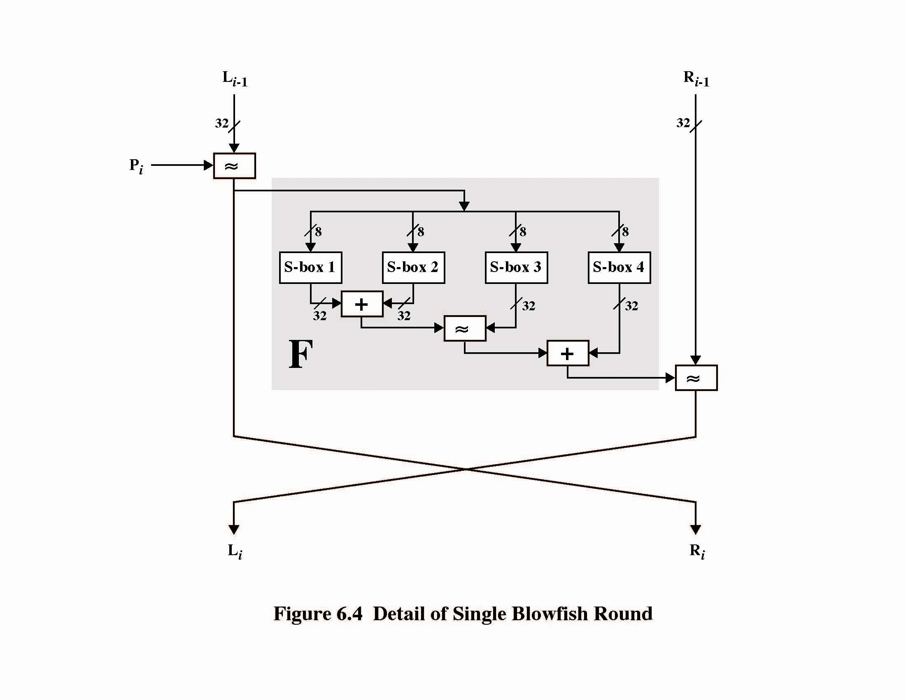

Slide 18
RC5
Can vary key size / input data size /rounds
Very clean and simple design
Easy implementation on various CPUs
Yet still regarded as secure
  Vary parameters to achieve trade-offs

Slide 19
RC5 Ciphers
RC5 is a family of ciphers RC5-w/r/b
  w = word size in bits (16/32/64) data=2w
  r = number of rounds (0..255)
  b = number of bytes in key (0..255)
nominal version is RC5-32/12/16
  ie 32-bit words so encrypts 64-bit data blocks
  using 12 rounds
  with 16 bytes (128-bit) secret key

Slide 20
RC5 Key Expansion
RC5 uses 2r+2 subkey words (w-bits)
  Two subkeys for each round
  2 subkeys for additional operations
subkeys are stored in array S[i], i=0..t-1
Key expansion: fill in pseudo-random bits to the original key K
Certain amount of one-wayness
  Difficult to determine K from S

Slide 21
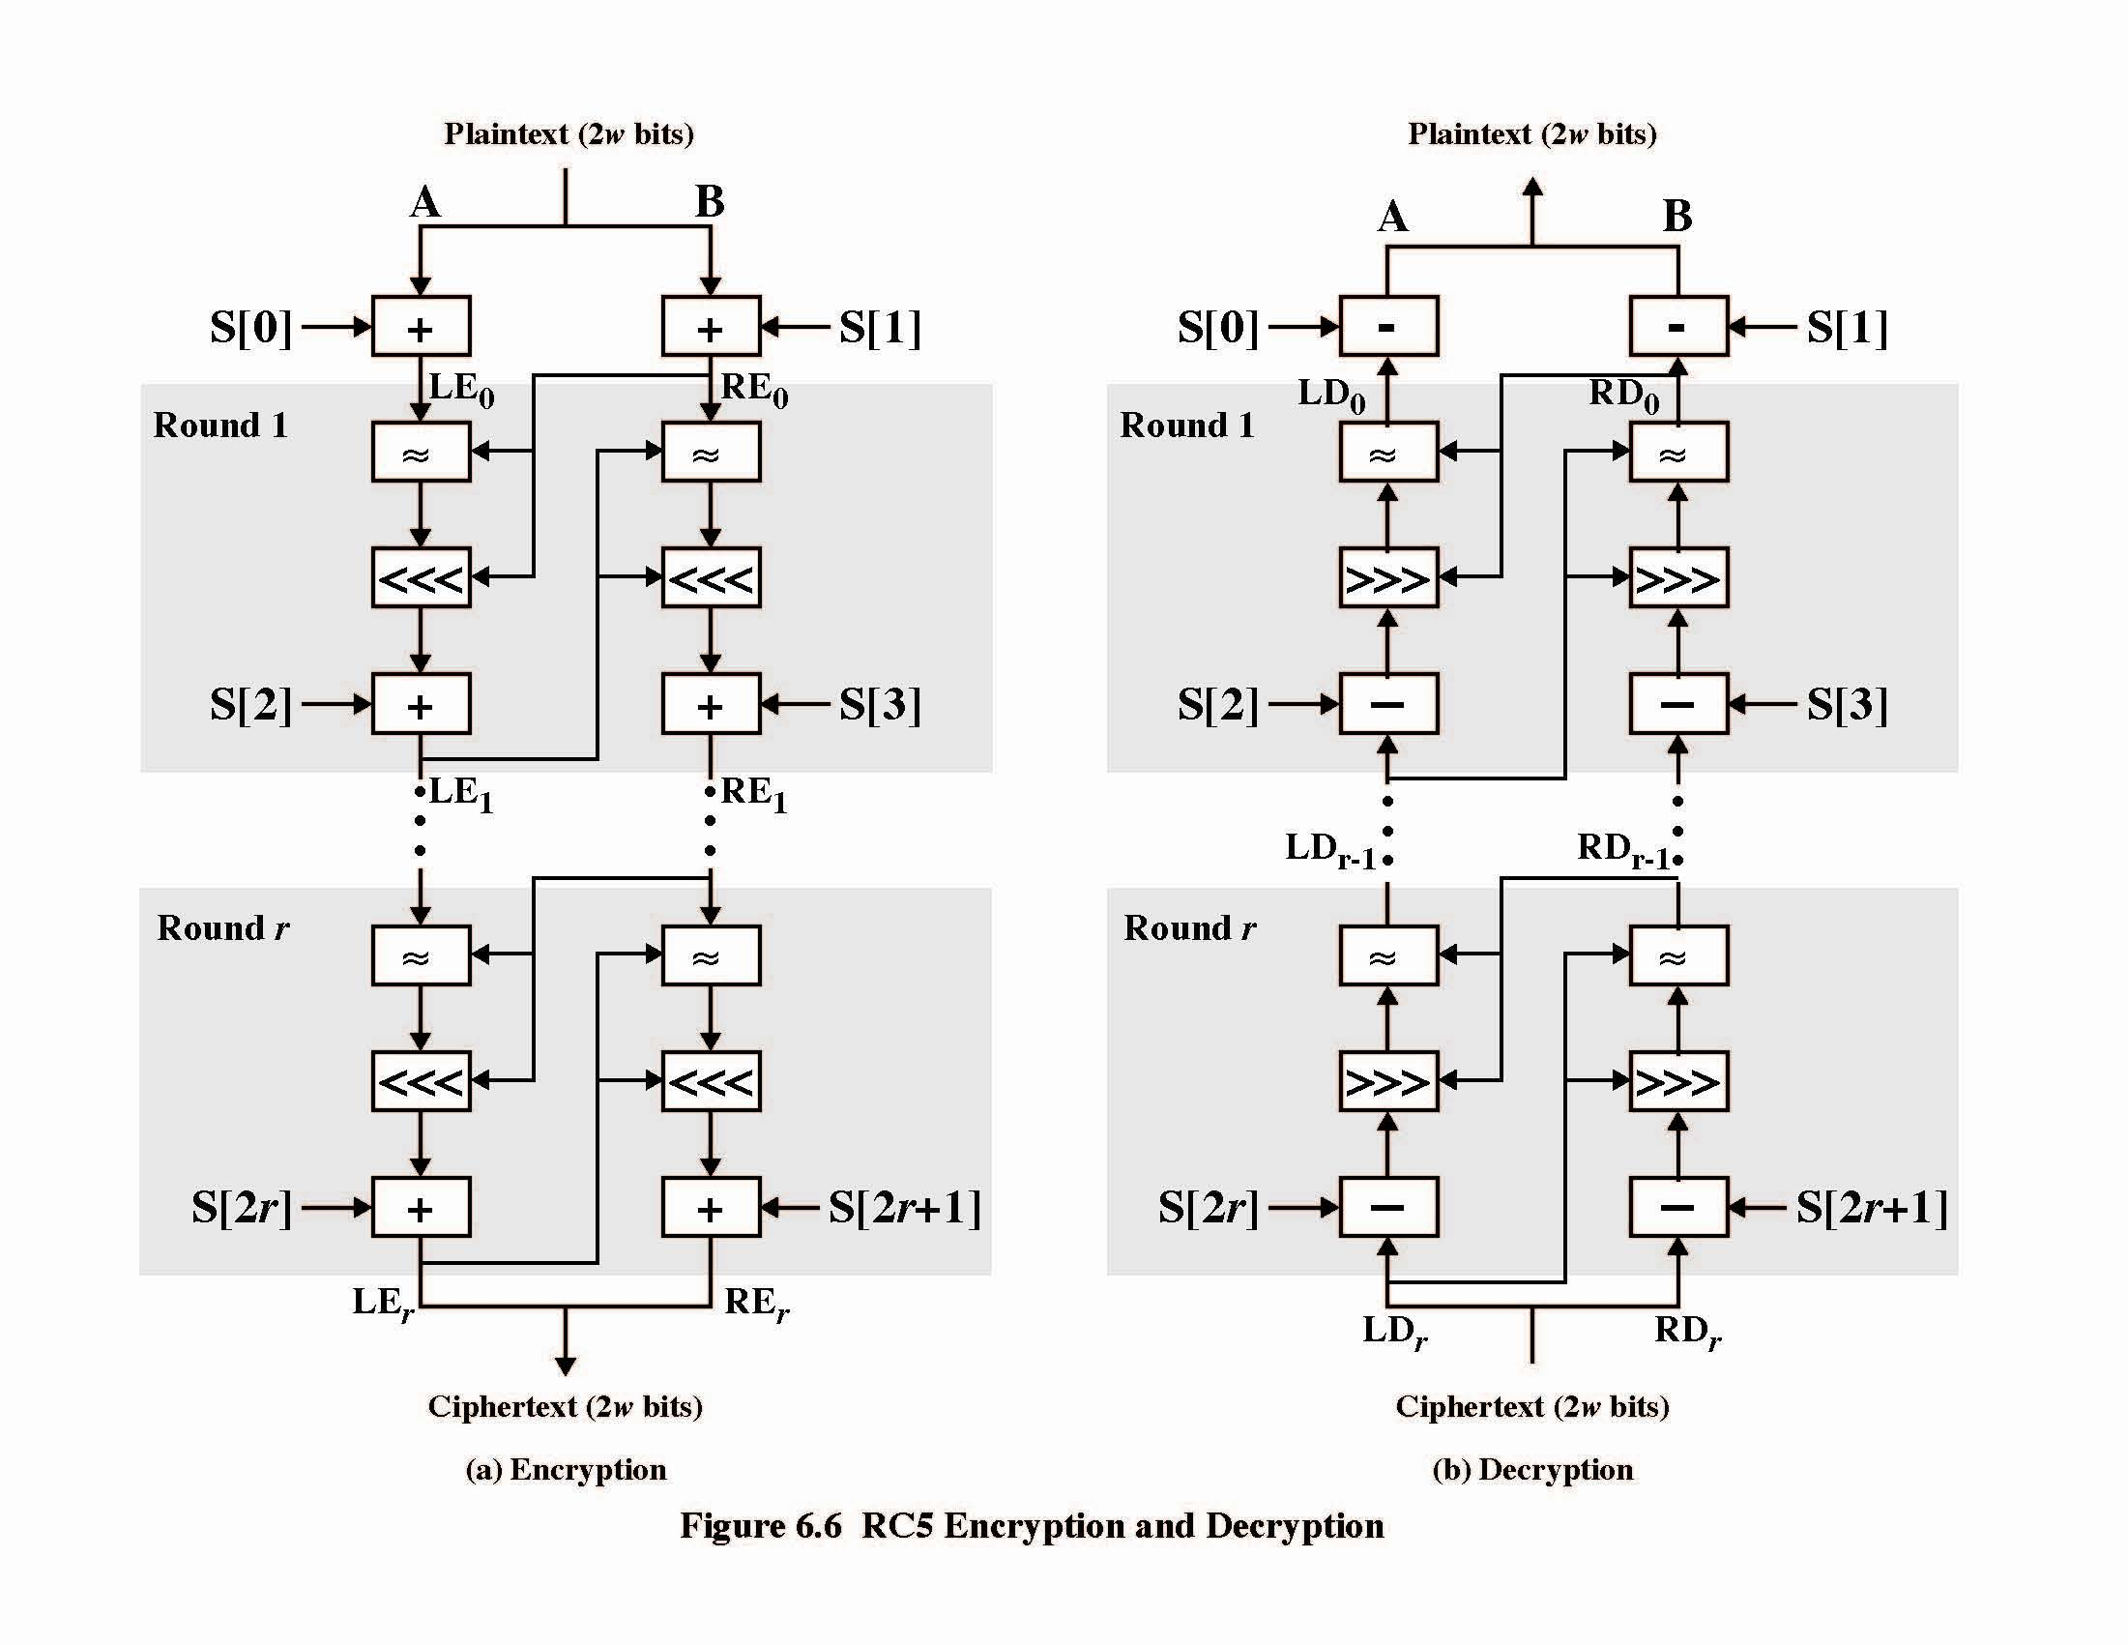

Slide 22
RC5 Encryption
split input into two halves A & B
  L₀ = A + S[0];
  R₀ = B + S[1];
  for i = 1 to r do
    L_{i} = ((L_{i-1} XOR R_{i-1}) <<< R_{i-1}) + S[2 x i];
    R_{i} = ((R_{i-1} XOR L_{i}) <<< L_{i}) + S[2 x i + 1];
each round is like 2 DES rounds
note rotation is main source of non-linearity
need reasonable number of rounds (eg 12-16)
Striking features: simplicity, data-dependent rotations

Slide 23
RC5 Modes
RFC2040 defines 4 modes used by RC5
  RC5 Block Cipher, is ECB mode
  RC5-CBC, input length is a multiples of 2w
  RC5-CBC-PAD, any length CBC with padding
    Output can be longer than input
  RC5-CTS, CBC with padding
    Output has same length than input

Slide 24
Advanced Block Cipher Characteristics
Features seen in modern block ciphers are:
  variable key length / block size / no rounds
  mixed operators
    data/key dependent rotation
    key dependent S-boxes
  more complex key scheduling
    Lengthy key generation, simple encryption rounds
  operation of full data in each round

Slide 25
Stream Ciphers
Process message bit by bit (as a stream)
Have a pseudo random keystream
Combined (XOR) with plaintext bit by bit
Randomness of stream key completely destroys statistically properties in message
  C_{i} = M_{i} XOR StreamKey_{i}
But must never reuse stream key
  otherwise can recover messages (cf book cipher)
Notes:
A typical stream cipher encrypts plaintext one byte (or bit) at a time, usually by XOR’ing with a pseudo-random keystream. The stream cipher is similar to the one-time pad discussed in Chapter 2. The difference is that a one-time pad uses a genuine random number stream, whereas a stream cipher uses a pseudorandom number stream. But rely on the randomness of stream key completely destroys statistically properties in message. However, you must never reuse a stream key since otherwise you can recover messages (as with a book cipher).

Slide 26

Stream Cipher Structure
Notes:
Stallings Figure 6.8 illustrates the general structure of a stream cipher, where a key is input to a pseudorandom bit generator that produces an apparently random keystream of bits, and which are XOR’d with message to encrypt it, and XOR’d again to decrypt it by the receiver.

Slide 27
Stream Cipher Properties
Some design considerations are:
  long period with no repetitions
  statistically random
  depends on large enough key
  large linear complexity
Properly designed, can be as secure as a block cipher with same size key
But usually simpler & faster
Notes:
[KUMA97] lists the following important design considerations for a stream cipher:
The encryption sequence should have a large period, the longer the period of repeat the more difficult it will be to do cryptanalysis.
The keystream should approximate the properties of a true random number stream as close as possible, the more random-appearing the keystream is, the more randomized the ciphertext is, making cryptanalysis more difficult.
To guard against brute-force attacks, the key needs to be sufficiently long. The same considerations as apply for block ciphers are valid here .Thus, with current technology, a key length of at least 128 bits is desirable.
With a properly designed pseudorandom number generator, a stream cipher can be as secure as block cipher of comparable key length. The primary advantage of a stream cipher is that stream ciphers are almost always faster and use far less code than do block ciphers.

Slide 28
Block/Stream Ciphers
Stream ciphers
  For applications that require encryt/decryt of a stream of data
  Examples: data communication channel, browser/web link
Block ciphers
  For applications dealing with blocks of data
  Examples: file transfer, e-mail, database
Either type can be used in virtually any application

Slide 29
RC4 Stream Cipher
A proprietary cipher owned by RSA DSI
Another Ron Rivest design, simple but effective
Variable key size, byte-oriented stream cipher
Widely used (web SSL/TLS, wireless WEP)
Key forms random permutation of all 8-bit values
Uses that permutation to scramble input info processed a byte at a time
Notes:
RC4 is a stream cipher designed in 1987 by Ron Rivest for RSA Security. It is a variable key-size stream cipher with byte-oriented operations. The algorithm is based on the use of a random permutation. Analysis shows that the period of the cipher is overwhelmingly likely to be greater than 10^100. Eight to sixteen machine operations are required per output byte, and the cipher can be expected to run very quickly in software. RC4 is probably the most widely used stream cipher. It is used in the SSL/TLS secure web protocol, & in the WEP & WPA wireless LAN security protocols. RC4 was kept as a trade secret by RSA Security, but in September 1994 was anonymously posted on the Internet on the Cypherpunks anonymous remailers list. In brief, the RC4 key is ued to form a random permutation of all 8-bit values, it then uses that permutation to scramble input info processed a byte at a time.

Slide 30
RC4 Key Schedule
Starts with an array S of numbers: 0..255
Use key to well and truly shuffle
S forms internal state of the cipher
  for i = 0 to 255 do
    S[i] = i
    T[i] = K[i mod keylen])
  j = 0
  for i = 0 to 255 do
    j = (j + S[i] + T[i]) (mod 256)
    swap (S[i], S[j])
Notes:
The RC4 key schedule initialises the state S to the numbers 0..255, and then walks through each entry in turn, using its current value plus the next byte of key to pick another entry in the array, and swaps their values over. After doing this 256 times, the result is a well and truly shuffled array. The total number of possible states is 256! - a truly enormous number, much larger even than the 2048-bit (256*8) max key allowed can select.

Slide 31
RC4 Encryption
Encryption continues shuffling array values
SSum of shuffled pair selects "stream key" value from permutation
XOR S[t] with next byte of message to en/decrypt
  i = j = 0
  for each message byte M_{i}
    i = (i + 1) (mod 256)
    j = (j + S[i]) (mod 256)
    swap(S[i], S[j])
    t = (S[i] + S[j]) (mod 256)
    C_{i} = M_{i} XOR S[t]
Notes:
To form the stream key for en/decryption (which are identical), RC4 continues to shuffle the permutation array S by continuing to swap each element in turn with some other entry, and using the sum of these two entry values to select another value from the permutation to use as the stream key, which is then XOR’d with the current message byte.

Slide 32
RC4 Security
Claimed secure against known attacks
  have some analyses, none practical
Result is very non-linear
Since RC4 is a stream cipher, must never reuse a key
Have a concern with WEP, but due to key handling rather than RC4 itself
Notes:
A number of papers have been published analyzing methods of attacking RC4, but none of these approaches is practical against RC4 with a reasonable key length, such as 128 bits.
A more serious problem occurs in its use in the WEP protocol, not with RC4 itself but the way in which keys are generated for use as input to RC4.
Currently RC4 its regarded as quite secure, if used correctly, with a sufficiently large key.

