Slide 1
Public Key Cryptography and RSA
Chapter 9
Notes:
Lecture slides by Lawrie Brown and from many websites and book for “Cryptography and Network Security”, 4/e, by William Stallings, Chapter 9 – “Public Key Cryptography and RSA”.

Slide 2
Private-Key Cryptography
Traditional private/secret/single key cryptography uses one key
Shared by both sender and receiver
If this key is disclosed communications are compromised
Also is symmetric, parties are equal
  Hence does not protect sender from receiver forging a message & claiming is sent by sender
Notes:
So far all the cryptosystems discussed, from earliest history to modern times, have been private/secret/single key (symmetric) systems.
All classical, and modern block and stream ciphers are of this form, and still rely on the fundamental building blocks of substitution and permutation (transposition).

Slide 3
Public-Key Cryptography
Probably most significant advance in the 3000 year history of cryptography
Uses two keys – a public & a private key
Two keys has profound consequences on the areas of confidentiality, key distribution and authentication
Asymmetric since parties are not equal
Complements rather than replaces private key cryptography
Notes:
Will now discuss the radically different public key systems, in which two keys are used. The development of public-key cryptography is the greatest and perhaps the only true revolution in the entire history of cryptography. It is asymmetric, involving the use of two separate keys, in contrast to symmetric encryption,which uses only one key. Anyone knowing the public key can encrypt messages or verify signatures, but cannot decrypt messages or create signatures, counter-intuitive though this may seem. It works by the clever use of number theory problems that are easy one way but hard the other. Note that public key schemes are neither more nor less secure than private key (security depends on the key size for both), nor do they replace private key schemes (they are too slow to do so), rather they complement them. Both also have issues with key distribution, requiring the use of some suitable protocol.

Slide 4
Public-Key Cryptography
Based on mathematical functions rather than on substitution and permutation
Uses clever application of number theoretic concepts to function
More secure than symmetric encryption
The security of any encryption schemes depends on
  The length of the key
  The computational work involved in breaking a cipher
Notes:
Will now discuss the radically different public key systems, in which two keys are used. The development of public-key cryptography is the greatest and perhaps the only true revolution in the entire history of cryptography. It is asymmetric, involving the use of two separate keys, in contrast to symmetric encryption,which uses only one key. Anyone knowing the public key can encrypt messages or verify signatures, but cannot decrypt messages or create signatures, counter-intuitive though this may seem. It works by the clever use of number theory problems that are easy one way but hard the other. Note that public key schemes are neither more nor less secure than private key (security depends on the key size for both), nor do they replace private key schemes (they are too slow to do so), rather they complement them. Both also have issues with key distribution, requiring the use of some suitable protocol.

Slide 5
Why Public-Key Cryptography?
Developed to address two key issues:
  key distribution – how to have secure communications in general without having to trust a KDC with your key
  digital signatures – how to verify a message comes intact from the claimed sender
Public invention due to Whitfield Diffie & Martin Hellman at Stanford Uni in 1976
  known earlier in classified community
Notes:
The concept of public-key cryptography evolved from an attempt to attack two of the most difficult problems associated with symmetric encryption: key distribution and digital signatures. The idea of public key schemes, and the first practical scheme, which was for key distribution only, was published in 1977 by Diffie & Hellman. The concept had been previously described in a classified report in 1970 by James Ellis (UK CESG) - and subsequently declassified [ELLI99]. Its interesting to note that they discovered RSA first, then Diffie-Hellman, opposite to the order of public discovery! There is also a claim that the NSA knew of the concept in the mid-60’s [SIMM93].

Slide 6
Public-Key Cryptography
Public-key/two-key/asymmetric cryptography involves the use of two keys:
  a public-key, which may be known by anybody, and can be used to encrypt messages, and verify signatures
  a private-key, known only to the recipient, used to decrypt messages, and sign (create) signatures
Is asymmetric because
  those who encrypt messages or verify signatures cannot decrypt messages or create signatures
Notes:
Emphasize here the radical difference with Public-Key Cryptography is the use of two related keys but with very different roles and abilities. Anyone knowing the public key can encrypt messages or verify signatures, but cannot decrypt messages or create signatures, all thanks to some clever use of number theory.

Slide 7
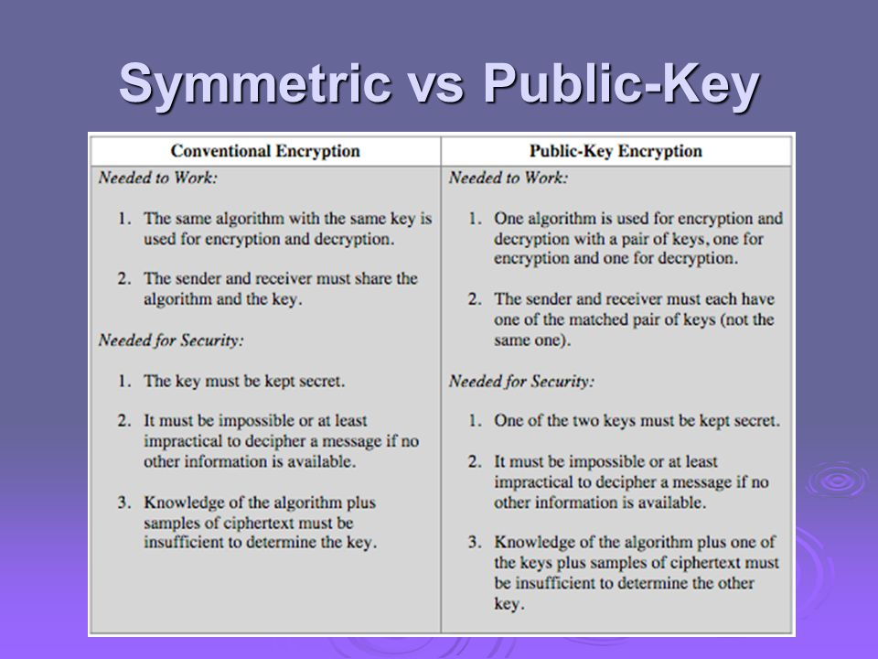

Slide 8
Public-Key Cryptosystem
A public-key encryption scheme has six ingredients:
  Plain text
  Encryption algorithm
  Public and private key
  Ciphertext
  Decryption algorithm
Notes:
Emphasize here the radical difference with Public-Key Cryptography is the use of two related keys but with very different roles and abilities. Anyone knowing the public key can encrypt messages or verify signatures, but cannot decrypt messages or create signatures, all thanks to some clever use of number theory.

Slide 9
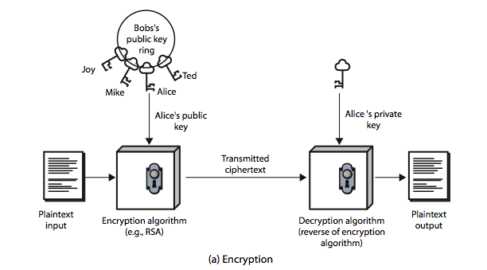
Encryption using Public-Key System
Notes:
Stallings Figure 9.1a “Public-Key Cryptography”, shows that a public-key encryption scheme has six ingredients: plaintext, encryption algorithm, public & private keys, ciphertext & decryption algorithm.
Consider the following analogy using padlocked boxes: traditional schemes involve the sender putting a message in a box and locking it, sending that to the receiver, and somehow securely also sending them the key to unlock the box. The radical advance in public key schemes was to turn this around, the receiver sends an unlocked box (their public key) to the sender, who puts the message in the box and locks it (easy - and having locked it cannot get at the message), and sends the locked box to the receiver who can unlock it (also easy), having the (private) key. An attacker would have to pick the lock on the box (hard).

Slide 10
Public-Key Encryption
Public-key Encryption
  1. Each end system generates a pair of keys.
  2. Each end system publishes its “public” encryption key.
  3. A sends B a message using B’s public key.
  4. B decrypts the message using B’s private key.

Slide 11
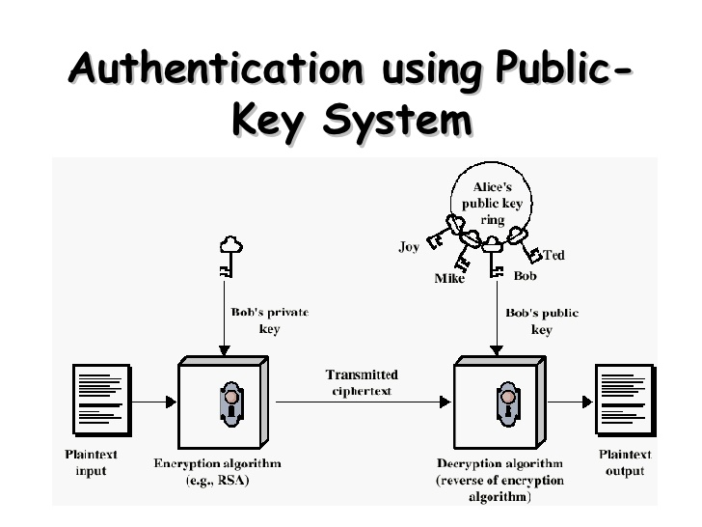
Notes:
Stallings Figure 9.1a “Public-Key Cryptography”, shows that a public-key encryption scheme has six ingredients: plaintext, encryption algorithm, public & private keys, ciphertext & decryption algorithm.
Consider the following analogy using padlocked boxes: traditional schemes involve the sender putting a message in a box and locking it, sending that to the receiver, and somehow securely also sending them the key to unlock the box. The radical advance in public key schemes was to turn this around, the receiver sends an unlocked box (their public key) to the sender, who puts the message in the box and locks it (easy - and having locked it cannot get at the message), and sends the locked box to the receiver who can unlock it (also easy), having the (private) key. An attacker would have to pick the lock on the box (hard).

Slide 12
Public-Key Authentication
Public-key Authentication
  1. A sends B a message encrypted with A’s private key.
  2. B decrypts the message using A’s public key.
  3. Entire message acts as a digital signature, since only A could have encrypted the message.

Slide 13
Public-Key Characteristics
Public-Key algorithms rely on two keys where:
  it is computationally infeasible to find decryption key knowing only algorithm & encryption key
  it is computationally easy to en/decrypt messages when the relevant (en/decrypt) key is known
  either of the two related keys can be used for encryption, with the other used for decryption (for some algorithms)
Notes:
Asymmetric algorithms rely on one key for encryption and a different but related key for decryption. These algorithms have the following important characteristic: that it is computationally infeasible to determine the decryption key given only knowledge of the cryptographic algorithm and the encryption key. That is public key schemes utilise problems that are easy (P type) one way but hard (NP type) the other way, eg exponentiation vs logs, multiplication vs factoring. In addition, some algorithms, such as RSA, are also able to use either key as public & other private.

Slide 14

Public-Key Cryptosystems : Secrecy and Authentication
Notes:
Stallings Fig 9-4.
Here see various components of public-key schemes used for both secrecy and authentication. Note that separate key pairs are used for each of these – receiver owns and creates secrecy keys, sender owns and creates authentication keys.

Slide 15
Digital Signatures
  Instead of the entire message, a small block can be used.
  This block, the authenticator, can then be encrypted using the sender’s private key.
  This serves as a signature that verifies origin, content, and sequencing.
  SHA-1 could serve as the authenticator.

Slide 16
Public-Key Applications
Can classify uses into 3 categories:
  encryption/decryption (provide secrecy)
  digital signatures (provide authentication)
  key exchange (of session keys)
Some algorithms are suitable for all uses, others are specific to one
Notes:
Public-key systems are characterized by the use of a cryptographic type of algorithm with two keys. Depending on the application, the sender uses either the sender’s private key or the receiver’s public key, or both, to perform some type of cryptographic function. In broad terms, we can classify the use of public-key cryptosystems into the three categories:
• Encryption/decryption: The sender encrypts a message with the recipient’s public key.
• Digital signature: The sender “signs”a message with its private key, either to the whole message or to a small block of data that is a function of the message.
• Key exchange: Two sides cooperate to exchange a session key. Several different approaches are possible, involving the private key(s) of one or both parties.
Some algorithms are suitable for all three applications, whereas others can be used only for one or two of these applications.

Slide 17
Security of Public Key Schemes
Like private key schemes brute force exhaustive search attack is always theoretically possible
But keys used are too large (>512bits)
Security relies on a large enough difference in difficulty between easy (en/decrypt) and hard (cryptanalyse) problems
More generally the hard problem is known, but is made hard enough to be impractical to break
Requires the use of very large numbers
Hence is slow compared to private key schemes
Notes:
Public key schemes are no more or less secure than private key schemes - in both cases the size of the key determines the security. Note also that you can't compare key sizes - a 64-bit private key scheme has very roughly similar security to a 512-bit RSA - both could be broken given sufficient resources. But with public key schemes at least there is usually a firmer theoretical basis for determining the security since its based on well-known and well studied number theory problems.

Slide 18
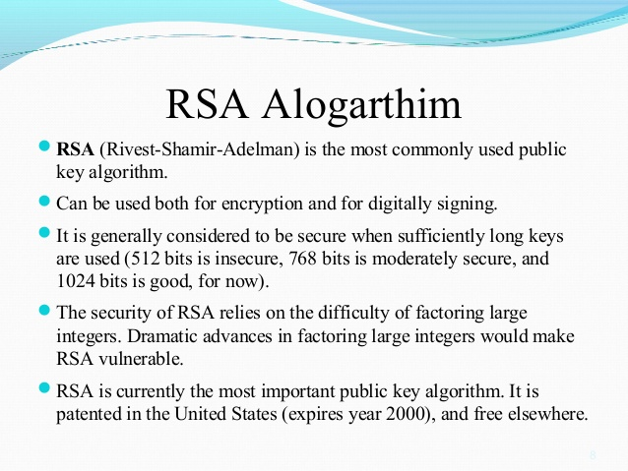

Slide 19
RSA Algorithm
  The RSA algorithm (1977) is widely used for public-key encryption.
  It is a block cipher, with plaintext and cipher text represented as integers from 0 to n-1.
  Based on exponentiation in a finite (Galois) field over integers modulo a prime
  Uses large integers (eg. 1024 bits)
  Security due to cost of factoring large numbers

Slide 20
Requirements for the RSA Algorithm
It is possible to find values of e, d, and n such that M^{ed} = M mod n for all integers M < n.
It is relatively easy to calculate Me and C^{d} for all values of M < n.
It is infeasible to determine d given e and n.

Slide 21
RSA Key Setup
Each user generates a public/private key pair by:
Selecting two large primes at random - p, q
Computing their system modulus n=p.q
  note ø(n)=(p-1)(q-1)
Selecting at random the encryption key e
    where 1<e<ø(n), gcd(e,ø(n))=1
Solve following equation to find decryption key d
  e.d=1 mod ø(n) and 0≤d≤n
Publish their public encryption key: PU={e,n}
Keep secret private decryption key: PR={d,n}
Notes:
RSA key setup is done once (rarely) when a user establishes (or replaces) their public key, using the steps as shown. The exponent e is usually fairly small, just must be relatively prime to ø(n). Need to compute its inverse mod ø(n) to find d. It is critically important that the factors p & q of the modulus n are kept secret, since if they become known, the system can be broken. Note that different users will have different moduli n.

Slide 22
RSA Algorithm Key Generation
Select two different prime numbers, p and q.
Calculate the product, n = p x q.
Calculate the Euler totient.
  φ(n) = (p - 1) x (q - 1).
Select integer e.
  gcd(φ(n) ,e) = 1; 1 < e < φ(n)

Slide 23
RSA Algorithm Key Generation
Calculate d.
  de = mod φ (n) = 1.
Public Key is KU = {e,n}.
Private Key is KR= {d,n}.

Slide 24
The RSA Algorithm
Encryption
  Public Key is KU = {e,n}.
  C = Me mod n, where M is the plaintext and C is the ciphertext (represented as integers).
Decryption
  Private Key is KR = {d,n}.
  M = C^{d} mod n.

Slide 25
RSA Use
To encrypt a message M the sender:
  obtains public key of recipient PU={e,n}
  computes: C = Me mod n, where 0≤M<n
To decrypt the ciphertext C the owner:
  uses their private key PR={d,n}
  computes: M = C^{d} mod n
Note that the message M must be smaller than the modulus n (block if needed)
Notes:
The actual RSA encryption and decryption computations are each simply a single exponentiation mod (n). Note that the message must be smaller than the modulus. The “magic” is in the choice of the exponents which makes the system work.

Slide 26
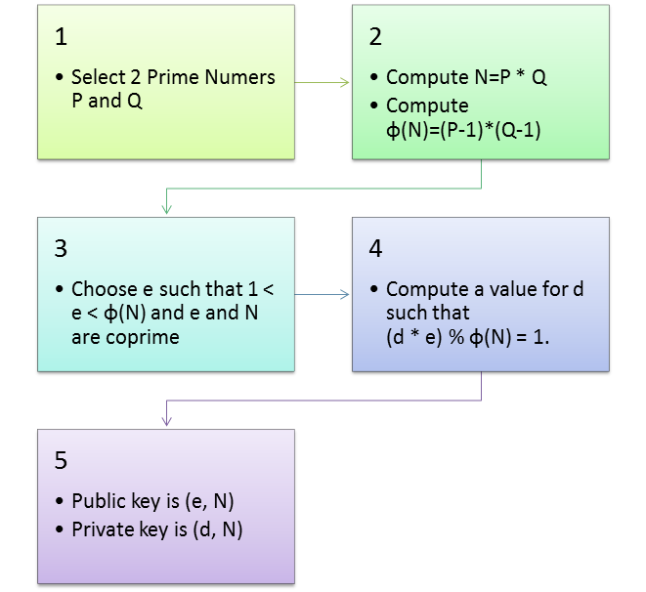
RSA Algorithm

Slide 27
Why RSA Works
Because of Euler's Theorem:
  a^{ø(n)}mod n = 1 where gcd(a,n)=1
In RSA have:
  n=p.q
  ø(n)=(p-1)(q-1)
  carefully chose e & d to be inverses mod ø(n)
  hence e.d=1+k.ø(n) for some k
Hence :
C^{d} = M^{e.d} = M^{1+k.ø(n)} = M¹.(M^{ø(n)})^{k}
= M¹.(1)^{k} = M¹ = M mod n
Notes:
Can show that RSA works as a direct consequence of Euler’s Theorem, so that raising a number to power e then d (or vica versa) results in the original number!

Slide 28
RSA Example - Key Setup
Select primes: p=17 & q=11
Compute n = pq =17 x 11=187
Compute ø(n)=(p–1)(q-1)=16 x 10=160
Select e: gcd(160, 7)=1; choose e=7
Determine d: de=1 mod 160 and d < 160 Value is d=23 since 23x7=161= 10x160+1
Publish public key PU={7,187}
Keep secret private key PR={23,187}
Notes:
Here walk through example RSA key generation using “trivial” sized numbers.
Selecting primes requires the use of a primality test.
Finding d as inverse of e mod ø(n) requires use of Euclid’s Inverse algorithm (see Ch4)

Slide 29
RSA Example-Encryption
Encryption Example
  Let M = 88.
  C = 88⁷ mod 187.
  Now, consider the following property of modular arithmetic:
    X^{a+b} mod n={(Xª mod n)(X^{b} mod n)}mod n.
    C={(88⁴mod187)(88²mod187)(88¹mod187)}mod187
    C={132 x 77 x 88} mod 187
    C = 11.

Slide 30
RSA Example-Decryption
Decryption Example
  Let C = 11.
  M = 11²³ mod 187.
  M={(11¹mod187)(11²mod187)(11⁴mod187) (11⁸mod187) (11⁸mod187)}mod187
    M={11 x 121 x 55 x 33x 33} mod 187
    M = 88.

Slide 31
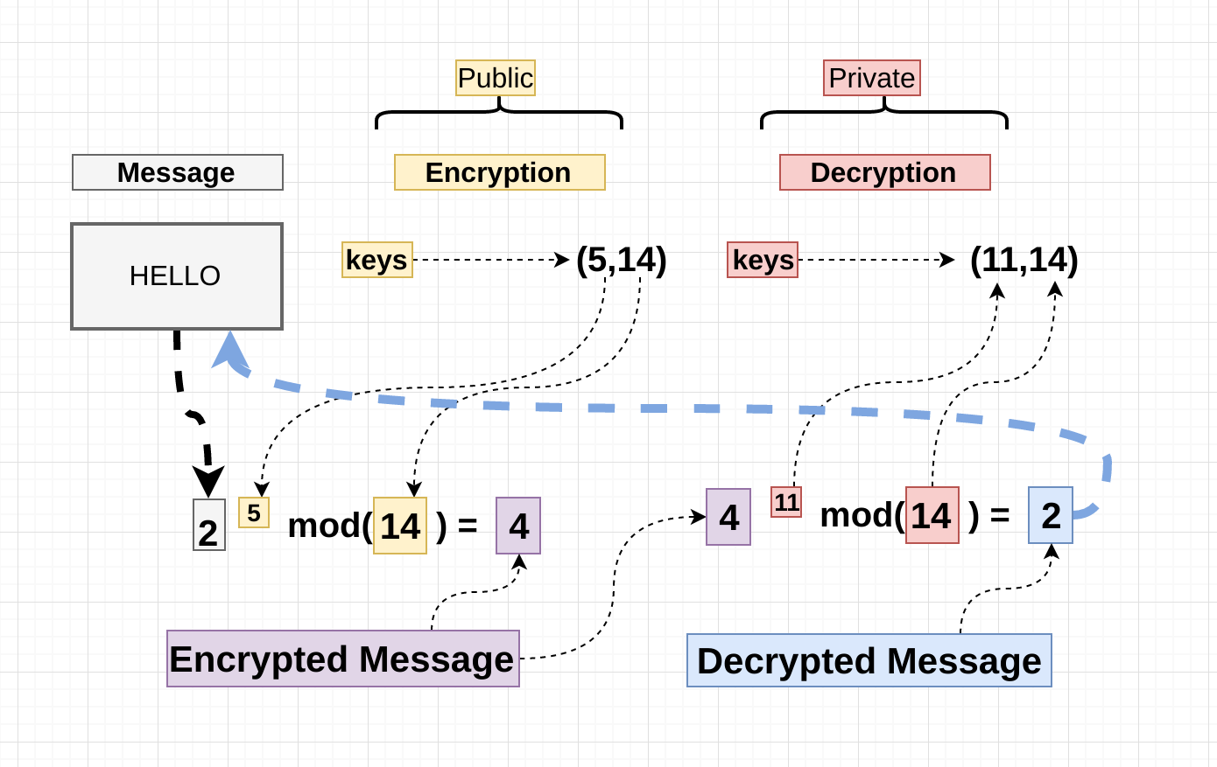
How does RSA works: Example

Slide 32
Exponentiation
Can use the Square and Multiply Algorithm
A fast, efficient algorithm for exponentiation
Concept is based on repeatedly squaring base
And multiplying in the ones that are needed to compute the result
Look at binary representation of exponent
Only takes O(log₂ n) multiples for number n
  eg. 7⁵ = 7⁴.7¹ = 3.7 = 10 mod 11
  eg. 3¹²⁹ = 3¹²⁸.3¹ = 5.3 = 4 mod 11
Notes:
To perform the modular exponentiations, you can use the “Square and Multiply Algorithm”, a fast, efficient algorithm for doing exponentiation.
The idea is to repeatedly square the base, and multiply in the ones that are needed to compute the result, as found by examining the binary representation of the exponent.

Slide 33
Exponentiation
c = 0; f = 1
for i = k downto 0
do c = 2 x c
f = (f x f) mod n
if b_{i} == 1 then
c = c + 1
f = (f x a) mod n
return f
Notes:
State here one version of the “Square and Multiply Algorithm”, from Stallings Figure 9.7.

Slide 34
Efficient Encryption
Encryption uses exponentiation to power e
Hence if e small, this will be faster
  often choose e=65537 (2¹⁶-1)
  also see choices of e=3 or e=17
But if e too small (eg e=3) can attack
  using Chinese remainder theorem & 3 messages with different modulii
If e fixed must ensure gcd(e,ø(n))=1
  ie reject any p or q not relatively prime to e
Notes:
To speed up the operation of the RSA algorithm using the public key, can choose to use a small value of e (but not too small, since its then vulnerable to attack).
Must then ensure any p or q chosen are relatively prime to the fixed e (and reject and find another if not), for system to work.

Slide 35
Efficient Decryption
Decryption uses exponentiation to power d
  this is likely large, insecure if not
Can use the Chinese Remainder Theorem (CRT) to compute mod p & q separately. Then combine to get desired answer
  approx 4 times faster than doing directly
Only owner of private key who knows values of p & q can use this technique
Notes:
To speed up the operation of the RSA algorithm using the private key, can use the Chinese Remainder Theorem (CRT) to compute mod p & q separately, and then combine results to get the desired answer. This is approx 4 times faster than calculating “C^d mod n” directly. Note that only the owner of the private key details (who knows the values of p & q) can do this, but of course that’s exactly where help is needed, since if e is small then d will be likely be large!

Slide 36
Attacks on RSA
Brute force--try all possible keys.
  This means large keys need to be used, but implementations will have longer computation time.
Factor n, into its prime factors (p and q.)
  For n large, this is a hard problem.

Slide 37
RSA Security
Possible approaches to attacking RSA are:
  brute force key search (infeasible given size of numbers)
  mathematical attacks (based on difficulty of computing ø(n), by factoring modulus n)
  timing attacks (on running of decryption)
  chosen ciphertext attacks (given properties of RSA)
Notes:
Note some possible possible approaches to attacking the RSA algorithm, as shown.
The defense against the brute-force approach is the same for RSA as for other cryptosystems, namely, use a large key space. Thus the larger the number of bits in d, the better. However because the calculations involved both in key generation and in encryption/decryption are complex, the larger the size of the key, the slower the system will run.
Will now review the other possible types of attacks.

Slide 38
Factoring Problem
Mathematical approach takes 3 forms:
  factor n=p.q, hence compute ø(n) and then d
  determine ø(n) directly and compute d
  find d directly
Currently believe all equivalent to factoring
  have seen slow improvements over the years
    as of May-05 best is 200 decimal digits (663) bit with LS
  biggest improvement comes from improved algorithm
    cf QS to GHFS to LS
  currently assume 1024-2048 bit RSA is secure
    ensure p, q of similar size and matching other constraints
Notes:
We can identify three approaches to attacking RSA mathematically, as shown. Mathematicians currently believe all equivalent to factoring.
See Stallings Table 9.4 for progress in factoring, where see slow improvements over the years, with the biggest improvements coming from improved algorithms.
The best current algorithm is the “Lattice Sieve” (LS), which replaced the “Generalized Number Field Sieve” (GNFS), which replaced the “Quadratic Sieve”(QS).
Have to assume computers will continue to get faster, and that better factoring algorithms may yet be found.
Numbers of size 1024-2048 bits look reasonable at present, provided the factors meet other constraints.

Slide 39
Timing Attacks
Developed by Paul Kocher in mid-1990’s
Exploit timing variations in operations
  eg. multiplying by small vs large number
  or IF's varying which instructions executed
Infer operand size based on time taken
RSA exploits time taken in exponentiation
Countermeasures
  use constant exponentiation time
  add random delays
  blind values used in calculations
Notes:
Had a new category of attacks developed by Paul Kocher in mid-1990’s, based on observing how long it takes to compute the cryptographic operations. Timing attacks are applicable not just to RSA, but to other public-key cryptography systems. This attack is alarming for two reasons: It comes from a completely unexpected direction and it is a ciphertextonly attack. A timing attack is somewhat analogous to a burglar guessing the combination of a safe by observing how long it takes for someone to turn the dial from number to number.
Although the timing attack is a serious threat, there are simple countermeasures that can be used, including using constant exponentiation time algorithms, adding random delays, or using blind values in calculations.

