Slide 1
Jane Street Competition

Slide 2
Data
10 partitions
In the following, I selected partition id = 9
Symbol = 1

Slide 3
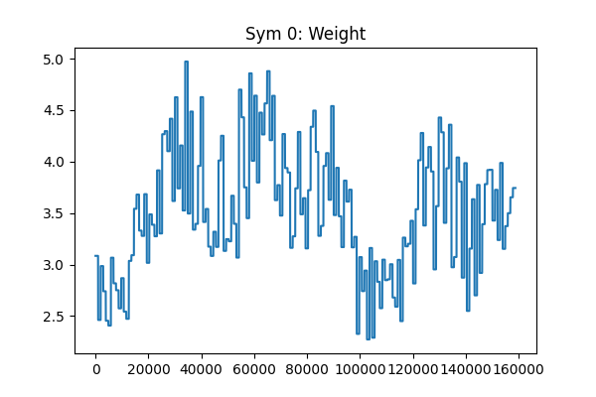
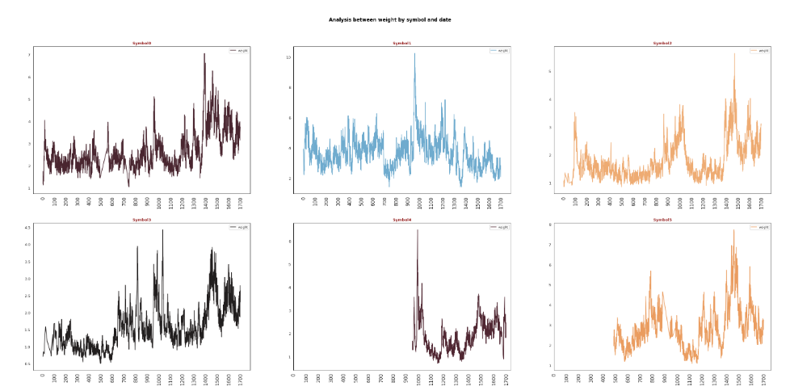
Weights
https://www.kaggle.com/code/ravi20076/janestreet2024-eda-v1

Slide 4
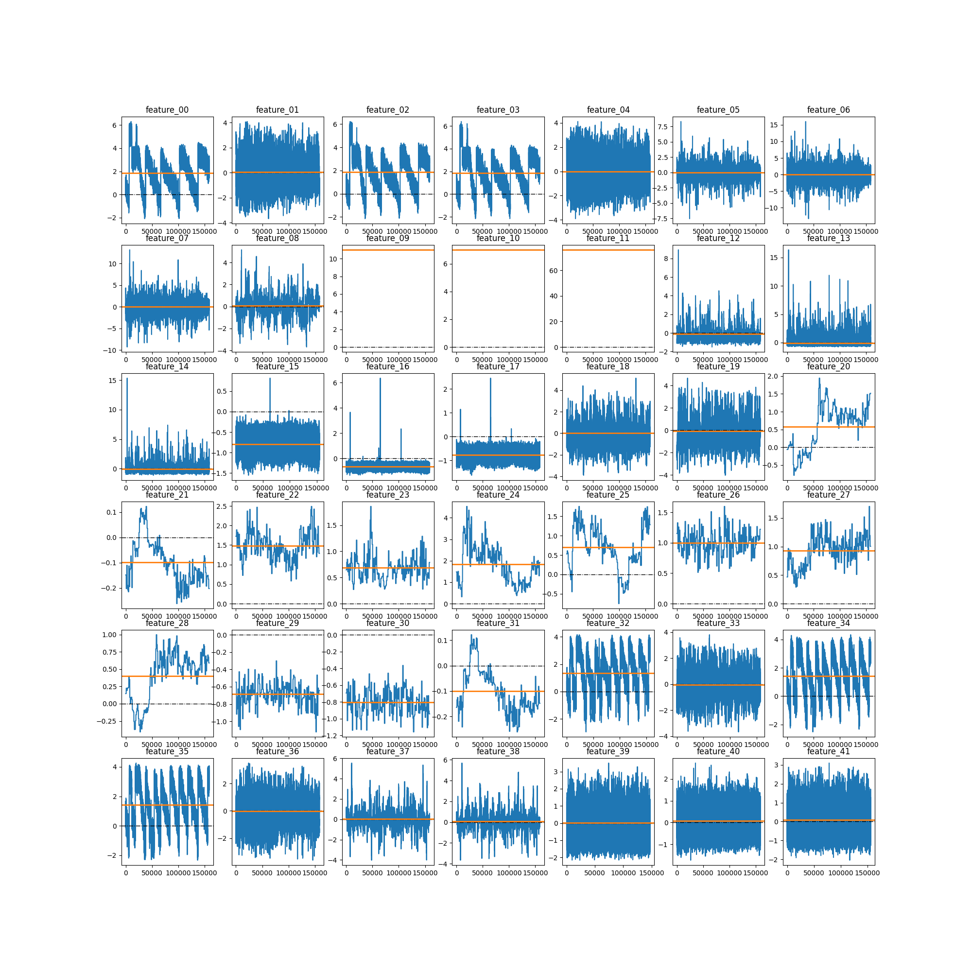
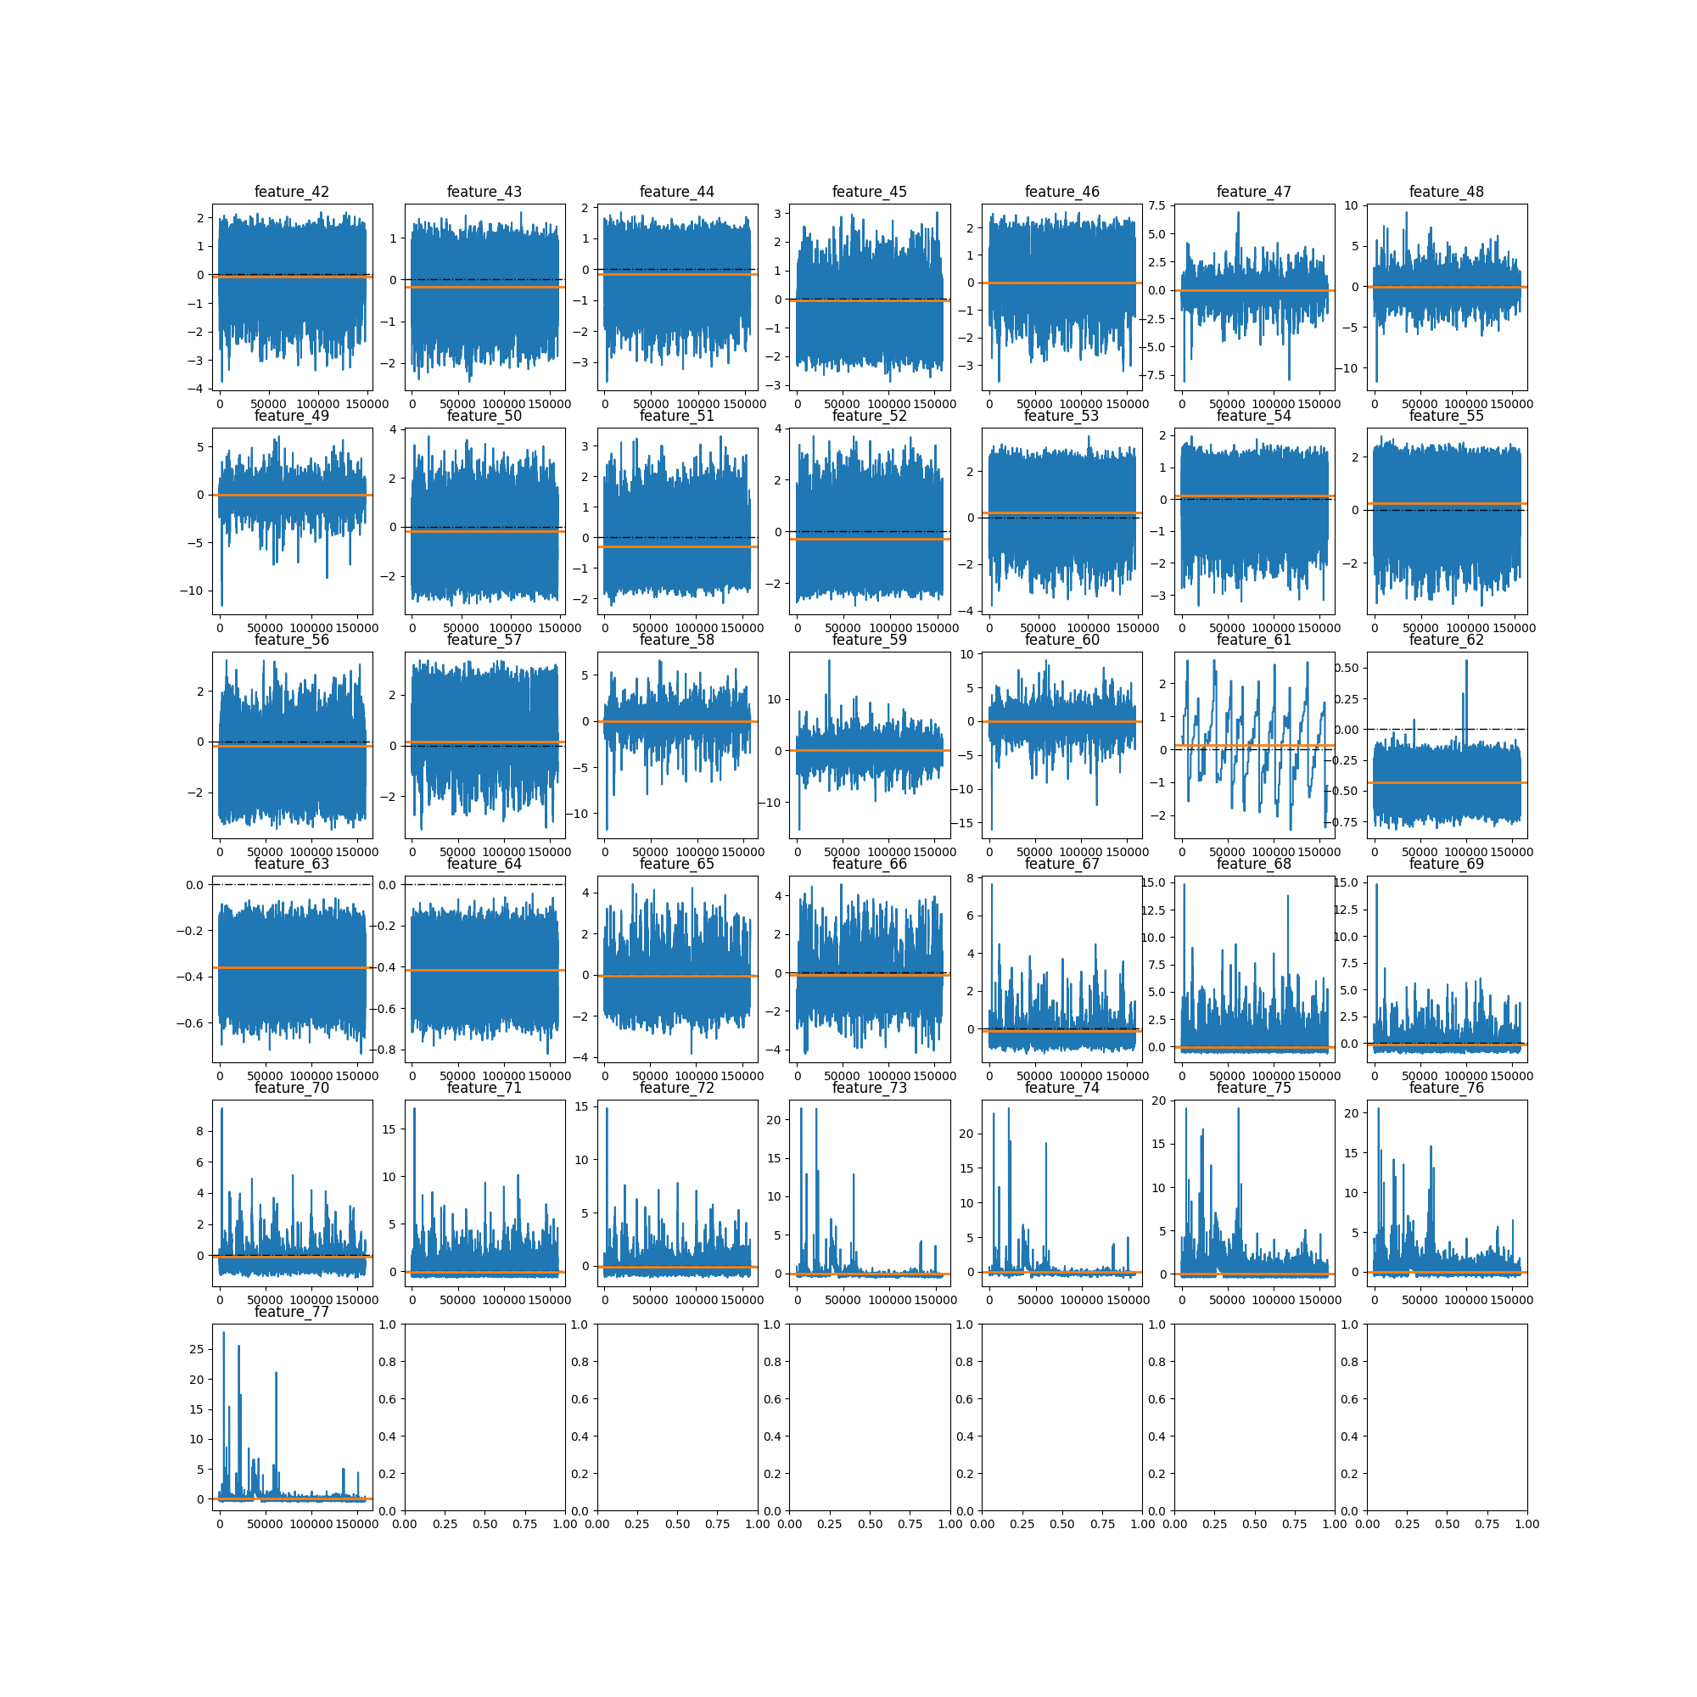
Features

Slide 5
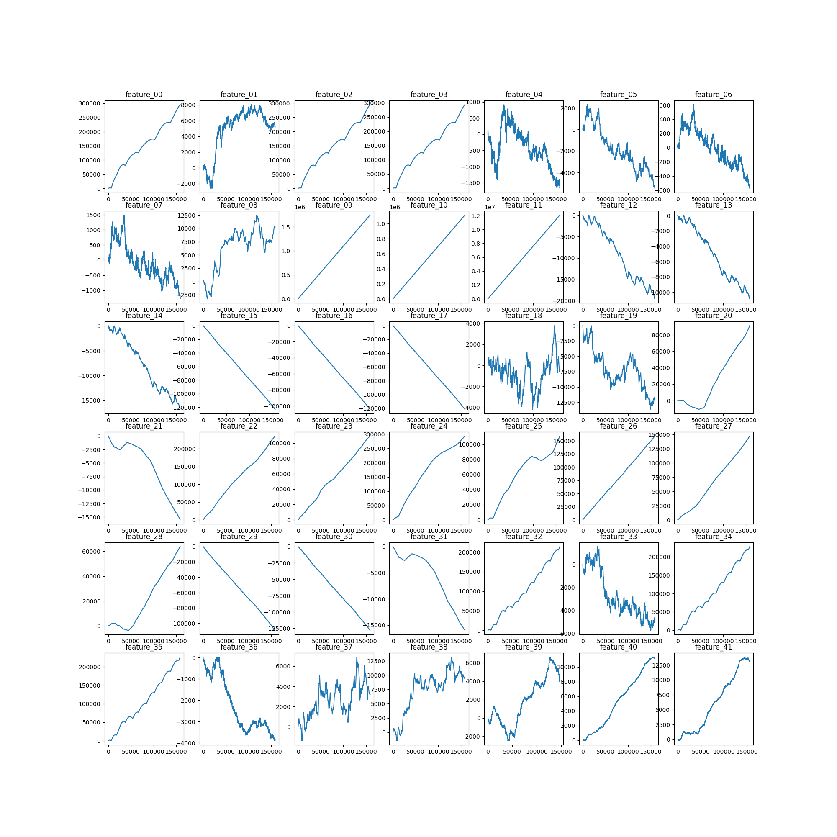
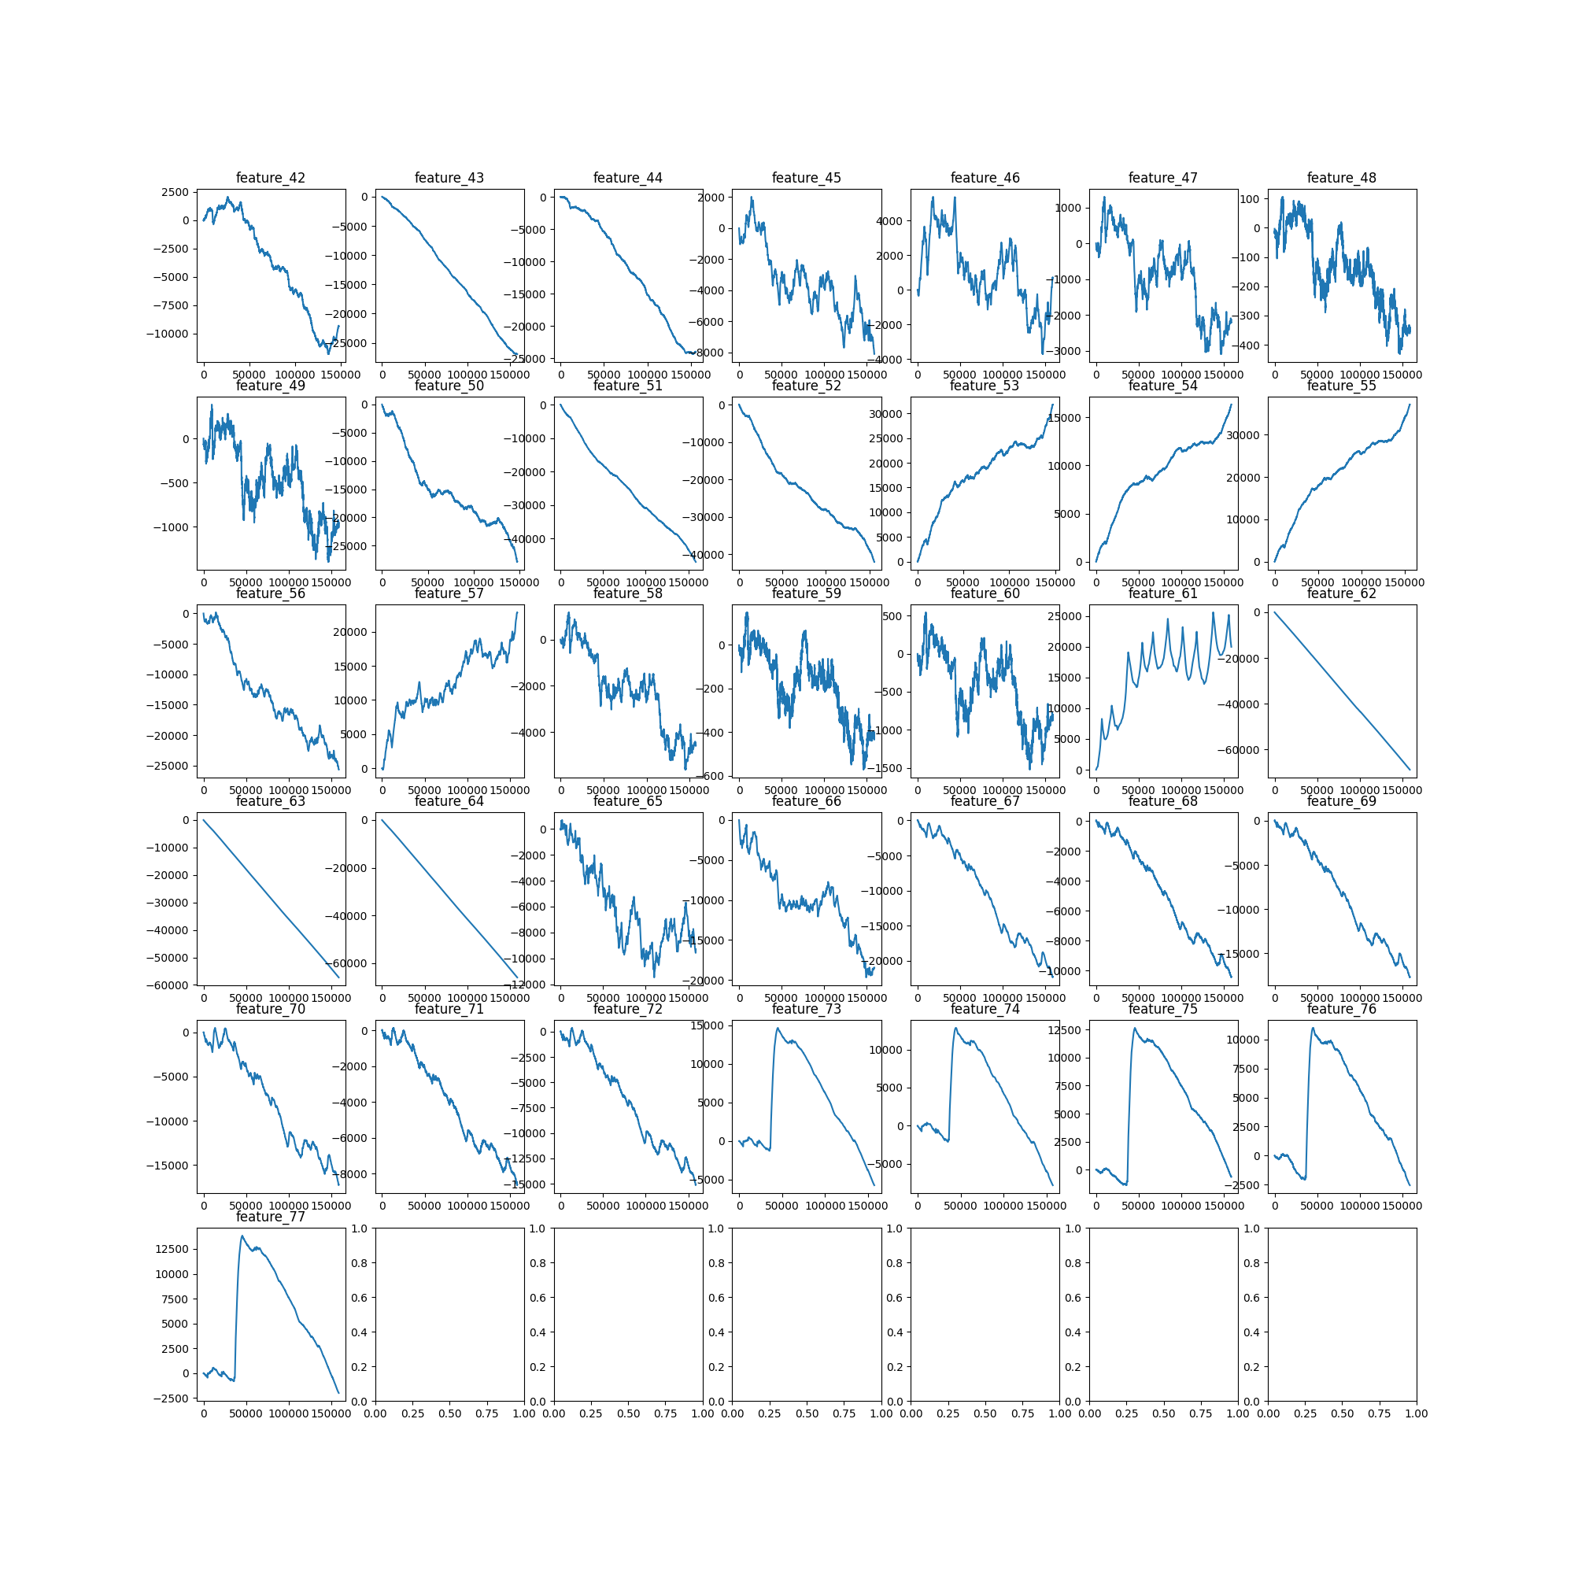
Features - Cumulative

Slide 6
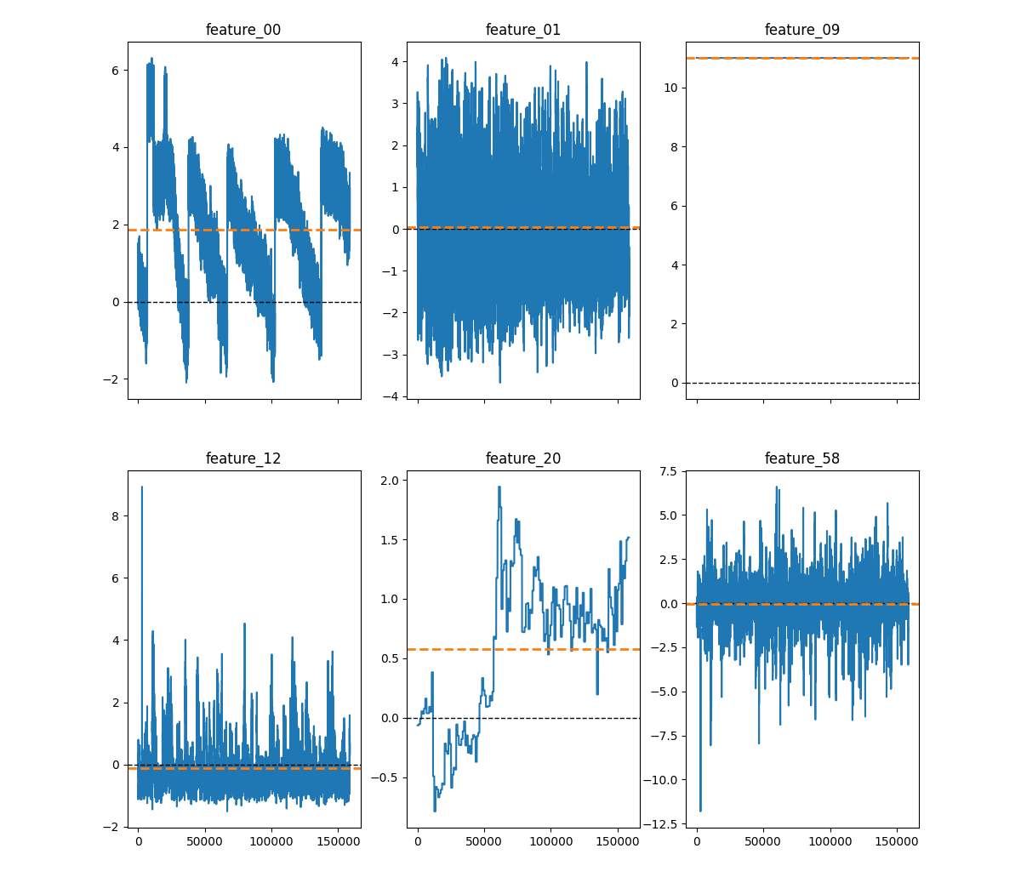
Features – Distributions
Very different from each other
Feature_09 is categorical
Features are not centralized per symbol

Slide 7
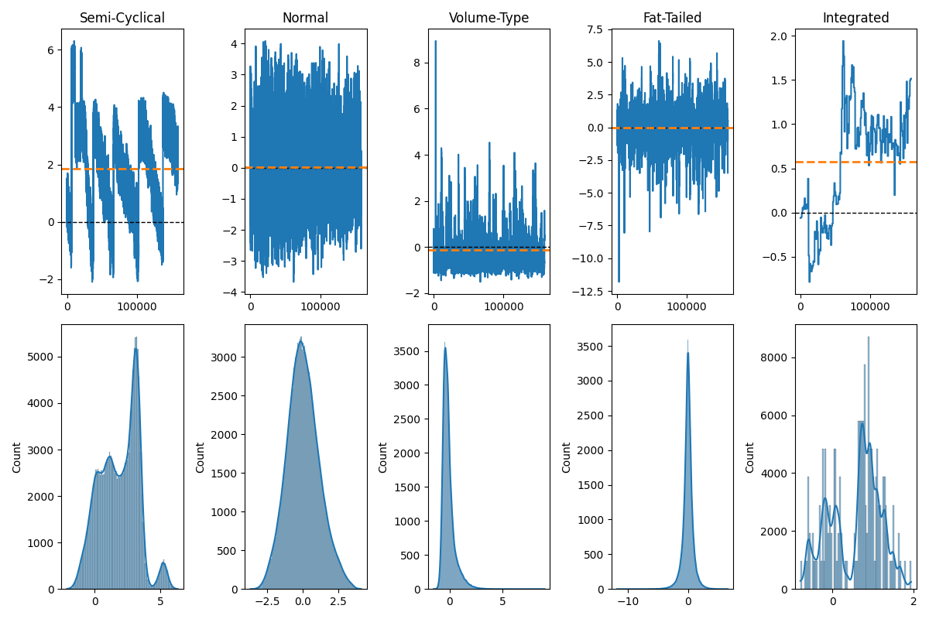
Features – Distributions
Likely, if we process the features appropriately, models will improve

Slide 8
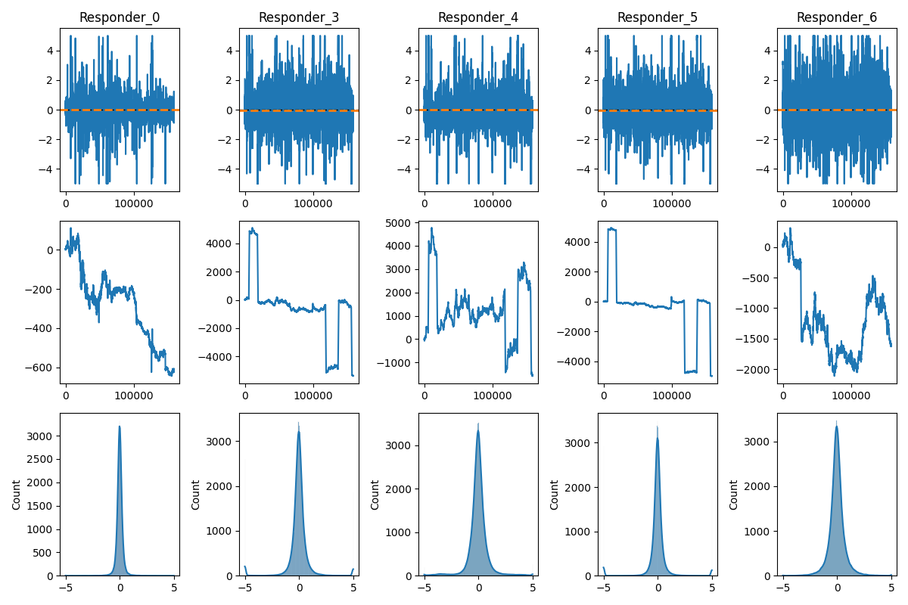
Responders (a Subset)
Nasty jump

Slide 9
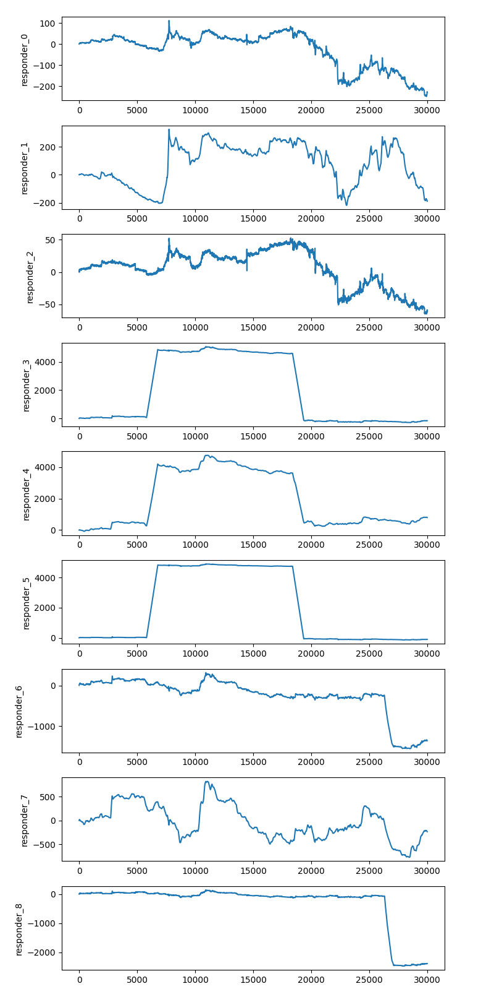
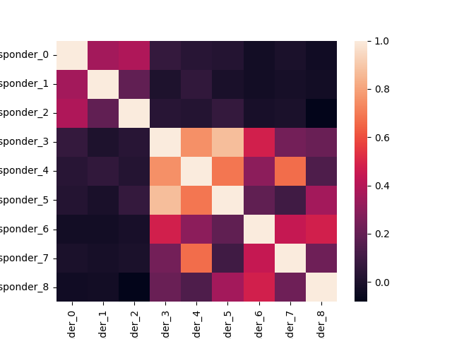
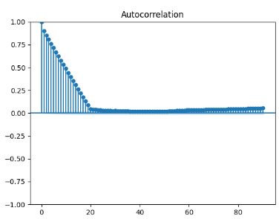
Responder 6 Jump
I guess, 3 groups of 3 responders
Jumps occur over a period of time: short but not instantaneous
Very strong autocorrelation, thus lag is a must since it’s likely the single best predictor

Slide 10
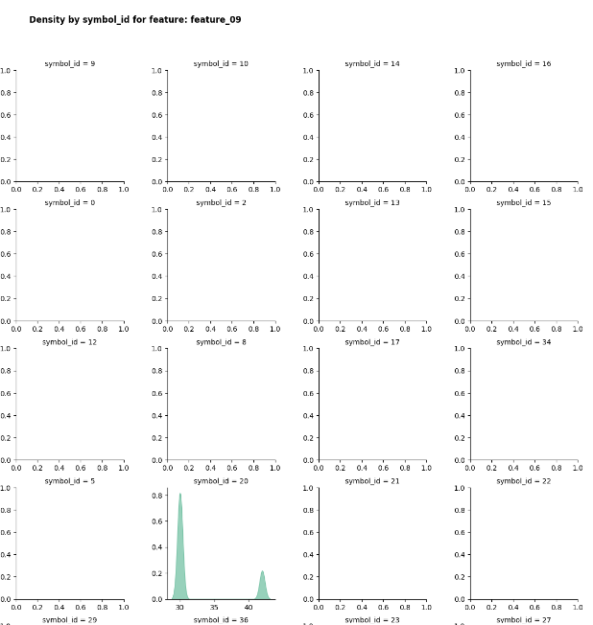
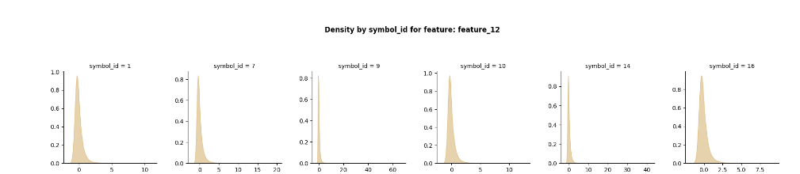
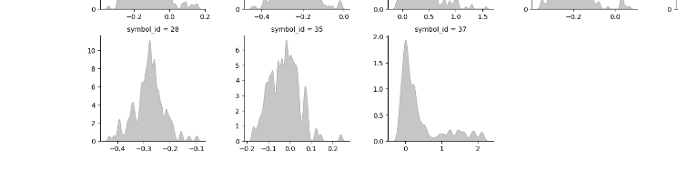
EDA - Crowd
https://www.kaggle.com/code/michau96/jane-street-features-by-financial-instruments

Slide 11
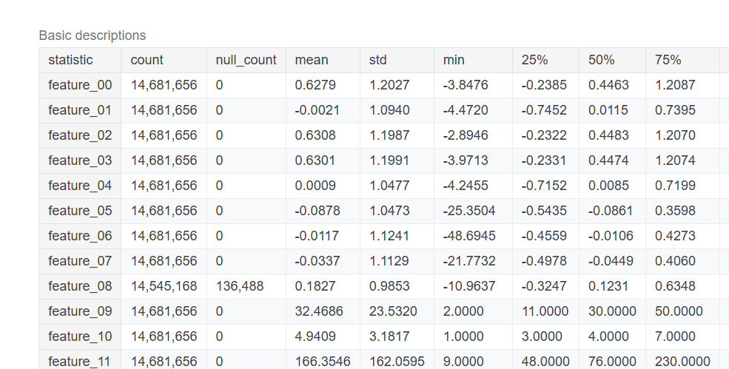
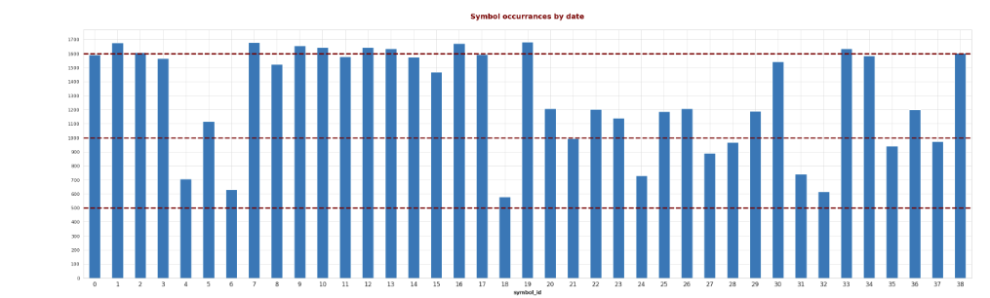
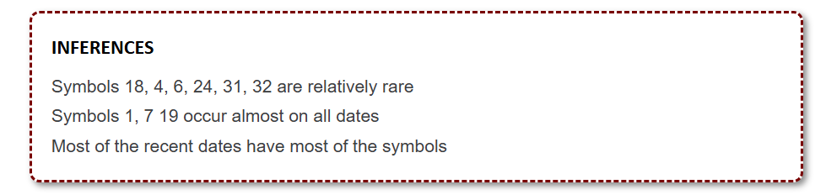
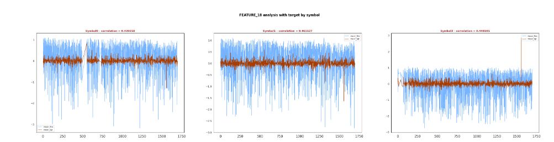
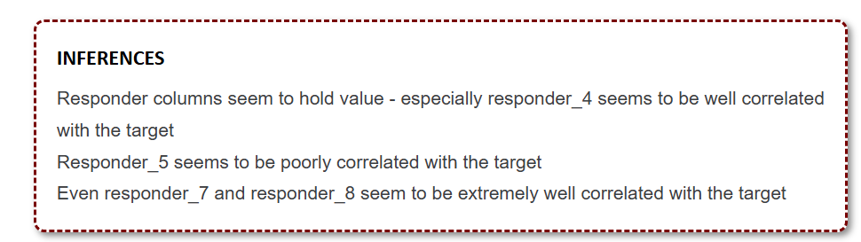
Stats
https://www.kaggle.com/code/ravi20076/janestreet2024-eda-v1

Slide 12
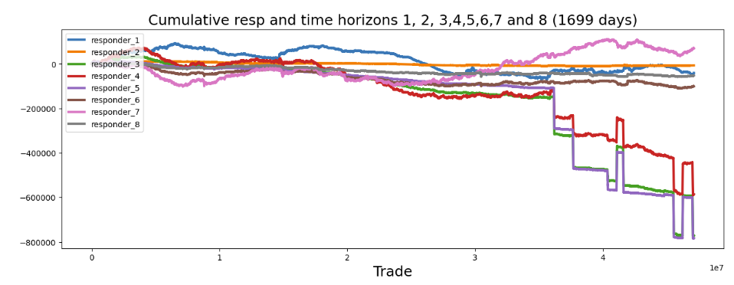
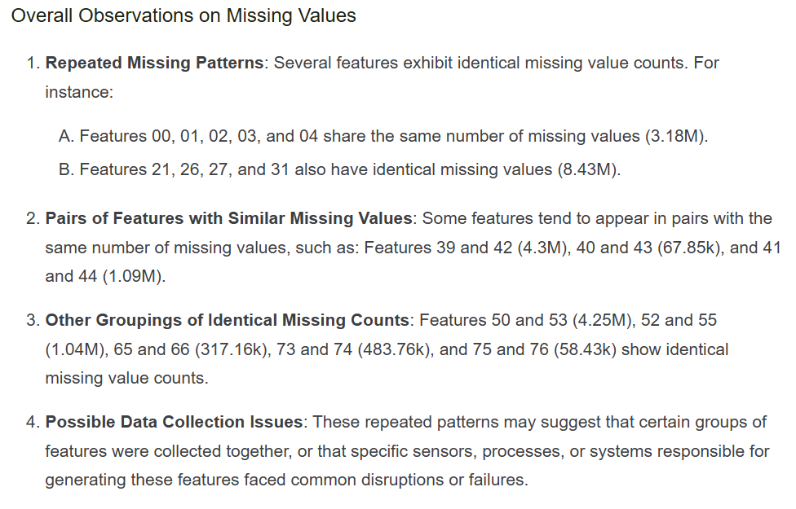
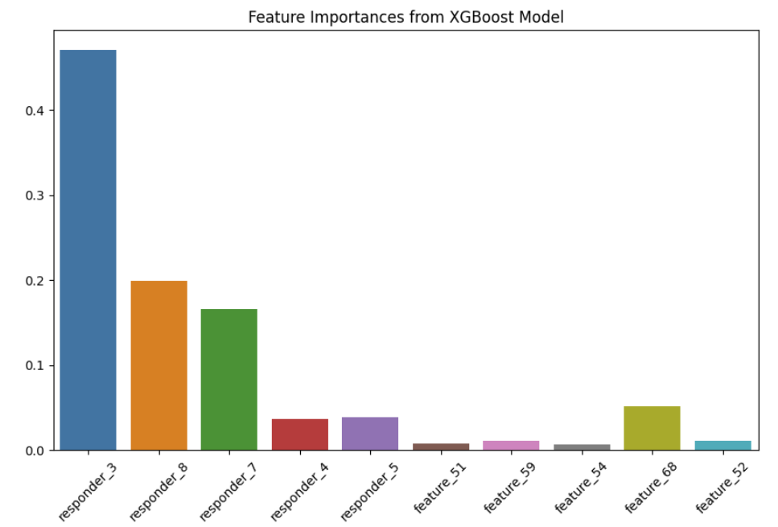
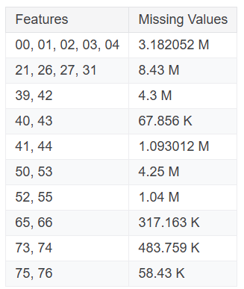
Feature Importance
https://www.kaggle.com/code/ahsuna123/jane-street-24-day-0-eda-and-feature-importance

Slide 13
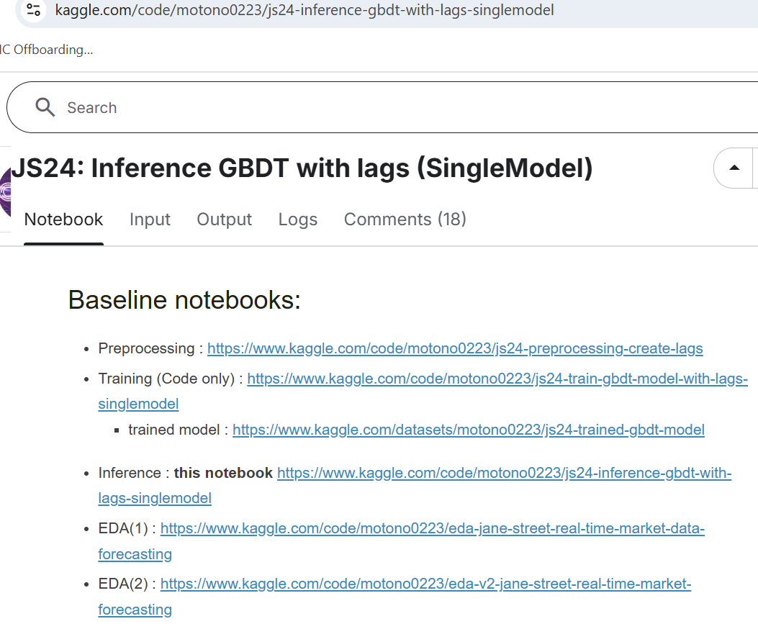
Some More Comprehensive Work

Slide 14
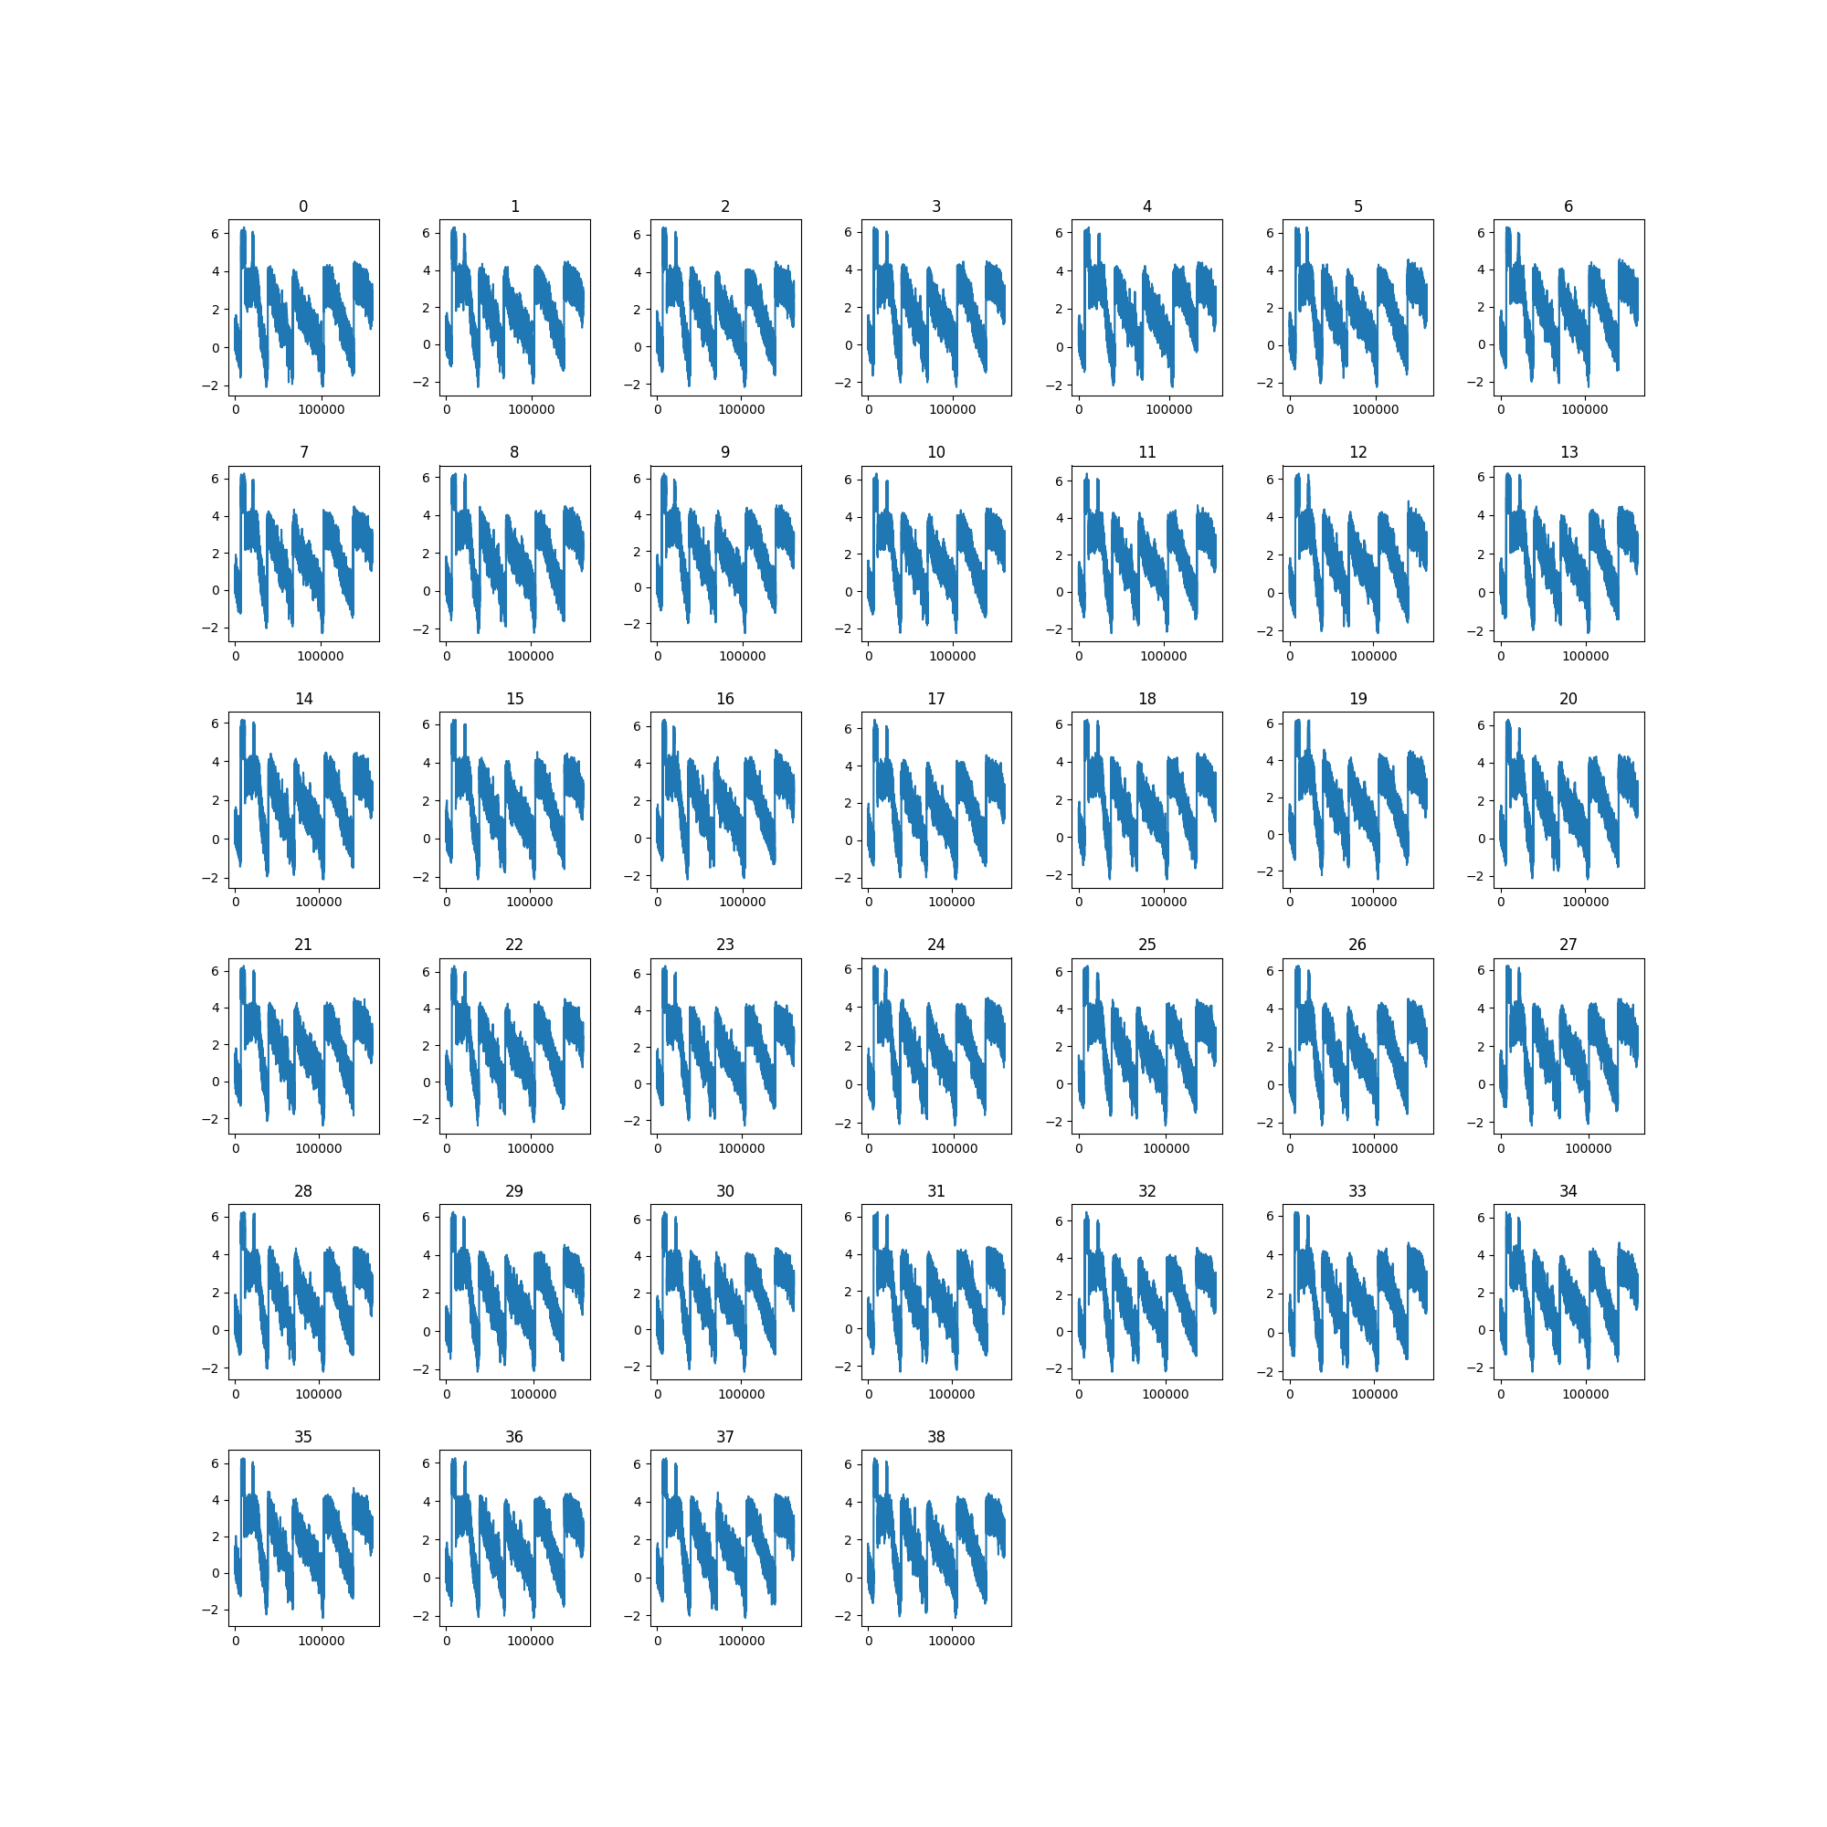
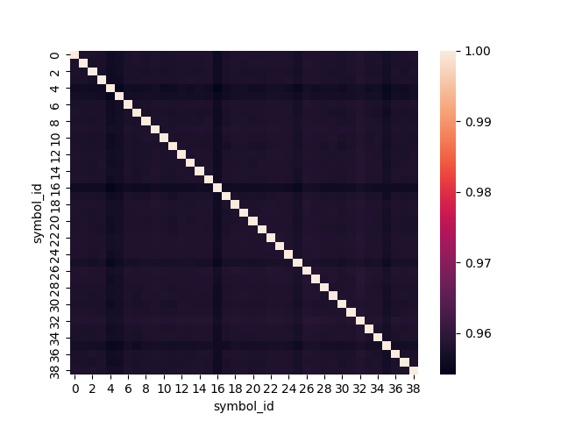
Feature 00 Across Symbols
At least visually, the ‘transitions’ seem to happen at the same time
The correlation between symbols is extremely high
Either it reflects a ‘fundamental’ signal
Or we need to pre-process it to extract the relevant piece for each symsbol

