Slide 1
Jane Street Competition

Slide 2
Data
10 partitions
In the following, I selected partition id = 9
Symbol = 1

Slide 3
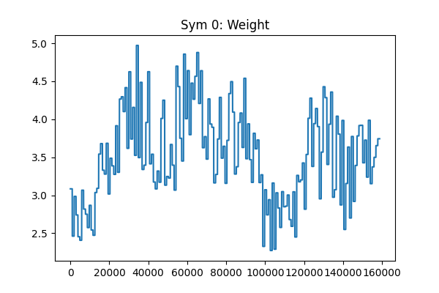
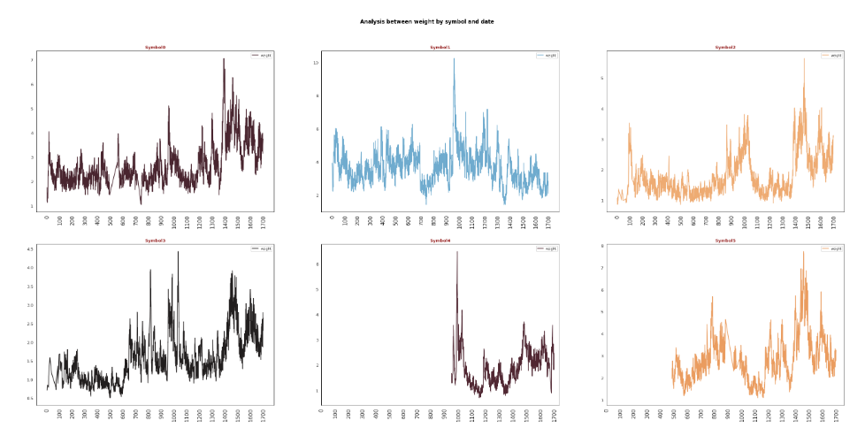
Weights
https://www.kaggle.com/code/ravi20076/janestreet2024-eda-v1

Slide 4
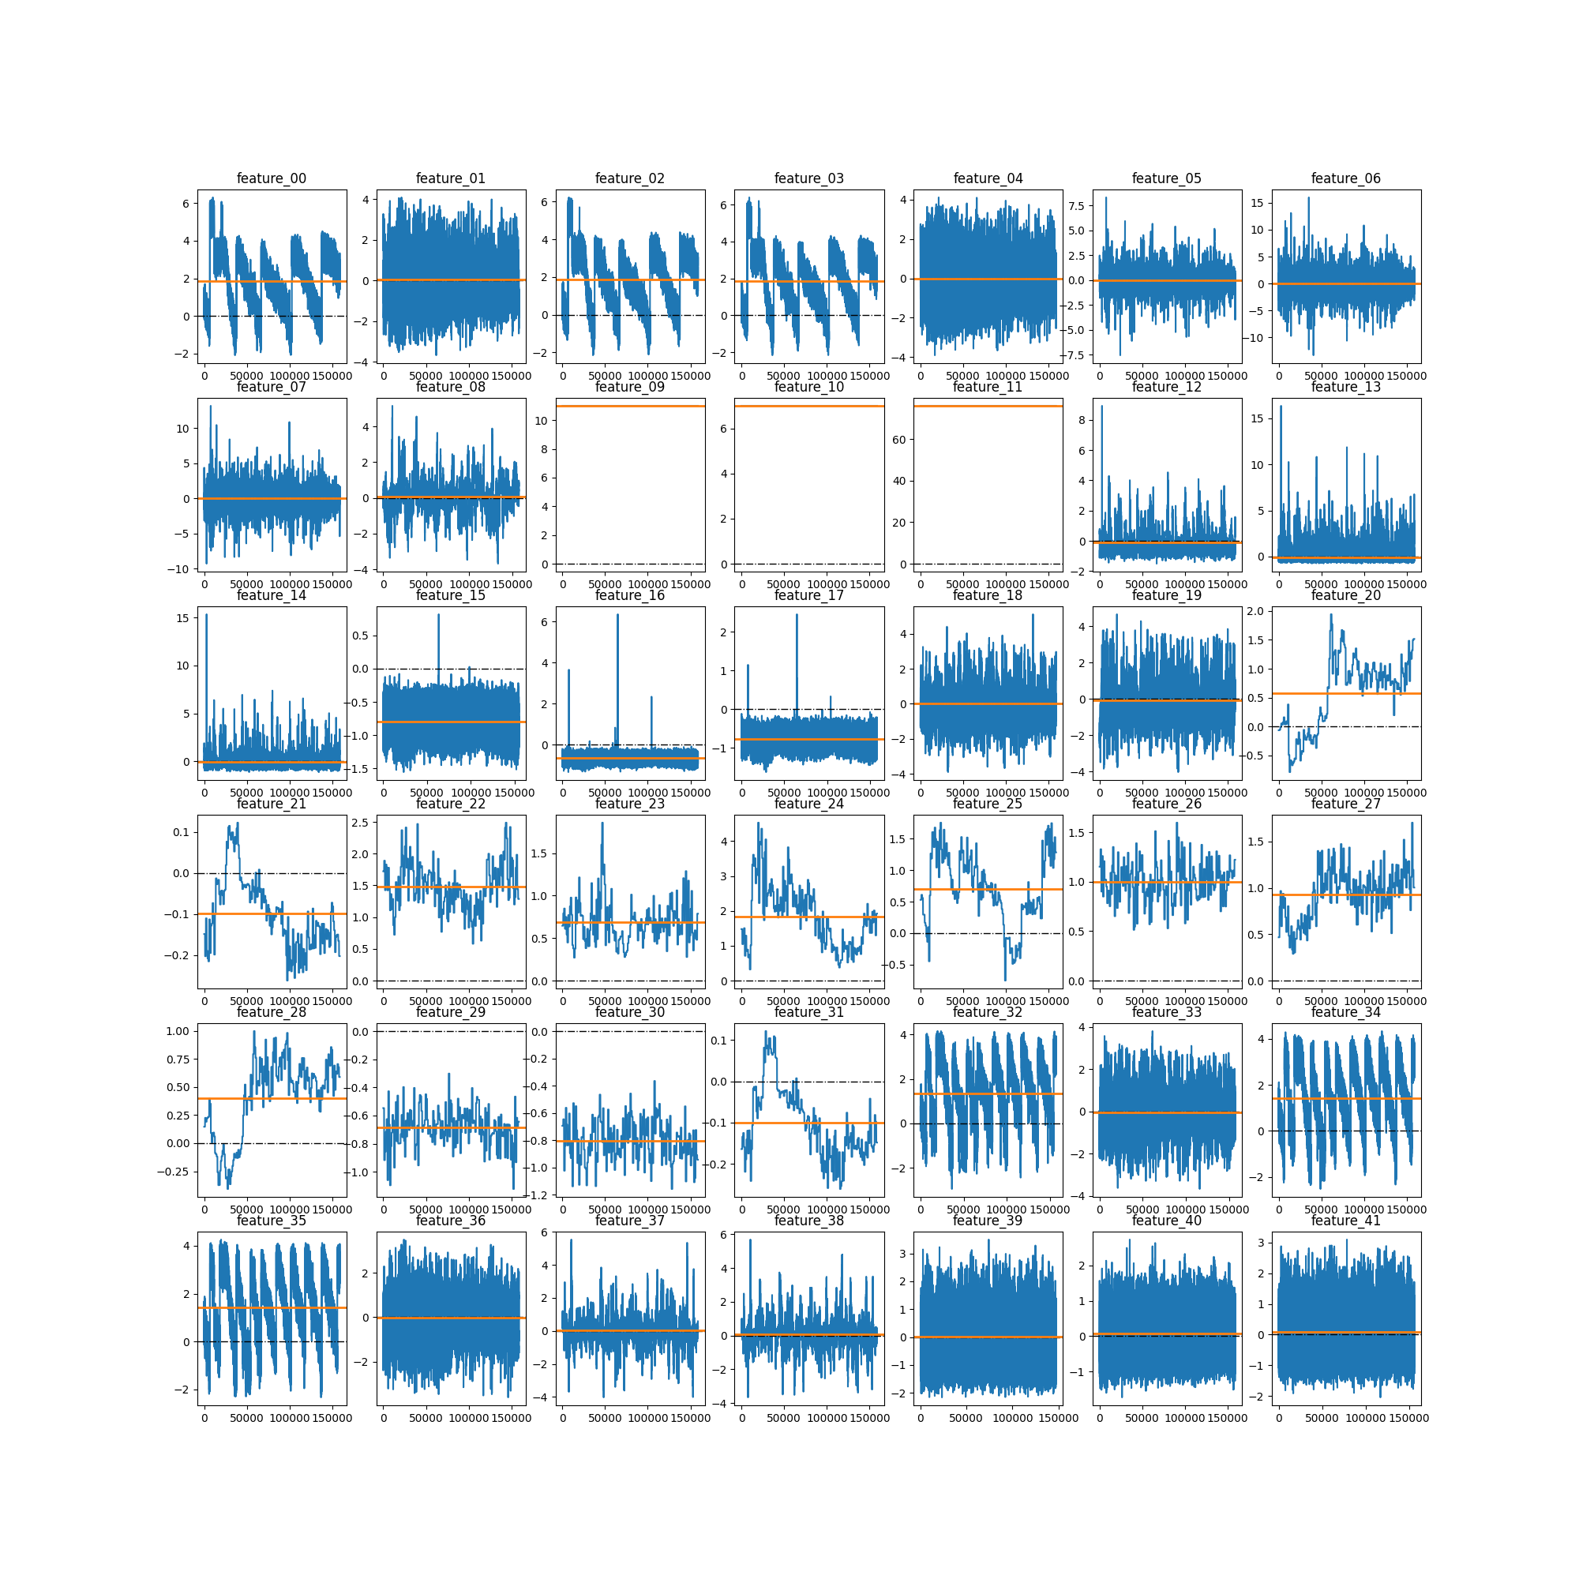
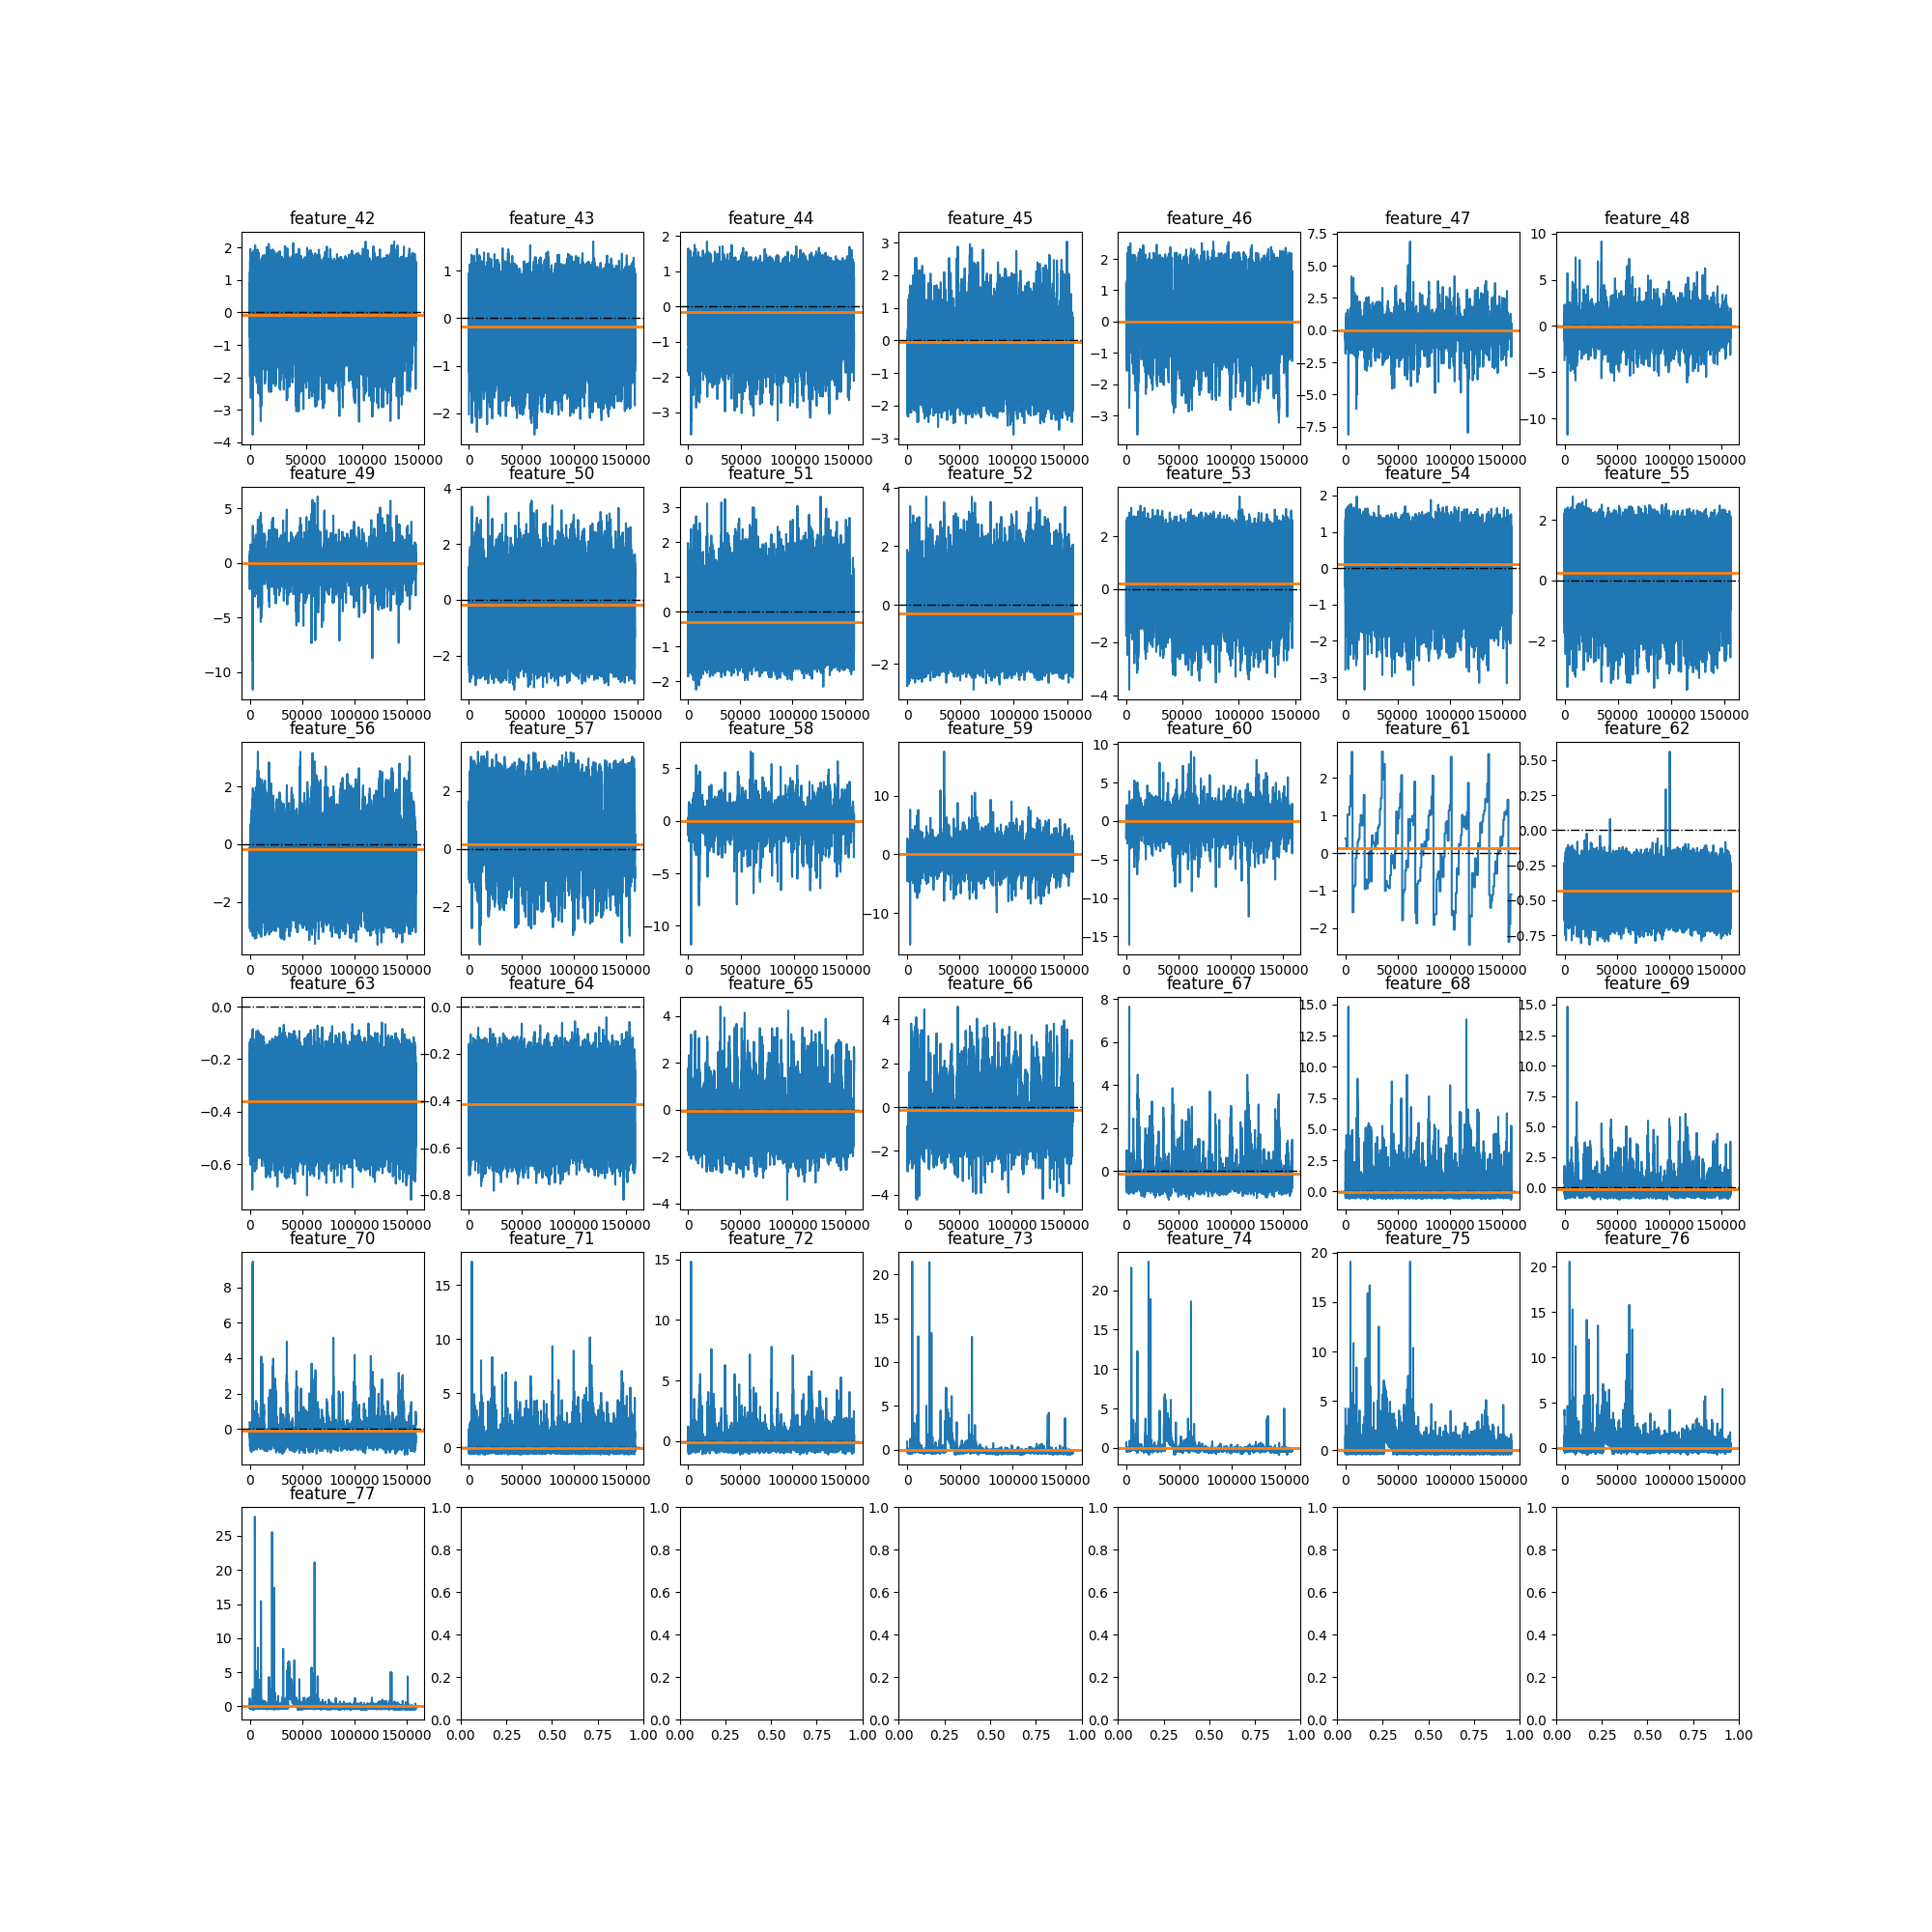
Features

Slide 5
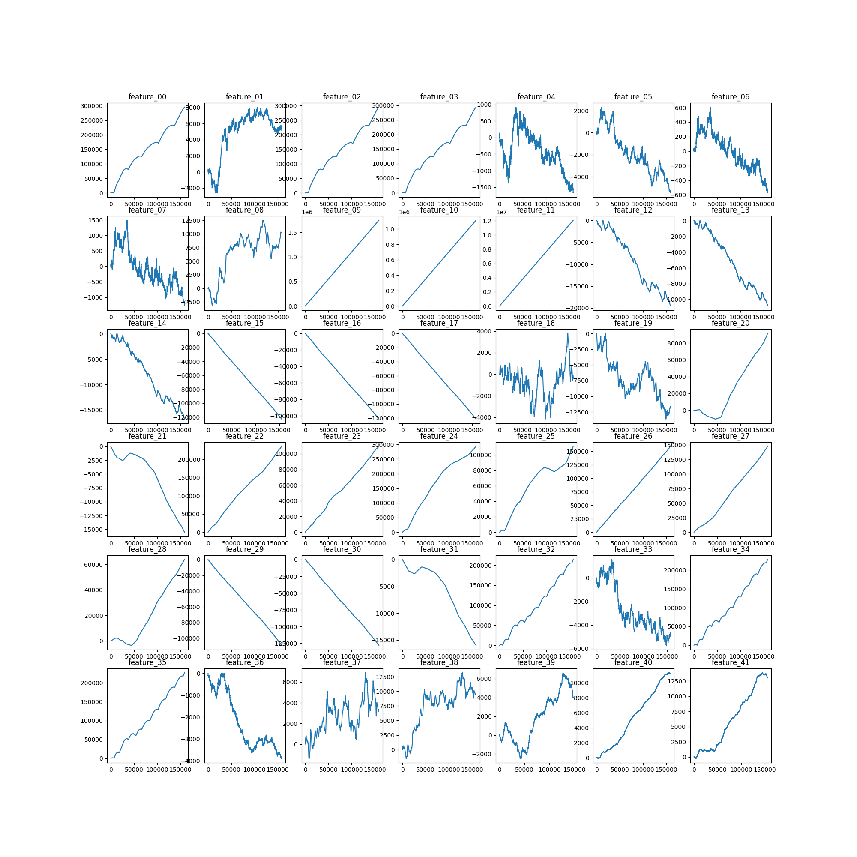
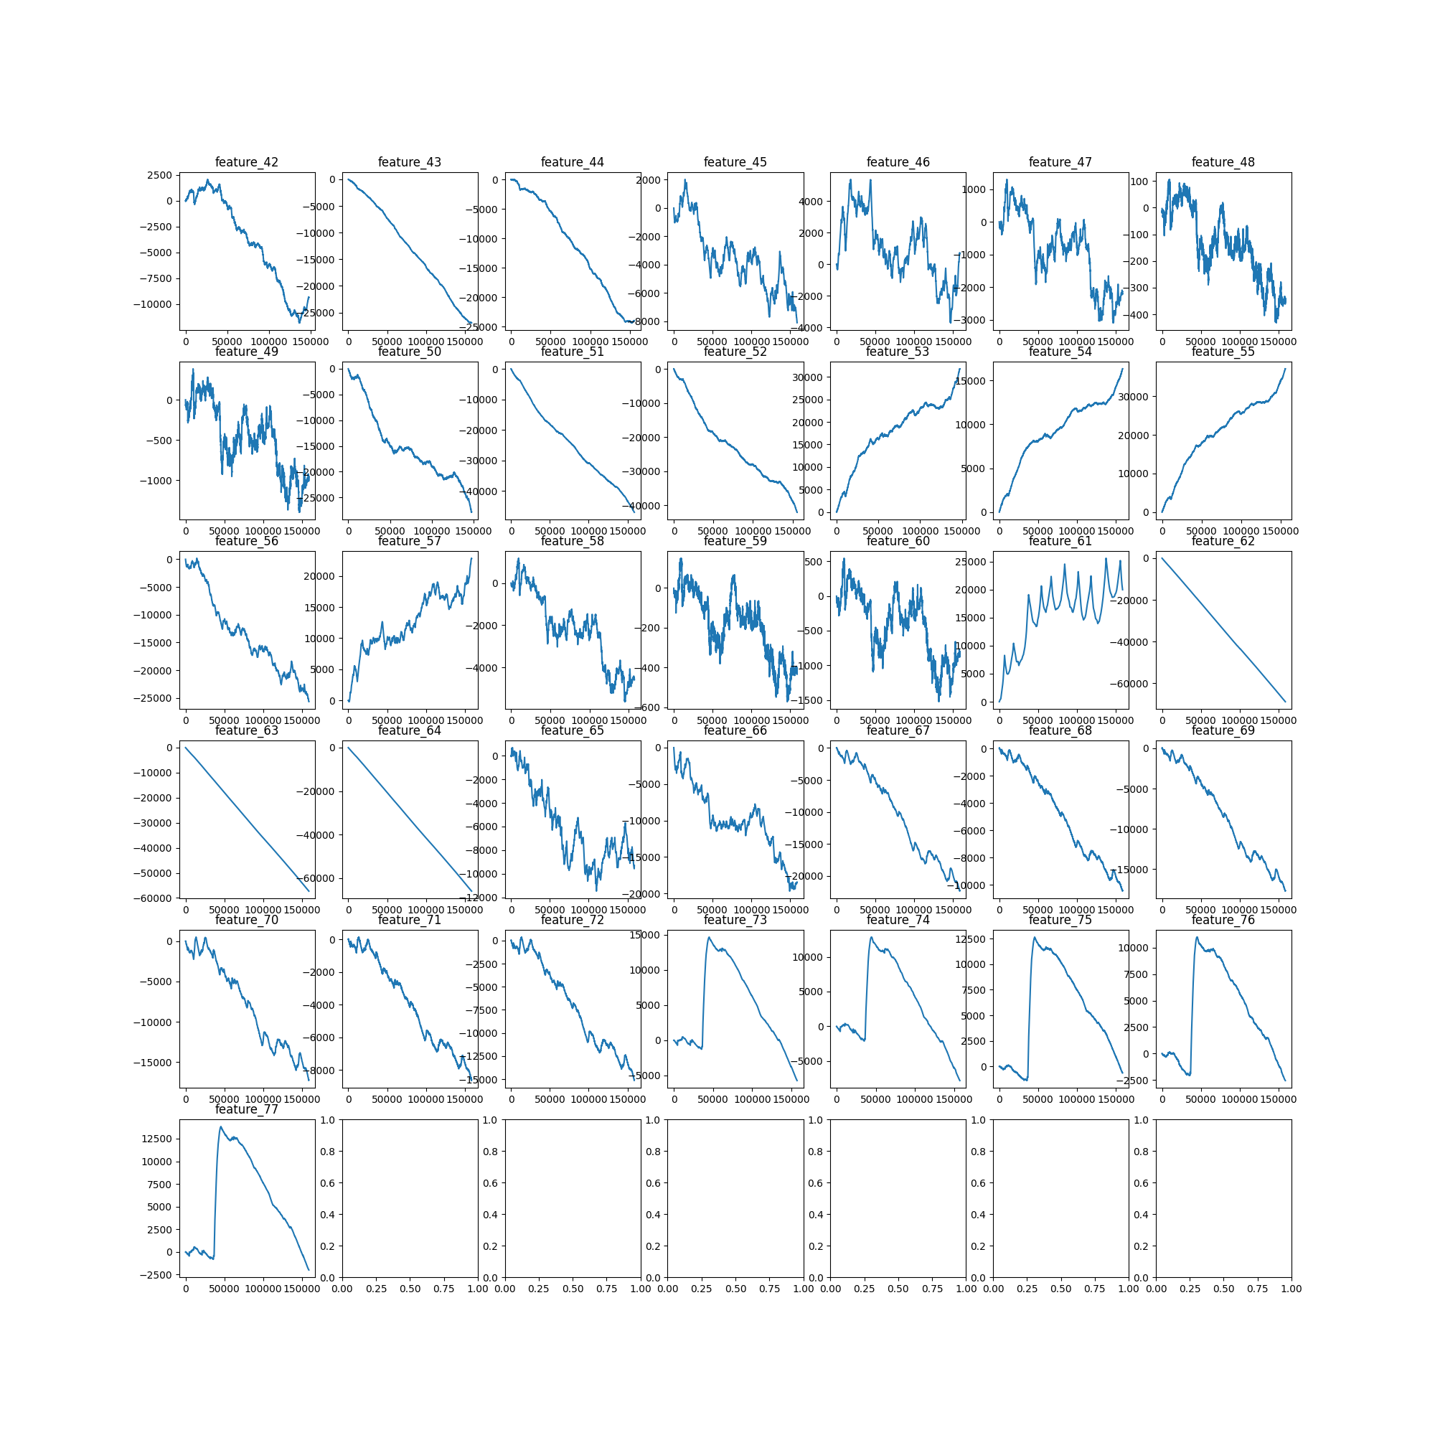
Features - Cumulative

Slide 6
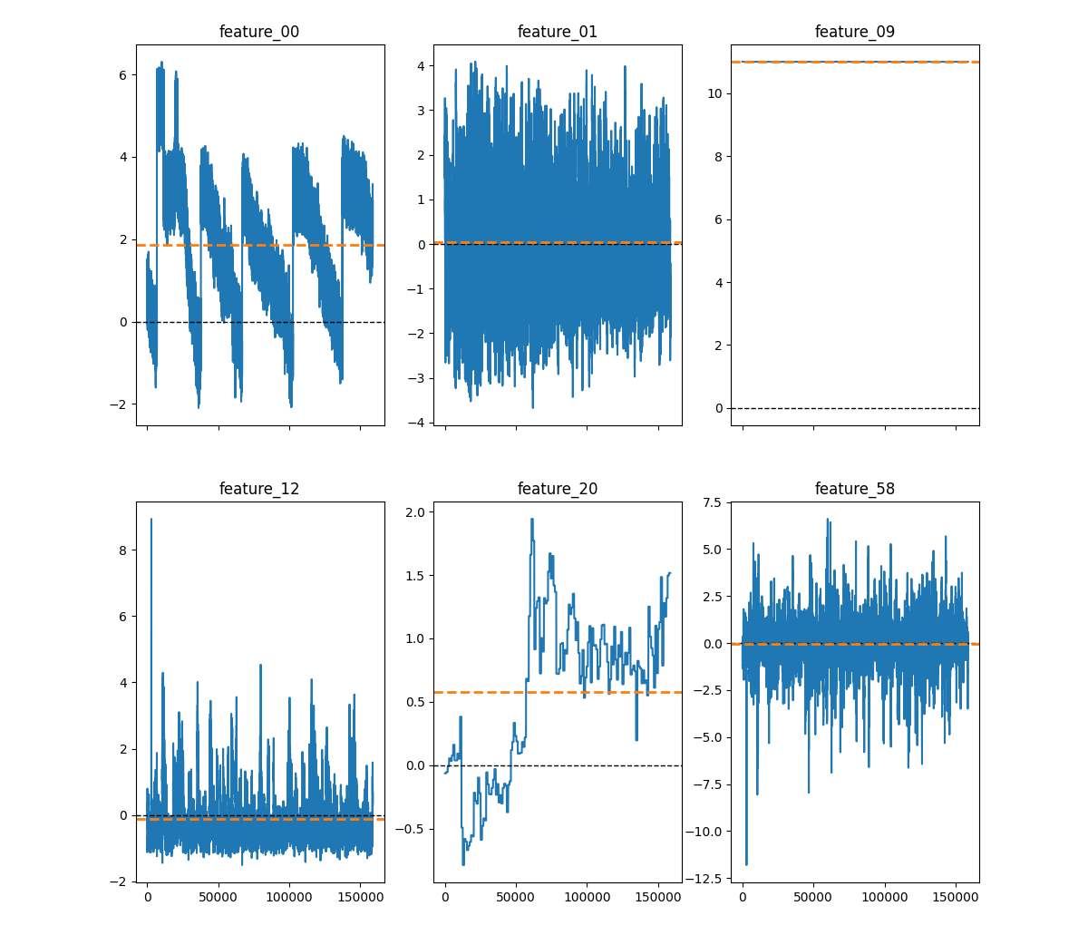
Features – Distributions
Very different from each other
Feature_09 is categorical
Features are not centralized per symbol

Slide 7
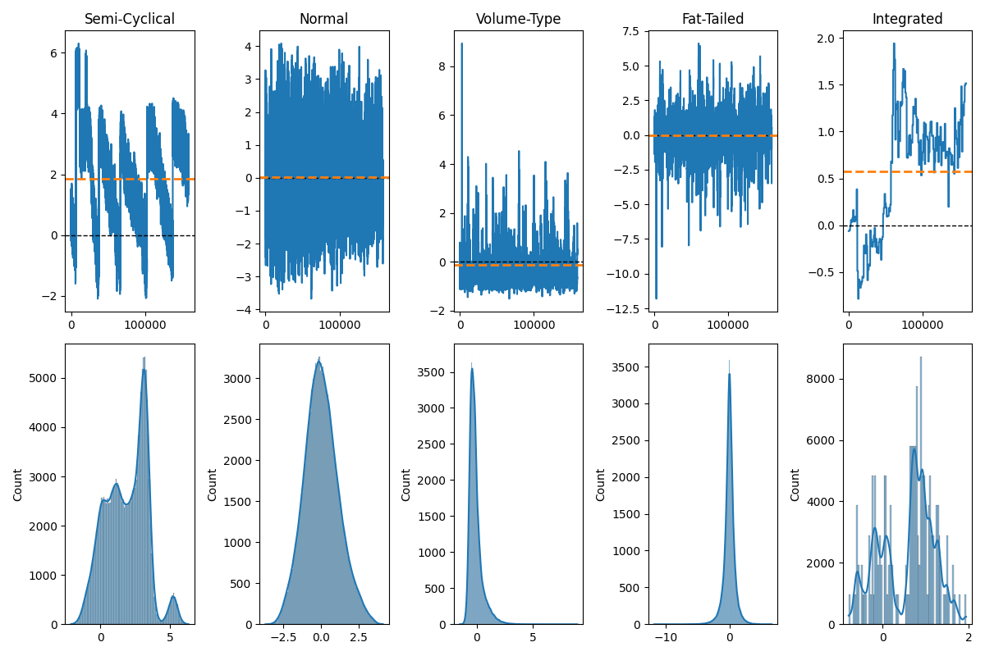
Features – Distributions
Likely, if we process the features appropriately, models will improve

Slide 8
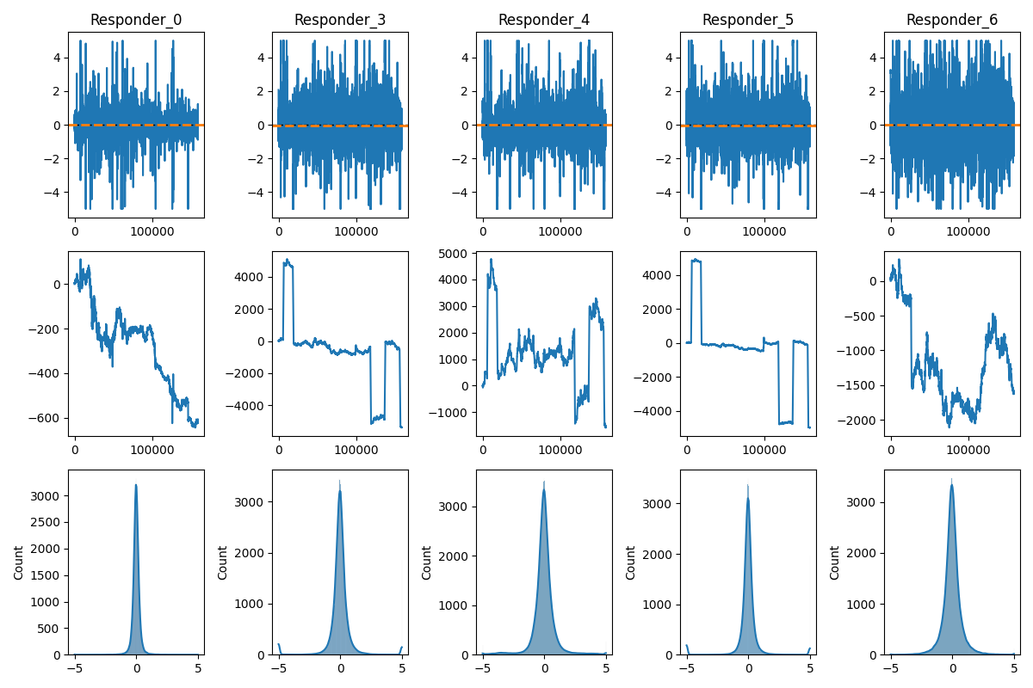
Responders (a Subset)
Nasty jump

Slide 9
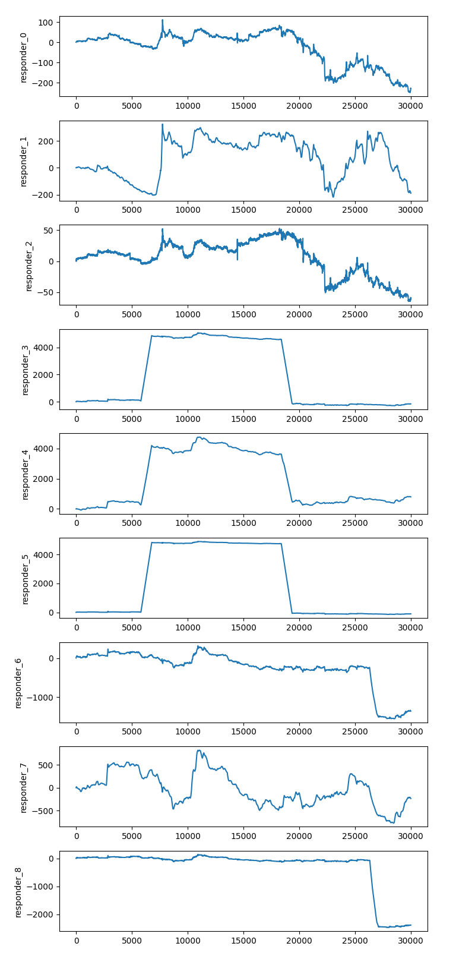
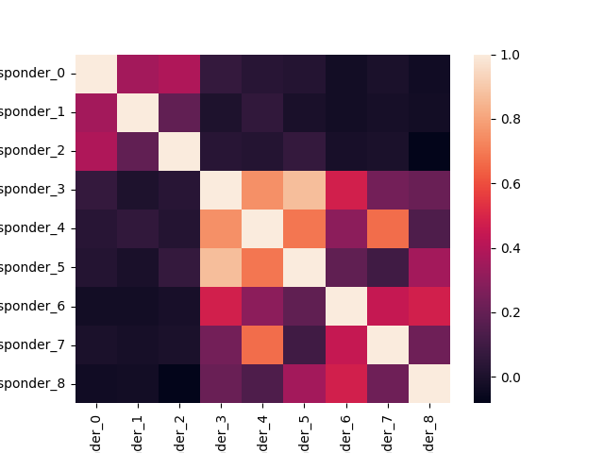
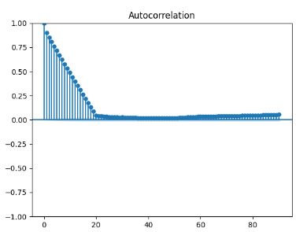
Responder 6 Jump
I guess, 3 groups of 3 responders
Jumps occur over a period of time: short but not instantaneous
Very strong autocorrelation, thus lag is a must since it’s likely the single best predictor

Slide 10
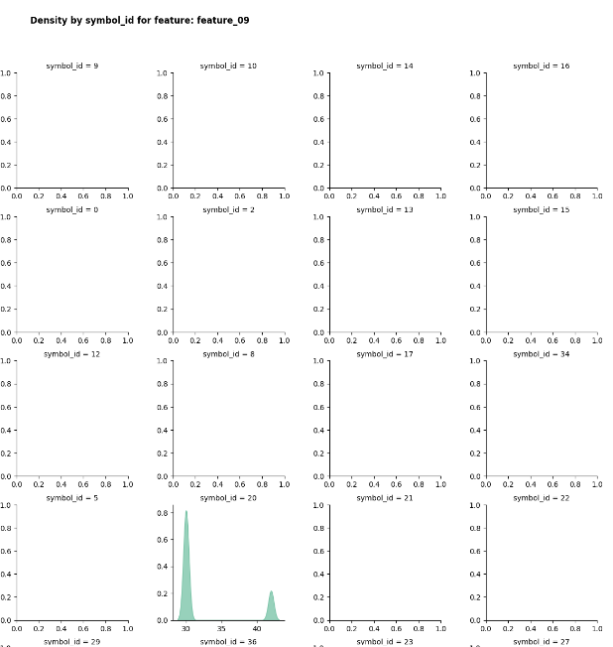
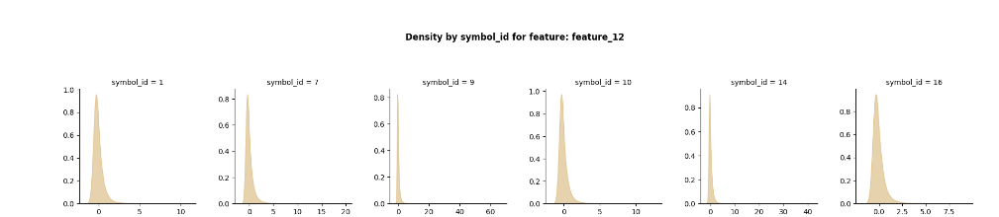
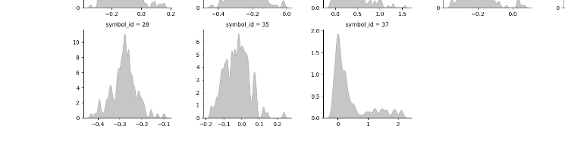
EDA - Crowd
https://www.kaggle.com/code/michau96/jane-street-features-by-financial-instruments

Slide 11
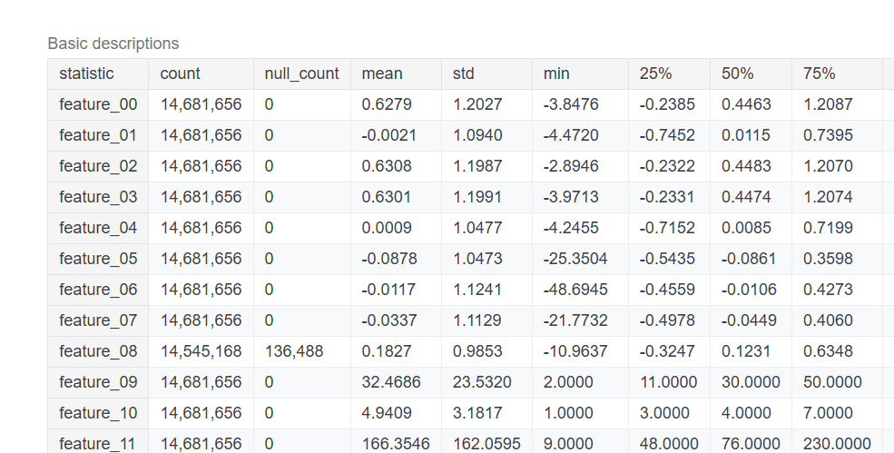
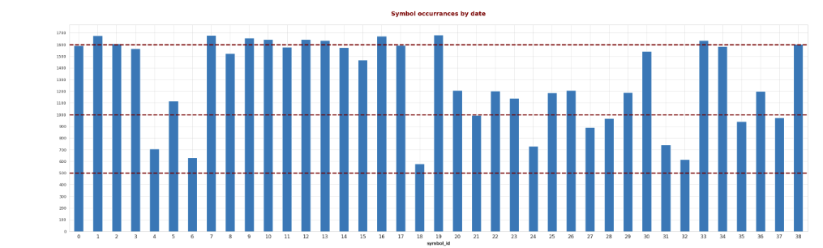
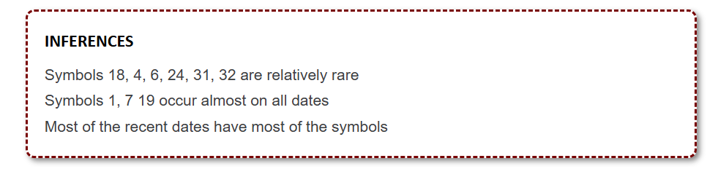
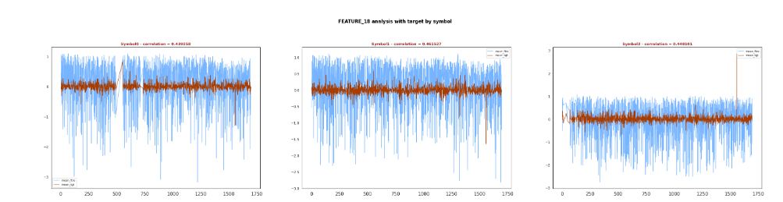
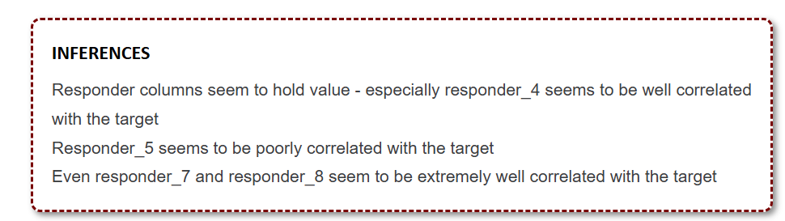
Stats
https://www.kaggle.com/code/ravi20076/janestreet2024-eda-v1

Slide 12
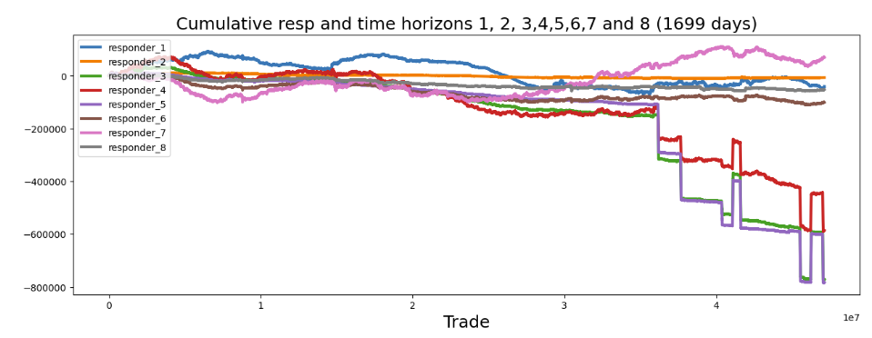
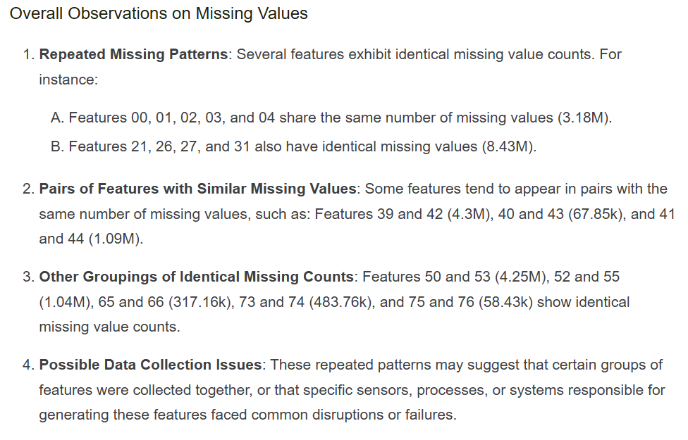
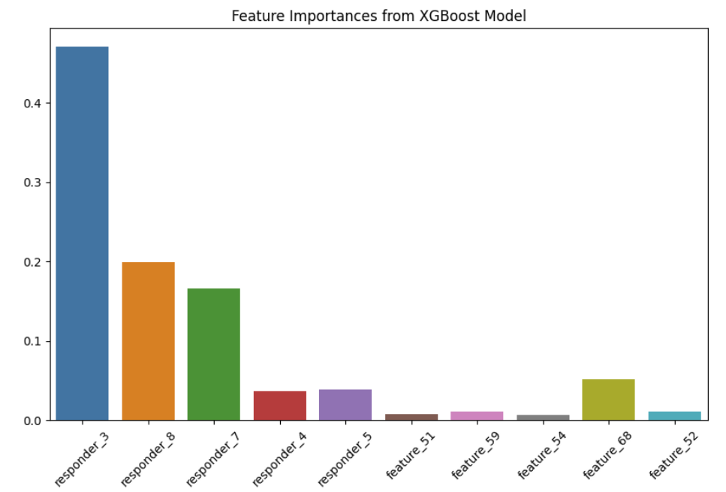
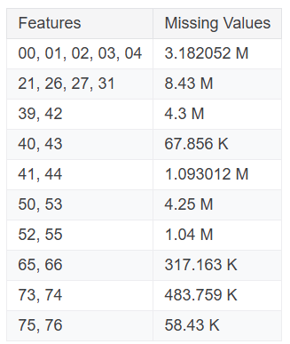
Feature Importance
https://www.kaggle.com/code/ahsuna123/jane-street-24-day-0-eda-and-feature-importance

Slide 13
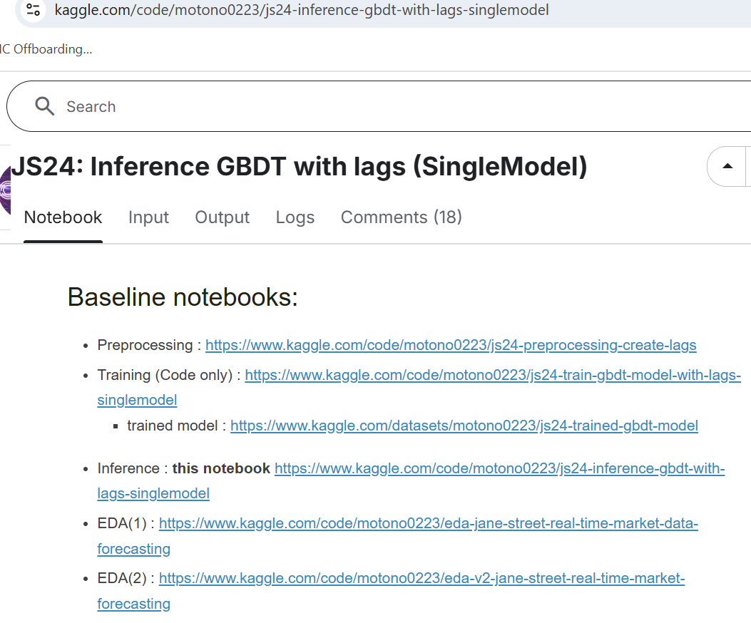
Some More Comprehensive Work

