Slide 1
Finding Median(kth Smallest Element) in a Set Using D&C in Expected Linear Time

Slide 2
TEAM MEMBERS
SRABON AICH -15
SAAD BIN ASAD – 32
ARIFUL ISLAM – 45
MD. RAFEUL ISLAM - 80

Slide 3
agenda
INTRODUCTION 3
PROBLEM SETUP 11
DIVIDE & CONQUER APPROACH 10
QUICKSELECT ALGORITHM 14
MEDIAN OF MEDIANS ALGORITHM 26
APPLICATIONS & USE CASES 33
CONCLUSION 35

Slide 4
overview
WHAT IS MEDIAN?
WHAT IS K-TH SMALLEST ELEMENT
MOTIVATION FOR SOLVING

Slide 5
problem setup
Definition
What is Median?
The median of an array of size n is defined as the middle element when n is odd and the average of the middle two elements when n is even.
[12, 3, 5, 7, 4, 19, 26] Median: 7 Explanation: Sorted sequence of given array [3, 4, 5, 7, 12, 19, 26] Since the number of elements is odd, the median is 4th element in the sorted sequence of given array, which is 7
[12, 3, 5, 7, 4, 26] Median: 6 Explanation: Since number of elements are even, median is average of 3rd and 4th element in sorted sequence of given array, which means (5 + 7)/2 = 6

Slide 6
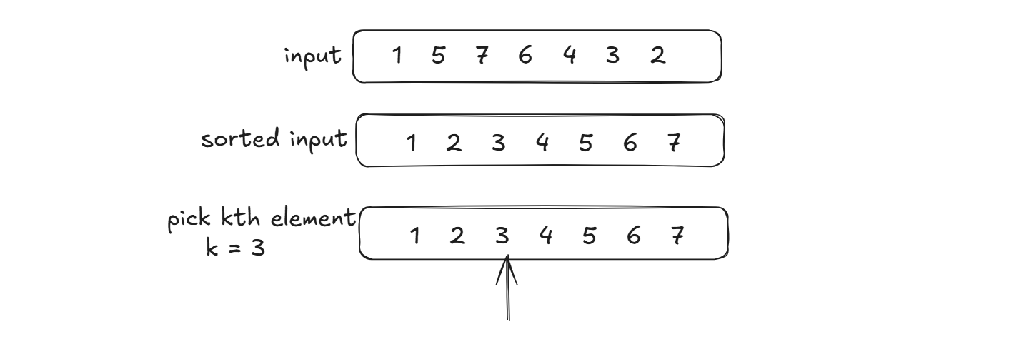
problem setup
Definition
What is k-th smallest element?
The kth smallest element in an array is the element that would be at the kth position if the array were sorted in ascending order
For Example:
Array [1, 5, 7, 6, 4, 3, 2] and k is 3, the 3rd smallest element is 3, as it’s larger than 1 and 2
Array [2, 3, 1, 20, 15] and k is 4, the 4th smallest element is 15

Slide 7
problem setup
Motivation
Why Not Sort Everything ?(The Naïve Approach)
This problem can be solved using Brute force approach which will take O(nlogn)
O(logn) is required to partition the array based on a pivot and
O(n) is required to swap the subarrays .
So the total complexity stands O(nlogn) & which is inefficient for large data
Can we do better??
Can we reduce the time complexity to O(n) , Linear Time Complexity?
Yes we can. For this we will use Divide & Conquer(D&C)

Slide 8
WHY EXPECTED LINEAR TIME IS IMPORTANT?
MOTIVATION FOR EFFICIENT ALGORITHM
Handling Large Datasets
Comparison with Other Algorithm
Scalability
Optimal Use of Resources
Efficiency in Real-Time Applications
Practical Applications

Slide 9
Handling Large Datasets
As the size of the dataset increases, algorithms with higher time complexities (like O(n log n) or O(n^2)) can become very slow, making it impractical to process large data within a reasonable time frame. Expected linear time (O(n)) ensures that even for large datasets, the algorithm can process the data quickly.
Efficiency in Real-Time Applications
For real-time systems or applications with time constraints, an algorithm that runs in linear time can be crucial. For instance, in data streaming or online data analysis, where processing speed is critical, algorithms with expected O(n) time are highly valuable.
Scalability
Expected linear time allows the algorithm to scale with the size of the input. As the input grows, the time complexity grows linearly
Optimal Use of Resources
By achieving linear time on average, the algorithm is efficient in terms of CPU usage and memory, which is important in resource-constrained environments like mobile devices or embedded systems.
Comparison with Other Algorithm
Many classical algorithms (e.g., sorting algorithms like MergeSort and QuickSort) have O(n log n) time complexity, which makes them less efficient than linear time algorithms when processing massive amounts of data.
Practical Applications
Many real-world applications, such as database queries, image processing, network routing, and machine learning, require the ability to process large amounts of data in an optimal time frame. Expected linear time helps in ensuring these tasks can be completed efficiently.

Slide 10
PROBLEM STATEMENT & CONSTRAINTS
Finding Median in a Set(array)
The Array will be Unsorted
Use Divide & Conquer strategy
Find median or k-th smallest in Linear Time( O(n) )

Slide 11

Divide & Conquer
“the reprobated axiom of tyranny” sir francis bacon

Slide 12
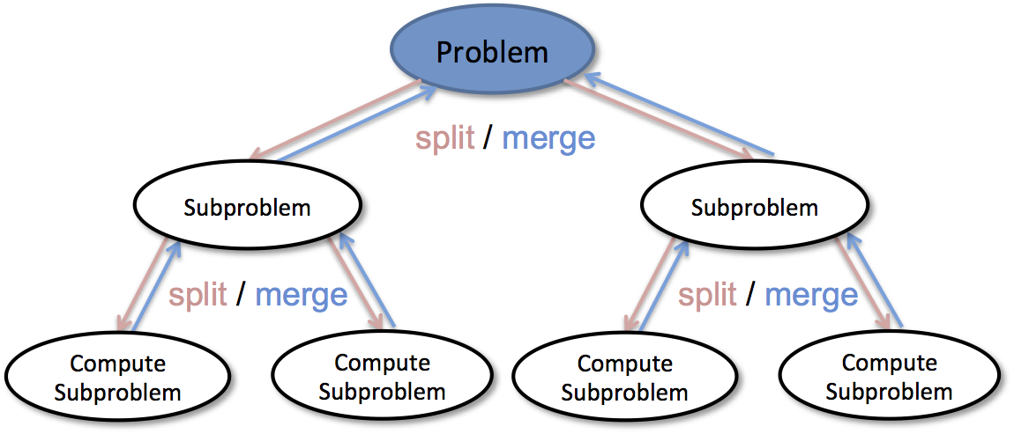
Working of D&C algorithm
DIVIDE
Break down the original problem into smaller subproblems
Each subproblem should represent a part of the overall problem.
The goal is to divide the problem until no further division is possible
CONQUER
Solve each of the smaller subproblems individually
If a subproblem is small enough(base case), we solve it directly without further recursion
The goal is to find solutions for these subproblems independently
MERGE
Combine the sub-problems to get the final solution of the whole problem
Once the smaller subproblems are solved, we recursively combine their solutions to get the solution of larger problem

Slide 13
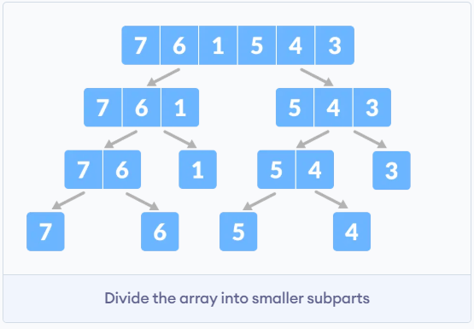
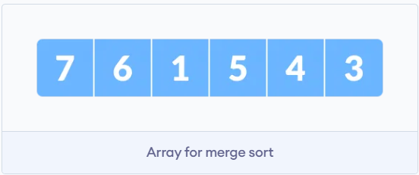
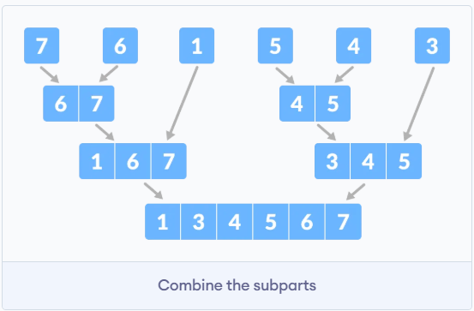
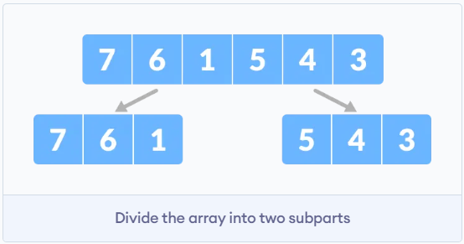
DIVIDE & CONQUER: Example
Let the given array be:
Again, divide each subpart recursively into two halves until we get individual elements
Divide the array into two halves:
Now, combine the individual elements in a sorted manner. Here conquer and combine steps go side by side

Slide 14
Quick Select Algorithm
Inspired by quick sort
Invented by C.A.R. Hoare

Slide 15
QUICK SELECT
Definition
Quick Select is a powerful selection algorithm designed to find the k-th smallest (or largest) element in an unsorted list, without needing to sort the entire array. It’s closely related to Quick Sort, but it optimizes time by only recursively processing the partition that contains the desired element.
Key Concepts:
Partitioning: Quick select uses a pivot to divide the array into two subarrays: element smaller than he pivot and elements larger than the pivot.
Recursive Approach: Unlike Quick sort, which recursively sorts both sides, quick select only focuses on the side that contains the k-th element, significantly reducing unnecessary computations.

Slide 16
QUICK SELECT
Steps for the algorithm
Choose a Pivot | Partition the Array | Check the Pivot’s Position
First select a pivot element. Common strategies include: Picking the first or last element Selecting a random element Using “median of medians” | After choosing the pivot, partition the array into two sections: Left: Elements smaller than pivot Right: Elements larger than the pivot The pivot is then placed in its correct sorted position | If the pivot’s position is exactly k, then the pivot is the k-th smallest element, and return it. If the pivot’s position is greater than k, apply Quick select to left partition If the pivot’s position is less than k, apply Quick select to the right partition with an updated k
This recursive process continues until the k-th element is found

Slide 17
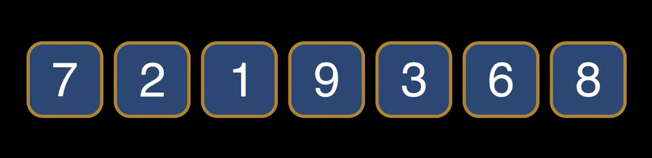
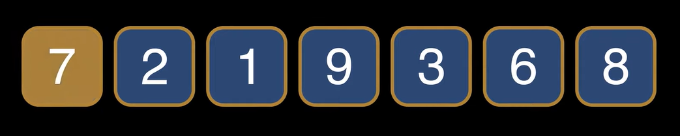
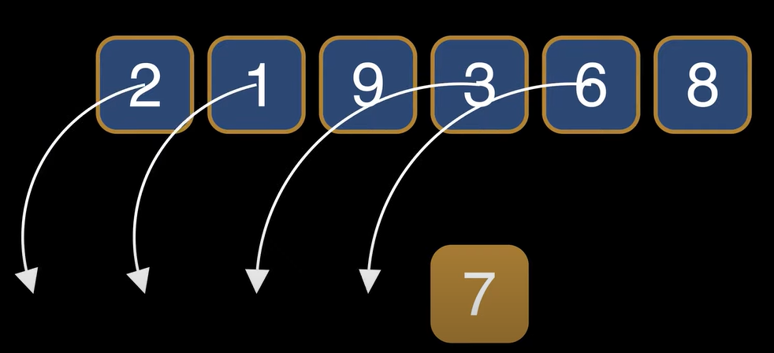
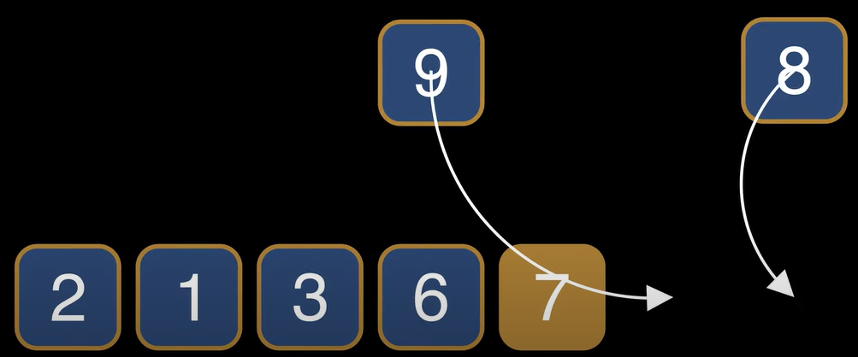
Quick Select : Step by Step Walkthrough
Let us consider an array:
Let’s choose 7 as pivot
Now we have partition the array so that every smaller element than pivot comes before and every larger element comes after pivot

Slide 18


Quick Select : Step by Step Walkthrough
Hoare Partitioning: Here is how we can efficiently partition the array
The segment between L and R decreases with each step. Partitioning finishes when L becomes R which means the segment consists of only the pivot.
We keep track of two indices in the array called L and R such that
The pivot is on the L position
Everything before L is smaller than the pivot
Everything after R is larger than pivot
The elements between L and R could be either smaller or greater

Slide 19
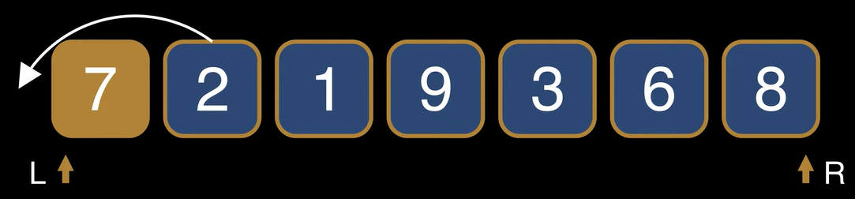
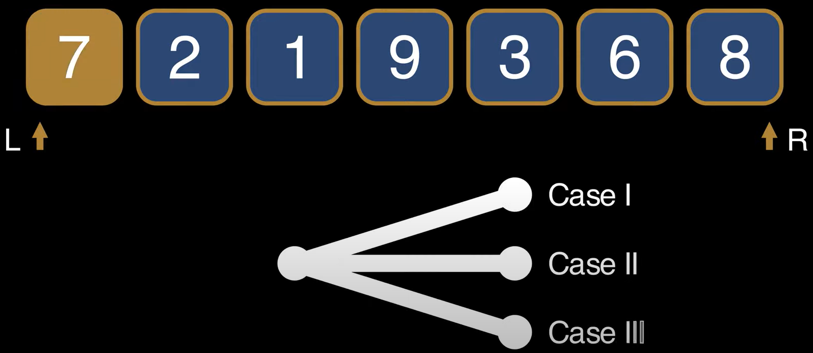
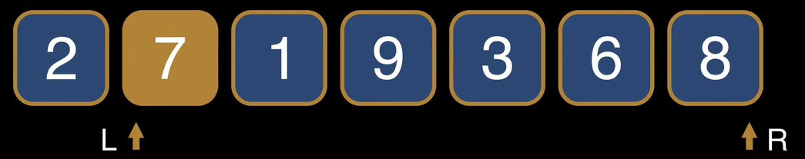
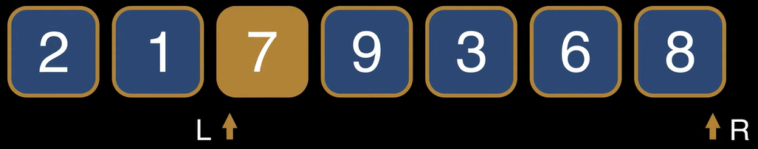
Quick Select : Step by Step Walkthrough
Case_1: (L+1 < Pivot) The element on the L+1 is smaller than the pivot so we move it to the left of the L-R segment
We start L = 0 and R = n-1. By choosing 7 as pivot we have to consider three cases in each step
For doing so, we swap the elements. We increase L afterwards
This step ensures to the left of L all elements are smaller than the pivot

Slide 20
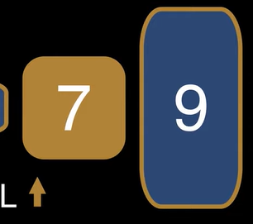
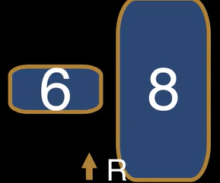
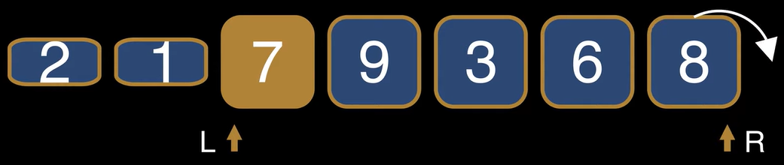
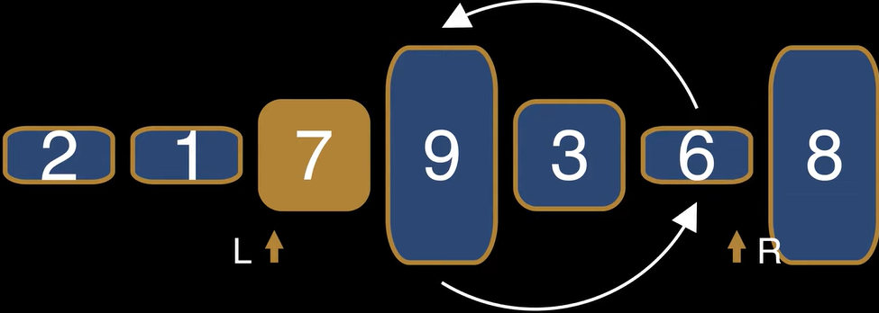
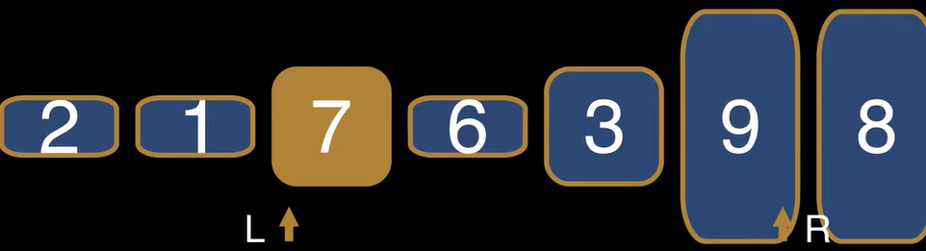
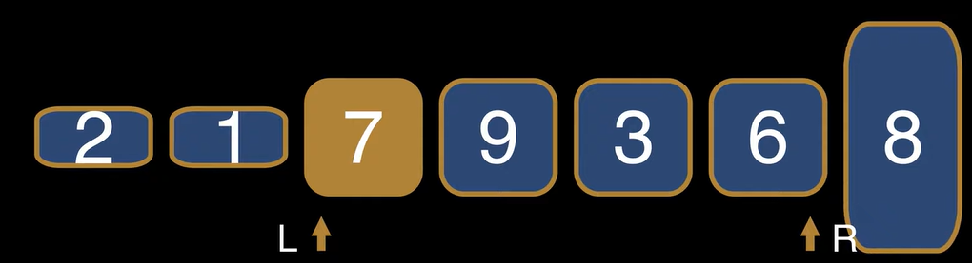
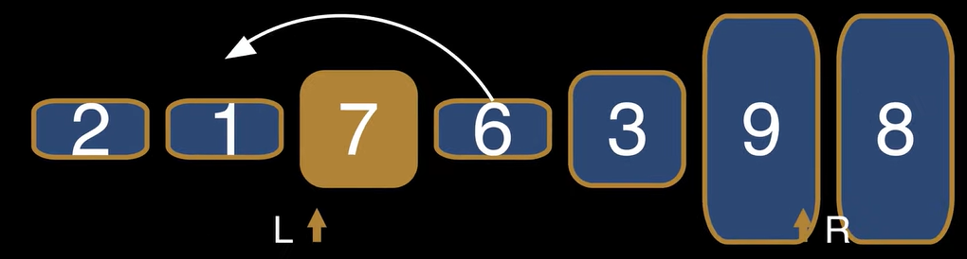
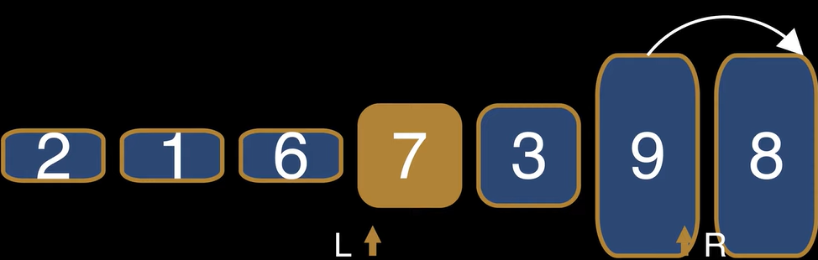
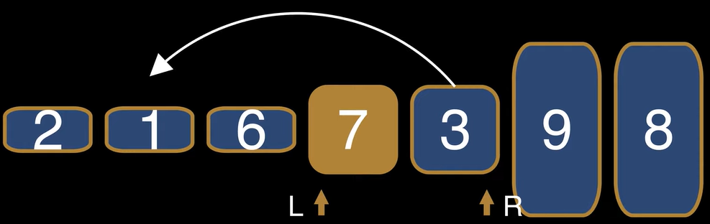
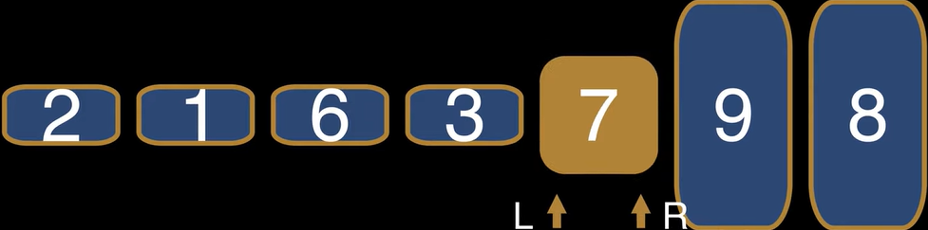
Quick Select : Step by Step Walkthrough
Case_2: (R > Pivot) The element on the R is greater than the pivot so we move it to the right of the L-R segment
Case_3: The segment L-R doesn’t decrease, so we follow 1 & 2 steps
The element on the L+1 is necessarily greater than the pivot. Otherwise we would be in case_1
The element on the R is necessarily smaller than the pivot. Otherwise we would be in case_2
We swap these two elements
We get
After that we simply decrease the value of R.
The size of segment remains same, we follow step1, 2 & 3 to shrink the segment
This step ensures to the right of R all elements are greater than the pivot
We keep applying one of the three steps until the segment L-R reduces to a single element which is necessarily the pivot and partitioning is done and the pivot is in it’s final position

Slide 21
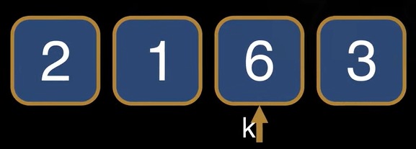
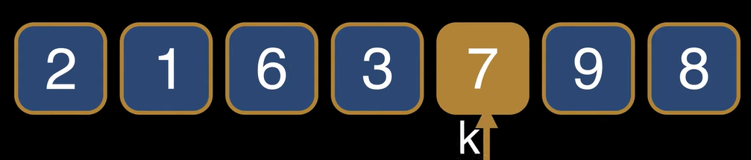
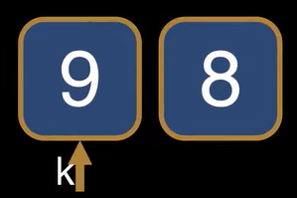
Quick Select : Step by Step Walkthrough
Determining the pivot’s position
If k is smaller than the position of the pivot , then we apply the quick select algorithm recursively on the subarray to left of the pivot
Let us consider the input k
If the pivot ends up exactly in k-th position then the pivot is the kth smallest element
If k is larger than the position of the pivot , then we apply the quick select algorithm recursively on the subarray to right of the pivot
Recursion ends when the pivot is exactly the element we are looking for as recursion stops when it hits a subarray of size 1

Slide 22
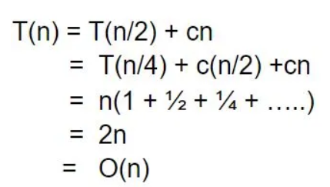
Quick Select : Time Complexity Analysis
Best Case Time Complexity: O(n)
Best case occurs when the pivot selection results in a near-equal partition. The number of elements on each side of the pivot in nearly the same, meaning the recursion depth is minimized
For example:
After the first partition, the pivot divides the array into two roughly equal parts.
We continue the recursion on the side where the k-th smallest element might be.
Since we’re halving the problem size in each step, the number of recursive calls is proportional to log(n), but since we’re dealing with a linear selection i.e., we’re not sorting the entire array, the overall time complexity is still linear:
Best Case : O(n)

Slide 23
Quick Select : Time Complexity Analysis
Average Case Time Complexity: O(n)
The Average case assumes that the pivot is selected randomly, leading to a good balance between the left and right subarrays.
In most cases, the pivot will split the array into subarrays of size approximately n/2 each, resulting in a recursive call on just one of the subarrays.
With each recursive call, the size of the array being processed reduces and since the pivot is not always the median but is still expected to divide the array fairly evenly.
The recurrence relation follows : T(n) = T(n/2) + O(n)

Slide 24
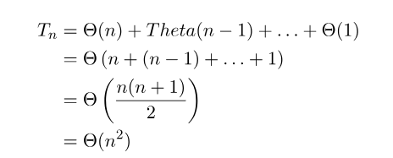
Quick Select : Time Complexity Analysis
Worst Case Time Complexity: O(n²)
The worst case occurs when the picot selection consistently results in extremely unbalanced partitions. This happens if we select the smallest or largest element as the pivot, leading to one subarray containing all the elements and the other containing only one element.
For example:
If the pivot is always the smallest or largest element, each partition only reduces the problem size by one element at each step, resulting in a linear recursion depth (i.e., n recursive calls)
Worst case recurrence: T(n) = T(n-1) + O(n)
Can we make it better??

Slide 25
Problem with Worst Case Scenario in Quick Select
The input array is sorted or nearly sorted, and
The pivot is always the smallest or largest element
In these cases, the partitions are extremely unbalanced and Quick select ends up doing unnecessary work, which is inefficient.
SOLUTION???

Slide 26
MEDIAN OF MEDIANS
YOU WON’T HIT O(n²)

Slide 27
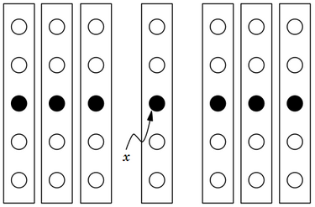
introduction
The median of medians is an approximate median-selection algorithm that helps building an asymptotically optimal, exact general selection algorithm by producing good pivot elements.
It was published at 1973 and sometimes called BFPRT after the last names of the authors
For most practical scenarios where the data is random and QuickSelect is used with a randomized pivot, we don’t need median of medians. However, for Deterministic Worst Case behavior, Median of Medians provides an optimal solution

Slide 28
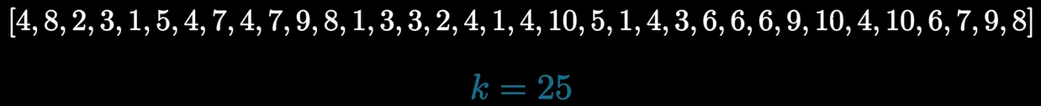
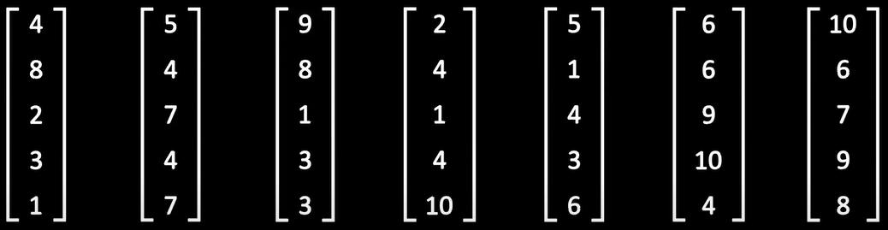
Median of medians: Step by step walkthrough
Let us consider an array. We have to find k =25th smallest element using MoM
Step-1: Divide the list into sublists each of length five.(if there are fewer than five elements available for the last list, that's fine)

Slide 29
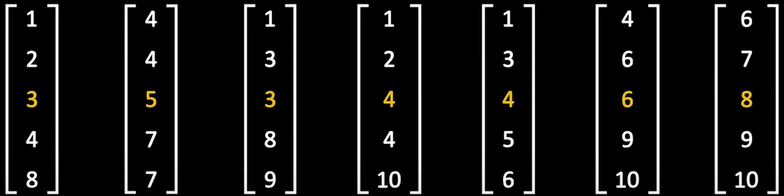
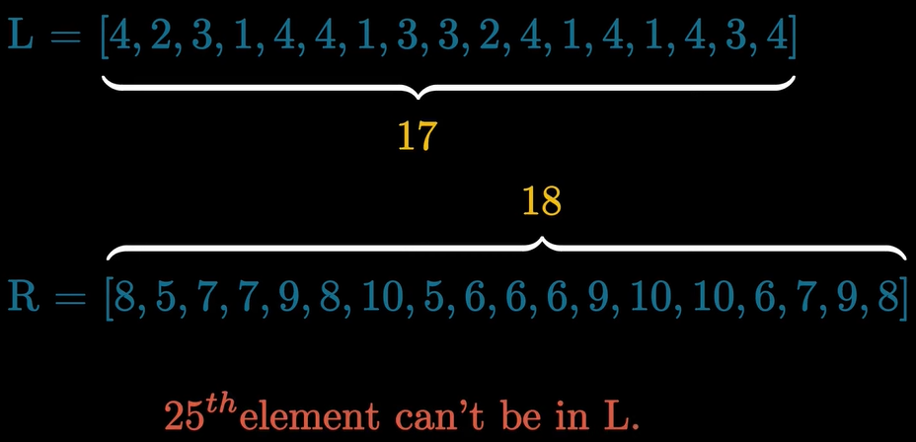
Median of medians: Step by step walkthrough
Step-2: Sort the sub lists and find the medians of each lists
Step-3: Find the median of medians of the sub lists
Step-4: L contains elements smaller than median, R contains elements larger than median. As k = 25 and L contains 17 elements so kth element can’t be in L
Therefore k = (25-L) = 8th element in R is the answer
We will follow the previous steps.

Slide 30
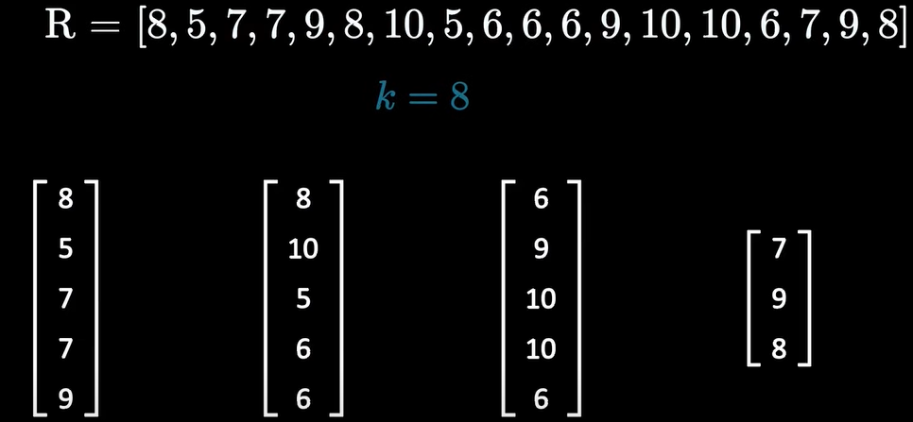
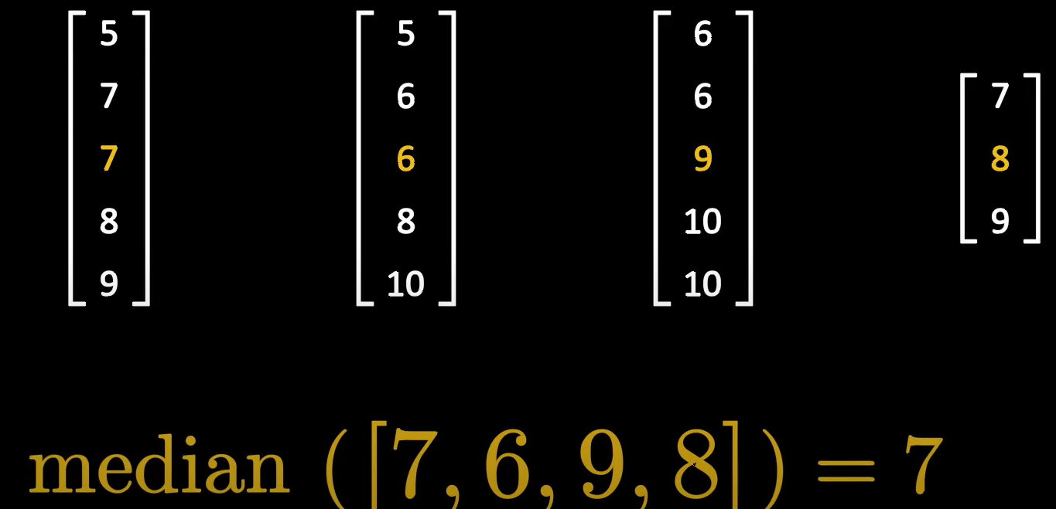
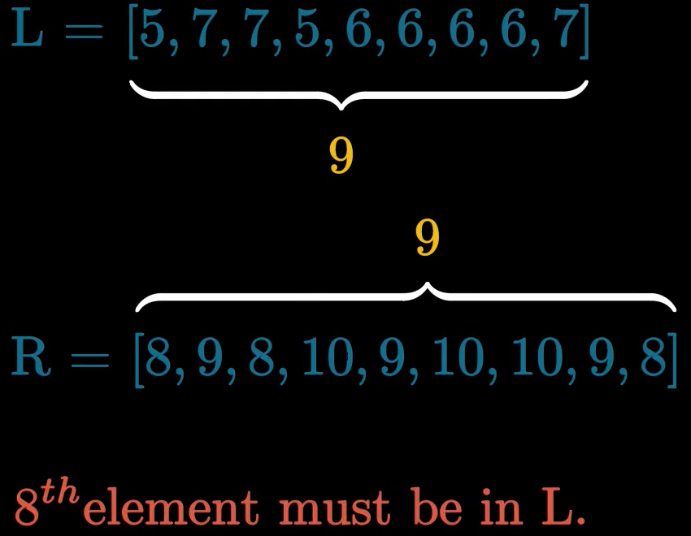
Median of medians: Step by step walkthrough
Step-5: We do the previous steps on R sub array (divide the array, sort the sub parts, find median of medians)
Step-6: As there are 9 elements in each sub part the, 8th element must be in L

Slide 31
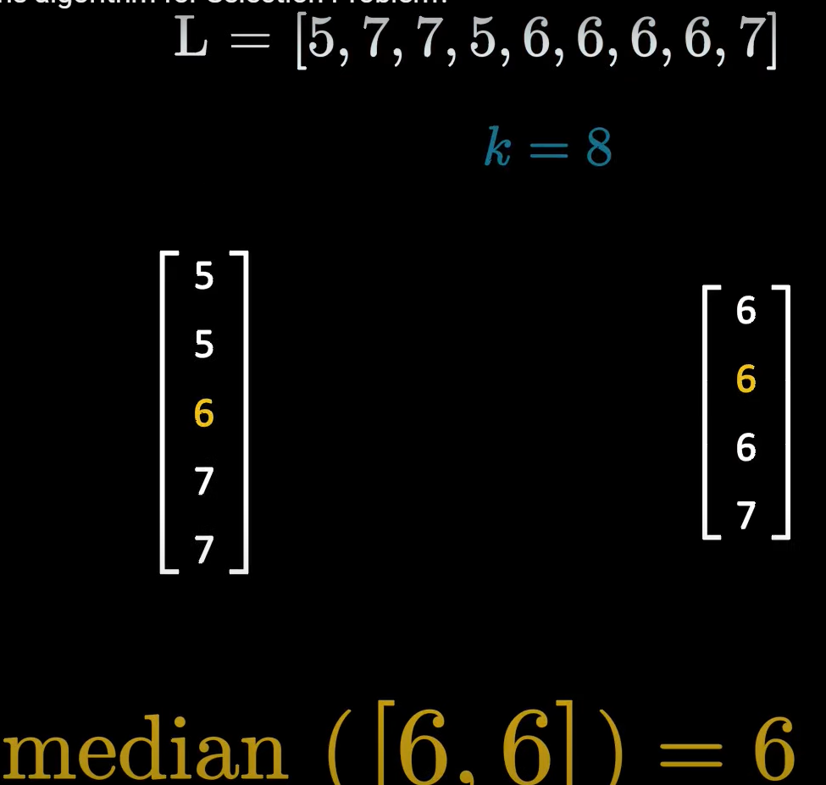
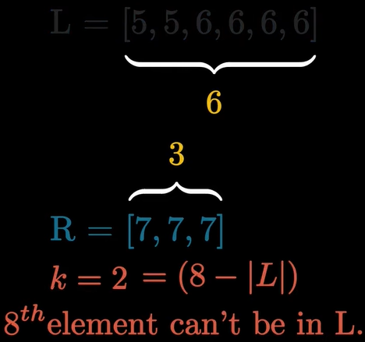
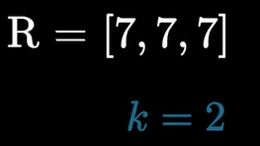
Median of medians: Step by step walkthrough
Step-7: This time we have to create two sub parts
Step-8: Since the size of L is smaller than k=8, 8th element must be in R
Step-9: Now R has lesser than 5 elements we can directly calculate the 2nd smallest element which is 7
Thus kth item in the original list : 7

Slide 32
Median of medians: Time Complexity Analysis
This algorithm runs in O(n) time. Let’s dive into it and understand how?
n is divided into n/5 sub lists of five elements each. If M is the list of all of the medians from these sub lists, then M has (n/5 -1) median for each of the n/5 sub lists.
Let’s call the median of this list (median of medians) p.
Half of the n/5 elements in M are less than p. Half of n/5 = n/10.
For each of these n/10 elements, there are two elements that are smaller than it (since these elements were medians in lists of five elements-two elements were smaller and two elements were larger).
Therefore, there are 3n/10 < p and , in the worst case, the algorithm may have to recurse on the remaining 7n/10 elements.
The time for dividing lists is T(n),
The time for finding medians of the sub lists is T(n/5)
The time for recursive call on median is T(n/5)
The time for partitioning is T(n)
The overall recurrence to describe the algorithm is
T(n) ≤ T( n/5​ ) + T( 7n/10 ​) + O( n )
Using master theorem we can show the running time is O(n)

Slide 33
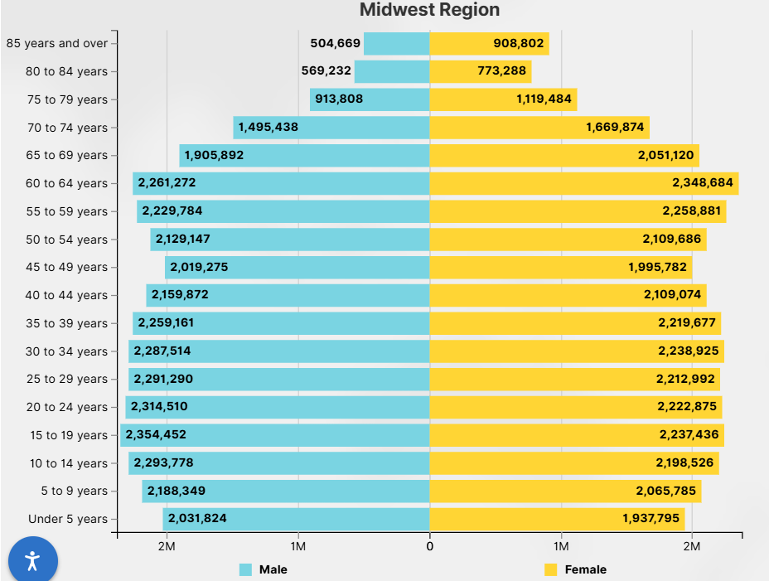
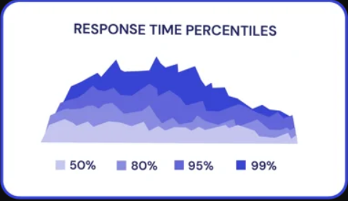
Quick Select – Real World Use Cases
Finding Median in a Dataset
Used in statistics or analytics to find the median without sorting he entire dataset.
Example: Finding the median income from millions of entries in a census database
Top K elements
Used in Search Engines or Ranking Systems to find the top k highest or lowest values
Example: Showing top 10 trending hashtags on Twitter
Real Time Analytics
Quick select is ideal when you need quick, approximate results
Example: Finding the 90th percentile latency in performance monitoring tools
Memory Efficient Selection
Requires less memory than sorting, especially for embedded devices.
Example: Processing sensor data on IoT devices to filter top/bottom values.

Slide 34
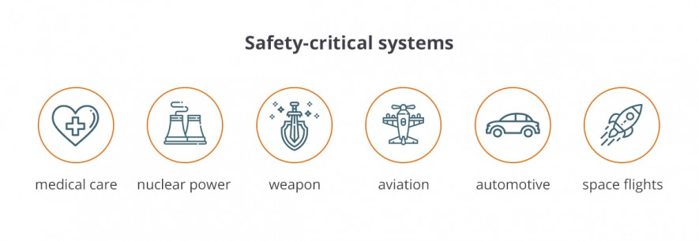
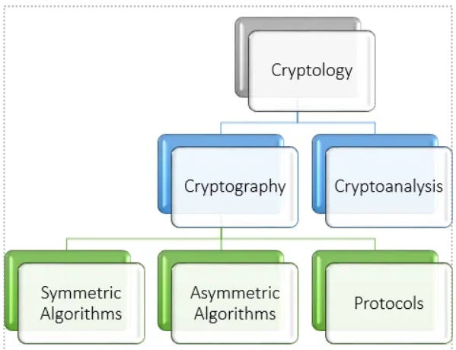
Median of Medians Real World Use Cases
Worst Case Performance Critical Systems
Used when predictable performance Is required even in the worst case scenario
Example: Safety critical applications (medical, aviation)
Deterministic Algorithms
Required in systems where randomization is not allowed (Cryptographic protocols)
Example: Secure computation system where result timing must be consistent
Data Structure Guarantees
Algorithms that require selection as a subroutine with guaranteed performance
Competitive Programming
Helps to solve problems that need to solved in linear time

Slide 35
CONCLUSION
Quick select: ideal for most scenarios with randomized inputs, where average performance is the priority
Median of medians: A deterministic solution for problems where worst case performance guarantees are required
Both algorithms are crucial tools in selection problems, with trade offs between speed and guaranteed performance

Slide 36
References
https://www.geeksforgeeks.org/dsa/kth-smallest-largest-element-in-unsorted-array/
https://interviewing.io/questions/kth-smallest-element
https://www.geeksforgeeks.org/dsa/quickselect-algorithm/
https://www.programiz.com/dsa/divide-and-conquer
https://www.geeksforgeeks.org/dsa/introduction-to-divide-and-conquer-algorithm/
https://en.wikipedia.org/wiki/Divide_and_conquer#
https://medium.com/nerd-for-tech/quick-select-algorithm-17ac146b6218
https://www.freecodecamp.org/news/quickselect-algorithm-explained-with-examples/
https://stackoverflow.com/questions/10846482/quickselect-algorithm-understanding
https://stackoverflow.com/questions/56940793/quickselect-time-complexity-explained
https://www.geeksforgeeks.org/dsa/hoare-s-partition-algorithm/
https://en.wikipedia.org/wiki/Median_of_medians
https://brilliant.org/wiki/median-finding-algorithm/
https://stackoverflow.com/questions/9489061/understanding-median-of-medians-algorithm
https://data.census.gov/profile/Midwest_Region?g=020XX00US2

Slide 37
any questions?

Slide 38
thank you
For any queries
srabonaich@gmail.com
rafeulsagor@gmail.com
saadbinashad2003@gmail.com
arafislam0015@gmail.com
Feel free to email

