Slide 1
Chapter 12: Physical Storage Systems

Slide 2
Classification of Physical Storage Media
Can differentiate storage into:
  volatile storage: loses contents when power is switched off
  non-volatile storage:
    Contents persist even when power is switched off.
    Includes secondary and tertiary storage, as well as batter-backed up main-memory.
Factors affecting choice of storage media include
  Speed with which data can be accessed
  Cost per unit of data
  Reliability

Slide 3
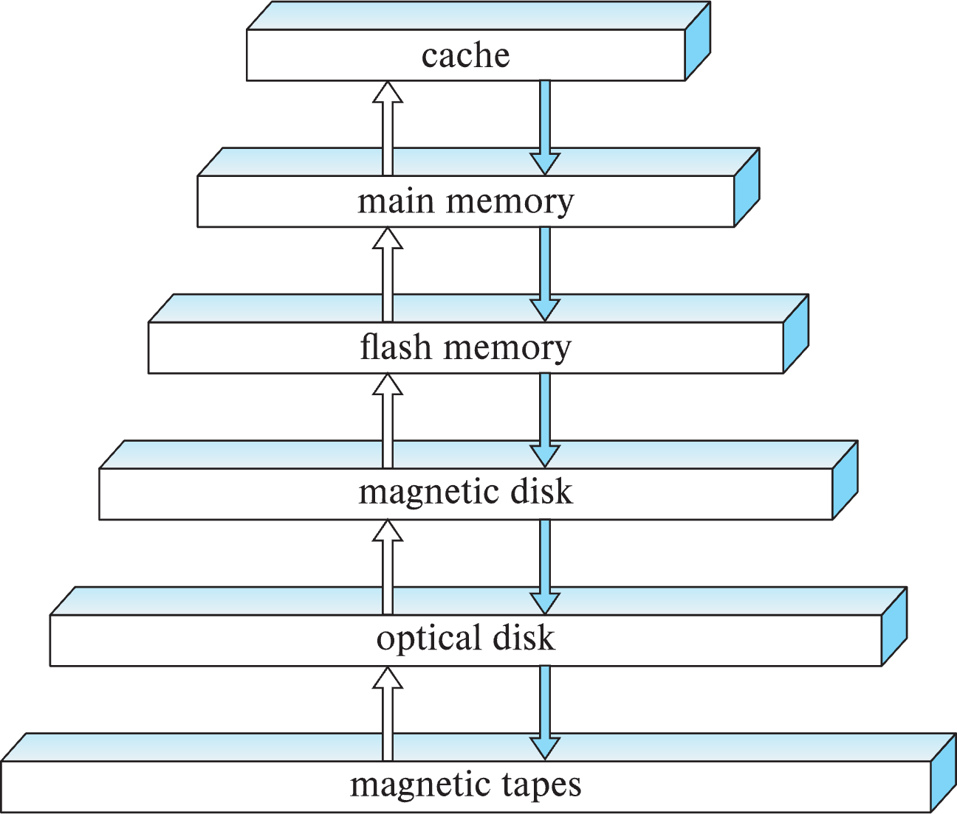
Storage Hierarchy
Primary Storage
Volatile Storage
Non Volatile Storage
Secondary Storage
Tertiary Storage

Slide 4
Storage Hierarchy: Access Time
1-5 nanoseconds
60-100 nanoseconds
cache-line-at-a-time
20-100 microseconds
page-at-a-time
5-10 milliseconds
page-at-a-time
100+ milliseconds
10-100 seconds or more

Slide 5
Storage Hierarchy (Cont.)
primary storage: Fastest media but volatile (cache, main memory).
secondary storage: next level in hierarchy, non-volatile, moderately fast access time
  also called on-line storage
  E.g. flash memory, magnetic disks
tertiary storage: lowest level in hierarchy, non-volatile, slow access time
  also called off-line storage and used for archival storage
  e.g. magnetic tape, optical storage
  Magnetic tape
    Sequential access, 1 to 12 TB capacity
    A few drives with many tapes
    Juke boxes with petabytes (1000’s of TB) of storage

Slide 6
Storage Interfaces
Disk interface standards families
  SATA (Serial ATA)
    SATA 3 supports data transfer speeds of up to 6 gigabits/sec
  SAS (Serial Attached SCSI)
    SAS Version 3 supports 12 gigabits/sec
  NVMe (Non-Volatile Memory Express) interface
    Works with PCIe connectors to support lower latency and higher transfer rates
    Supports data transfer rates of up to 24 gigabits/sec
Disks usually connected directly to computer system
In Storage Area Networks (SAN), a large number of disks are connected by a high-speed network to a number of servers
In Network Attached Storage (NAS) networked storage provides a file system interface using networked file system protocol, instead of providing a disk system interface

Slide 7
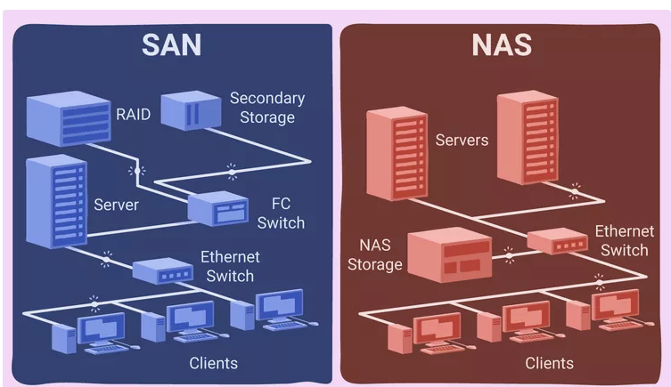

Slide 8
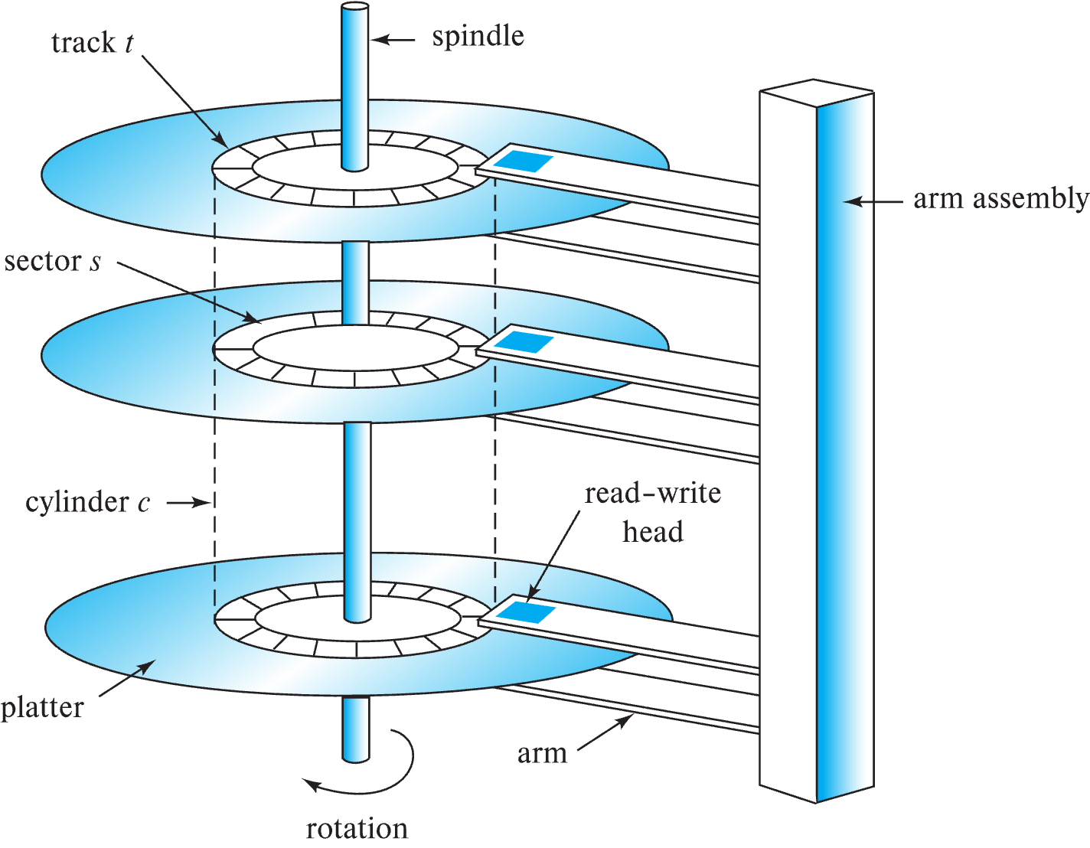
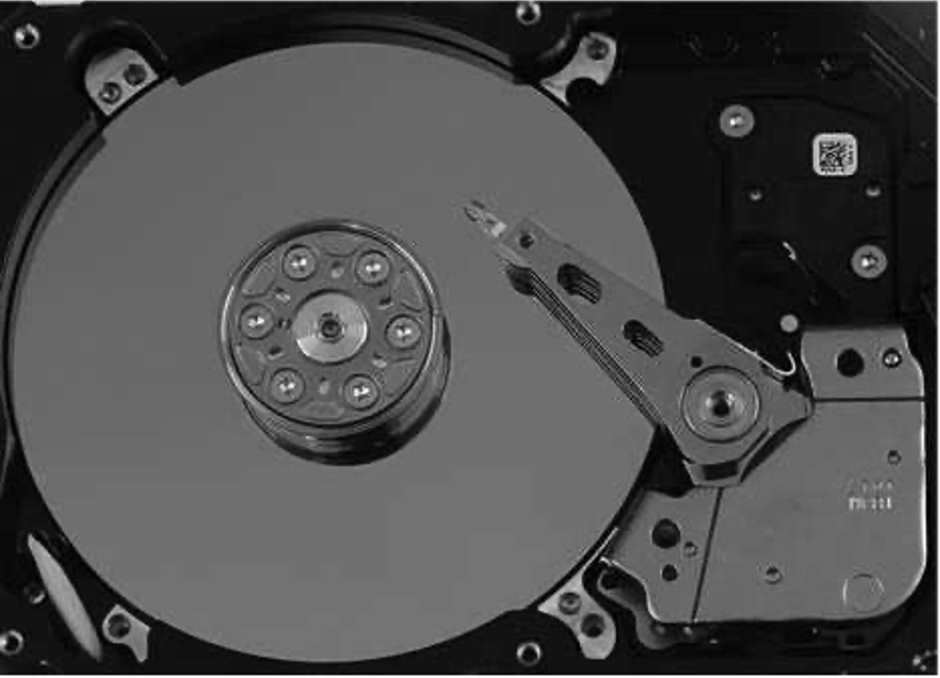
Magnetic Hard Disk Mechanism
Schematic diagram of magnetic disk drive
Photo of magnetic disk drive

Slide 9
Magnetic Disks
Read-write head
Surface of platter divided into circular tracks
  Over 50K-100K tracks per platter on typical hard disks
Each track is divided into sectors.
  A sector is the smallest unit of data that can be read or written.
  Sector size typically 512 bytes
  Typical sectors per track: 500 to 1000 (on inner tracks) to 1000 to 2000 (on outer tracks)
To read/write a sector
  disk arm swings to position head on right track
  platter spins continually; data is read/written as sector passes under head
Head-disk assemblies
  multiple disk platters on a single spindle (1 to 5 usually)
  one head per platter, mounted on a common arm.
Cylinder i consists of i^{th} track of all the platters
Notes:
Mention: checksums, bad sector remapping

Slide 10
Magnetic Disks (Cont.)
Disk controller – interfaces between the computer system and the disk drive hardware.
  accepts high-level commands to read or write a sector
  initiates actions such as moving the disk arm to the right track and actually reading or writing the data
  Computes and attaches checksums to each sector to verify that data is read back correctly
    If data is corrupted, with very high probability stored checksum won’t match recomputed checksum
  Ensures successful writing by reading back sector after writing it
  Performs remapping of bad sectors

Slide 11
Performance Measures of Disks
Access time – the time it takes from when a read or write request is issued to when data transfer begins. Consists of:
  Seek time – time it takes to reposition the arm over the correct track.
    Average seek time is 1/2 the worst case seek time.
      Would be 1/3 if all tracks had the same number of sectors, and we ignore the time to start and stop arm movement
    4 to 10 milliseconds on typical disks
  Rotational latency – time it takes for the sector to be accessed to appear under the head.
    4 to 11 milliseconds on typical disks (5400 to 15000 r.p.m.)
    Average latency is 1/2 of the above latency.
  Overall latency is 5 to 20 msec depending on disk model
Data-transfer rate – the rate at which data can be retrieved from or stored to the disk.
  25 to 200 MB per second max rate, lower for inner tracks

Slide 12
Performance Measures (Cont.)
Disk block is a logical unit for storage allocation and retrieval
  4 to 16 kilobytes typically
    Smaller blocks: more transfers from disk
    Larger blocks: more space wasted due to partially filled blocks
Sequential access pattern
  Successive requests are for successive disk blocks
  Disk seek required only for first block
Random access pattern
  Successive requests are for blocks that can be anywhere on disk
  Each access requires a seek
  Transfer rates are low since a lot of time is wasted in seeks
I/O operations per second (IOPS)
  Number of random block reads that a disk can support per second
  50 to 200 IOPS on current generation magnetic disks

Slide 13
Performance Measures (Cont.)
Mean time to failure (MTTF) – the average time the disk is expected to run continuously without any failure.
  Typically 3 to 5 years
  Probability of failure of new disks is quite low, corresponding to a
  “theoretical MTTF” of 500,000 to 1,200,000 hours for a new disk
    E.g., an MTTF of 1,200,000 hours for a new disk means that given 1000 relatively new disks, on an average one will fail every 1200 hours
  MTTF decreases as disk ages
Annualized Failure Rate (AFR): =( (365*24) / MTTF)*100%
  MTTF=1,200,000 🡺 AFR = 0.73%
Suppose MTTF is 1,200,000 hours for a disk. Then, in a system with 1000 disks, how often will a disk fail on average?
  Answer: on average one will fail every 1200 hours (50 days)
    Equivalently, 7.3 disks per year

Slide 14
Flash Storage
NOR flash vs NAND flash
NAND flash
  used widely for storage, cheaper than NOR flash
  requires page-at-a-time read (page: 512 bytes to 4 KB)
    20 to 100 microseconds for a page read
    Not much difference between sequential and random read
  Page can only be written once
    Must be erased to allow rewrite
Solid state disks
  Use standard block-oriented disk interfaces, but store data on multiple flash storage devices internally
  Transfer rate of up to 500 MB/sec using SATA, and
  up to 3 GB/sec using NVMe PCIe

Slide 15
Flash Storage (Cont.)
Erase happens in units of erase block
  Takes 2 to 5millisecs
  Erase block typically 256 KB to 1 MB (128 to 256 pages)
Remapping of logical page addresses to physical page addresses avoids waiting for erase
Flash translation table tracks mapping
  also stored in a label field of flash page
  remapping carried out by flash translation layer
Page write
Physical Page
Structure
Logical Page
Address
Physical Page
Address
Logical address
Valid bit
Page Data
Flash Translation
Table
Notes:
Where is FTL stored? How is it reconstructed on system startup?
How to track number of erases per block (extra storage per block)

Slide 16
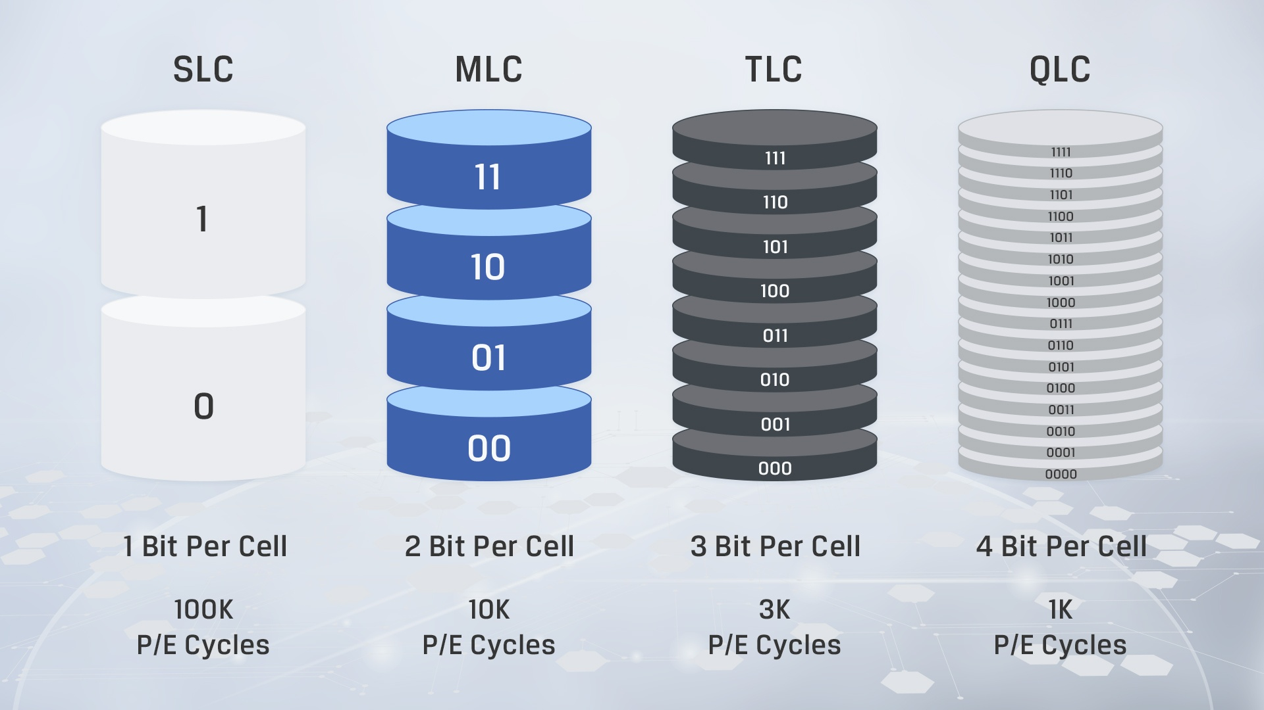
Flash Storage (Cont.)
SLC After about 1,00,000 erases (SLC Flash) to as low as 10,000 or 1000 erases (TLC/QLC Flash) erase block becomes unreliable and cannot be used
  wear leveling: store infrequently updated (“cold”) data in blocks that have been erased many times already
Source: Kingston.com
Notes:
Where is FTL stored? How is it reconstructed on system startup?
How to track number of erases per block (extra storage per block)

Slide 17
SSD Performance Metrics
Random reads/writes per second
  Typical 4 KB reads: 10,000 reads per second (10,000 IOPS)
  Typical 4KB writes: 40,000 IOPS
  SSDs support parallel reads
    Typical 4KB reads:
      100,000 IOPS with 32 requests in parallel (QD-32) on SATA
      350,000 IOPS with QD-32 on NVMe PCIe
    Typical 4KB writes:
      100,000 IOPS with QD-32, even higher on some models
Data transfer rate for sequential reads/writes
  400 MB/sec for SATA3, 2 to 3 GB/sec using NVMe PCIe
Hybrid disks: combine small amount of flash cache with larger magnetic disk

Slide 18
Storage Class Memory
3D-XPoint memory technology pioneered by Intel
Available as Intel Optane
  SSD interface shipped from 2017
    Allows lower latency than flash SSDs
  Non-volatile memory interface announced in 2018
    Supports direct access to words, at speeds comparable to main-memory speeds

Slide 19
RAID
RAID: Redundant Arrays of Independent Disks
  disk organization techniques that manage a large numbers of disks, providing a view of a single disk of
    high capacity and high speed by using multiple disks in parallel,
    high reliability by storing data redundantly, so that data can be recovered even if a disk fails
The chance that some disk out of a set of N disks will fail is much higher than the chance that a specific single disk will fail.
  E.g., a system with 100 disks, each with MTTF of 100,000 hours (approx. 11 years), will have a system MTTF of 1000 hours (approx. 41 days)
  Techniques for using redundancy to avoid data loss are critical with large numbers of disks

Slide 20
Improvement of Reliability via Redundancy
Redundancy – store extra information that can be used to rebuild information lost in a disk failure
E.g., Mirroring (or shadowing)
  Duplicate every disk. Logical disk consists of two physical disks.
  Every write is carried out on both disks
    Reads can take place from either disk
  If one disk in a pair fails, data still available in the other
    Data loss would occur only if a disk fails, and its mirror disk also fails before the system is repaired
      Probability of combined event is very small
        Except for dependent failure modes such as fire or building collapse or electrical power surges
Mean time to data loss depends on mean time to failure,
and mean time to repair
  E.g. MTTF of 100,000 hours, mean time to repair of 10 hours gives mean time to data loss of 500*10⁶ hours (or 57,000 years) for a mirrored pair of disks (ignoring dependent failure modes)

Slide 21
Improvement of Reliability via Redundancy
Redundancy – store extra information that can be used to rebuild information lost in a disk failure
E.g., Mirroring (or shadowing)
  Duplicate every disk. Logical disk consists of two physical disks.
  Every write is carried out on both disks
    Reads can take place from either disk
Mean time to data loss depends on mean time to failure,
and mean time to repair
  E.g. MTTF of 100,000 hours, mean time to repair of 10 hours gives mean time to data loss of 500*10⁶ hours (or 57,000 years) for a mirrored pair of disks (ignoring dependent failure modes)
Notes:
If one disk in a pair fails, data still available in the other
Data loss would occur only if a disk fails, and its mirror disk also fails before the system is repaired
Probability of combined event is very small
Except for dependent failure modes such as fire or building collapse or electrical power surges

Slide 22
Improvement in Performance via Parallelism
Goals of parallelism in a disk system:
  1. Load balance multiple small accesses to increase throughput
  Parallelize large accesses to reduce response time.
  Improve transfer rate by striping data across multiple disks.
Bit-level striping – split the bits of each byte across multiple disks
  In an array of eight disks, write bit i of each byte to disk i.
  Each access can read data at eight times the rate of a single disk.
  But seek/access time worse than for a single disk
    Bit level striping is not used much any more
Block-level striping – with n disks, block i of a file goes to disk (i mod n) + 1
  Requests for different blocks can run in parallel if the blocks reside on different disks
  A request for a long sequence of blocks can utilize all disks in parallel

Slide 23
Improvement in Performance via Parallelism
Goals of parallelism in a disk system:
  1. Load balance multiple small accesses to increase throughput
  Parallelize large accesses to reduce response time.
  Improve transfer rate by striping data across multiple disks.
Bit-level striping
  Not used in practice
Block-level striping – with n disks, block i of a file goes to disk (i mod n) + 1
  Requests for different blocks can run in parallel if the blocks reside on different disks
  A request for a long sequence of blocks can utilize all disks in parallel

Slide 24
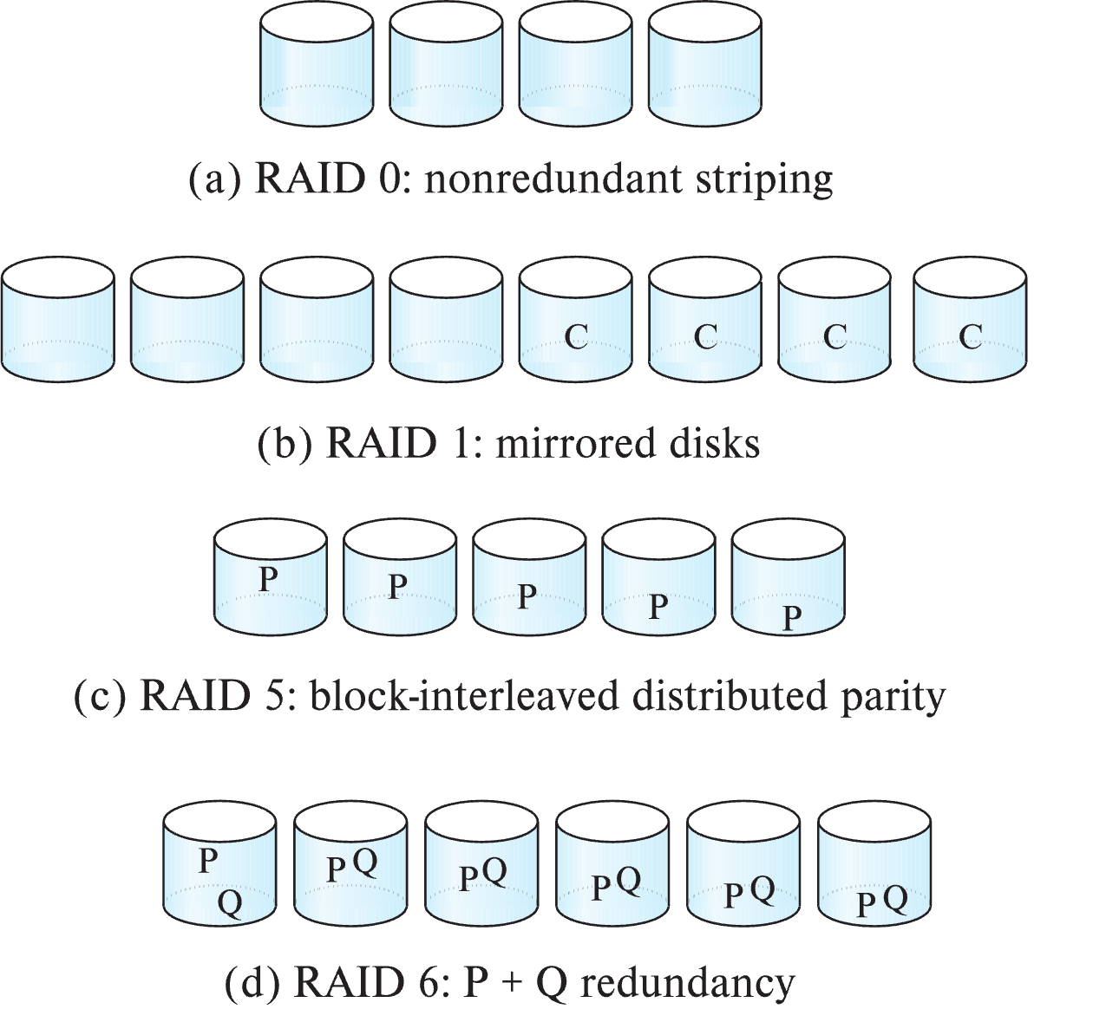
RAID Levels
RAID Level 0: Block striping; non-redundant.
  Used in high-performance applications where data loss is not critical.
RAID Level 1: Mirrored disks with block striping
  Offers best write performance.
  Popular for applications such as storing log files in a database system.

Slide 25
RAID Levels (Cont.)
Parity blocks: Parity block j stores XOR of bits from block j of each disk
  When writing data to a block j, parity block j must also be computed and written to disk
    Can be done by using old parity block, old value of current block and new value of current block (2 block reads + 2 block writes)
    Or by recomputing the parity value using the new values of blocks corresponding to the parity block
      More efficient for writing large amounts of data sequentially
  To recover data for a block, compute XOR of bits from all other blocks in the set including the parity block

Slide 26
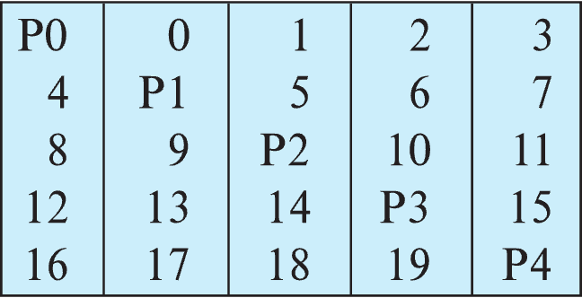
RAID Levels (Cont.)
RAID Level 5: Block-Interleaved Distributed Parity; partitions data and parity among all N + 1 disks, rather than storing data in N disks and parity in 1 disk.
  E.g., with 5 disks, parity block for nth set of blocks is stored on disk (n mod 5) + 1, with the data blocks stored on the other 4 disks.

Slide 27
RAID Levels (Cont.)
RAID Level 5 (Cont.)
  Block writes occur in parallel if the blocks and their parity blocks are on different disks.
RAID Level 6: P+Q Redundancy scheme; similar to Level 5, but stores two error correction blocks (P, Q) instead of single parity block to guard against multiple disk failures.
  Better reliability than Level 5 at a higher cost
    Becoming more important as storage sizes increase

Slide 28
RAID Levels (Cont.)
Other levels (not used in practice):
  RAID Level 2: Memory-Style Error-Correcting-Codes (ECC) with bit striping.
  RAID Level 3: Bit-Interleaved Parity
  RAID Level 4: Block-Interleaved Parity; uses block-level striping, and keeps a parity block on a separate parity disk for corresponding blocks from N other disks.
    RAID 5 is better than RAID 4, since with RAID 4 with random writes, parity disk gets much higher write load than other disks and becomes a bottleneck

Slide 29
Choice of RAID Level
Factors in choosing RAID level
  Monetary cost
  Performance: Number of I/O operations per second, and bandwidth during normal operation
  Performance during failure
  Performance during rebuild of failed disk
    Including time taken to rebuild failed disk
RAID 0 is used only when data safety is not important
  E.g. data can be recovered quickly from other sources

Slide 30
Choice of RAID Level (Cont.)
Level 1 provides much better write performance than level 5
  Level 5 requires at least 2 block reads and 2 block writes to write a single block, whereas Level 1 only requires 2 block writes
Level 1 had higher storage cost than level 5
Level 5 is preferred for applications where writes are sequential and large (many blocks), and need large amounts of data storage
RAID 1 is preferred for applications with many random/small updates
Level 6 gives better data protection than RAID 5 since it can tolerate two disk (or disk block) failures
  Increasing in importance since latent block failures on one disk, coupled with a failure of another disk can result in data loss with RAID 1 and RAID 5.

Slide 31
Hardware Issues
Software RAID: RAID implementations done entirely in software, with no special hardware support
Hardware RAID: RAID implementations with special hardware
  Use non-volatile RAM to record writes that are being executed
  Beware: power failure during write can result in corrupted disk
    E.g. failure after writing one block but before writing the second in a mirrored system
    Such corrupted data must be detected when power is restored
      Full scan of disk may be required!
      NV-RAM helps to efficiently detected potentially corrupted blocks
Notes:
Recovery from corruption is similar to recovery from failed disk
Otherwise all blocks of disk must be read and compared with mirror/parity block

Slide 32

Hardware Issues (Cont.)
Latent sector failures: data successfully written earlier gets damaged
  can result in data loss even if only one disk fails
Data scrubbing:
  continually scan for latent failures, and recover from copy/parity
Hot swapping: replacement of disk while system is running, without power down
  Supported by some hardware RAID systems,
  reduces time to recovery, and improves availability greatly
Spare disks are kept online, and used as replacements for failed disks immediately on detection of failure
  Reduces time to recovery greatly
To avoid single point of failure
  Redundant power supplies with UPS backup
  Multiple network controllers/network interconnections

Slide 33
Optimization of Disk-Block Access
Buffering: in-memory buffer to cache disk blocks
Read-ahead: Read extra blocks from a track in anticipation that they will be requested soon
Disk-arm-scheduling algorithms re-order block requests so that disk arm movement is minimized
  elevator algorithm
R6
R3
R1
R5
R2
R4
Inner track
Outer track

Slide 34
Optimization of Disk Block Access (Cont.)
File organization
  Allocate blocks of a file in as contiguous a manner as possible
  Allocation in units of extents
  Files may get fragmented
    E.g. if free blocks on disk are scattered, and newly created file has its blocks scattered over the disk
    Sequential access to a fragmented file results in increased disk arm movement
    Some systems have utilities to defragment the file system, in order to speed up file access
Non-volatile write buffers

Slide 35
End of Chapter 12

Slide 36
Magnetic Tapes
Hold large volumes of data and provide high transfer rates
  Few GB for DAT (Digital Audio Tape) format, 10-40 GB with DLT (Digital Linear Tape) format, 100 GB+ with Ultrium format, and 330 GB with Ampex helical scan format
  Transfer rates from few to 10s of MB/s
Tapes are cheap, but cost of drives is very high
Very slow access time in comparison to magnetic and optical disks
  limited to sequential access.
  Some formats (Accelis) provide faster seek (10s of seconds) at cost of lower capacity
Used mainly for backup, for storage of infrequently used information, and as an off-line medium for transferring information from one system to another.
Tape jukeboxes used for very large capacity storage
  Multiple petabyes (10¹⁵ bytes)

Slide 37
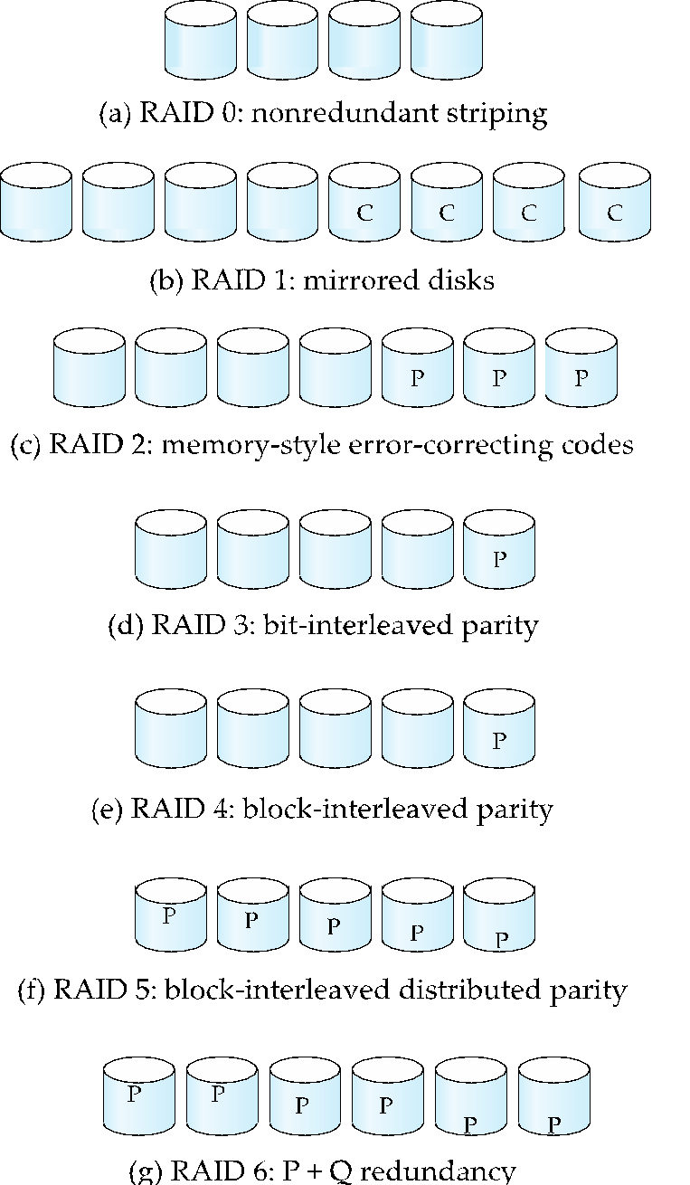
Figure 10.03

Slide 38
