Slide 1
PQ
Power Query
Data Cleaning
HR Employee Dataset · Before & After
From messy, inconsistent records to a clean,
analysis-ready table - 22 applied steps in Power Query.

Slide 2
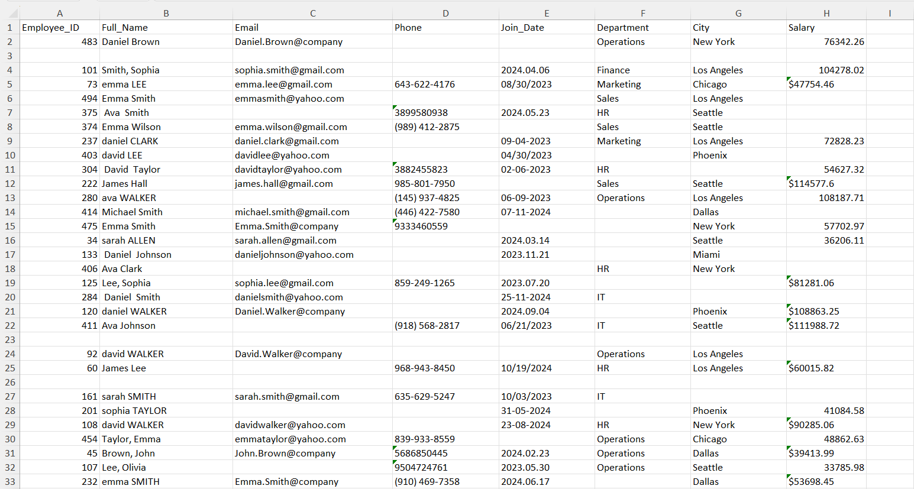
01
The Messy Data
Raw HR export before cleaning
Inconsistent name casing, missing emails/phones, mixed date formats (2024.04.06 vs 08/30/2023), and blank department, city, or salary fields.

Slide 3
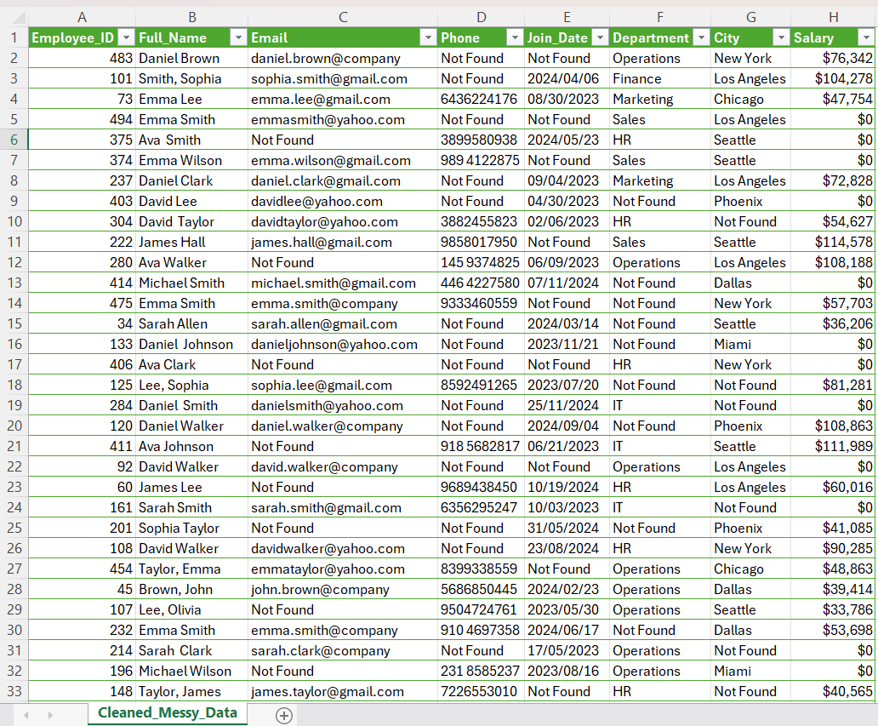
02
After Cleaning
Standardized, complete, and analysis-ready
Names capitalized, emails standardized, phone numbers formatted, dates unified as YYYY/MM/DD, and nulls replaced with “Not Found” or $0.

Slide 4
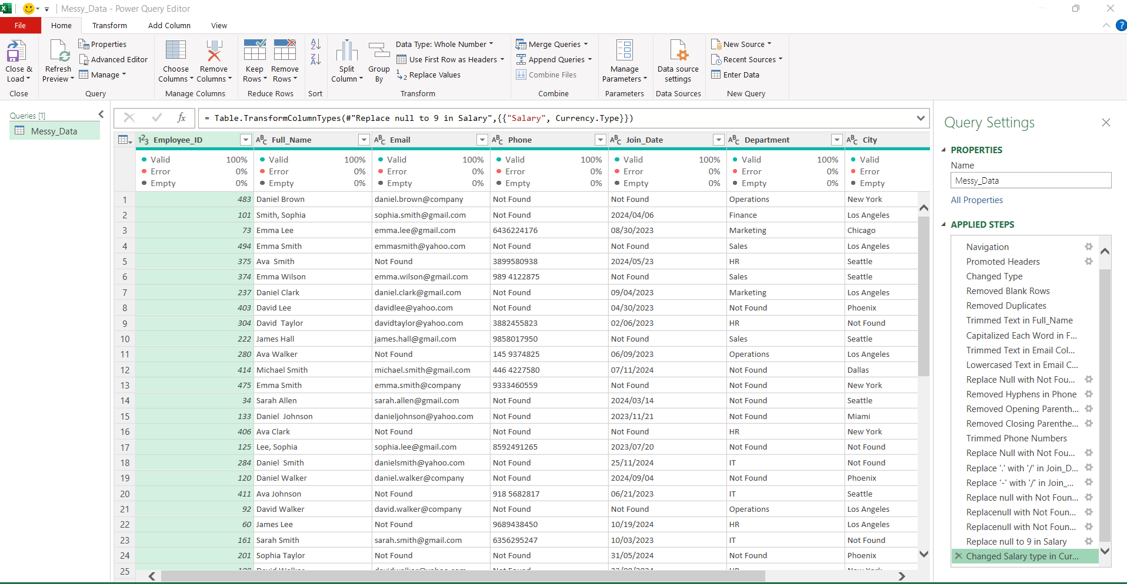
03
Behind the Scenes
Power Query Editor - Applied Steps panel
22 steps recorded automatically - every transformation is repeatable with one click of Refresh.

Slide 5
What Each Step Did
Grouping the 22 applied steps by purpose
1
Text Cleanup
Trimmed extra spaces, capitalized each word in Full_Name, and lowercased Email addresses.
2
Fixing Missing Values
Replaced blank Phone, Department, City fields with “Not Found”, and blank Salary with 9.
3
Formatting Consistency
Removed hyphens and parentheses from Phone numbers; standardized Join_Date to one format.
4
Data Quality
Removed blank rows and duplicate records, then set Salary to Currency type.

Slide 6
Key Takeaway
Clean data isn’t deleted -
it’s corrected, standardized,
and made trustworthy.
Practiced 22 Power Query steps on one dataset
Focused on text, dates, phone numbers & currency
Built a repeatable, refreshable cleaning pipeline

