Slide 1
01
Data Cleaning
Before vs After
How I manually cleaned a messy, inconsistent dataset into a clean, analysis-ready table using Microsoft Excel.
Swipe to see the results →

Slide 2
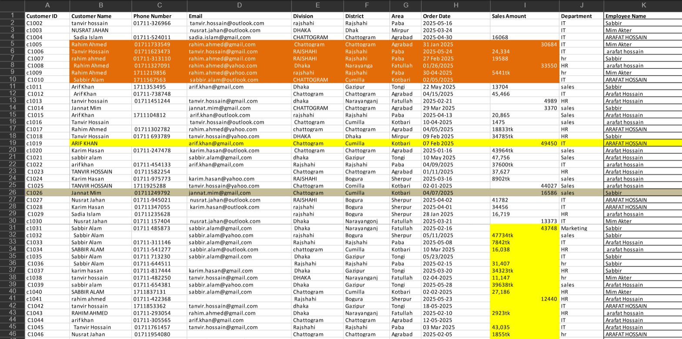
THE PROBLEM
02
The Raw, Messy Data
⚠ BEFORE - Raw, unstructured data with multiple issues

Slide 3
ISSUES FOUND
0
8 Data Quality Problems Identified
1
Inconsistent Customer IDs
5
Missing Phone Numbers
Mixed uppercase/lowercase: C1001 vs c1001
Multiple blank cells in Phone Number column
2
Inconsistent Name Casing
6
Missing & Incorrect Email Addresses
RAHIM AHMED vs rahim ahmed vs Rahim Ahmed
Several rows with invalid & no email data
3
Non-standard Date Formats
7
Inconsistent Division Names
2025-05-16, 31 Jan 2025, 04/15/2025, 30-04-2025
RAJSHAHI vs Rajshahi vs rajshahi
4
Mixed Sales Amount Formats
8
Highlighted/Colored Rows
Numbers stored as text: 47734tk, 2923tk, 5441tk
Random cell highlights - no clear logic or meaning

Slide 4
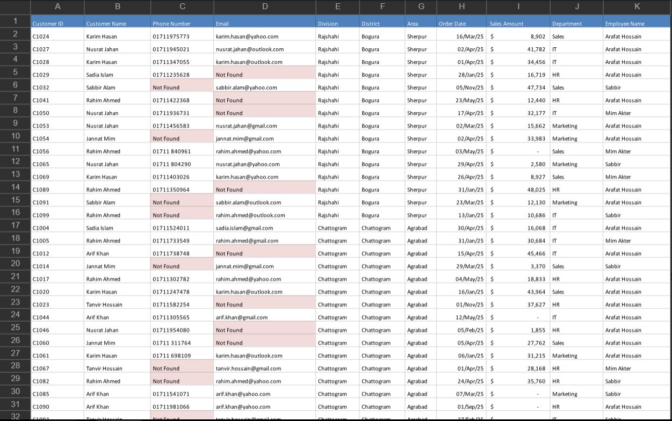
THE RESULT
04
The Clean, Analysis-Ready Data
✓ AFTER - Consistent, clean, fully structured and ready for analysis

Slide 5
WHAT WAS FIXED
05
Every Fix, Step by Step
✓
Standardized Customer IDs
✓
Handled Missing Phones
All IDs now follow consistent C#### uppercase format
Marked as “Not Found” - clearly flagged for follow-up
✓
Normalized Name Casing
✓
Handled Missing Emails
PROPER CASE applied - Rahim Ahmed, Jannat Mim
Missing values set as “Not Found” and invalid entries corrected
✓
Unified Date Format
✓
Standardized Division Names
All dates converted to DD/Mon/YY - e.g. 16/Mar/25
Proper Case: Rajshahi, Chattogram, Dhaka throughout
✓
Cleaned Sales Amounts
✓
Removed All Cell Highlights
Removed 'tk' suffix, converted to numeric with $ sign
Clean white background - no misleading color coding

