Slide 1


PRS
PRS
Getting Started Guide
Getting Started Guide
This guide will help you get started using the PRS Personnel Recruitment System.
Use this guide stand-alone or in conjunction with the free demonstration version of the PRS which is available from methods: Recruitment Systems.
methods:
Recruitment Systems Limited
Exit
Previous
Next

Slide 2
PRS Application Domain
Interactive recruitment and HR information and management system
Web publication, Email and SMS Texting tools
Document management and search tools
Performance and CRM management system
Billing and contract management system
methods:
Recruitment Systems Limited
Exit
Previous
Next

Slide 3
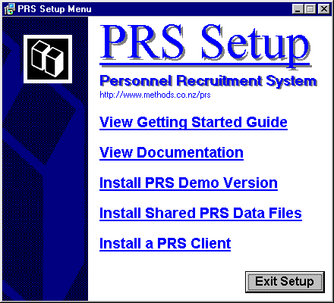
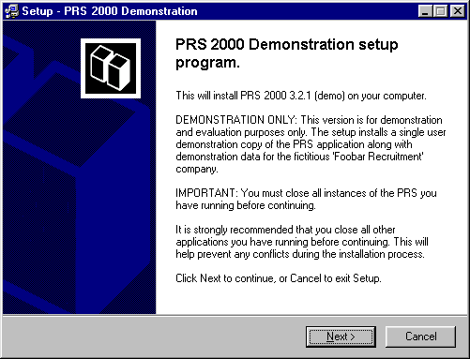
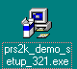

Installing the PRS Demo
PRS Setup Menu program (CD-ROM only)
This program starts automatically after you insert the CD-ROM.
If you have a PRS CD-ROM insert it in your PC’s CD-ROM drive and press the Install PRS Demonstration Version button.
PRS Demonstration Setup Wizard
This wizard will step you through the installation (if you’re unsure which options to select accept the defaults).
Exit
Previous
Next

Slide 4
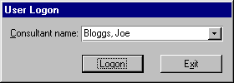
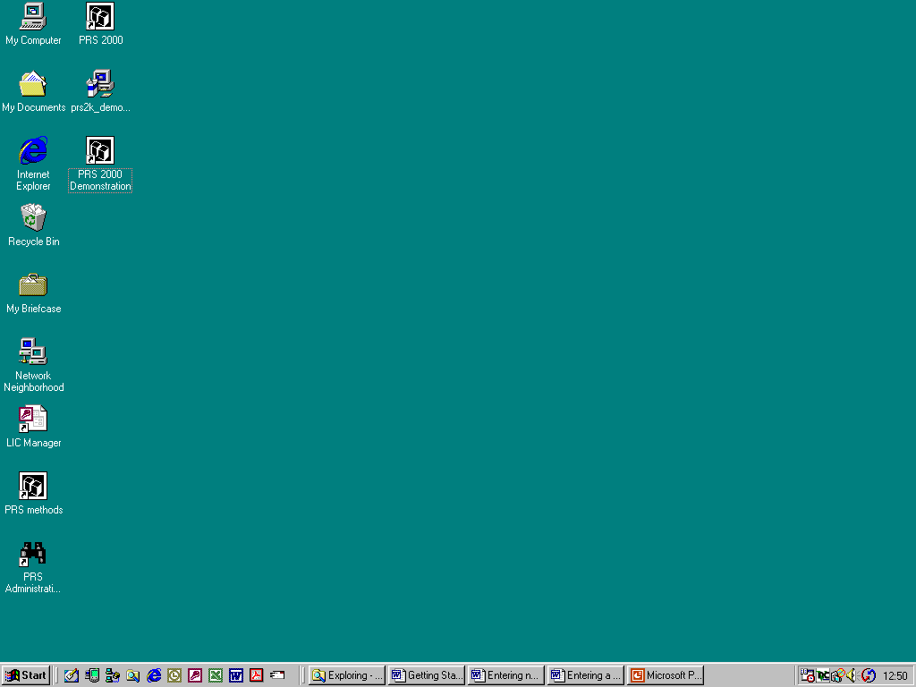
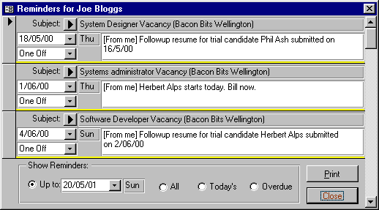
Starting the PRS
Consultant Logon dialog
1
Double-click the PRS icon on the Windows desktop (installed by the PRS setup program).
2
Select a consultant logon name from the drop-down list and press the logon button.
3
Browse your reminders then press the Reminders Close button.
Consultant Reminders form
Exit
Previous
Next

Slide 5
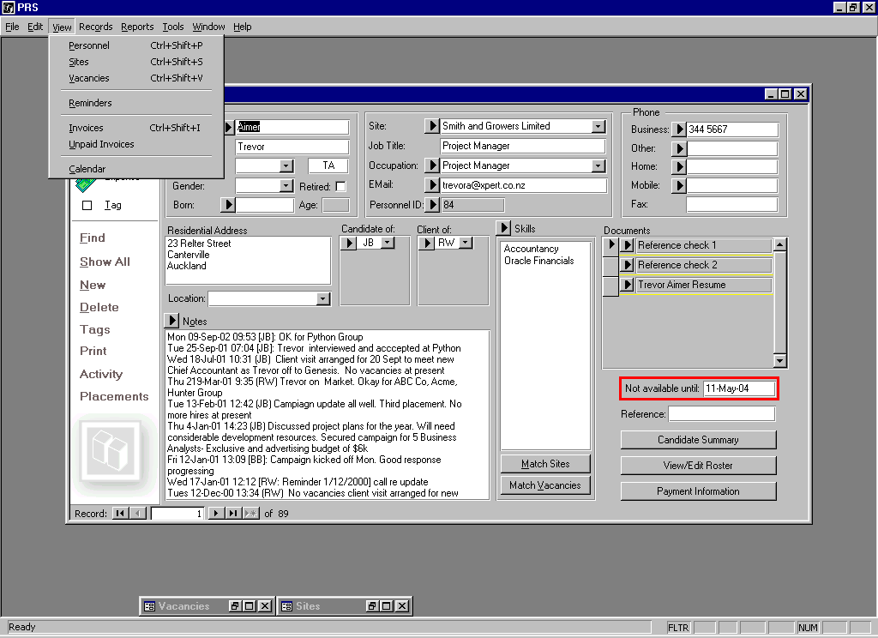
The PRS Desktop
Personnel form
Vacancies form (iconized)
Sites form (iconized)
Exit
Previous
Next

Slide 6



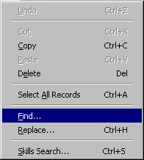
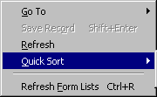

Things you should know
Tips to help you use the PRS more effectively:
Before you can enter or modify data on Personnel, Vacancies, Sites or Invoices forms you must unlock the form by pressing the Lock/Unlock button (or F4 shortcut key). The Lock/Unlock button is displayed with a red outline when the form is unlocked.
For more tips see the TIPS section of the PRS Essential Reference.
Goto buttons are everywhere, use them to drill down into the data. In addition to database navigation Goto buttons are used to send Email messages, open Web sites and dial phone numbers.
Many form-based controls pop up a control tip when the mouse pointer is positioned over them. A control tip window displays a short description of the control’s purpose.
All drop-down lists have an auto-complete function, just start typing and the first matching item will be shown. Use this feature to avoid having to use the mouse to scroll through long drop-down lists.
Use the Records menu Quick Sort commands to sort forms or datasheets by the current field.
Use the Edit menu Find... command (Ctrl+F) to find matching field values in form or datasheet view.
Use the Edit menu Skills Search... command (Ctrl+S) to find personnel, sites and vacancies with specific skills.
Exit
Previous
Next

Slide 7
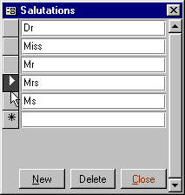
Record Lists
Record lists are common in the PRS. They may take up the whole form or may be embedded within a form. You can tell a record list by the record selectors in the left hand margin.
Record selectors
Delete record from list
To delete a record: highlight the record selector with a mouse click then press the Delete key.
Add new record to list
To add a new record: scroll to the end of the record list and enter record data in the empty record that has an asterisk in the record selector.
NOTE: You won’t be able to add a new record if the form is locked (press F4 to unlock).
Exit
Previous
Next

Slide 8
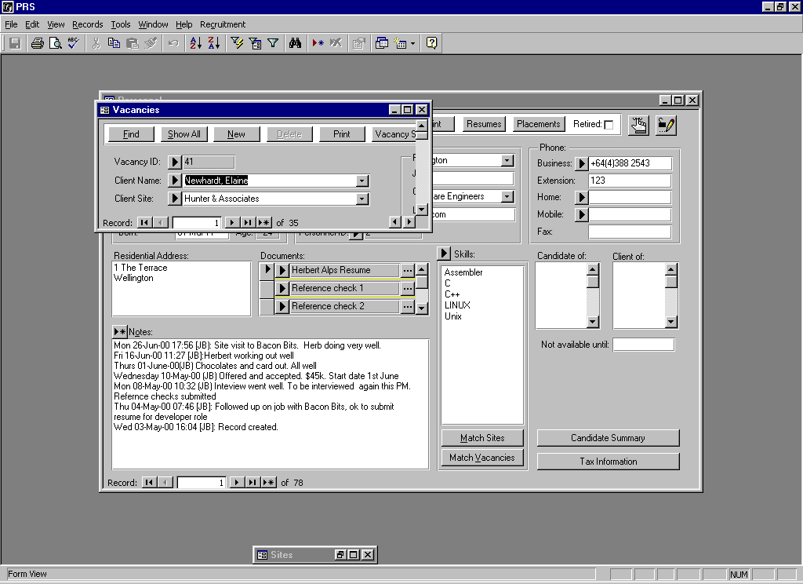
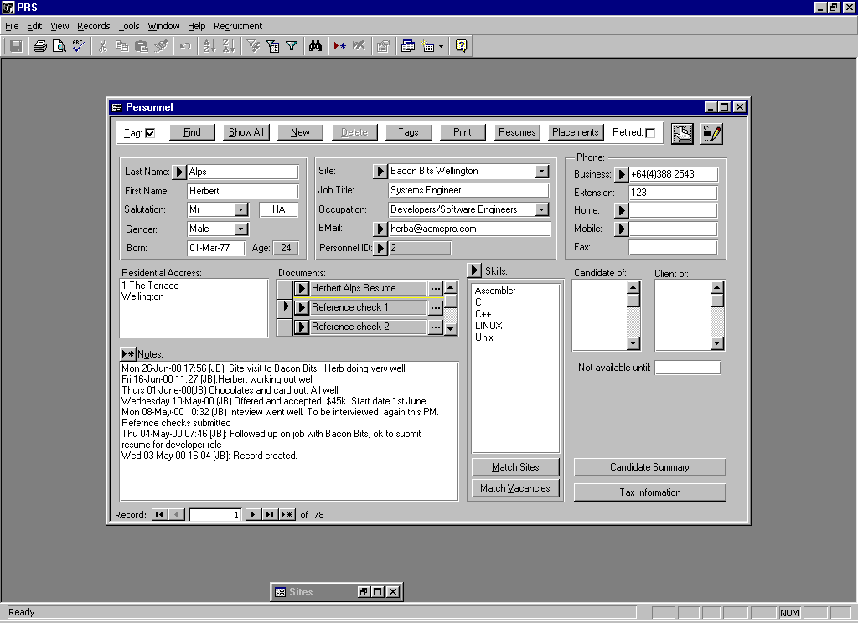

Saving and Undoing Changes
Saving an Edited Record
Changes to the current record are saved to the database when you:
Move to another record
Close the form or exit the PRS
Press the Shift+Enter key combination
Shift
+
Enter
(Hold down Shift and then press Enter)
Lock the from (press the Lock Form button F4 or Ctrl+L)
Undoing an Edited Record
Provided you haven’t yet saved the current record you can undo changes you have entered:
Press the Escape key once to undo changes to the current field.
Esc
Press the Escape key twice to undo changes to all edited fields in the current record..
Esc
+
Esc
TIP: For a full list of keyboard shortcuts see the PRS Keyboard Shortcuts section at the back of the PRS Essential Reference.
Exit
Previous
Next

Slide 9
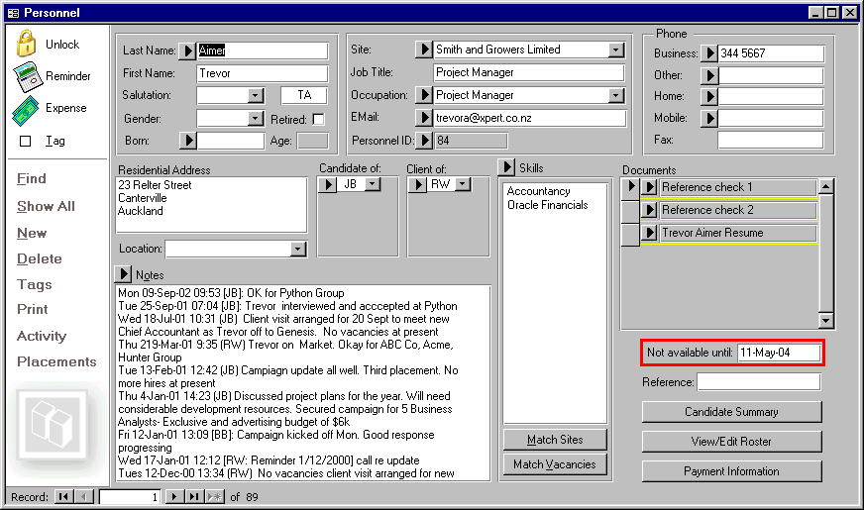
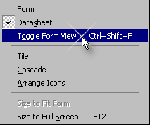
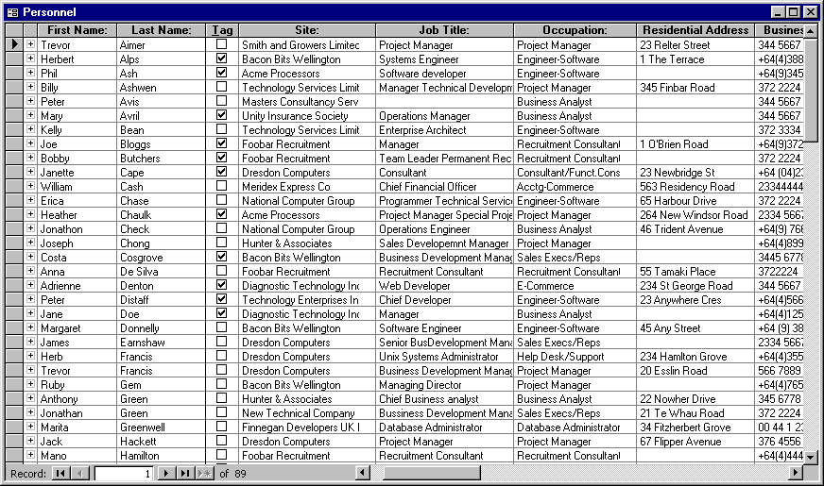
Form and Datasheet Views
Use the Toggle Form View command (Ctrl+Shift+F) from the Window menu to switch forms between Form and Datasheet views (Personnel, Sites, Vacancies and Invoice forms).
Exit
Previous
Next

Slide 10

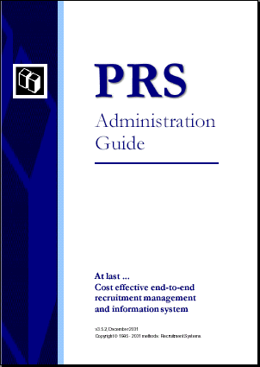
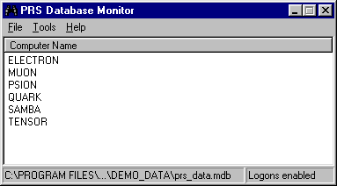
System Administration
The PRSMon application is used to administer the PRS shared database. The PRSMon can be run from the Start Menu or by pressing the Run PRS Monitor button in the PRS Options dialog.
The PRS Administration Guide has been written to assist the system administrator. It can be accessed on-line from the PRS Help menu (a PDF version can be downloaded from the PRS Web Site or the PRS CD-ROM).
PRS Administration Guide
PRSMon database administration program
Exit
Previous
Next

Slide 11
PRS Feature Highlights
Key concepts: Personnel, Sites and Vacancies.
Built-in reminders, Email and SMS messaging management.
Resume submission, client interview and job offer management.
Extensive personnel and vacancy search criteria.
Related documents can be linked to personnel, sites and vacancies and can be opened or Emailed directly from the PRS.
Keyword and phrase document searches using the integrated Document Search Tool.
Printed reports can be exported to HTML, Excel, text or RTF files.
Mail-merge personnel data directly to Microsoft Word using built-in Document Manager.
Off-line data access for off-site laptop operation.
Export vacancies, personnel and reminders to Palm PCs.
User customisable invoices and tax names.
Numerous financial, management and statistical reports.
Database audit reports.
methods:
Recruitment Systems Limited
Exit
Previous
Next

Slide 12
Key Concepts
Personnel
Sites
Vacancies
methods:
Recruitment Systems Limited
Exit
Previous
Next

Slide 13
Personnel Form
Post reminder
Goto Site record
Dial phone number
Allot an expense
Send Email
Send SMS message
Edit skills list
Assign consultant management
Link and manage documents
Insert time and user stamped notes
Exit
Previous
Next

Slide 14
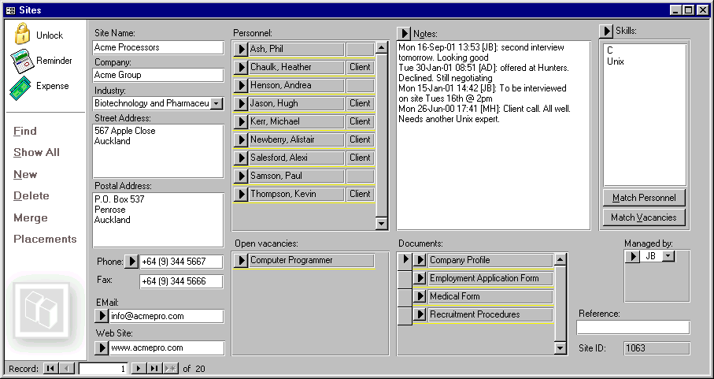
Sites Form
Post site reminder
Goto Personnel record
Edit skills list
Allot an expense
Insert time and user stamped notes
Dial phone number
Assign consultant management
Send Email
Goto Vacancy record
Links and manage documents
View website
Exit
Previous
Next

Slide 15
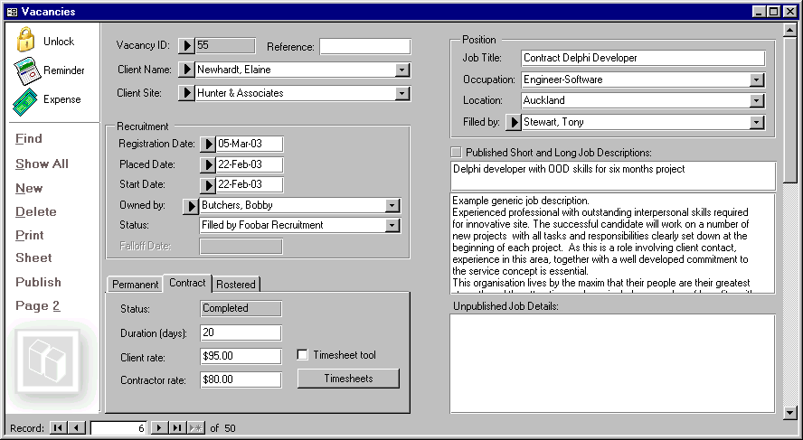
Vacancies Form (page 1)
Post reminder
Goto client Personnel record
Goto client site record
Allot an expense
Goto consultant Personnel record
Goto page two of the vacancies form
Exit
Previous
Next

Slide 16
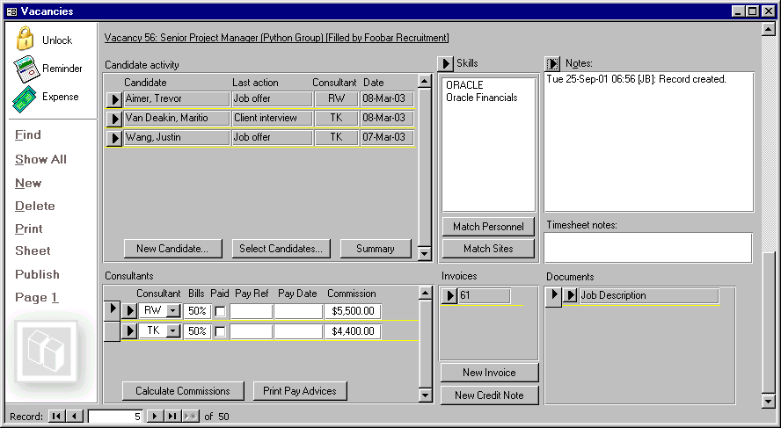
Vacancies Form (page 2)
Edit skills list
Insert time and user stamped notes
Assign and edit candidate activity records
Goto related Invoice record
Links and manage documents
Goto page one of the vacancies form
Assign and edit consultant vacancy ownership and billing records
Exit
Previous
Next

Slide 17
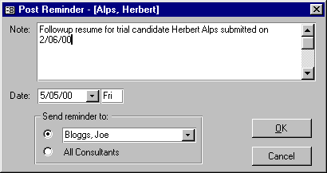

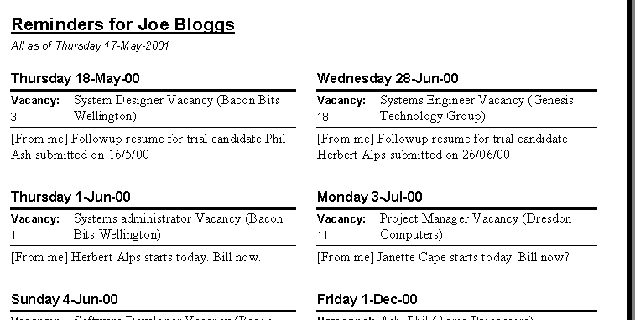
Reminders
1
Press the Reminders button
2
Enter the reminder and press OK
Use the PRS integrated messaging to post a reminder about the current person, site or vacancy to yourself, another consultant or to all consultants
View your reminders when you logon or using the Reminders command in the Recruitment menu
3
4
Print your reminders in handy pocket fold report format
Exit
Previous
Next

Slide 18
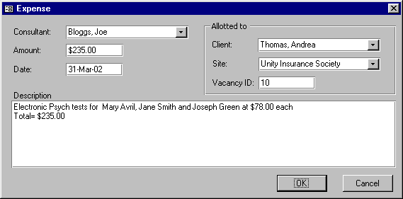

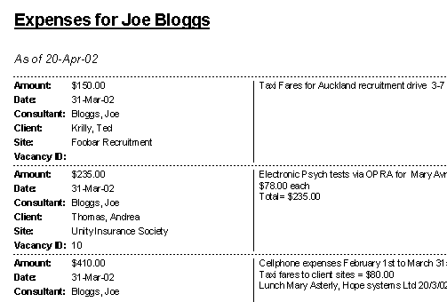
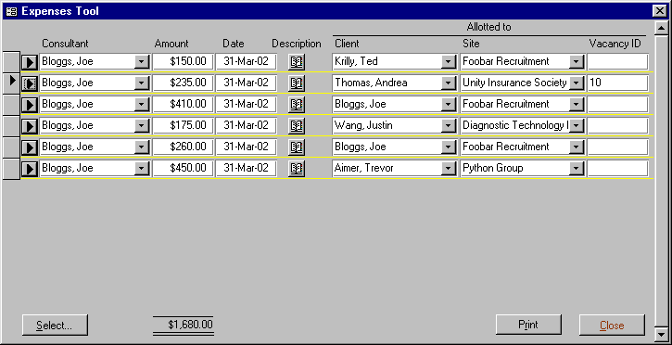
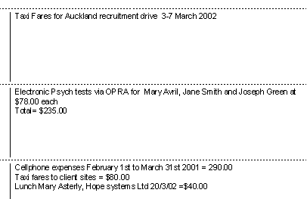
Expenses
Press the Expenses button on the Personnel, Sites or Vacancies forms
1
Use the integrated PRS expenses management system to allot an expense to a person, a site or a vacancy then use the Expenses Tool to selectively view and print expenses
2
Enter the expense and press OK
Use the Expenses Tool to select, view and print expenses
Print selected expenses
Exit
Previous
Next

Slide 19
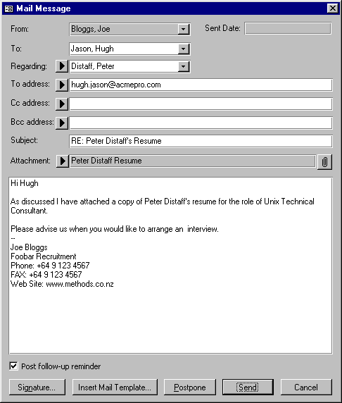
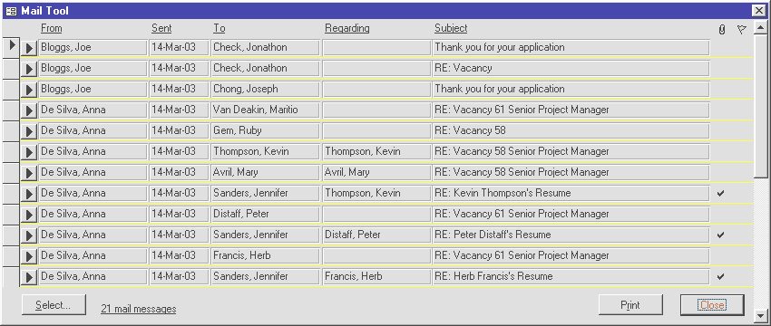
Email
Email resumes, linked documents and acknowledgements directly from the PRS
The PRS includes a tightly integrated Email dispatch and logging system that automates candidate and client messaging
Include attached documents
Use the Mail Tool to selectively view and print Email messages
Post a follow-up reminder
Insert a Mail Template containing your own customised responses
Customise your mail signature
Mail Templates and Mail Tool functionality is only available if your Email client is Microsoft Outlook
Exit
Previous
Next

Slide 20

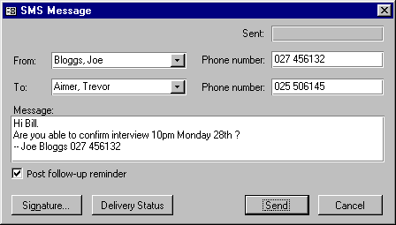
SMS Messaging (Texting)
Text client and candidate mobiles directly from the PRS
Post a follow-up reminder
Use the Mail Archive Tool to selectively view and print SMS messages
Customise your mail signature
SMS messaging is an optional license option.
Exit
Previous
Next

Slide 21
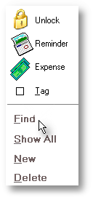
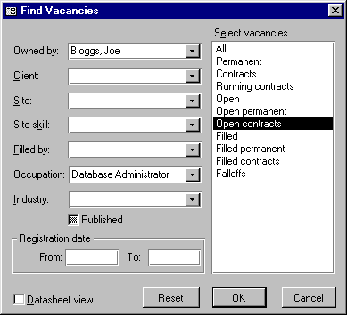
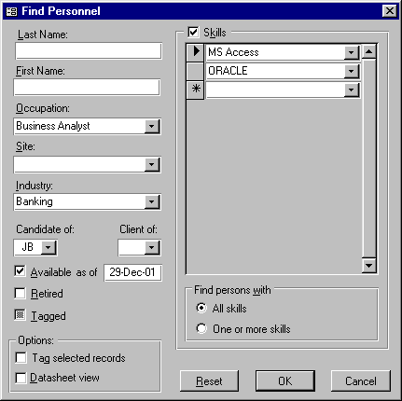
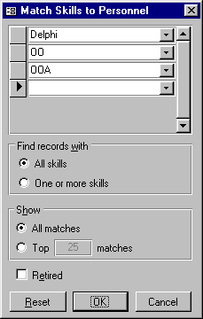
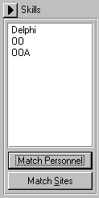
Finding Data
Here are just a few of the ways you can search for data
Find Personnel Records
Find Vacancy Records
Skills based searches
Exit
Previous
Next

Slide 22
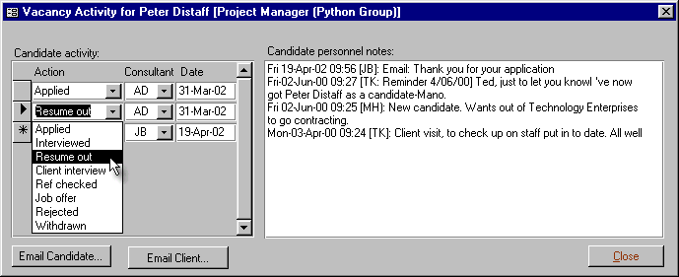
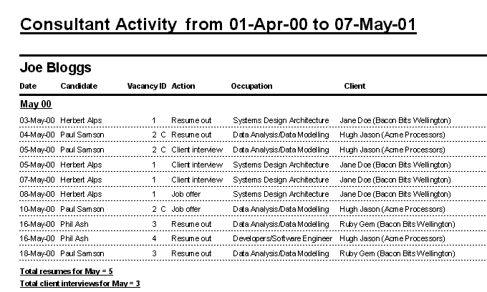
Candidate/Consultant Activity
Record and report candidate vacancy activity
Enter Candidate activity records from Page 2 of the Vacancies form
One of a number of Consultant activity reports
Exit
Previous
Next

Slide 23

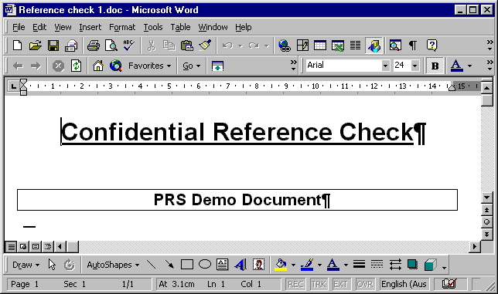
Document Linking
PRS Personnel, Site and Vacancy document lists
Open, Print, Email, Link documents
Application associated with linked document
Exit
Previous
Next

Slide 24
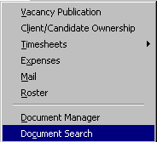
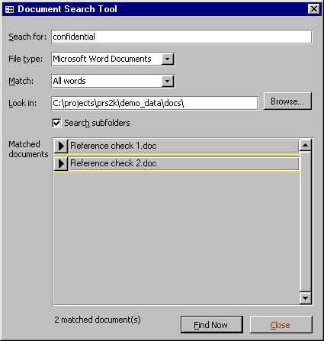
Document Searches
1
Use the Document Search Tool to find words or phrases in Microsoft Word documents
Open the Document Search Tool (in the Recruitment|Tools submenu)
3
Press Goto button to open found documents
2
Enter search criteria and press Find Now
Exit
Previous
Next

Slide 25
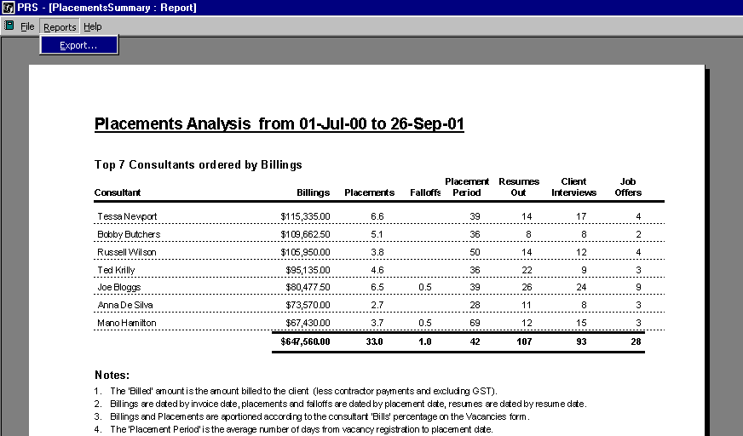
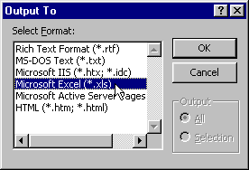
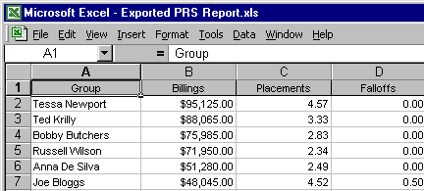
Exporting Data
Use the Reports Export command to save PRS data in a number of electronic file formats
Preview the desired report then execute the Reports|Export... menu command
2
Select the desired export format and press OK
1
3
You can new use the exported file data in other applications
Exit
Previous
Next

Slide 26
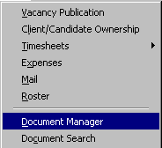
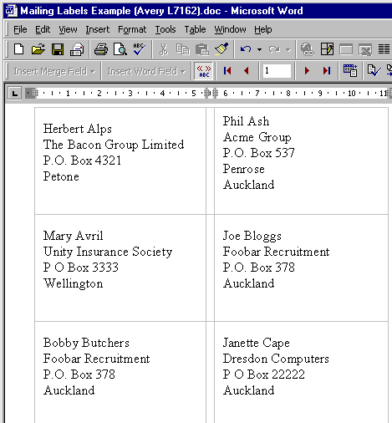
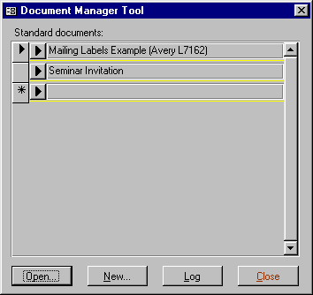
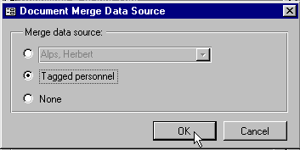
Integrated Mail-Merge
The Document Manager Tool can be used to create, open and export selected Personnel records to Microsoft Word mail-merge documents
1
Open Document Manager Tool (in the Tools menu)
2
Select the merge data source
3
Open mail-merge document with selected Personnel data
Exit
Previous
Next

Slide 27
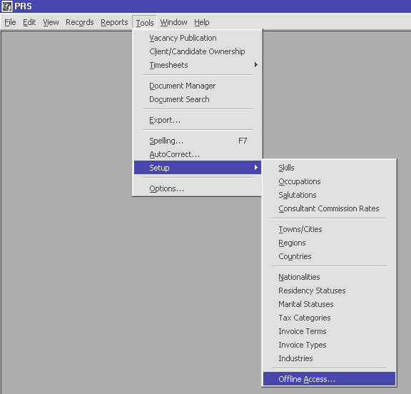
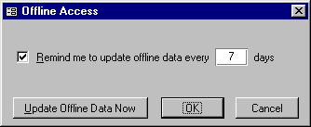
Off-line Database Access
The Offline Access function maintains a local copy of the shared PRS database which is useful for mobile workers using laptop computers
1
Execute the Offline Access menu command
2
Select the off-line update period and press OK
Exit
Previous
Next

Slide 28
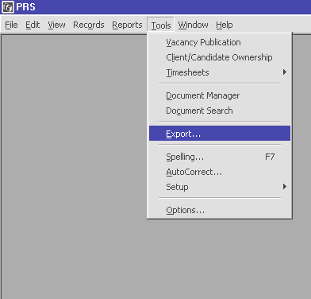
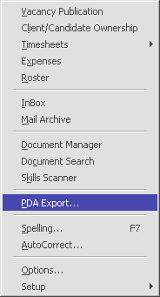


Export PRS Data to Palm PC
PRS Vacancies, Personnel and Reminders can be exported to Palm PCs
1
Execute the Tools|PDA Export... menu command
2
Select the data you want to export to your Palm PC and press OK
3
Press the OK button then HotSync the data to your Palm PC
To find out how to configure Palm PC exports press the F1 key and search the PRS Help for the phrase Palm PC.
Exit
Previous
Next

Slide 29


Invoice Customisation
To create and edit Invoice Types execute the Invoice Types menu command from the Tools|Setup submenu
To create a new invoice template or edit an existing one press the ellipsis button
The PRS supports multiple invoice series. You can fully customise invoice layouts by editing the Invoice Templates using Microsoft Word.
Exit
Previous
Next

Slide 30



Rostered Vacancies
Rostered Vacancies are multi-person shift oriented vacancies that are managed using the PRS Roster Tool, Personnel Roster and Vacancy Roster.
1
Roster entries can be managed using the Tools|Roster menu command (or by opening Personnel or Vacancy Rosters directly from the Personnel and Vacancies forms)
3
Roster entries are billed and paid using the Process Roster... command
2
Use Roster commands to select, add, copy, delete and print roster entries
Exit
Previous
Next

Slide 31


Timesheets
Contract vacancy timesheets manage contractor payments, client invoicing and consultant commissions.
Timesheets are created and viewed from the Vacancies form
Exit
Previous
Next

Slide 32




Timesheet Tools
The PRS Timesheet Tools allow bulk timesheet creation and management, making it easy to process large numbers of contractors
1
New timesheets are created in bulk using the Tools|Timesheets|New... menu command
2
Timesheet management tasks can be applied to all selected timesheets
Exit
Previous
Next

Slide 33


Publish Vacancies
Publish long and short vacancy descriptions directly from the Vacancies form
Enter vacancy publication details for export to HTML web files and other file formats (see next slide)
Exit
Previous
Next

Slide 34



Export Published Vacancies
Use the PRS Vacancy Publication tool to create permanent and contract HTML vacancy indices plus linked vacancy detail pages
1
Open the Vacancy Publication Tool (from the Tools menu)
2
Press the Export button to generate linked HTML vacancy indices and detail pages
User customisable HTML publication templates
Index entries linked to vacancy detail pages
Exit
Previous
Next

Slide 35



Reports
The PRS has over two dozen distinct CRM and financial reports. User options result in literally hundreds of report combinations.
Here is just one example. We’ll leave it up to you to explore more reports in the Reports menu.
Choose a report from the PRS Reports menu
1
2
Customise the report options
One of a number of Consultant activity reports
3
Preview and print the report
Exit
Previous
Next

Slide 36


Database Audits
1
Open the Database Audits form using the Audit item in the Reports menu.
2
Select the audits and the Audit Level you wish to report
3
Run the audit report
Check the integrity of your data by running PRS data audits
Exit
Previous
Next

Slide 37
methods: Recruitment Systems
methods: Recruitment Systems
The PRS is a product of methods: Recruitment Systems Limited.
For pricing or more information about the PRS call us or visit our website:
http://www.methods.co.nz/prs/
Contact Information
Call Peggy Lee:
Phone +64 9 415 6260
FAX +64 9 415 6289
Mobile +64 25 766 146
EMail support@methods.co.nz
Web: http://www.methods.co.nz/prs
Postal Address:
methods: Recruitment Systems Limited
Box 300-570, Albany
Auckland
NEW ZEALAND
Exit
Previous
Next

