Slide 1
Problem statement
Identify the factors causing chronic kidney disease.
Build a model that can help to determine if a patient is suffering from kidney chronic disease or not.

Slide 2
Data Understanding
The data is gathered for two months from patients at a hospital. You need to make utilization of the features presented in the data set for your task. The data set and a document containing the information about the attributes are attached with the assignment problem statement.
Make yourself familiar with these attributes as these might help you in determining the patients with kidney chronic disease

Slide 3
Dataset columns
There are 25 columns in the data set 24 + class(predict)
11 are Numeric variables:
Age
Blood Pressure(bp)
Blood Glucose Random(bgr)
Blood Urea(bu)
Serum Creatinine(sc)
Sodium(sod)
Potassium(pot)
Hemoglobin(hemo)
Packed Cell Volume(pcv)
White Blood Cell Count(wbcc)
Red Blood Cell Count(rbcc)
5 Yes/No columns:
Hypertension (htn)
Diabetes Mellitus(dm)
Coronary Artery Disease(cad)
Pedal Edema(pe)
Anemia(ane)

Slide 4
Dataset columns cont..
9 Categorical columns:
Specific Gravity(sg)
Albumin(al)
Sugar(sc)
Red Blood Cells(rbc)
Pus Cell(pc)
Pus Cell clumps(pcc)
Bacteria(ba)
Appetite(appet)
Class: this variable is predict (Y) variable contains ‘ckd’, ‘notckd’
ckd: person contains Chronic Kidney Disease
notckd: person does not have Chronic Kidney Disease

Slide 5
Data Cleaning and Manipulation
Identified some ‘?’ in dataset and replace ‘?’ with null values
“Red Blood Cells(rbc)” column have more no. of null values around 38% , hence dropped the “Red Blood Cells” column
Dropped null values rows for categorical variables.
For numerical variables replace the null values with “mean”(bgr, bu,hemo,pcv,wbcc,rbcc) and “mode”(bp, sc, sod,pot) values based on the distribution plots.

Slide 6
Data Cleaning and Manipulation cont…
Converted ‘yes’-> 1 and ‘No’ -> 0 for below columns
Hypertension (htn)
Diabetes Mellitus(dm)
Coronary Artery Disease(cad)
Pedal Edema(pe)
Anemia(ane)
Predicted variable(class) and other categorical variables convert to numeric variables using pandas ‘pd.get_dummies’ method and dropping the first column

Slide 7
Dummy variables
class_ckd | class_notckd
1 | 0
1 | 0
1 | 0
1 | 0
1 | 0
Converted class data to dummy variables
It has created two columns class_ckd, and class_notckd
Instead of using both features one can be enough to use, as for the dummy variable condition n-1 features need to be considered.
Same condition applied for all other categorical variables

Slide 8
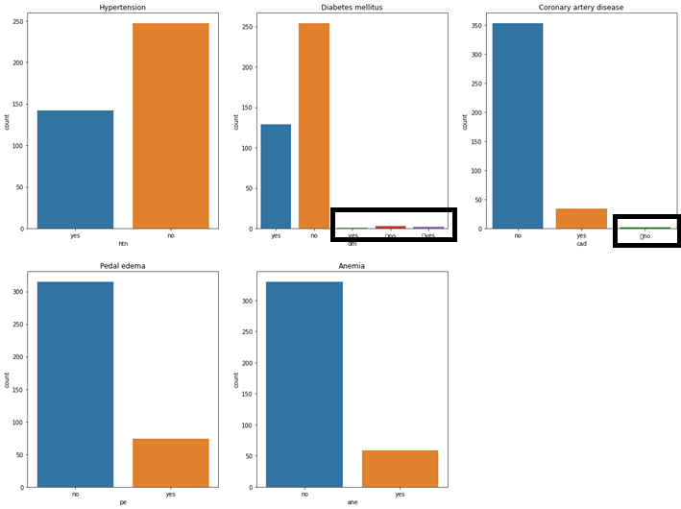
Yes-No columns
Observed there are some data which is not matched ‘yes’ and ‘no’ text.
Those data also removed form the data set.

Slide 9
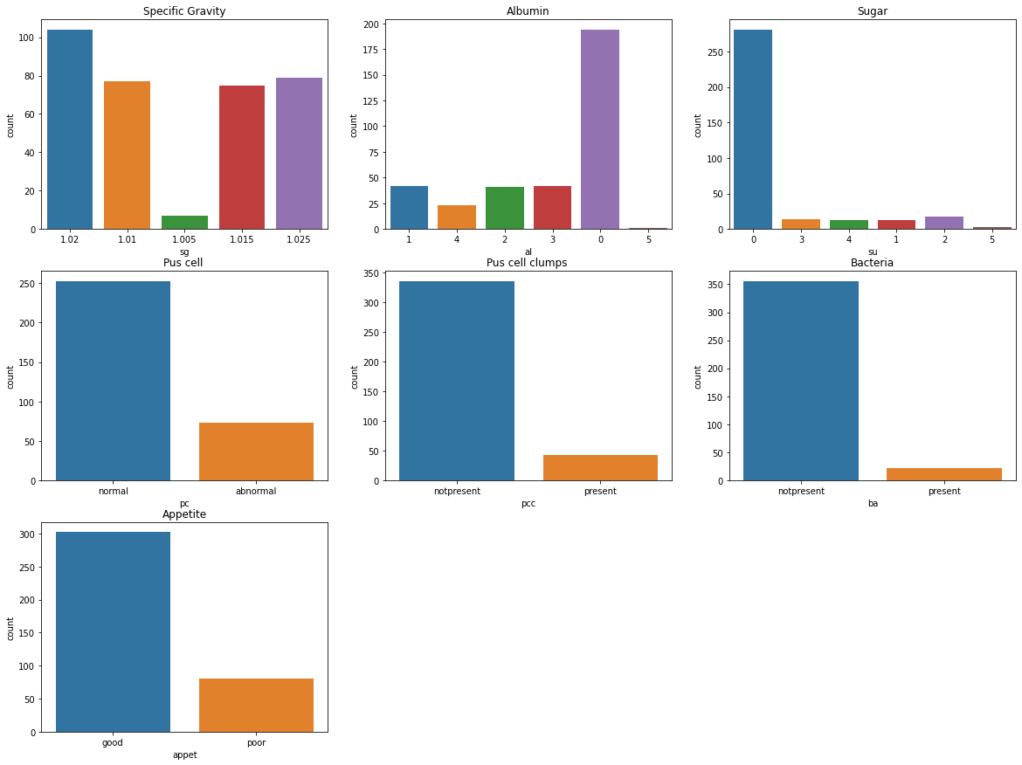
Categorical variables count plot

Slide 10
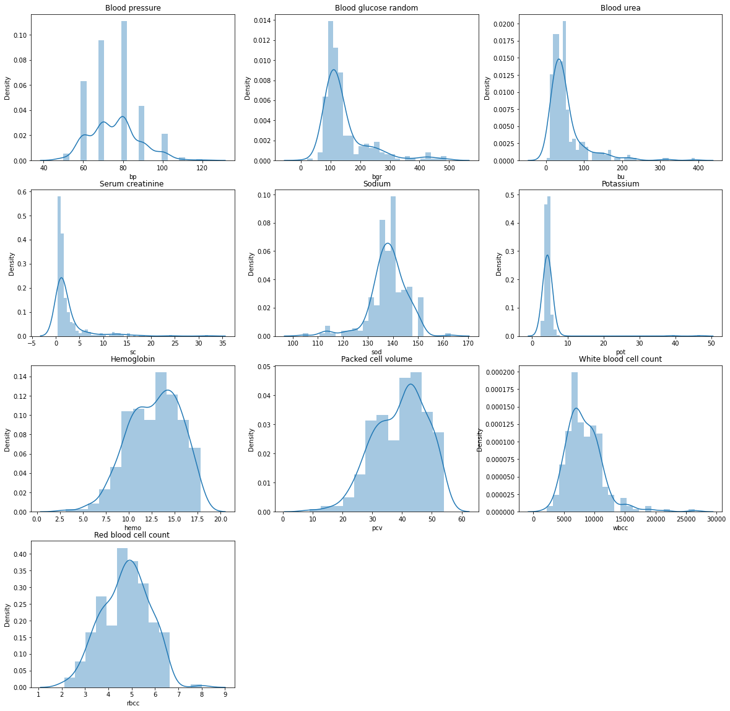
Numerical variables distribution plots

Slide 11
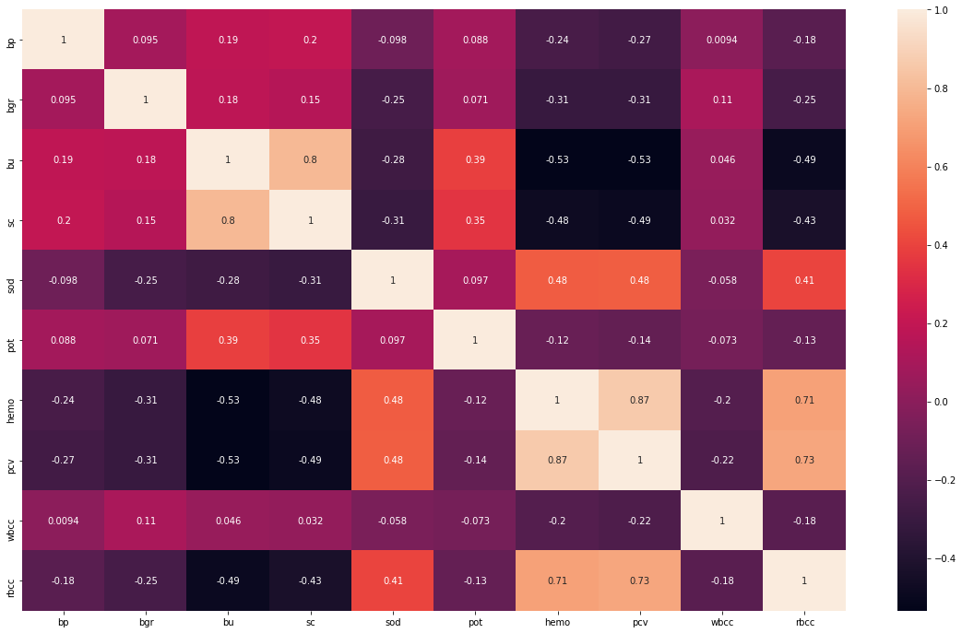
Numerical variables heatmap

Slide 12

Model Selection- Logistic regression
Logistic Regression is one of the most simple and commonly used Machine Learning algorithms for two-class classification. It is easy to implement and can be used as the baseline for any binary classification problem
Logistic regression is a statistical method for predicting binary classes. The outcome or target variable is dichotomous in nature. Dichotomous means there are only two possible classes. For example, it can be used for cancer detection problems. It computes the probability of an event occurrence.
It is a special case of linear regression where the target variable is categorical in nature. It uses a log of odds as the dependent variable. Logistic Regression predicts the probability of occurrence of a binary event utilizing a logit function.

Slide 13
RFE
Feature ranking with recursive feature elimination.
Given an external estimator that assigns weights to features (e.g., the coefficients of a linear model), the goal of recursive feature elimination (RFE) is to select features by recursively considering smaller and smaller sets of features. First, the estimator is trained on the initial set of features and the importance of each feature is obtained either through any specific attribute or callable. Then, the least important features are pruned from current set of features. That procedure is recursively repeated on the pruned set until the desired number of features to select is eventually reached.

Slide 14
Model building
Considering 15 features from the given data applying recursive feature elimination(RFE)
P-value of "appet_poor" is 0.785 more hence dropping of this feature. And p-value should <= 0.05
P-value of "pcv" is 0.778 more hence dropping of this feature. And p-value should <= 0.05
P-value of "sg_1.01" is 0.749 more hence dropping of this feature. And p-value should <= 0.05
P-value of "dm" is 0.481 more hence dropping of this feature. And p-value should <= 0.05
P-value of "pe" is 0.311 more hence dropping of this feature. And p-value should <= 0.05
P-value of "sc" is 0.395 more hence dropping of this feature. And p-value should <= 0.05
P-value of "sg_1.015 " is 0.072 more hence dropping of this feature. And p-value should <= 0.05
All the P-values are < 0.05, so that we can select the remaining features for validation

Slide 15
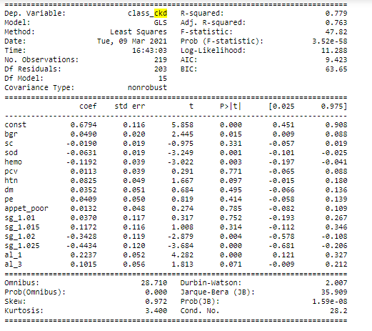
Model building
Considering 15 features form rfe

Slide 16
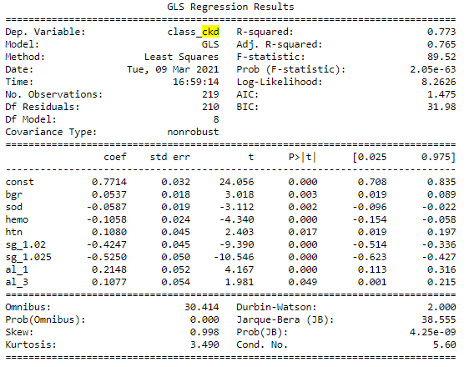
Model building

Slide 17
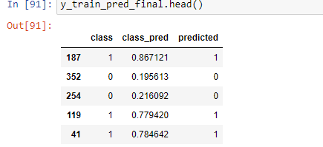
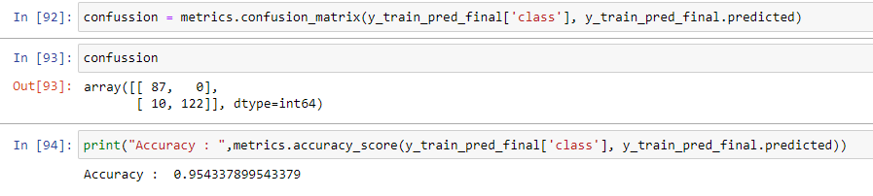
Model evaluation
Accuracy of the model is 0.95433

Slide 18
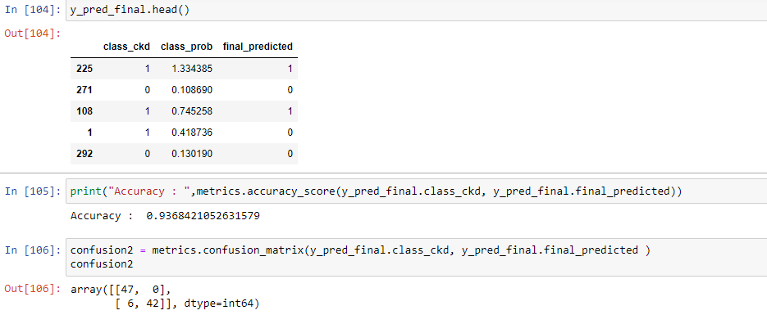
Model Testing
The accuracy of the model is 0.95 for training data, and for test is 0.93

Slide 19
Results
The accuracy of the model is 0.95 for training data, and for test it is 0.93
Selected features for building the model are listed below.
Blood Glucose Random(bgr)
Sodium(sod)
Hemoglobin(hemo)
Hypertension(htn)
Specific Gravity(sg_1.02)
Specific Gravity(sg_1.025)
Albumin(al_1)
Albumin(al_3)
For identifying Kidney disease, we are recommending the above features.

