Slide 1
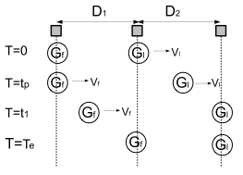
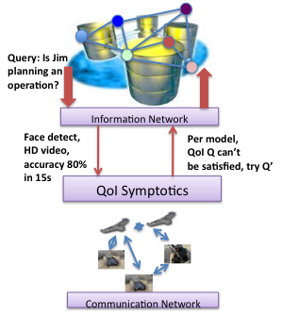
QoI- and Mobility-Symptotics
State-of-the-Art
Asymptotic analysis: Does not consider real-world issues such as control protocols, traffic diversity, bottlenecks etc.
Wireless protocol analysis restricted to single protocols (e.g. 802.11) rather than entire system
Symptotics thus far restricted to stationary networks and to analysis based on traditional “bits” or “throughput”
Insight: Symptotics can capture the tradeoff space between scalability and application QoI (e.g. accuracy and timeliness), and accommodate mobility using analysis of “stages”.
Effective
rate
Contention
factor (CF)
ηW = Σ_{j} (1 + ϒ_{j}) ξ(Q) (1 + Τ_{j})
Army Need/Benefits
Army needs to quickly, assess the scalability/capacity of a system deployment and associated “what if” scenarios, incl.
Performance under military mobility scenarios
Tradeoff with application desired QoI
Benefit: Military waveform (SRW, WNW) assessment under mobility, managing tradeoffs in QoI, for instance in checkpoint face recognition
QoI to
rate function
Transit
factor (TF)
Repeated Traversal Military Mobility
CF for
stage k
Load
ηW = Σ_{j} (1 + ϒ_{j}(k)).L_{j}.
(1 + Τ_{j}(k))
TF for
stage k
PIs: Ram Ramanathan (BBN), Tom La Porta (PSU)
Collaboration: BBN, PSU, USC
1
Notes:
INSTRUCTIONS: This template is the 2-slide version for presenting a highlighted technical result (includes this slide and the following one). Please keep this layout and subheadings.
Note that the emphasis must be on work and results from the current program year (Y4, which started 28 Sep 2012). Be sure to include any
substantive collaboration with government researchers or use of government resources, data, or expertise.
You may choose whether to use the 2-slide or the 1-slide version for each technical highlight; please provide at least two but no more
than three technical highlights.

Slide 2

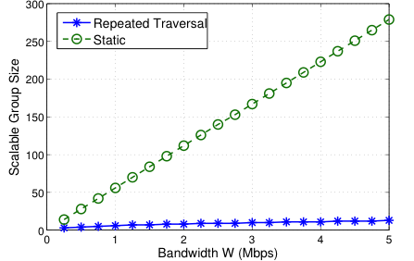
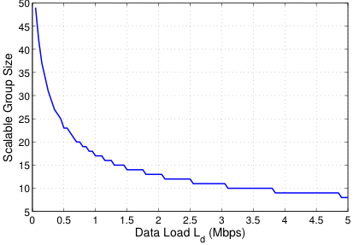
QoI- and Mobility-Symptotics
Actual face recognition and OCR data from PSU shows significant non-linearity in accuracy vs image scale that influences scalability.
Accuracy impact on scalability higher at lower accuracies; timeliness impact roughly same in range studied ; Unicast scalability is 10x that of anycast scalability for FR
Result: Scalability impact of OCR and FR desired QoI differs for accuracy vs timeliness. Repeated traversal mobility can reduce scalability by an order of magnitude vs equivalent stationary
Repeated
Traversal
Stages
(M= Group size= Network size/2)
Face recognition over multihop mesh (Anycast* scenario)
~14x
Long-Term Goals
Study other applications, e.g. data exfiltration using techniques from USC, other conops, e.g finding achievable QoI for given network
Study symptotics of social network information flow.
* We have also studied unicast, and both any/unicast for OCR
QoI and Mobility extensions to symptotics enables selection of QoI parameters to meet a given scalability requirement, and helps assess scalability of typical military mobility patterns
2
Notes:
R. Ramanathan, A. Samanta, T. La Porta, “Symptotics: A Framework for Analyzing Real-World Wireless Networks, Proc. ACM PE-WASUN, 2012.
E. Ciftcioglu, R.Ramanathan, T. La Porta, “Scalability of Tactical Mobility Patterns,” submitted to IEEE Milcom 2013

