Slide 1
PUBLIC LIBRARY
Implemented
By-
Sindhuja Raghupatruni
Divya Ammana

Slide 2
ER Diagram

Slide 3
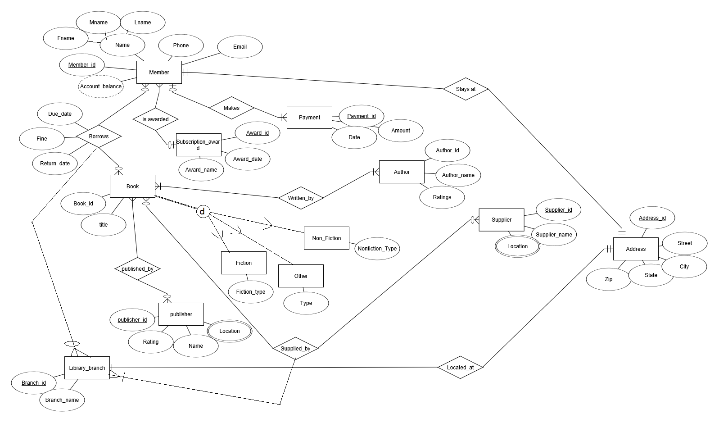

Slide 4
Relational Schema

Slide 5
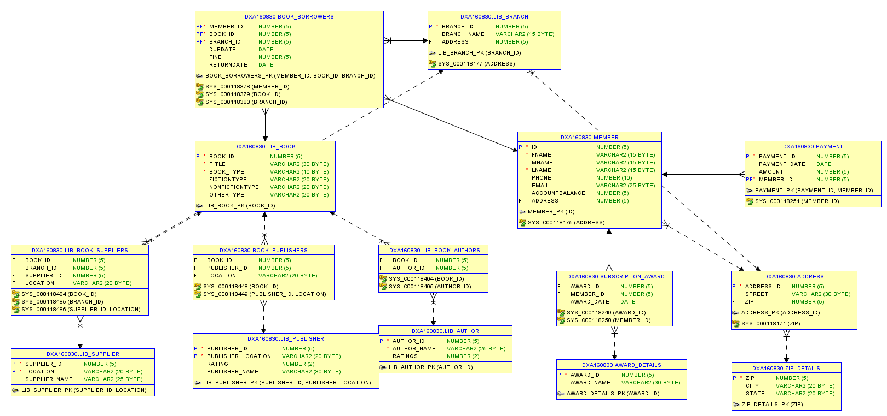

Slide 6
Procedures
Account Balance Calculation
This procedure calculates the account balance of a member of library by taking into consideration the fine and the payments made by a particular member. The member id is passed as a parameter to the procedure.
2. Rate the author
This procedure increases the ratings of the authors who published a particular book type. The type of the book and the genre are passed as parameters to the procedure by the user.

Slide 7
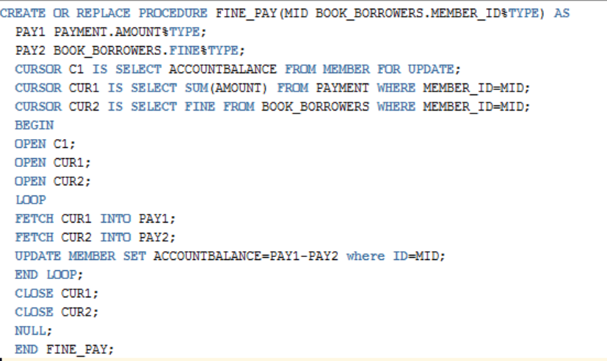

Slide 8
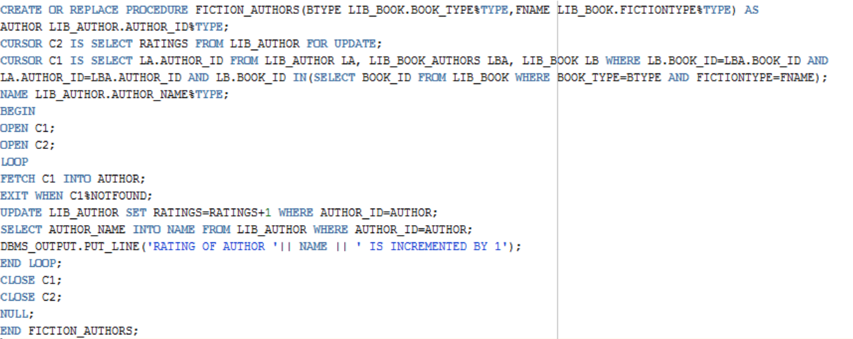

Slide 9
Triggers
Update fine after insertion or update of borrows table
- This Trigger updates fine when a new record is inserted to the borrowers table or when the return date is updated to the table.
2. Trigger to update award based on book lending
- This trigger updates the award of the member by counting the number of books lent by him, whenever a new row is added to the borrowers table.

Slide 10
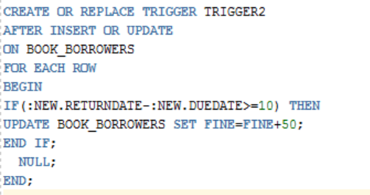

Slide 11
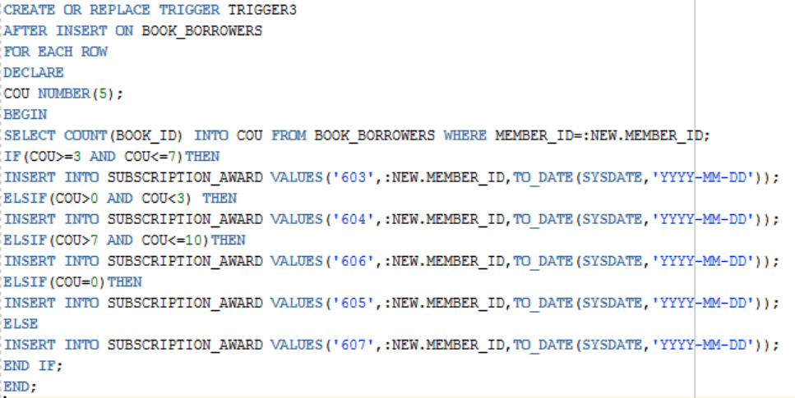

Slide 12
Business Rules
A member is awarded awards based on the number of books lent.
A supplier supplies multiple books to multiple library branches.
A member borrows any number of books from any branch of the library.
Account balance of the member is found from the fine and the payments made by the member.
All the books fall into either fiction, non-fiction or other categories.
6. A book can be written by anonymous i.e. he may not have an author in the author table.

Slide 13
Business Rules
6. A member can make multiple payments.
There are multiple branches for the publishers and the suppliers.

Slide 14
THANK YOU

